Slide 1
Abbreviated
Interrupted Time-Series
What is Interrupted Time Series (ITS)?
  Rationales
  Designs
  Analysis

Slide 2
What is ITS?
A series of observations on the same dependent variable over time
Interrupted time series is a special type of time series where treatment/intervention occurred at a specific point and the series is broken up by the introduction of the intervention.
If the treatment has a causal impact, the post-intervention series will have a different level or slope than the pre-intervention series

Slide 3
The effect can be a change in intercept

Slide 4
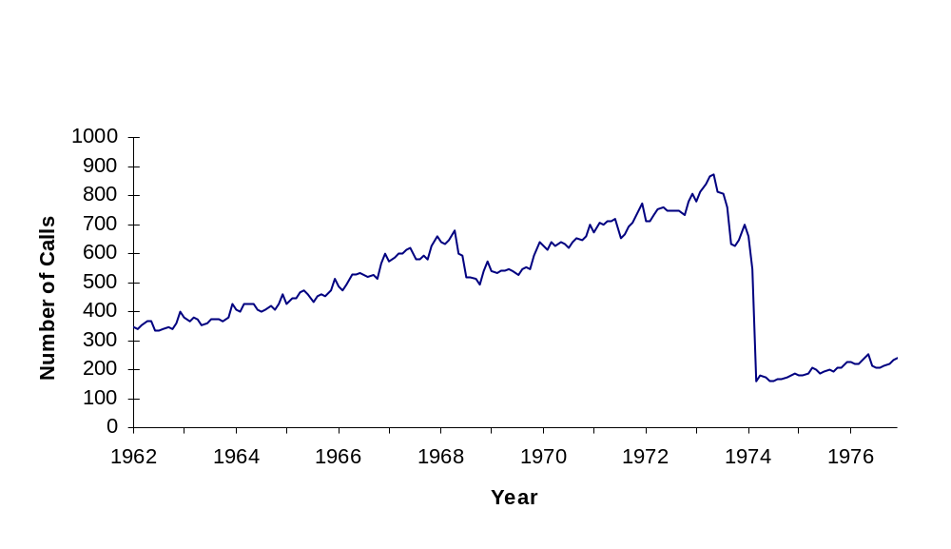
The effects of charging for directory assistance in Cincinnati
Intervention

Slide 5
The effect can be a change in slope

Slide 6
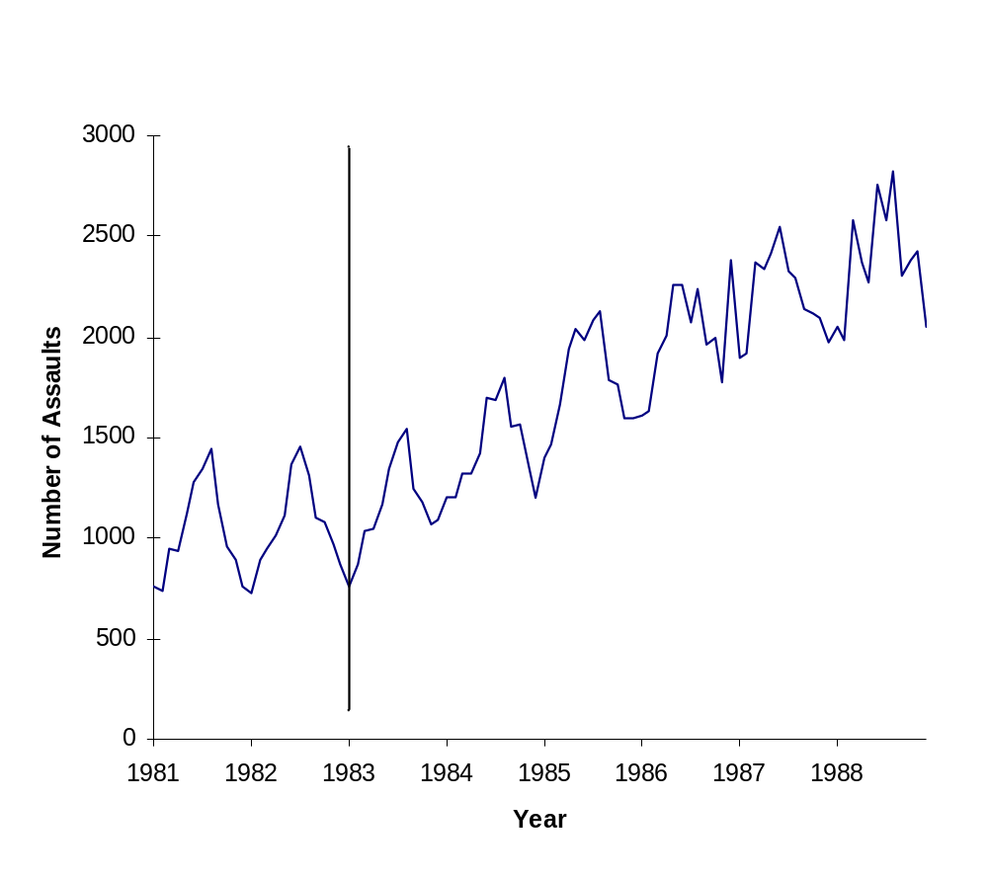
Canada Sexual Assault Law Reform

Slide 7
The effect can be delayed in time.

Slide 8
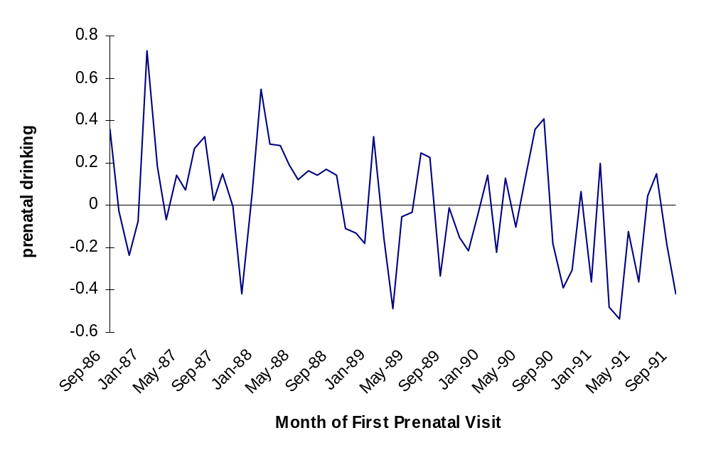
The effects of an alcohol warning label on prenatal drinking
Label
Law
Date
Impact
Begins

Slide 9
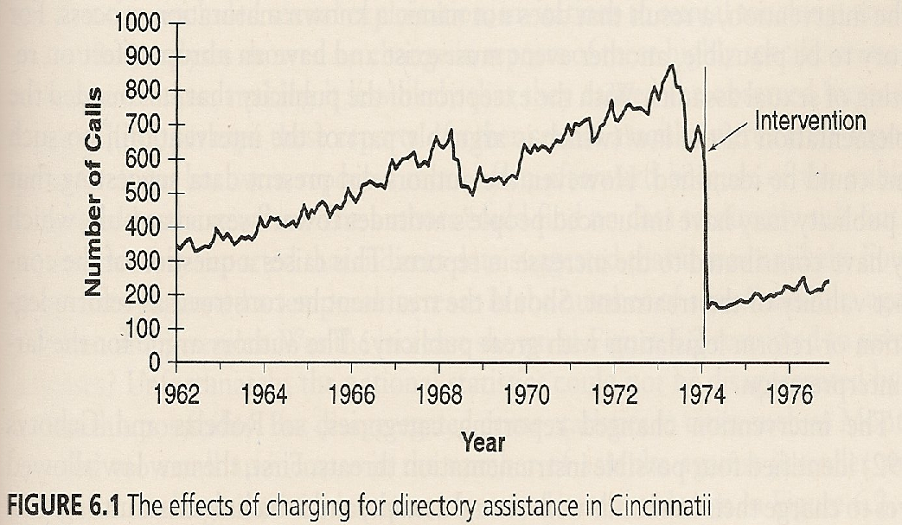
Interrupted Time Series Can Provide Strong Evidence for Causal Effects
Clear Intervention Time Point
Huge and Immediate Effect
Clear Pretest Functional Form + many Observations
No alternative Can Explain the Change
Notes:
Here we have an example of how interrupted time series can provide strong evidence of causal effects.
This graph show how a new policy to charge for directory assistance in Cincinnati resulted in a significant drop in the number of calls.
The causal effect is very clear because
There is a clear intervention time point
The effect is instantaneous effect and huge
There is no ambiguity about the function form since data have been collected since 1962 and it’s been steadily going up
There are no alternative explanations for the huge and sudden drop observed at precisely the same time that the intervention occurred

Slide 10
How well are these
Conditions met in Most Ed Research?
The Box & Jenkins tradition require roughly 100 observations to estimate cyclical patterns and error structure, but
This many data points is rare in education, and so we will have to deviate (but borrow from) the classical tradition.
Moreover,…

Slide 11
Meeting ITS Conditions in Educational Research
Long span of data not available and so the pretest functional form is often unclear
Implementing the intervention can span several years
Instantaneous effects are rare
Effect sizes are usually small
And so the need arises to develop methods for abbreviated time series and to supplement them with additional design features such as a control series to help bolster the weak counterfactual associated with a short pretest time series

Slide 12
Abbreviated Interrupted Time Series
We use abbreviated ITS loosely
  series with only 6 to 50 time points
Pretest time points are important
  valuable for estimating pre-intervention growth (maturation)
  control for selection differences if there is a comparison time series
Posttest for identifying nature of the response, especially its temporal persistence

Slide 13
Theoretical Rationales for more Pretest Data Points in SITS
O X O
Describes starting level/value - yet fallibly so because of unreliability
But pre-intervention individual growth is not assessed, and this is important in education

Slide 14
O O X O
Describes initial standing more reliably by averaging the two pretest values
Describes pre-intervention growth better, but even so it is still only linear growth
Cannot describe stability of this individual linear growth estimate

Slide 15
O O O X O
Initial standing assessed even more reliably
Individual growth model can be better assessed—allow functional form to be more complex, linear and quadratic
Can assessed stability of this individual growth model (i.e., variation around linear slope)

Slide 16
Generalizing to 00000000X0
Stable assessment of initial mean and slope and cyclical patterns
Estimation of reliability of mean and slope
Help determine a within-person counterfactual
Check whether anything unusual is happening before intervention

Slide 17
Threats to Validity: History
With most simple ITS, the major threat to internal validity is history—that some other event occurred around the same time as the intervention and could have produced the same effect.
Possible solutions:
  Add a control group time series
  Add a nonequivalent dependent variable
  The narrower the intervals measured (e.g., monthly rather than yearly), the fewer the historical events that can explain the findings within that interval.

Slide 18
Threats to Validity: Instrumentation
Instrumentation: the way the outcome was measured changed at the same time that the intervention was introduced.
  In Chicago, when Orlando Wilson took over the Chicago Policy Department, he changed the reporting requirements, making reporting more accurate. The result appeared to be an increase in crime when he took office.
  It is important to explore the quality of the outcome measure over time, to ask about any changes that have been made to how measurement is operationalized.

Slide 19
Threat to SCV
When a treatment is implemented slowly and diffusely, as in the alcohol warning label study, the researcher has to specify a time point at which the intervention “took effect”
  Is it the date the law took effect?
  Is it a later date (and if so, did the researcher capitalize on chance in selecting that date)?
  Is it possible to create a “diffusion model” instead of a single date of implementation?

Slide 20
Construct Validity
Reactivity threats (due to knowledge of being studied) are often less relevant if archival data are being used.
However, the limited availability of a variety of archival outcome measures means the researcher is often limited to studying just one or two outcomes that may not capture the real outcomes of interest very well

Slide 21
External Validity
The essence of external validity is exploring whether the effect holds over different units, settings, outcome measures, etc.
In ITS, this is only possible if the time series can be disaggregated by such moderators, which is often not the case.

Slide 22
Adding a Control Group Time Series

Slide 23
O X O
O O
Now we add a comparison group that did not receive treatment and we can
  Assess how the two groups differ at one pretest
  But only within limits of reliability of test
  Have no idea how groups are changing over time

Slide 24
O O X O
O O O
Now can test mean difference more stably
Now can test differences in linear growth/change
But do not know reliability of each unit’s change
Or of differences in growth patterns more complex than linear

Slide 25
O O O X O
O O O O
Now mean differences more stable
Now can examine more than differences in linear growth
Now can assess variation in linear change for each unit and for group
Now can see if final pre-intervention point is an anomaly relative to earlier two

Slide 26
Example from Education: Project Hope
A merit-based financial aid program in Georgia
  Implemented in 1993
  Cutoff of a 3.0 GPA in high school (RDD?)
Aimed to improve
  Access to higher education
  Educational outcomes
Control Groups
  US data
  Southeast data

Slide 27
Results:
Percent of Students Obtaining High School GPA ≥ 3.00
Percent of Students Reporting B or Better
90.00%
88.00%
86.00%
84.00%
Southeast
Percent
82.00%
US
80.00%
GA
78.00%
76.00%
74.00%
90
92
94
96
98
2000
Year

Slide 28
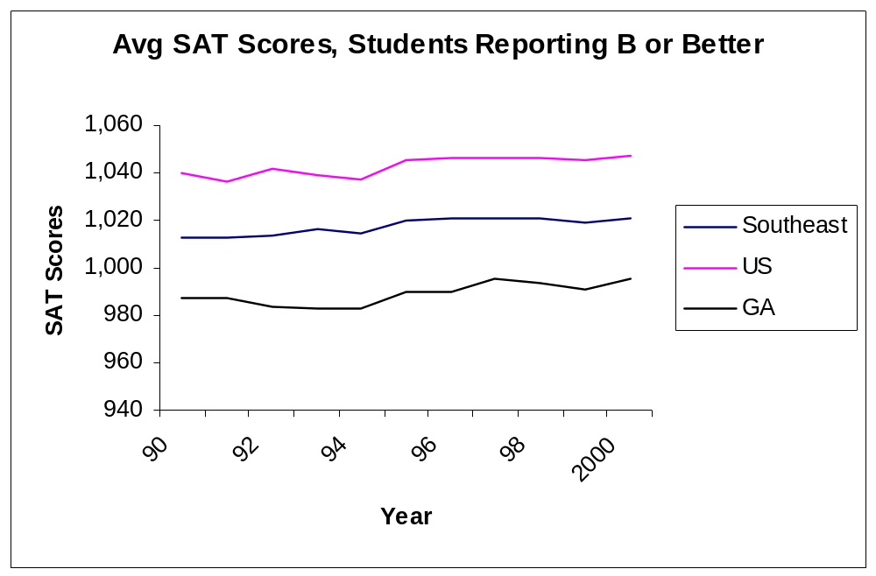
Results:
Average SAT scores for students reporting high school GPA ≥ 3.00

Slide 29
Adding a nonequivalent dependent variable to the time series
NEDV: A dependent variable that is predicted not to change because of treatment, but is expected to respond to some or all of the contextually important internal validity threats in the same way as the target outcome

Slide 30
Example: British Breathalyzer Experiment
Intervention: A crackdown on drunk driving using a breathalyzer.
Presumed that much drunk driving occurred after drinking at pubs during the hours pubs were open.
Dependent Variable: Traffic casualties during the hours pubs were open.
Nonequivalent Dependent Variable: Traffic casualties during the hours pubs were closed.
Helps to reduce the plausibility of history threats that the decrease was due to such things as:
  Weather changes
  Safer cars
  Police crackdown on speeding

Slide 31
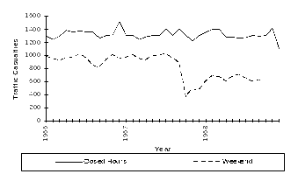
Note that the outcome variable (open hours on weekend) did show an effect, but the nonequivalent dependent variable (hours when clubs were closed) did not show an effect.

Slide 32
Example: Media Campaign to Reduce Alcohol Use During a Student Festival at a University (McKillip)
Dependent Variable: Awareness of alcohol abuse.
Nonequivalent Dependent Variables (McKillip calls them “control constructs”):
  Awareness of good nutrition
  Awareness of stress reduction
If the effect were due to secular trends (maturation) toward better health attitudes in general, then the NEDVs would also show the effect.

Slide 33
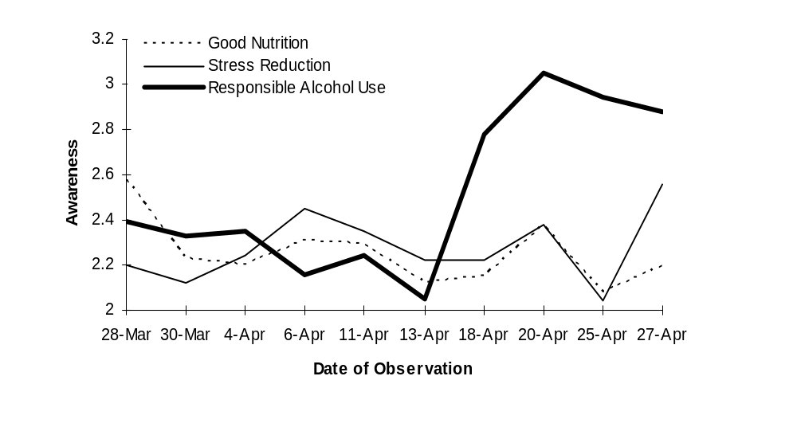
Only the targeted dependent variable, awareness of responsible alcohol use, responded to the treatment, suggesting the effect is unlikely to be due to secular trends in improved health awareness in general
Campaign

Slide 34
Adding more than one nonequivalent dependent variable to the design of SITS to increase internal validity

Slide 35
Example: Evaluating No Child Left Behind

Slide 36
NCLB
National program that applies to all public school students and so no equivalent group for comparison
We can use SITS to examine change in student test score before and after NCLB
Increase internal validity of causal effect by using 3 possible types of non-equivalent groups or 3 types of contrasts for comparison

Slide 37
Contrast Type 1 & 2
Contrast 1: Test for NCLB effect nationally
  Compare student achievement in public schools with private schools (both Catholic and non-Catholic)
Contrast 2: Test for NCLB effects at the state level
  Compare states varying in proficiency standards.
    States with higher proficiency standards are likely to have more schools fail to make AYP and so more schools will need to “reform” to boost student achievement

Slide 38
Contrast 1: Public vs Private Schools
Public schools got NCLB but private ones essentially did not
  If NCLB is raising achievement in general, then public schools should do better than private ones after 2002
Hypothesis is that changes in mean, slope or both after 2002 will favor public schools

Slide 39
Hypothetical NCLB effects on public (red) versus private schools (blue)
NAEP Test Score
208
200
NCLB
Time

Slide 40
Contrast 1: Public vs Private Schools
Two independent datasets: Main and Trend NAEP data can be used to test this
Main NAEP four posttest points. Data available for both Catholic and other private schools
Trend NAEP only one usable post-2002 point and then only for Catholic schools

Slide 41
Analytic Model
NCLB Public vs. Catholic school contrast
Model
Low Power
  Only 3 groups (public, Catholic, non-Catholic private) with 8 time points. So only 24 degrees of freedom
Autocorrelation
  Few solutions
  Cannot use clustering algorithm because there are not enough groups
  Robust s.e. used but results less conservative

Slide 42
Main NAEP Time Series Graphs
Public vs. Catholic
Public vs. Other Private

Slide 43
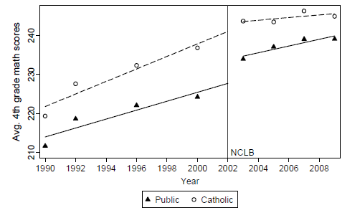
Main NAEP 4th grade math scores by year:
Public and Catholic schools

Slide 44
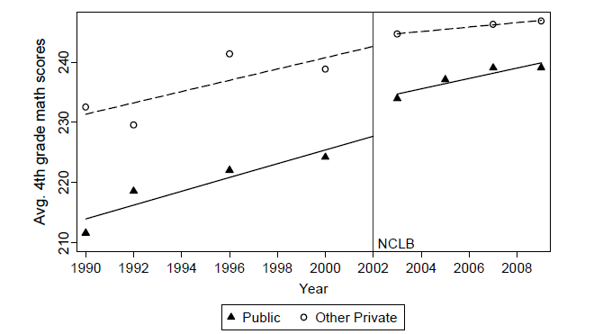
Main NAEP 4th grade math scores by year:
Public and Other Private schools

Slide 45
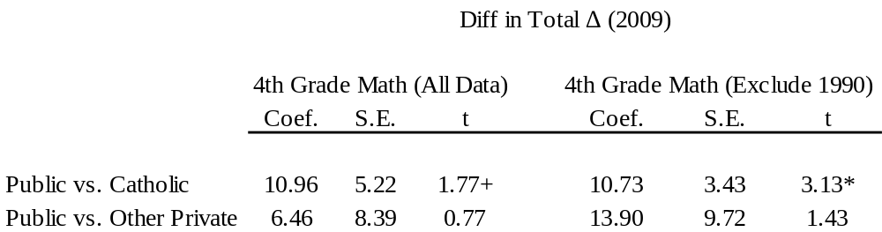

Difference in differences in Total change for 4th Grade Math
Analyses based on Main NAEP data

Slide 46
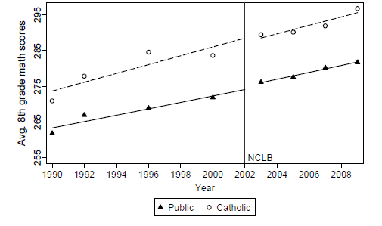
Main NAEP 8th grade math scores by year:
Public and Catholic schools

Slide 47
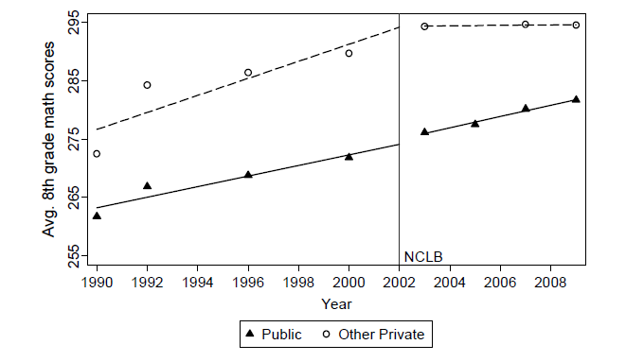
Main NAEP 8th grade math scores by year:
Public and Other Private schools

Slide 48
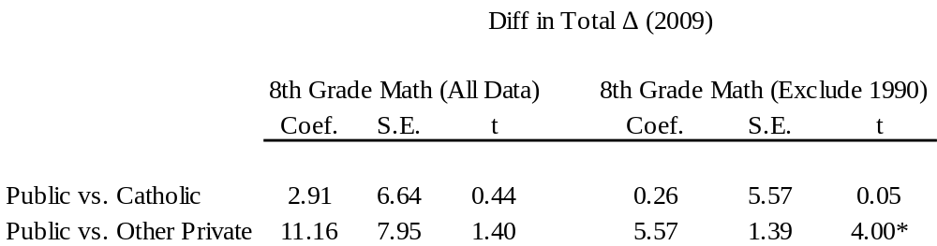
Difference in differences in Total change for 8th Grade Math
Analyses based on Main NAEP data

Slide 49
Trend NAEP Time Series Graphs
Public vs. Catholic School Contrast
(Other private school data unavailable and only 1 post-intervention time point)

Slide 50
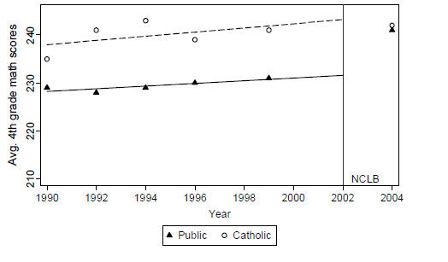
Trend NAEP 4th grade math scores by year:
Public and Catholic schools

Slide 51
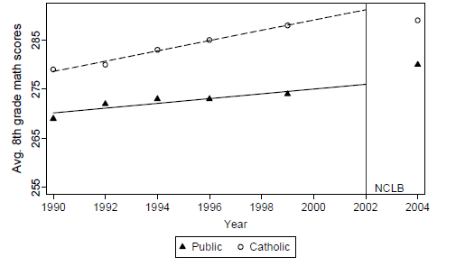
Trend NAEP 8th grade math scores by year:
Public and Catholic schools

Slide 52
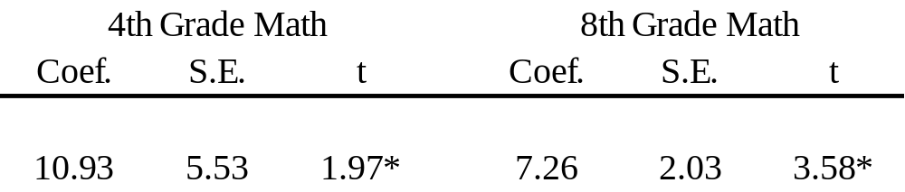
Difference in Differences in Mean Change in 2004 for Math
Analyses based on Trend NAEP data
Public vs. Catholic Contrast

Slide 53
Public vs Private School Findings
All effects on 4th and 8th grade math are in right direction, and some statistically significant
No effect on 4th grade reading but all are in the right direction (results not shown here)
This suggests that NCLB has a significant math effect nationally, but…

Slide 54
Concerns with Contrast 1
Possible low power due to low number of groups (3: public, Catholic, non-Catholic private) with 8 time points
  So only 24 degrees of freedom
Catholic sex abuse scandals in 2002 result in parents taking their children out of Catholic schools
No evidence that
  school leavers caused a drop in average student achievement in Catholic schools or
  public and other private school effects are due to transfers from Catholic schools
Data from other private schools provides a unconfounded replicate, but never stat sig.

Slide 55
Contrast 2: Comparing States that vary in Proficiency Standards
Some states set high standards for making AYP and so many schools fail and have to change their educational practices
  (more serious NCLB implementers, higher dosage of treatment)
Other states set low standards and so do not have to change much
  (less serious NCLB implementers, lower dosage of treatment)

Slide 56
Define Proficiency Standards Based on the Percentage of Students Deemed Proficient
To determine a state’s overall level of proficiency standard, we average the percentage of students deemed proficient across grades (4th and 8th grade) and across subjects (math and reading) using state assessment data from 2003
States that deemed less than 50% of students proficient have high proficiency standards
States that deemed 75% or more proficient are states have low proficiency standards
States between 50% and 75% are moderate

Slide 57
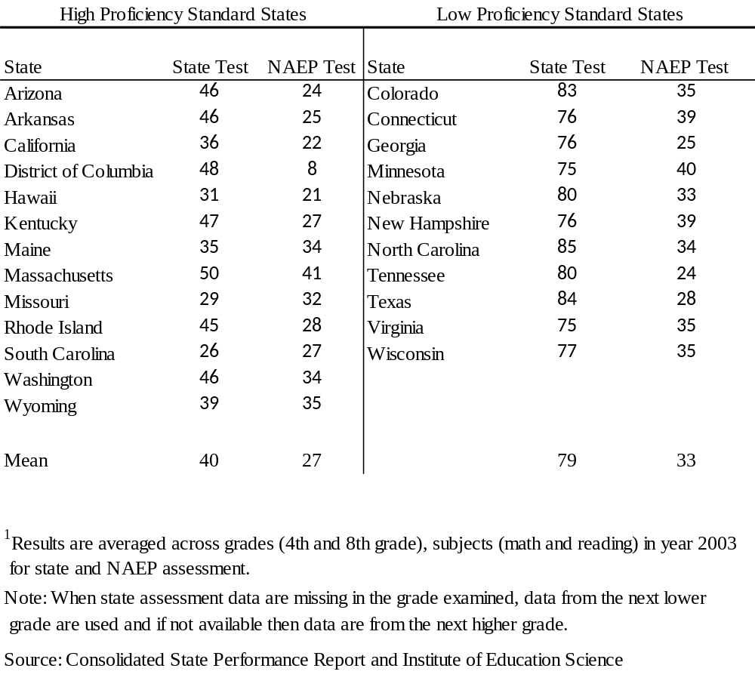
Evidence of Differing Standards

Slide 58
So Contrast 2 is…
Compare states at three levels of standards - high, medium and low
  Cut offs at 50% and 75% of students being proficient
Hypothesis is that in states with higher standards there should be more of a post-2002 change in mean, slope or both
Using Main NAEP data from 1990 to 2009 for Math and to 2007 for 4th grade Reading

Slide 59
Main NAEP Time Series Graphs
States with High vs. Medium vs. Low
Proficiency Standards

Slide 60
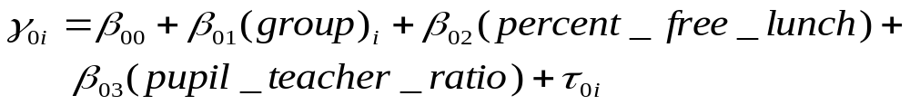



Adjusting for Autocorrelation
NCLB State Contrast
Option 1:
  HLM model can control for autocorrelation
Level 1:
Level 2:

Slide 61
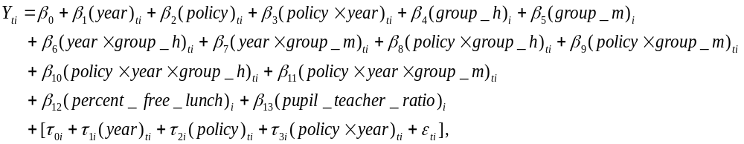


Analytic Model – Cont.
Full Model
Main Variables of Interest

Slide 62
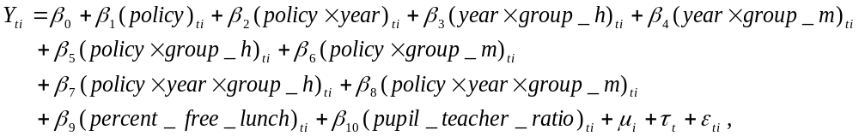
Adjusting for Autocorrelation
Option 2:
Fixed effects model because we are looking at the entire population of states
  Use cluster option in stata

Slide 63
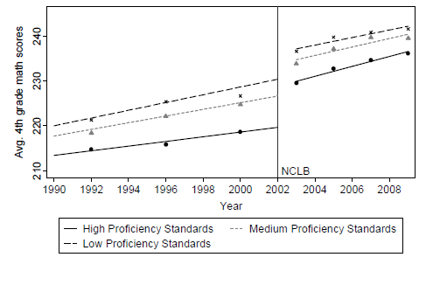
Main NAEP 4th grade math scores
by year and proficiency standards

Slide 64
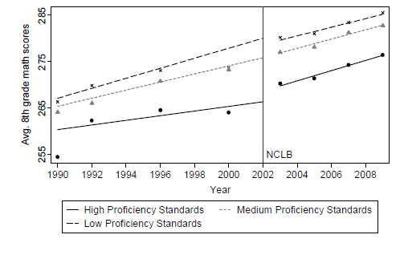
Main NAEP 8th grade math scores
by year and proficiency standards

Slide 65
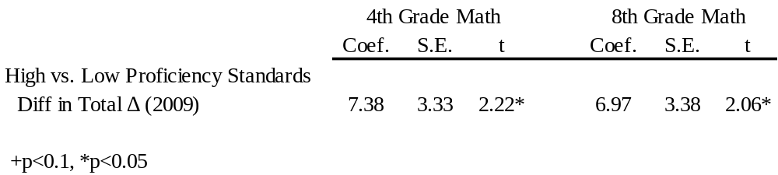
Difference in differences in 2009 Total change for Math
Analyses based on Main NAEP data

Slide 66
Contrast 2 Study Conclusions
NCLB increased
  4th Grade Math
      8 points.
      6 months of learning
      .26 SD
      .21 Pct
  8th grade math
      8 points
      12 months of learning
      .19 SD
      .20 pct
  4th Grade Reading
    No significant effect for either contrast but all are in the hypothesized direction

Slide 67
Overall Conclusions
Similar results obtain from both strategies:
  significant 4th and 8th grade math effects but not for reading
Viable internal threats are factors independent of NCLB that changed in 2002 and are correlated with both the public/private and the high/low proficiency contrasts
Most alternative interpretations do not apply to both strategies, and this should reduce concerns about internal validity
A few are shared (e.g., changes in math standards in public schools in 2002). These are discussed in the paper and shown to highly unlikely.

Slide 68
Contrast 3:
Dee & Jacob

Slide 69
Basic Insight of D & J
NCLB passed in 2002 and is a system of accountability by performance standards with inevitable sanctions for school failure
Some states had such a system earlier - e.g, via Improving American Schools Act
States whose accountability system pre 2002 had no sanctions then become “treatment” group that gets consequential accountability (CA) via NCLB in 2002
States with systems that had sanctions pre-2002 then become a comparison group post 2002

Slide 70
Basic Method of D & J
Prior studies can be used to determine which states did and did not have accountability system pre 2002
Dee & Jacob uses Hanushek’s measure
Main NAEP provides the pre-intervention (2002) and post-intervention time-series for both reading and math
Hypothesis again is that NCLB should increase mean or slope or both after 2002 by more in states without a prior accountability system

Slide 71
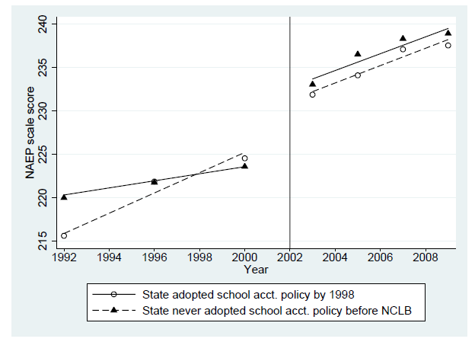
D & J Results: 4th Grade Math

Slide 72
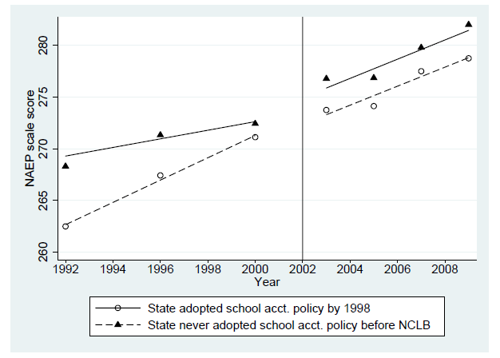
D & J Results: 8th Grade Math

Slide 73
Dee and Jacob Results
Similar causal findings to Wong, Cook & Steiner
Strong Evidence of a 4th Grade Math Effect
Some evidence of 8th Grade Math Effect
No Reading Effect

Slide 74
Two Causal Mechanisms
D & J claim results due to NCLB requiring some states to insert sanctions into their accountability systems in 2002 - the consequential accountability mechanism (CA)
WC&S claim their results due to higher proficiency standards after 2002 imposing more sanctions and school change compared to states with lower proficiency standards - the proficiency standards mechanism (S)
Correlation between two - our measure and Hanushek’s - is .05. So independent mechanisms.
How do the two combined relate to reading?

Slide 75
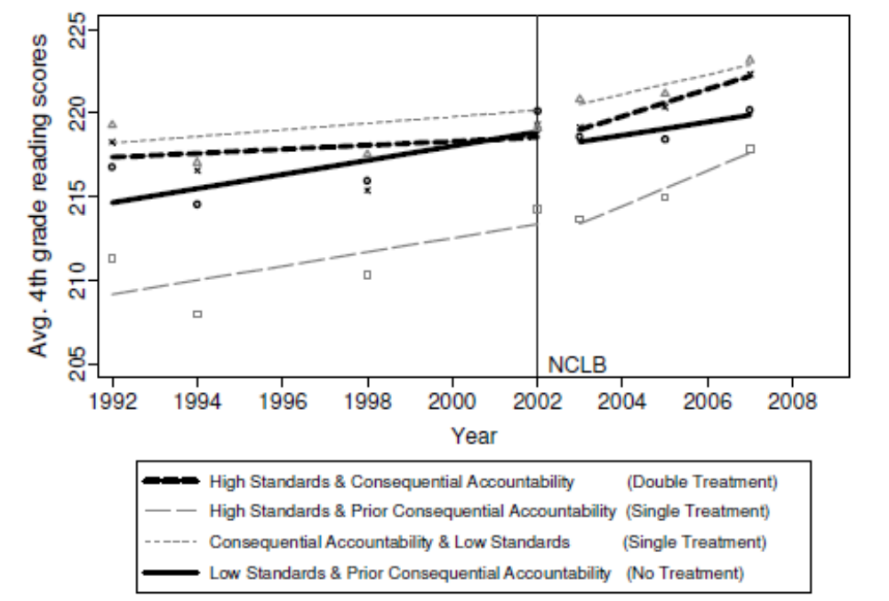
4th Grade Reading

Slide 76
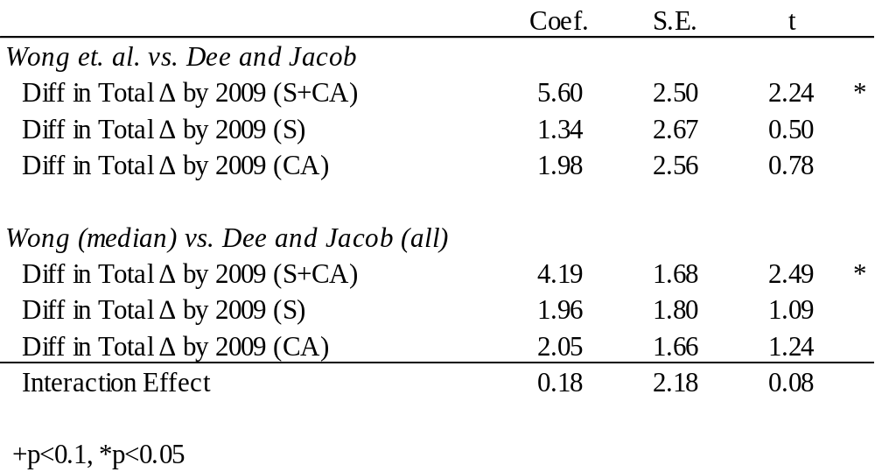
Differences in differences in total change post-NCLB
4th Grade Reading

Slide 77
The Use of Multiple Comparison Groups and Replications
ALL three ITS contrasts point to a clear math effect
  public vs. private
  high vs. low standards
  early versus late CA
When Standards and CA are combined, a modest reading effect appears in states that have a new sanction system and set high standards compared to states that already have a sanction system in place but set low standards after 2002.

Slide 78
Why did we need multiple comparison TS?

Slide 79
Adding Treatment Introduction and Removal: Examples from Research on Students with Disabilities

Slide 80
Example: Ayllon et al., A Behavioral Alternative to Drugs for Hyperactive Students
Drugs control hyperactivity, but can interfere with academic performance
Ayllon et al. used a behavioral intervention to try to control hyperactivity while improving academic performance as measured by
  Math
  Reading

Slide 81
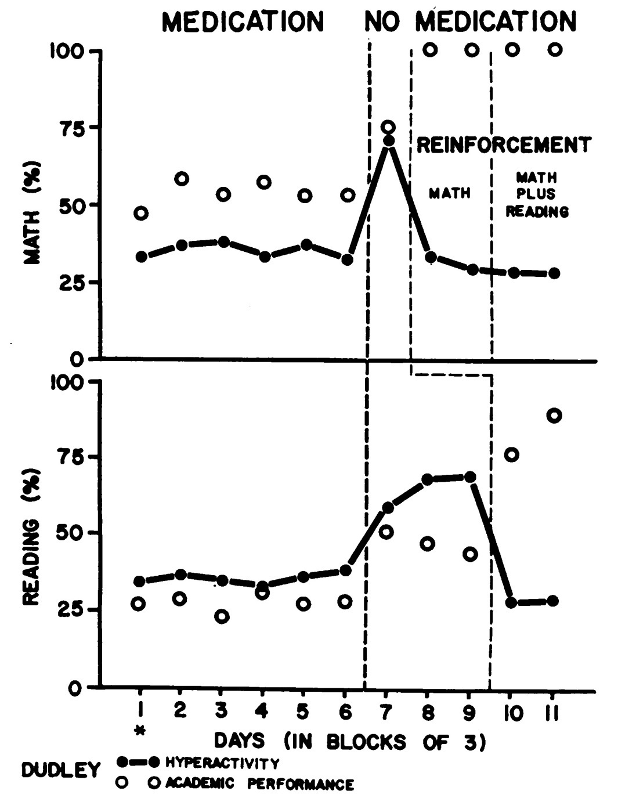
Medication decreased hyperactivity, but also affected academic performance.
The behavioral reinforcement program reduced hyperactivity but allowed academic performance to increase even more.
Removal of medication increased hyperactivity but allowed academic performance to recover a bit.

Slide 82
Multiple Baselines on Different Dependent Variables

Slide 83
Example: Chorpita
A child with difficulties attending school, with symptoms including
  Somatic complaints
  Tantrums and anger
  Crying
Intervention was a behavioral extinction and reinforcement schedule
Multiple baseline adding treatment for each of the three symptoms over time.

Slide 84
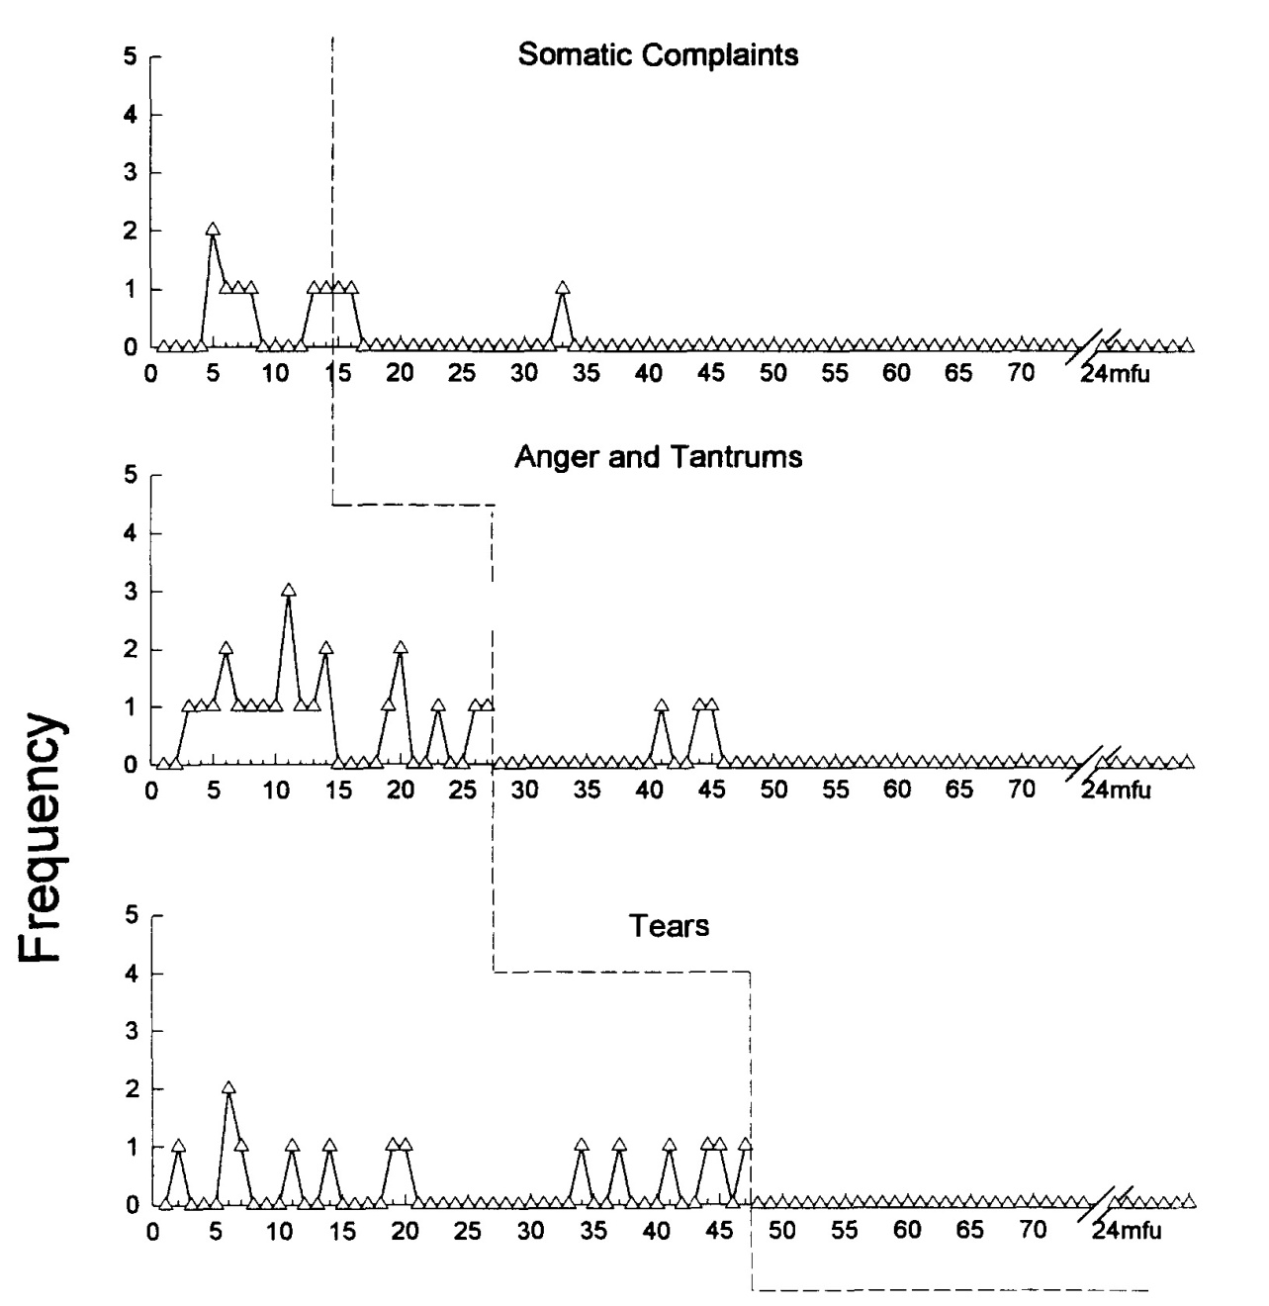
Initially, only somatic complaints were targeted.
Then, both somatic complaints and anger/tantrums were targeted.
Finally, all three sets of symptoms were targeted in the third phase.

Slide 85
Multiple Baselines on Different Units

Slide 86
Example: Blandford and Lloyd
Two learning disabled boys
Intervention: A self-instructional card with seven instructions on how to improve handwriting.
Outcome: Percent of possible points on a handwriting test
Multiple Baseline: Intervention was introduced at two different times for the two boys.

Slide 87
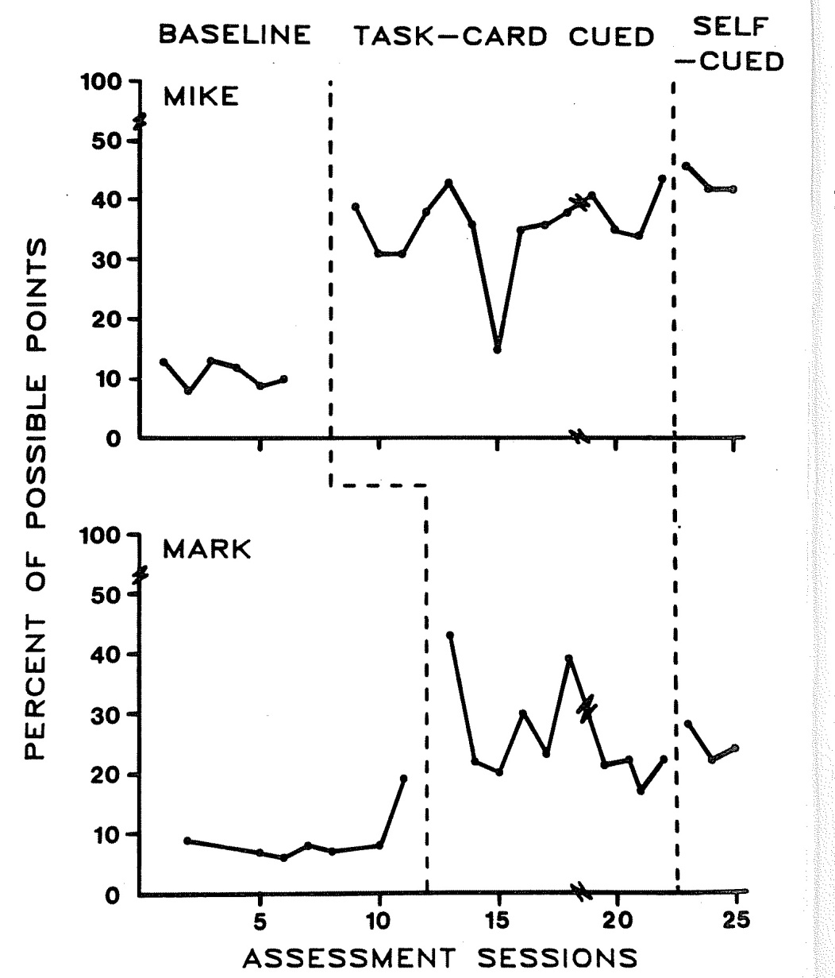

Slide 88
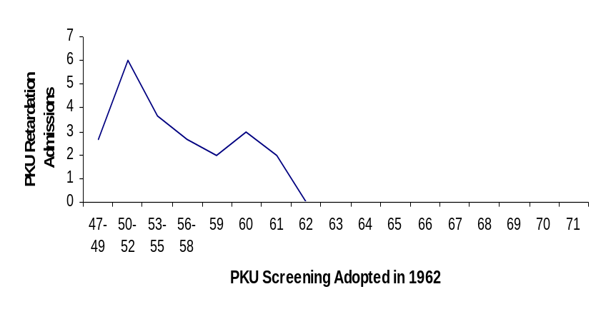
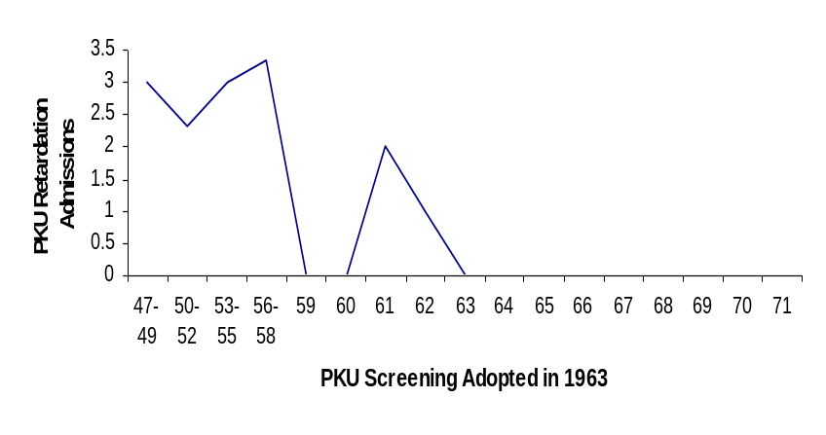
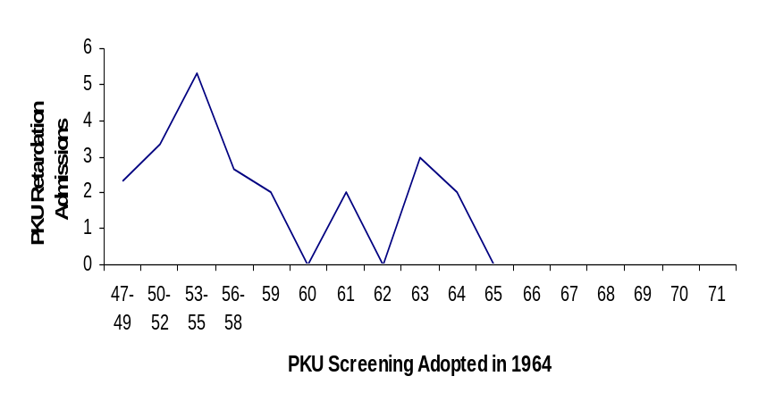
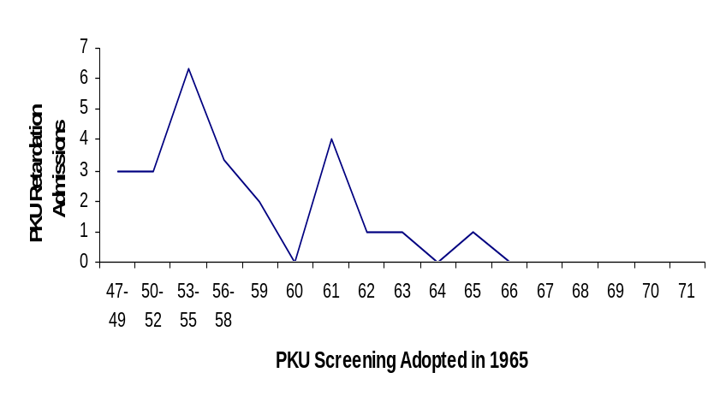
The effects of screening for phenylketonuria retardation

Slide 89
Analyses for Short Time Series
Early proposals to use ordinary least squares statistics
The above ignores the fact that times series data are auto-correlated

Slide 90
Multilevel Models: Current Work
Applying multilevel models to these data allows for different behavior patterns across cases, and can account for those differences using characteristics of the cases in the model.
We began analyses with a 1-phase study (treatment only), then 2-phase studies (AB), and are now working to model 4-phase studies (ABAB).
At each stage, we’ve discovered new technical issues to be considered and accommodated.

Slide 91
Potential advantages of using HLM to analyze and synthesize SCD data both within and across studies:
Appropriately considers observations as nested within cases
Does not require that all cases have the same number of observations or the same spacing of observations over time
Allows treatment effects to vary across cases, attempting to explain any heterogeneity of effects by adding subject or setting characteristics to the model
Can provide reliable estimates even with only few data points per cases

Slide 92
Potential drawbacks of using HLM to analyze and synthesize SCD data (both within and across studies):
Can be intimidating to some researchers
Can be difficult to estimate parameters when models get complex
  Especially when number of time points and number of cases is small.
  Especially when modeling quadratic terms.
  Especially when using a fully random effects model.

Slide 93
Example: Stuart 1967
8 time series, one on each of 8 people
Weight loss intervention over one year
Wt loss in pounds as dv
Here are the 8 time series:

Slide 94
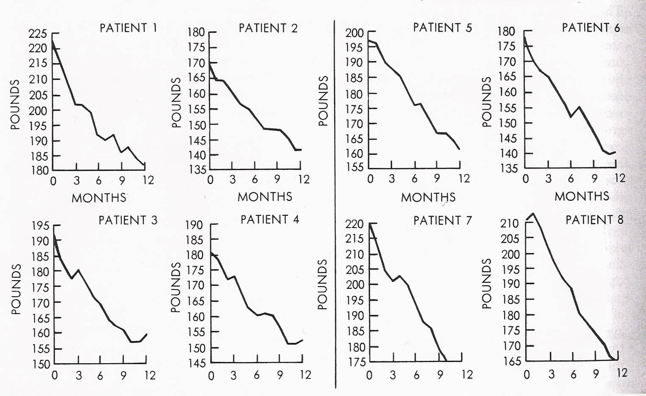
Stuart Data
Example (Stuart, 1967)
Notes:
Patients all lost weight at a fairly rapid rate over the 12 month period of the study.
But the rate of loss was not uniform across all patients. Some lost weight even faster than others. (ex: pt 8 vs. pt 4)
We want to find a simple model for each patient’s data. A straight line may do, or maybe a slight curve.
At this point, we only had data in this print form. In order to analyze it, we needed the raw data. So we first extracted the data using a program called “Ungraph”.

Slide 95
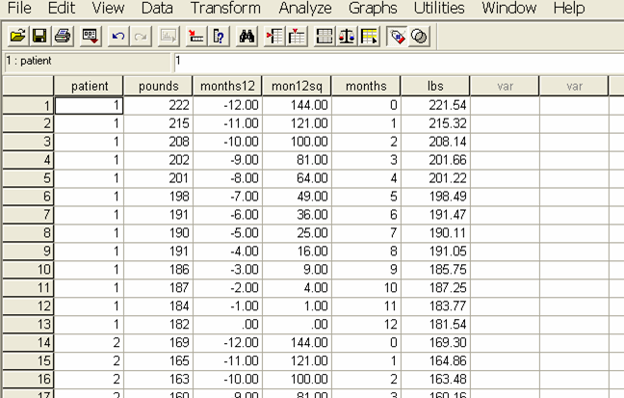
Level 1 (time within persons)
Notes:
Some Level-1 variables needed to be modified to accommodate our analyses.
Patient = subject ID
Pounds = rounded version of “lbs” (Ungraph read in “lbs”)
Months12 = rescaled (centered) version of “months” (to allow for more meaningful interpretation, we rescaled months so that 0 represented end weight. Months12= months-12.)
Mon12sq = months12² (We had an idea that the data may have a curve in it. In order to test this later, we needed to create a quadratic – or squared time variable – here first.)

Slide 96
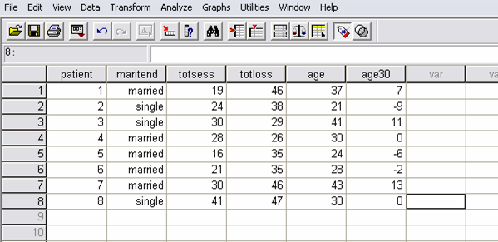
Level 2 data: Persons
Level-2 data (subject characteristics):
Notes:
A separate SPSS file was created manually for the Level-2 data (subject characteristics).
patient = subject ID
Maritend = whether the patient was married or single at the end of treatment
Totsess = how many total treatment sessions each patient attended
Age = age in years
Age30 = age in years recentered at 30 (age30=age-30)

Slide 97
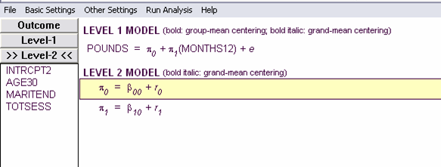
An Example of Modeling These Data in HLM
Building a Simple Linear Model in HLM:
POUNDS_{ij} = π₀ + π₁*(MONTHS12) + e_{ij}
  π₀ = average ending weight
  π₁ = average rate of change in weight per month

Slide 98
HLM: Linear Model Estimates
Final estimation of fixed effects:
Standard Approx.
Fixed Effect Coefficient Error T-ratio d.f. P-value
----------------------------------------------------------
For INTRCPT1,P0
INTRCPT2, B00 156.439560 5.053645 30.956 7 0.000
For MONTHS12 slope, P1
INTRCPT2, B10 -3.078984 0.233772 13.171 7 0.000
----------------------------------------------------------
The outcome variable is POUNDS
----------------------------------------------------------
POUNDS_{ij} ≈ 156.4 – 3.1*(MONTHS12) + e_{ij}
Notes:
The estimated ending weight for the average patient is 156 lbs. The average patient is estimated to lose about 3 lbs per month (Note: months was coded from 0 to -12). This is the estimated treatment effect and assumes loss is constant across all months.
Not shown here, but variance estimates were large and significant (meaning, this estimation of average ending weight and average rate of loss per month are not accurate for all the data.
Since the exploratory analysis didn’t suggest any patient characteristics might explain a large portion of this variance in intercepts or slopes, and since we had suspected that weight loss might have followed a curvilinear trend, we added a quadratic time term into the equation and re-ran HLM…

Slide 99
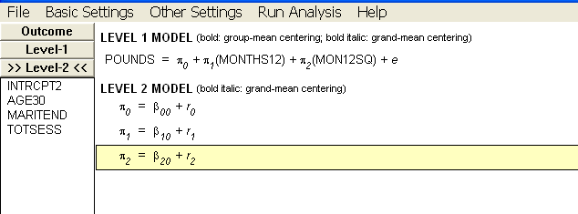
Quadratic Model Building
  POUNDS_{ij} = π₀+ π₁*(MONTHS12)+ π₂*(MON12SQ)+e_{ij}
  π₀ = average ending weight
  π₁ = average rate of change in weight per month near the end of the study
  π₂ = average rate of change in slope, or effect of time on weight loss

Slide 100
HLM Output from Quadratic Model:
Final estimation of fixed effects:
Standard Approx.
Fixed Effect Coefficient Error T-ratio d.f. P-value
-----------------------------------------------------------
For INTRCPT1, P0
INTRCPT2, B00 158.833791 5.321806 29.846 7 0.000
For MONTHS12 slope, P1
INTRCPT2, B10 -1.773039 0.358651 -4.944 7 0.001
For MON12SQ slope, P2
INTRCPT2, B20 0.108829 0.021467 5.070 7 0.001
-----------------------------------------------------------
The outcome variable is POUNDS
-----------------------------------------------------------
POUNDS_{ij} ≈ 158.8 – 1.8(MONTHS12) + 0.1*(MON12SQ) + e_{ij}
Notes:
The estimated ending weight for the average patient in this model is 159 lbs. The average patient is estimated to lose just under 2 lbs per month near the end of the study and that this slope gets about 0.1 LESS STEEP each month. So instead of assuming loss is constant across months, this quadratic model says that patients lose the most weight per month towards the beginning of treatment, but that this effect flattens out as treatment continues.
Not shown here – variance among intercepts (ending weight) and slopes (rate of loss per month near the end of treatment) remained significant. However, variance among the change in slopes (the quadratic piece) was NOT significant. It seems that the quadratic model fits well for all patients.

Slide 101
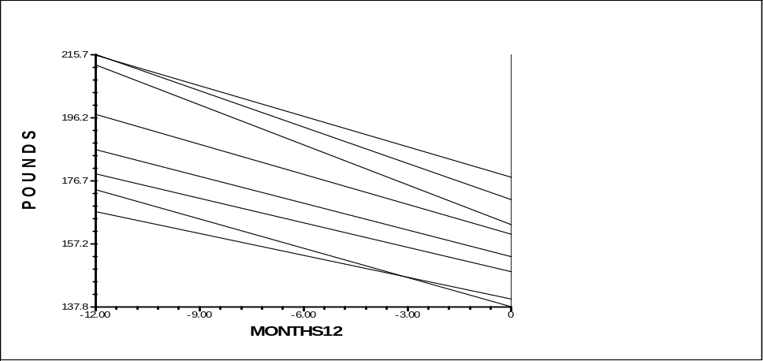
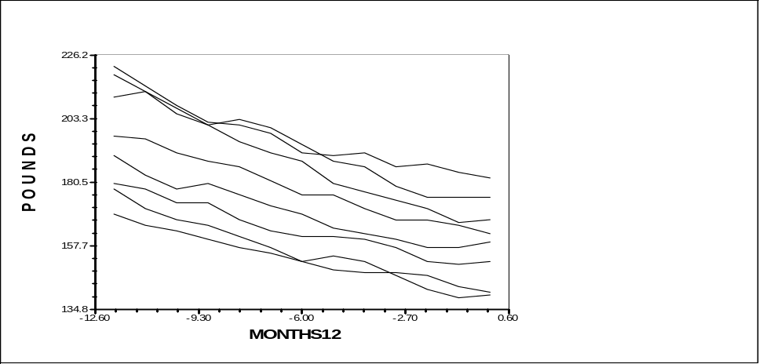
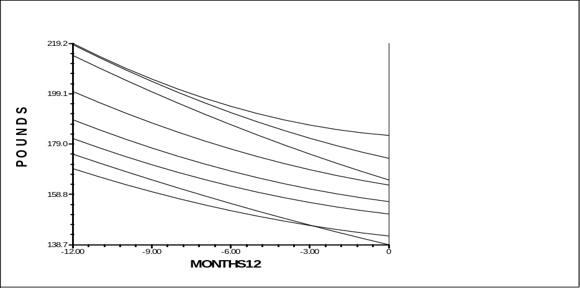
Comparing Models
Stuart (1967) – Actual Data
Linear Model Prediction (HLM)
Quadratic Model Prediction (HLM)
Even graphically, the quadratic model looks to be a better fit to the original data.
Patients lost weight at a faster rate at the beginning of treatment and at a slower rate towards the end of the one-year treatment.

Slide 102
So Simple: What Could Go Wrong?
HLM has problems
  when all effects are random
  with autoregressive model
WinBUGS works well, but harder to learn
  Fortunately, the WinBUGS estimates closely approximate the HLM estimates.

Slide 103
What Else Could Go Wrong?
Different studies have time series that use different outcome metrics (both between and often within studies)
  Counts, rates, means, ratings, totals, etc.
  With timed or untimed administration
  With constant or variable number of “items”

Slide 104
Problematically
Different combinations of these have different distributions, e.g.,
  Binomial for counts with fixed n of trials
  Poisson for rates with variable n of trials
HLM usually assumes normally distributed data.
  One can change this, but
  It isn’t clear HLM how can allow different distributions for different studies in the same meta-analysis.

Slide 105
So We Are Working On
Categorizing the different kinds of metrics and associated distributions, and
Seeing whether they can be modeled correctly in programs like HLM or WINBUGS.

Slide 106
Do you have any examples to share with us?

Slide 107
Summary
ITS is a very powerful design, but feasibility depends on the availability of a good archived outcome, or ability to gather original data
Much prior information is available in education, at individual, cohort and school levels
But it is not much used in education outside of special education with individual cases. Why?
Its use is not recommended without a comparison time series due to unclear extrapolations from pretest alone and uncertainty about when an effect should appear

