Slide 1
correcting bias with panel data
Fundamentals of
PROGRAM EVALUATION
JESSE LECY

Slide 2

Management Bias (Mundlak, 1965)
Farm
Productivity
(per acre)
b
Agricultural
Inputs
$$crop_yield=b_{0}+b_{1}∙fertilizer+e$$
(each data represents a specific farm)

Slide 3
Management Bias (Mundlak, 1965)
Farm
Productivity
(per acre)
b
β
Agricultural
Inputs
Policy impact did not meet expectations based upon the data.

Slide 4
Management Bias (Mundlak, 1965)
Farm
Productivity
(per acre)
b
β
Agricultural
Inputs
Farm
Output
Omitted
Variable?
Fertilizer

Slide 5
Management Bias (Mundlak, 1965)
Farm
Productivity
(per acre)
Contribution of inputs over-stated because high levels of input are correlated with other best practices
b
β
Agricultural
Inputs
Farm
Output
Inputs
Outputs
Good farming
practices
(timing of planting,
timing of harvest,
care of soil,
quality of inputs)
Skill of
Farmer
Management
Skill /
Org Culture
Fertilizer

Slide 6
Management Bias (Mundlak, 1965)
Farm
Productivity
(per acre)
b
β
Agricultural
Inputs
How can we hold skill constant?
What if we instead focus on how the output changes on each farm when they change input?

Slide 7
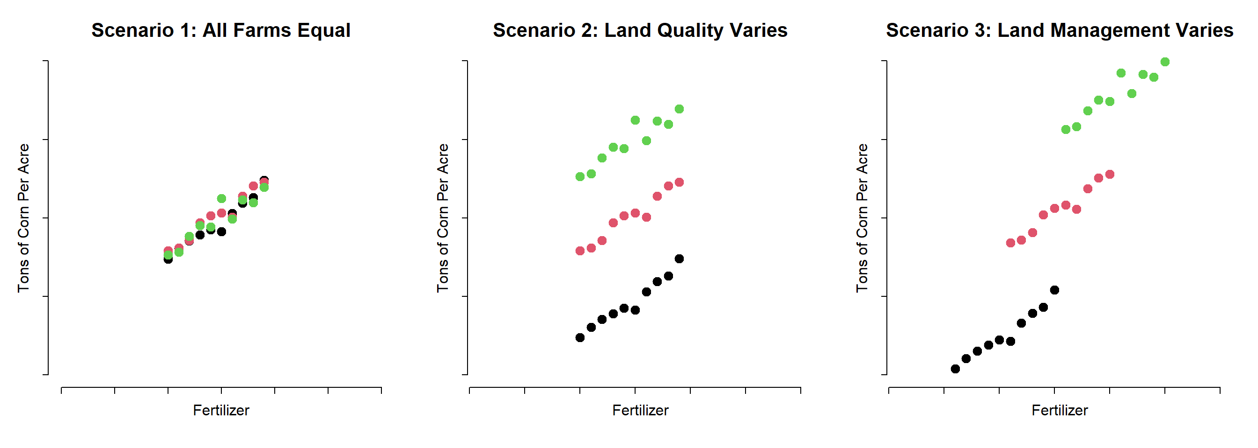
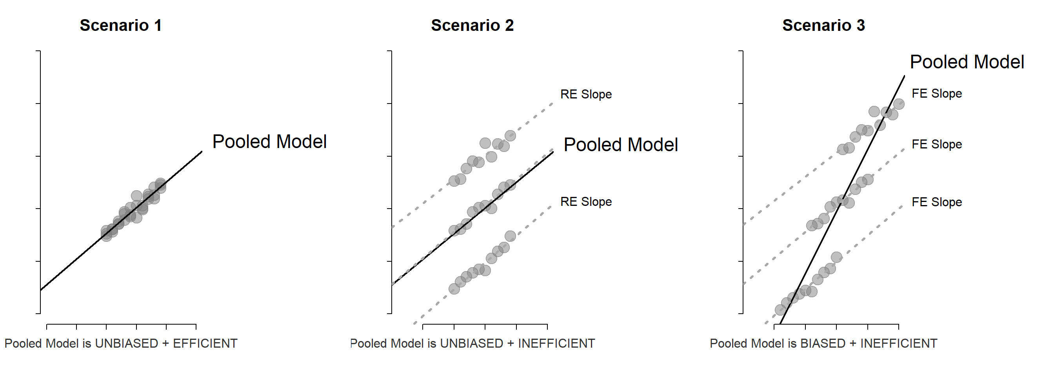
Management Bias (Mundlak, 1965)

Slide 8
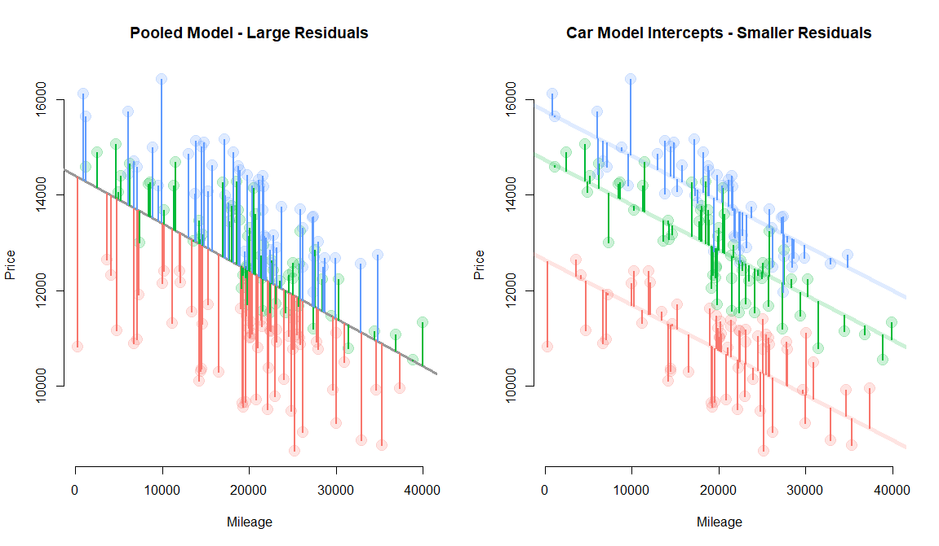

Slide 9
Panel data

Slide 10
Panel Data
Cross Section
Time Series
X | Y | Gender
1 | 8 | Male
3 | 6 | Female
2 | 5 | Female
2 | 3 | Male
Time | Y
1 | 8
2 | 6
3 | 5
4 | 3
Panel Data
ID | Time | X | Y
A | 1999 | 1 | 8
A | 2000 | 3 | 6
B | 1999 | 2 | 5
B | 2000 | 2 | 3

Slide 11
Is this program effective?
Outcome
(more is
better)
Time=1
Time=2
Program
O₁ x O₂

Slide 12
What about now?
Outcome
(more is
better)
Control Group
Treatment Group
Time=1
Time=2
Program
Treatment: O₁ x O₂
Control: O₁ O₂

Slide 13
What about now?
Outcome
(more is
better)
Treatment Group
Time=1
Time=2
Program
Treatment: O₁ x O₂
Control: O₁ O₂

Slide 14
What about now?
Outcome
(more is
better)
Treatment Group
Control Group
Time=1
Time=2
Program
Treatment: O₁ x O₂
Control: O₁ O₂

Slide 15
HOW ARE WE REASONING
ABOUT IMPACT?
Is the treated group better off than the control?
T2 – T1 = C2 – C1 ?
Change
over
time
Change
over
time
Outcome
(more is
better)
Treatment Group
Control Group
Time=1
Time=2
Program

Slide 16
HOW ARE WE REASONING
ABOUT IMPACT?
Diff-in-diff models are appropriate when:
Treatment is discrete (yes or no you received it)
The outcome is continuous
We have data from before and after the intervention
Limitations:
Many treatments are better represented as levels (how many hours at the gym is better than did you go to the gym)
We often have many groups, not just treatment and control
Outcome
(more is
better)
Treatment Group
Control Group
Time=1
Time=2
Program

Slide 17
The context –
the initial level of outcomes for treatment and control groups
– is important !

Slide 18

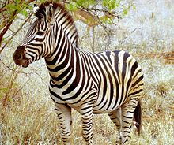
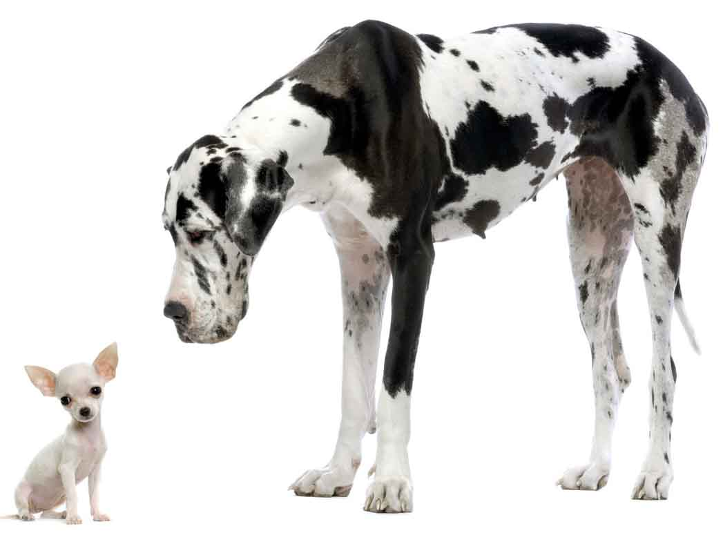
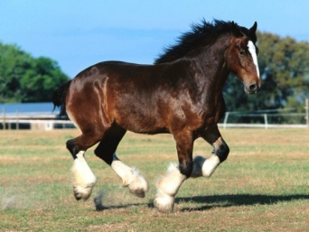
Group structure matters
When individuals are isolated by geography or institution they develop differently. This geographic / group structure matters a great deal in social sciences.

Slide 19


Heterogeneity Bias
Bias that results when you try to determine the impact of a program or policy and you don’t take into account group structure, i.e. different initial starting conditions of the outcome.
Would we treat all ungulates the same in a study?

Slide 20
Group structure In regression terms? fixed effects models

Slide 21
levels
Living
Standards
Aid
This is what the “levels” data will look like. Note that poor countries NEED the most aid, so the direction of causality is opposite of what this regression suggests. We cannot interpret the slope as a program impact here.

Slide 22
Change in levels
One Specific Country at Different Points in Time
Change in
Living
Standard
More aid
Change in
Living Standard
Less aid
Change
in Aid
If we look at changes in the levels of aid for one specific country, we can look at how that change either increases or decreases the standard of living in the country.

Slide 23
Living
Standards
BETWEEN Country
What the relationship looks like when you estimate the policy impact using all of the data from many countries.
Aid
One Point in Time
(cross-section)
Change in
Living
Standard
WITHIN Country
The relationship focusing on one country over time.
Change
in Aid
Change Over Time
(panel)

Slide 24
Each color represents data from a state over the 17-year study period.
Levels of spending and levels of economic development represent the specific characteristics of a group (a state in this case).
What is our inference about the policy impact of increased infrastructure spending when we use all of the data together, and does it change when we take into account group structure?
(data from Baltagi & Pinnoi 1995)

Slide 25
levels
Living
Standards
Aid
This is what the “levels” data will look like. Note that poor countries NEED the most aid, so the direction of causality is opposite of what this regression suggests. We cannot interpret the slope as a program impact here.

Slide 26
Change in levels
One Specific Country at Different Points in Time
Change in
Living
Standard
More aid
Change in
Living Standard
Less aid
Change
in Aid
If we look at changes in the levels of aid for one specific country, we can look at how that change either increases or decreases the standard of living in the country.

Slide 27
Living
Standards
Between Country
What the relationship looks like when you estimate the policy impact using all of the data from many countries.
Aid
Change in
Living
Standard
Within Country
The relationship focusing on one country over time.
Change
in Aid

Slide 28
Differences Between “Levels” and Changes in Levels
If you are looking at the relationship between foreign aid and the standard of living within a country, there is a large potential for bias because the countries that receive the most aid are going to be the poorest countries.
As a result, if you regress the standard of living onto aid – simply looking at the levels of living standards and the levels of foreign aid – you will incorrectly conclude that foreign aid actually hurts nations.
If we think about it more like an experiment, we would want to randomly assign levels of aid to different countries to see if it helps. That is not politically feasible, so instead we might think of a different experiment. What if we took all of the countries that are receiving aid, and we randomly assign them a one-unit increase or a one-unit decrease in aid. So they still receive close to the same levels of aid as the previous year, but they get a small boost or a small shock.
We are moving from an examination of the “levels” of foreign aid to changes in foreign aid.

Slide 29
Living
Standards
The fixed effect model does this by examine changes that occur within-group over time.
Aid
Change in
Living Standard
By adding an intercept for each group, you are putting them on the same axis so now you can estimate a common slope while taking into account the effects of the unique history/culture of the groups.
Change
in Aid

Slide 30
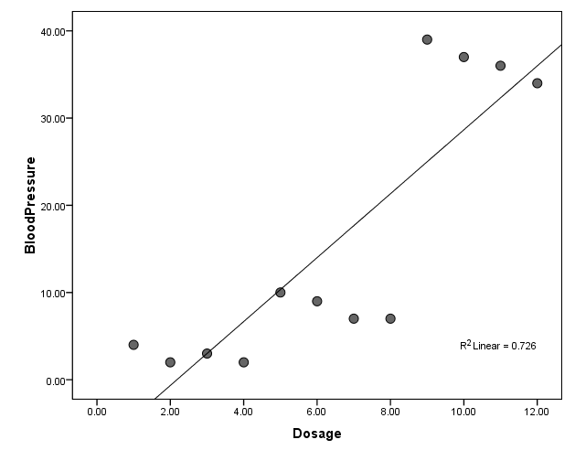
Cross-Section Variation (Levels)
Is the medication causing high blood pressure?
mg of Blood Pressure Med

Slide 31
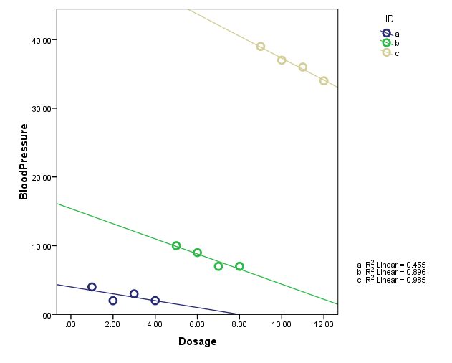
Within Group Variation
Blood pressure variation by individual depending upon changes to their prescription – increased dosage lowers blood pressure
Individuals
in the study
mg of Blood Pressure Med

Slide 32
Why do the slopes change?
Blood Pressure
Drug
Dosage
Individual Behaviors / Genetics
CORRELATION
Dosage is set based upon the baseline levels
Fixed traits that shape the baseline blood pressure

Slide 33
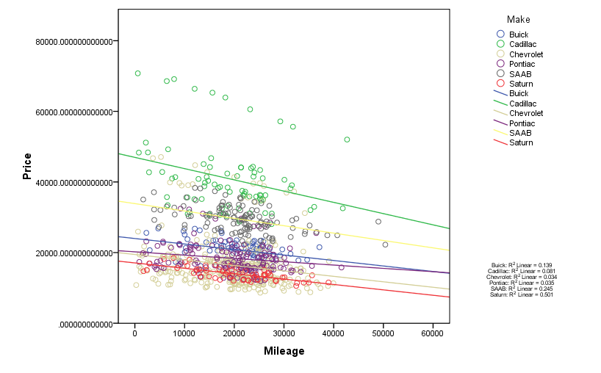
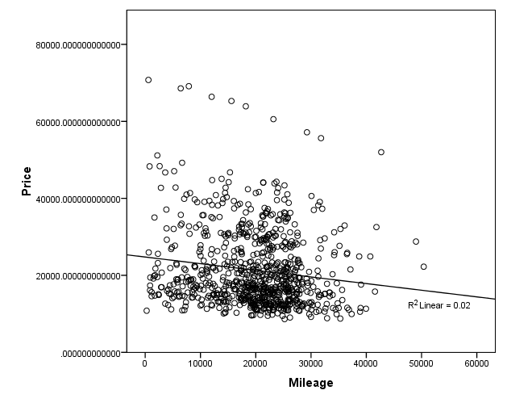
Another Example

Slide 34
Why are the slopes the same?
Farm
Productivity
(per acre)
b
β
Agricultural
Inputs
Farm
Output
Inputs
Outputs
Good farming
practices
(timing of planting,
timing of harvest,
care of soil,
quality of inputs)
Skill of
Farmer
Management
Skill /
Org Culture
Fertilizer

Slide 35
Why are the slopes the same?
Farm
Productivity
(per acre)
No correlation between land quality and inputs means the OLS and the FE models produce the same slopes
Land quality anchors each farms productivity at the over-time farm average
Farm A
Farm B
β
Farm C
Agricultural
Inputs
Land
Quality
Farm
Output
Inputs
Outputs
Quality of
Land
FIXED TRAIT
Land quality is uncorrelated with inputs per acre
Fertilizer

Slide 36
Why are the slopes the same?
Price
Mileage
Make
Sale price
Make and mileage are uncorrelated
Mileage acts independently on price – 10,000 extra miles drops the price the same amount for each car no matter which model
Car model
sets the baseline
price
β
Mileage

Slide 37
When to use Fixed Effects?
Y
Time-Invariant
Group-Level
Trait
Policy
Variable

Slide 38
The “Fixed Effect” is a catch-all variable for anything about the group that is “fixed” across time
Y
“Culture”
Race
Gender
IQ
Management or Productivity
Ability
X1
Fixed Trait
Even if we cannot
measure it,
we can get rid of it!

Slide 39
Isolating Change
Over Time
Change in Y
Change in X

Slide 40
How it works mathematically:
If any covariate is time-invariant:

Slide 41
“Fixed Effects” Regression Model

Slide 42
“Fixed Effects” Regression Model
Note – there is no intercept term. Why is this?
Perfect Multicollinearity

Slide 43
“Fixed Effects” Regression Model
Also note, there is only one slope in the model.

Slide 44
Bias Can go in the Other Direction
Y
X

Slide 45
Difference in Fit
X_{t=2}
Y_{t=2}
ΔX
Y_{t=1}
ΔY
X_{t=1}

Slide 46
Difference in Fit

Slide 47
ECONOMIC DEVELOPMENT
POLICY EXAMPLE:

Slide 48
Each color represents data from a state over the 17-year study period.
Levels of spending and levels of economic development represent the specific characteristics of a group (a state in this case).
What is our inference about the policy impact of increased infrastructure spending when we use all of the data together, and does it change when we take into account group structure?
(data from Baltagi & Pinnoi 1995)

Slide 49
EXAMPLE

Slide 50
EXAMPLE

Slide 51
Why does this happen?
Economic
Growth
Public
Spending
On Infrastructure
State
Characteristics
Public
Infrastructure
?
Economic
Growth
+
Tax Base
+
+
Tech Boom/
Discover Oil

