Slide 1
REGRESSION DISCONTINUITY DESIGN

Slide 2
3 valid counterfactuals:
Each variety of counterfactual has a different formula for the program effect estimate.
Pre-Post Reflexive
Estimator
effect = T2-T1
Post-Only
Estimator
effect = T2-C2
Pre-Post w Comparison
Estimator
effect = (T2-T1) – (C2-C1)
(Diff-in-Diff)
effect
effect
A
effect:
A-B
B
t=1
t=2
t=1
t=2
t=1
t=2
Program
Program
Program
Treatment Groups, T1=before, T2=post-program measure
Control Groups, C1=before, C2=post-program measure

Slide 3
The “selection” problem
Outcome
Choice to
participate
Program
When happens when people are given the choice to participate in a program? When do problems arise? How do we estimate program impact in this case?

Slide 4
Solution: randomization
Outcome
Choice to
Participate
in RCTs
Treatment

Slide 5
The “selection” problem when participation is mandatory but you need to qualify
Outcome
Choice to
Program
participation
Outcome
Choice to
Program
participation
Program
Program
What about means-tested programs?
E.g. Medicare, housing vouchers, food stamps,
honors classes, college scholarships, summer school

Slide 6
REGRESSION DISCONTINUITY DESIGN

Slide 7
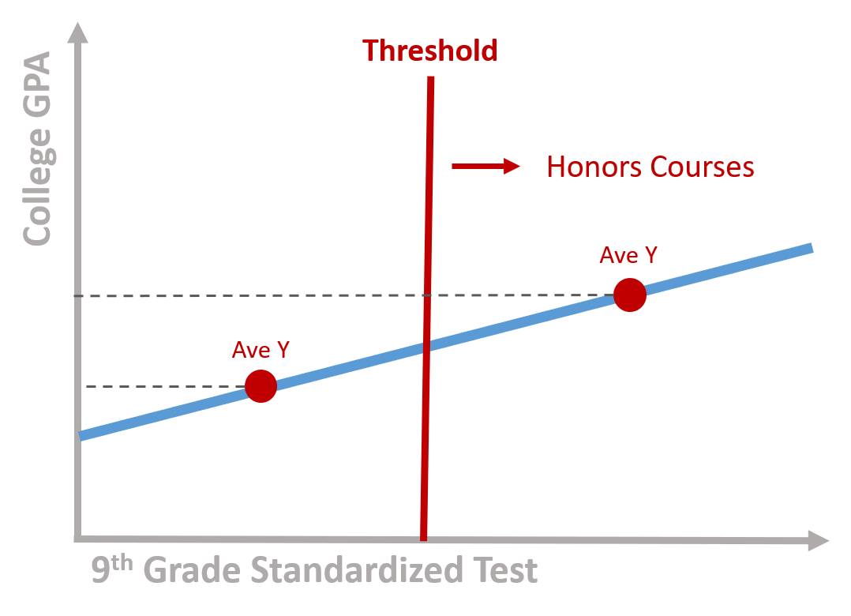

Slide 8
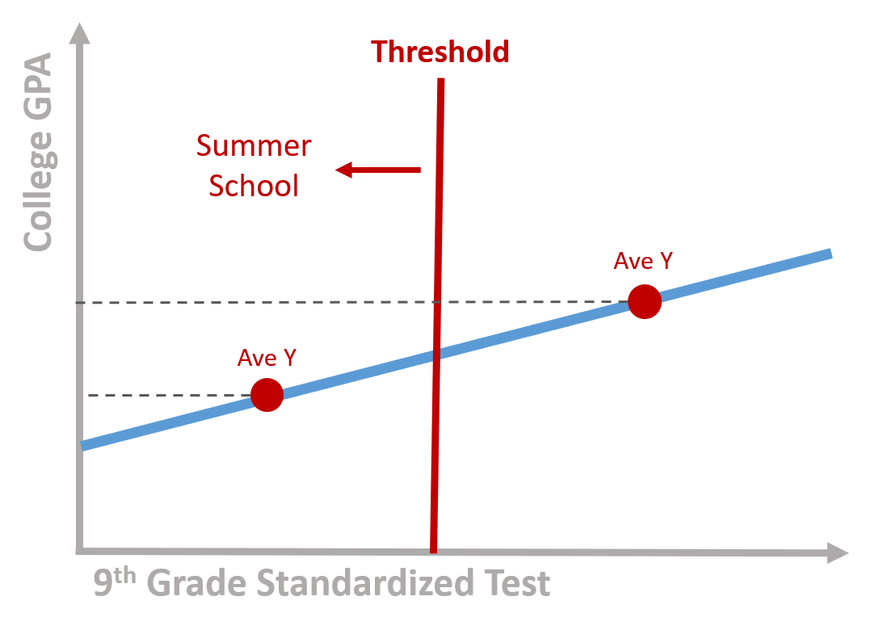

Slide 9
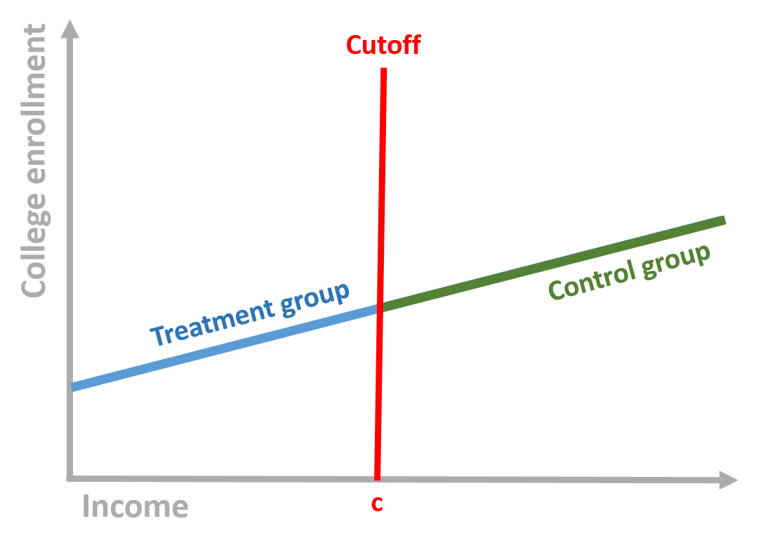
Outcome
Criteria for Program Participation

Slide 10
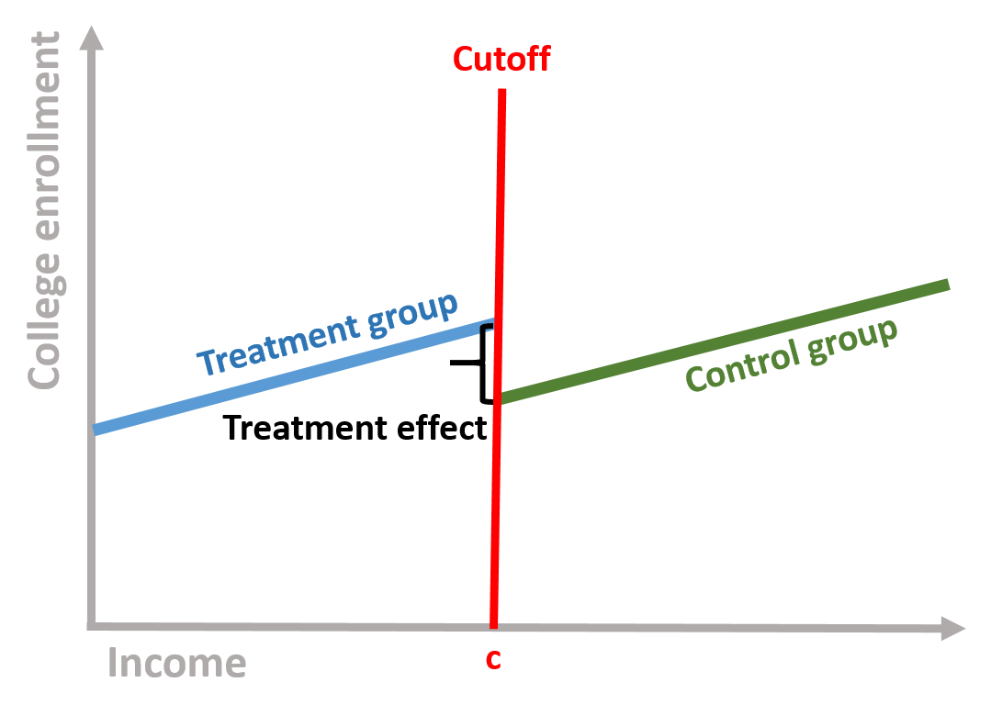
Outcome
Criteria for Program Participation

Slide 11
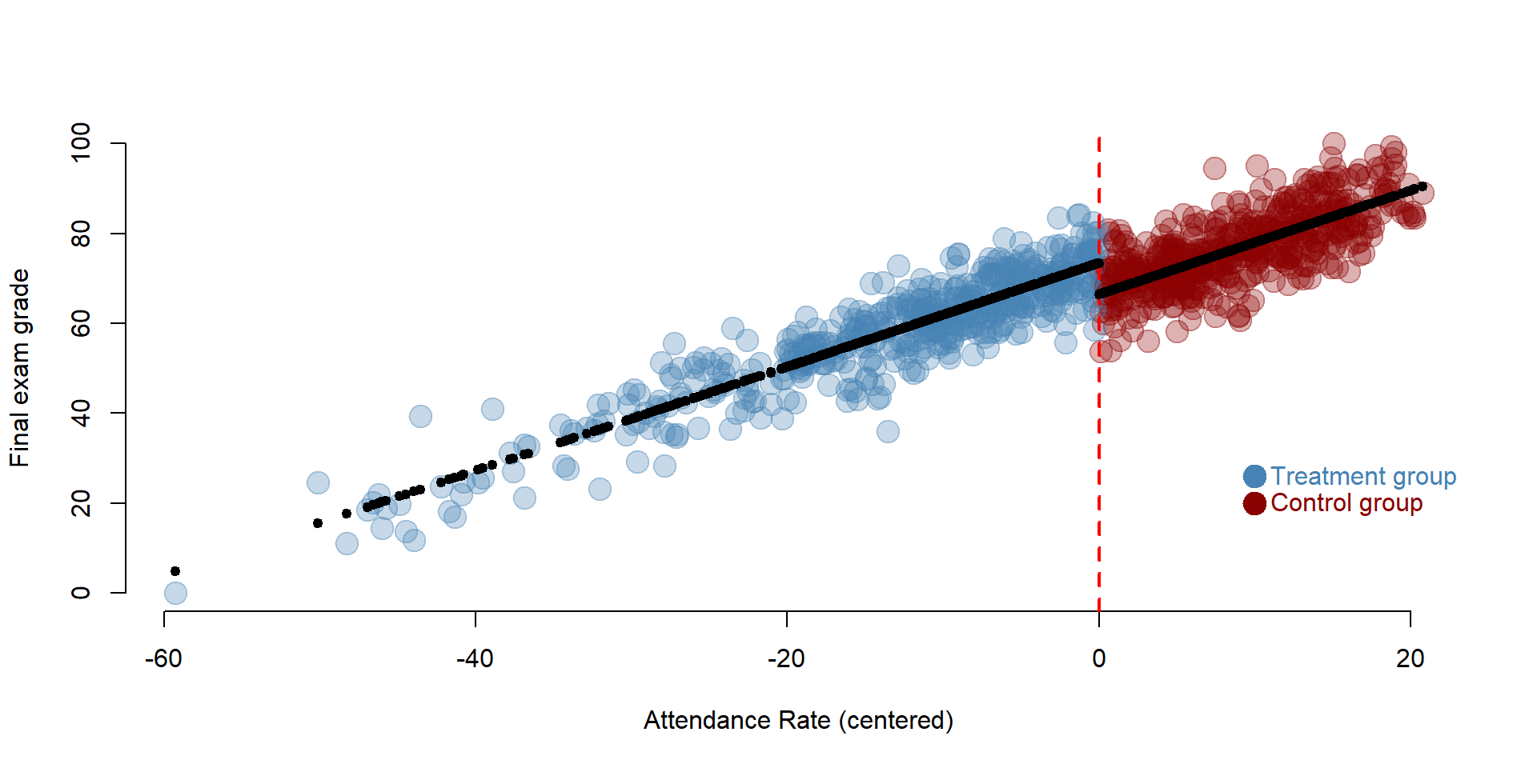
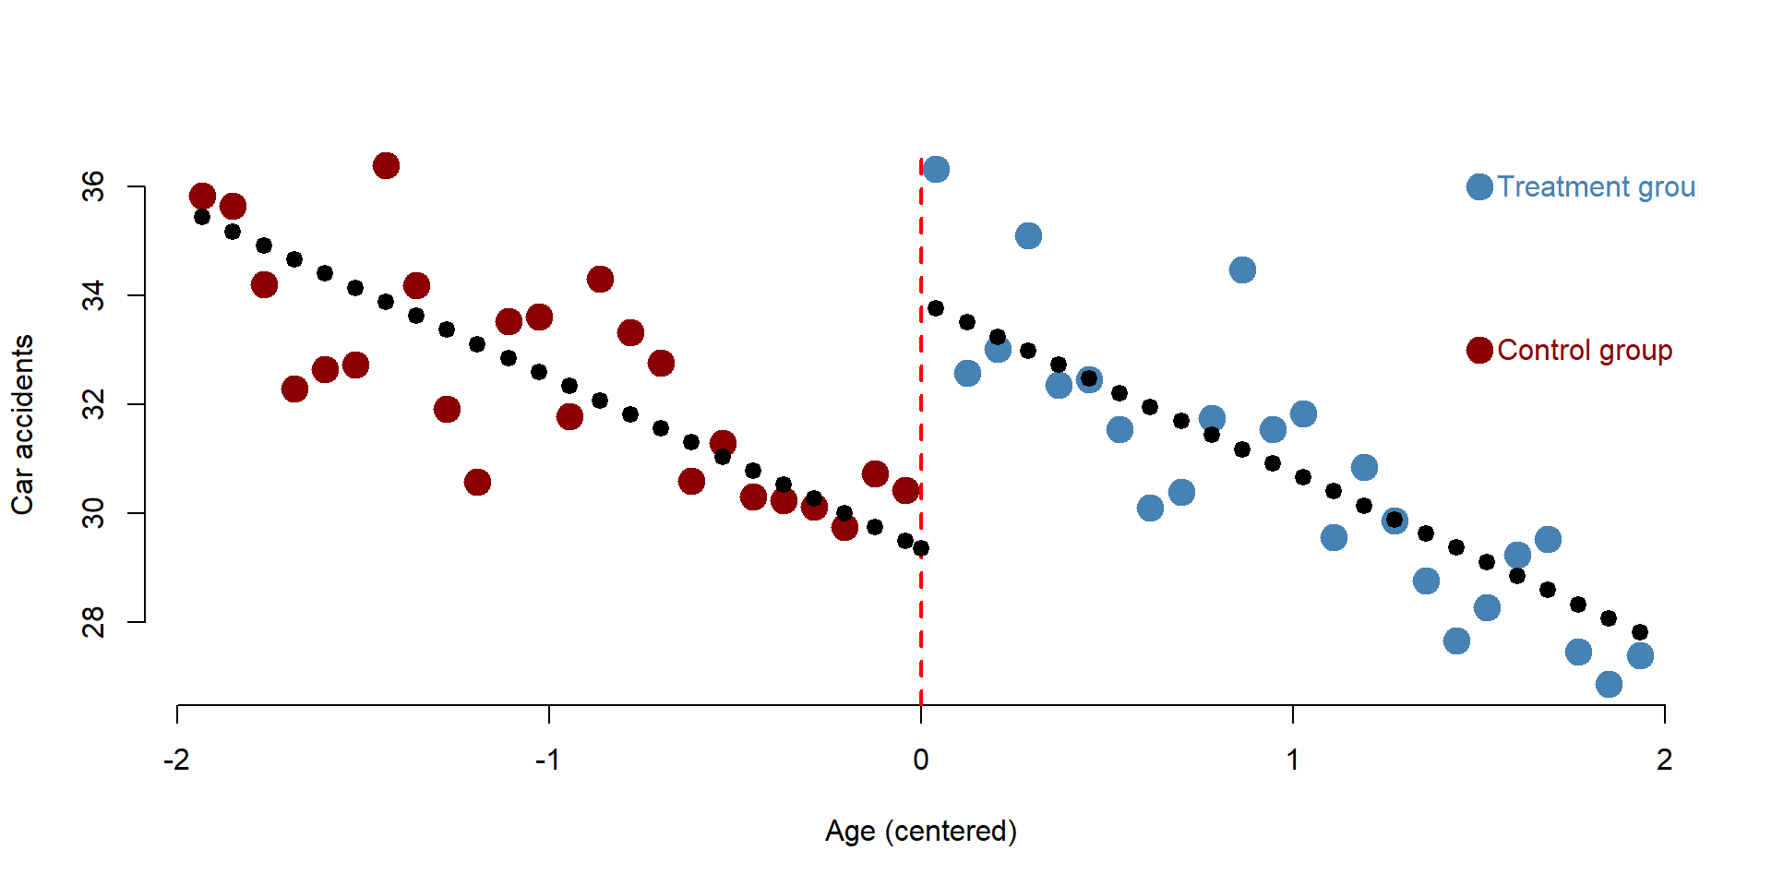

Slide 12
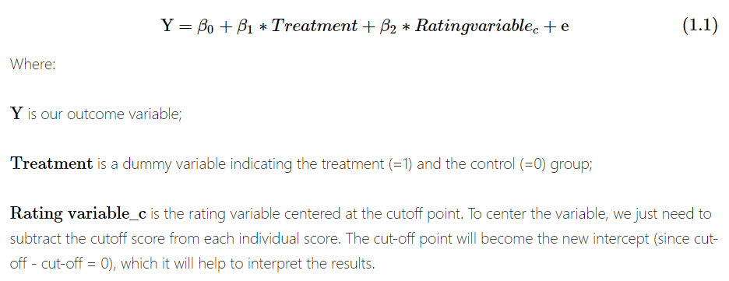

Slide 13
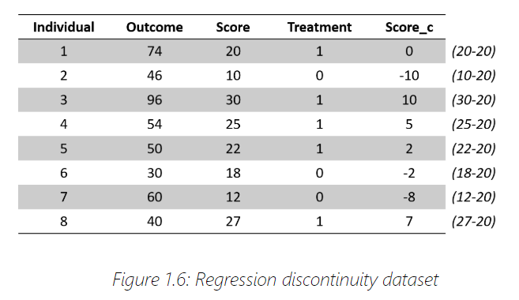
Centered
On Cutoff
20

Slide 14
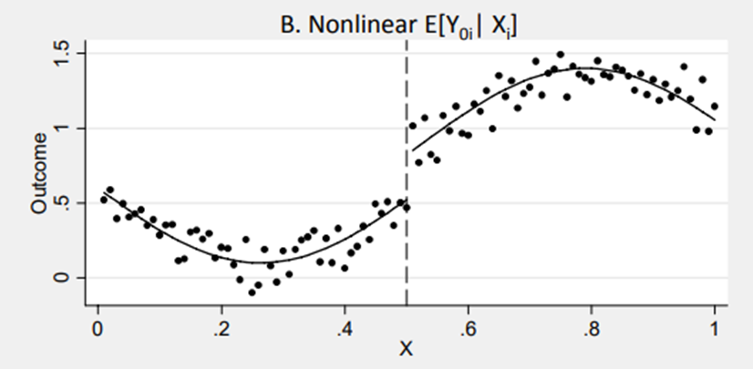

Slide 15
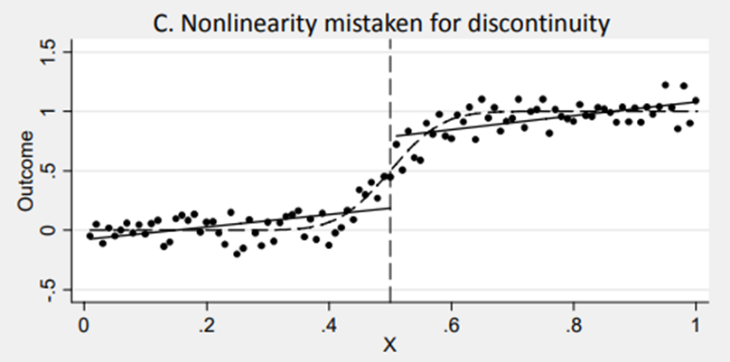

Slide 16
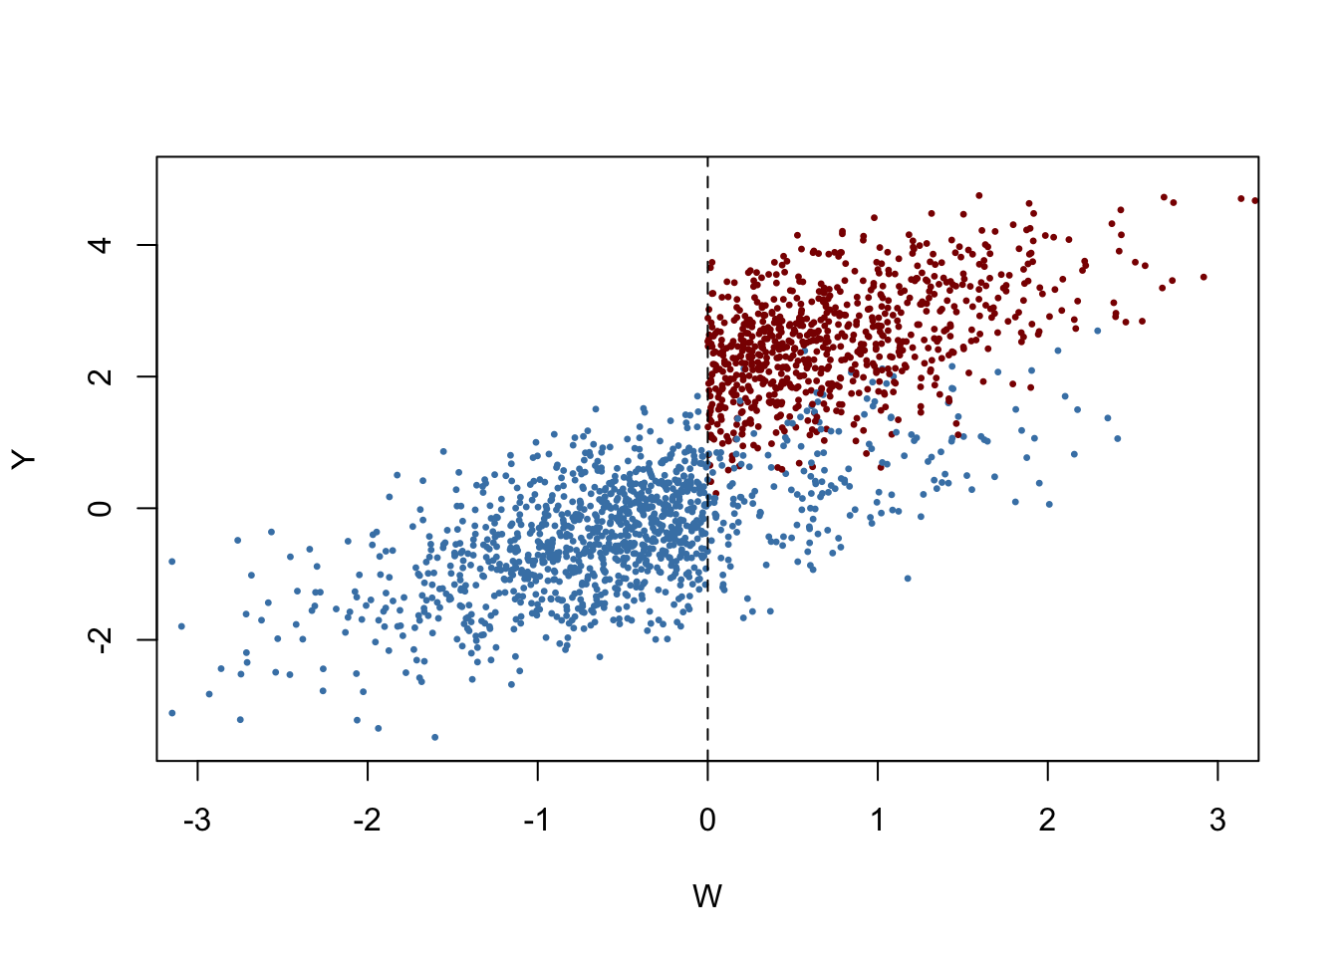

Slide 17
COMPARISON OF METHODS

Slide 18
Regression discontinuity and time series

Slide 19
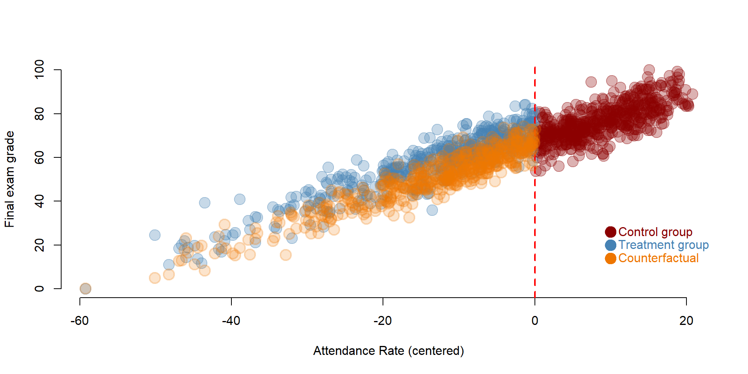

Slide 20
Pay attention to the axis:
Regression Discontinuity
Time Series
Program
Program

Slide 21
Pay attention to the axis:
Regression Discontinuity
Time Series
Eligibility
Criteria
Time

Slide 22
Interrupted Time Series Regression Models:
Y = outcome
T = time
D = dummy
P = time after program starts
Y | T | D | P
17 | 1 | 0 | 0
19 | 2 | 0 | 0
22 | 3 | 0 | 0
24 | 4 | 1 | 1
27 | 5 | 1 | 2
27 | 6 | 1 | 3
30 | 7 | 1 | 4

Slide 23
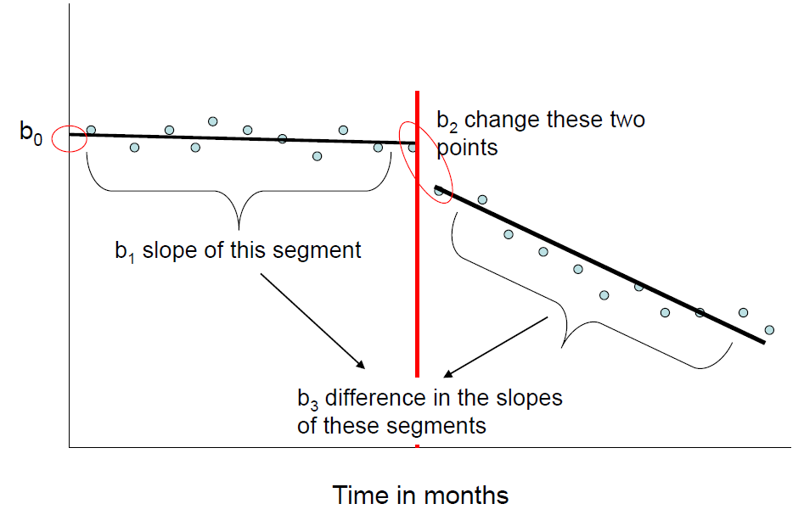
Interrupted Time Series
Regression Models:
Y | T | D | P
17 | 1 | 0 | 0
19 | 2 | 0 | 0
22 | 3 | 0 | 0
24 | 4 | 1 | 1
27 | 5 | 1 | 2
27 | 6 | 1 | 3
30 | 7 | 1 | 4

Slide 24
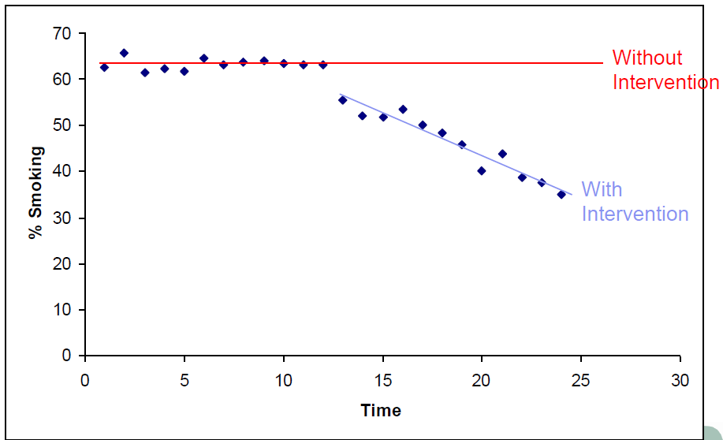
How do you define “effect size”?

Slide 25
How do you define “effect size”?

Slide 26
effect

Slide 27
3 valid counterfactuals:
Each variety of counterfactual has a different formula for the program effect estimate.
Pre-Post Reflexive
Estimator
effect = T2-T1
Post-Only
Estimator
effect = T2-C2
Pre-Post w Comparison
Estimator
effect = (T2-T1) – (C2-C1)
(Diff-in-Diff)
effect
effect
A
effect:
A-B
B
t=1
t=2
t=1
t=2
t=1
t=2
Program
Program
Program
Treatment Groups, T1=before, T2=post-program measure
Control Groups, C1=before, C2=post-program measure

Slide 28
Difference-in-Difference Estimator
T2
Pre-Post w Comparison
Estimator
effect = (T2-T1) – (C2-C1)
T1
A
effect:
A-B
C2
C1
B
(Diff-in-Diff)
t=1
t=2
Program
Accounts for initial difference in groups and secular trends

Slide 29
Difference-in-Difference Estimator
Pre-Post w Comparison
effect = (T2-T1) – (C2-C1)
effect:
A-B
A
Gains during the program period by treatment group
Gains independent of the program (secular trends)
B
t=1
t=2
Program

Slide 30
“Control” Versus “Comparison” Groups
Outcome
T2
Policy / program group
The term “control group” typically refers to a group created through randomization, so they are assumed to be identical. We sometimes use the terminology “comparison group” to differentiate the these cases. The control groups represents the counterfactual, the comparison group does not (it just captures trend in this case).
T1
C2
C1
Control / comparison group
time=1
time=2
Program
Single Difference: Difference in Difference:
Effect = T2 – T1 Effect = (T2 – T1) – (C2 – C1)
Effect = T2 – C2
*trend*

Slide 31
2 remaining counterfactuals:
Pre-Post Reflexive
Estimator
effect = T2-T1
Post-Only
Estimator
effect = T2-C2
Pre-Post w Comparison
Estimator
effect = (T2-T1) – (C2-C1)
(Diff-in-Diff)
effect
effect
A
effect:
A-B
B
t=1
t=2
t=1
t=2
t=1
t=2
Program
Program
Program

