Slide 1
Standard error of the slope
Fundamentals of
PROGRAM EVALUATION
JESSE LECY

Slide 2
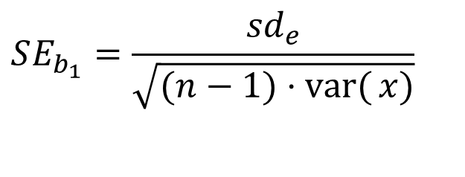
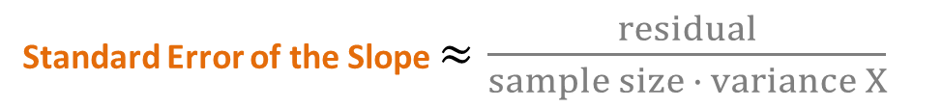
Standard error of the slope
We want to end up here. Need to work backwards.
This is the one formula you need to remember.
Standard Error of the Slope $≈\frac{residual}{sample size ∙ variance X}$
$$SE_{b_{1}}=\frac{{sd}_{e}}{\sqrt{(n−1)⋅\operatorname{var}{(}x)}}$$

Slide 3
The variance calculation
Distance between y_{i} and y-bar
Y
Distance between y_{i} and y-bar
X
Variance: square the distances, add them up, divide by n-1

Slide 4
Partitioning the Variance of Y
Total SS
Error SS
Regression SS
Regression Line

Slide 5



Y
unexplained
Point i
explained
$$\overline{Y}$$
X
Two parts of the variance of Y
$${Unexplained: Y}_{i}−{\hat{Y}}_{i}=e_{i}$$
The Venn diagram is a simplified representation of the regression model. In our regression, the explained portion of the variance of outcome will always be the distance from the mean to the predicted value of Y (which always falls on the regression line), and the unexplained portion is the distance between the regression line and the actual data point, also called the residual or the error e.
$$Explained: { \hat{Y}}_{i}−\overline{Y}$$

Slide 6
Standard error of the slope

Slide 7


Standard Error in Regression
Point i
$$Y_{i}−{\hat{Y}}_{i}=e_{i}$$
$$\overline{Y}$$
$$Y_{i}−\overline{Y}$$
Sum of Squared Error Terms
Variance of the residual
The standard error of the slope is one of the most important concepts in regression because it determines the size of the confidence interval and thus the statistical significance of our study. We want standard errors to be as small as possible. We see here that the size of the standard error will be directly related to the amount of unexplained variance we have in our model, the residual e. The important thing to note is the unexplained portion shows up in the numerator of the standard error. As a result, the size of the standard error will be proportional to the amount of unexplained variance (plus a couple of other considerations to be covered later).
Standard error of the slope

Slide 8
Standard Error in Regression
The size of the standard error of the mean is driven by the variance of the variable, and the sample size.
We can write the formula for the standard error of the slope in a couple of ways. I prefer the top because it is explicit about sample size and var(x).
Similarly, the standard error of the slope is a function of the variance of the residual (the amount of unexplained variance in the outcome), the sample size (n-1), AND the variance of the explanatory variable.

Slide 9
The Intuitive Standard Error
Note:
Thus:
Therefore:

Slide 10

Standard error of the Slope
Don’t get too caught up with the math. The formula for the standard error of a regression coefficient is actually quite simple when you break it down. There are three moving parts – three things that can affect the size of the standard error. The portion of unexplained variance of the dependent variable (the residual), the sample size of the regression, and the amount of variance in the variable X associated with the regression slope.
Standard Error of the Slope $≈\frac{residual}{sample size ∙ variance X}$
$$SE_{b_{1}}=\frac{{sd}_{e}}{\sqrt{(n−1)⋅\operatorname{var}{(}x)}}$$

Slide 11
standard error as a Sampling Statistic

Slide 12
standard error of the slope
sample size = 10

Slide 13
standard error of the slope
sample size = 50

Slide 14
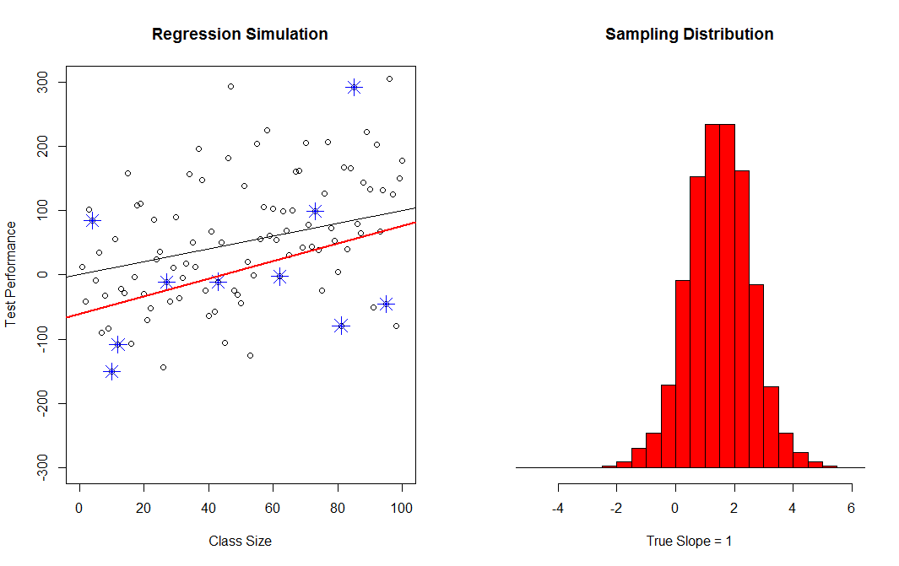
standard error of the slope
Sampling Distribution
of the Slope
(Our Sample)
*
Best Guess of the Slope
*
*
*
*
*
*
True Slope
*
*
*
“Average Error”
(Of the slope estimate)

Slide 15
Translating Concepts
Standard Error of the Mean
Standard Error of the Slope
X ← Source of Variance → Y
Increase sample size
← Reduction of St. Error →
(1) Increase sample size
(2) Explain more variance of Y
(i.e. add controls)
(3) Increase variance of X

Slide 16
Standard deviation versus Standard error
The standard deviation is, how far the data is from the mean, on average.
~
The standard error is, how far our best guest is from ‘the truth’, on average.
The ‘truth’ means different things depending upon what kind of standard error you are calculating.

Slide 17
The Road Map
Of the Mean:
Of the Slope:
Sampling
Variance:
(for x)
(using the residual)
Standard Deviation:
Standard Error:
Confidence Interval
(of the mean)
(of the slope)

Slide 18
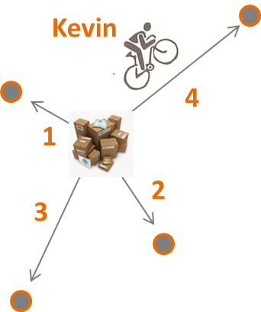
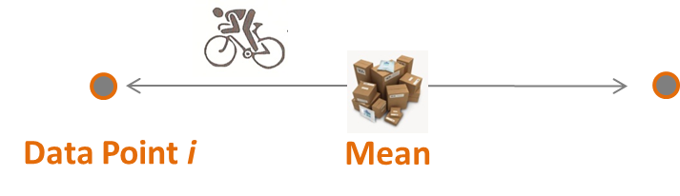

Useful Metaphors
Variance
Standard Deviation
Standard Error
Confidence Interval
b₁
b₁
B₁

Slide 19
What should be clear in my mind?
We split the variance of Y into explained and unexplained portions with a trick, inserting the regression line y-hat.
The standard error of the slope is derived from the unexplained portion of Y, the residual.

