Slide 1
Regression Review
Fundamentals of
PROGRAM EVALUATION
JESSE LECY

Slide 2
Regression Review
The Road Map
Of the Mean:
Of the Slope:
Variance:
(for x)
(using the residual)
Standard Deviation:
Standard Error:
Confidence Interval
(of the mean)
(of the slope)
All of the statistical concepts that you have learned in the previous course using variance, standard errors, and confidence intervals of a estimates of the mean from a single variable apply to regression, but they have to be adapted.
Make note that statistical concepts always need to be followed by the phrase “of the” because they are general concepts and the specific calculations are determined by the variables you are working with. The standard error around an estimated mean is different than the standard error around an estimated slope.

Slide 3
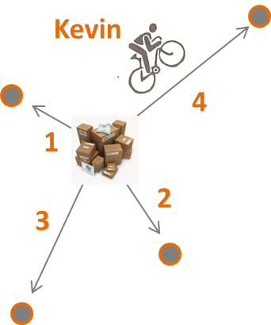
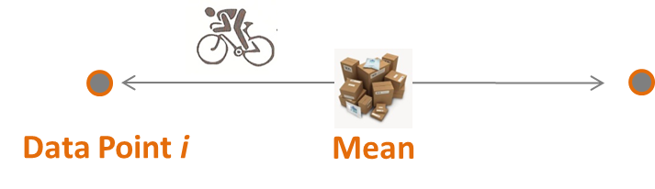

Regression Review
Useful Metaphors
Variance
Standard Deviation
Standard Error
Confidence Interval
b₁
b₁
B₁

Slide 4
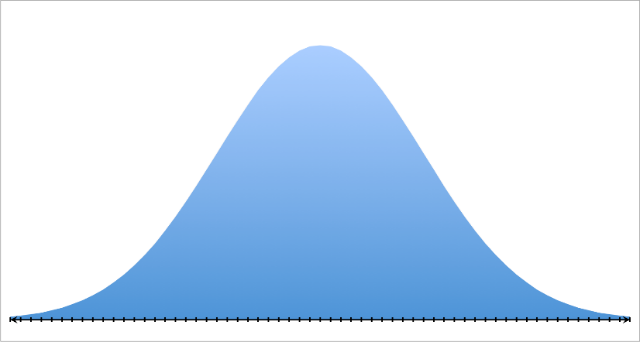


Regression Review
Sampling
Distributions
Population Statistic →
$$μ=5$$
6
3
5
6
7
Sample Statistic →
$$\overline{x}=5.4$$

Slide 5
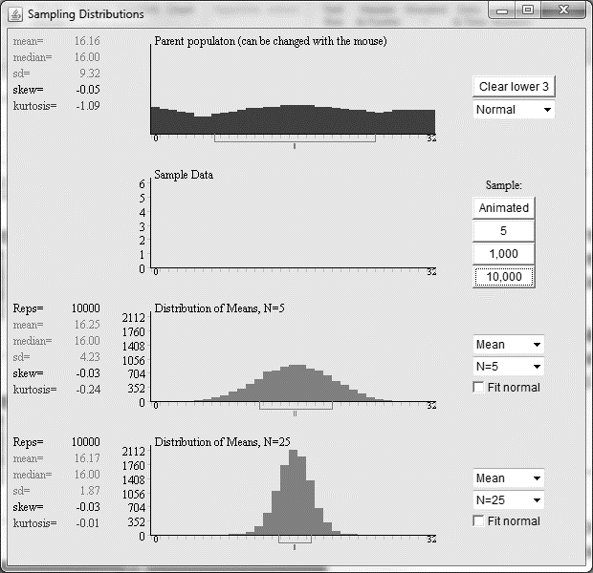
Regression Review
standard error of a sample mean
http://onlinestatbook.com/stat_sim/sampling_dist/index.html

Slide 6




Regression Review
standard error of a sample mean
$$μ=5$$
Population:
Sample size = 5
6
$$\frac{3+5+6+6+7}{5}=5.4$$
3
5
6
7
$$μ=5$$
$$\overline{x}=5.4$$
How far, on average, will our best guess be from the true mean?
http://onlinestatbook.com/stat_sim/sampling_dist/index.html

Slide 7
Regression Review
standard error of a sample mean
$$μ=5$$
Population:
Sample size = 5
6
3
5
6
7
$$\frac{3+5+6+6+7}{5}=5.4$$
How far, on average, will our best guess be from the true mean?
“Average Error”
(Of the Sample STAT)
STANDARD ERROR →
http://onlinestatbook.com/stat_sim/sampling_dist/index.html

Slide 8
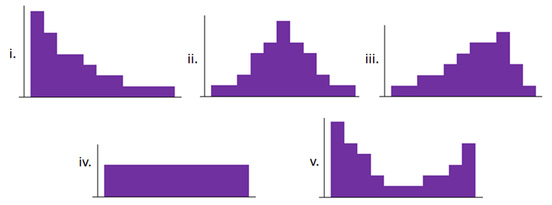
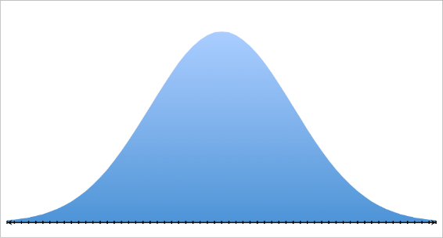
Regression Review
central limit theorem aside
no matter what the population looks like
the sampling distribution of the mean is always normal
(otherwise we would not have inferential statistics)
http://onlinestatbook.com/stat_sim/sampling_dist/index.html

Slide 9
Regression Review
standard error of the slope

Slide 10
Regression Review
standard error of the slope
sample size = 10

Slide 11
Regression Review
standard error of the slope
sample size = 50

Slide 12
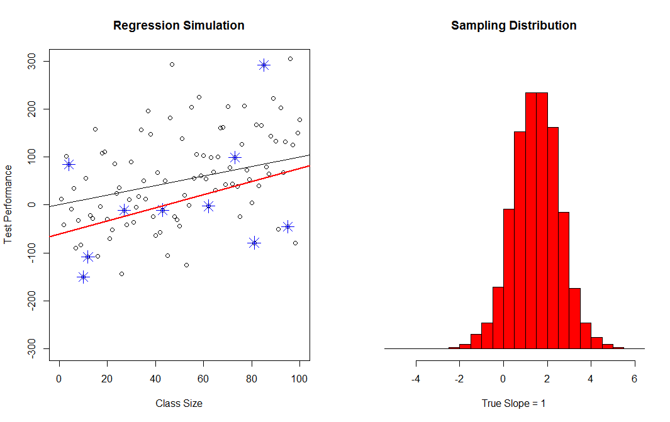
Regression Review
standard error of the slope
Sampling Distribution
of the Slope
(Our Sample)
*
Best Guess of the Slope
*
*
*
*
*
*
True Slope
*
*
*
“Average Error”
(Of the slope estimate)

Slide 13
Regression Review
The Intuitive Standard Error
Note:
Thus:
Therefore:

Slide 14
Regression Review
confidence intervals
An interval that will contain the true slope in 95% of the samples that we draw.

Slide 15

Regression Review
confidence intervals
Sample drawn from the left tail
95% CI
C.I. contains
the population mean
$$μ$$

Slide 16
Regression Review
confidence intervals
Sample drawn from the right tail
C.I. contains
the population mean
95% CI
$$μ$$

Slide 17
Regression Review
confidence intervals
Sample drawn from the FAR right tail
C.I. DOES NOT
contain the population mean
95% CI
$$μ$$
How often will this happen?

Slide 18
Regression Review
confidence intervals
µ
C.I. of the sample mean

Slide 19
Regression Review
confidence interval
Of the slope
C.I. of the Slope

Slide 20
Regression Review
The Road Map
Of the Mean:
Of the Slope:
Variance:
(for x)
(using the residual)
Standard Deviation:
Standard Error:
Confidence Interval
(of the mean)
(of the slope)
All of the statistical concepts that you have learned in the previous course using variance, standard errors, and confidence intervals of a estimates of the mean from a single variable apply to regression, but they have to be adapted.
Make note that statistical concepts always need to be followed by the phrase “of the” because they are general concepts and the specific calculations are determined by the variables you are working with. The standard error around an estimated mean is different than the standard error around an estimated slope.

Slide 21
Regression Review
Understanding regression error and the standard error of the regressors.
What should be clear in my mind?
What is a sampling distribution?
What is the relationship between the sampling distribution and the standard error?
We care about the sampling variance of which statistic in regression?
What role does the standard error play in the confidence interval?

