Slide 1
Bias from specification OR Measurement

Slide 2
Anscombe’s quartet a lesson in model fit

Slide 3
Anscombe's Quartet
 | x1 | y1 |  | x2 | y2 |  | x3 | y3 |  | x4 | y4
1 | 10 | 8.04 |  | 10 | 9.14 |  | 10 | 7.46 |  | 8 | 6.58
2 | 8 | 6.95 |  | 8 | 8.14 |  | 8 | 6.77 |  | 8 | 5.76
3 | 13 | 7.58 |  | 13 | 8.74 |  | 13 | 12.74 |  | 8 | 7.71
4 | 9 | 8.81 |  | 9 | 8.77 |  | 9 | 7.11 |  | 8 | 8.84
5 | 11 | 8.33 |  | 11 | 9.26 |  | 11 | 7.81 |  | 8 | 8.47
6 | 14 | 9.96 |  | 14 | 8.1 |  | 14 | 8.84 |  | 8 | 7.04
7 | 6 | 7.24 |  | 6 | 6.13 |  | 6 | 6.08 |  | 8 | 5.25
8 | 4 | 4.26 |  | 4 | 3.1 |  | 4 | 5.39 |  | 19 | 12.5
9 | 12 | 10.84 |  | 12 | 9.13 |  | 12 | 8.15 |  | 8 | 5.56
10 | 7 | 4.82 |  | 7 | 7.26 |  | 7 | 6.42 |  | 8 | 7.91
11 | 5 | 5.68 |  | 5 | 4.74 |  | 5 | 5.73 |  | 8 | 6.89
Mean | 9 | 7.5 |  | 9 | 7.5 |  | 9 | 7.5 |  | 9 | 7.5
Variance | 11 | 4.12 |  | 11 | 4.12 |  | 11 | 4.12 |  | 11 | 4.12
Correlation | 0.816 |  |  | 0.816 |  |  | 0.816 |  |  | 0.816
Regression | y = 3 + 0.5x |  |  | y = 3 + 0.5x |  |  | y = 3 + 0.5x |  |  | y = 3 + 0.5x
Four datasets that produce IDENTICAL descriptive stats, correlations, and regression models

Slide 4
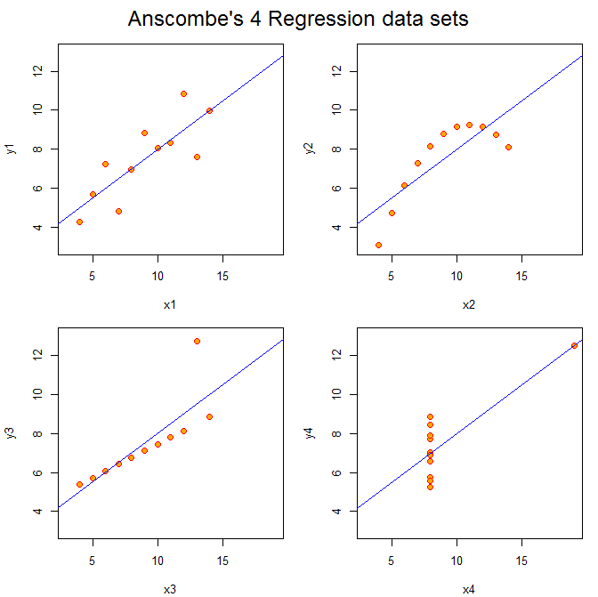
But they are very different
relationships!

Slide 5
Non-linear model
OK
Anscombe’s Quartet is often cited because (a) whoever created this example is a genius, and (b) it is a vivid demonstration of causes and consequences of specification bias.
We will consider what happens to slopes when outliers are present, or we use a linear specification when the relationship is non-linear.
outliers
outliers

Slide 6
Classes of inferential failure type I and type II errors

Slide 7
Type I Error
False positive
Claiming program has impact when it doesn’t
Type II Error
False NEGATIVE
Failing to identify true program impact
True program impact
No true program impact
bias causes non-significance
bias causes significance
bias causes significance
Increase in SE’s causes non-significance
Type I errors are typically caused by OVB
Type II Errors can be caused by bias or inflated standard errors

Slide 8
Implications of measurement error

Slide 9
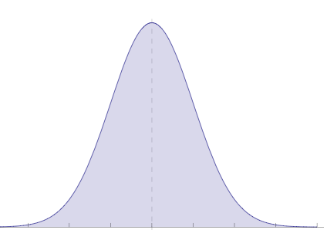
Add 100 to every X
var(x) = s
var(x+100) = s
mean(x) = u
mean(x+100) = u+100
“Linear Transformations”
X2 = X1 + 100
Variance of X is unchanged

Slide 10
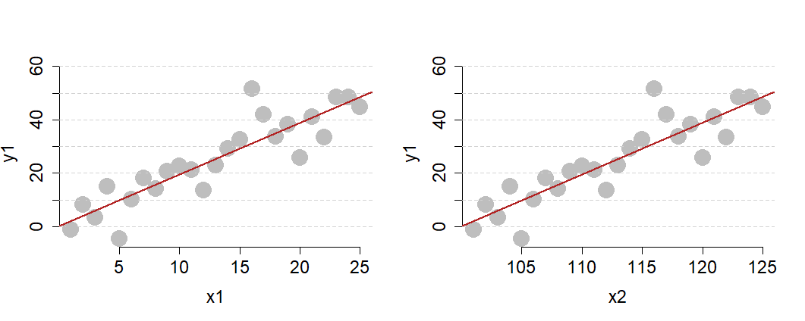
Add 100 to each X
var(x) = s
var(x+100) = s
5
25
105
125
mean(x) = u
mean(x+100) = u+100
Y=b0+b1(X)
Y=b0+b1(X+100)
After linear transformations
slopes b1 are identical
var(x2) = var(x1) → slopes and standard errors same
mean(x2) = mean(x1) + 100 → x-axis moves right
Intercept b0 (y when x=0) will be different
Notes:
x <- 1:25
y1 <- 2*x + rnorm(25,0,7)
plot( x, y, pch=19, cex=2, bty="n" )
y2 <- 25+y1
par( mfrow=c(1,2) )
plot( x, y1, pch=19, cex=2, bty="n", col="gray", ylim=c(-5,80) )
abline( h=seq(0,80,10), lty=2, col="lightgray" )
points( x, y1, pch=19, cex=2, bty="n", col="gray" )
abline( lm(y1~x), col="firebrick", lwd=2 )
plot( x, y2, pch=19, cex=2, bty="n", col="gray", ylim=c(-5,80) )
abline( h=seq(0,80,10), lty=2, col="lightgray" )
points( x, y2, pch=19, cex=2, bty="n", col="gray" )
abline( lm(y2~x), col="firebrick", lwd=2 )
x1 <- 1:25
x2 <- 100+x1
par( mfrow=c(1,2) )
plot( x1, y1, pch=19, cex=3, bty="n", col="gray",
ylim=c(-5,60), cex.lab=1.5, cex.axis=1.5 )
abline( h=seq(0,80,10), lty=2, col="lightgray" )
points( x1, y1, pch=19, cex=2, bty="n", col="gray" )
abline( lm(y1~x1), col="firebrick", lwd=2 )
plot( x2, y1, pch=19, cex=3, bty="n", col="gray",
ylim=c(-5,60), cex.lab=1.5, cex.axis=1.5 )
abline( h=seq(0,80,10), lty=2, col="lightgray" )
points( x2, y1, pch=19, cex=2, bty="n", col="gray" )
abline( lm(y1~x2), col="firebrick", lwd=2 )

Slide 11
Add 100 to X
var(x) = s
var(x+100) = s
mean(x) = u
mean(x+100) = u+100
“Linear Transformations”
X2 = X1 + 100
Must add the same constant to every value of X
Just moves the distribution to right or left

Slide 12
X1
Measurement Error
X2 = X1 + ε
var(x1) = s
mean(x1) = u
Add random error to every X.
Random means each X is equally likely to be over-measured as under-measured.
X2 has the same mean as X1, but more variance
X2
var(x2) = s+ ε
mean(x2) = u

Slide 13
Adding Measurement Error to the DV
(no bias)
Increase in standard errors
Type II Error risk

Slide 14
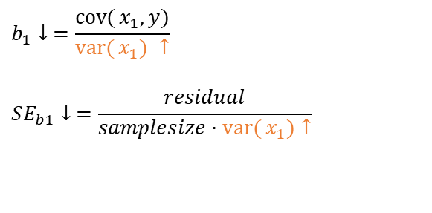
Adding Measurement Error to the independent variable:
“Attenuation bias”
Toward b1=zero
True program impact
slope with measurement
error
Smaller slope
Smaller SE
Toward b1=zero
$$b_{1}↓ =\frac{\operatorname{cov}{(}x_{1},y)}{\operatorname{var}{(}x_{1}) ↑}$$
$$SE_{b1}↓ =\frac{residual}{samplesize⋅\operatorname{var}{(}x_{1})↑}$$

Slide 15
outliers

Slide 16
Slopes too large
SE larger
Slopes ok
SE larger
Slopes too small
SE larger
Extreme of X:
Risk of bias in slope ↑
Risk of false positive
Middle of X:
Don’t bias slope
Increased risk of false negative
Extreme of X:
Risk of bias in slope ↓
Increased risk of false negative

Slide 17
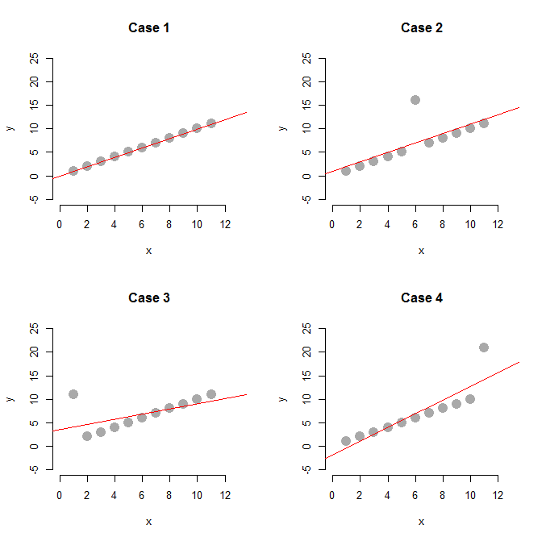
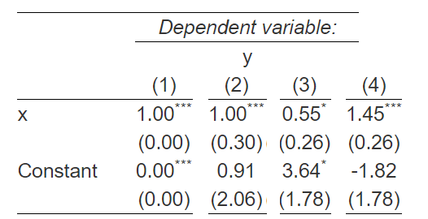

Slide 18
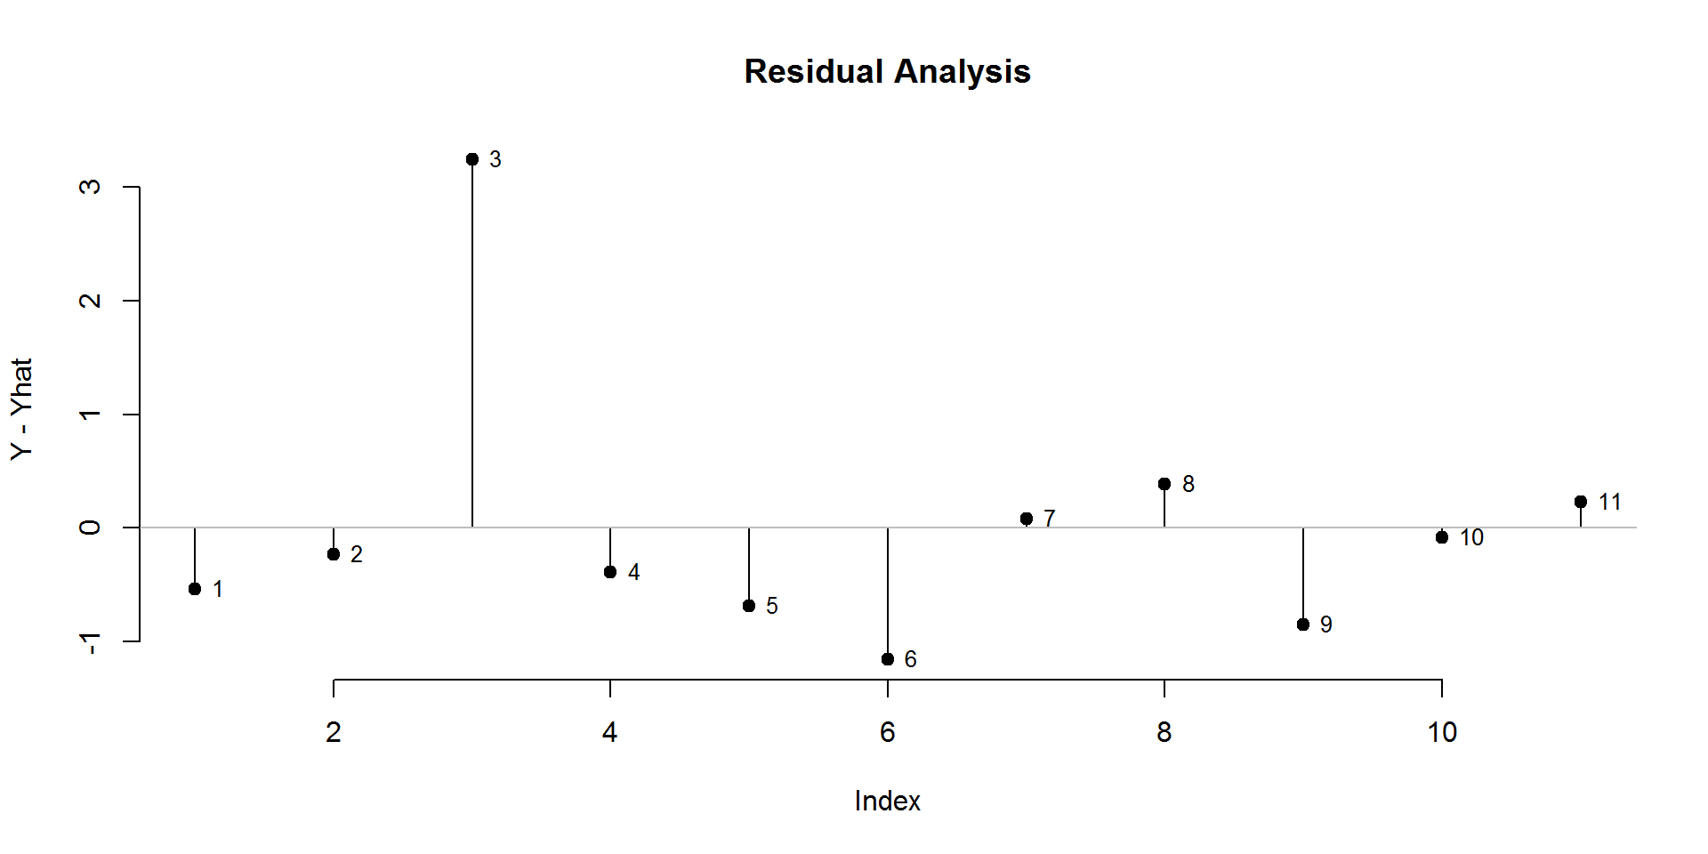
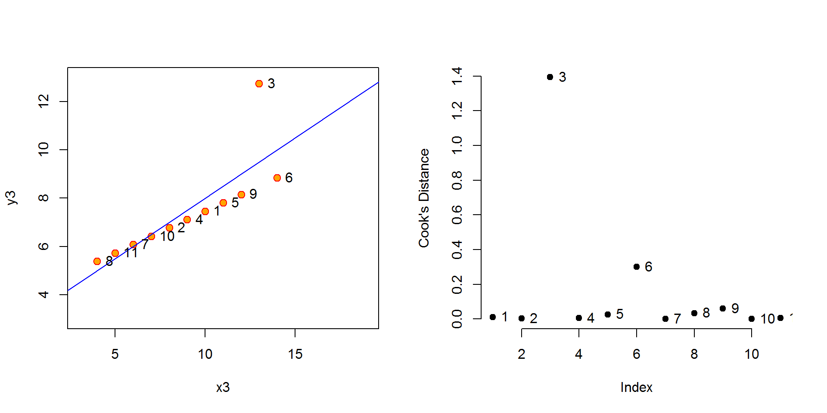
Identifying
Outliers
Using
Residuals
And cook’s
distance

Slide 19
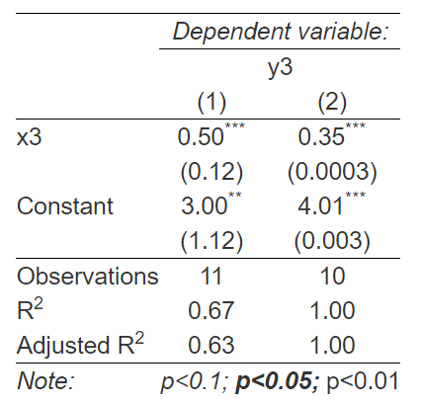
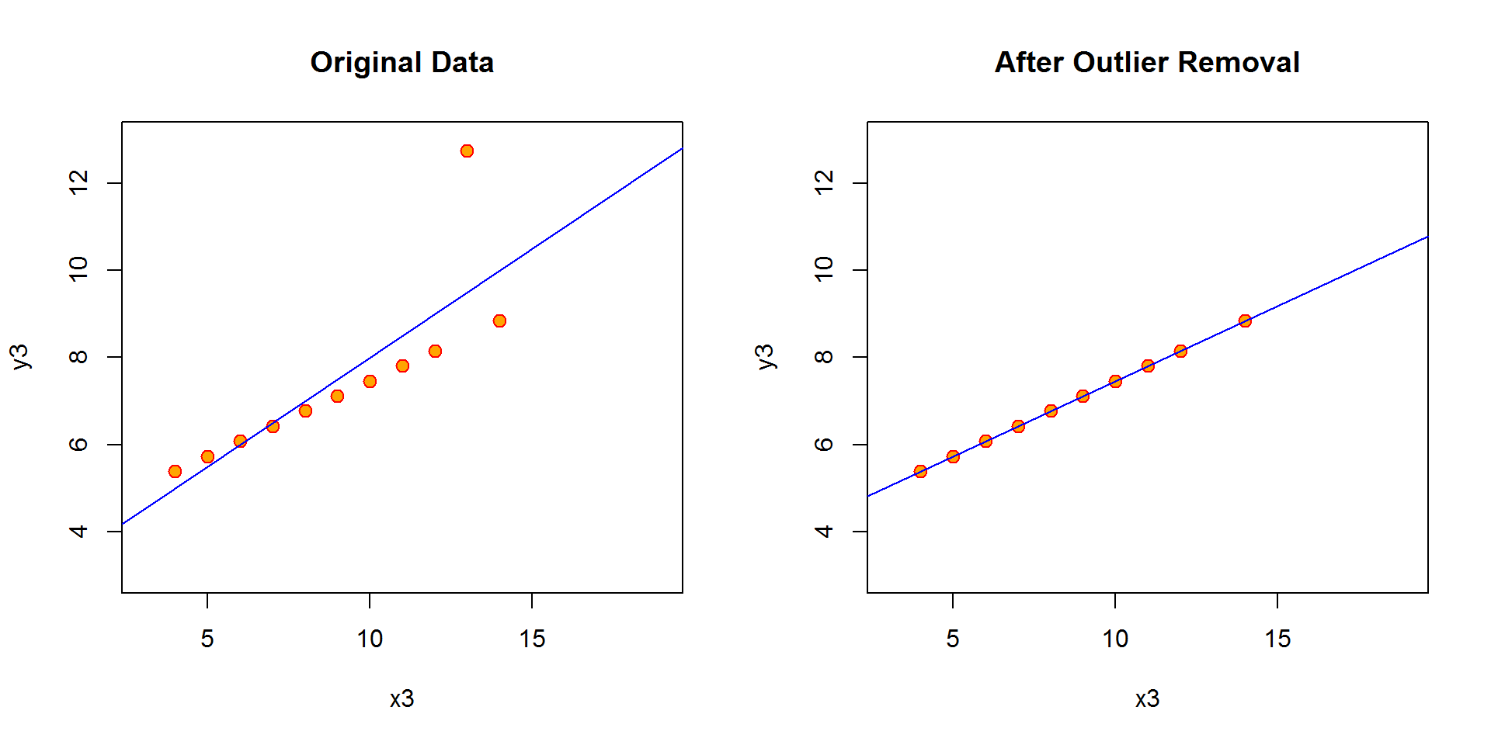

Slide 20
logged regression models

Slide 21
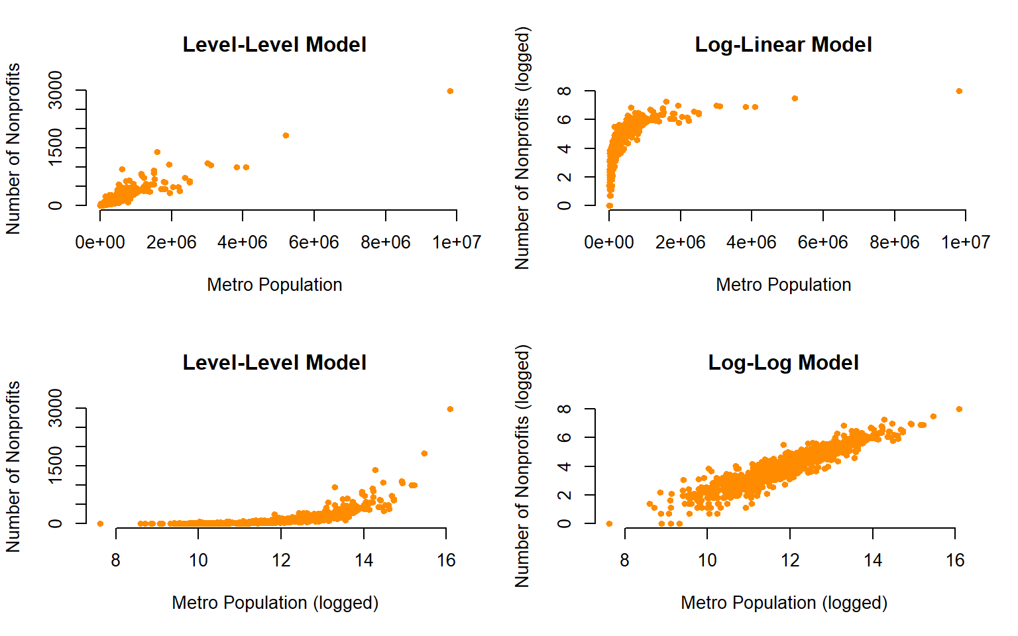
The other common type of outlier comes from highly-skewed data. These problems can be fixed using log transformation of variables to convert data into a linear format for better model fit.

Slide 22
Linear-Log
Highly-Skewed Data
Linear Relationship

Slide 23
Non-Linear Relationships quadratic models

Slide 24
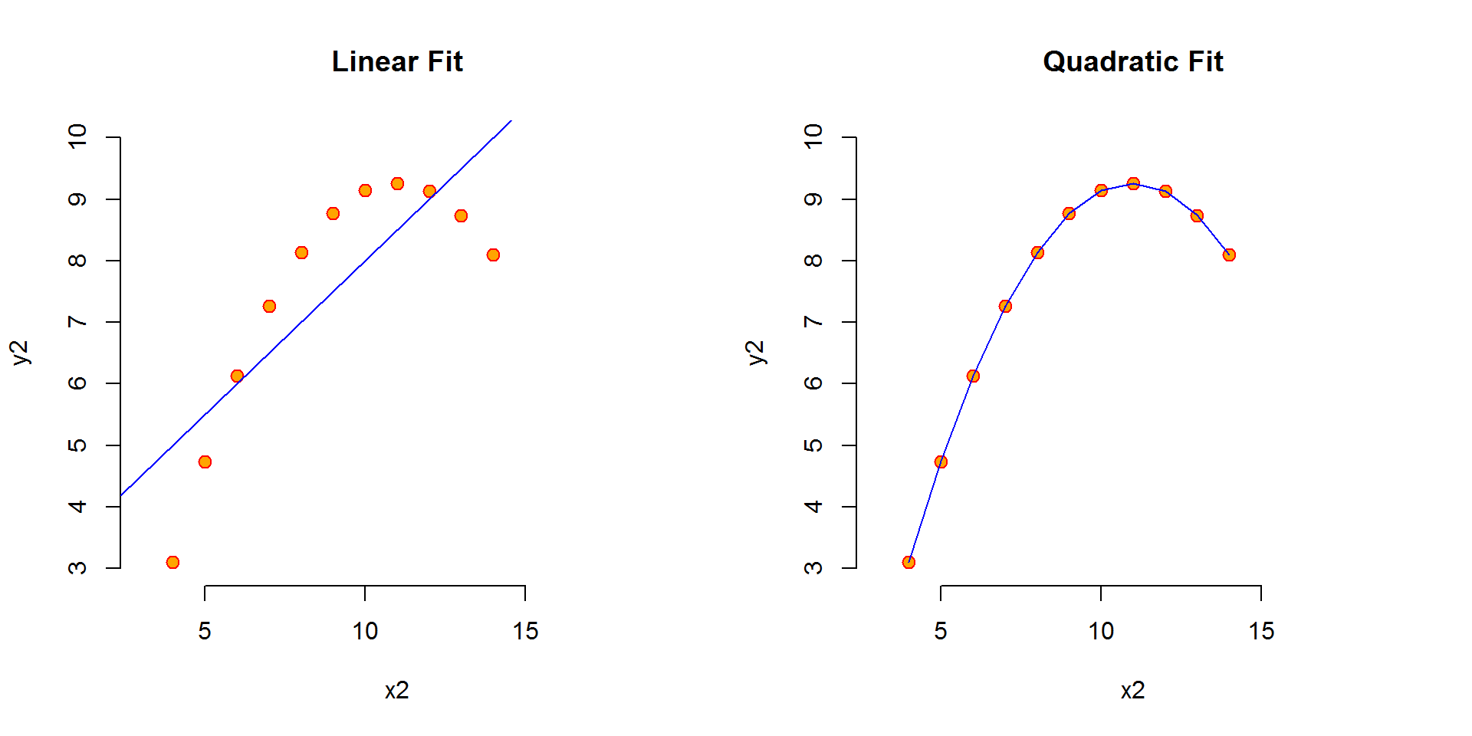
Linear: Y = b0 + b1(X₁) + e
Quadratic: Y = b0 + b1(X₁) + b2(X₁) ² + e

