Slide 1
Sampling distribution

Slide 3
Sampling Distribution
sample size = 10

Slide 4
Sampling Distribution
sample size = 50

Slide 5
Confidence intervals

Slide 6
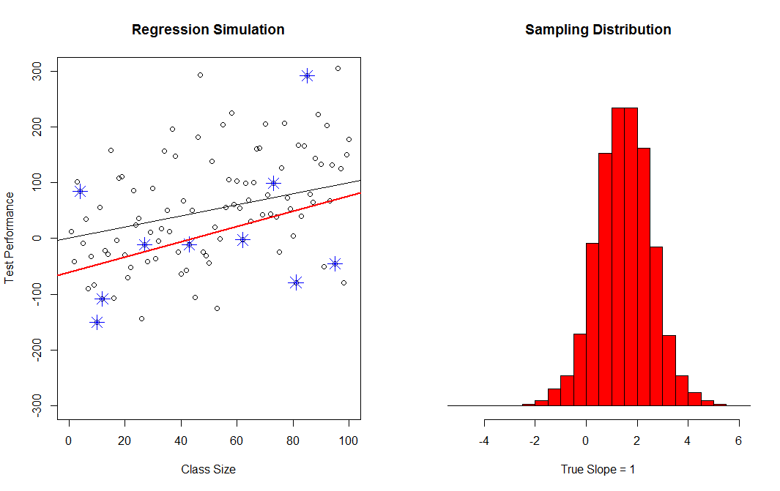
95% confidence Interval
Sampling Distribution
of the Slope
*
Our One
Sample
Best Guess of the Slope
*
*
*
True Slope
*
*
*
*
*
2.5% of
Sample Statistics
Smaller Than C.I.
2.5% of
Sample Statistics
Greater Than C.I.
*
95%
Confidence
Interval

Slide 7
60% Confidence Interval
90% Confidence Interval
95% Confidence Interval
99% Confidence Interval

Slide 8
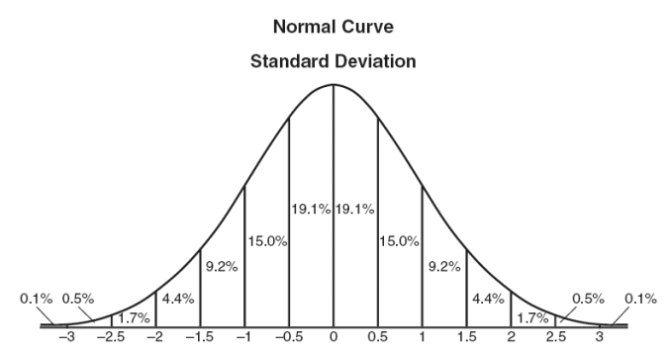
Data in Normal Distribution

Slide 9
Sampling Distribution
sample size = 50

Slide 10
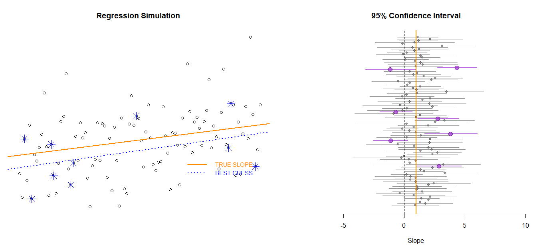
Alpha = 0.05
(level of confidence)
Confidence intervals from
100 samples (the sampling distribution)
CI that does NOT contain the true slope (happens in alpha % of samples)
Confidence interval from a single sample
Both Cis contain the true slope but only one is statistically significant
Note that statistical power is different from the level of confidence. Power determines how often we reject the null (the CI does not contain ZERO). Level of confidence is how often a confidence interval drawn from a random sample will contain the TRUE SLOPE. Here we observe Type I Errors in 7 out of 100 cases (the sample CI does not contain the true slope). But note that we would fail to reject the null in more than half of the samples (p-values > alpha), even though the true slope is not zero. This means the sample framework has low power (ability to detect actual effects).
NULL HYPOTHESIS:
SLOPE = 0
TRUE SLOPE = 1
Point estimate plus the standard error (size of the CI) determines the p-value. The p-value is roughly the probability that the slope = 0

Slide 11
Note that we are using Type I Error, or a FALSE POSITIVE, in two distinct ways.
The first type of FALSE POSITIVE is linked to the level of confidence (alpha), which determines how often we will tolerate confidence intervals that fail to contain the true slope. This is the statistical sampling version that uses the true slope as the NULL. The purple CIs are all samples that would lead us to conclude that the slope is NOT equal to one (even though it is).
The more important version is the program evaluation context, in which case a TYPE I ERROR or a FALSE POSITIVE means we conclude that a program produced a meaningful change when it did not. This version assumes the NULL is zero (no program effect). The p-value produced by a regression model corresponds to this version. Here, since about half of the Cis contain zero, the p-value would be around 0.50.
Similarly, a TYPE II ERROR (a FALSE NEGATIVE) is when we can’t differentiate the true slope from the NULL, even when they differ.
STATISTICAL POWER is the probability of identifying a specific program effect (slope or effect size) using a specific sampling framework. In this case power is very low.
Alpha = 0.05
(level of confidence)
CI that does NOT contain the true slope (happens in alpha % of samples)
Both Cis contain the true slope but only one is statistically significant
NULL HYPOTHESIS:
SLOPE = 0
TRUE SLOPE = 1
Point estimate plus the standard error (size of the CI) determines the p-value. The p-value is roughly the probability that the slope = 0

Slide 12
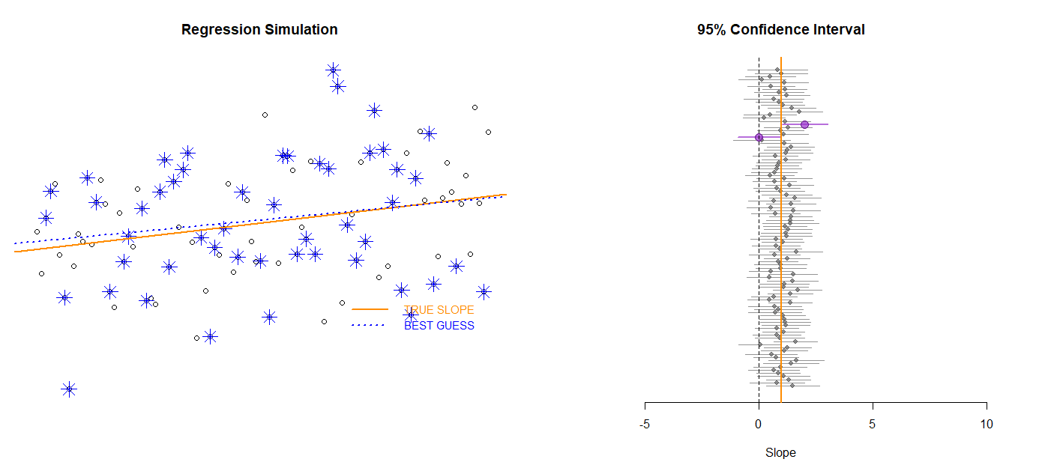
We can increase STATISTICAL POWER by increasing the sample size or adding control variables, thus reducing the standard error and shrinking confidence intervals. Increasing the sample size from 10 to 50 has improved our ability to detect program effects. We are only failing to reject the NULL in 1/3 of cases instead of ½ of cases.

Slide 13
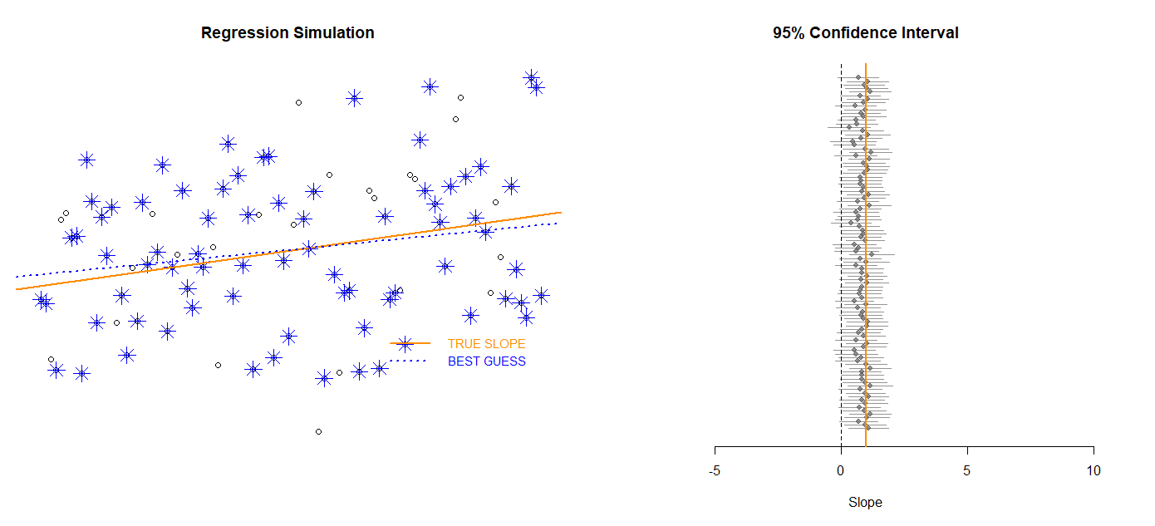

Slide 14
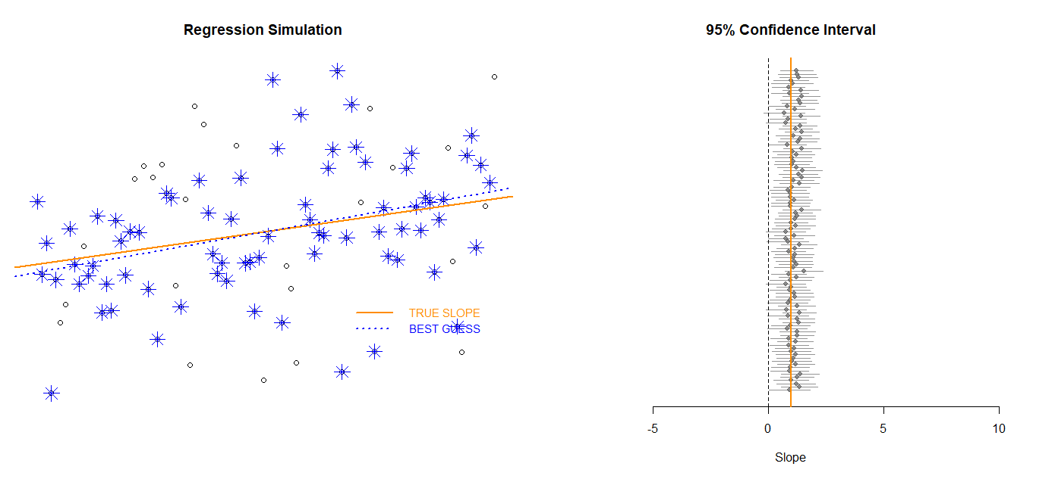
We do even better when the sample size is increased to 75. Now we only fail to identify program effects around 5% to 10% of the time in these case (about 5 or 10 CIs still contain zero).

Slide 15
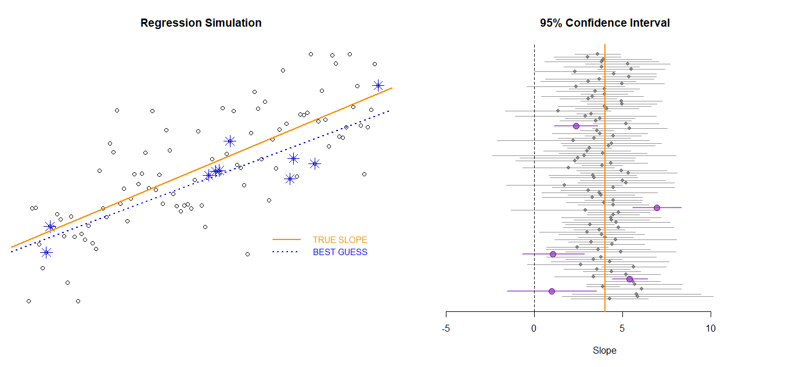
If the sample size remains low (n=10) but the program impact is large (slope of 4 instead of slope of 1) we achieve a lot more statistical power.
This should be somewhat intuitive - it is easier to detect large changes than small changes.
NULL HYPOTHESIS:
SLOPE = 0
TRUE SLOPE = 4

Slide 16
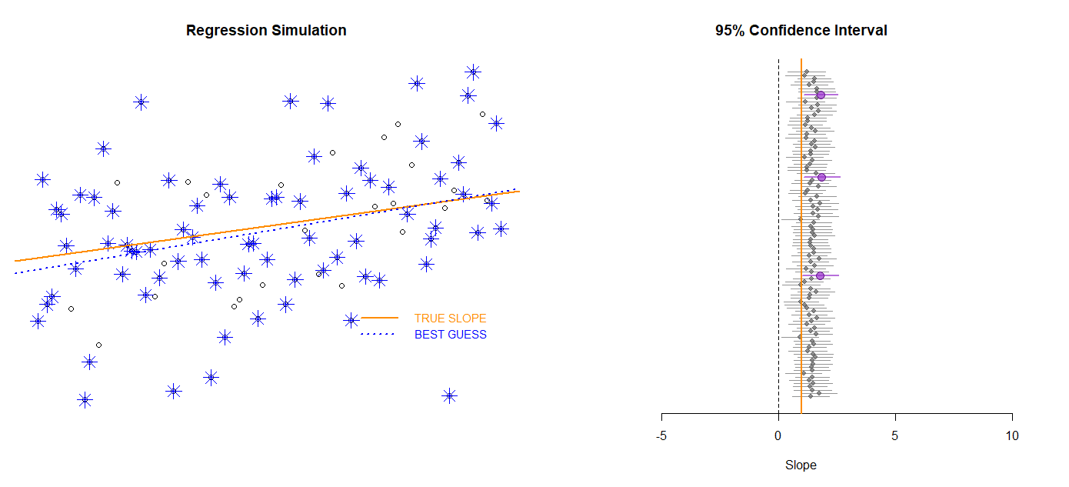
Any idea what is happening here? The sample slope estimates are systematically too large, even though they represent random samples? Hint, it is a type of specification bias.

Slide 17
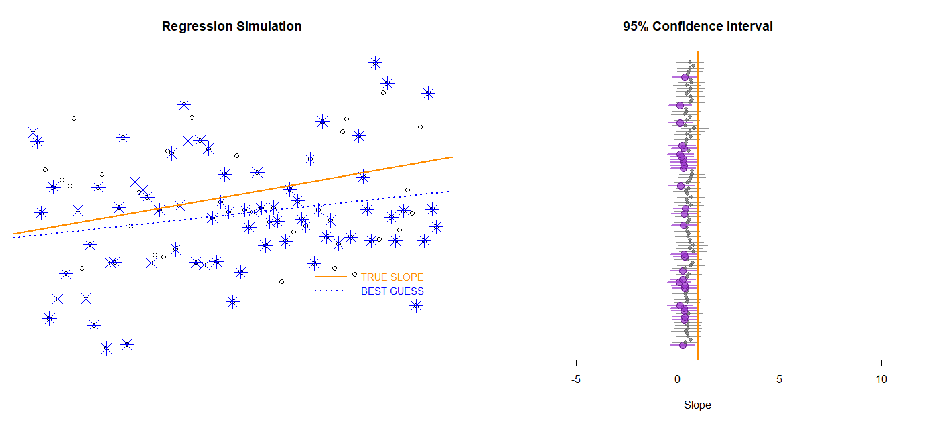
And similarly, here?

Slide 18
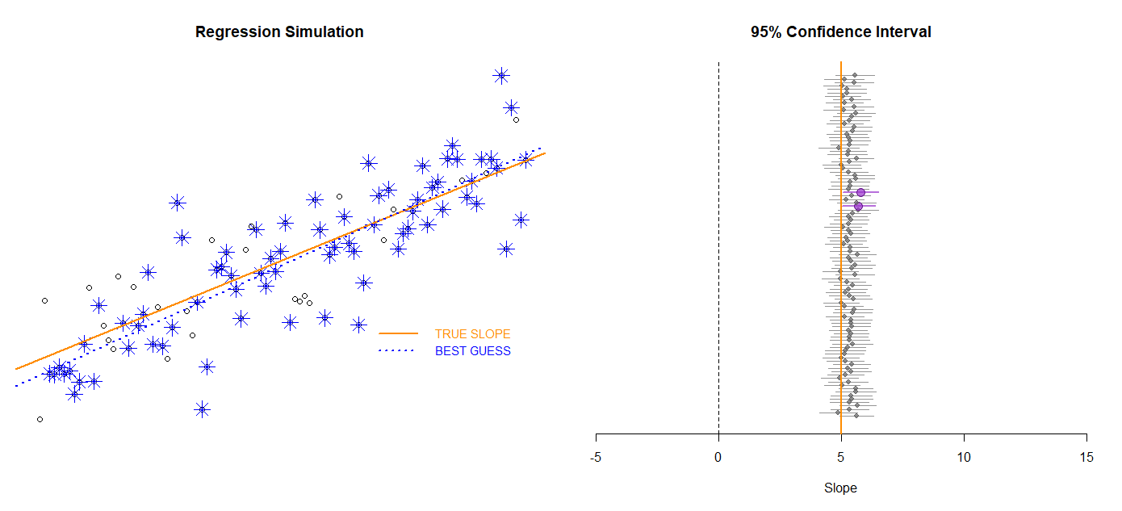
“Leverage”
“Leverage”

Slide 19
“Leverage”

