Slide 1
Nonprofit size and 990 form notes

Slide 2
Full 990 (PC)
SOI Extracts
200 financial variables
990-EZ
Form 990-EZ can be filed by organizations with gross receipts of less than $200,000 and total assets of less than $500,000 at the end of their tax year.
Efilers (~80% prior to 2023)
990 BACKGROUND
990-N “Postcard”
Most small tax-exempt organizations whose annual gross receipts are normally $50,000 or less are required to electronically submit Form 990-N, also known as the e-Postcard.

Slide 3
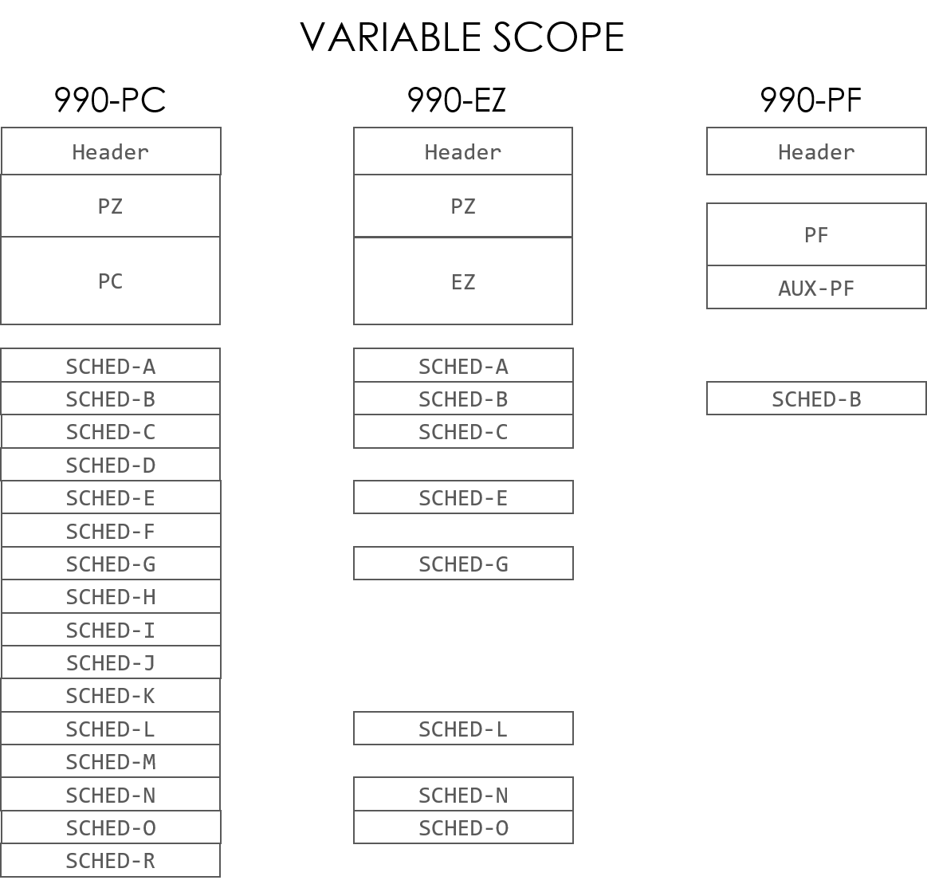
https://www.irs.gov/charities-non-profits/required-filing-form-990-series

Slide 4
Large Nonprofits (> $10m)
2%
Medium-Sized ($100k to $10m)
23%
Small Nonprofits (< $100k)
75%

Slide 5
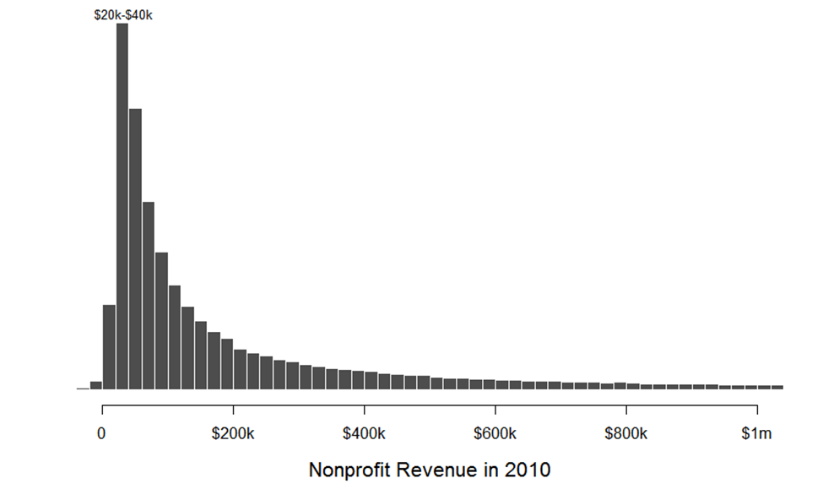

Slide 6
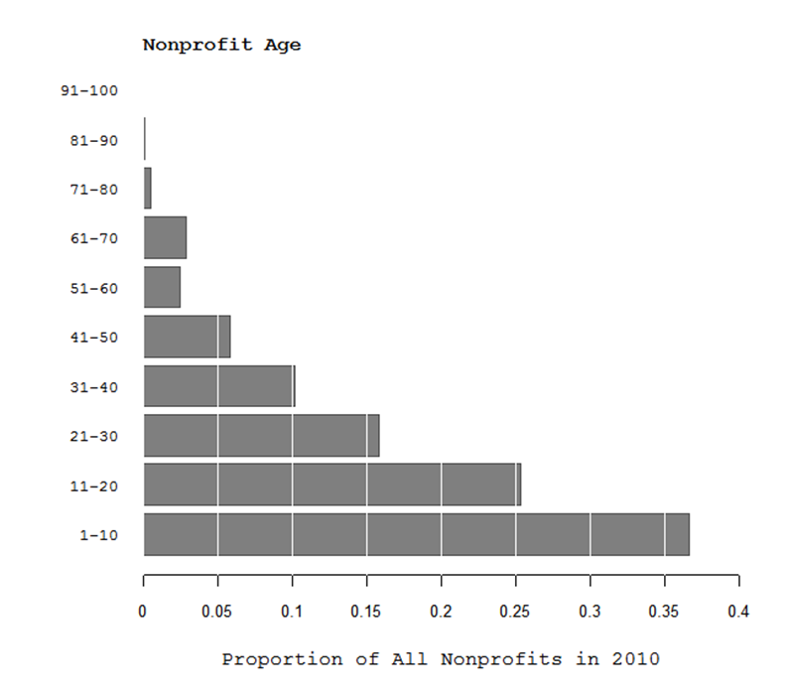

Slide 8
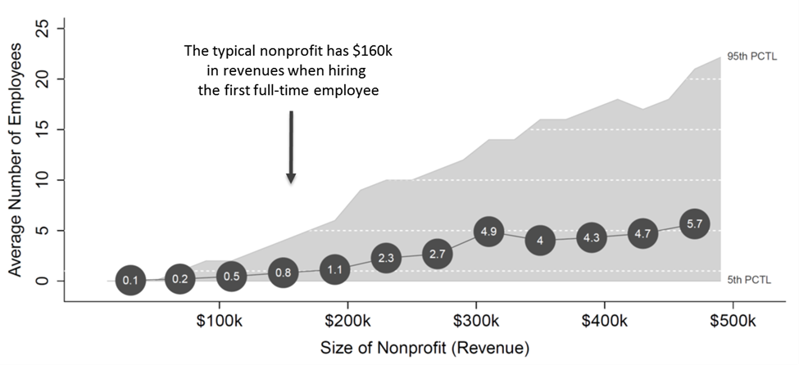

Slide 9
