Slide 2
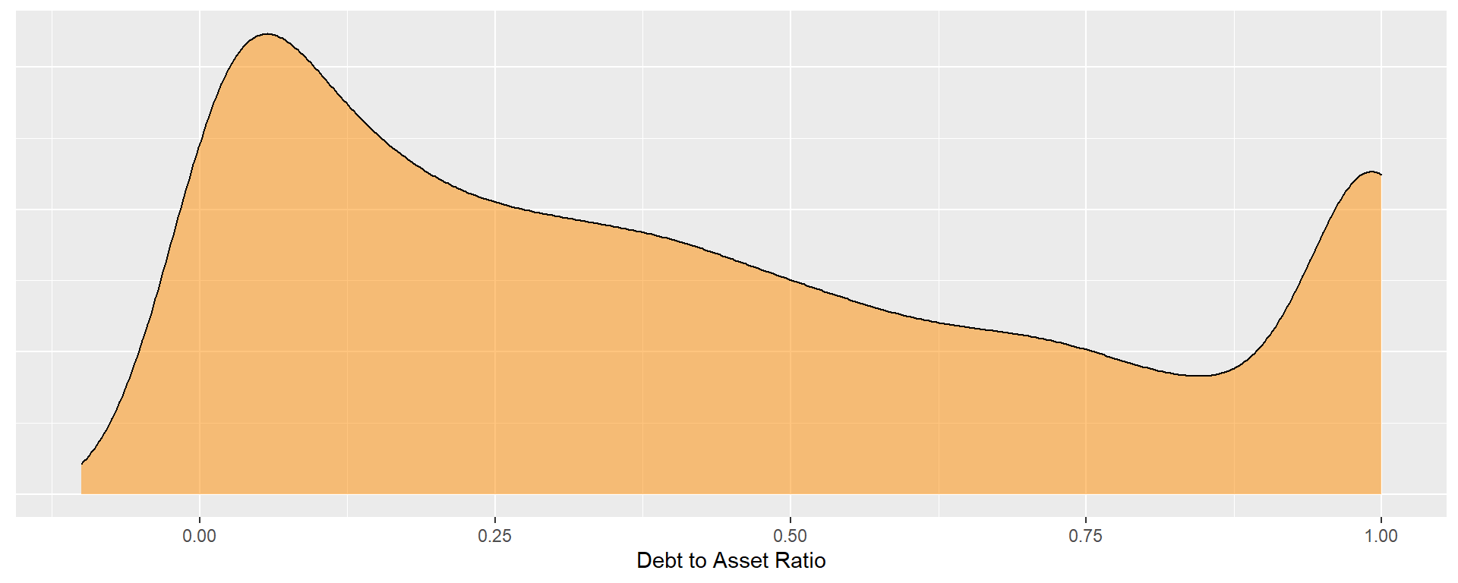
LOW
debt to asset ratio
MODERATE
HIGH
debt to asset ratio

Slide 3
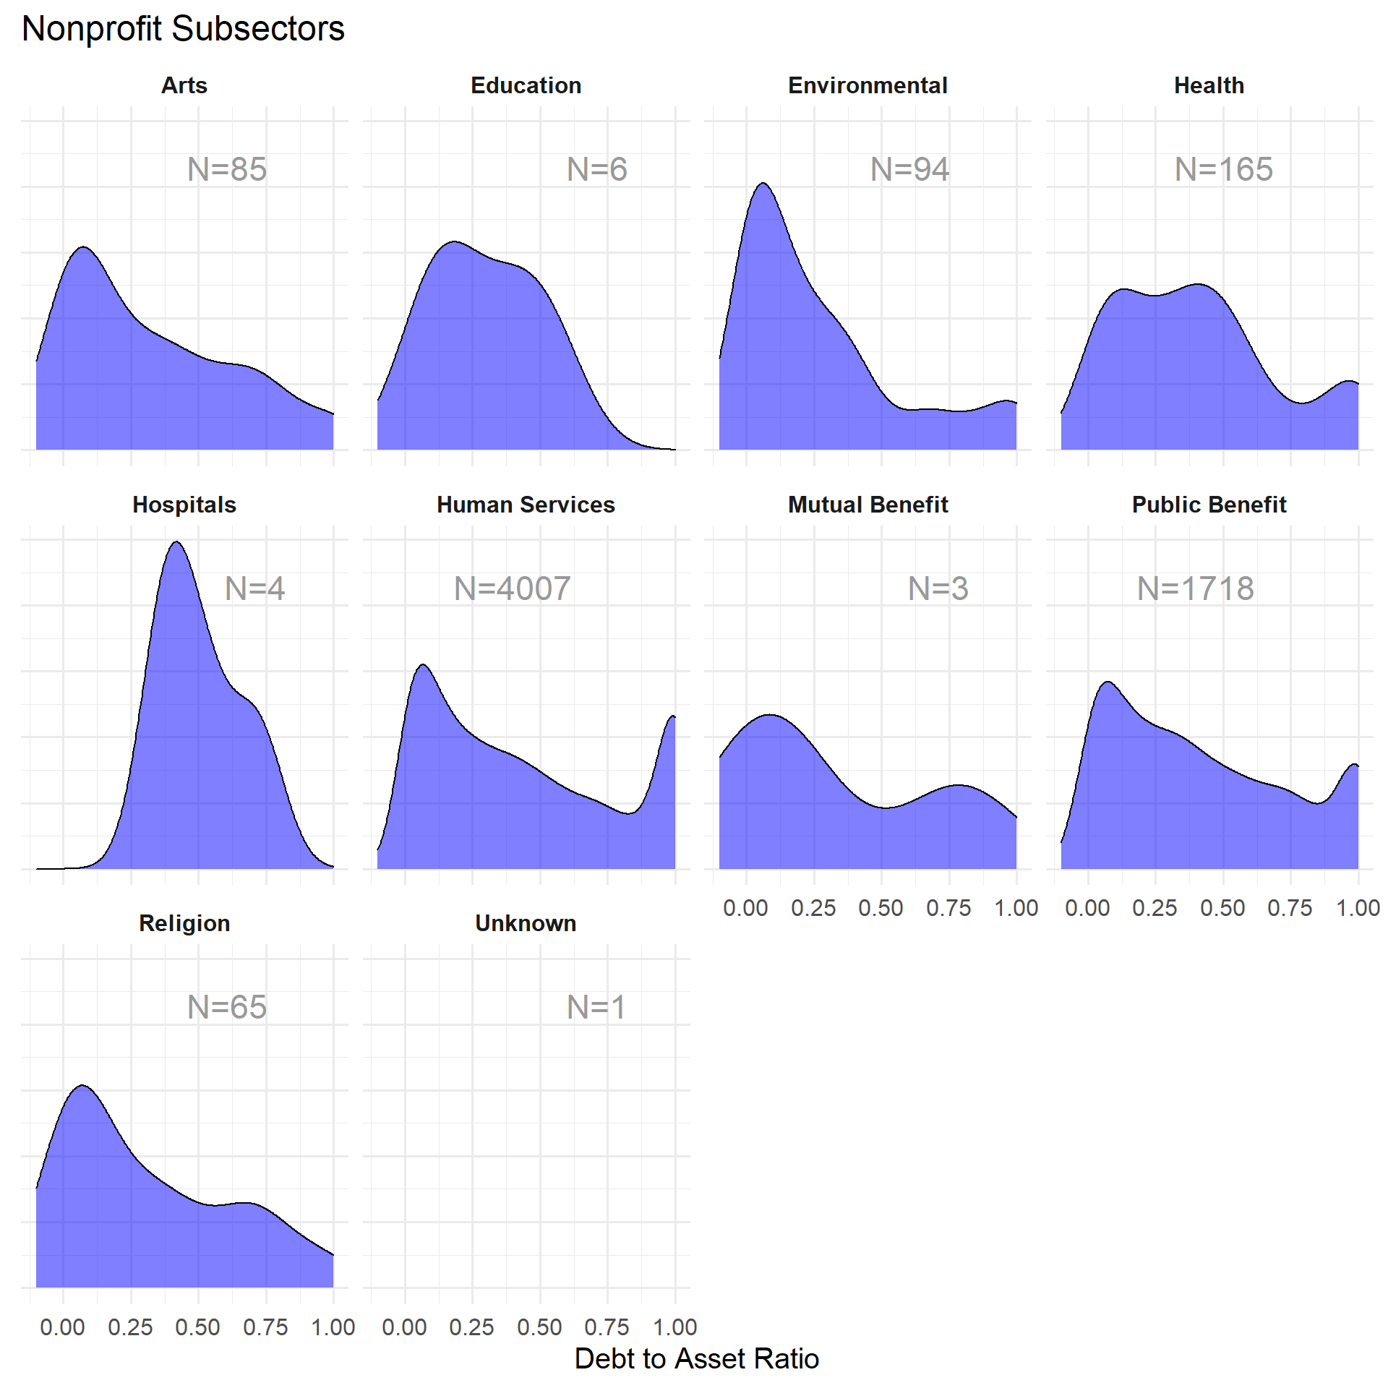
Modal ratio is low, few orgs that are highly leveraged
Bi-modal, small group of highly-leveraged orgs

