Slide 2
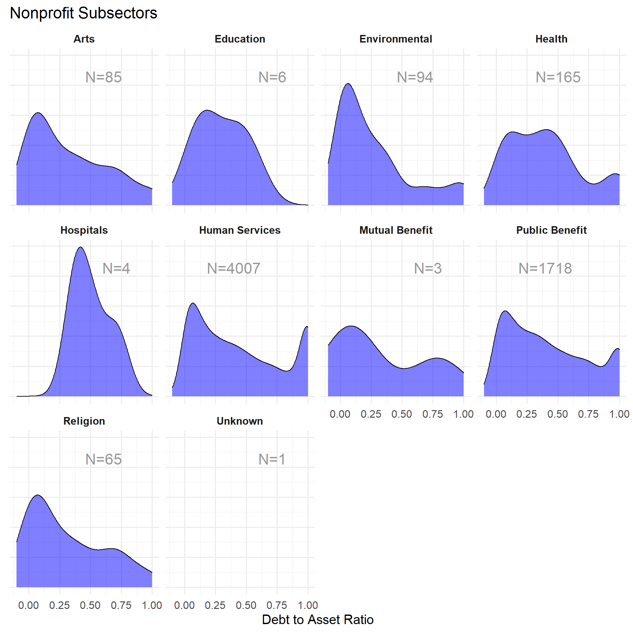
Modal ratio is low, few orgs that are highly leveraged
Bi-modal, small group of highly-leveraged orgs

