Slide 1

Workshop on
Semantic Network Analysis
Korean Development Institute
June 2012
Jesse D Lecy
Public Management and Policy

Slide 2
Semantic Networks
Article Titles
Processed Titles
Semantic Network
“Economic policy of juche in a time of growing capital markets.”
econ_policy
juche capital_markets
capital_markets
econ_policy
juche
“The need for juche during periods of agricultural reform.”
juche
agricult_reform
agricult_reform

Slide 3
Common Applications
Comparing knowledge or beliefs across groups
(between-group analysis)
Examining change in knowledge or beliefs over time
(within-group analysis – often diffusion models)

Slide 4
Choi, C., Lecy, J. “A Semantic Network Analysis of Economic Policy Regime Changes in North Korea from the Mid 1980s to 2009.” Governance, forthcoming.
Kyongje Yongu journal of North Korean economic policy
Year | 86 | 87 | 88 | 89 | 90 | 91 | 92 | 93 | 94 | 95 | 96 | 97 | 98 | 99
Count | 18 | 34 | 35 | 47 | 63 | 60 | 63 | 59 | 63 | 61 | 60 | 57 | 58 | 62
Year | 00 | 01 | 02 | 03 | 04 | 05 | 06 | 07 | 08 | 09 | TOTAL
Count | 65 | 70 | 71 | 85 | 79 | 84 | 86 | 88 | 89 | 101 | 1558
- 1993
1994 - 2001
2002 - 2005
2006 - Present
Self-Reliance Ideology (Juche)
Economic Collapse and Arduous March
Liberalization of Socialist System
Development Through Military Buildup

Slide 5
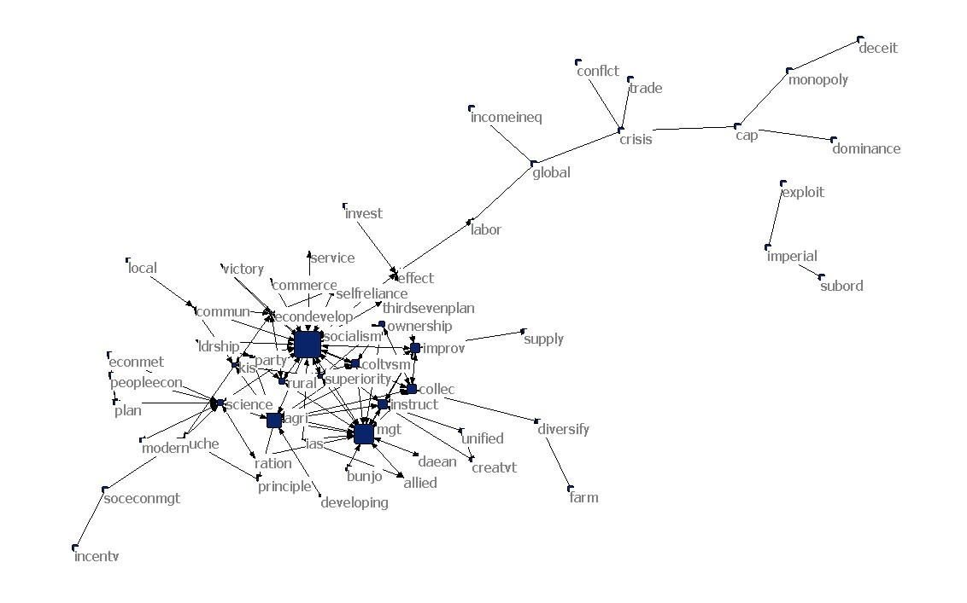
1986-1993

Slide 6
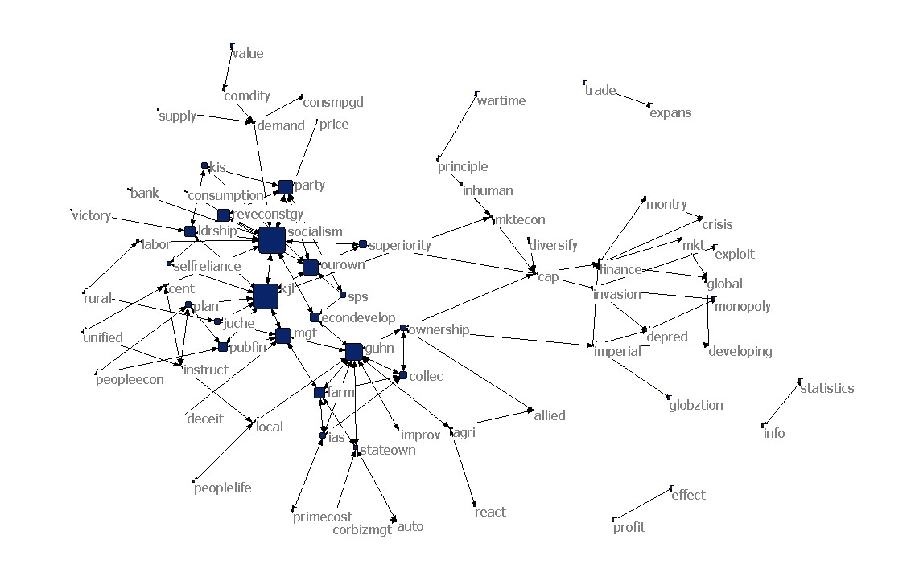
1994-2001

Slide 7
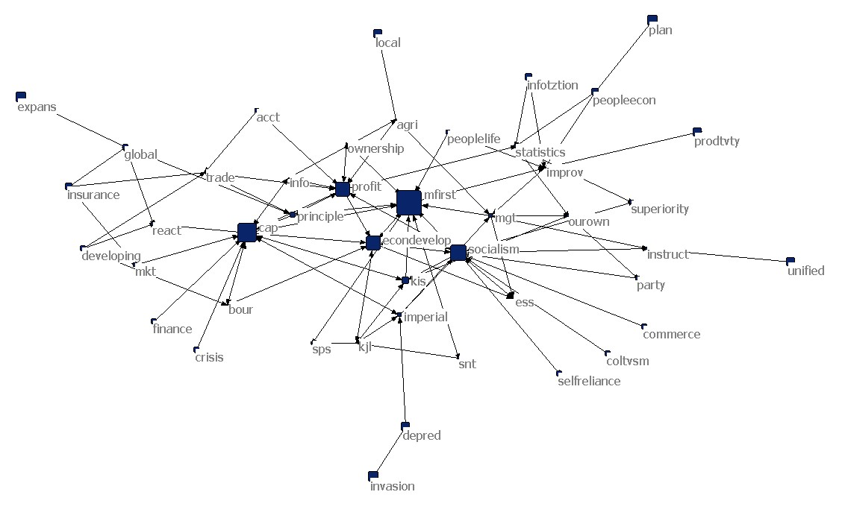
2002-2005

Slide 8
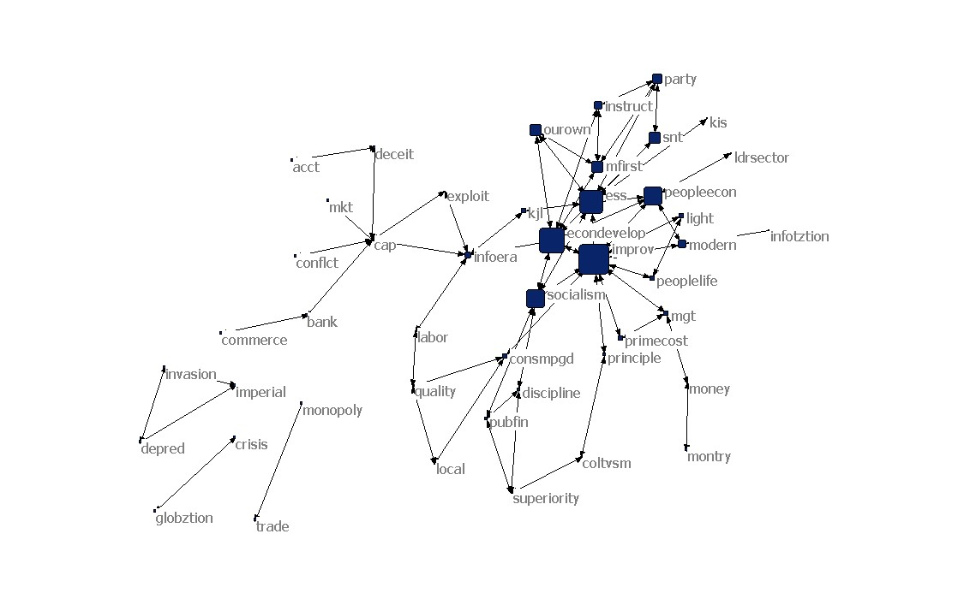
2006-2009

Slide 9
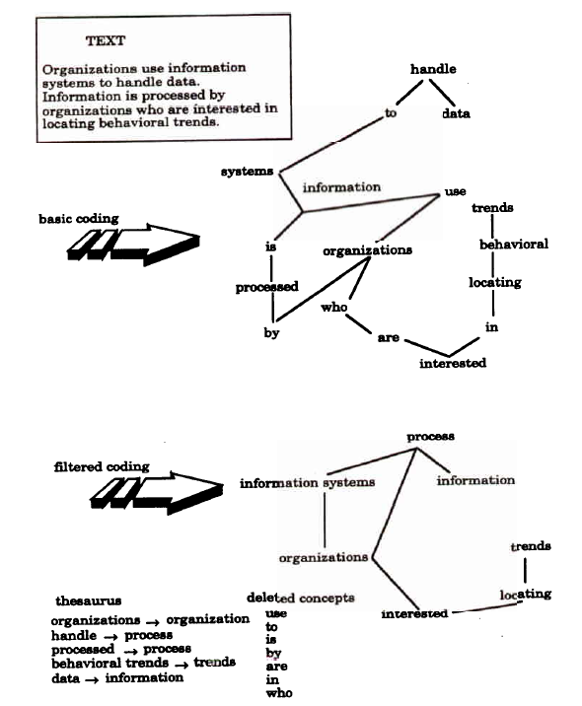
Kathleen Carley (1997). “Extracting team mental models through textual analysis.“ Journal of Org Behavior.

Slide 10
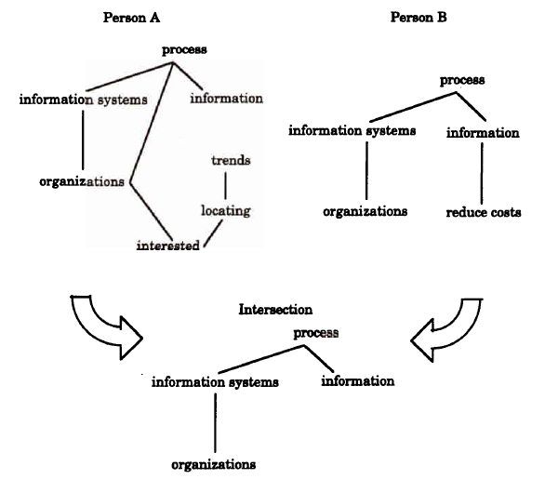

Slide 11
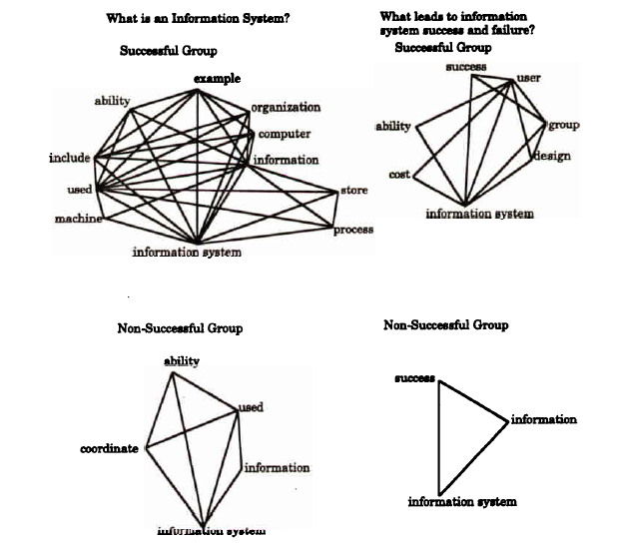

Slide 12
Steps in Semantic Network Analysis
Identify core concepts in the study
  Create a word list
  Examine bi-grams
Pre-process the corpus
  Map multiple words onto a single concept
    Stemming
    Thesaurus
  Remove non-essential text
    Apply the delete list
    Or use thesaurus words only
Generate the semantic network
  Apply the appropriate window for the study
Perform network analysis
  Centrality, density, clustering
  Filter networks across groups or time periods

Slide 13
Core Concepts:
Corpus
Concept
Statement
Node, edge
Weighted network
Pre-processing
Delete list
Thesaurus

Slide 14
Generating networks
Choice of the delete list and ‘window size’ settings and their implications

Slide 15
Example: “I went to NYC to see the Yankees play.”
Delete List: I, to, the
Direct Deletion: “went NYC see Yankees play.”
Rhetorical Deletion: “xxx went xxx NYC xxx see xxx Yankees play.”

Slide 16
Original Text
A federal health official's ruling has cleared the way for 50 different types of cancer to be added to the list of sicknesses covered by a $4.3 billion fund set up to compensate and treat people exposed to the toxic smoke, dust and fumes in the months after the Sept. 11, 2001, terrorist attack.
The decision, released on Friday afternoon, came as a vindication for hundreds and perhaps thousands of people who have claimed often in the face of resistance from public health officials that their cancers were caused by their exposure to the dust cloud and debris thrown up in the aftermath of the attack.

Slide 17
Direct Deletion
federal health official's ruling has cleared way 50 different types cancer be added list sicknesses covered by $4.3 billion fund set up compensate treat people exposed toxic smoke, dust fumes in months after Sept. 11, 2001, terrorist attack.
decision, released on Friday afternoon, came vindication hundreds perhaps thousands people have claimed often in face resistance from public health officials cancers were caused by exposure dust cloud debris thrown up in aftermath attack.

Slide 18
Rhetorical Deletion
xxx federal health official's ruling has cleared xxx way xxx 50 different types xxx cancer xxx be added xxx xxx list xxx sicknesses covered by xxx $4.3 billion fund set up xxx compensate xxx treat people exposed xxx xxx toxic smoke, dust xxx fumes in xxx months after xxx Sept. 11, 2001, terrorist attack.
xxx decision, released on Friday afternoon, came xxx xxx vindication xxx hundreds xxx perhaps thousands xxx people xxx have claimed often in xxx face xxx resistance from public health officials xxx xxx cancers were caused by xxx exposure xxx xxx dust cloud xxx debris thrown up in xxx aftermath xxx xxx attack.

Slide 19
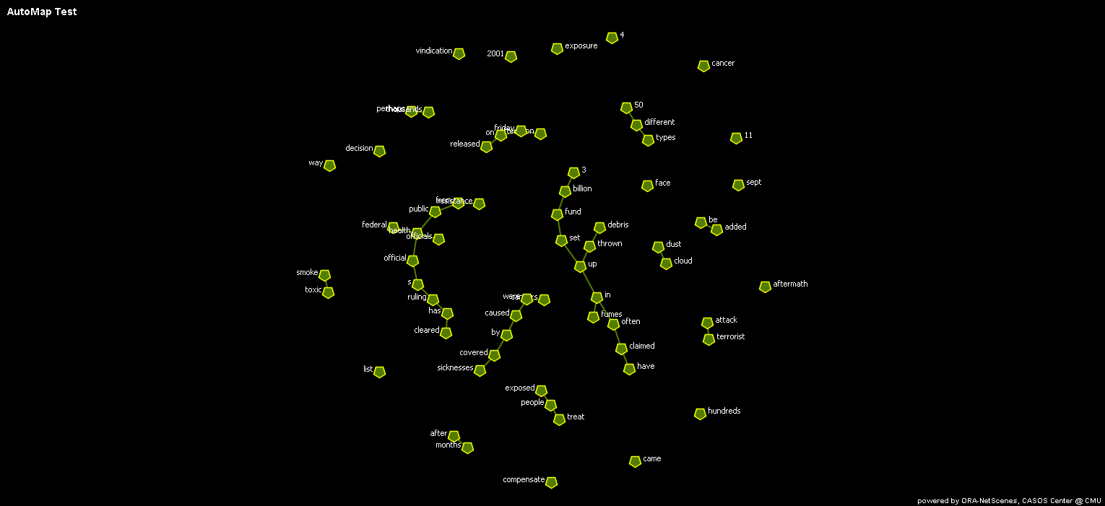
Window Size 2, ‘Rhetoric’ Deletion

Slide 20
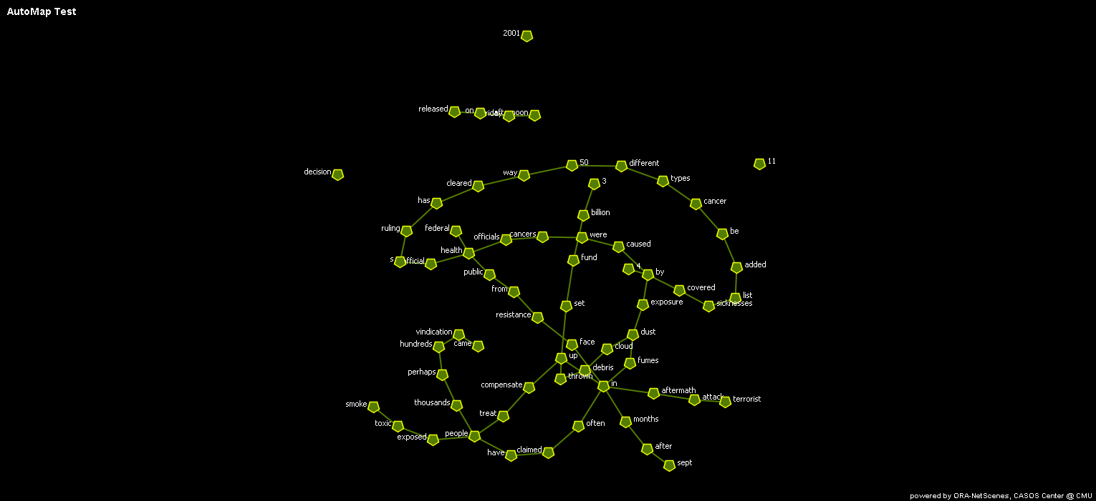
Window Size 2, Direct Deletion

Slide 21
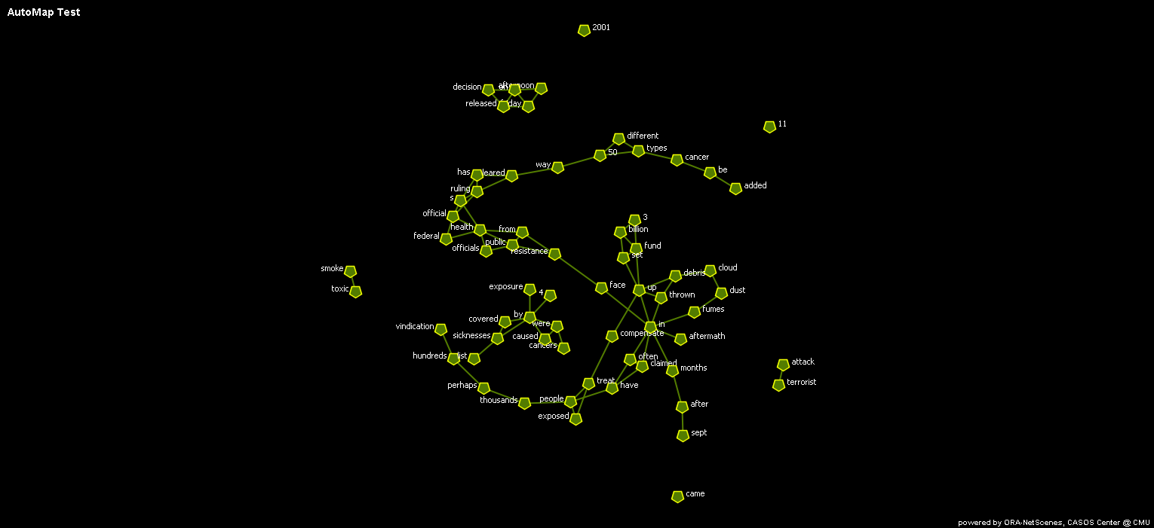
Window Size 3, Rhetorical Deletion

Slide 22
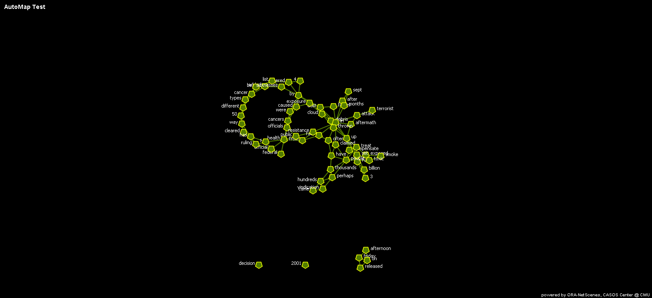
Window Size 3, Direct Deletion

Slide 23
Data reduction and Meaningful networks

Slide 24
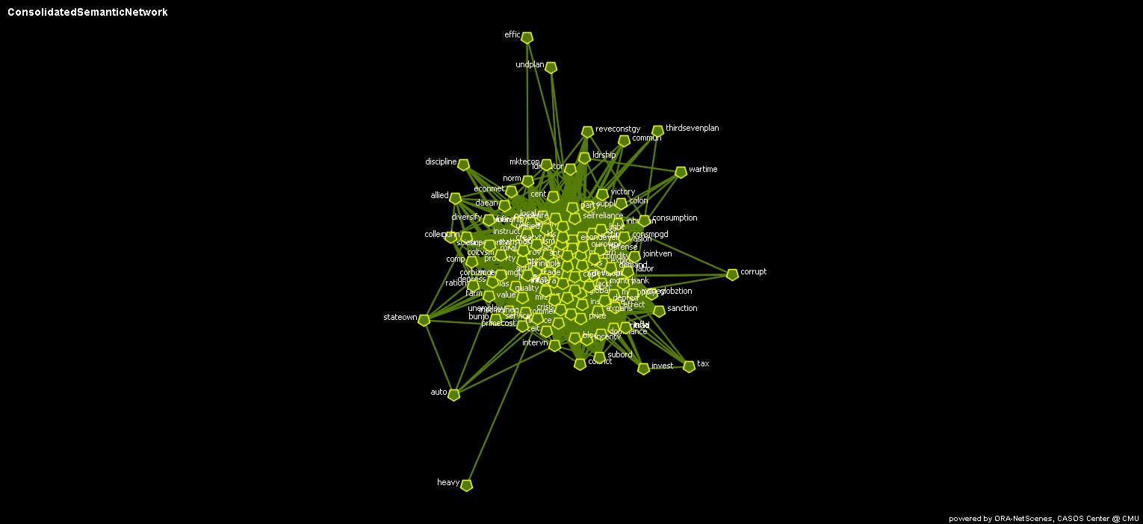
Using Decision Theory to Identify ‘Meaningful’ Networks

Slide 25
Group1
Group2
4
2
1
2
3
3
8
6
5
7
5
4
1
2
3
Union
and
Intersection
8
6
5
7
Doesn’t work well with dense weighted graphs

Slide 26
Data structure of a weighted network:
Frequency | Concept1 | Concept2
10 | econ | dev
7 | self | reliance
5 | dev | con
5 | globla | econ
4 | local | econ
4 | soc | econ
3 | econ | socialism
3 | finance | global
3 | global | finance
3 | global | impsm
3 | impsm | global
3 | impsm | invasion
Is it significant that economic development was mentioned ten times?

Slide 27
What is the probability of getting two blue balls from a random selection of five balls?

Slide 28
In General:

Slide 29
1994-2001

Slide 30
Additional Topics of Interest:
Networks within networks (see Carley and Krackhardt, meta-network analysis)
  Within an organization there are social networks, resource networks, and knowledge networks – to understand one you need to understand others
Profiler Plus developed by Peg Hermann at Syracuse University
  Uses speeches to extract latent models of leadership style and predict behavior in specific circumstances
Advanced content analysis by Gary King and colleagues at Harvard
  Semi-automated method for processing very large collections of text

Slide 31
jdlecy@gsu.edu

