Slide 1
What can the science of cities teach us about the nonprofit sector:
An Exploration of philanthropic resource environments and nonprofit density
Jesse Lecy
Arizona State University

Slide 2
The New Science of Cities: Scaling and Complexity
Bettencourt, L. M. A. (2013). The origins of scaling in cities. Science, 340(6139), 1438–1441. https://doi.org/10.1126/science.1235823
Bettencourt, L. M. A., Lobo, J., Helbing, D., Kühnert, C., & West, G. B. (2007). Growth, innovation, scaling, and the pace of life in cities. Proceedings of the National Academy of Sciences, 104(17), 7301–7306. https://doi.org/10.1073/pnas.0610172104
Bettencourt, L. M. A., Lobo, J., Strumsky, D., & West, G. B. (2010). Urban scaling and its deviations: Revealing the structure of wealth, innovation, and crime across cities. PLoS ONE, 5(11), e13541. https://doi.org/10.1371/journal.pone.0013541
Batty, M. (2008). The size, scale, and shape of cities. Science, 319(5864), 769–771. https://doi.org/10.1126/science.1151419
Batty, M. (2013). The new science of cities. MIT Press.
West, G. (2017). Scale: The universal laws of life, growth, and death in organisms, cities, and companies. Penguin Press.
Youn, H., Bettencourt, L. M. A., Lobo, J., Strumsky, D., Samaniego, H., & West, G. B. (2016). Scaling and universality in urban economic diversification. Journal of the Royal Society Interface, 13(114), 20150937. https://doi.org/10.1098/rsif.2015.0937
Lobo, J., Bettencourt, L. M. A., & Strumsky, D. (2020). Energy, information, and the environment: The nexus of urban and global sustainability. Current Opinion in Environmental Sustainability, 44, 1–8. https://doi.org/10.1016/j.cosust.2019.09.005
Pan, W., Ghoshal, G., Krumme, C., Cebrian, M., & Pentland, A. (2013). Urban characteristics attributable to density-driven tie formation. Nature Communications, 4, 1961. https://doi.org/10.1038/ncomms2961
Schläpfer, M., Bettencourt, L. M. A., Grauwin, S., et al. (2014). The scaling of human interactions with city size. Journal of the Royal Society Interface, 11(98), 20130789.

Slide 3
The Statistical Laws of Cities
Cities follow universal scaling laws — innovation and problems grow superlinearly, infrastructure grows sublinearly.

Slide 4
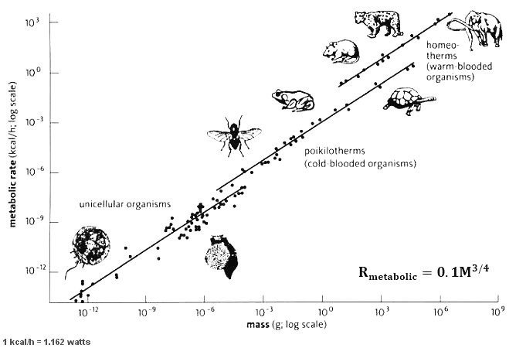
Infrastructure
The total length of infrastructure networks (roads, pipes, cables) grows roughly POP ^{0.75}
(population raised to the 3/4 power)

Slide 5
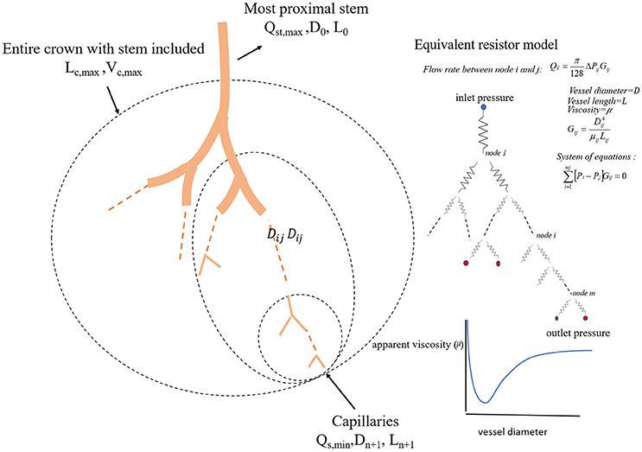

Slide 6
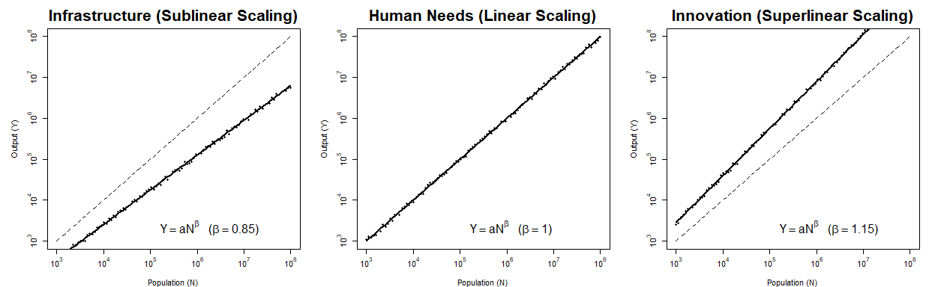
B=0.85
B=1
B=1.15
Warehouses
Logistics hubs
Manufacturing plants
Construction supply firms
Gas stations
Utilities (water, waste, power)
Mining, extraction
Restaurants
Cafes, bars
Grocery stores
Pharmacies
Big-box retail
Salons, laundromats
R&D firms
Software, biotechnology
Semiconductors
Scientific services
Engineering consulting
Architecture & design firms
Creative (film, music, arts)
Legal, finance, advertising

Slide 7
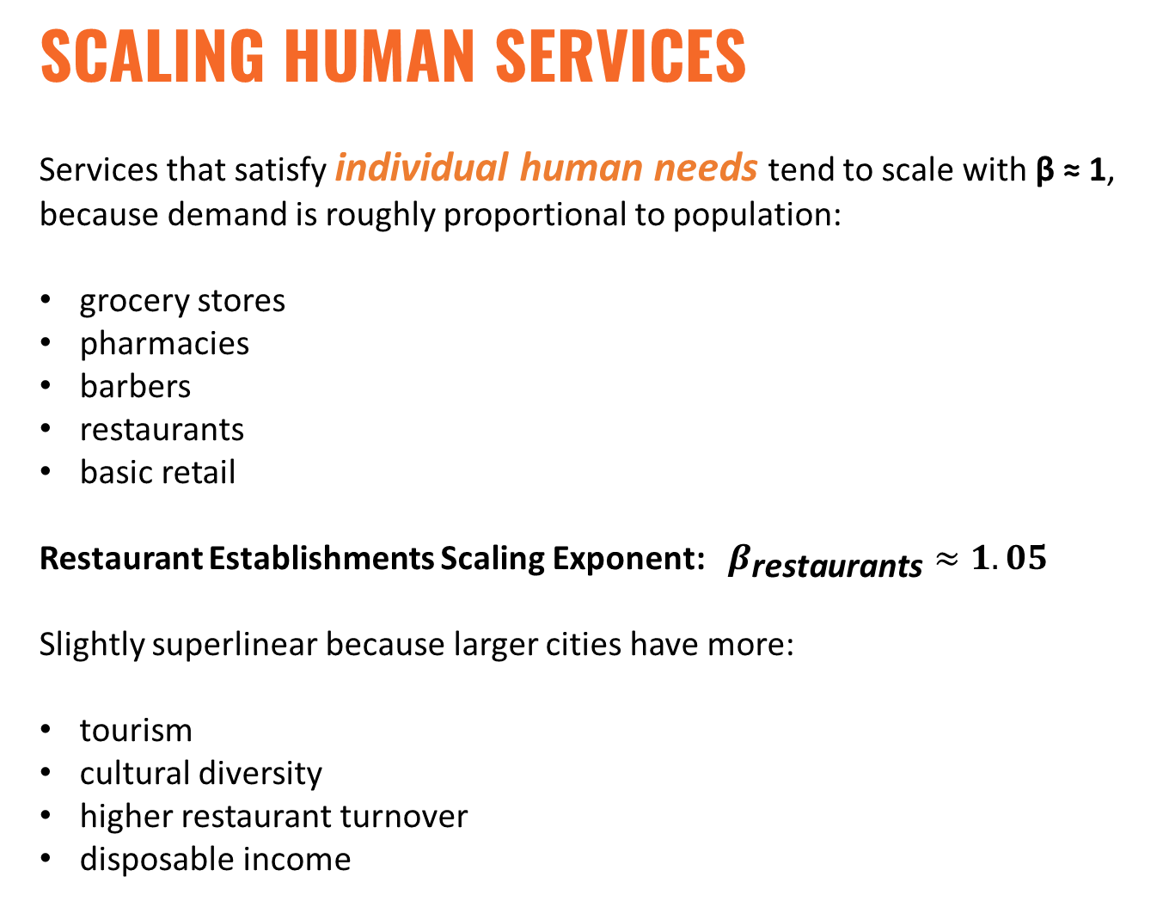
SCALING Human Services
Services that satisfy individual human needs tend to scale with β ≈ 1, because demand is roughly proportional to population:
grocery stores
pharmacies
barbers
restaurants
basic retail
Restaurant Establishments Scaling Exponent: $β_{\text{restaurants}}≈1.05$
Slightly superlinear because larger cities have more:
tourism
cultural diversity
higher restaurant turnover
disposable income

Slide 8
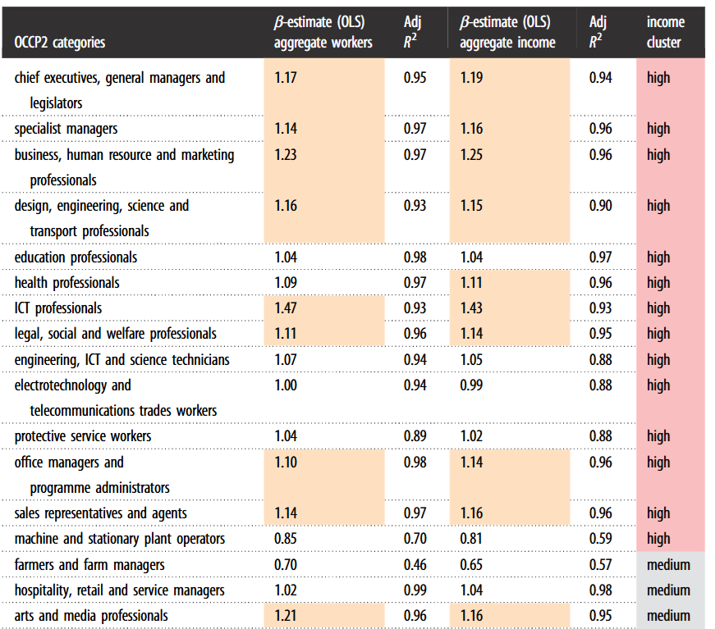
Evidence for localization and urbanization economies in urban scaling (2020)

Slide 9
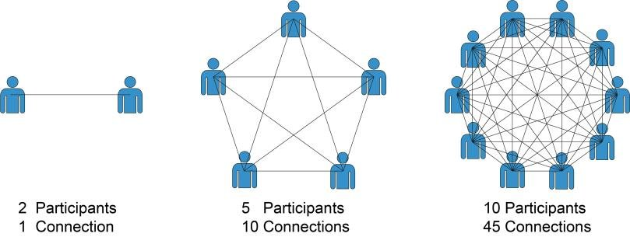
The Statistical Laws of Cities
Cities follow universal scaling laws — innovation and problems grow superlinearly, infrastructure grows sublinearly.
Social networks drive city performance — cities are engines of interaction.

Slide 10
The Statistical Laws of Cities
Cities follow universal scaling laws — innovation and problems grow superlinearly, infrastructure grows sublinearly.
Social networks drive city performance — cities are engines of interaction.
Large cities are more efficient yet more challenging — both productivity and crime rise faster than population.
Cities must innovate faster as they grow — to avoid collapse or stagnation.

Slide 12
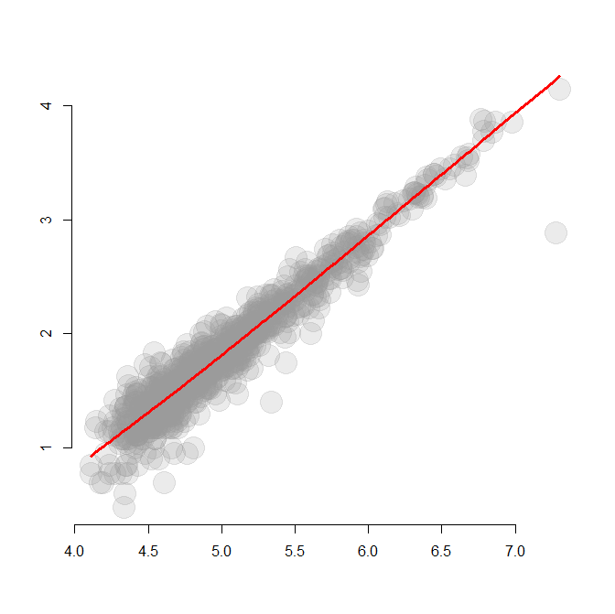
===============================================
Dependent variable:
---------------------------
logN
-----------------------------------------------
logP 1.025***
(0.010)
Constant -3.318***
(0.050)
-----------------------------------------------
Observations 868
R2 0.926
Adjusted R2 0.926
Residual Std. Error 0.160 (df = 866)
F Statistic 10,783.110*** (df = 1; 866)
===============================================
Note: *p<0.1; **p<0.05; ***p<0.01

Slide 13
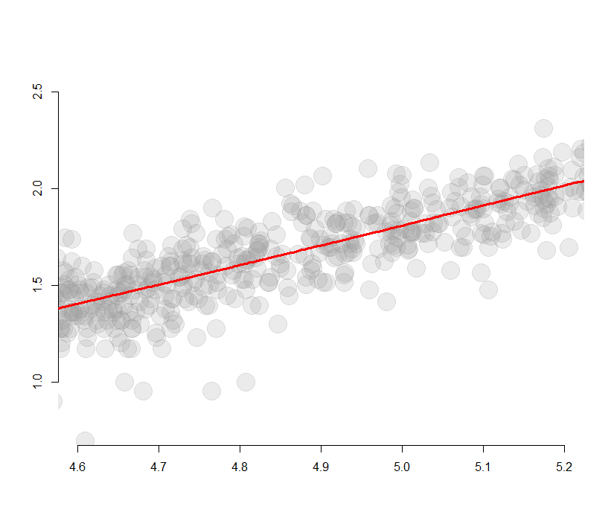
Nonprofit
Density
It is a consistent measure (the low and high ratios are parallel lines) but challenging to interpret because the score is relative to metro size
45% more nonprofits
than typical city
1 sd
popM low.ratio high.ratio
1 0.01 0.67 1.50
2 0.03 0.70 1.40
3 0.10 0.69 1.45
4 0.32 0.69 1.44
5 1.00 0.69 1.45
6 3.16 0.69 1.45
7 10.00 0.69 1.45
typical density
for a city
that size
1 sd
31% fewer nonprofits
than typical city
Metro Size
(logged)

Slide 14
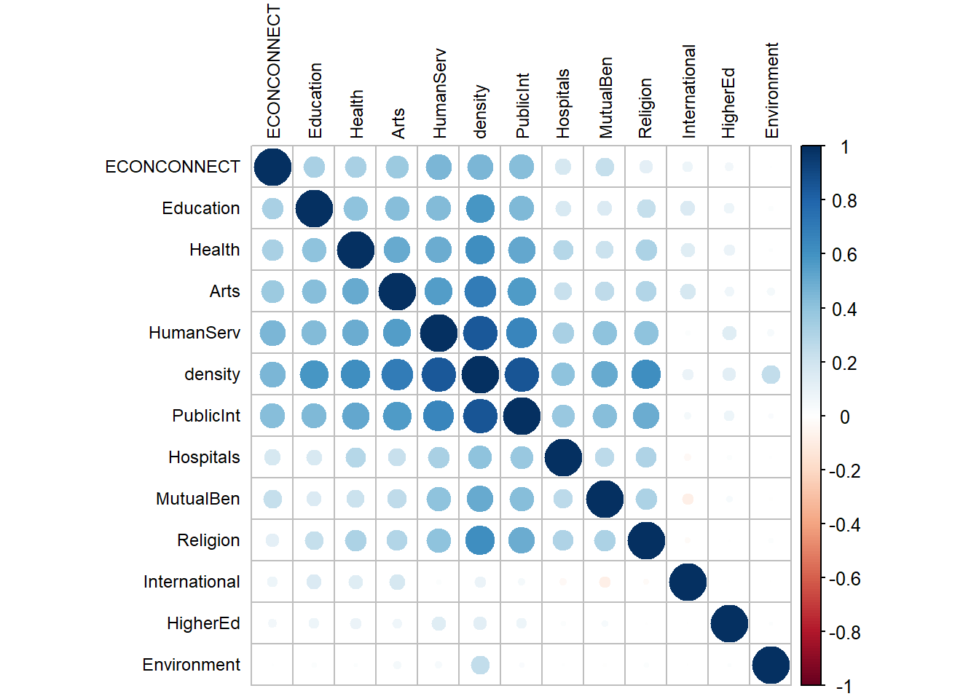
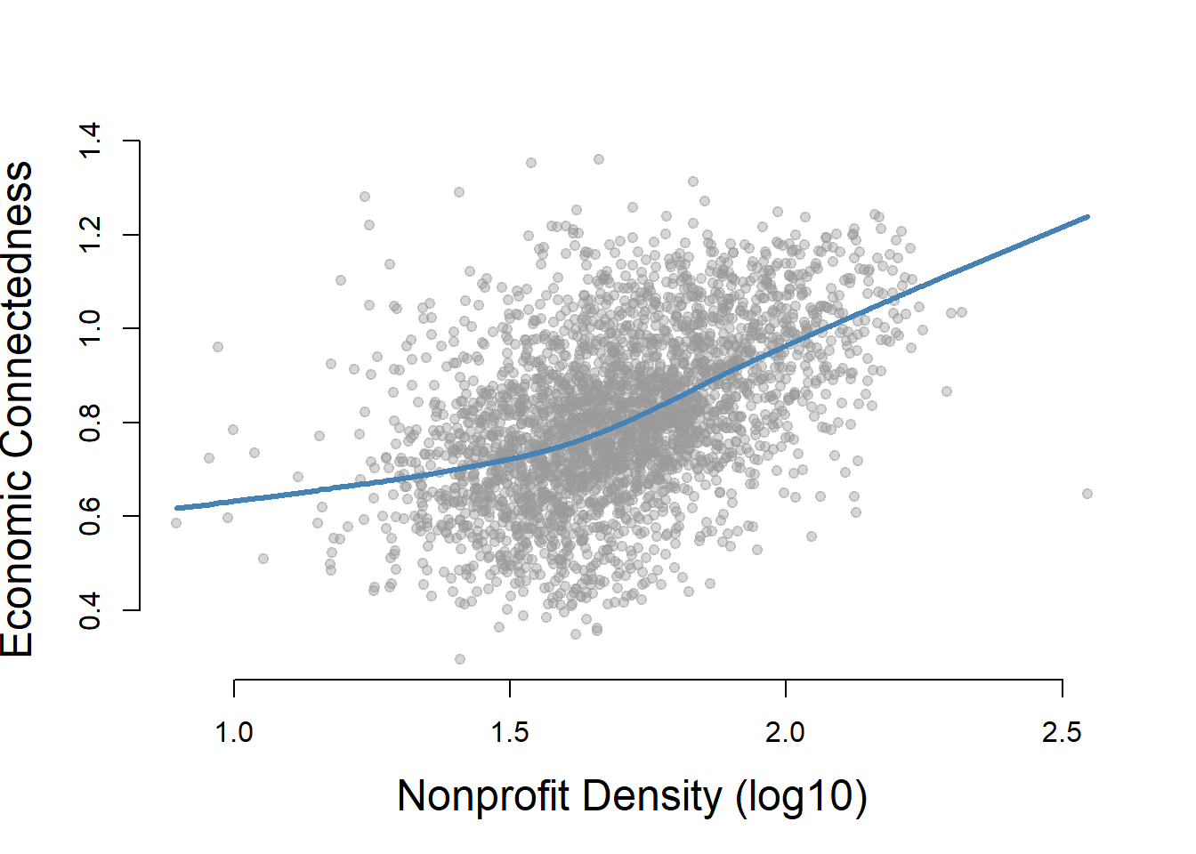

Slide 15
internally Consistent benchmarking:
Scale-Adjusted Metropolitan indicators (SAMIs)

Slide 16
Per capita measures of urban performance are ubiquitous in official statistics, policy documents and in the scientific literature. For example, official statistics on wages, income or gross domestic product (GDP) compiled by governmental agencies and international bodies worldwide report on both total amounts and per capita quantities as a means to compare the economic performance of various places. Similarly, official crime statistics (see e.g. the FBI Uniform Crime Reports) are expressed in terms of crime rates (number of crimes per 100,000 inhabitants per year). Many other important indicators that measure local economic and social well-being, such as unemployment rates, innovation rates, cost of living index, morbidity and mortality rates, poverty rates, etc, all are reported on a per capita basis.
The use of per capita indicators assumes implicitly that, on average, specific urban characteristics increase linearly with population size. However, this approach is unsuitable for characterizing and comparing cities because it ignores the fundamental emergent phenomenon of agglomeration resulting from non-linear interactions in social dynamics and organization as cities grow. Such non-linearities are fundamental to the very existence of cities…

Slide 17
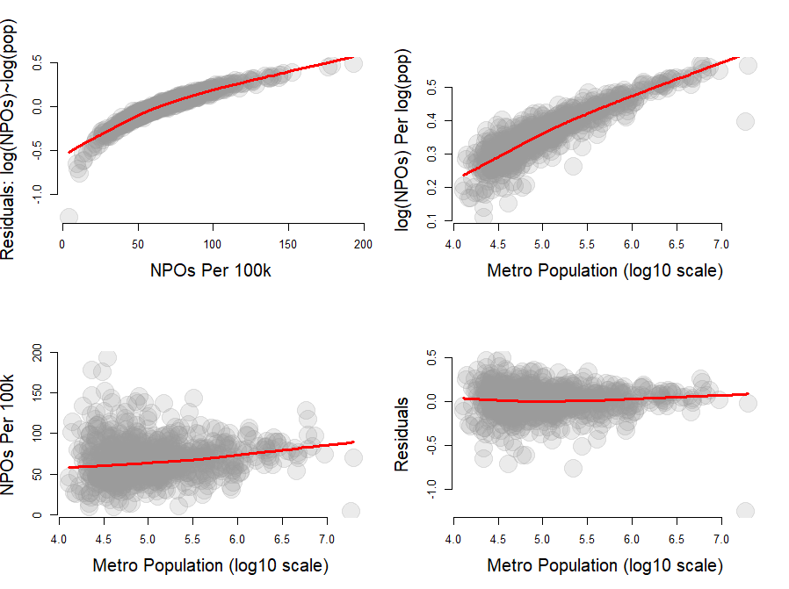
still modeling population, not relative density
population size and the density metric are uncorrelated: cleaner measure of relative density independent of population

Slide 18
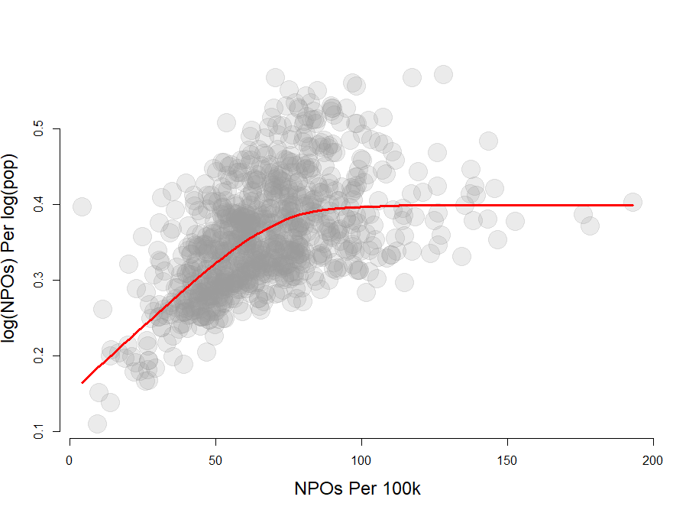
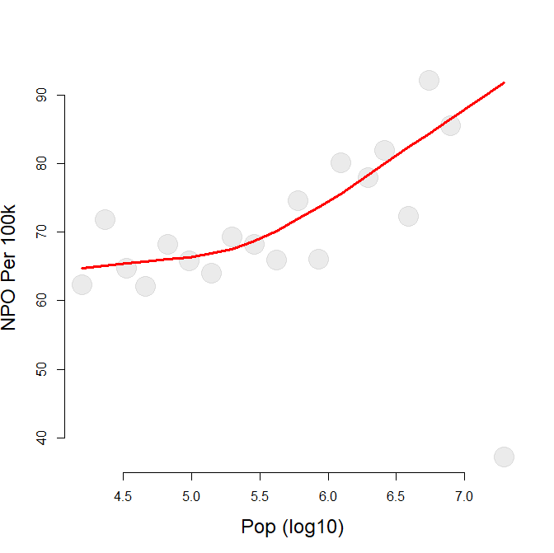
Population=1 million
Population=400k
Similar measures but they diverge once cities get above ~500k

Slide 19
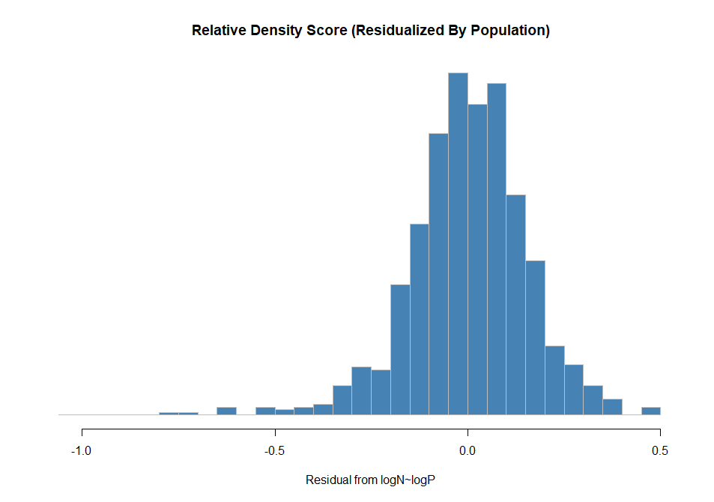
popM low ave high low.ratio high.ratio
1 0.01 4 6 9 0.67 1.50
2 0.03 14 20 28 0.70 1.40
3 0.10 44 64 93 0.69 1.45
4 0.32 144 209 302 0.69 1.44
5 1.00 470 679 982 0.69 1.45
6 3.16 1529 2211 3195 0.69 1.45
7 10.00 4977 7194 10399 0.69 1.45
Ratio relative to ave level for a city of that size
log10(Num NPO) = -3.318 + 1.025·log10(pop)
sd( residual ) = 0.15
Cities with 10 million people have between 4,977 and
10,399 new nonprofits
45% more nonprofits
than typical city
1 sd
typical city
31% fewer nonprofits
than typical city
> summary( dd2$residuals )
Min. 1st Qu. Median Mean 3rd Qu. Max.
-1.252324 -0.086992 0.008122 0.000000 0.095839 0.495278

Slide 20
Per Capita Metric
Residualized log-log Metric
since the metric is not independent from population we cannot compare rates across cities of different sizes
population size and the density metric are uncorrelated: cleaner measure of relative density independent of population

Slide 21
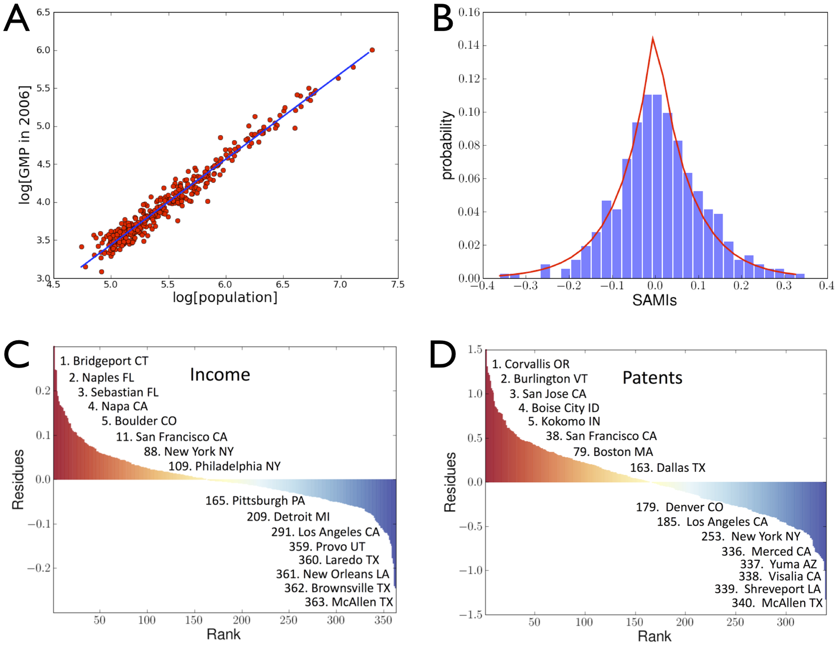
Scale-Adjusted Metropolitan Indicators (SAMIs)
Urban Scaling and Its Deviations: Revealing the Structure of Wealth, Innovation and Crime across Cities (2010)

Slide 22
Scale-Adjusted Metropolitan Indicators (SAMIs) are not strongly correlated (cities don’t consistently perform high or low on many categories).
Cities tend to overperform in some domains and underperform in others, and these patterns are surprisingly independent across categories.

Slide 23
Innovation
patents
creative occupations
R&D jobs
STEM industries
Crime & social stress
violent crime
certain property crimes
policing intensity
public health emergencies
Consumption & amenity
restaurants
bars
creative arts venues
tourism
nightlife intensity
clusters ONLY appear within functional categories
They are modest correlations
Across clusters the SAMIs
are nearly independent

Slide 24
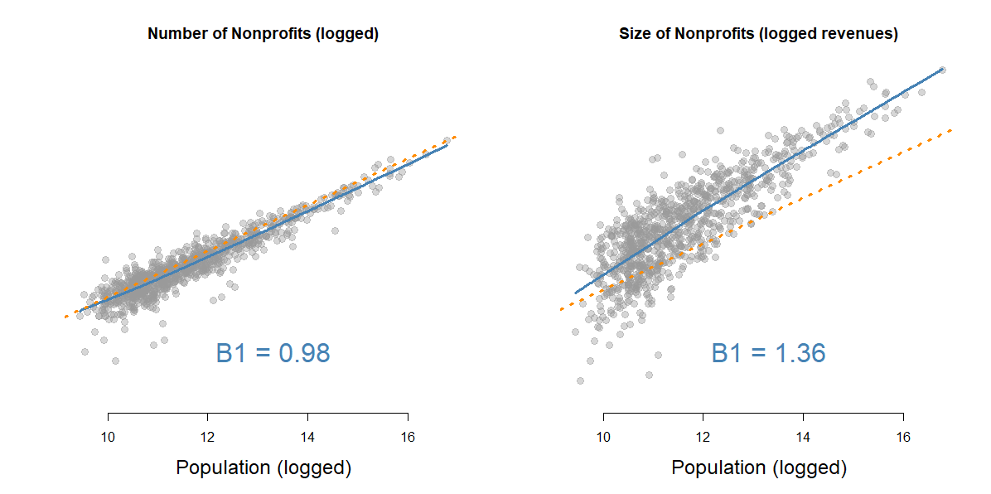
Counts of Nonprofits
log(NP) ~ B0 + B1 x log(pop)
| SUBSECTOR B1 |
|-----------------------|
| ARTS | 0.92 |
| EDUCATION | 1.02 |
| ENVIRONMENT | 0.86 |
| HEALTH | 0.94 |
| HUMAN SERV | 0.94 |
| HOSPITALS | 0.50 |
|-----------------------|
| AVERAGE | 0.96 |

Slide 25
TOTAL EXPENDITURES
log( totexp ) = b0 + b1 log(pop)
| SUBSECTOR B1 |
|------------------------|
| ARTS 1.44 |
| EDUCATION 1.48 |
| ENVIRONMENT 1.51 |
| HEALTH 1.57 |
| HUMAN SERVICES 1.27 |
| HOSPITALS 1.50 |
|------------------------|
| AVERAGE 1.35 |

Slide 26
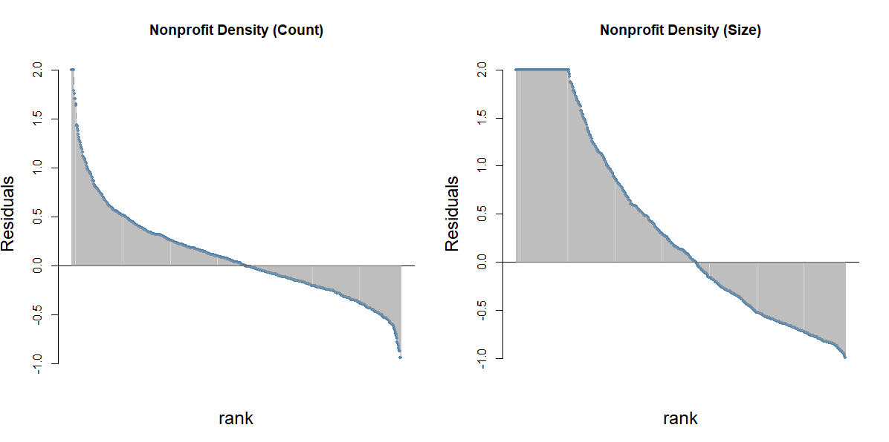

Slide 27
Resource environments

Slide 28
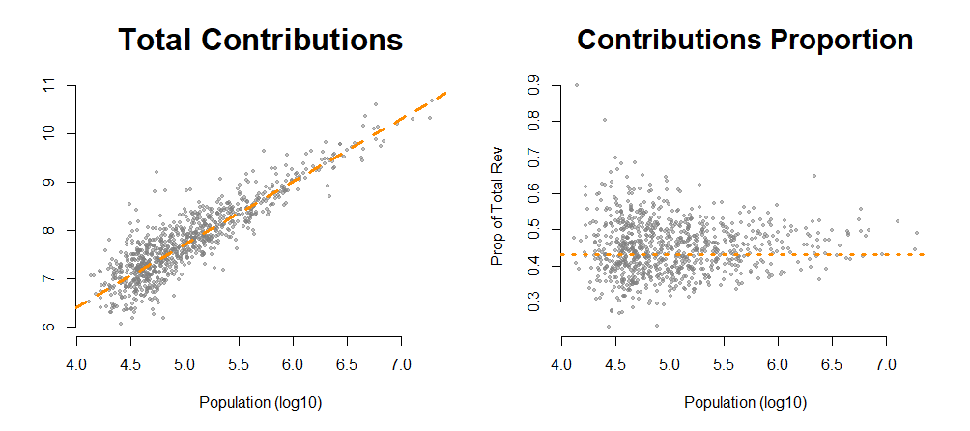

Slide 30
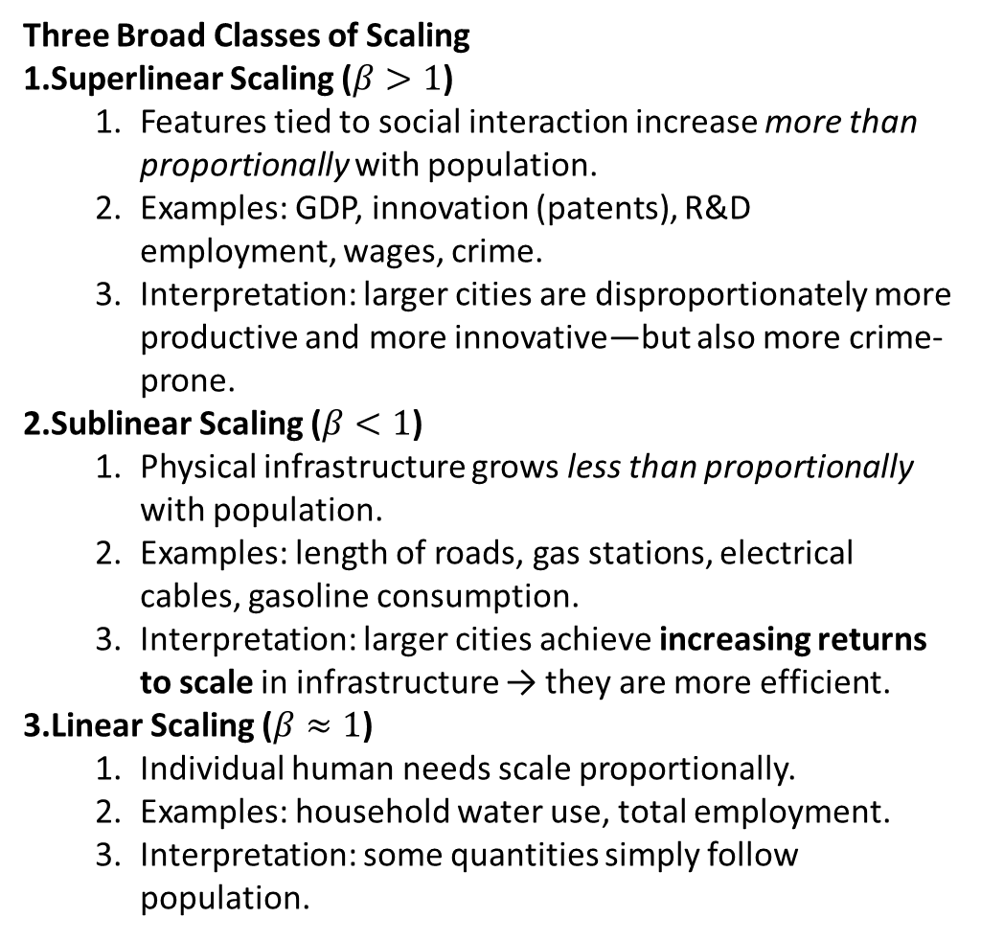
Three Broad Classes of Scaling
Superlinear Scaling ($β>1$)
  Features tied to social interaction increase more than proportionally with population.
  Examples: GDP, innovation (patents), R&D employment, wages, crime.
  Interpretation: larger cities are disproportionately more productive and more innovative—but also more crime-prone.
Sublinear Scaling ($β<1$)
  Physical infrastructure grows less than proportionally with population.
  Examples: length of roads, gas stations, electrical cables, gasoline consumption.
  Interpretation: larger cities achieve increasing returns to scale in infrastructure → they are more efficient.
Linear Scaling ($β≈1$)
  Individual human needs scale proportionally.
  Examples: household water use, total employment.
  Interpretation: some quantities simply follow population.

Slide 31
Infrastructure Efficiency Is a Network Phenomenon
Sublinear scaling for infrastructure is not “nice to have” but structurally required:
Larger cities wire and connect more efficiently.
The total length of infrastructure networks (roads, pipes, cables) grows roughly with population to the 3/4 power.
This parallels biological organisms, where metabolic networks scale sublinearly.
Insight:
Cities demonstrate economies of scale in their physical networks, enabling high densities of population to exist at lower per-capita infrastructure cost.

Slide 32
Innovation and Growth Accelerate as Cities Grow — But So Do Their Problems
Core paradox:
“The very same factors that produce increased productivity and creativity also produce increased crime, disease, and inequality.”
Cities turbocharge:
Innovation
Wage growth
Scientific output
Entrepreneurship
Cultural production
But the same scaling processes also yield:
Crime increases superlinearly
Infectious disease spreads more rapidly
Housing costs rise disproportionately
Social inequality grows
Insight:
Cities produce good and bad at increasing rates, driven by the same underlying mathematics.

Slide 33
Cities Are Non-Equilibrium Dynamical Systems
West and Bettencourt emphasize that cities do NOT converge to equilibrium; they must grow or they stagnate.
Implications:
Cities require continuous innovation to avoid collapse (“Red Queen effect”).
They behave like open systems with constant energy, material, and information throughput.
Economic growth is tied to sustaining socially-driven superlinear returns.
Insight:
Urban systems survive by maintaining a pace of innovation that matches the accelerating growth of their social networks.
6. Failures and Crises Are Predictable Features of Scaling
Bettencourt West argue that scaling predicts increasingly frequent crises unless innovation offsets them.
Examples:
Housing affordability crises
Infrastructure congestion
Epidemics
Crime spikes
Energy demands
Cities must innovate faster the larger they get to stay ahead of systemic pressures.
Insight:
Urban crises are structural and predictable, not random—they stem from the mathematics of scaling.

Slide 34
7. Urban Growth, Pace of Life, and Tempo Accelerate with Size
Empirical data show larger cities:
Move faster
Innovate faster
See higher pace of daily rhythms
Exhibit faster turnover in cultural trends
Quantitative finding:
Choreographed aspects of life (walking speed, tempo of interactions) scale superlinearly.
Insight:
The “pace of life” empirically increases with city size — a measurable acceleration of human activity.

Slide 35
popM low ave high low.ratio high.ratio
1 0.01 4 6 9 0.67 1.50
2 0.03 14 20 28 0.70 1.40
3 0.10 44 64 93 0.69 1.45
4 0.32 144 209 302 0.69 1.44
5 1.00 470 679 982 0.69 1.45
6 3.16 1529 2211 3195 0.69 1.45
7 10.00 4977 7194 10399 0.69 1.45
log10(Num NPO) = -3.318 + 1.025·log10(pop)
sd( residual ) = 0.15
45% more nonprofits
than typical city
1 sd
typical city
31% fewer nonprofits
than typical city
> summary( dd2$residuals )
Min. 1st Qu. Median Mean 3rd Qu. Max.
-1.252324 -0.086992 0.008122 0.000000 0.095839 0.495278

Slide 36
Per Capita Metric
Residualized log-log Metric
since the metric is not independent from population we cannot compare rates across cities of different sizes
population size and the density metric are uncorrelated: cleaner measure of relative density independent of population

Slide 37
Per Capita Metric
Residualized log-log Metric
since the metric is not independent from population we cannot compare rates across cities of different sizes
population size and the density metric are uncorrelated: cleaner measure of relative density independent of population
50% more nonprofits
than typical city
typical
city:
ave = 0
across
metro size
50% fewer nonprofits
than typical city

Slide 38
HOW DO FIRMS SCALE?
Type of Industry | Scaling Exponent (β) | Why?
Knowledge, innovation, professional services | Superlinear (1.1–1.3) | Productivity from social interactions
Consumption-based retail & restaurants | Linear (~1.0) | Proportional to population
Infrastructure & spatial industries | Sublinear (0.8–0.95) | Economies of scale, shared networks

Slide 39
Sectors That Scale Superlinearly (β > 1)
These are sectors that benefit from dense social interaction, knowledge spillovers, agglomeration economies, and diverse networks.
Innovation & Knowledge Industries (β ≈ 1.1–1.3)
R&D firms
Software companies
Biotechnology
Semiconductors
Scientific services
Engineering consulting
Architecture & design firms
Creative industries (film, music, arts)
Professional services (legal, finance, advertising)
Why superlinear?
These sectors depend on idea recombination, talent pooling, and frequent face-to-face interactions—all of which accelerate with population.
Examples (empirical β values):
R&D establishments: β ≈ 1.25
High-tech firms: β ≈ 1.20
Creative industries: β ≈ 1.15–1.20
Finance/insurance: β ≈ 1.10–1.15

Slide 40
Sectors That Scale Sublinearly (β < 1)
These industries rely heavily on land, transport networks, or energy, where large cities share infrastructure efficiently or reduce relative demand.
Infrastructure & Utility-Intensive Sectors (β ≈ 0.8–0.95)
Warehouses
Logistics hubs
Manufacturing plants
Construction supply firms
Gas stations
Utilities (water, waste, power)
Mining, extraction, primary industries
Why sublinear?
Bigger cities use infrastructure more efficiently and centralize activity, so you need fewer establishments per capita.
Examples (empirical β values):
Gas stations: β ≈ 0.85
Manufacturing establishments: β ≈ 0.92
Warehouses: β ≈ 0.90
Electric/water utilities: β ≈ 0.85

Slide 41
Sectors That Scale Linearly (β ≈ 1.0)
These depend on per-capita consumption and basic household demand rather than network effects.
Consumption Services (β ≈ 1.0)
Restaurants
Cafes, bars (sometimes slightly > 1 due to nightlife)
Grocery stores
Pharmacies
Big-box retail
Personal services (salons, laundromats)
Restaurants scale almost exactly linearly because each person eats roughly the same amount regardless of city size.
Why linear?
These businesses serve individual needs, not social interaction networks.

Slide 43
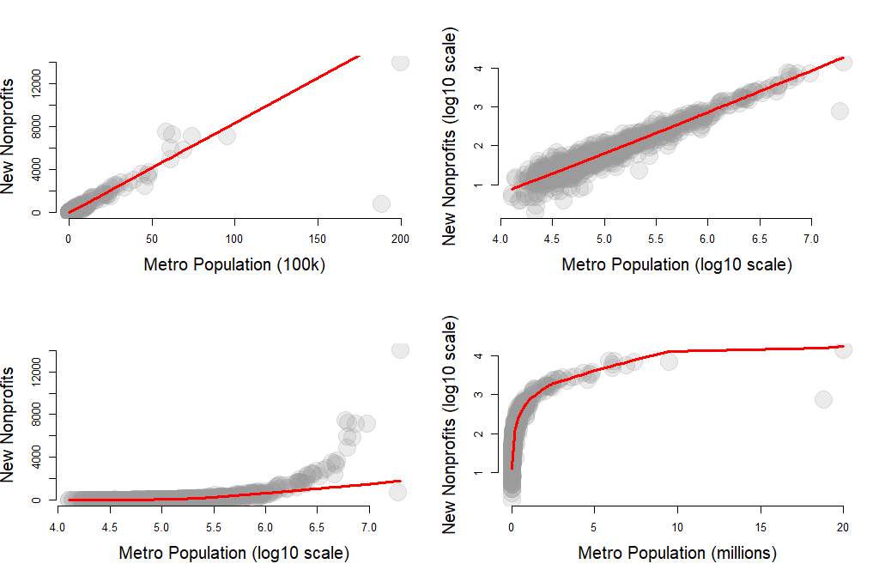
BEST WAY TO NORMALIZE?

Slide 46
Market Competition Metrics
Market = MSA + NTEE

Slide 47
Market Competition Metrics
285 MSAs + 12 NTEE Categories = 2,979 “markets” examined
HHI
CR4 – four-firm competition ratio
Kwoke index – HHI of three largest firms in market
Gini coefficient
Density – number of nonprofits
Demand density – number of nonprofits / 10,000 people
Big Dog Ratio (# orgs rev > $1m / # orgs)
Little Pup Ratio (# orgs rev < $100k / # orgs)
Density of commercial nonprofits
Resource availability index (total rev / # orgs – ave size of org in market)
Fundraising efficiency for NPs with > $1m in revenue
Ave fiscal health in market
Ave growth rate in market
Growth equity: ave growth rate top quintile / ave growth rate smallest quintile
Birth rates (rate of new org formation) [should this be new orgs / current, or new orgs per 10k people?
Five-year “smallness” index
Death rate (rate of closure) [closures per 10k people? What is expected rate?]
Five-year closure rate
Philanthropic capital
Generosity index

Slide 48
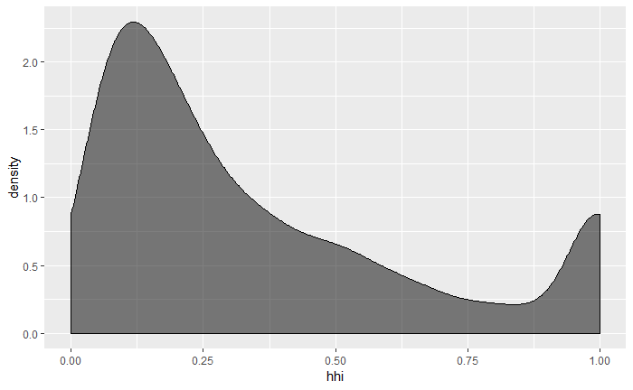
Distribution of HHI Metrics Across 285 Metro Areas
These Cities
Have A
Dominant
Nonprofit
In these Cities
Nonprofits are
Similar Sizes
80%
25%
25%
25%
25%
10%
(Market Share by NPO)
(Market Share by NPO)
Competitive Markets
Monopolistic

Slide 49
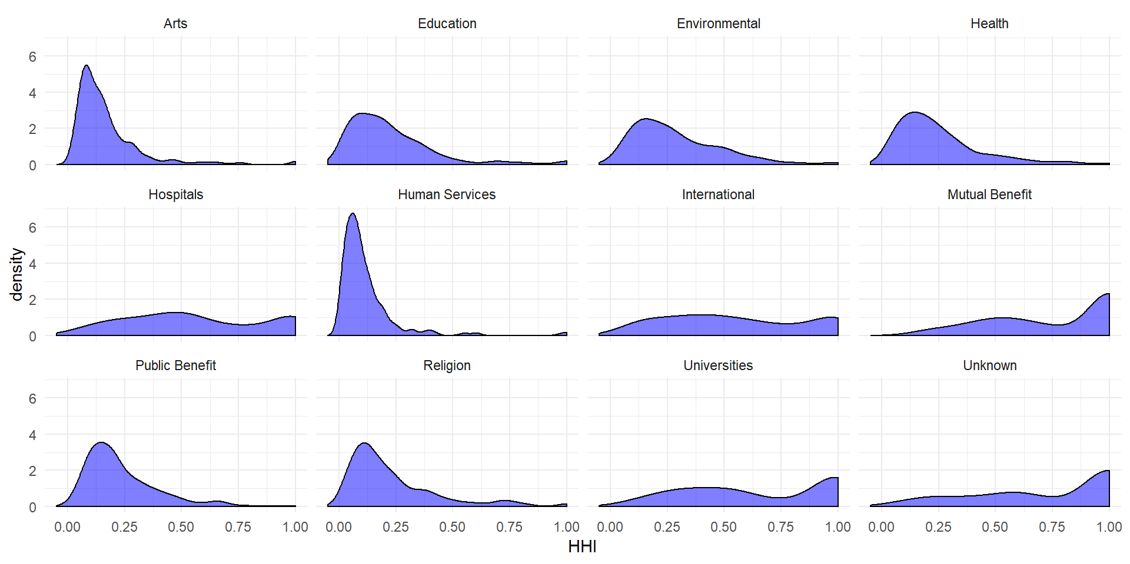
Competitive
Monopolistic

Slide 50
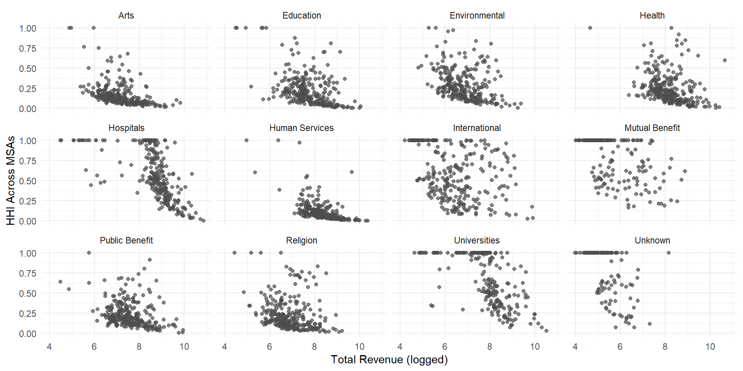
Competitive
Monopolistic
Market Size

Slide 51
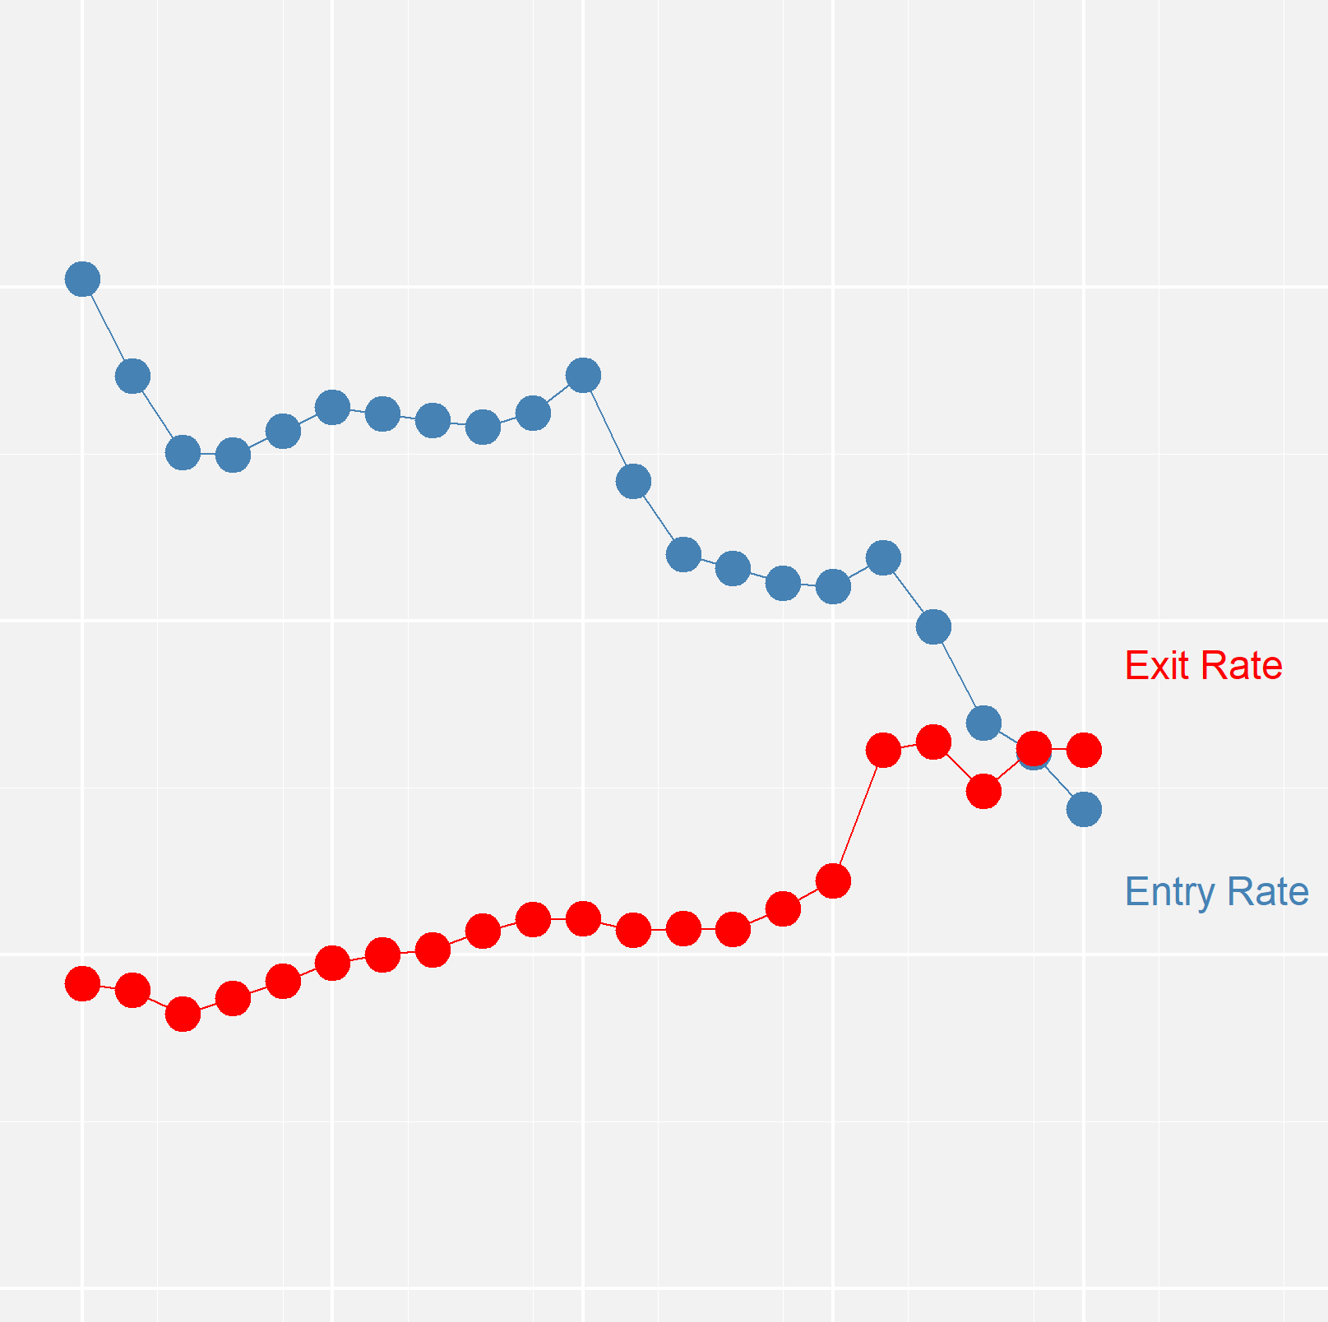
(new nonprofits created each year)
MOTIVATION:
Are we at a tipping point in the growth of the US Nonprofit Sector?
entry rate
entry rates
are falling
exit rate
exit rates
are rising
(nonprofit closures)
1990
2015

Slide 52
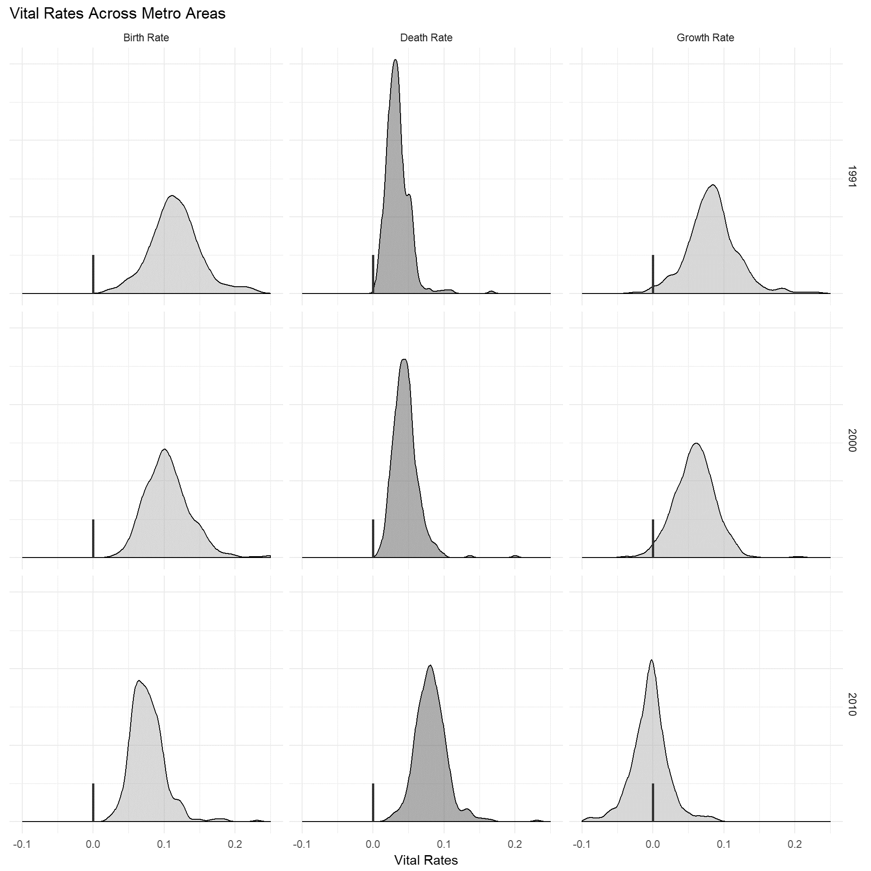
“entry”
rates
“exit”
rates
sector
growth
Tipping Point in the growth of the US Nonprofit Sector?
12%
4%
8%
1991
ave.
sector
growth
7%
7%
0%
2010
Vital rates across all US Metros

Slide 53
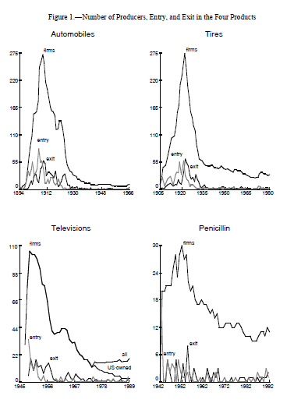
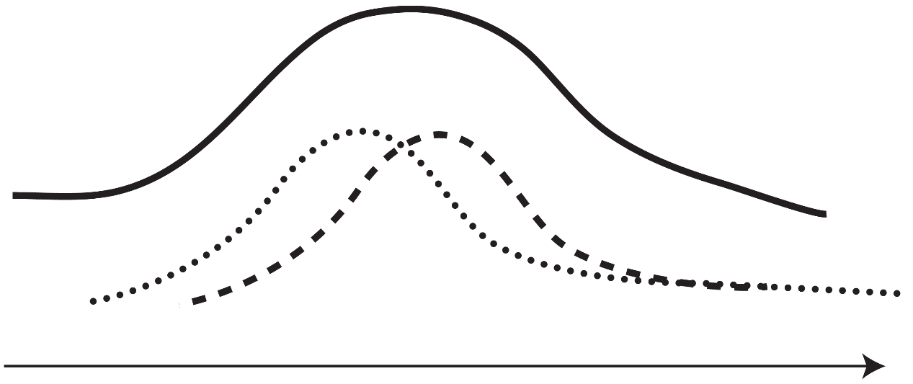
market peak:
large number
of firms
Automobiles
Tires
new industry,
few firms & small
consolidation,
few firms & large
275
275
exit rate
number
of active
firms
5
40
firm entry rate
tipping point:
firm exits exceed entry
time
Televisions
Penicillin
Industry Shake-Out
110
30
12
Klepper, S., & Simons, K. L. (2005). Industry shakeouts and technological change. International Journal of Industrial Organization, 23(1), 23-43.
20

Slide 54
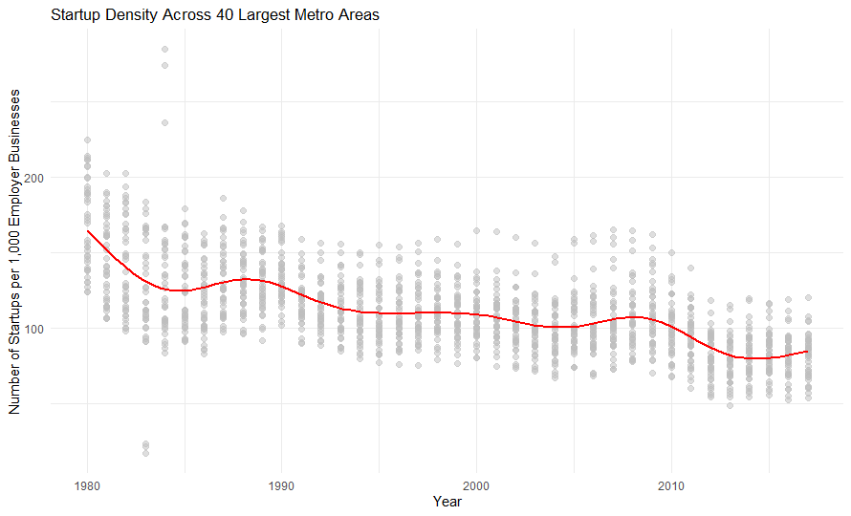
Change in for-profit startup density
The Startup Density of a region: the number of new employer businesses normalized by the business population (total employer businesses)

Slide 55
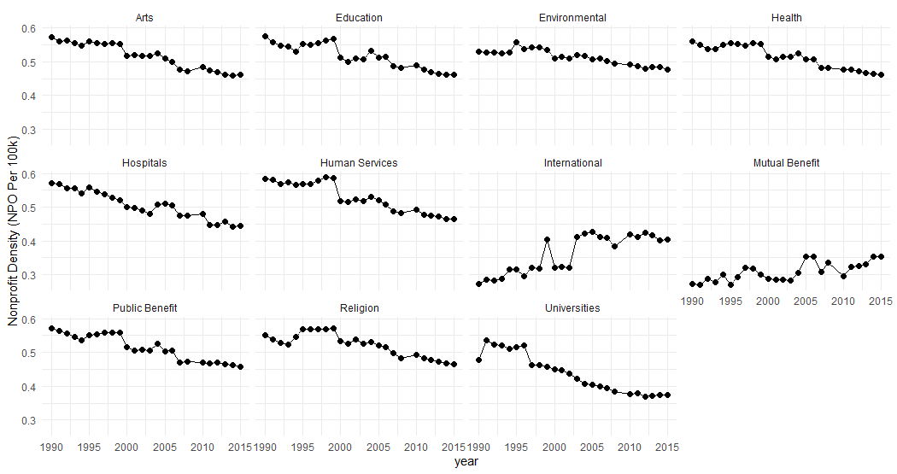
Change in Nonprofit density: NPOs per 100k
Some Growth
Consistent
Downward
Trend

Slide 56
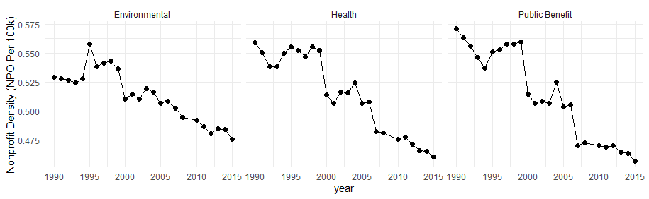
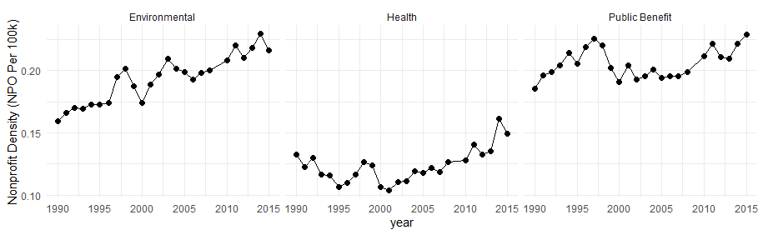
Total density vs small nonprofit density
Fall in
Overall
Density
Growth of
Small
Nonprofit
Density

Slide 57
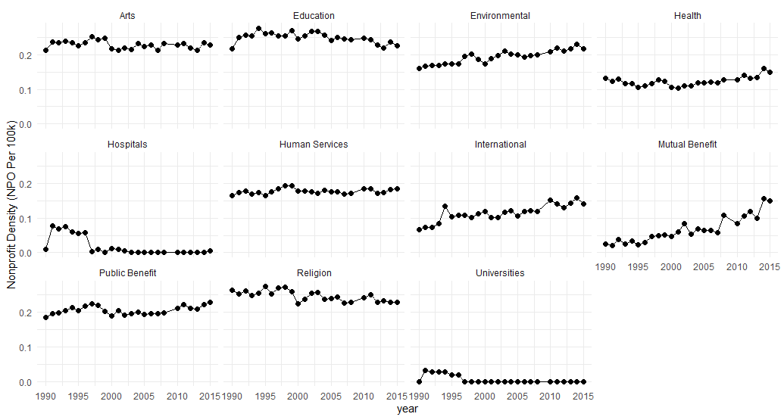
density of small nonprofits 1990-2015
Flat
Lots of Small NPOs
Hospitals
0% Small
Universities
0% Small

Slide 58
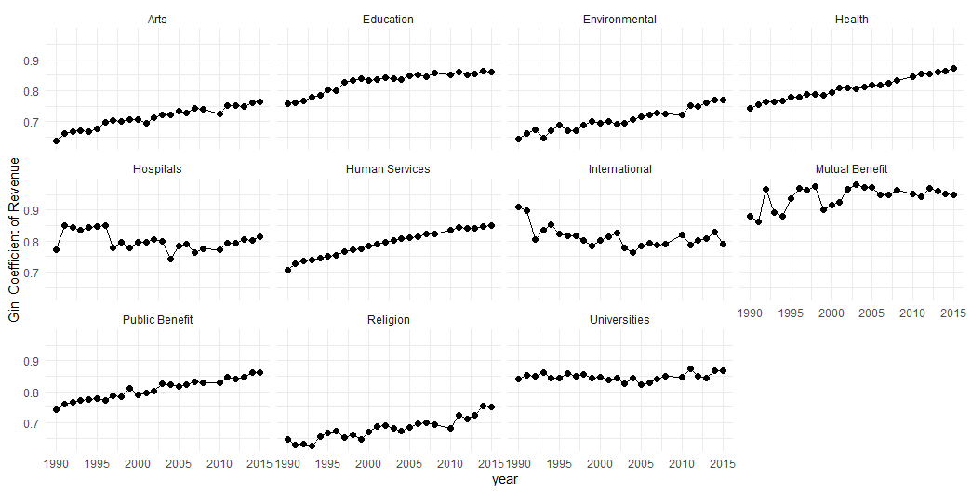
Market concentration: revenue gini coefficient
Consolidation of Resources by Large Nonprofits

Slide 59
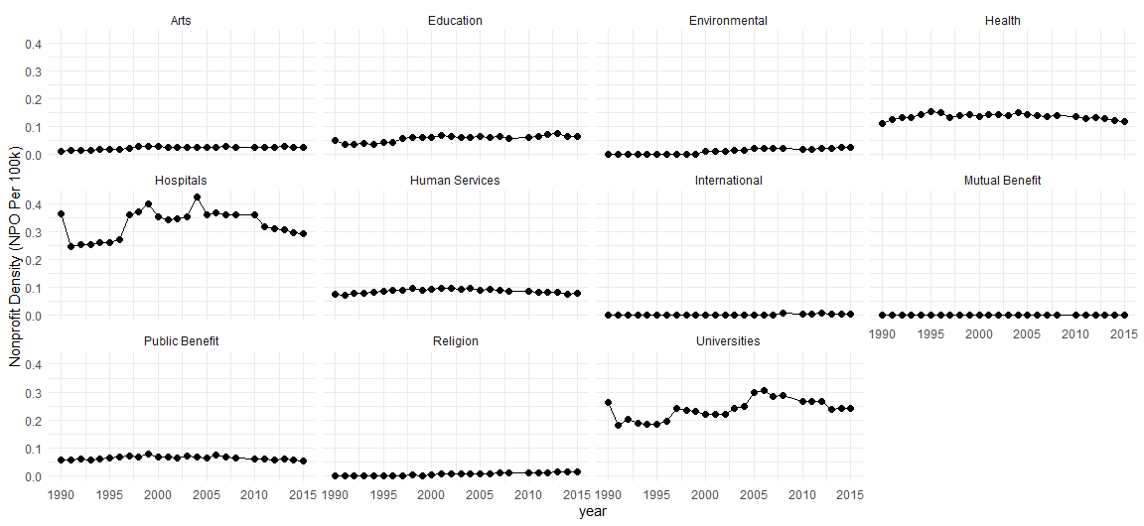
Density of large nonprofits 1990-2015

Slide 60
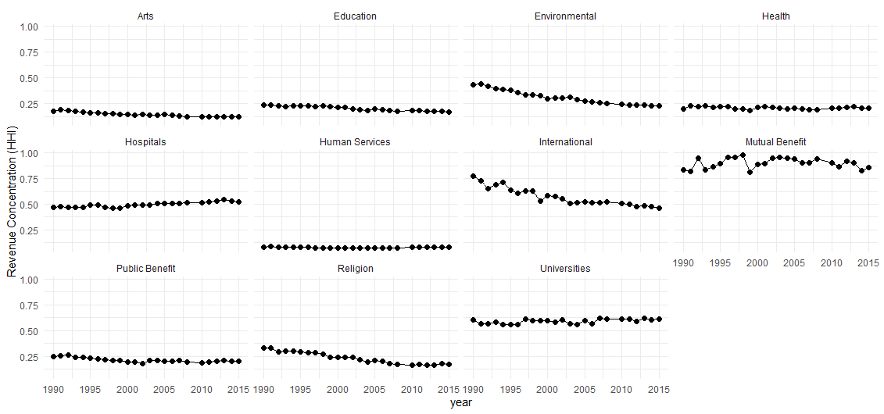
Revenue concentration by county (HHI-N)

