Slide 1
Demo presentation

Slide 2
Overall
Project technical
Project structure
Project overall
Project features
Limitations

Slide 3
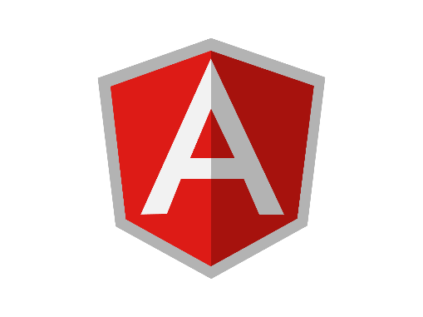
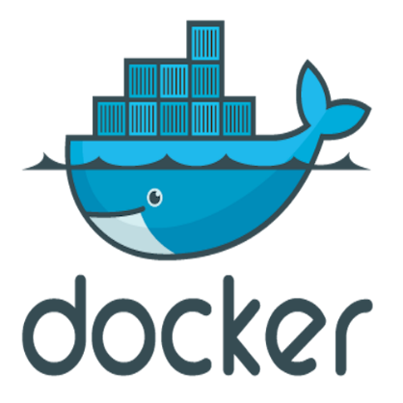
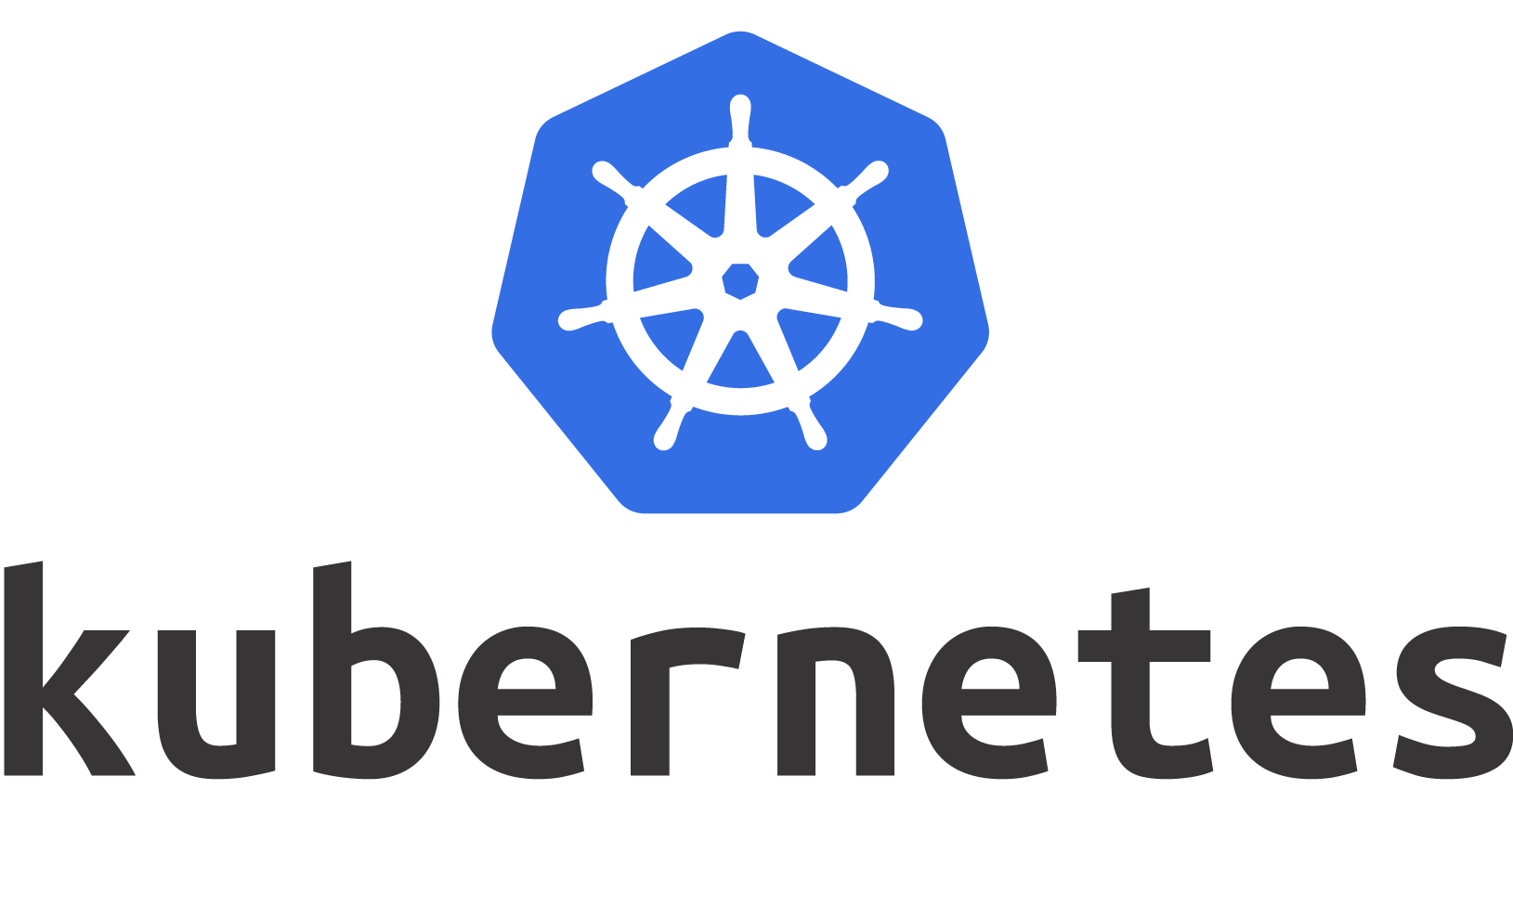
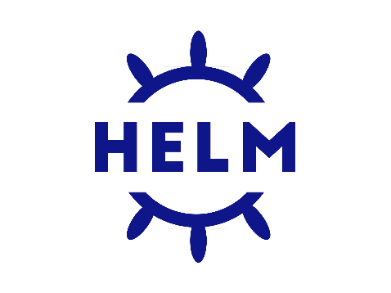


1. Project technical

Slide 4
1.1 . Project technical Detail
Name | Description
Angular
Spring boot
Apache camel
Docker
Kubernetes
Helm chart

Slide 5
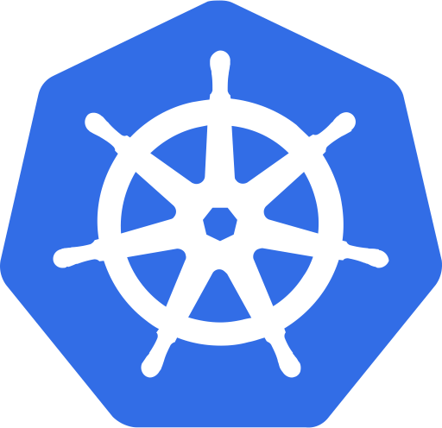

1.2. Project build
Dev
Source code
QC
PRODUCTION

Slide 6
2. Project structure
Helm-chart
eureka-server
Data-service
Comm-client
Profile-service
Project
Profile-management-server
User-service
schedule-service
docker-compose
profile-management-ui

Slide 7
2.1 . Project structure Detail
Name | Description
Helm-chart | server-chart comm-client-chart profile-service-chart schedule-service-chart web-ui-chart mysql-chart
Data-service | The project is designed as a centralized library containing pre-defined Entities and Repositories.
Profile-management-server | Eureka-server Comm-client: Common client Profile-service : Handle business logic for profile User-service: Handle business logic for user Schedule-service: Handle schedule some task for example: send mail to notification everyday Docker-compose
Profile-management-ui | The web-ui

Slide 8

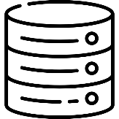
3. Project Overall
profile-management-server
eureka-server
comm-client
Discovery service
profile-management-ui
user
user-service
profile-service
schedule-service
Mail
\MailSchedule()
Database
Data-service

Slide 9
4. Project features
Profile Management
Create profile
Delete/ multiple delete
View detail
Filter/ search
Send mail

Slide 10
5. Limitations
Item | Description
Deploy all services in one node | For best practice we should deploy all service on more than one node

Slide 11
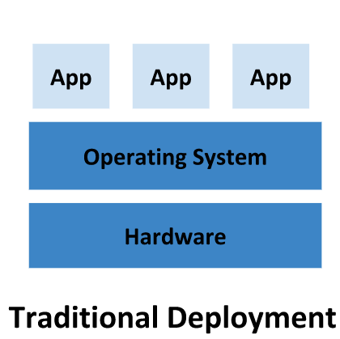
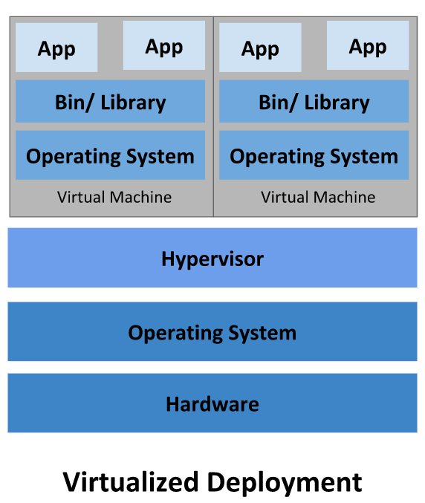
6. Why K8s
Traditional Deployment
Solve the problem of centrally running all applications on one server
When an app needs to increase resources, it must increase resources for the server
Virtualized Deployment
To solve the problem of running each application on each VM, you must install software on each VM to be able to run the application

Slide 12
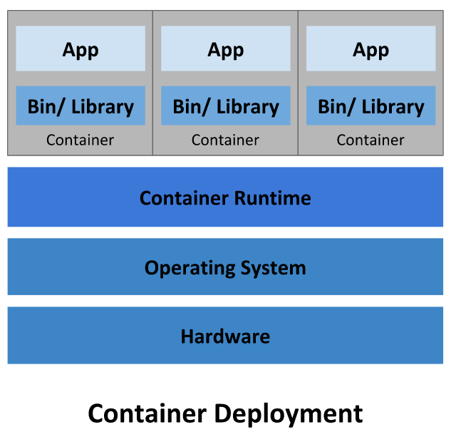
6. Why K8s
Container Deployment (K8s)
Extensible to manage containerized applications
Applications running in production environments do not experience downtime, and if one container is shut down, another needs to be started up.

