Slide 1
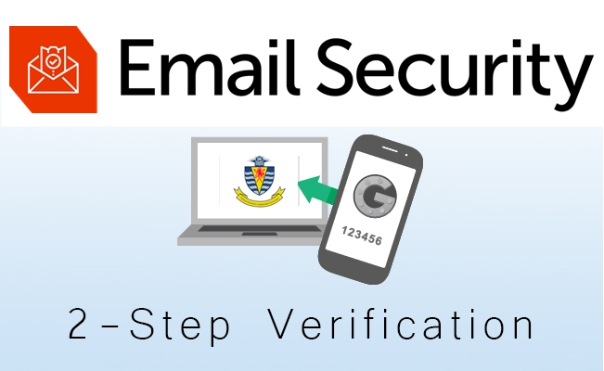

Slide 2
What is 2-Step Verification?
Two-Step Verification is an additional layer of security that you can add onto your email account. This verification method increases the security of your account.
Important
If you lose access to your phone number and you don't have a backup set, you will need to IT Help-desk to reset the password.
If you ever get a login notification for your account when you are not trying to log in, that means your password has been compromised; you should immediately change your password . Call IT Department.
Be aware from Scams and unknown emails.
CALL IT HELPDESK AT ext. 261 or email: helpdesk@aitchison.edu.pk

Slide 3
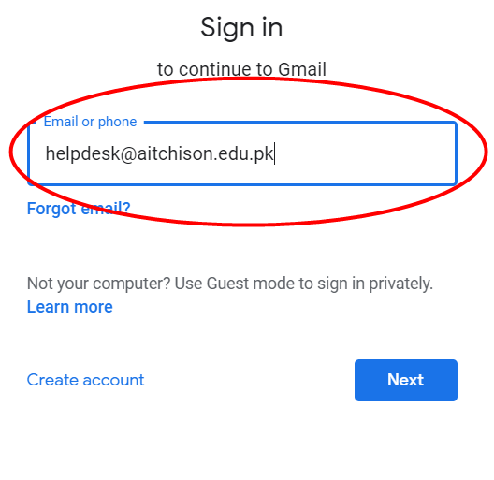
Step - 1. Enter your email address.

Slide 4
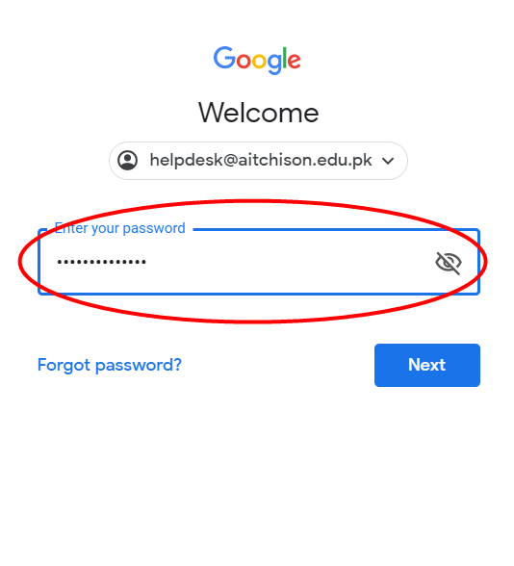
Step - 2. Enter your password and click on next button.

Slide 5
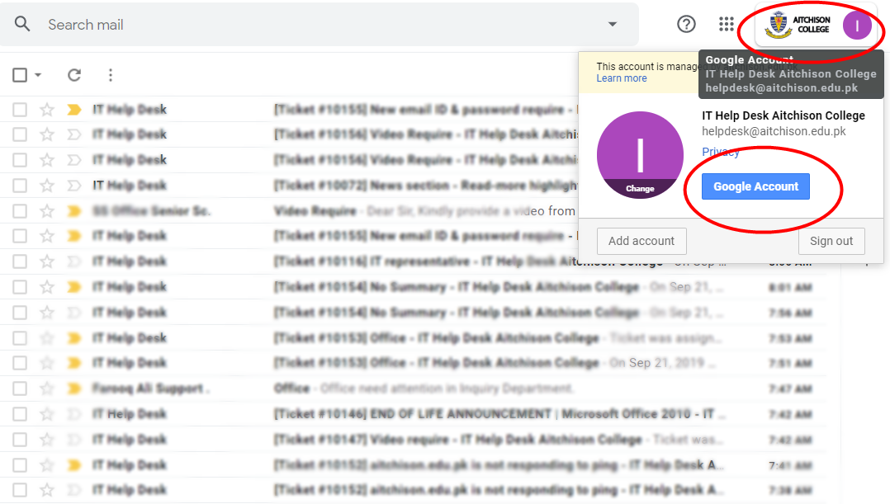
Step – 3. Click on Aitchison College or AC logo on top right side of your screen. Click on Google account.

Slide 6
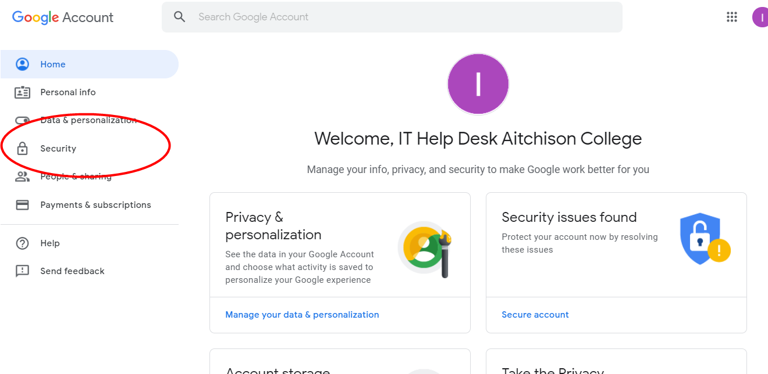
Step – 4. Click on security link on left side.

Slide 7
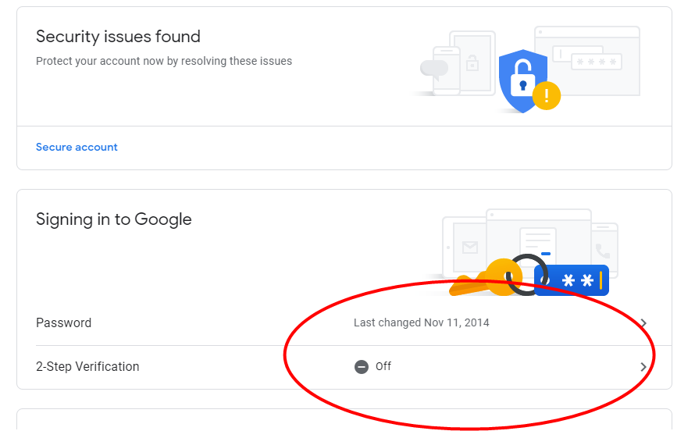
Step – 5 Turn on 2-Step Verification

Slide 8
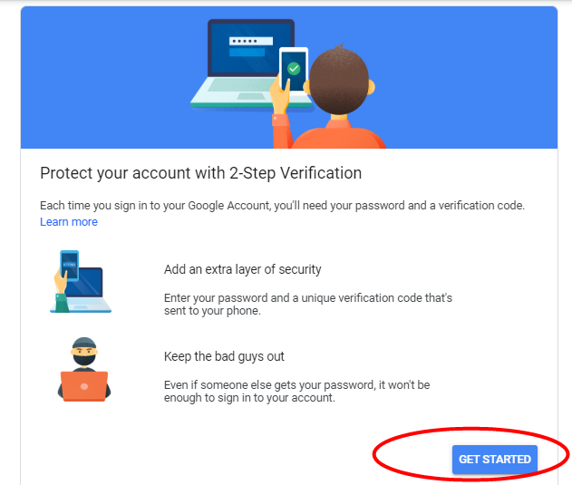
Step – 6 Click on GET STARTED

Slide 9
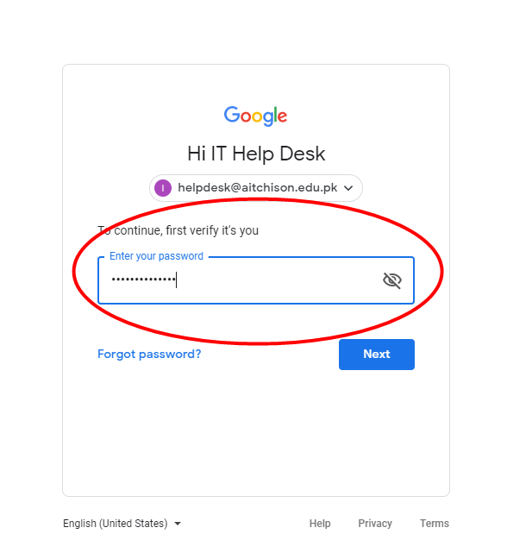
Step – 7 Enter your email password again.

Slide 10
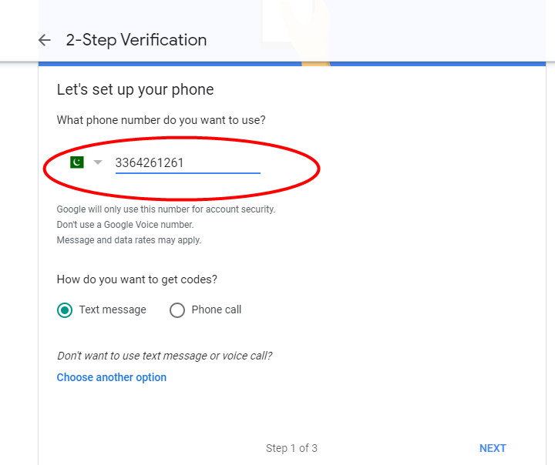
Step – 8 Enter your mobile number so that you could receive code and login information on your phone.

Slide 11
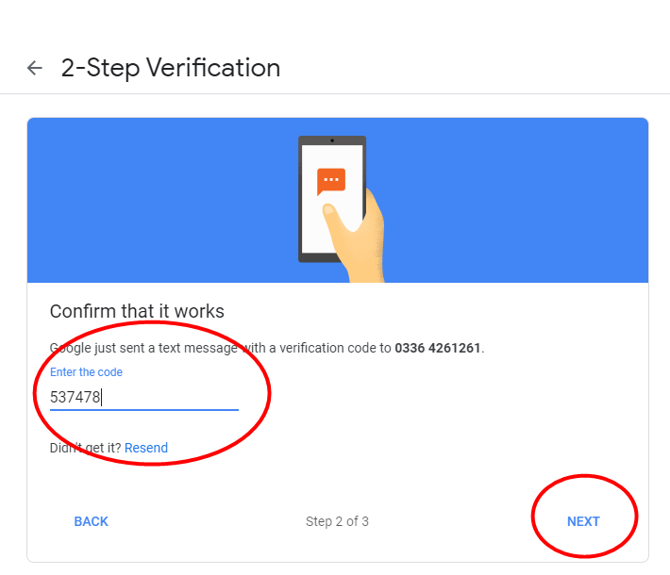
Step – 9 You will receive a code on your phone. Enter that code and click next.

Slide 12
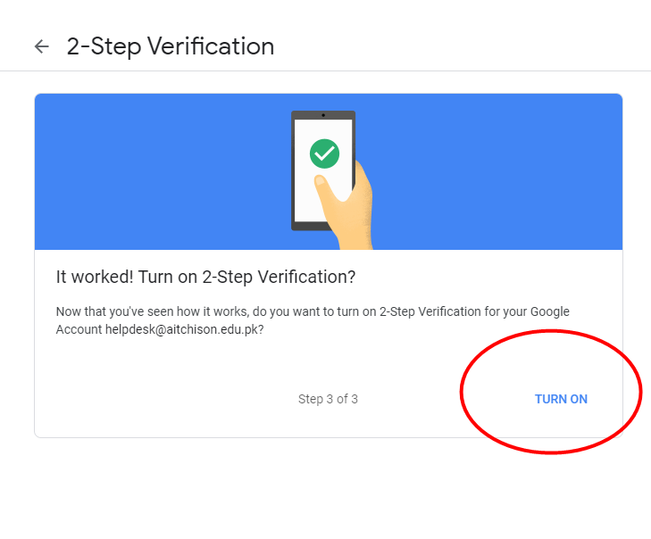
Step – 10 Click on “Turn On” button.

Slide 13
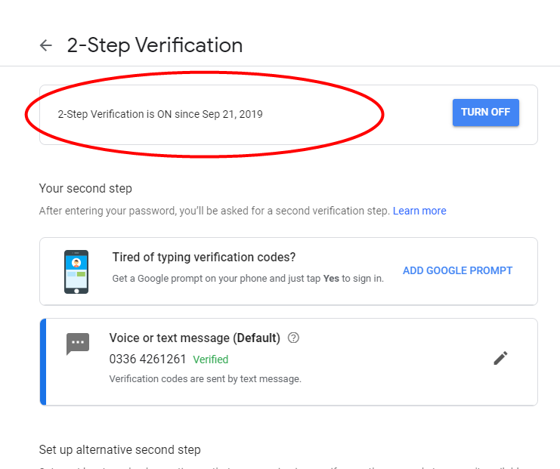
Step – 11 You will see a confirmation screen.

Slide 14
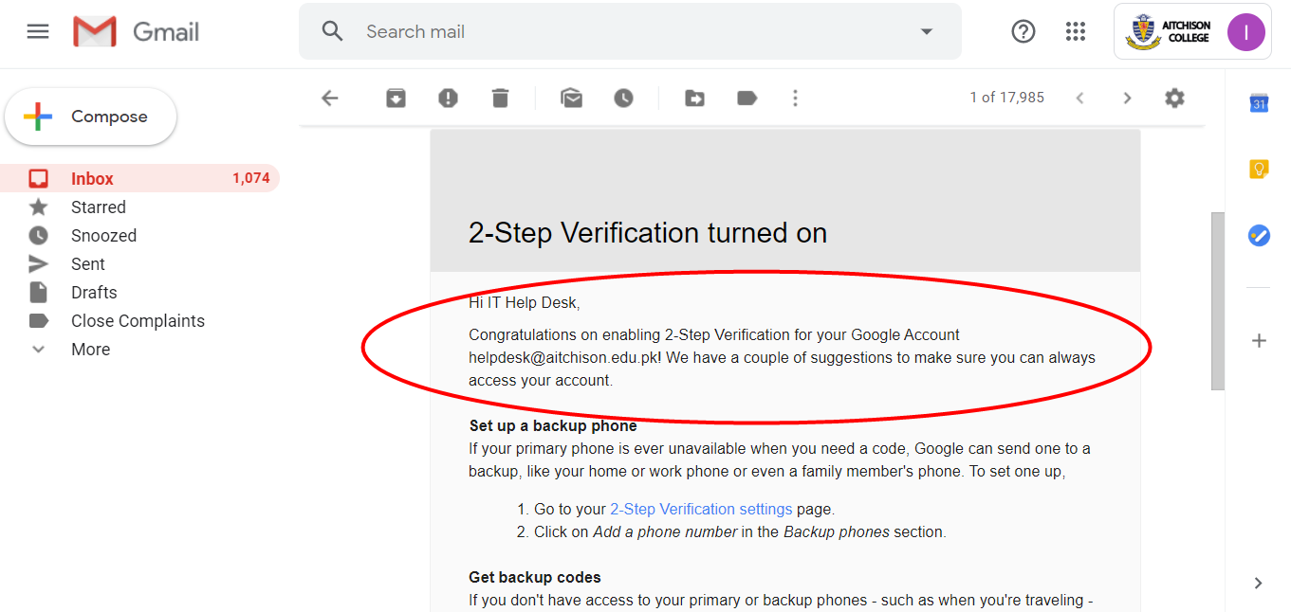
Finally, you will receive a confirmation email.

Slide 15

For technical assistance, please contact the IT Service Desk on ext. 261 or helpdesk@aitchison.edu.pk.
Thank you
IT Help Desk

