Slide 1
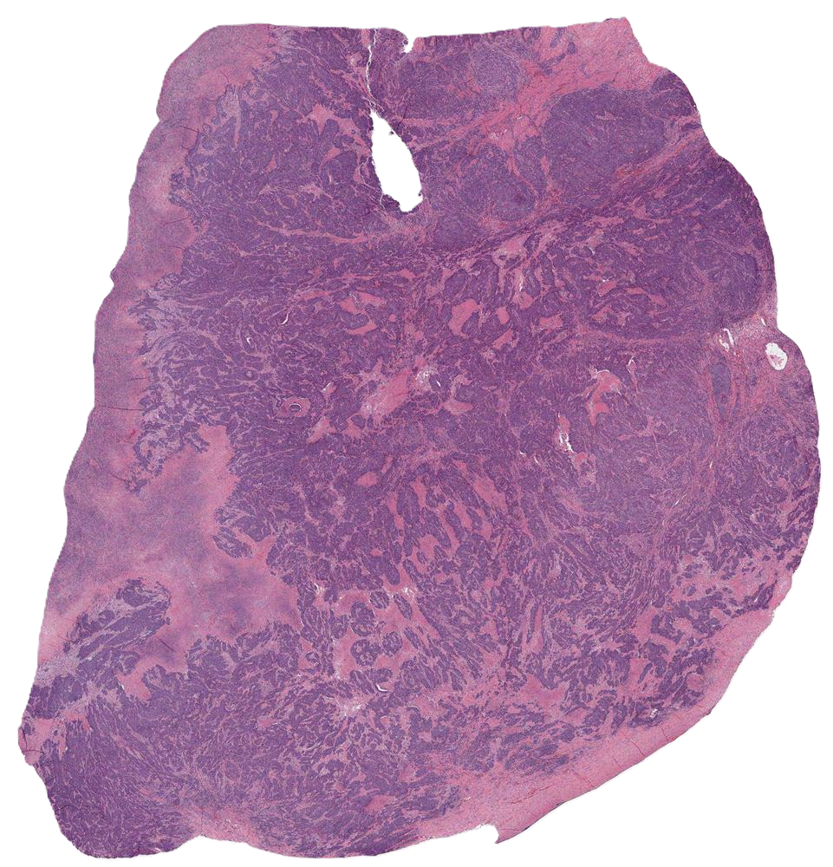



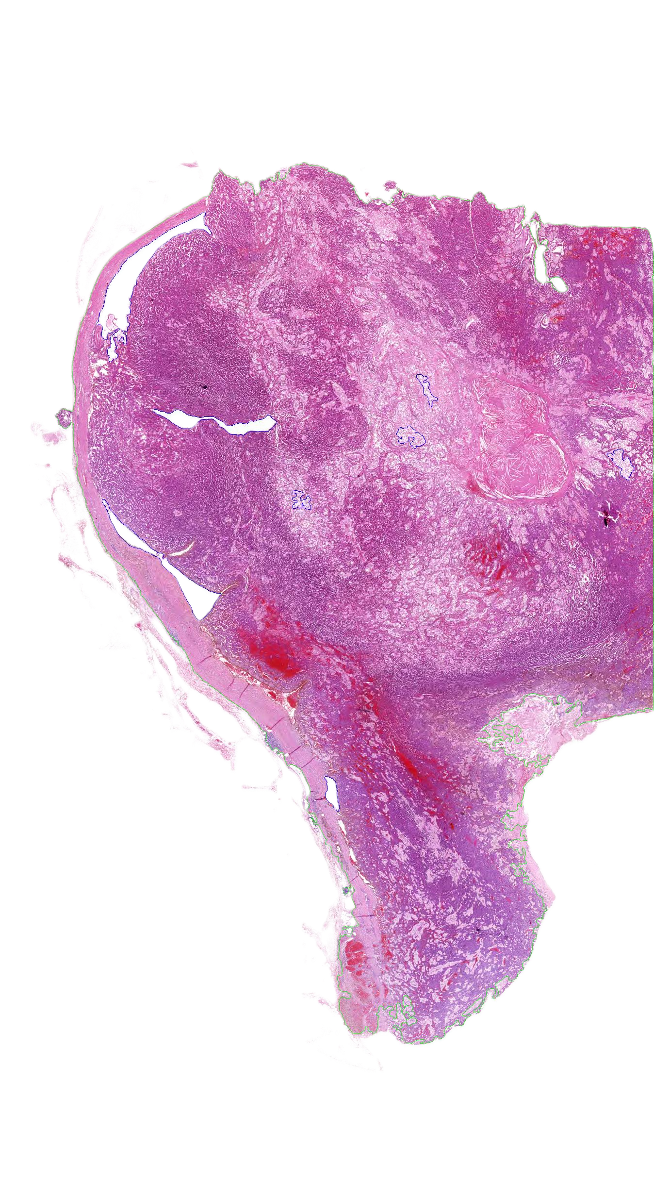
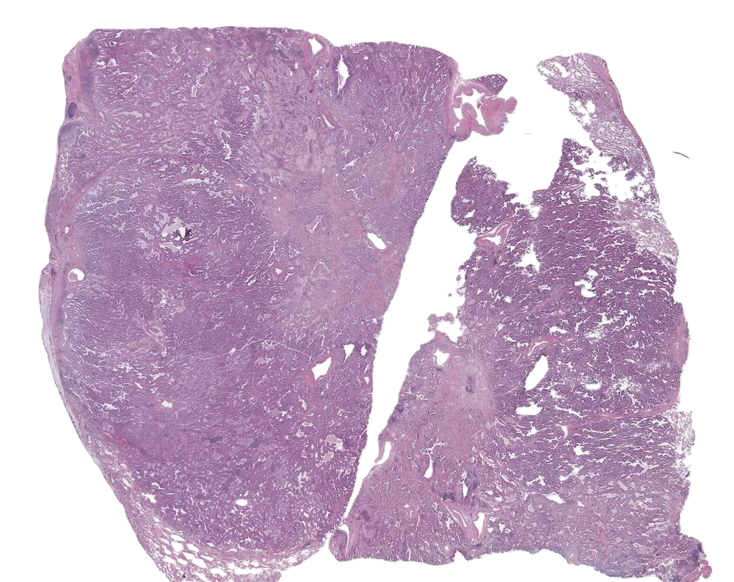
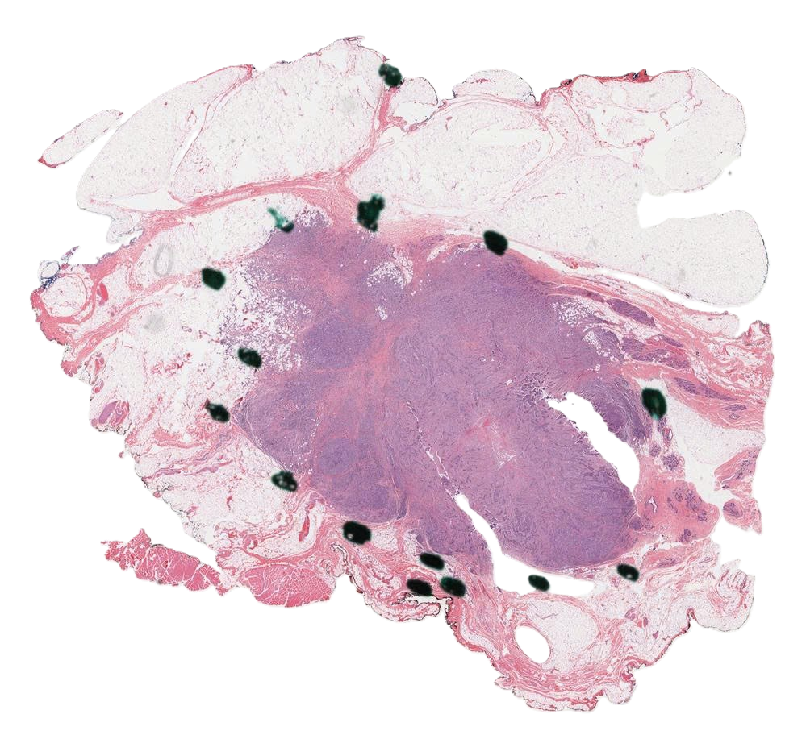
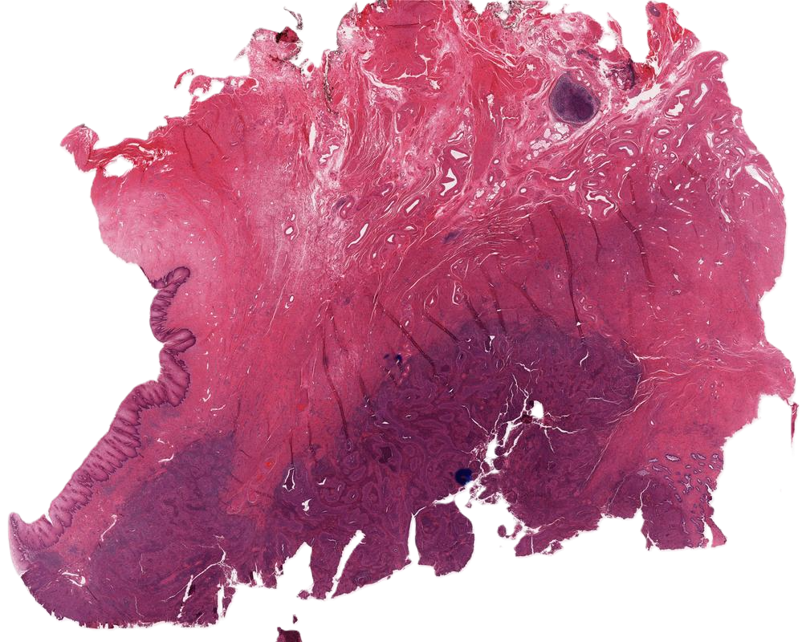
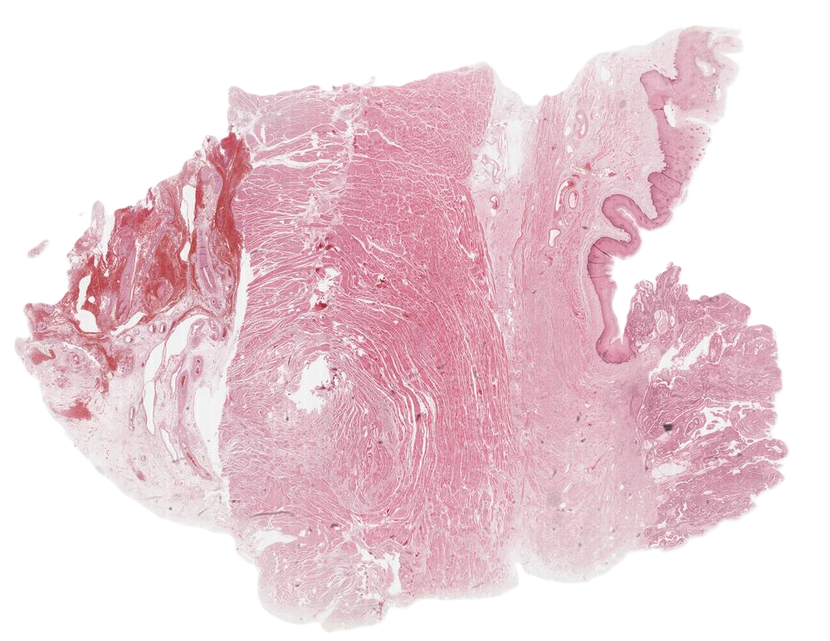




































































$$ℛ_{forget}$$
$${\tilde{θ}}_{1:t}$$
(2) Stabilized Drift-Controlled Adaptation
$$×n$$
$$X_{i}$$
…
$$θ_{e}$$
EMA
(1) Reliability-Gated Sub-bag Selection
$$ℒ_{task}$$
$$ℬ_{i}^{′}$$
(3) Confidence-Guided Post-Adaptation Inference
…
$${\tilde{θ}}_{1:t}≡$$
$$θ_{s}$$
$$Z_{i}$$
$$H_{i}^{𝒯}$$
$$ℒ_{AVST}$$
$${\hat{𝒴}}_{global}$$
…
…
$$y_{i}^{AVST}$$
…
True
$$μ_{i}>δ$$
False
Truth Task?
…
$$X_{i}$$
Anchor Confident?
No
Stop Grad
EMA
False
…
$$τ_{ent}$$
…
$$θ_{s}$$
EMA
$$θ_{e}$$
True
$$ℬ_{i}^{′}$$
…
$$Z_{i}$$
Verified Soft Target Construction
$$ℬ_{i}$$
$$ℒ_{class}$$
$$Z_{i}$$
…
…
$$𝒟_{1:t}^{test}$$
Selected Sub-bag
$$H_{i}^{𝒞}$$
$$ℬ_{i}$$
Augmented Sub-bags
Random Sampling
Task logits
$$\hat{𝒴}$$
…
Rejected Sub-bag
Continual Test-Time Adaptation – CAST-Slide Framework
Task-specific Fine-Tuning
Continual Model Merging
Task-Level Prompt
$$θ_{1}$$
$$θ_{2}$$
$$θ_{3}$$
…
$$θ_{t}$$
New information
$$E^{C,3}$$
$$E^{C,1}$$
$$E^{C,2}$$
…
$$E^{C,T}$$
$$θ_{base}$$
$$E^{C,1}$$
$$θ_{base}$$
$$E^{C,2}$$
$$θ_{base}$$
$$E^{C,3}$$
$$θ_{base}$$
$$E^{C,t}$$
Old information
…
$$λ_{T−1}$$
$$P^{C,1}$$
$$P^{C,2}$$
$$P^{C,3}$$
$$P^{C,t}$$
$$𝒢(∙)$$
$$𝒟_{1}^{train}$$
$$𝒟_{2}^{train}$$
$$𝒟_{3}^{train}$$
$$𝒟_{t}^{train}$$
$$SVD$$
Average
$$τ_{t}$$
$${\overset{˜}{τ}}_{1:t−1}$$
$$+$$
$${\tilde{θ}}_{1:t}$$
$$θ_{base}$$
$$λ_{T}$$
…
“a histopathological image showing invasive ductal carcinoma”
$$−$$
$$θ_{base}$$
$$−$$
$${\tilde{θ}}_{1:t−1}$$
$$E^{𝒯,1}$$
$$E^{𝒯,2}$$
$$E^{𝒯,3}$$
$$E^{𝒯,t}$$
“a histopathological image showing invasive lobular carcinoma”
MLP-free Task-specific Fine-Tuning and Continual Model Merging
Task-level Prompt Embedding
Class-aware Prompt Embedding
Class-aware Prompt
Text encoder
Layer Normalization
Trainable
Frozen

