Slide 1
Forecasting Water Levels in Hydropower Reservoirs
CS336 – Data Mining and Application
Group 10

Slide 2
Task Assignment Table
Student ID – Name | Task | Contribution
23521440 – Huynh Nhat Thanh | Collected hydropower data sources. Performed EDA, preprocessing, and feature engineering on both datasets (hydropower and weather). Prepared presentation slides | 30%
23521441 – Le Duc Thanh | Crawled hydropower data. Conducted EDA, preprocessing, and feature engineering for hydropower data. Evaluated three models: CNN+LSTM, XGBoost, and Decision Tree. Developed the web demo with calculating the predicted results on those three models and EDA. Prepared presentation slides | 30%
23521443 – Le Ngoc Thanh | Collected and crawled weather data. Performed preprocessing for weather data. Evaluated the CNN+LSTM model. Prepared presentation slides | 25%
23521454 – Nguyen Tien Thanh | Collected and crawled weather data. Evaluated the XGBoost model. Developed the web demo with calculating the predicted results on XGBoost model. Prepared presentation slides | 15%

Slide 3
Table of contents
Introduction
Data Engineering
01
04
EDA
02
Preprocessing
03
Modeling
05
DEMO
06

Slide 4
Introduction
01

Slide 5
Introduction
Forecasting hydropower reservoir water levels is vital for efficient power generation, dam safety, and sustainable water management.
It helps operators plan electricity production, prevent flooding, and ensure reliable energy supply.

Slide 6
Introduction
The Hoa Binh Hydropower Plant, located on the Da River in northern Vietnam, is one of the country’s largest and most important hydroelectric facilities. Built with support from the former Soviet Union and completed in 1994, it has a total capacity of 1,920 MW. The reservoir plays a crucial role in electricity generation, flood control, and water regulation for the Red River Delta.

Slide 7
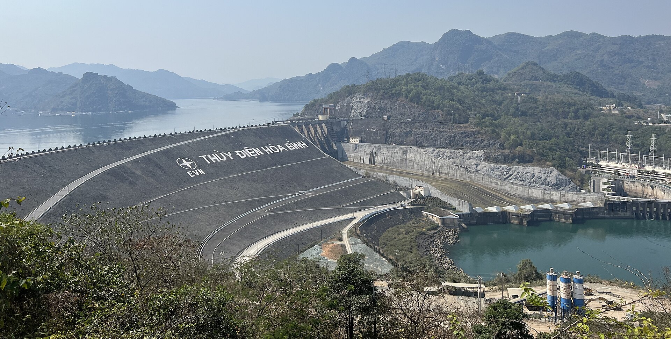
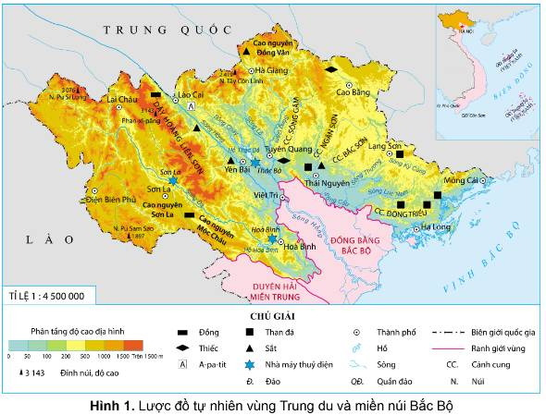
Introduction
Image of Hoa Binh Hydropower Dam
Geographical Location

Slide 8

Introduction
The water level data of the Hoa Binh Hydropower Dam: were collected from the official website of Vietnam Electricity (EVN) https://hochuathuydien.evn.com.vn/PageHoChuaThuyDienEmbedEVN.aspx

Slide 9

Introduction
The weather data: were obtained from the Open-Meteo include variables such as temperature, precipitation, humidity, and wind speed, which are used to support hydropower reservoir forecasting https://open-meteo.com/en/docs/historical-weather-api

Slide 10
Introduction
Input: Target time to be predicted and Upstream water level, inflow to the reservoir, and weather data from the previous 28 days
Output: Predicted water level at the target time
Target time
Predicted water level at the target time
Model
Dam and weather data from the previous 28 days

Slide 11
EDA
02

Slide 12
Contents of The weather data
Time | Date and time, representing the timestamp of each recorded observation.
precipitation_(mm) | Total amount of rainfall measured in millimeters during each hour.
temperature_2m_(°C) | Air temperature measured at 2 meters above the ground (°C).
relative_humidity_2m_(%) | Relative humidity (%) at 2 meters above the ground.
cloud_cover_(%) | Percentage of the sky covered by clouds (%).

Slide 13
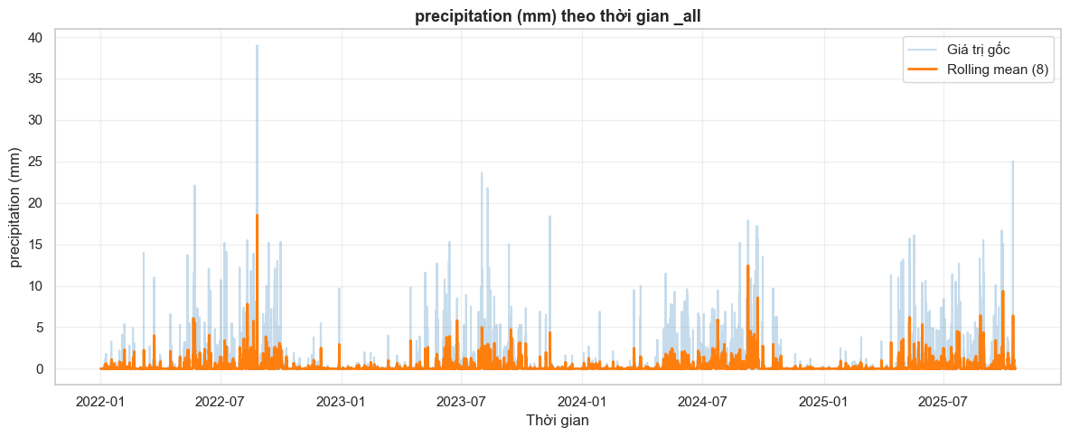
EDA

Slide 14
EDA

Slide 15
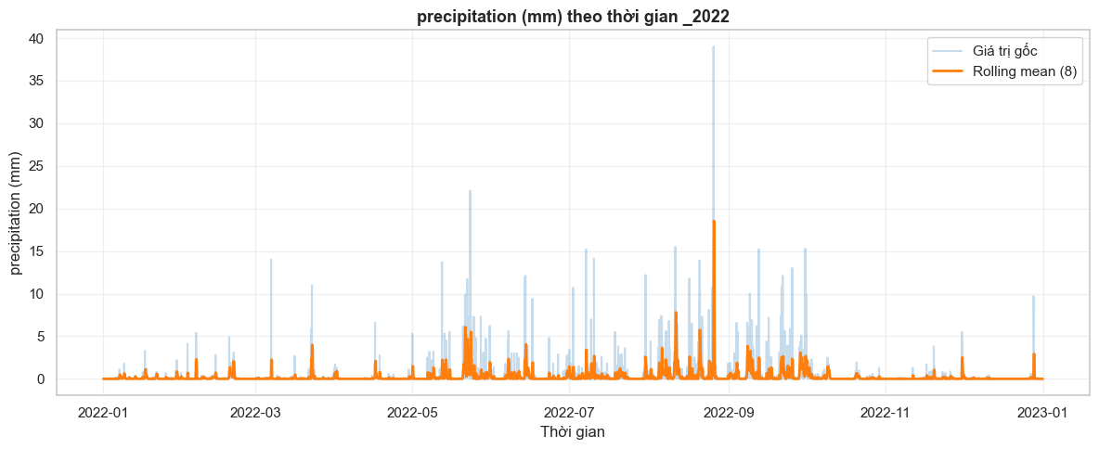
EDA

Slide 16
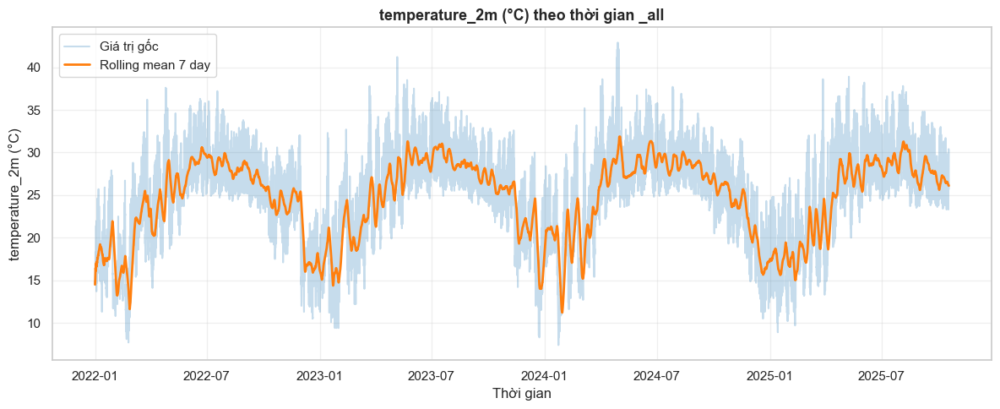
EDA

Slide 17
EDA

Slide 18
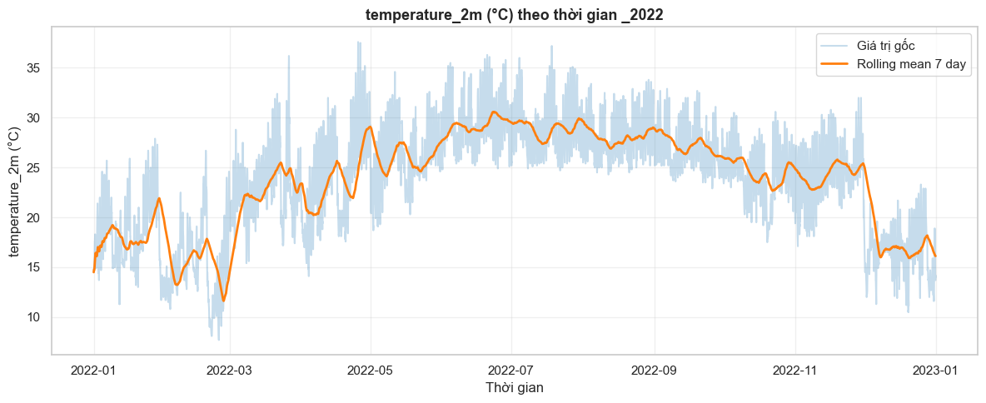
EDA

Slide 19
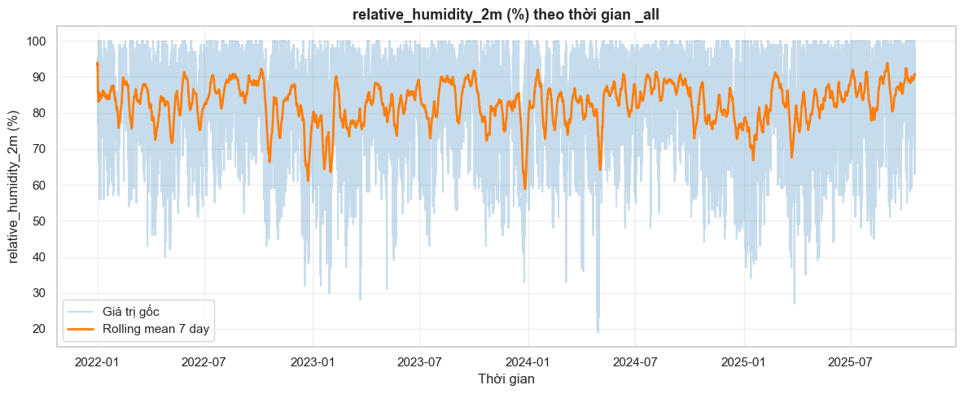
EDA

Slide 20
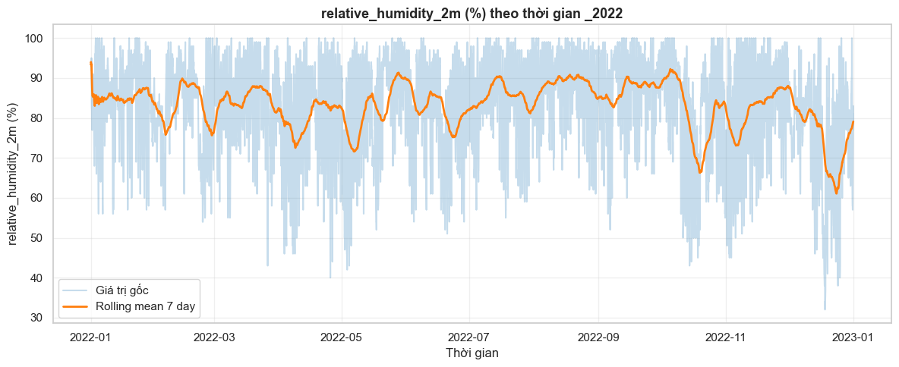
EDA

Slide 21
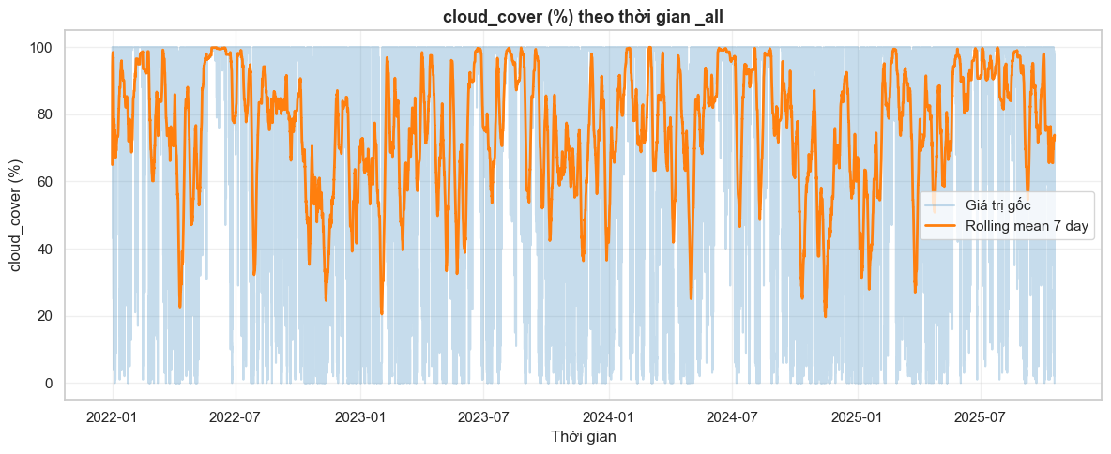
EDA

Slide 22
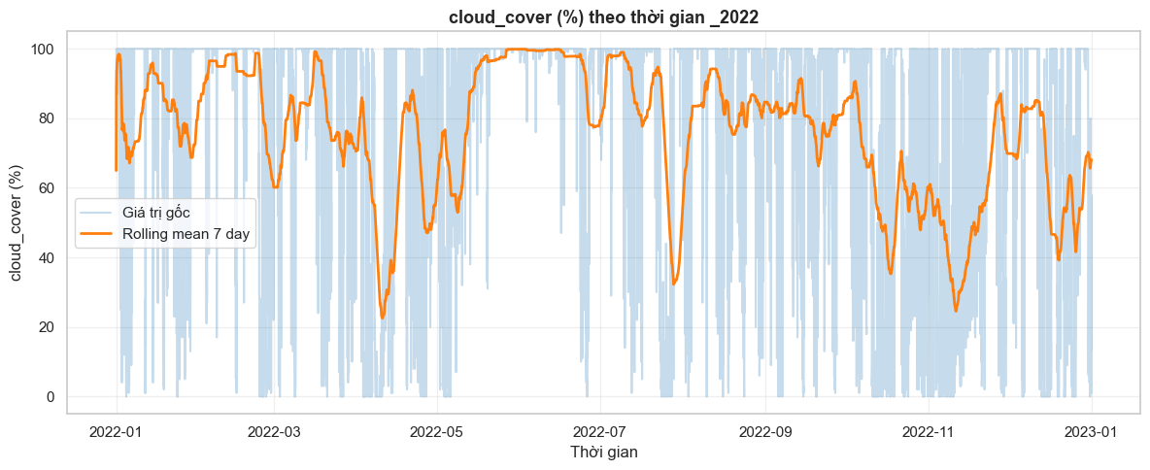
EDA

Slide 23
Contents of The Hoa Binh’s Dam data
thoi_diem | Timeline of hydroelectric reservoir operation data recording
muc_nuoc_thuong_luu_m | Indicates the current condition of the reservoir
muc_nuoc_dang_binh_thuong_m | Upper limit during normal operation
muc_nuoc_chet_m | Lowest exploitable level of the reservoir
luu_luong_den_ho_m3_s | Volume of water entering the reservoir
tong_luong_xa_m3_s | Total water released through all outlets
tong_luong_xa_qua_dap_tran_m3_s | Flood release; does not generate electricity
tong_luong_xa_qua_nha_may_m3_s | Used for electricity generation
so_cua_xa_sau | Releases water from the bottom of the dam
so_cua_xa_mat | Releases water from the surface of the reservoir

Slide 24
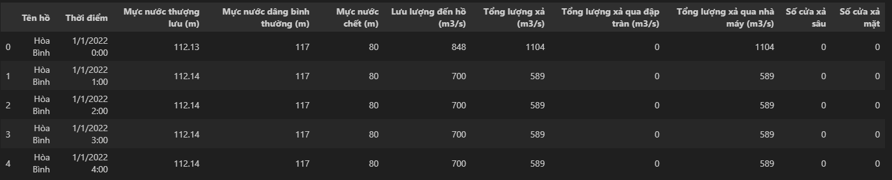
EDA

Slide 25
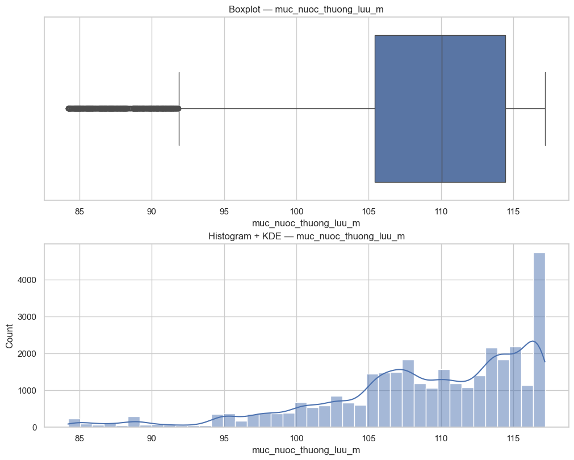
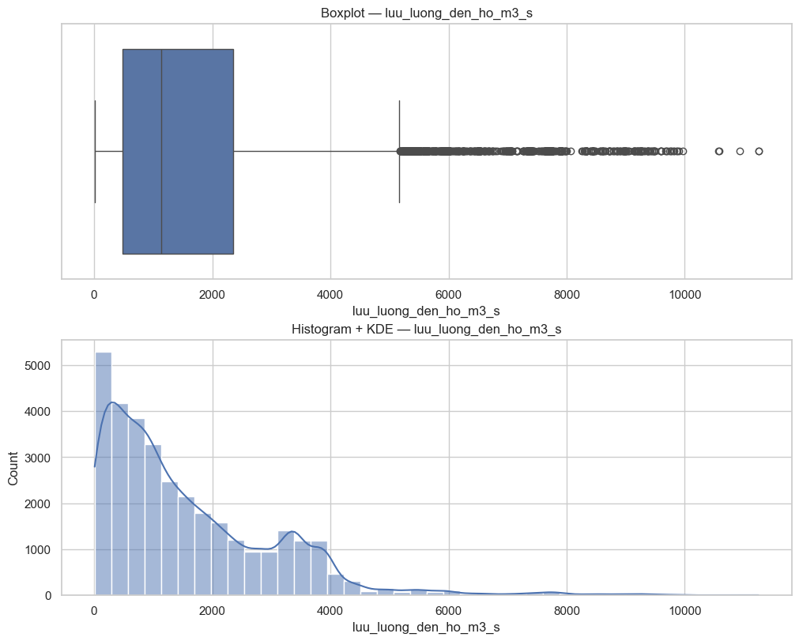
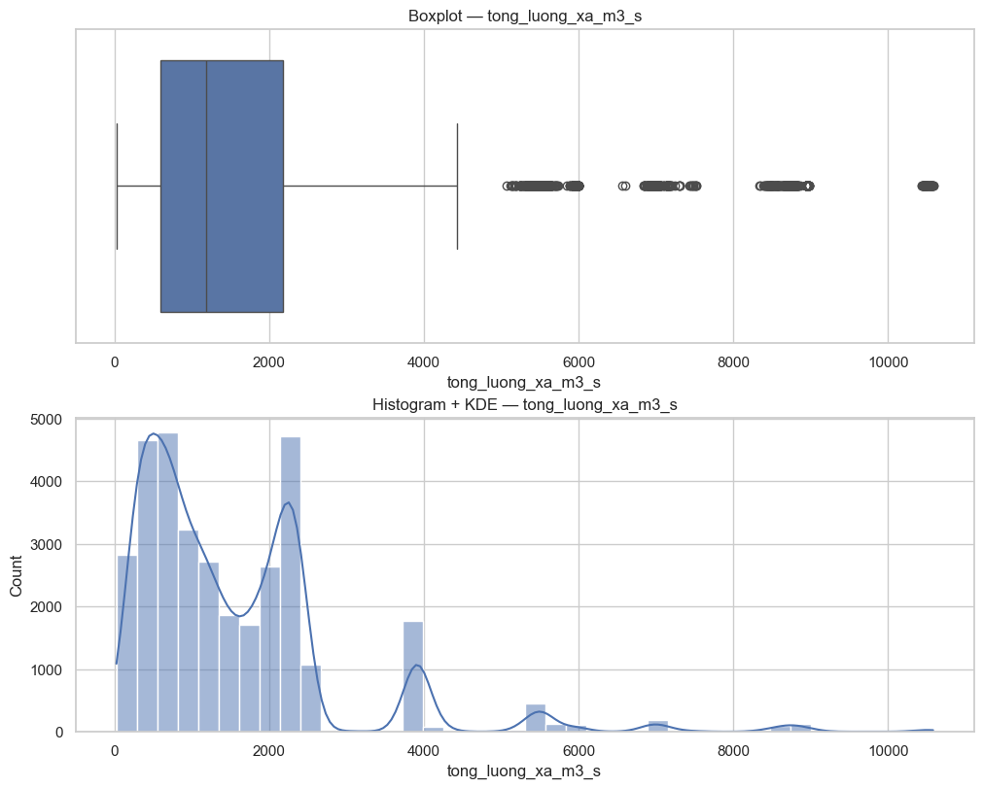
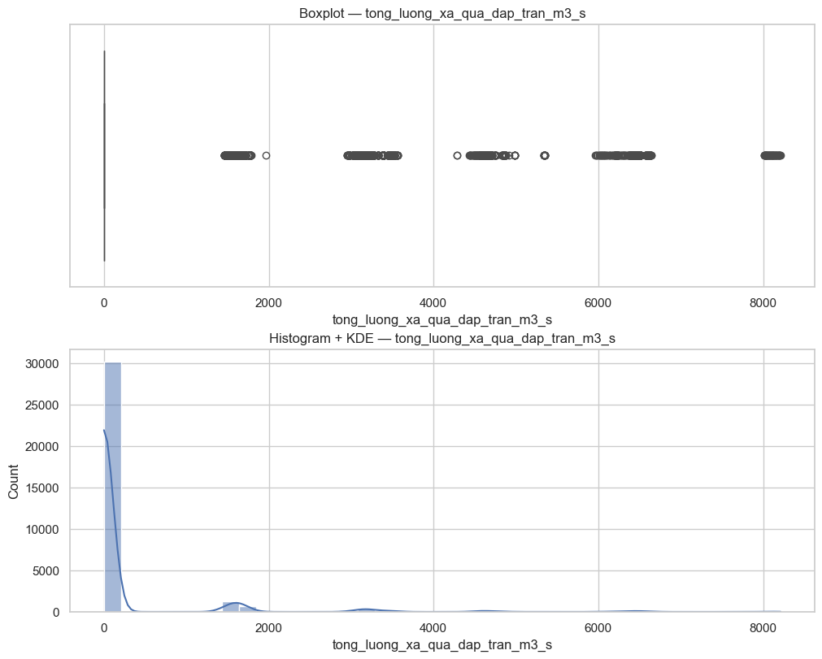
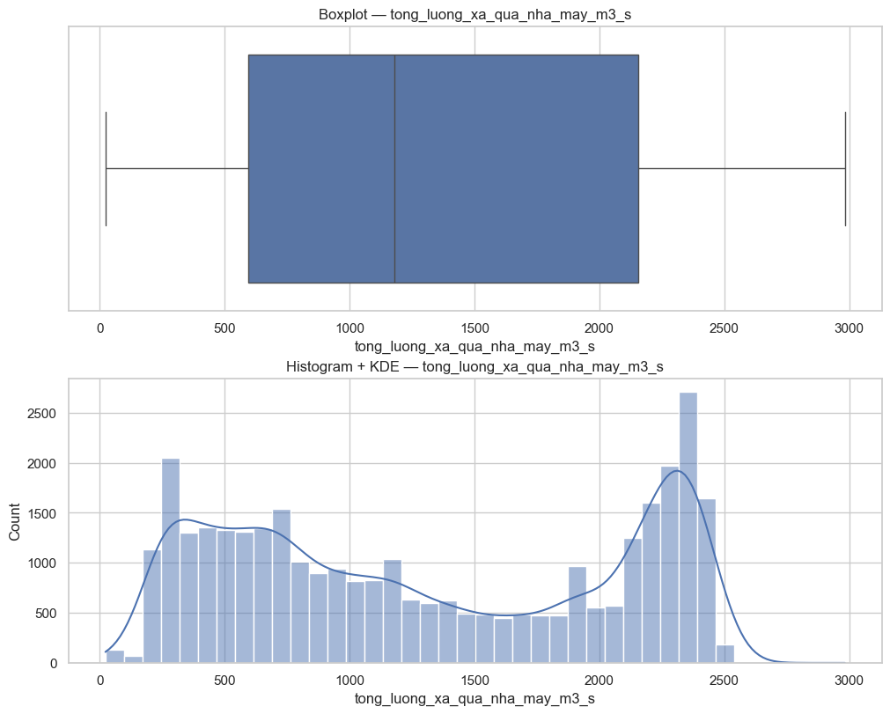
EDA

Slide 26
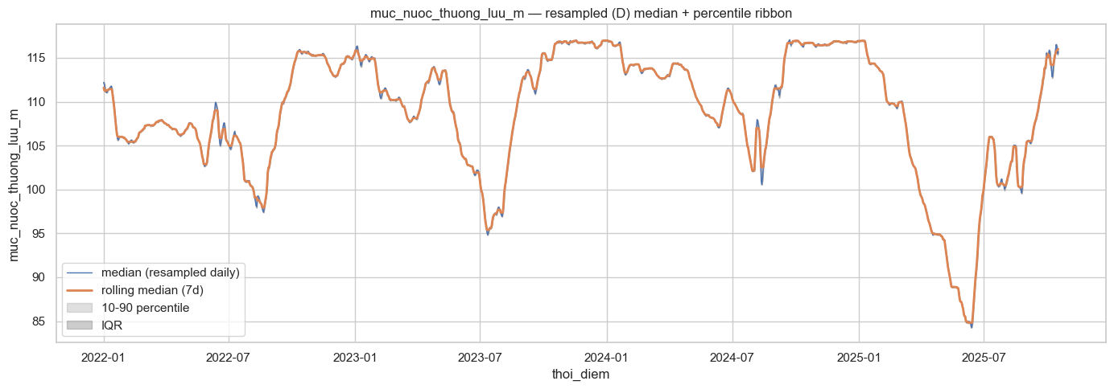
EDA
muc_nuoc_thuong_luu_m

Slide 27
EDA
muc_nuoc_thuong_luu_m

Slide 28
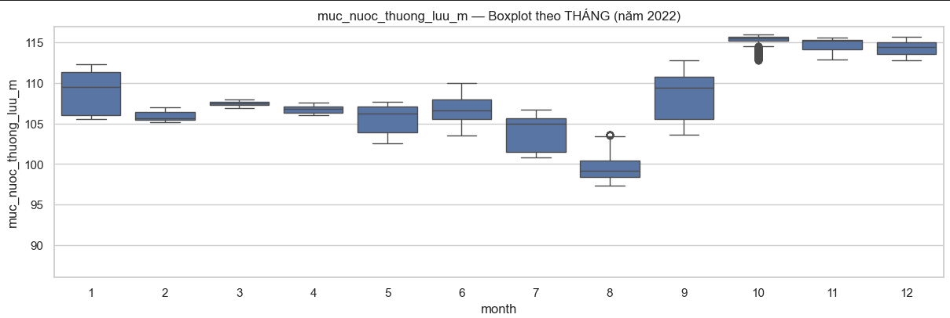
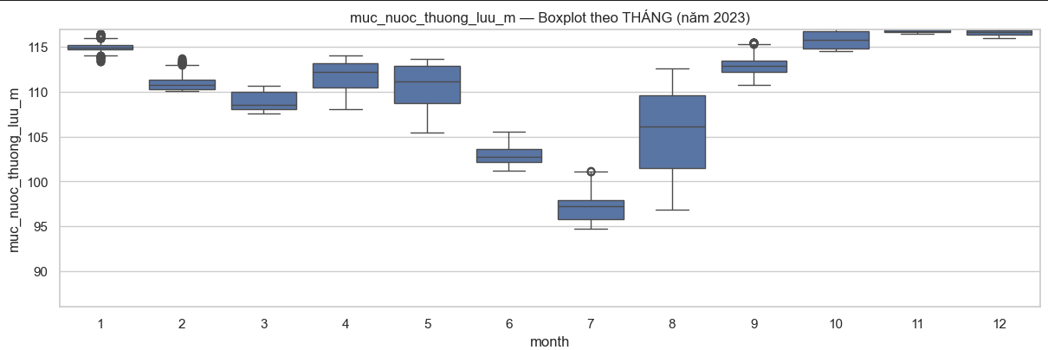
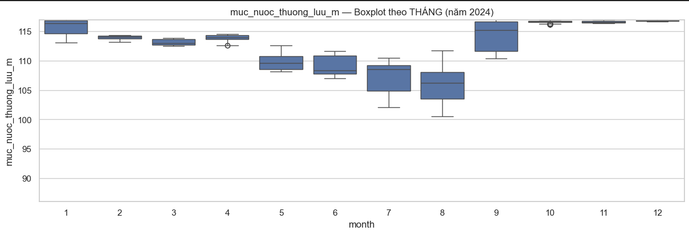
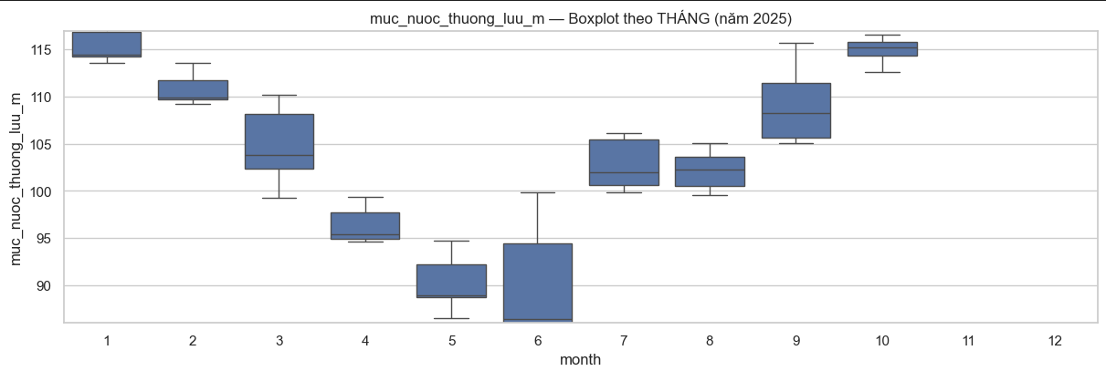
EDA
muc_nuoc_thuong_luu_m

Slide 29
EDA
muc_nuoc_thuong_luu_m

Slide 30
EDA
muc_nuoc_thuong_luu_m

Slide 31
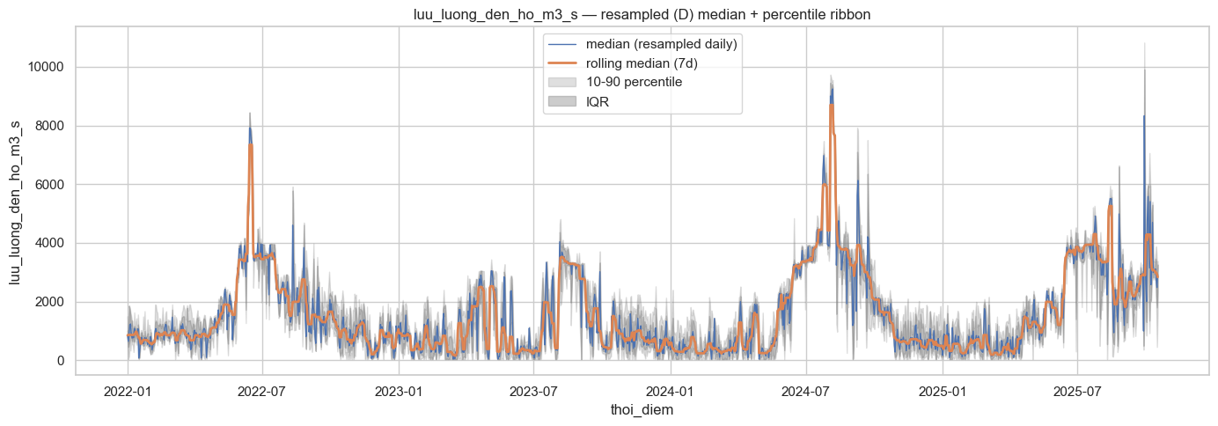
EDA
luu_luong_den_ho_m3_s

Slide 32
EDA
luu_luong_den_ho_m3_s

Slide 33
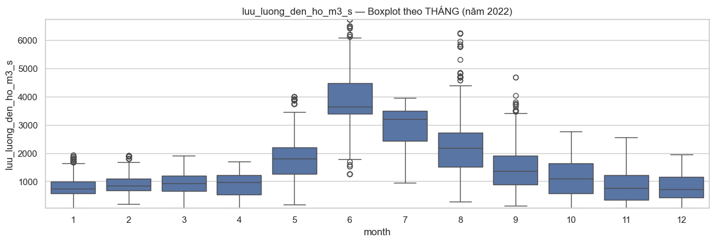
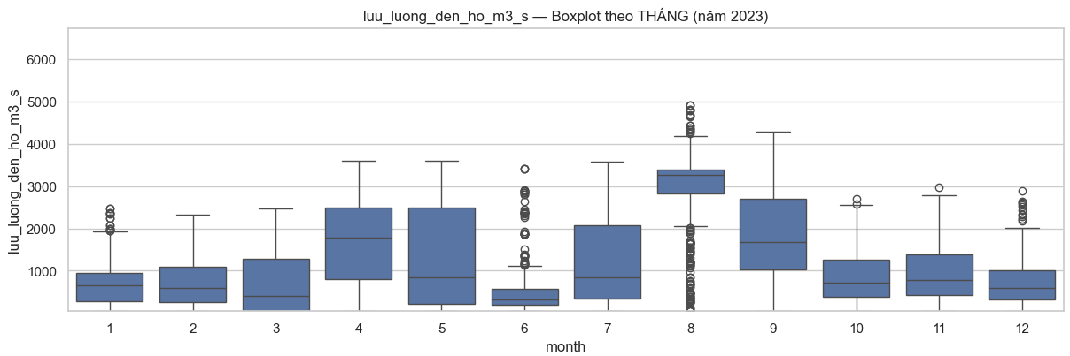
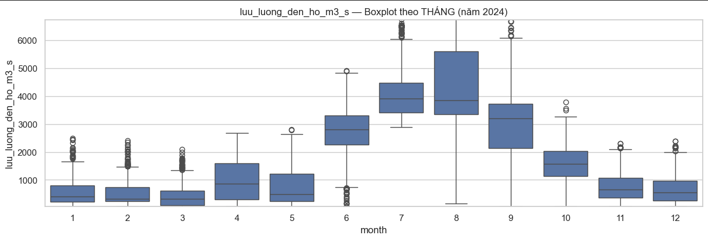
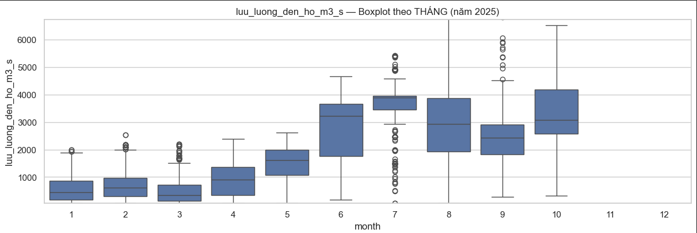
EDA
luu_luong_den_ho_m3_s

Slide 34
EDA
luu_luong_den_ho_m3_s

Slide 35
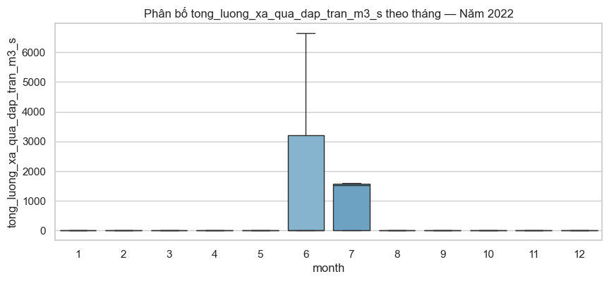
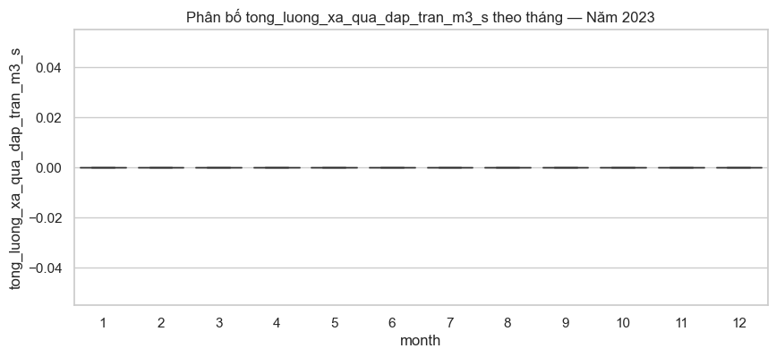
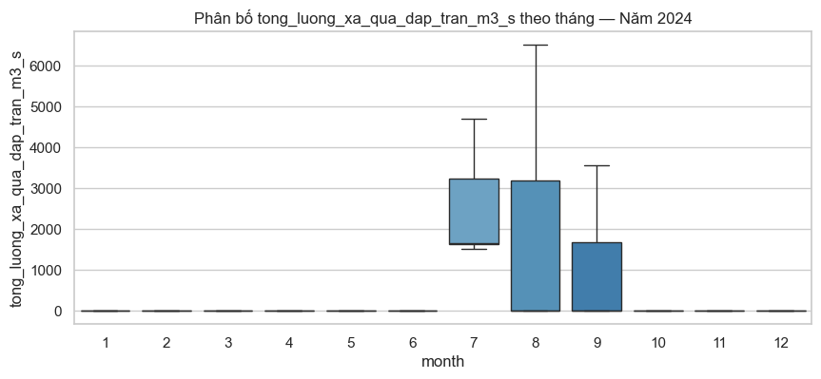
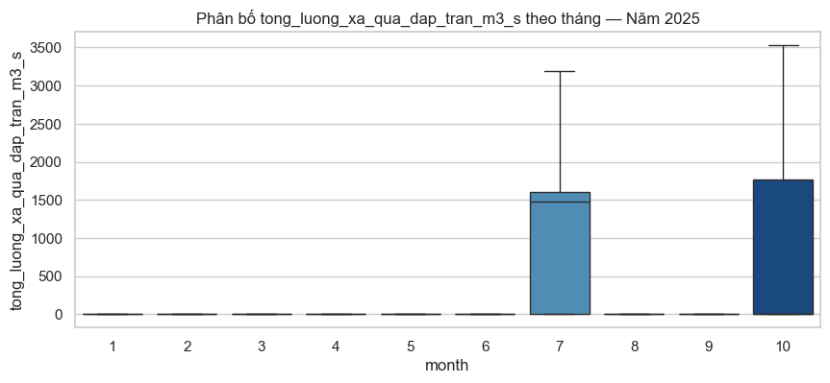
EDA
tong_luong_xa_qua_dap_tran_m3_s

Slide 36
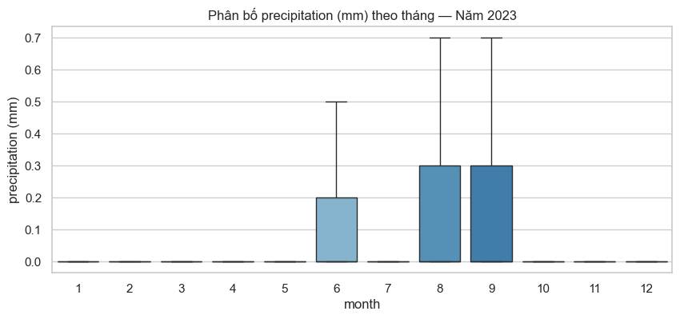
EDA

Slide 37
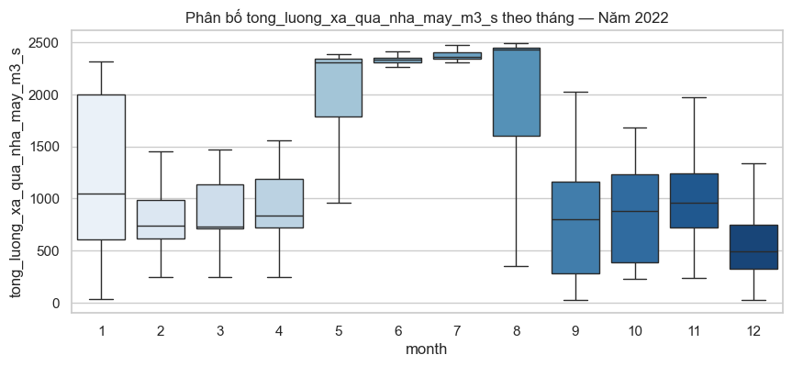
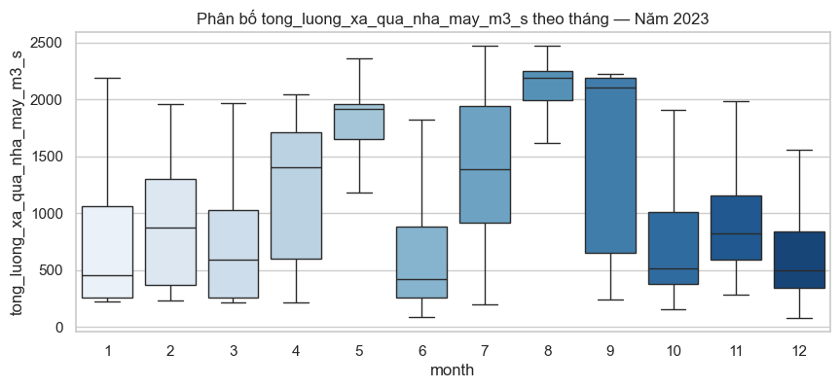
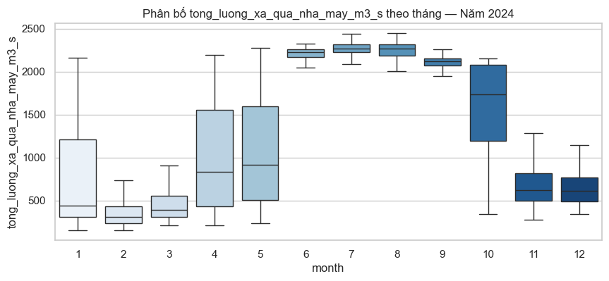
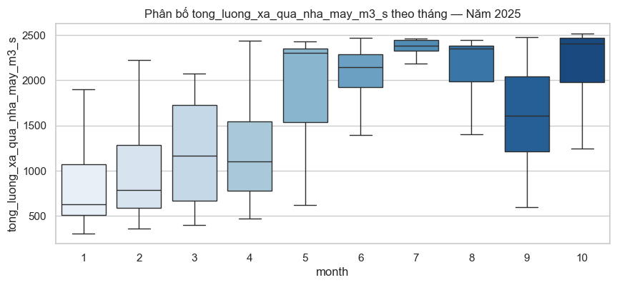
EDA
tong_luong_xa_qua_nha_may_m3_s

Slide 38
Preprocessing
03

Slide 39
Contents of The Hoa Binh’s Dam data
thoi_diem | Timeline of hydroelectric reservoir operation data recording
muc_nuoc_thuong_luu_m | Indicates the current condition of the reservoir
muc_nuoc_dang_binh_thuong_m | Upper limit during normal operation
muc_nuoc_chet_m | Lowest exploitable level of the reservoir
luu_luong_den_ho_m3_s | Volume of water entering the reservoir
tong_luong_xa_m3_s | Total water released through all outlets
tong_luong_xa_qua_dap_tran_m3_s | Flood release; does not generate electricity
tong_luong_xa_qua_nha_may_m3_s | Used for electricity generation
so_cua_xa_sau | Releases water from the bottom of the dam
so_cua_xa_mat | Releases water from the surface of the reservoir

Slide 40
Contents of The Hoa Binh’s Dam data
thoi_diem | Timeline of hydroelectric reservoir operation data recording
muc_nuoc_thuong_luu_m | Indicates the current condition of the reservoir
muc_nuoc_dang_binh_thuong_m | Upper limit during normal operation
muc_nuoc_chet_m | Lowest exploitable level of the reservoir
luu_luong_den_ho_m3_s | Volume of water entering the reservoir
tong_luong_xa_m3_s | Total water released through all outlets
tong_luong_xa_qua_dap_tran_m3_s | Flood release; does not generate electricity
tong_luong_xa_qua_nha_may_m3_s | Used for electricity generation
so_cua_xa_sau | Releases water from the bottom of the dam
so_cua_xa_mat | Releases water from the surface of the reservoir

Slide 41
Preprocessing
thoi_diem | Timeline of hydroelectric reservoir operation data recording
muc_nuoc_thuong_luu_m | Indicates the current condition of the reservoir
luu_luong_den_ho_m3_s | Volume of water entering the reservoir
tong_luong_xa_qua_dap_tran_m3_s | Flood release; does not generate electricity
tong_luong_xa_qua_nha_may_m3_s | Used for electricity generation

Slide 42
Preprocessing
thoi_diem | Timeline of hydroelectric reservoir operation data recording
muc_nuoc_thuong_luu_m | Indicates the current condition of the reservoir
luu_luong_den_ho_m3_s | Volume of water entering the reservoir
tong_luong_xa_qua_dap_tran_m3_s | Flood release; does not generate electricity
tong_luong_xa_qua_nha_may_m3_s | Used for electricity generation

Slide 43
Preprocessing
muc_nuoc_thuong_luu_m

Slide 44
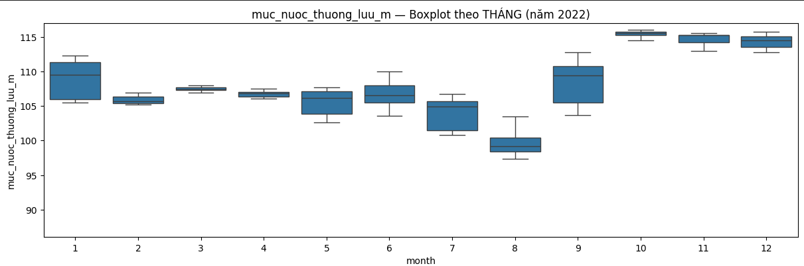
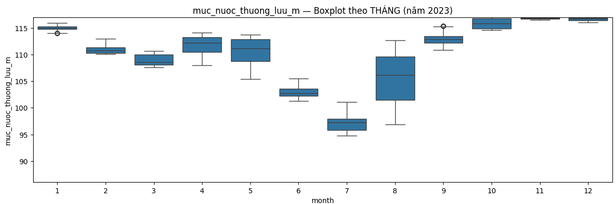
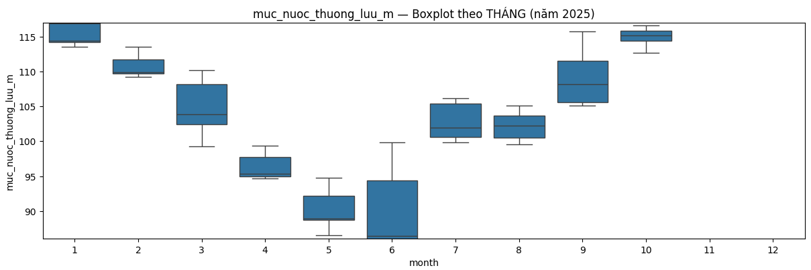
Preprocessing
muc_nuoc_thuong_luu_m - preprocessed

Slide 45
Preprocessing
thoi_diem | Timeline of hydroelectric reservoir operation data recording
muc_nuoc_thuong_luu_m | Indicates the current condition of the reservoir
luu_luong_den_ho_m3_s | Volume of water entering the reservoir
tong_luong_xa_qua_dap_tran_m3_s | Flood release; does not generate electricity
tong_luong_xa_qua_nha_may_m3_s | Used for electricity generation

Slide 46
Preprocessing
thoi_diem | Timeline of hydroelectric reservoir operation data recording
muc_nuoc_thuong_luu_m | Indicates the current condition of the reservoir
luu_luong_den_ho_m3_s | Volume of water entering the reservoir
tong_luong_xa_qua_dap_tran_m3_s | Flood release; does not generate electricity
tong_luong_xa_qua_nha_may_m3_s | Used for electricity generation
Processed in parallel during the data engineering step

Slide 47
Preprocessing
luu_luong_den_ho_m3_s

Slide 48
Preprocessing
luu_luong_den_ho_m3_s

Slide 49
Preprocessing
Is_event_month
luu_luong_den_ho_m3_s

Slide 50
Preprocessing
Is_event_month = 0
Is_event_month = 1
luu_luong_den_ho_m3_s

Slide 51
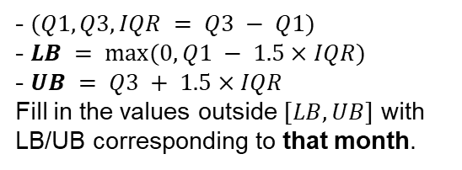
Preprocessing
Is_event_month = 0
Is_event_month = 1
- $(Q1, Q3, IQR = Q3 − Q1)$
- $LB = max⁡(0, Q1 − 1.5×IQR)$
- $UB = Q3 + 1.5×IQR$
Fill in the values ​​outside $[LB, UB]$ with LB/UB corresponding to that month.
luu_luong_den_ho_m3_s

Slide 52
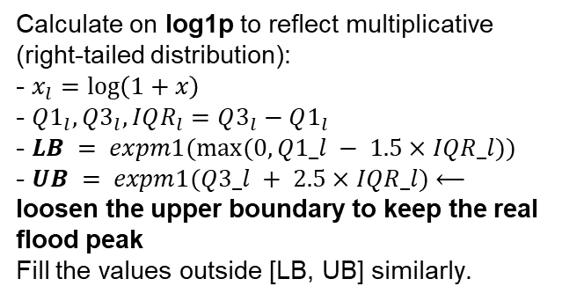
Preprocessing
Is_event_month = 0
Is_event_month = 1
- $(Q1, Q3, IQR = Q3 − Q1)$
- $LB = max⁡(0, Q1 − 1.5×IQR)$
- $UB = Q3 + 1.5×IQR$
Fill in the values ​​outside $[LB, UB]$ with LB/UB corresponding to that month.
Calculate on log1p to reflect multiplicative (right-tailed distribution):
- $x_{l}=log\left(1+x\right)$
- $Q1_{l},Q3_{l},IQR_{l}=Q3_{l}−Q1_{l}$
- $LB = expm1(max⁡(0, Q1_l − 1.5×IQR_l))$
- $UB = expm1(Q3_l + 2.5×IQR_l)$⟵ loosen the upper boundary to keep the real flood peak
Fill the values ​​outside [LB, UB] similarly.
luu_luong_den_ho_m3_s

Slide 53
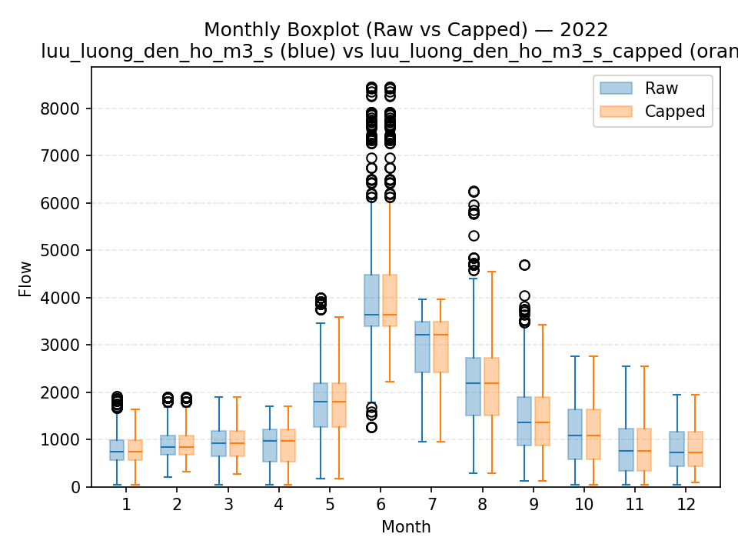
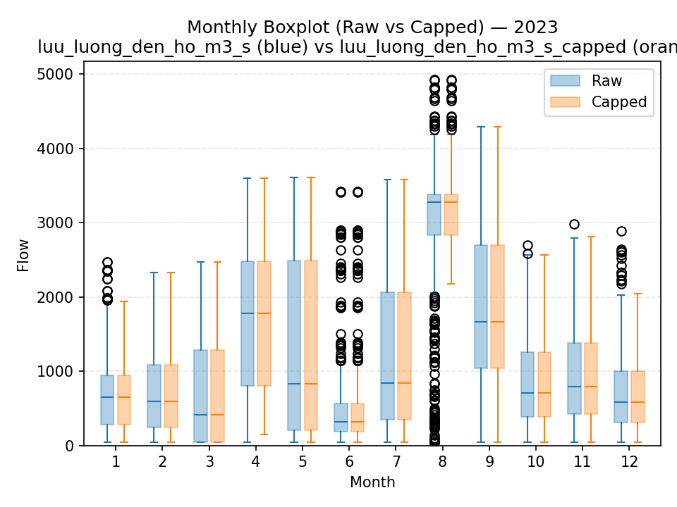
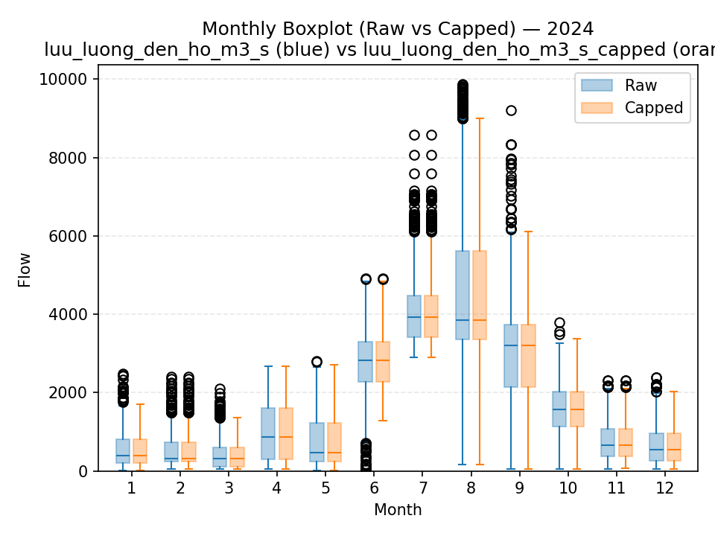
Preprocessing

Slide 54
Preprocessing
thoi_diem | Timeline of hydroelectric reservoir operation data recording
muc_nuoc_thuong_luu_m | Indicates the current condition of the reservoir
luu_luong_den_ho_m3_s | Volume of water entering the reservoir
tong_luong_xa_qua_dap_tran_m3_s | Flood release; does not generate electricity
tong_luong_xa_qua_nha_may_m3_s | Used for electricity generation

Slide 55
Preprocessing
thoi_diem | Timeline of hydroelectric reservoir operation data recording
muc_nuoc_thuong_luu_m | Indicates the current condition of the reservoir
luu_luong_den_ho_m3_s | Volume of water entering the reservoir
tong_luong_xa_qua_dap_tran_m3_s | Flood release; does not generate electricity
tong_luong_xa_qua_nha_may_m3_s | Used for electricity generation

Slide 56
Preprocessing
thoi_diem | Timeline of hydroelectric reservoir operation data recording
muc_nuoc_thuong_luu_m | Indicates the current condition of the reservoir
luu_luong_den_ho_m3_s | Volume of water entering the reservoir
tong_luong_xa_qua_dap_tran_m3_s | Flood release; does not generate electricity
tong_luong_xa_qua_nha_may_m3_s | Used for electricity generation

Slide 57
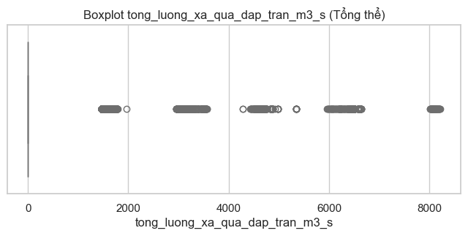
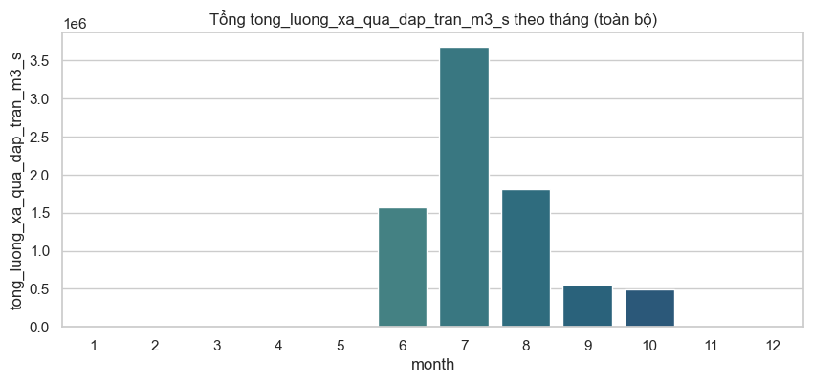
Preprocessing

Slide 58
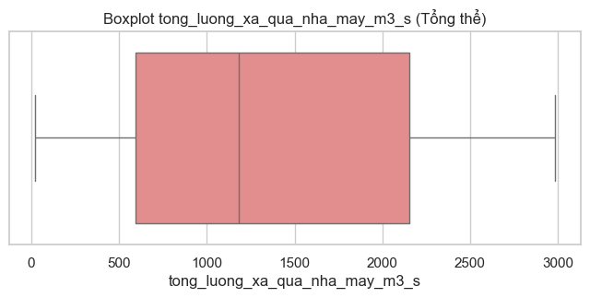
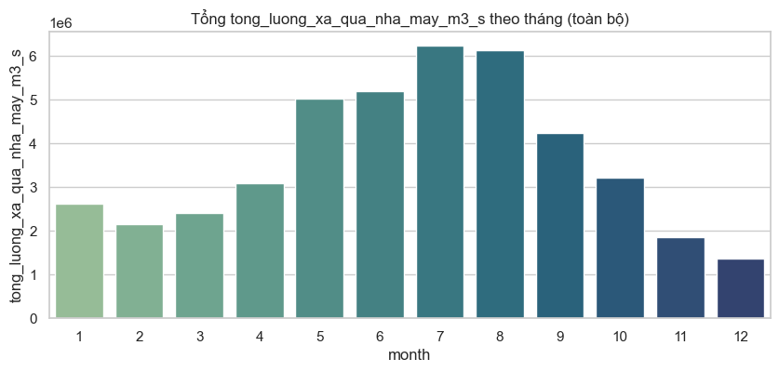
Preprocessing

Slide 59
Preprocessing
thoi_diem | Timeline of hydroelectric reservoir operation data recording
muc_nuoc_thuong_luu_m | Indicates the current condition of the reservoir
luu_luong_den_ho_m3_s | Volume of water entering the reservoir
dap_tran_norm | Normalized spillway discharge (0–1), calculated by dividing the actual discharge by the maximum value.
dap_tran_max | Maximum discharge capacity of the spillway (m³/s).
nha_may_norm | Normalized turbine discharge (0–1), calculated by dividing the actual discharge by the maximum value.
nha_may_max | Maximum discharge through the power plant turbines (m³/s).

Slide 60
Feature engineering
04

Slide 61
Contents of The weather data
Time | Date and time, representing the timestamp of each recorded observation.
precipitation_(mm) | Total amount of rainfall measured in millimeters during each hour.
temperature_2m_(°C) | Air temperature measured at 2 meters above the ground (°C).
relative_humidity_2m_(%) | Relative humidity (%) at 2 meters above the ground.
cloud_cover_(%) | Percentage of the sky covered by clouds (%).

Slide 62
Feature engineering

Slide 63
Contents of The weather data
Time | Date and time, representing the timestamp of each recorded observation.
precipitation_(mm) | Total amount of rainfall measured in millimeters during each hour.
temperature_2m_(°C) | Air temperature measured at 2 meters above the ground (°C).
relative_humidity_2m_(%) | Relative humidity (%) at 2 meters above the ground.
cloud_cover_(%) | Percentage of the sky covered by clouds (%).
Season | Seasonal classification based on rainfall patterns: Rainy (May–October) and Dry (November–April).

Slide 64
Contents of The Hoa Binh’s Dam data
thoi_diem | Timeline of hydroelectric reservoir operation data recording
muc_nuoc_thuong_luu_m | Indicates the current condition of the reservoir
luu_luong_den_ho_m3_s | Volume of water entering the reservoir
dap_tran_norm | Normalized spillway discharge (0–1), calculated by dividing the actual discharge by the maximum value.
dap_tran_max | Maximum discharge capacity of the spillway (m³/s).
nha_may_norm | Normalized turbine discharge (0–1), calculated by dividing the actual discharge by the maximum value.
nha_may_max | Maximum discharge through the power plant turbines (m³/s).

Slide 65
Contents of The Hoa Binh’s Dam data
thoi_diem | Timeline of hydroelectric reservoir operation data recording
muc_nuoc_thuong_luu_m | Indicates the current condition of the reservoir
luu_luong_den_ho_m3_s | Volume of water entering the reservoir
dap_tran_norm | Normalized spillway discharge (0–1), calculated by dividing the actual discharge by the maximum value.
dap_tran_max | Maximum discharge capacity of the spillway (m³/s).
nha_may_norm | Normalized turbine discharge (0–1), calculated by dividing the actual discharge by the maximum value.
nha_may_max | Maximum discharge through the power plant turbines (m³/s).

Slide 66
Feature engineering
The Red River Basin Inter-Reservoir Process stipulates 3 flood season phases:
Early flood (June 15–July 19): highest water level before flood ~ 105.0 m
Main flood (July 20–August 21): reduced to 101.0 m
Late flood (August 22–September 15): after September 16, water is allowed to gradually accumulate to 117 m → The reservoir is forced to lower from June–August to receive the flood → Flow distribution is significantly lower in these months.
Before June 26: regulations on cutting off minor floods, the reservoir uses a capacity of up to 107 m to cut off early-season floods. → May–June may peak and then decrease rapidly.
https://luatvietnam.vn/tai-nguyen/quyet-dinh-740-qd-ttg-2019-van-hanh-lien-ho-chua-tren-luu-vuc-song-hong-174744-d1.html

Slide 67
Contents of The Hoa Binh’s Dam data
thoi_diem | Timeline of hydroelectric reservoir operation data recording
muc_nuoc_thuong_luu_m | Indicates the current condition of the reservoir
luu_luong_den_ho_m3_s | Volume of water entering the reservoir
tong_luong_xa_m3_s | Total water released through all outlets
tong_luong_xa_qua_dap_tran_m3_s | Flood release; does not generate electricity
tong_luong_xa_qua_nha_may_m3_s | Used for electricity generation
phase | Flood season stages

Slide 68
Contents of The Hoa Binh’s Dam data
thoi_diem | Timeline of hydroelectric reservoir operation data recording
muc_nuoc_thuong_luu_m | Indicates the current condition of the reservoir
luu_luong_den_ho_m3_s | Volume of water entering the reservoir
dap_tran_norm | Normalized spillway discharge (0–1), calculated by dividing the actual discharge by the maximum value.
dap_tran_max | Maximum discharge capacity of the spillway (m³/s).
nha_may_norm | Normalized turbine discharge (0–1), calculated by dividing the actual discharge by the maximum value.
nha_may_max | Maximum discharge through the power plant turbines (m³/s).

Slide 69
Feature engineering
Detecting “Event month”:
With the aim of identifying months with extreme or unusual volatility, to loosen the capping margin (not cutting off valid peaks).

Slide 70
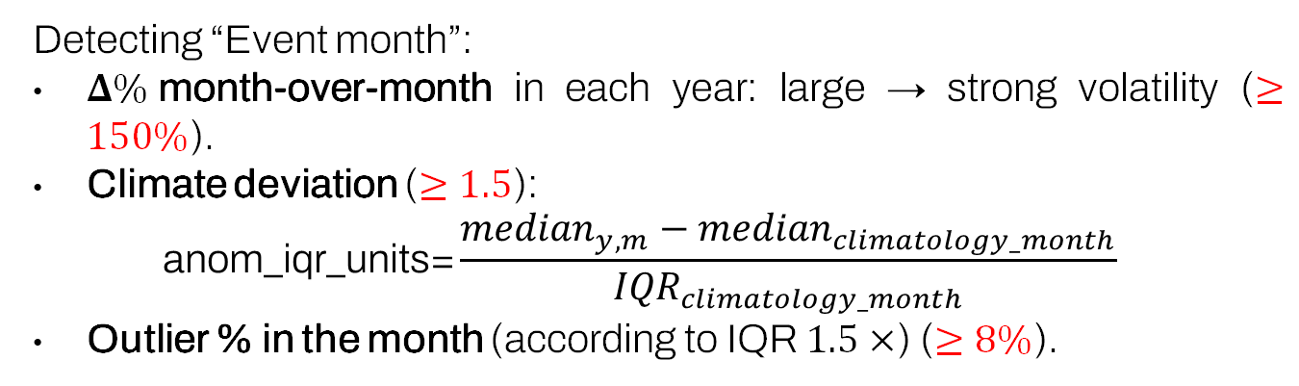
Feature engineering
Detecting “Event month”:
$Δ\%$month-over-month in each year: large → strong volatility ($≥150\%$).
Climate deviation ($≥1.5$):
$$\text{anom}\text{_}\text{iqr}\text{_}\text{units}\text{=}\frac{{median}_{y,m}−{median}_{climatology_month}}{{IQR}_{climatology_month}}$$
Outlier % in the month (according to IQR $1.5×$) ($≥8\%$).

Slide 71
Contents of The Hoa Binh’s Dam data
thoi_diem | Timeline of hydroelectric reservoir operation data recording
muc_nuoc_thuong_luu_m | Indicates the current condition of the reservoir
luu_luong_den_ho_m3_s | Volume of water entering the reservoir
dap_tran_norm | Normalized spillway discharge (0–1), calculated by dividing the actual discharge by the maximum value.
dap_tran_max | Maximum discharge capacity of the spillway (m³/s).
nha_may_norm | Normalized turbine discharge (0–1), calculated by dividing the actual discharge by the maximum value.
nha_may_max | Maximum discharge through the power plant turbines (m³/s).
phase | Flood season stages
luu_luong_den_ho_m3_s_capped_month_median | Monthly crop platform
…

Slide 72

Contents of The Hoa Binh’s Dam data
…
luu_luong_den_ho_m3_s_capped_ pct_in_month | Relative position in the month
pct_change | Sudden fluctuations between months ($≥150\%$)
anom_iqr_units | Climate deviation (median/IQR) ($≥1.5$)
out_pct | Extreme value ratio in the month ($≥8\%$)
is_event_month | Event Background

Slide 73
Modeling
05

Slide 74
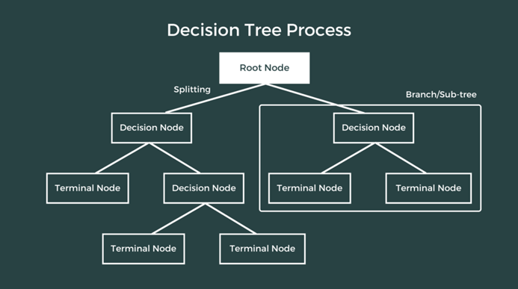
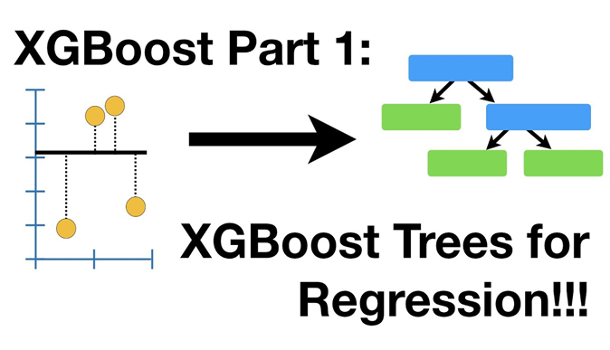

Modeling

Slide 75
Modeling
Decision Tree — Interpretable Baseline:
Provides a simple and explainable benchmark for nonlinear or threshold-based relationships (e.g., water level, inflow, rainfall) with very low training cost, allowing quick validation of whether the data and features are informative.

Slide 76
Modeling
XGBoost — Strong Standard for Tabular Data:
Delivers high and stable performance on tabular datasets with many engineered features over a 28-day window (lags, rolling statistics, quantiles). It effectively captures nonlinearities and interactions between hydrological and weather variables, while its built-in regularization helps prevent overfitting.

Slide 77
Modeling
CNN+LSTM — Specialist for Multivariate Time Series:
Directly models the temporal patterns and dependencies within the 28-day sequence — CNN extracts local patterns (e.g., rainfall spikes, flow surges), while LSTM captures long-term and delayed dependencies — enabling the model to learn dynamic behaviors that tree-based models cannot capture without handcrafted features.

Slide 78

Modeling
CNN + LSTM

Slide 79


Modeling
Descision Tree
XGBoost

Slide 80
Metric Summary
Method | N | MAE | RMSE | R2
Decision Tree | 6,653 | 1.3386 | 3.3292 | 0.8649
XGBoost | 6,653 | 1.5412 | 3.5458 | 0.8381
CNN-LSTM | 6,653 | 2.0146 | 3.6451 | 0.8289

Slide 81
DEMO
06

Slide 82
Thanks for your attention!

