Slide 1


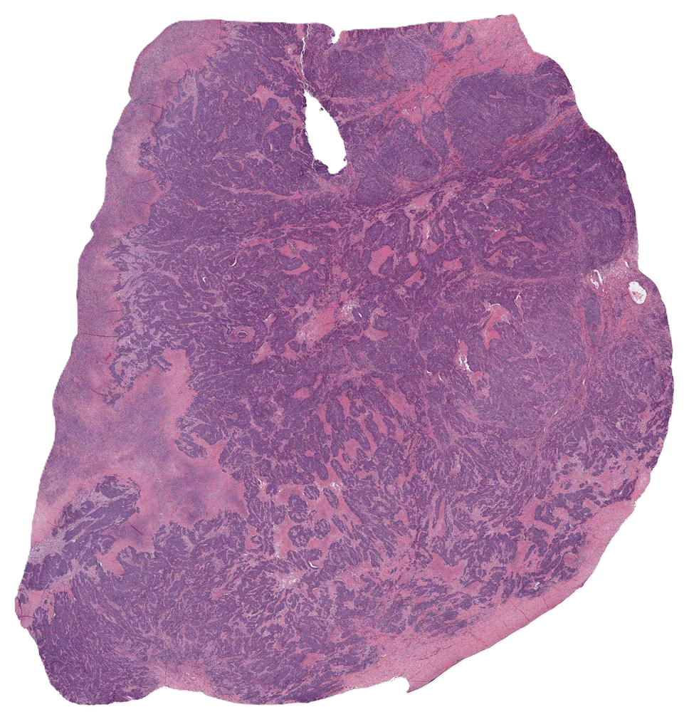
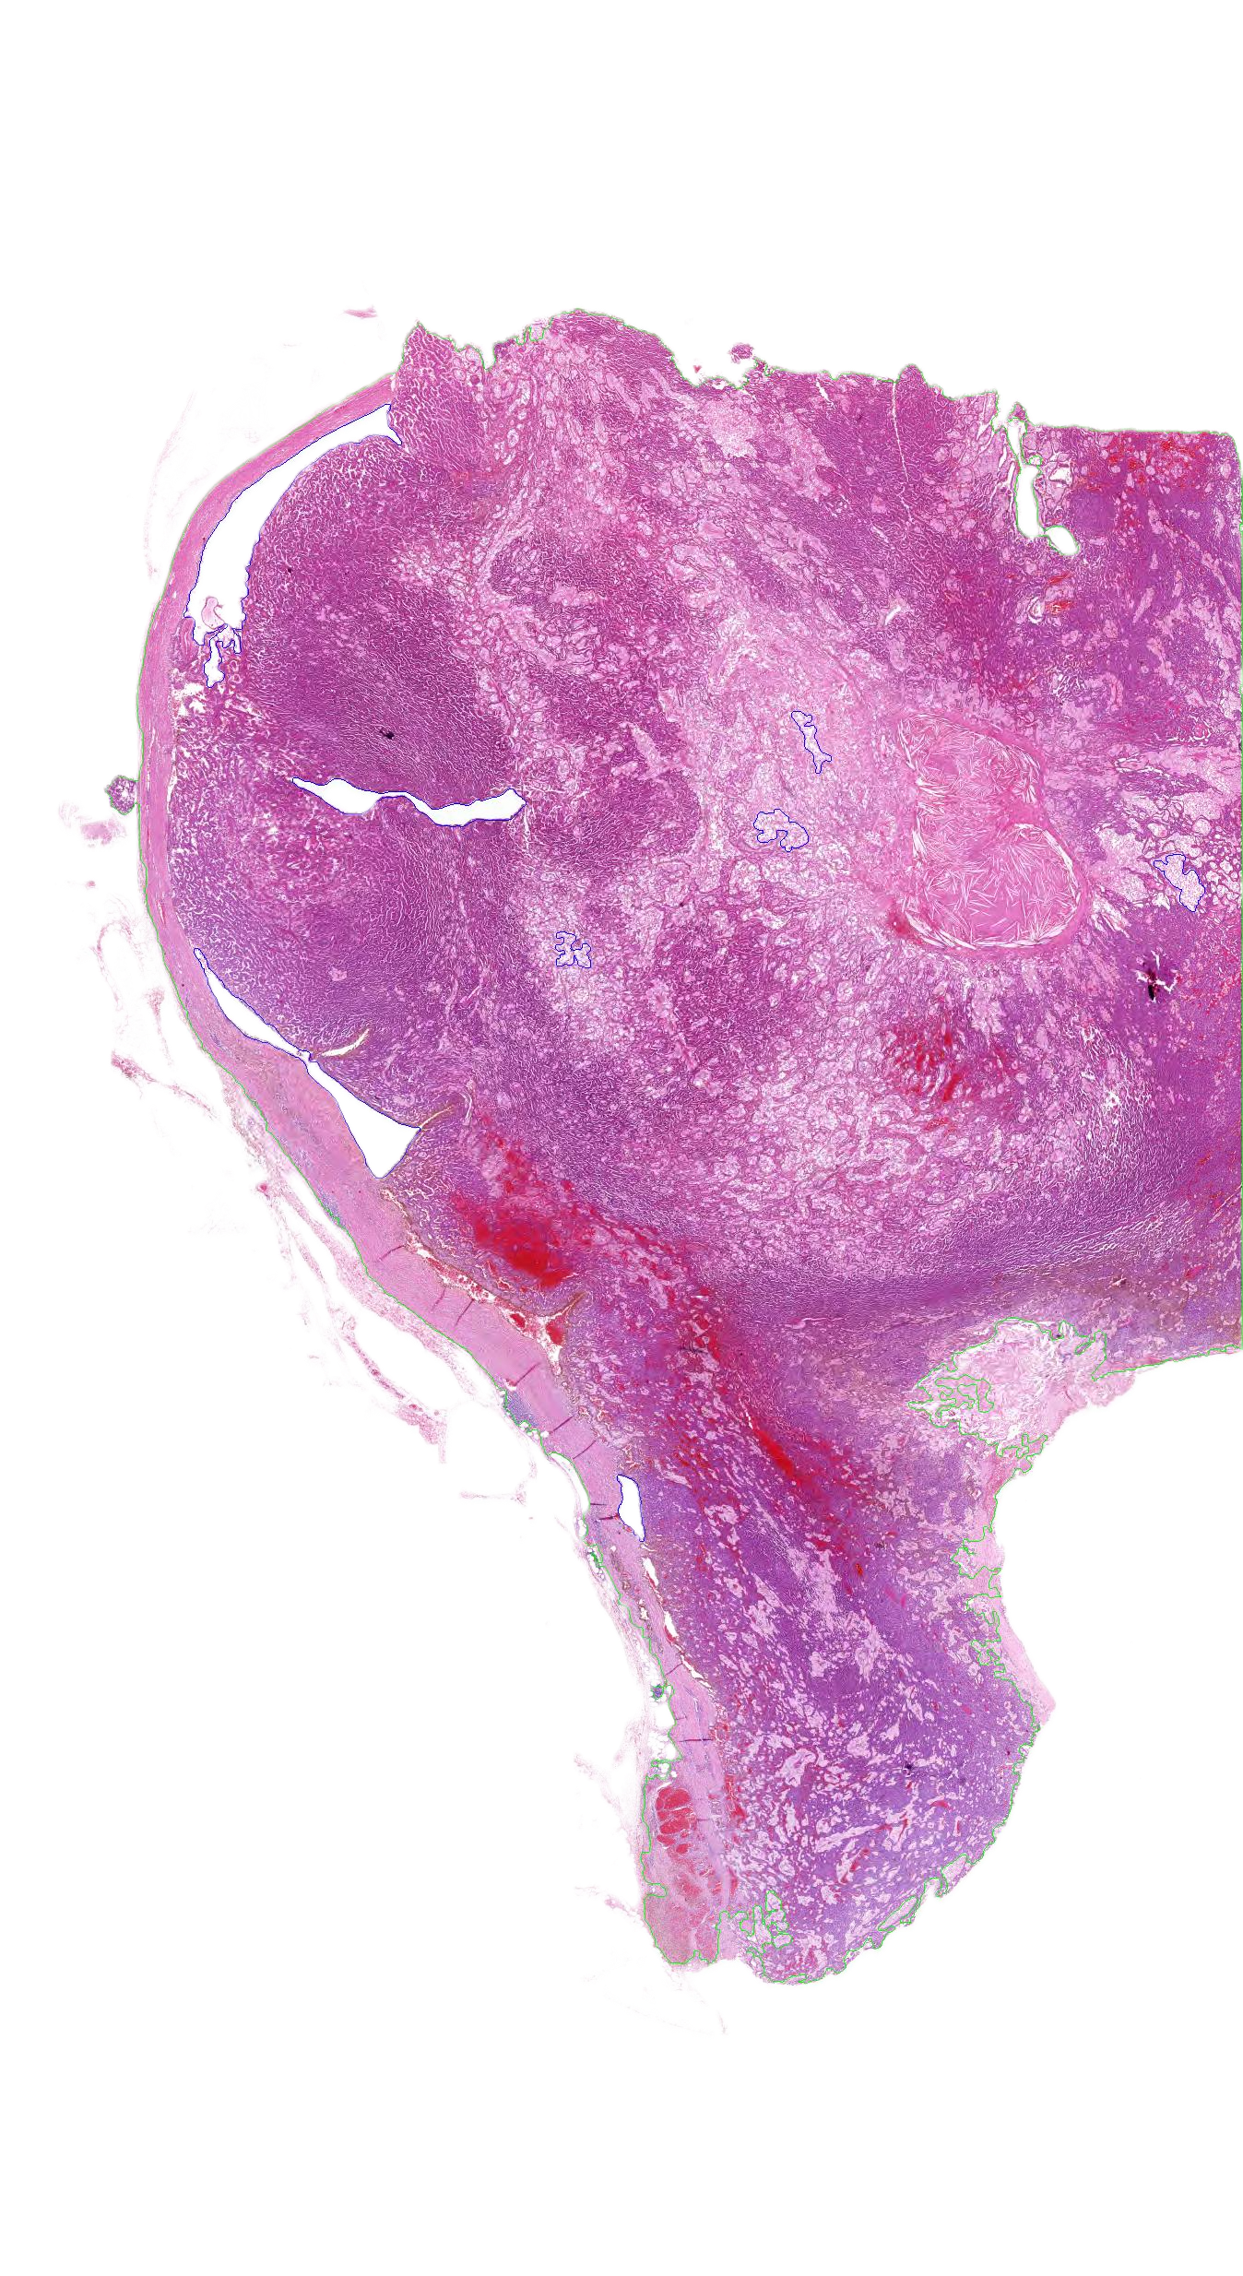
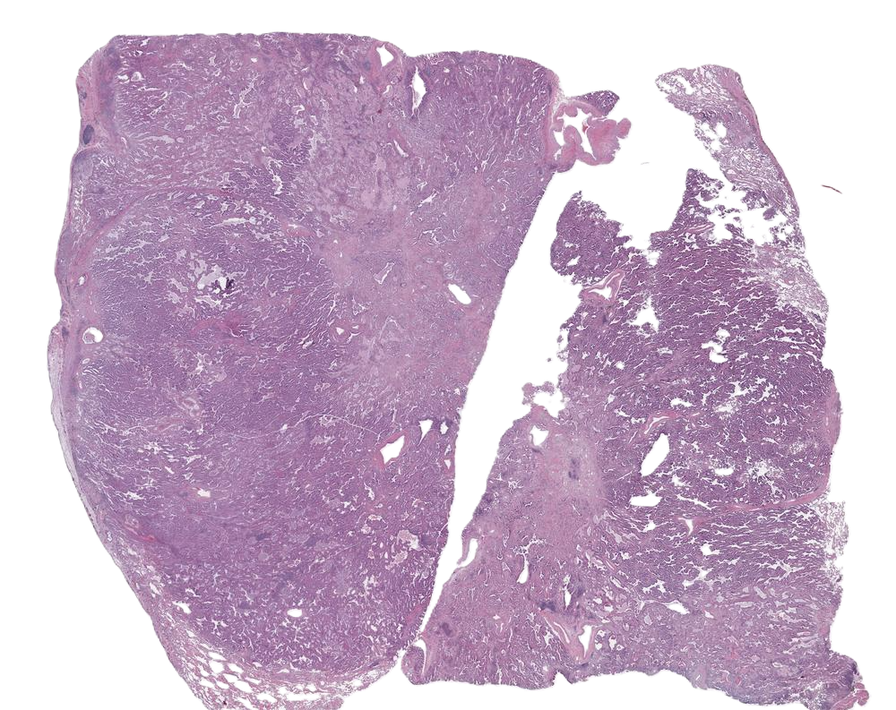
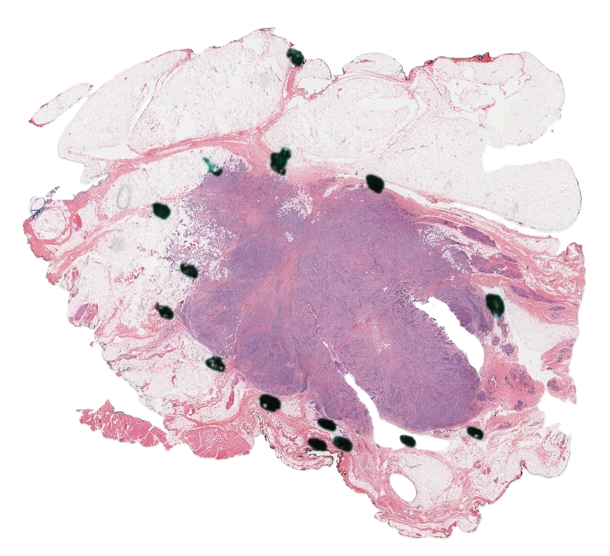
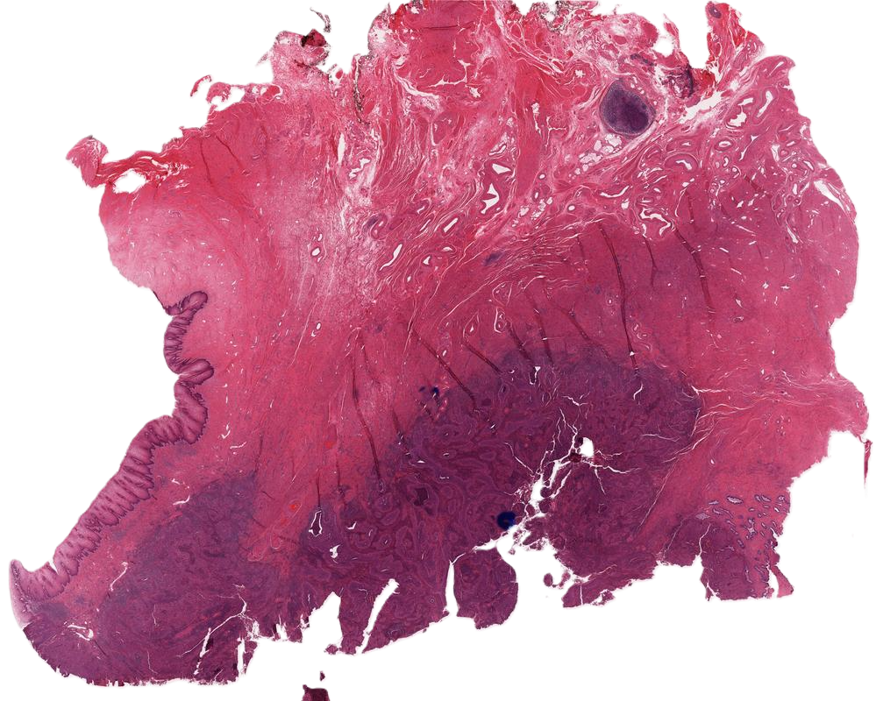
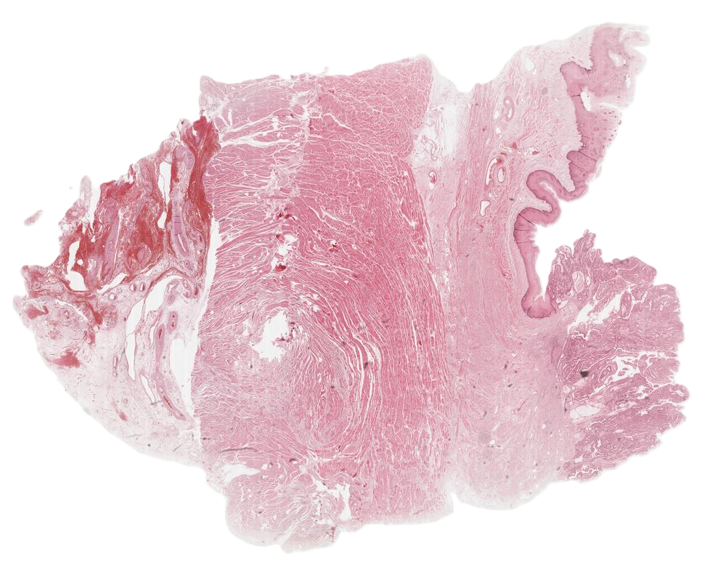








































































$$×n$$
$${\hat{𝒴}}_{global}$$
Random Sampling
$$ℛ_{forget}$$
$$ℒ_{class}$$
$$y_{i}^{AVST}$$
$$ℒ_{AVST}$$
True
False
Truth Task?
$${\tilde{θ}}_{1:t}$$
$$θ_{e}$$
EMA
$$μ_{i}>δ$$
Augmented Sub-bags
EMA
…
Anchor Confident?
No
Stop Grad
False
$$Z_{i}$$
True
…
$$Z_{i}$$
$$ℒ_{task}$$
Verified Soft Target Construction
$$θ_{e}$$
…
…
$${\tilde{θ}}_{1:t}≡$$
$$θ_{s}$$
Text encoder
…
…
$$Z_{i}$$
…
…
Task entropy
EMA
Task logits
$$H_{i}^{𝒯}$$
$$\hat{𝒴}$$
$$X_{i}$$
$$τ_{ent}$$
$$θ_{s}$$
Confidence-Guided Post-Adaptation Inference
Trainable
…
…
Task-Level Prompt
$$ℬ_{i}^{′}$$
Reliability-Gated Sub-bag Selection
$$∩$$
…
$$ℬ_{i}$$
Class entropy
$$E^{C,2}$$
$$E^{C,3}$$
$$E^{C,t}$$
$$H_{i}^{𝒞}$$
$$X_{i}$$
$$E^{C,1}$$
Frozen
$$𝒟_{1:t}^{test}$$
$$τ_{ent}$$
…
$$∅$$
$$ℬ_{i}$$
$$ℬ_{i}^{′}$$
Stabilized Drift-Controlled Adaptation
…
Class-aware Prompt
…
$$E^{𝒯,1}$$
$$E^{𝒯,2}$$
$$E^{𝒯,3}$$
$$E^{𝒯,t}$$
Continual Test-Time Adaptation – CAST-Side Framework
Task-level Prompt Embedding
MLP-free Task-specific Fine-Tuning
Continual Model Merging
New information
$$θ_{1}$$
$$θ_{2}$$
$$θ_{3}$$
…
$$θ_{t}$$
$$−$$
$$θ_{base}$$
$$−$$
$${\tilde{θ}}_{1:t−1}$$
Old information
$$θ_{base}$$
$$E^{C,1}$$
$$θ_{base}$$
$$E^{C,2}$$
$$θ_{base}$$
$$E^{C,3}$$
$$θ_{base}$$
$$E^{C,t}$$
$$λ_{T−1}$$
…
$$τ_{t}$$
$${\overset{˜}{τ}}_{1:t−1}$$
Class-aware Prompt Embedding
$$P^{C,1}$$
$$P^{C,2}$$
$$P^{C,t}$$
$$SVD$$
$$+$$
$${\tilde{θ}}_{1:t}$$
$$θ_{base}$$
$$𝒟_{1}^{train}$$
$$𝒟_{2}^{train}$$
$$𝒟_{3}^{train}$$
$$P^{C,3}$$
$$𝒟_{t}^{train}$$
$$𝒢(∙)$$
$$λ_{T}$$
“a histopathological image showing invasive ductal carcinoma”
Layer Normalization
“a histopathological image showing invasive lobular carcinoma”
MLP-free Task-specific Fine-Tuning and Continual Model Merging

