Slide 1
K-means cluster
CS115.M12.KHCL, GV: Lê Minh Hưng
Introdoctor: Lê Văn Duy _ 20521233
Phạm Hữu Hùng - 20521371
Notes:
We designed this template so that each member of the project team has a set of slides with its own theme. Members, here’s how you add a new slide to just your set:
Mark where you want to add the slide: Select an existing one in the Thumbnails pane, click the New Slide button, then choose a layout. The new slide gets the same theme as the other slides in your set.
Careful! Don’t annoy your fellow presenters by accidentally changing their themes. That can happen if you choose a different theme from the Design tab, which changes all of the slides in the presentation to that look.

Slide 2
Topics
K-means cluster Description
K-means cluster ideas and algorithms
Application
Conclusion

Slide 3
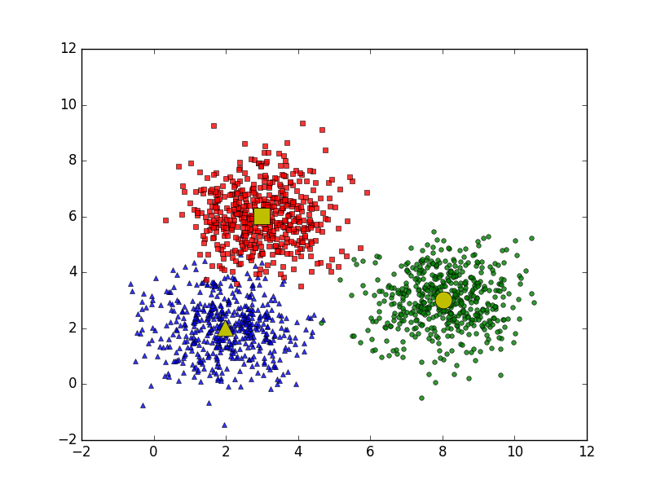
K-Means Cluster Description
K-means clustering is a type of unsupervised learning .
For instance, objects could be house and their properties are size, number of floor, location, power comsumtion per year… the goal is classify house dataset into groups which are luxury, average, poor or other features…

Slide 4

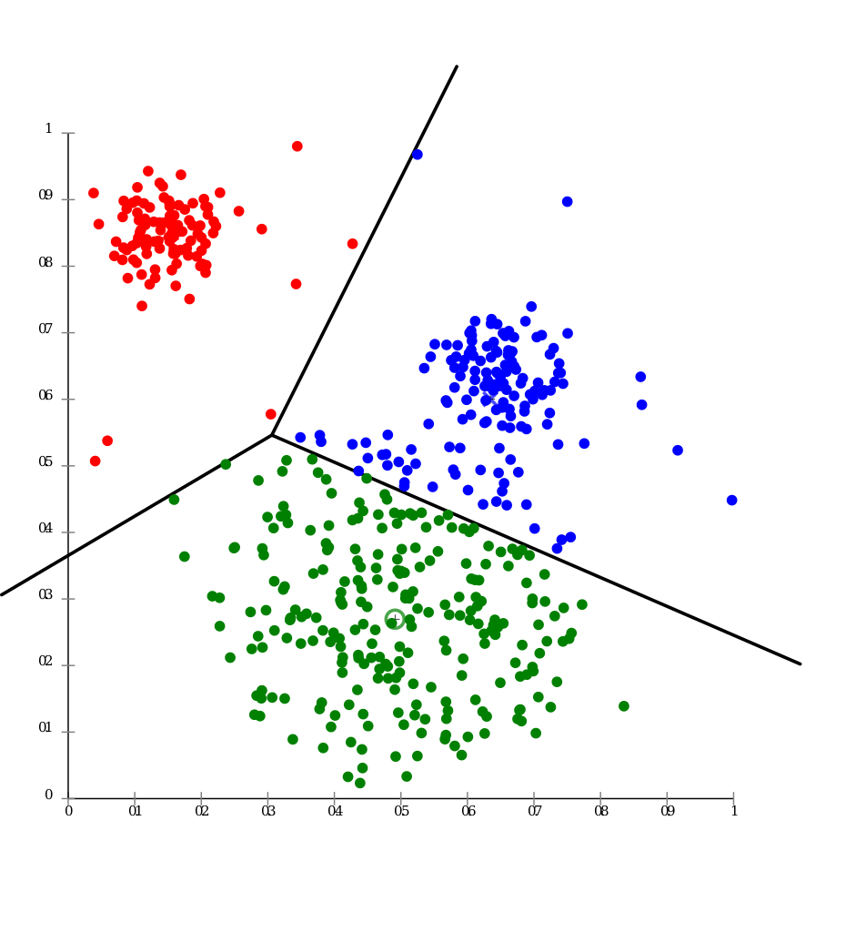
Idea and Algorithms
K-means is used when you have unlabeled data (i.e., data without defined categories or groups). The goal of this algorithm is to find groups in the data, with the number of groups represented by the variable K. The algorithm works iteratively to assign each data point to one of K groups based on the features that are provided. Data points are clustered based on feature similarity.

Slide 5
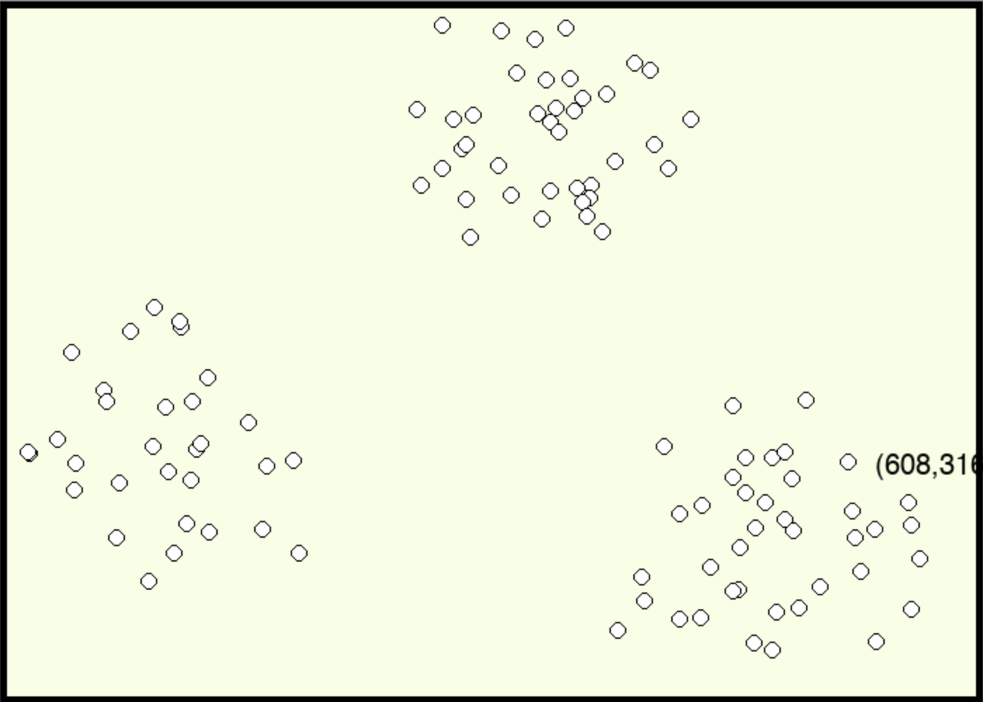
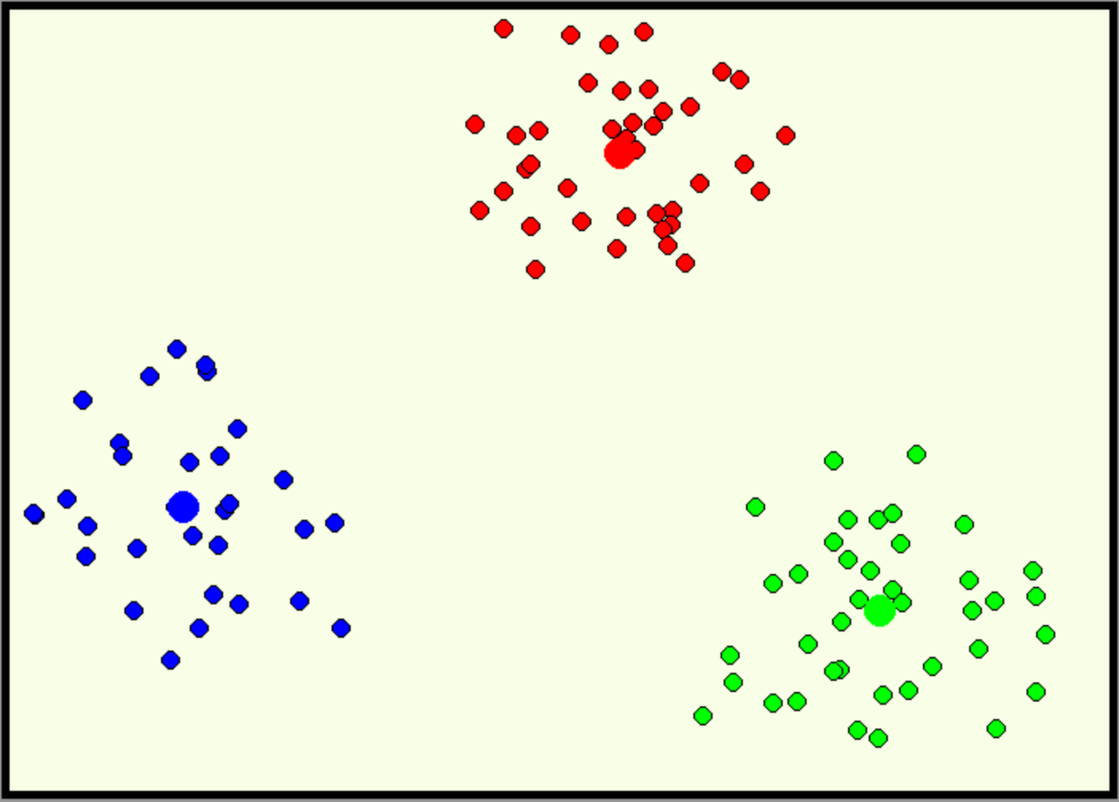
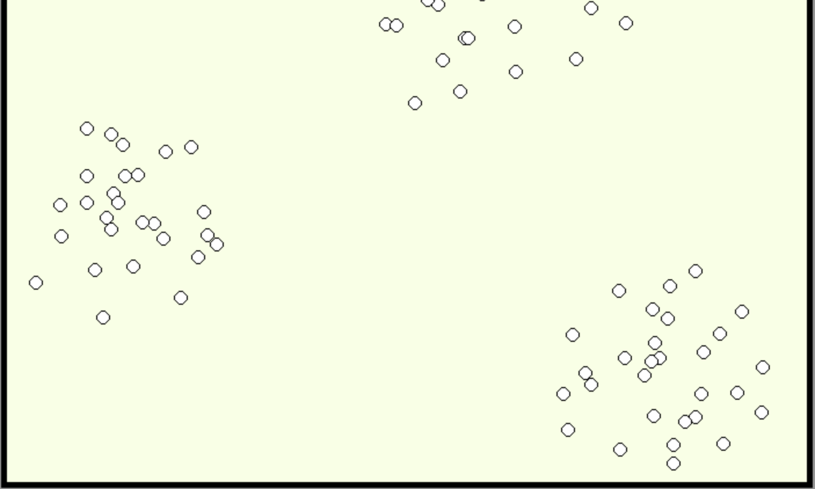

Idea and Algorithms
Example: Take each point in a panel as a objects and each object has two properties which are x-axis and y-axis location. And input K =3. The algorithms correctly finds the cluster

Slide 6
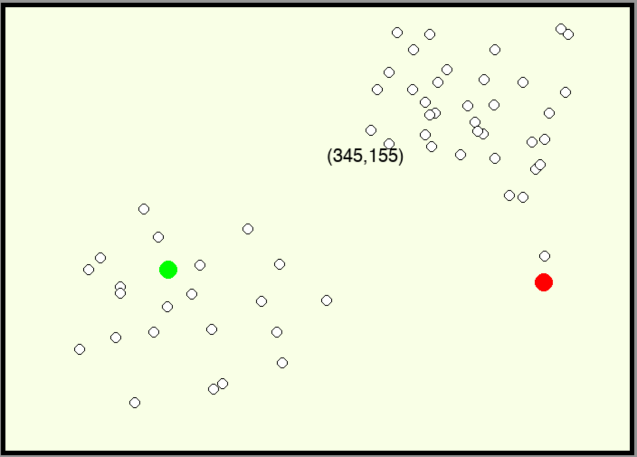
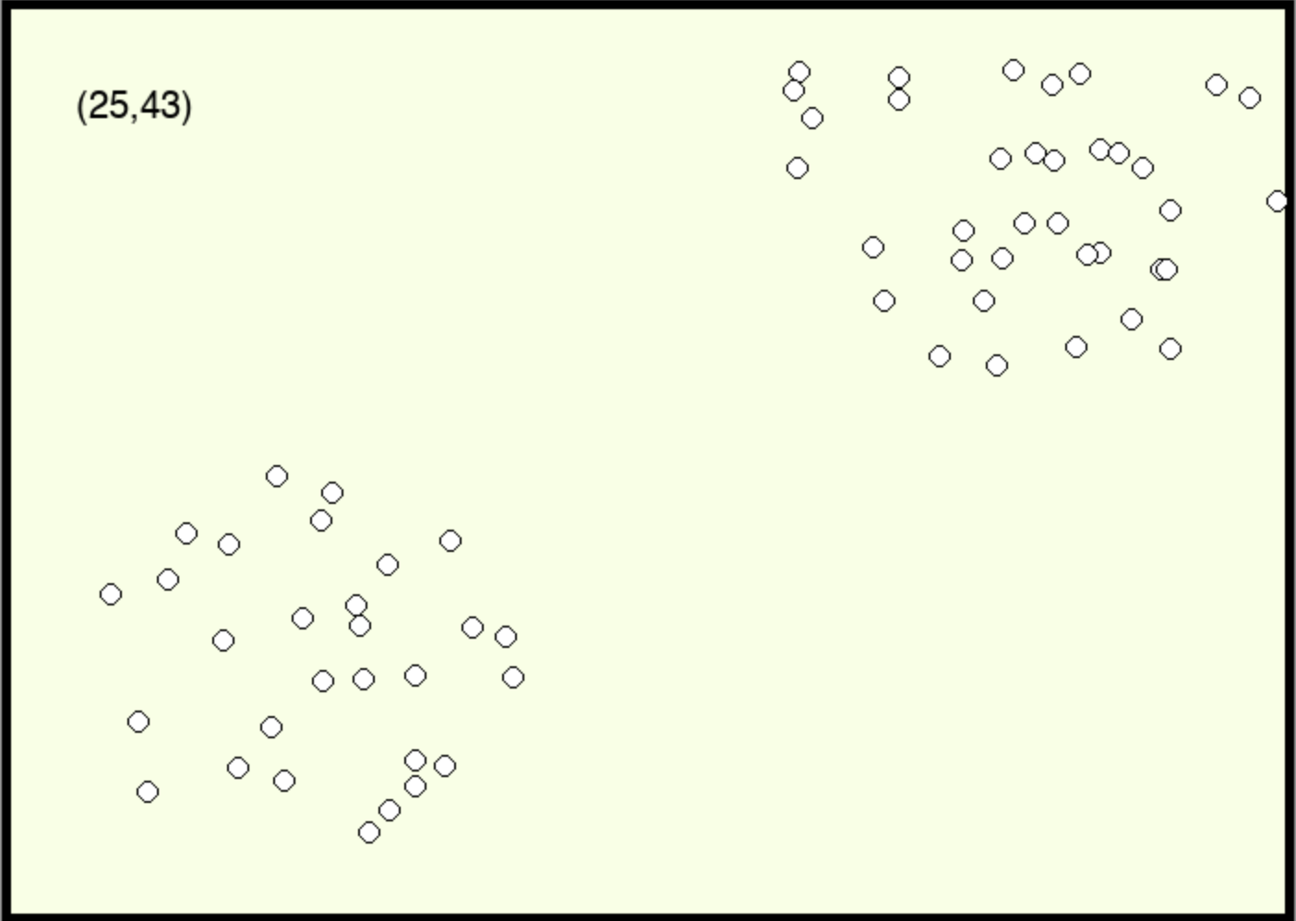
Algorithms
Step1: Choose the number K of clusters. Here we should choose K = 2.

Slide 7
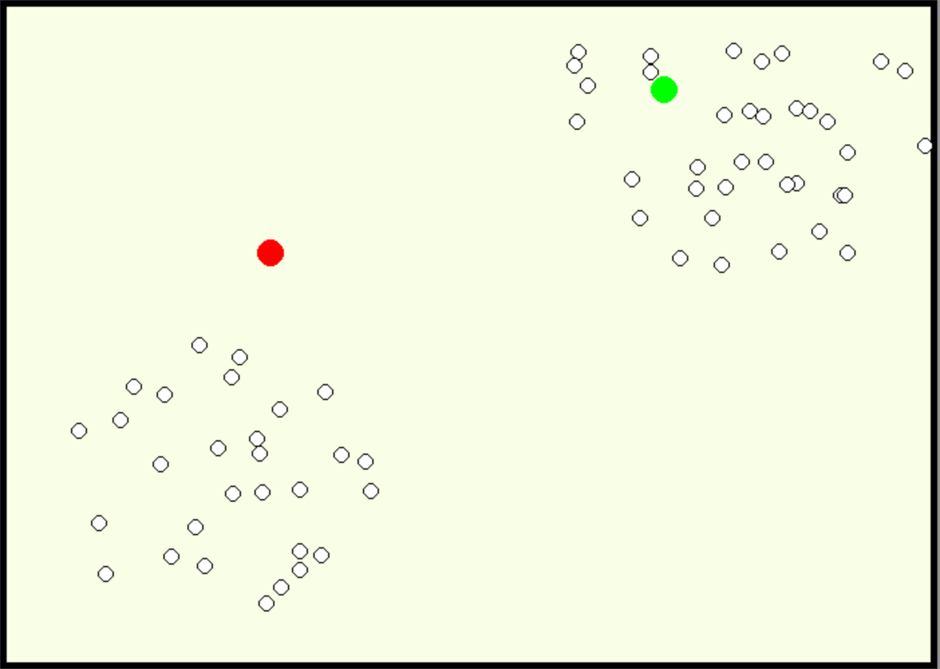
Algorithms
Step1: Choose the number K of clusters. Here is K = 2
Step2: Select at random K points, the centroids(not necessarily from dataset)

Slide 8
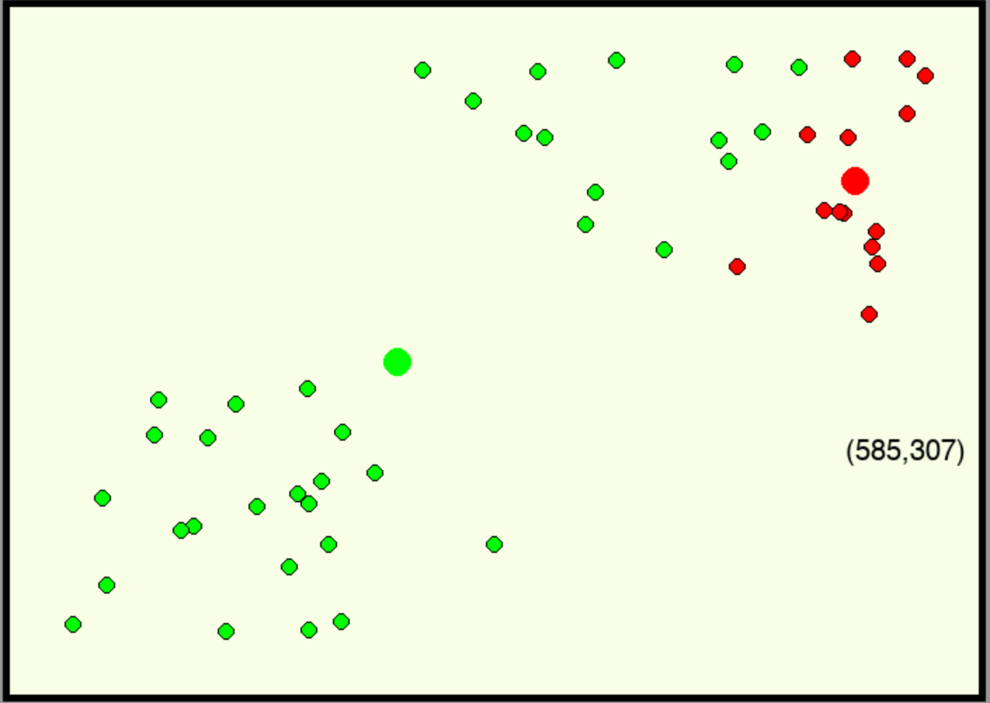
Algorithms
Step1: Choose the number K of clusters. Here is K = 2
Step2: Select at random K points, the centroids.
Step 3: Assgin each data point to the closest centroid -> That forms K clusters.

Slide 9
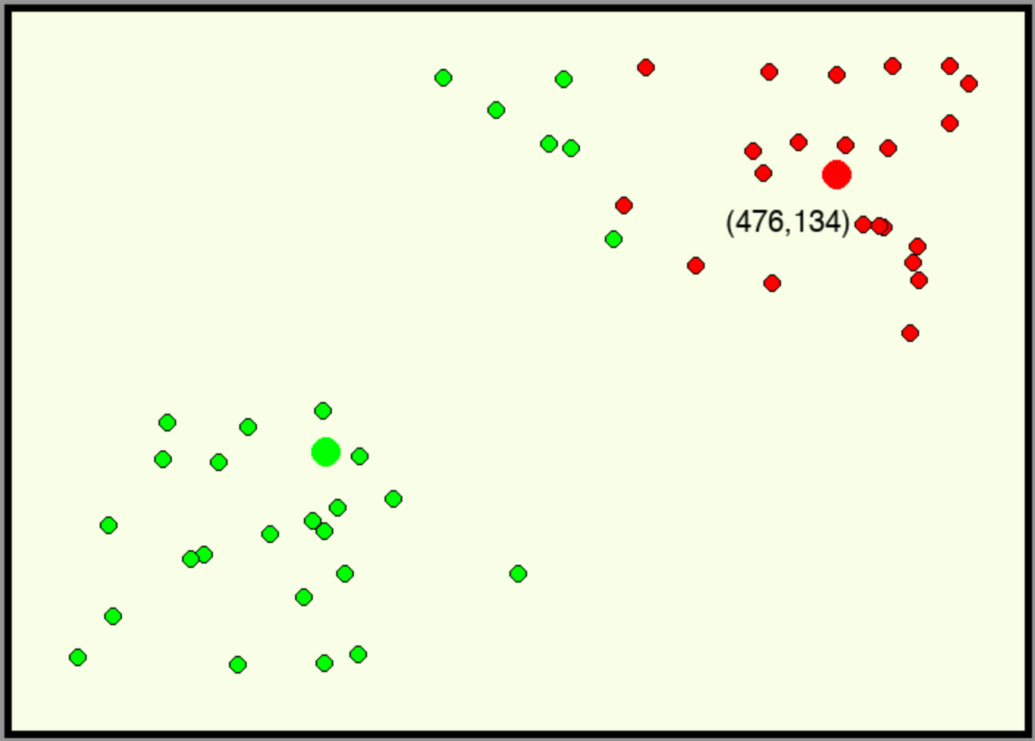
Algorithms
Step1: Choose the number K of clusters. Here is K = 2
Step2: Select at random K points, the centroids.
Step 3: Assgin each data point to the closest centroid
Step 4: Compute and place the new centroid of each cluster

Slide 10
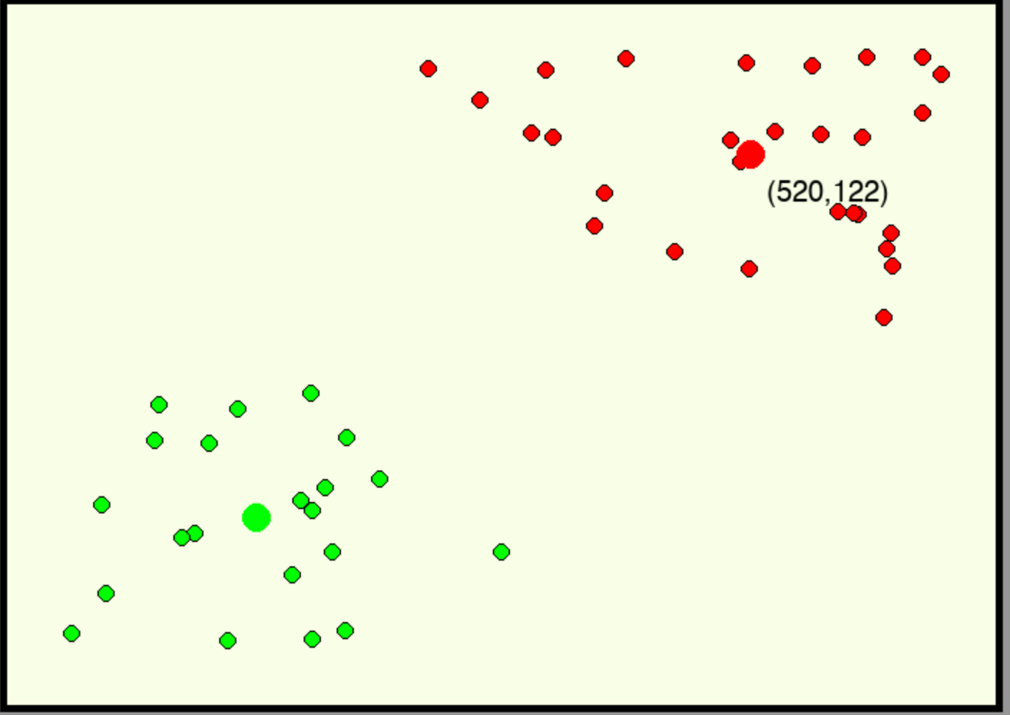
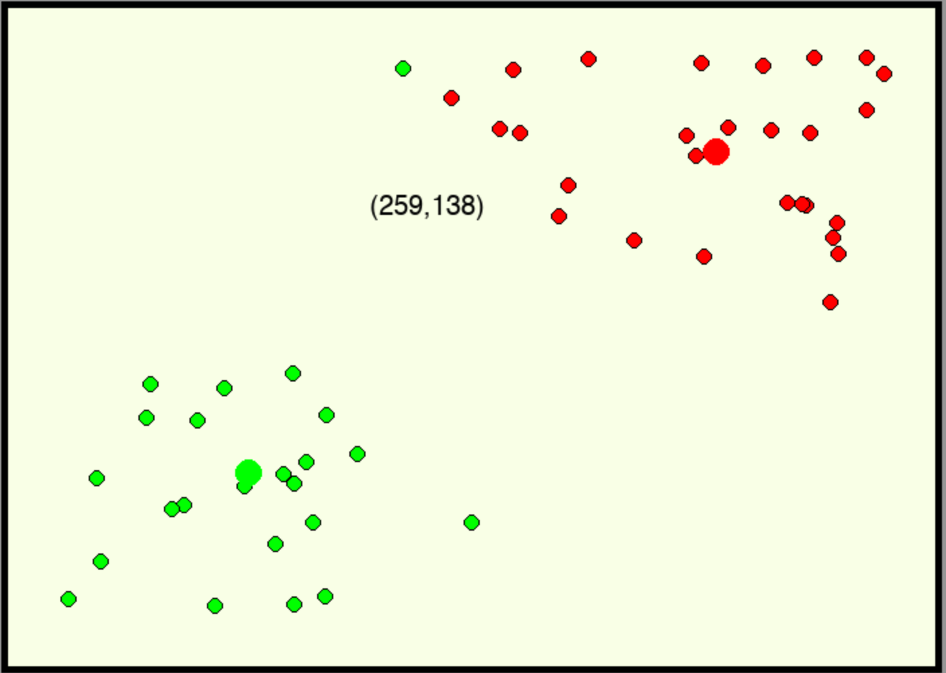
Algorithms
Step1: Choose the number K of clusters. Here is K = 2
Step2: Select at random K points, the centroids.
Step 3: Assgin each data point to the closest centroid.
Step 4: Compute and place the new centroid of each cluster.
Step 5: Reassgin each data point to the new closest centroid. If any reassginment took place, go to Step 4, otherwise go to finish.

Slide 11
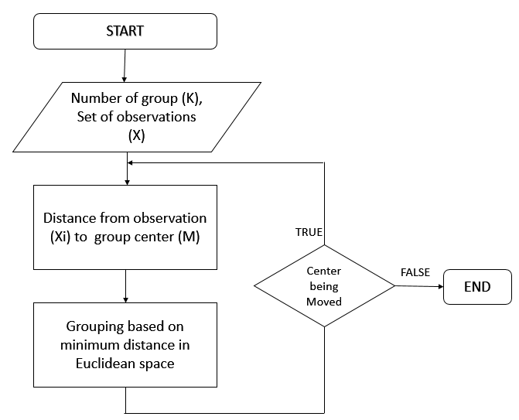
Algorithm summary and Flowchart
1. Summary
Step1. Clusters the data into k group where k is predefined
Step 2. Select k point as random las cluster centers
Step 3. Assign objects to their coset cluster center according
to the Euclidean distance function
Step 4. Cacalate the centroid or mean of all objects in each cluster.
Step 5. Repeat step 2

Slide 12
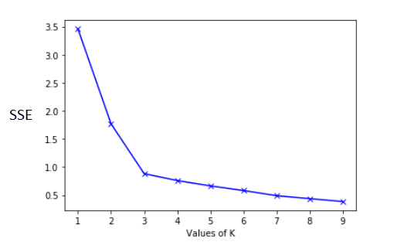
Choosing the right K
The Elbow Method is then used to choose the best K value. In the depiction below we can see that after 3 there's no significant decrease in WCSS so 4 is the best here. Therefore there's an elbow shape that forms and it is usually a good idea to pick the number where this elbow is formed. There would be many times when the graph wouldn't be this intuitive but with practice it becomes easier.

Slide 13
Conclusion
K-means clustering is the unsupervised machine learning algorithms that is part of a much deep pool of data techniques and operations in the realm of Data Science. It is the fastest and most efficient algorithm to categorize data points into groups even when very little information is available about data.
More on, similar to other unsupervised learning, it is necessary to understand the data before adopting which technique fits well on a given dataset to solve problems. Considering the correct algorithm, in return, can save time and efforts and assist in obtaining more accurate results.

Slide 14
Conclusion
K-Means Advantages : 1) If variables are huge, then K-Means most of the times computationally faster than hierarchical clustering, if we keep k smalls. 2) K-Means produce tighter clusters than hierarchical clustering, especially if the clusters are globular. K-Means Disadvantages : 1) Difficult to predict K-Value. 2) With global cluster, it didn't work well. 3) Different initial partitions can result in different final clusters. 4) It does not work well with clusters (in the original data) of Different size and Different density

