Slide 1

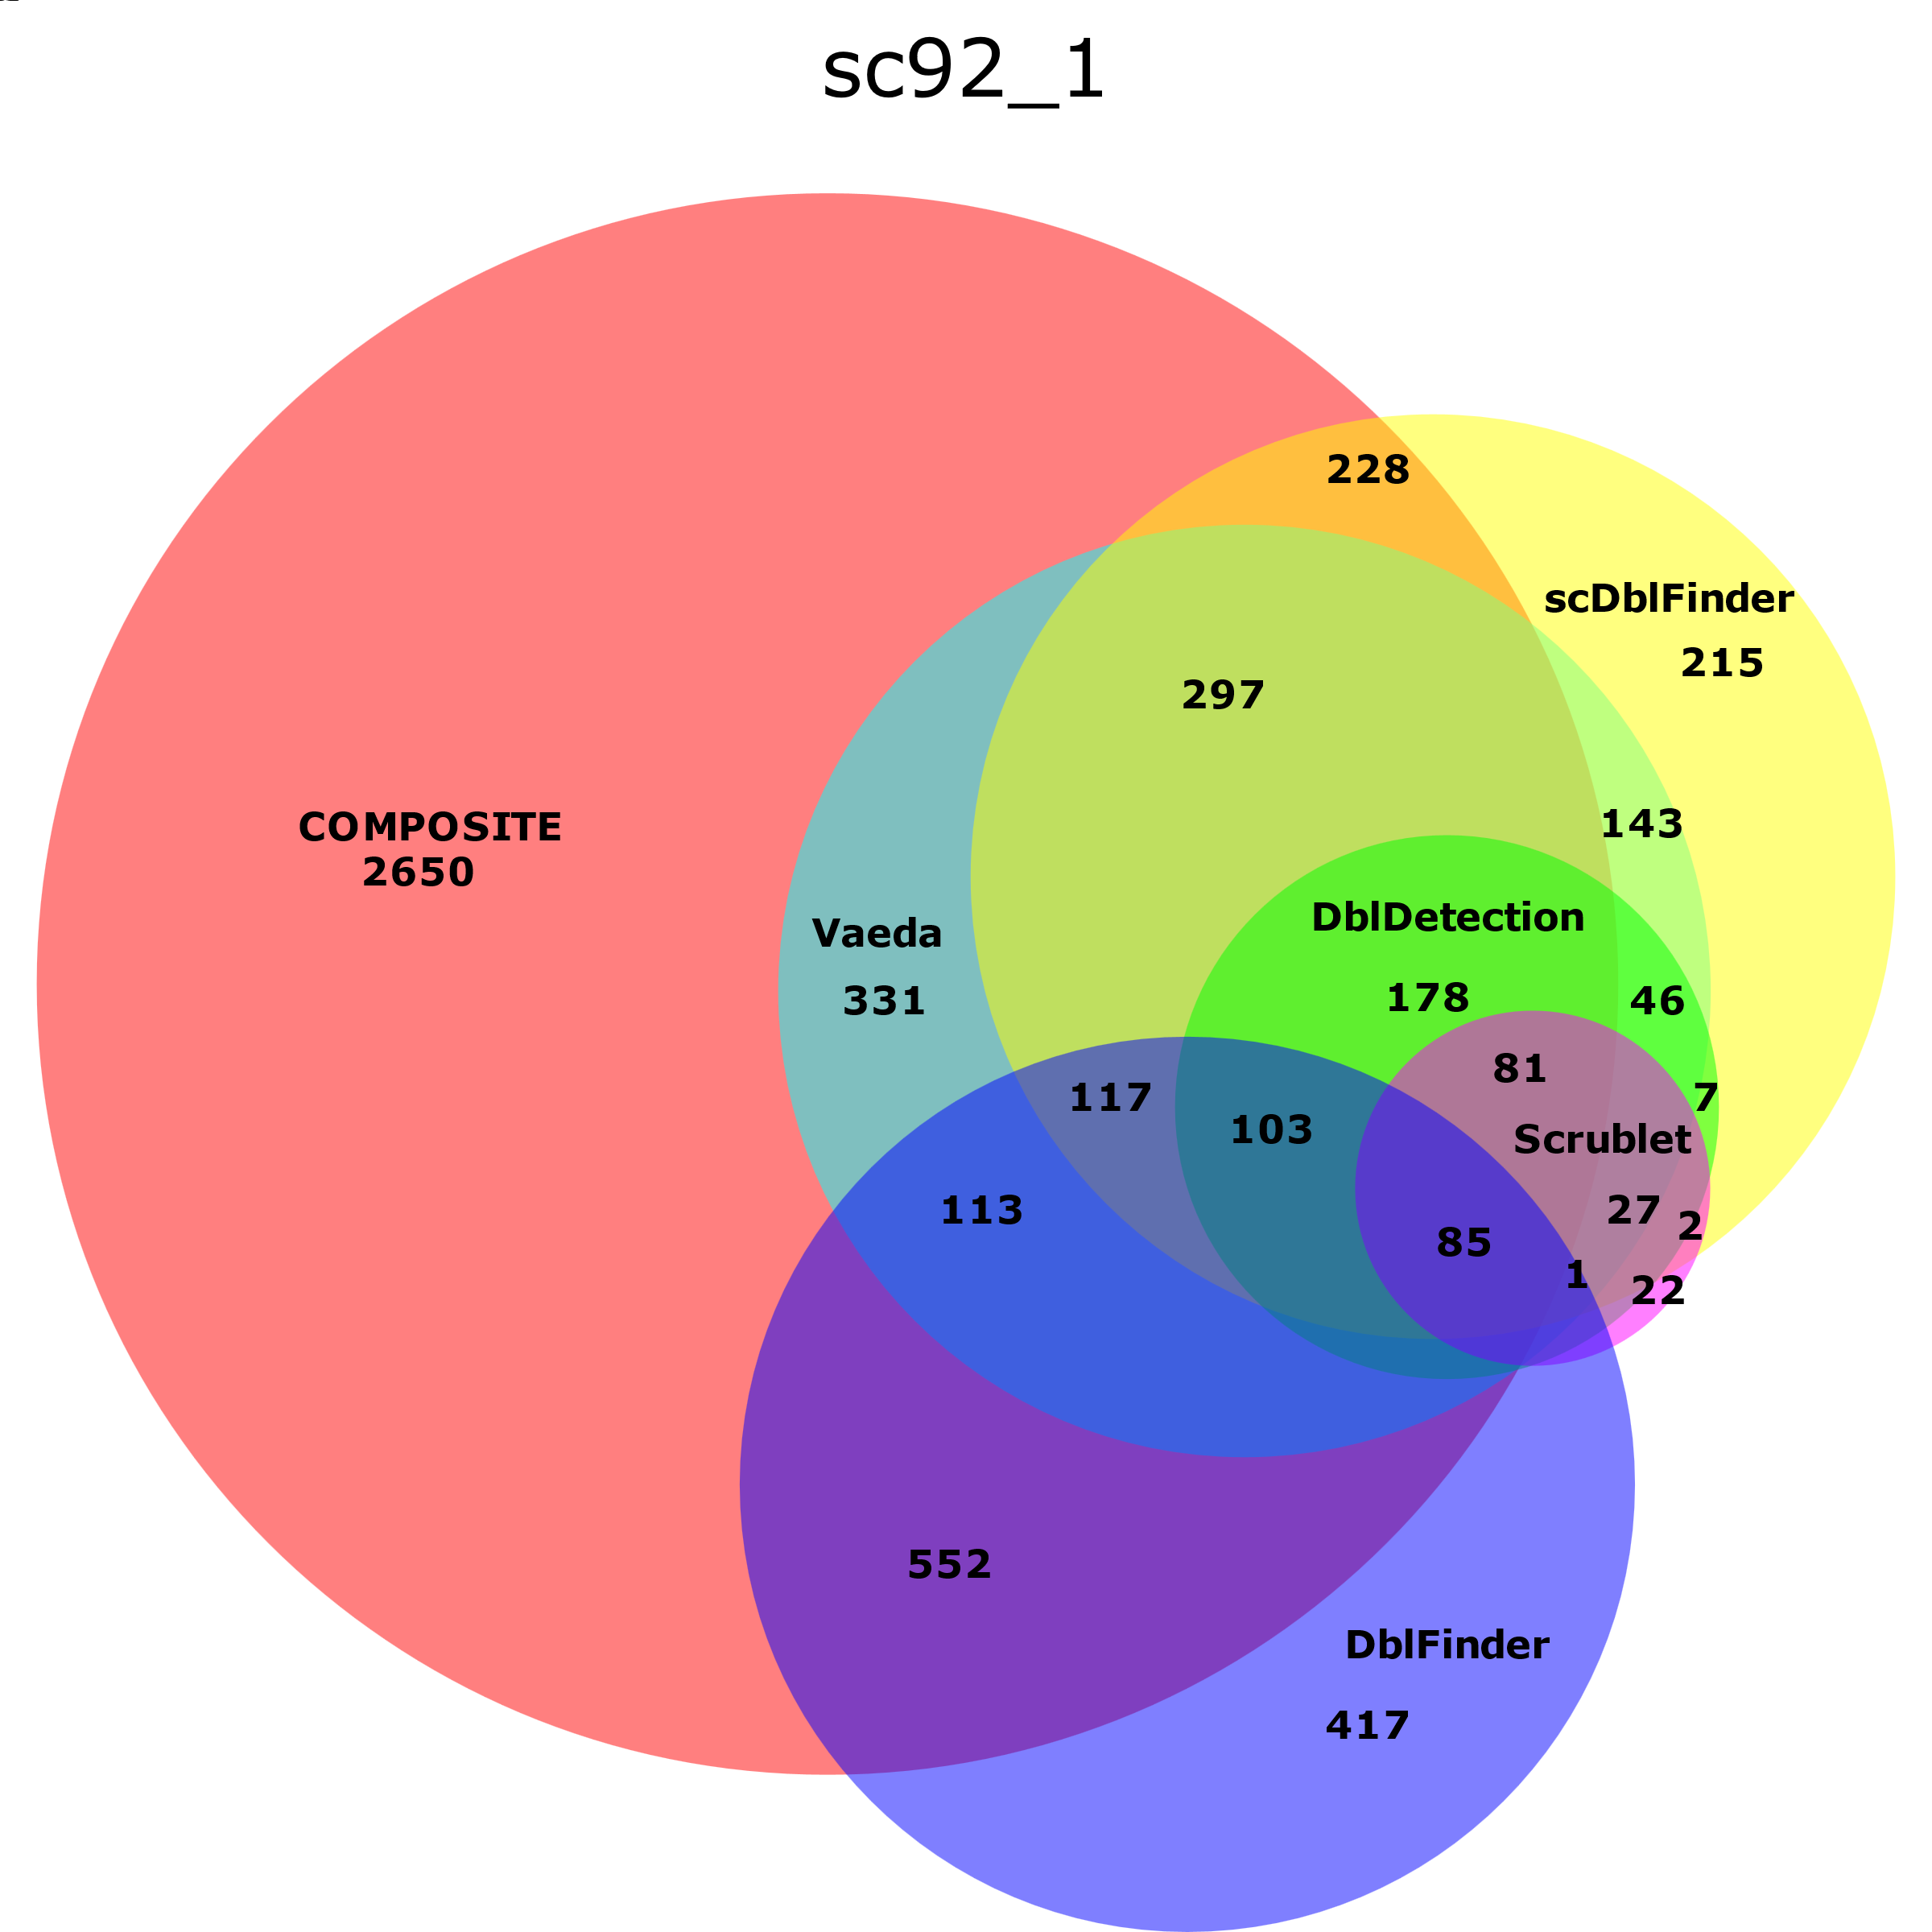
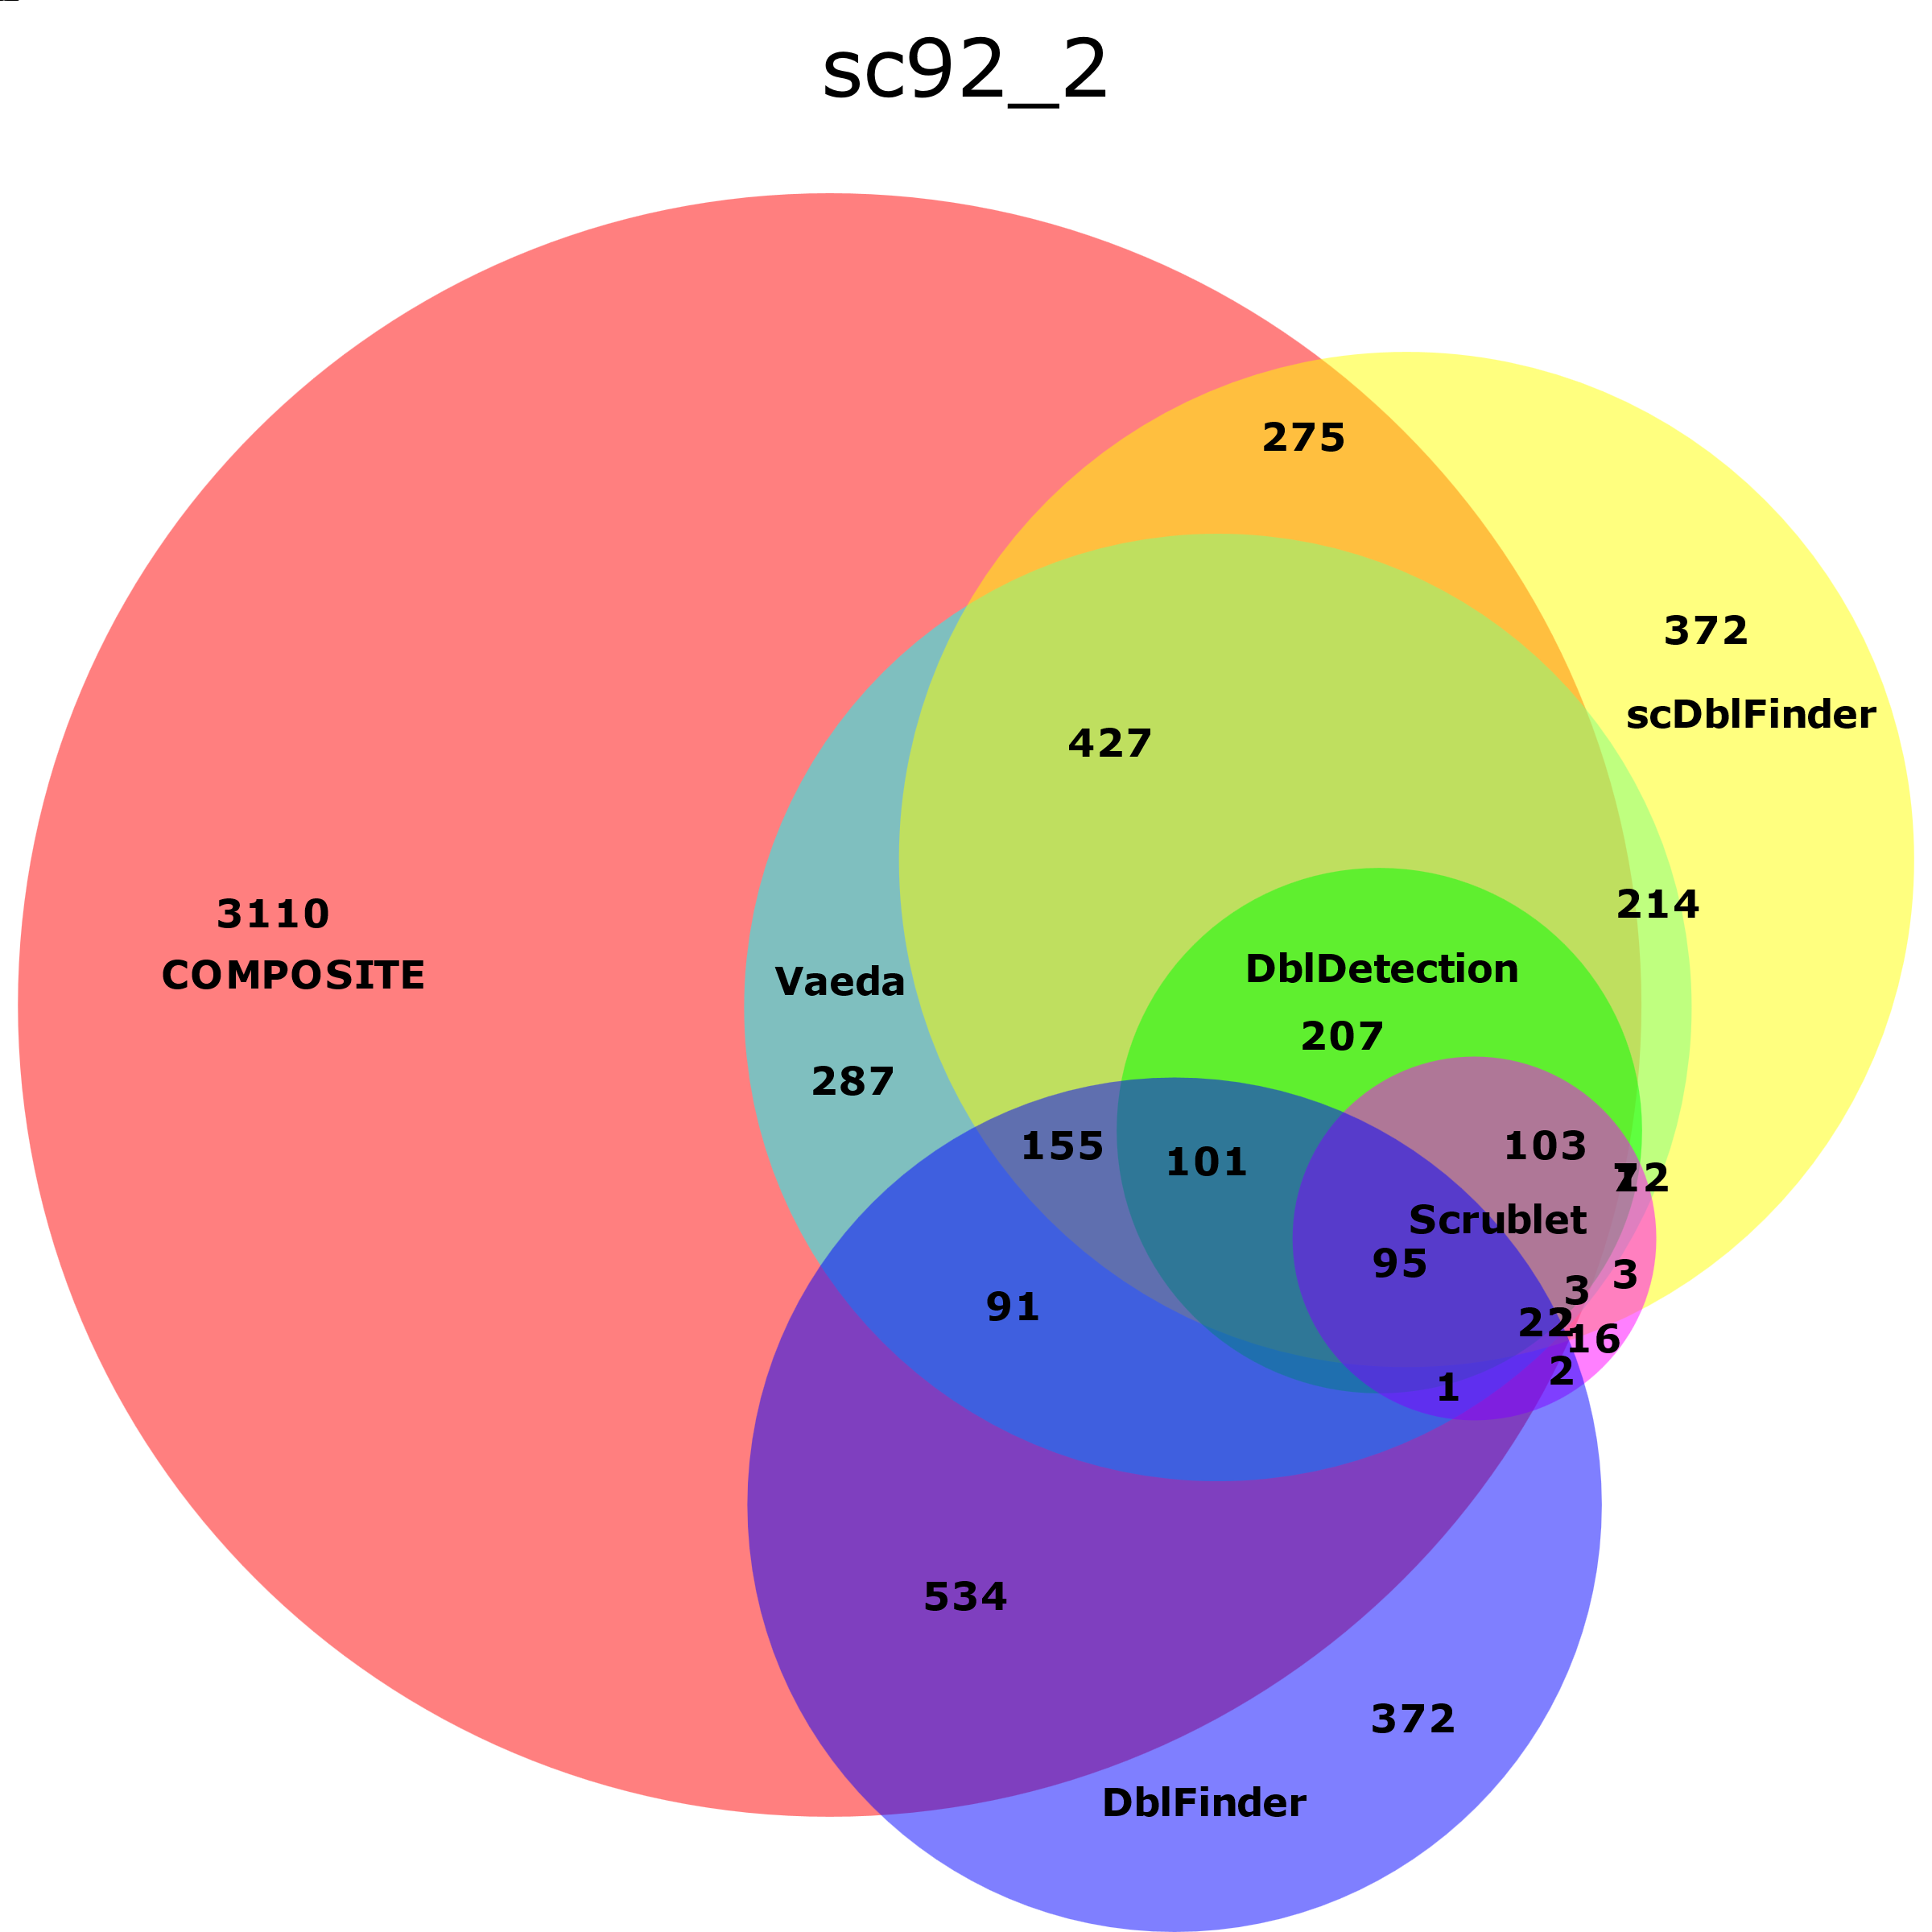
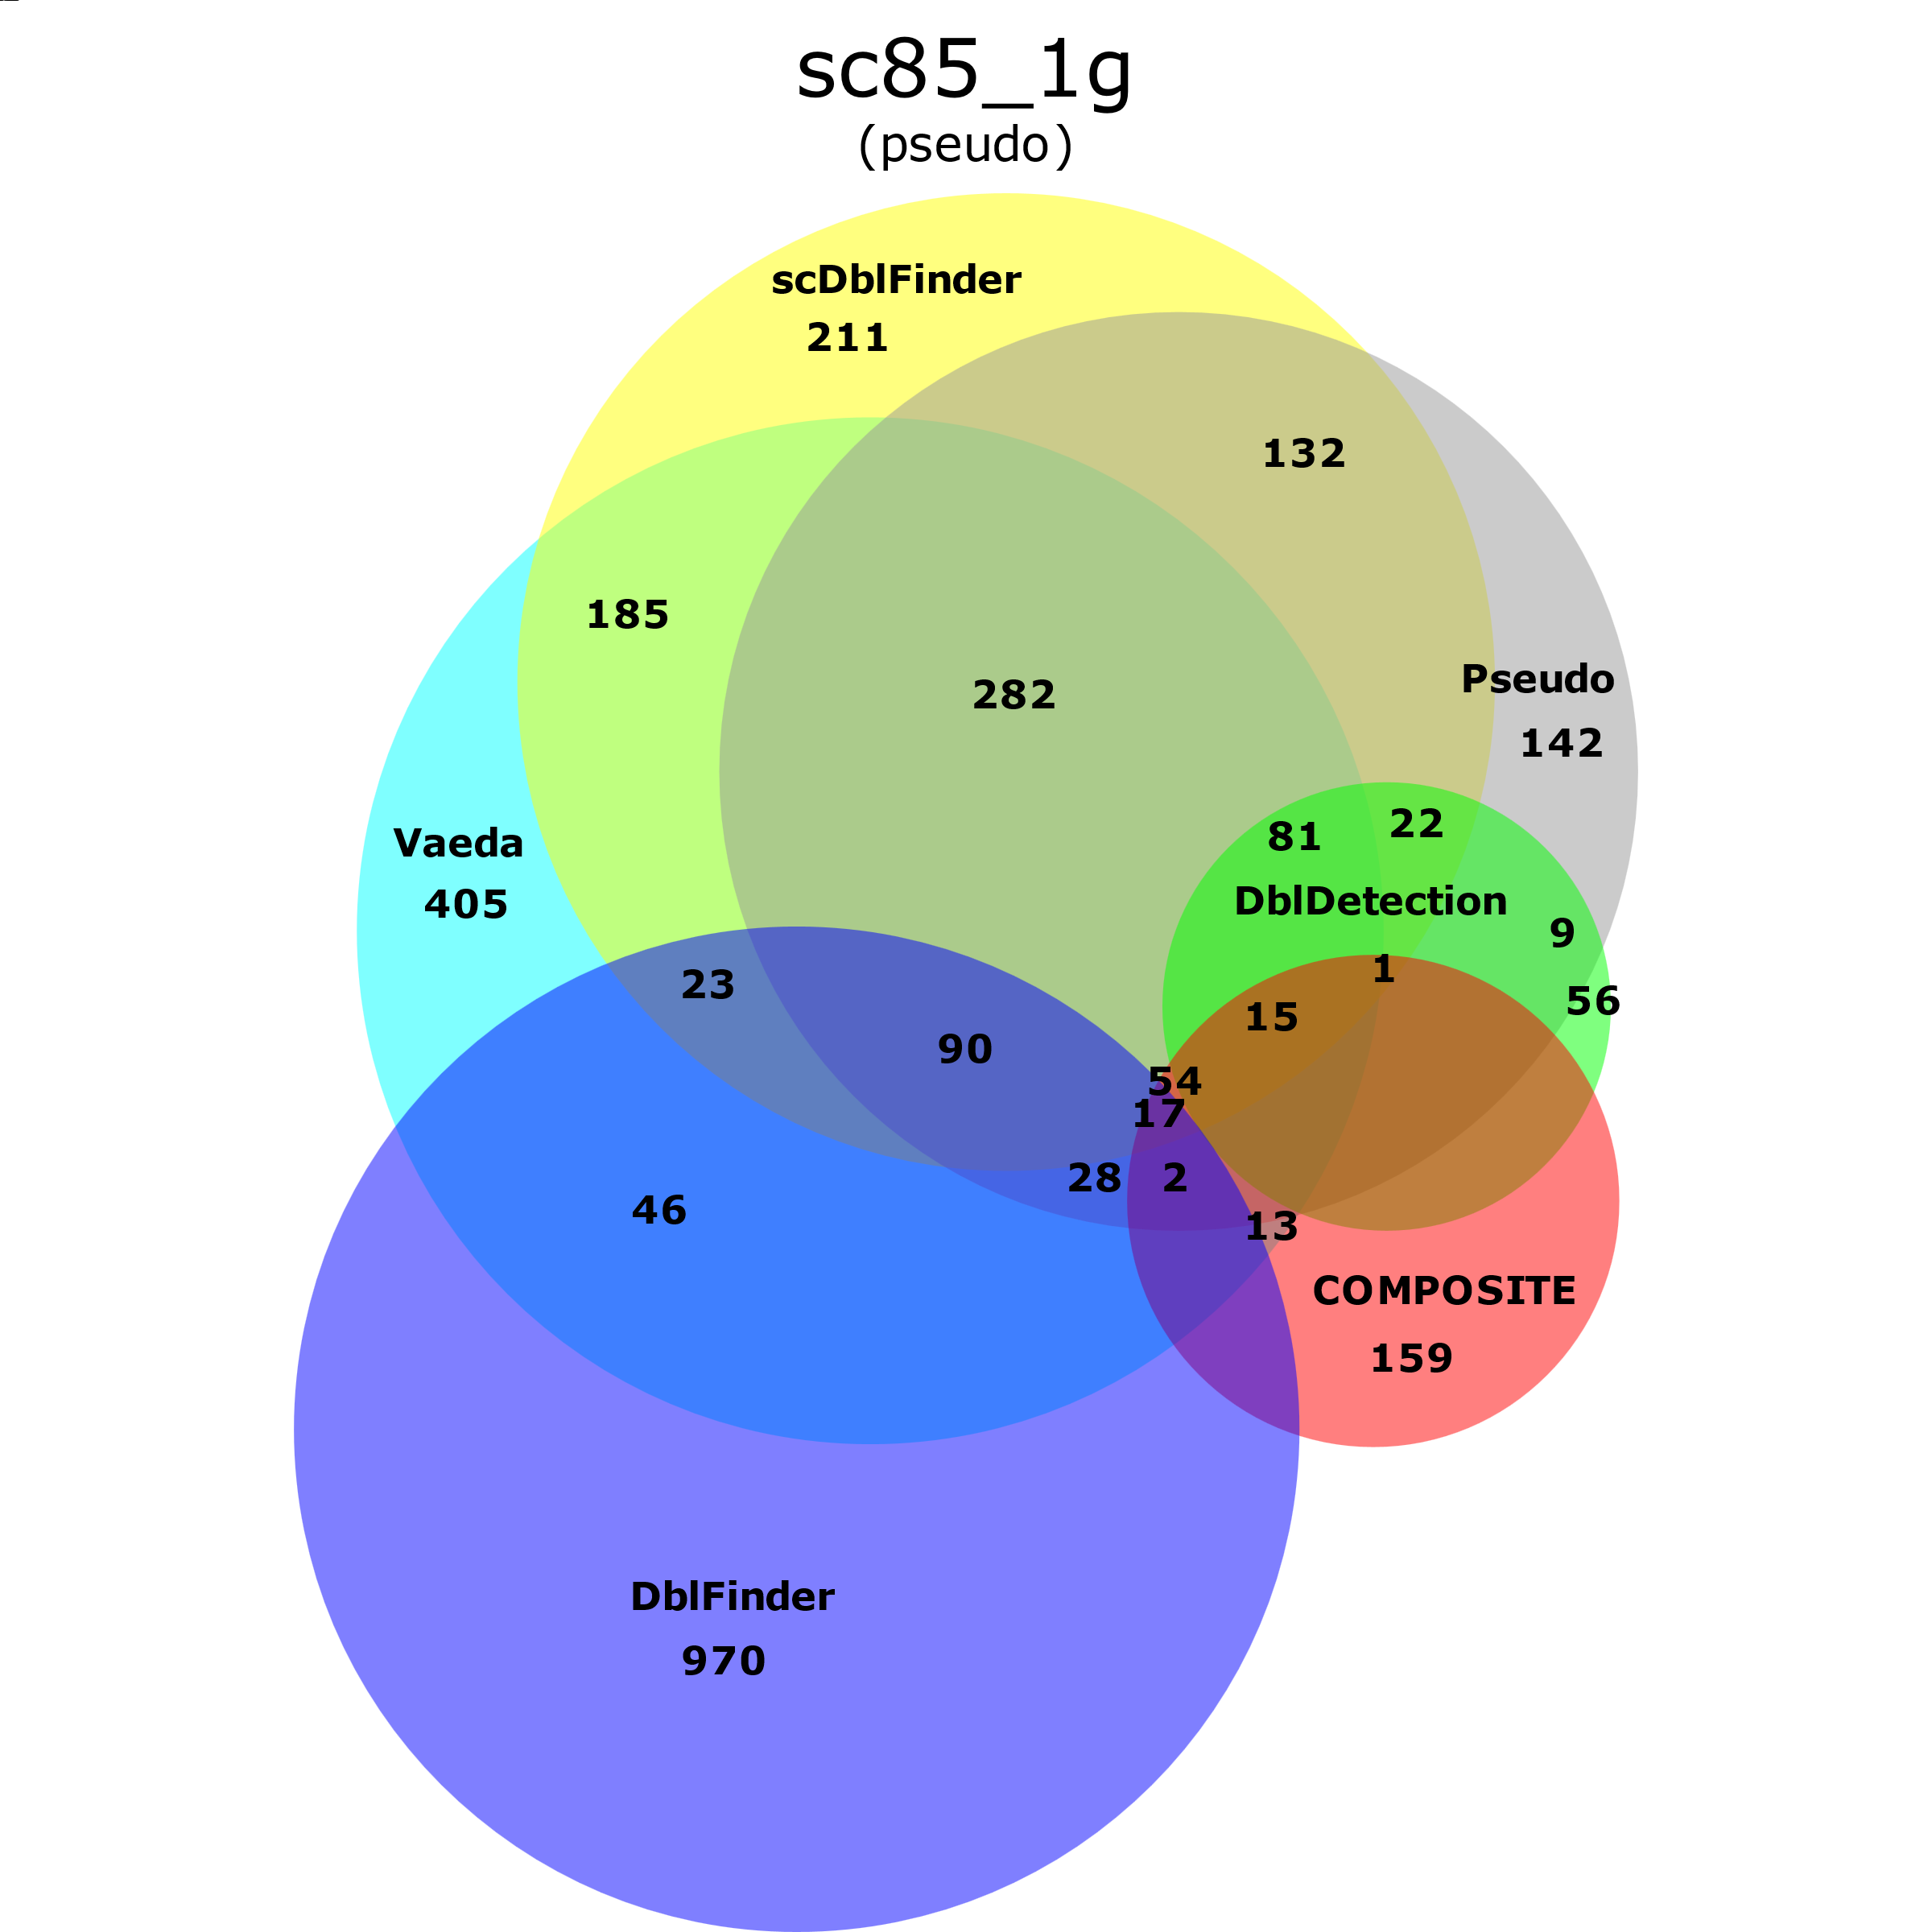
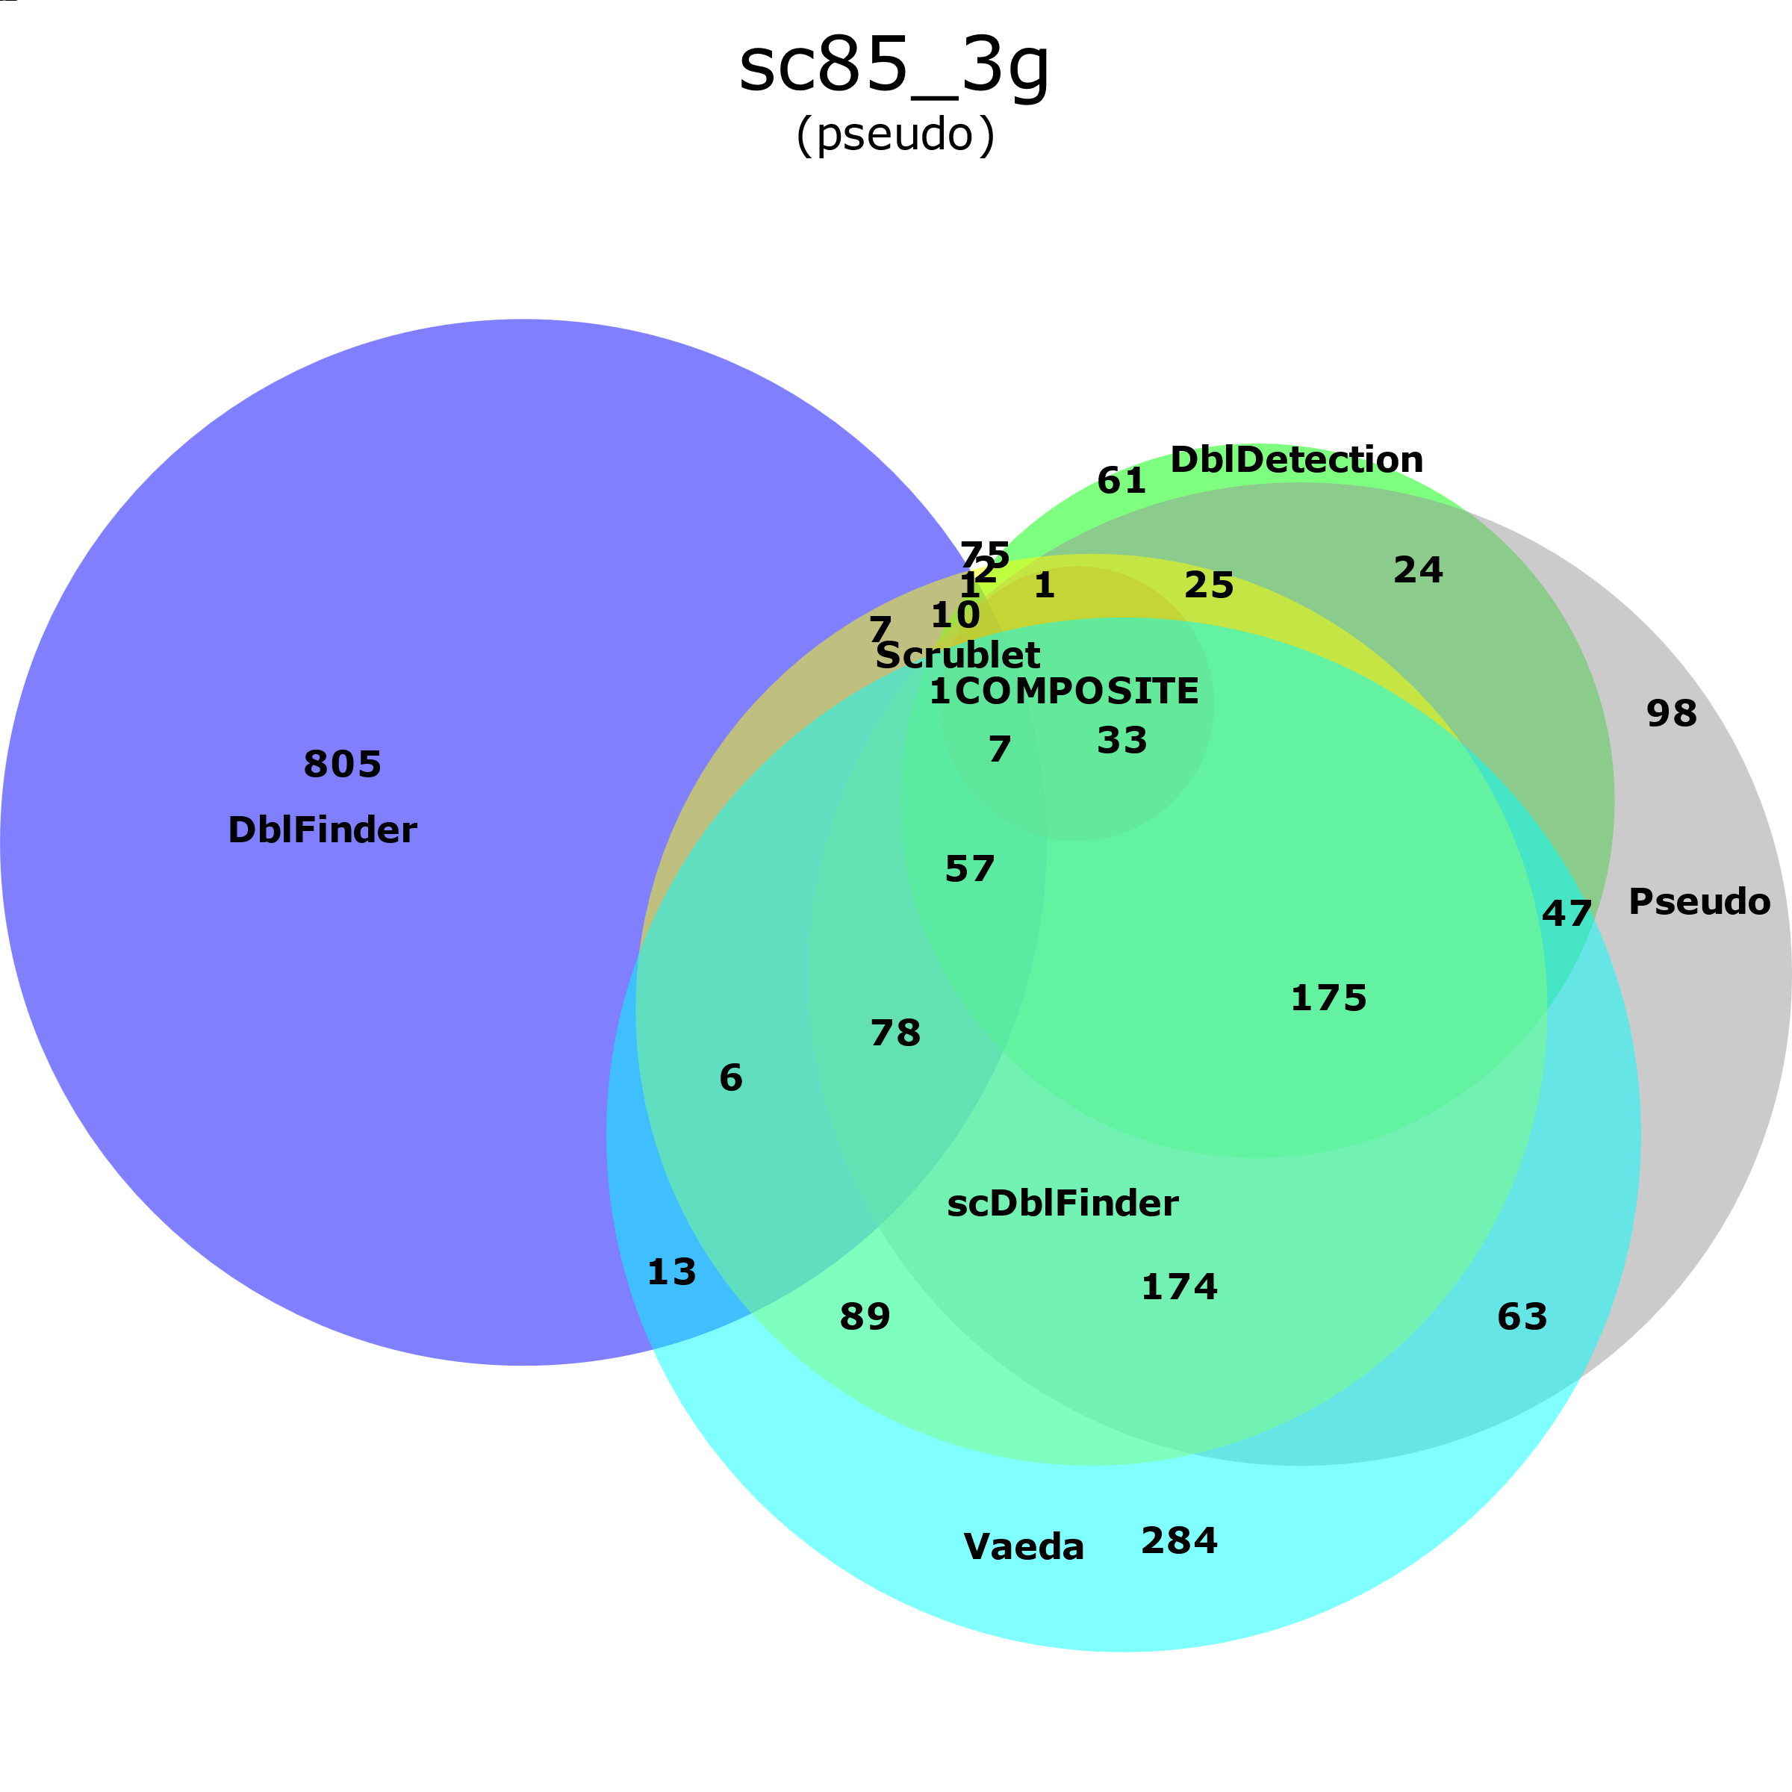
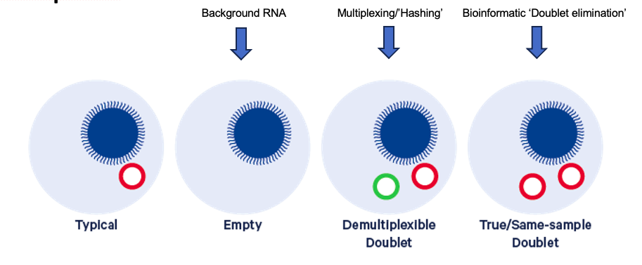
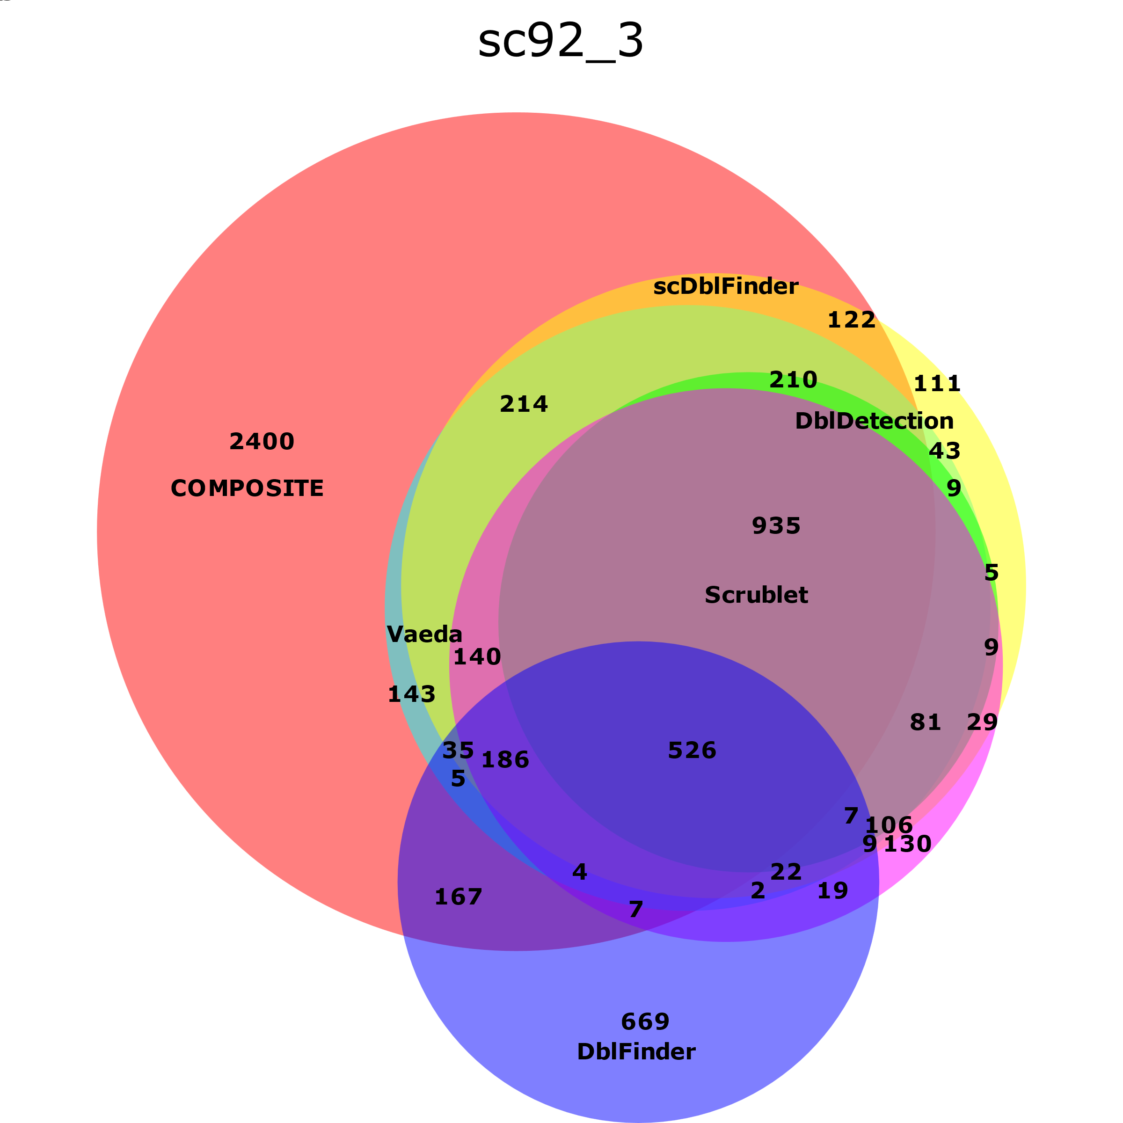
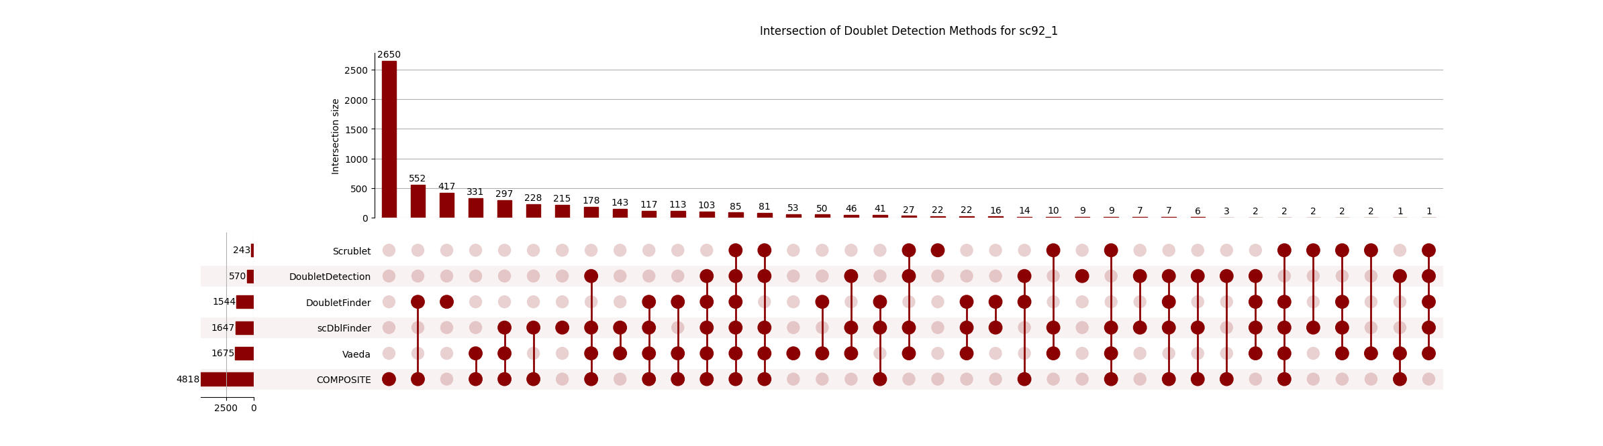
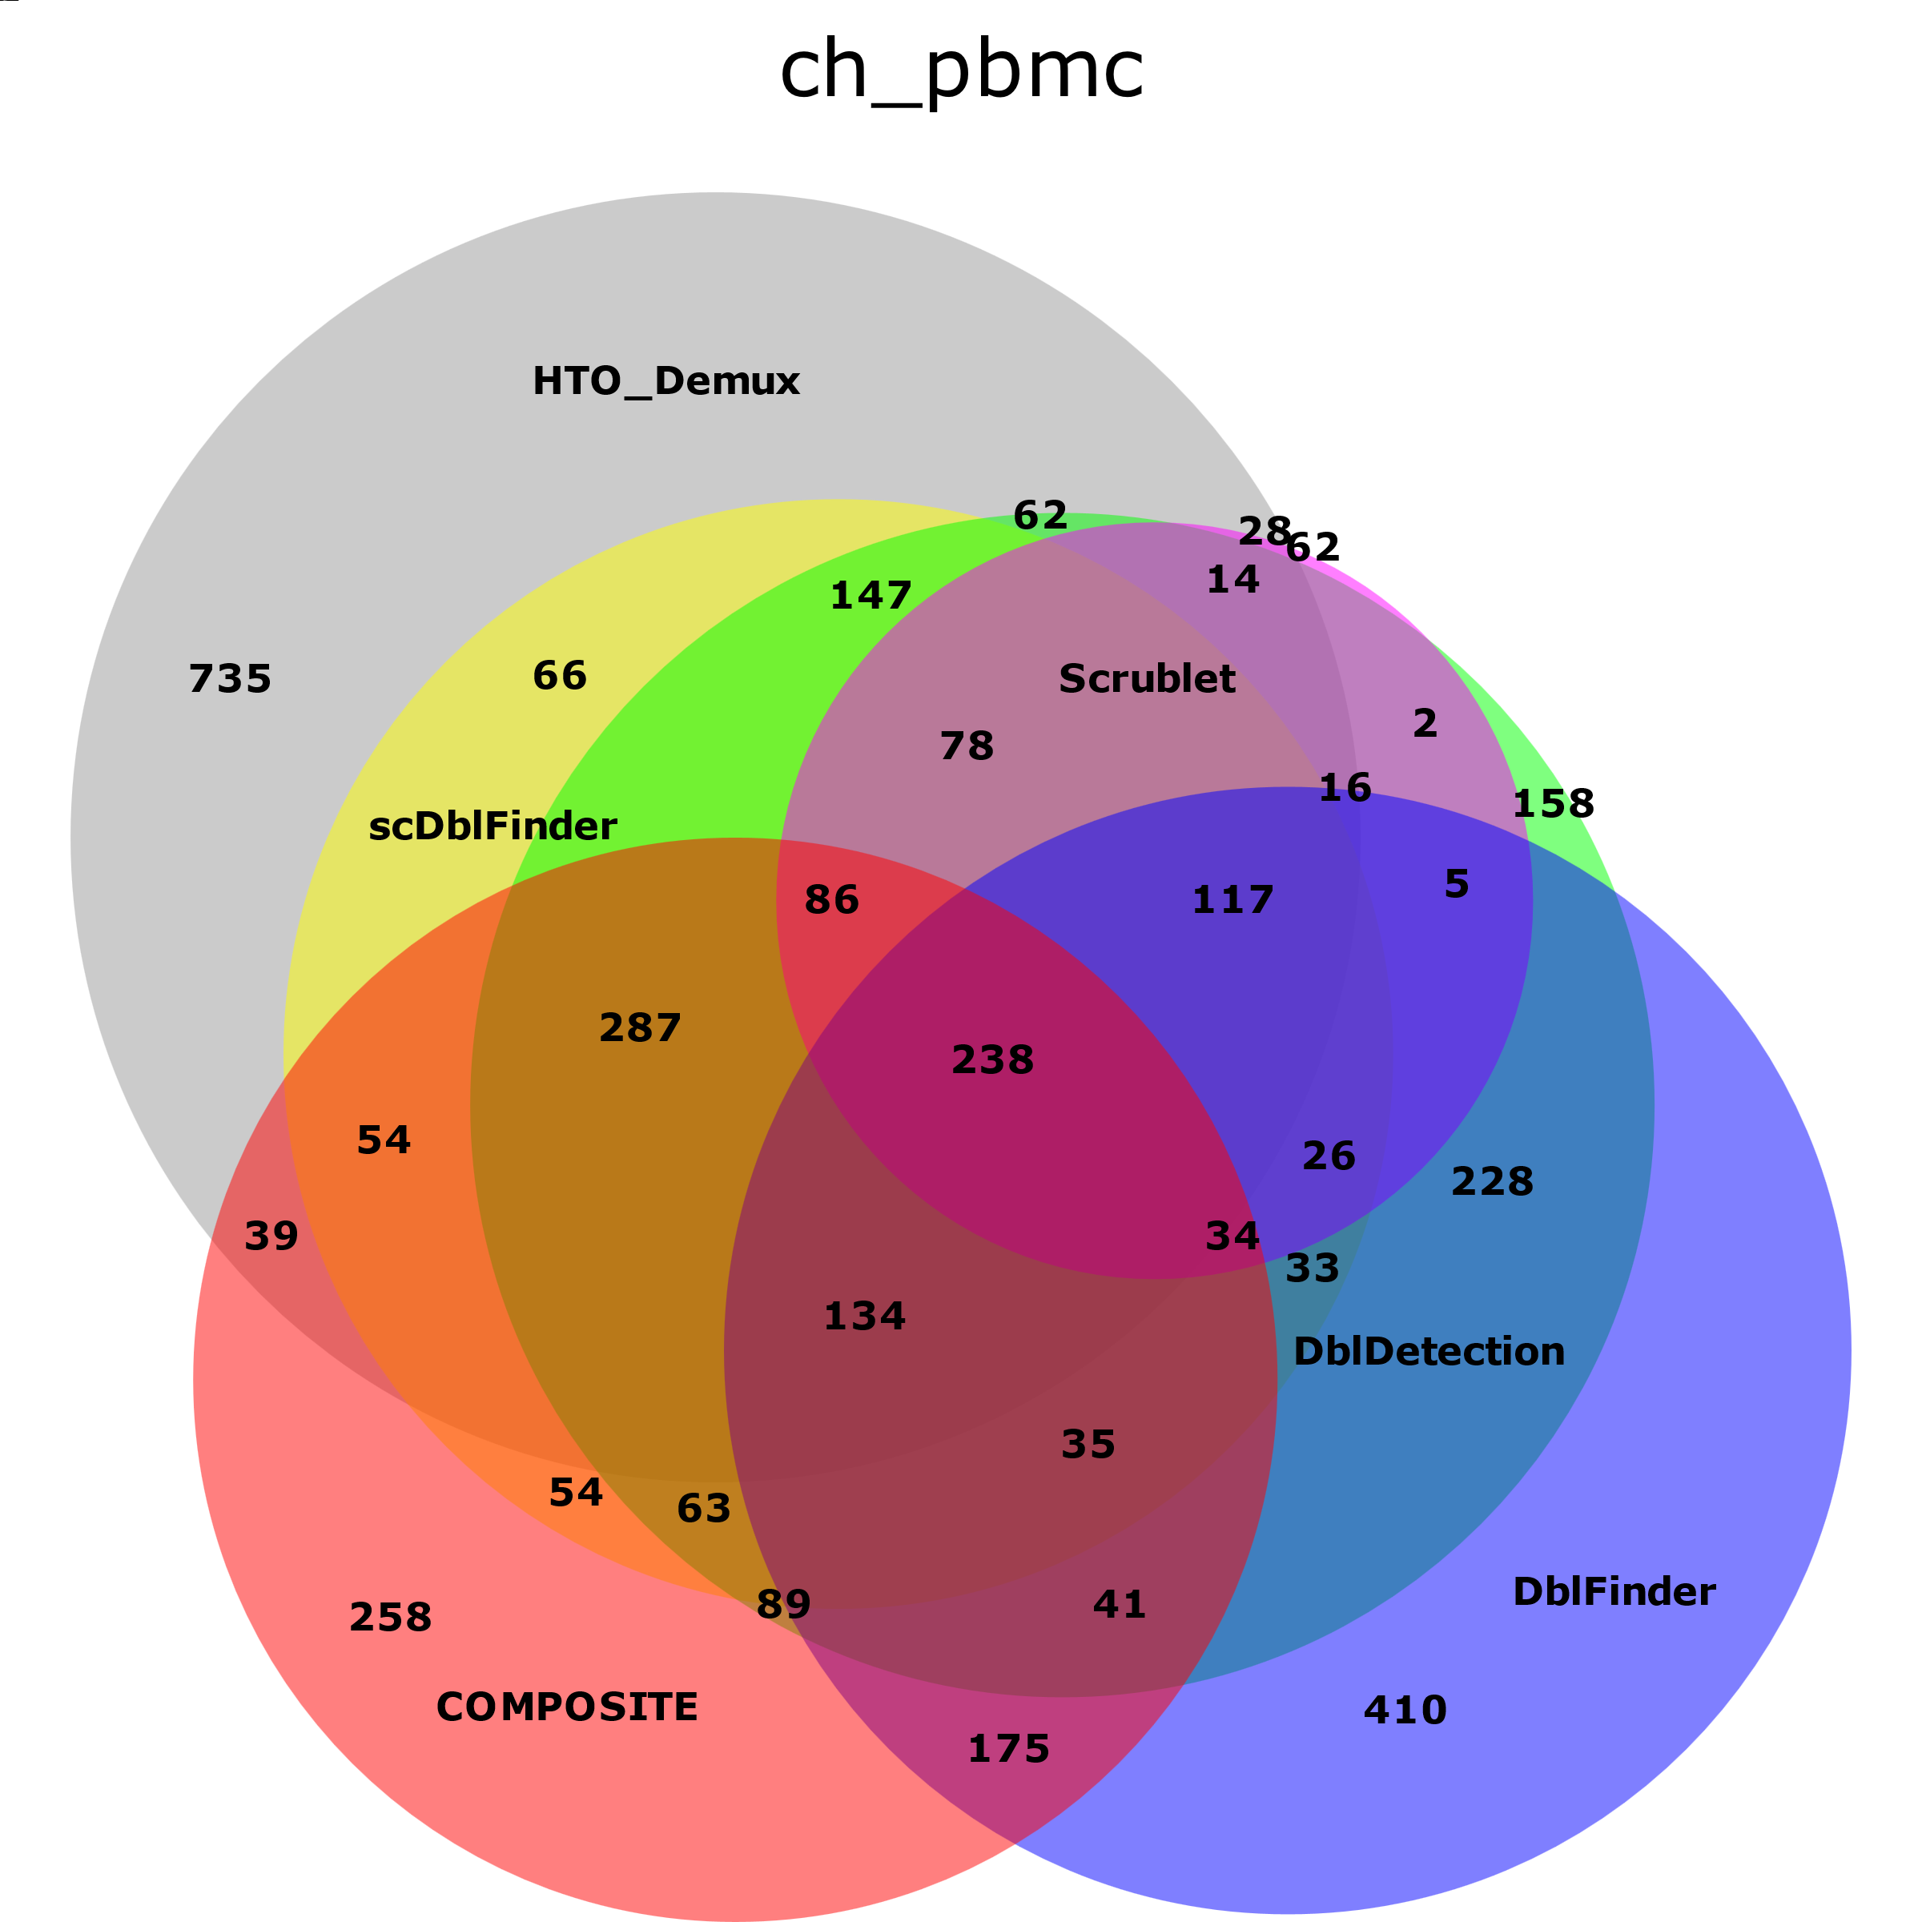
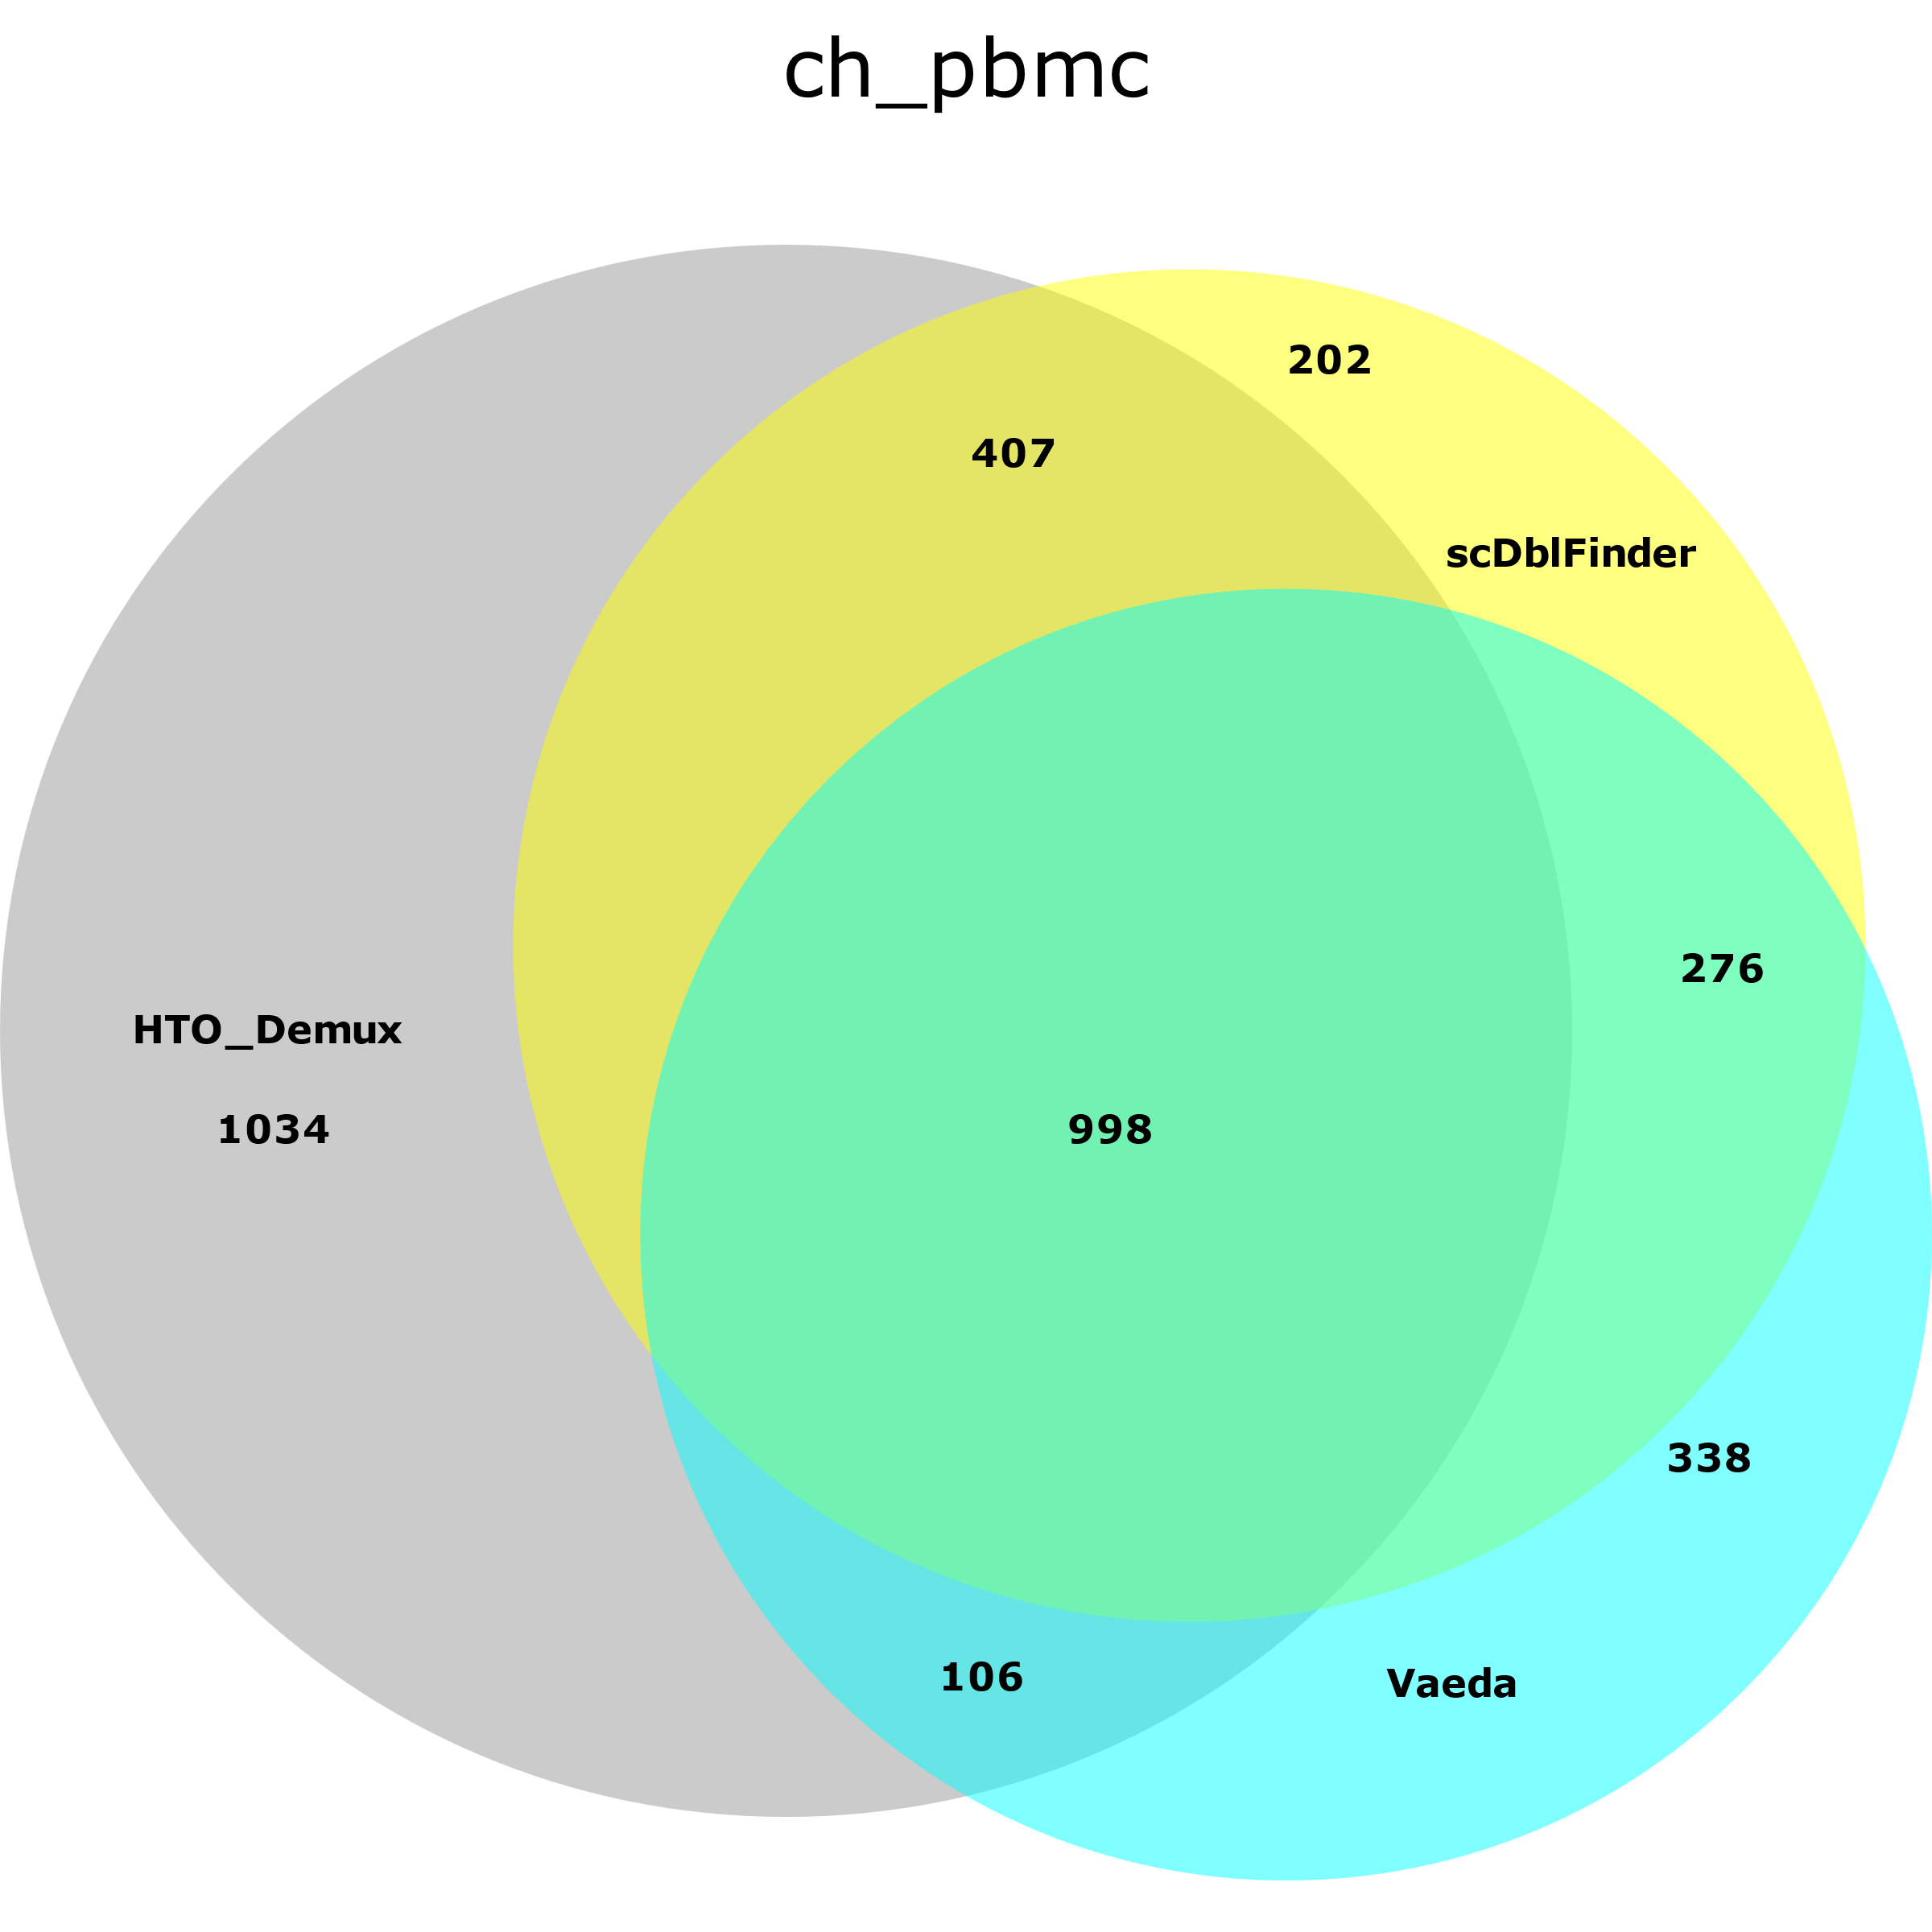
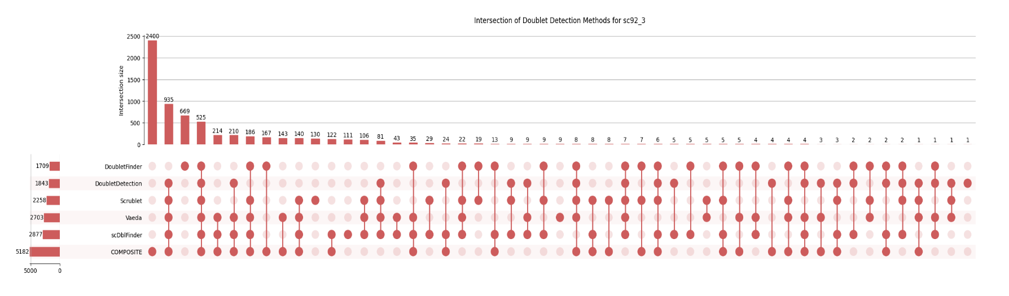
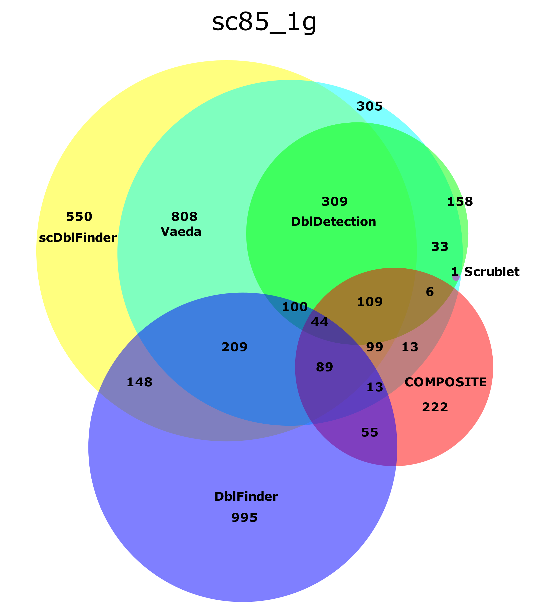
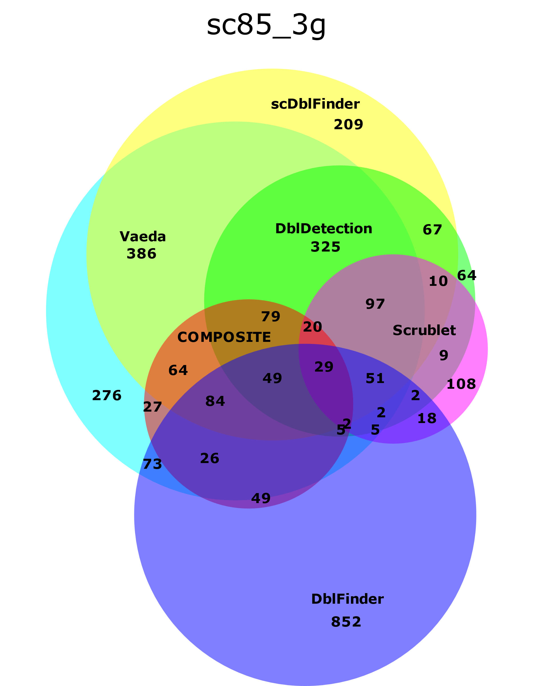
Comparative Analysis on Doublet Detection Methods for Single-Cell/Nuclei RNA Sequencing
Hannah Lee¹, Tiffany Lin¹, Christine Song¹, Ellie Lu¹, Victoria Chu¹, Cyrus Clabeaux¹, Gabriella Vaccaro¹, Barbara Rosati¹,², David McKinnon³
¹Stony Brook University Single Cell Genomics Facility, ²Dept. Physiology & Biophysics, ³Dept. Neurobiology & Behavior, Stony Brook University, Stony Brook, NY.
Introduction
Results
Single cell RNA-sequencing (scRNA-seq) and single-cell ATAC-sequencing (scATAC-seq) enable high-resolution analysis of cellular heterogeneity and chromatin accessibility, respectively. However, the presence of doublets or multiplets (two or more cells captured and sequenced as a single cell) formed during single cell/nuclei capture can confound downstream analysis. Accurately detecting and removing doublets from the analysis pipeline is critical for preserving data integrity. To improve our understanding of the available doublet detection methods, we compared their performance across a diverse set of datasets. These datasets include single-nuclei RNA sequencing data from mouse lung (sc92), multiplexed single cell PBMCs from eight unique donors labeled using cell-hashing (ch_pbmc), and data from whole killifish embryo (sc85).
A
B
A
B
Figure 1. Comparison of GEMs (Gel Beads-in-emulsion) generated during multiplexing. Source: 10x Genomics
C
D
Figure 4. Comparison of six doublet detection methods in sc85 datasets modified to detect artificially generated doublets (A) (B).
Methodology
A
B
The doublet detection methods examined include scDblFinder, DoubletFinder, DoubletDetection, Vaeda, COMPOSITE, and Scrublet. Beginning with the filtered-feature count matrix of each dataset, we implemented each doublet detection method using either Python or R, with default parameters. Using tools such as DeepVenn or Python libraries like matplotlib and numpy, we generated a combination of Venn diagrams and upset plots to visualize and compare the doublet IDs produced by each method.
For the PMBC dataset, experimental annotation of doublets was also possible using the demultiplexing method HTODemux, a cell-hashing–based method that identifies doublets by detecting multiple sample-specific tags. This allowed us to compare the computational methods to a putative ground truth.
Another ground truth test set used artificially created doublets using the getArtificialDoublets method from the scDblFinder library. This method generated pseudo doublets from the whole killifish embryo datasets following removal of all the doublets previously detected by the six methods tested.
In order to validate our confidence in scDblFinder’s performance and to ensure that the method is not biased towards the 10x Genomics expected value for doublet number, we reconducted scDblFinder on the whole killifish embryo datasets after removing just the doublets detected by this method in the previous run.
To fully understand each tool’s architecture, the mathematical approaches behind each of the doublet detection methods were examined and compared.
Figure 2. Comparison of six doublet detection methods in sc92 granuloma datasets (A) (B) (C). Upset Plots to highlight detailed intersections for sc92_1 and sc92_3 (D).
A
B
Figure 5. Analysis of doublets in the ch_pbmc dataset including HTODemux (A). Comparison between doublet removal performance between Vaeda and scDblFinder in context of ch_pbmc (B).
Conclusion
Our results point towards potential improvements in doublet detection methodologies, a crucial aspect of quality control for single cell/nuclei sequencing data and will be shared with the facility’s users. Future goals of this analysis include developing better methods to verify the accuracy of these doublet detection methods and examining other machine learning architectures that might perform this task more reliably.
Acknowledgements
Figure 3. Comparison of six doublet detection methods in sc85 granuloma datasets (A) (B).
We would like to acknowledge Deboparna Banerjee for her assistance with the analysis of the computational methods.

