Slide 1
Oppenheimer Project
By Lee Ai Ring

Slide 2
Key Content
Functional Testing
Non-Functional Testing
Feature Recommendations

Slide 3

Functional Testing
Verify against the functional requirements or acceptance criteria
Consist of positive and negative test cases

Slide 4
Additional Test Cases
“Refresh Tax Relief Table” button
“Visit Swagger” button (Is this even supposed to be displayed?)
“natid” and “relief” displayed correctly
“Total Tax Relief” (Amount & No. Of Hero) should be displayed correctly when there is single or multiple heroes’ record

Slide 5
Non-Functional Testing
Security Testing
Compatibility Testing
Load Testing

Slide 6
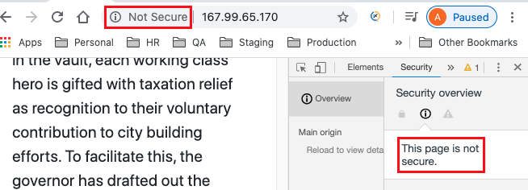
Security Testing
Portal not secure
Web page is served over HTTP protocol, which is an insecure protocol
Information sent and received with that page is unprotected and it could potentially be stolen, read, or modified
Solution - Enable the HTTPS protocol

Slide 7
2. Request sent via API is not secure
Uses HTTP protocol
No authentication
Solution - Use authentication tokens/secret key/Basic authentication (hashed/encrypted username & password)

Slide 8
Compatibility Testing
Best to use available cross-browser compatibility testing tool
Tested good on Google Chrome v81, Safari v13.1, and Firefox 75.0

Slide 9
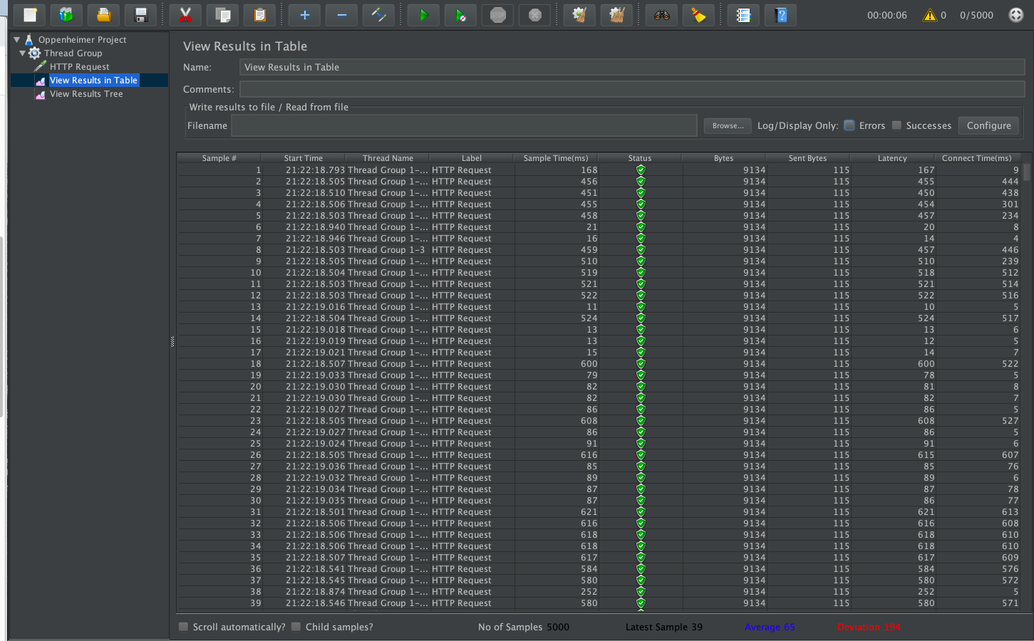
Load Testing
View installation guide on “Load Testing.md”

Slide 10
Feature Recommendations
Login
Portal
Option 1: 1 domain and UI changes based on the login account
Option 2: 3 portals for 3 different user
API
Validate authentication

Slide 11
Feature Recommendations
2. Tax Relief Report/View Tax Relief page
To allow Bookkeeping Manager to view Tax Relief Report without the help of Bookkeeper (Based requirement no. 4)
Display all the tax relief for all hero and its statuses

Slide 12
Feature Recommendations
3. BE error validation
Use 400 (Bad request) HTTP status code for field validation error
Provide friendlier error messages
FE display error messages from BE

Slide 13
Feature Recommendations
4. Update & Delete records
Hero info
5. UI
Need to improve on the UI. Does NOT provide good user experience.

Slide 14
Feature Recommendations
6. Date & Status Info
Date
Date & Time of hero info creation
Dispensation Date & Time

Slide 15
Feature Recommendations
B. Status
INFO_CREATED : Add hero info
INFO_UPDATED
INFO_DELETED
AMOUNT_DISPENSED
TRANSACTION_COMPLETED : Payment transaction completed

Slide 16
Feature Recommendations
7. Dispense tax relief based on hero
Allow Governor to dispense tax relief for a single/multiple working class hero
8. History Log
Display who did what (eg. “Jason added hero info”, “Taylor dispensed amount”)

