Slide 1
Predicting the price of skincare products using regression model
Jing Lee
April 20, 2022
Metis project 2
Web scraping and regression

Slide 2
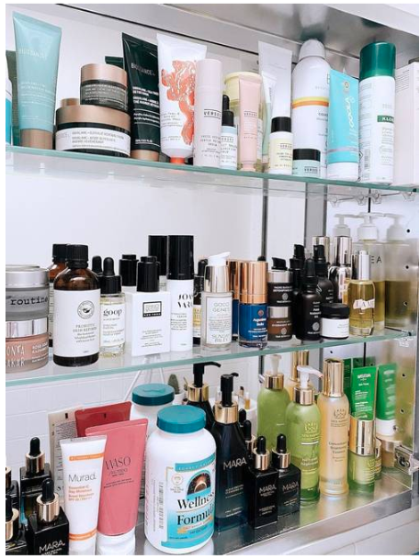
Introduction
Motivation
Skincare is a multibillion-dollar growing industry
The price for 1 oz cream range from $10 to $200+
What determine the pricing of products?
Budget brands vs luxury brands?
Objective
Investigation the features that contribute to the pricing of products
Use a regression model to predict price of skincare products
Goals
Consumers can decide what products to buy within their budget
New skincare companies can understand how products are priced

Slide 3
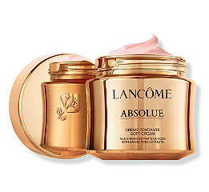
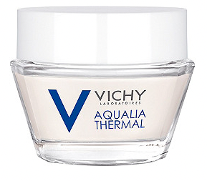
What goes into the pricing of products?
$123 per 1 oz
Parent company: L’oreal
Luxury brand
Rating: 4.6 stars
Reviews: 3,919
$17 for 1 oz
Parent company: L’oreal
Budget brand
Rating 4.12 stars
Reviews: 112

Slide 4
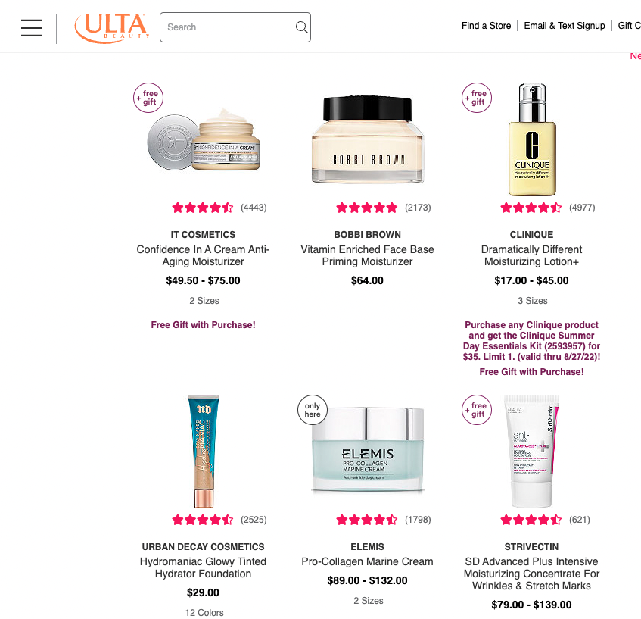
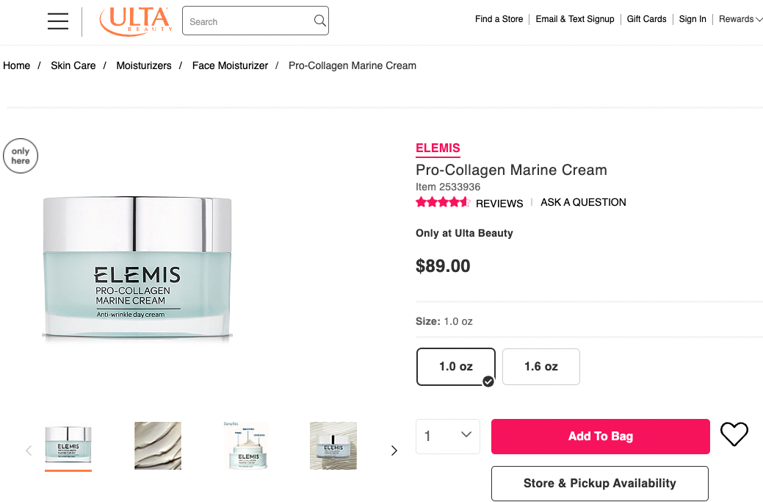
Methodology: data collection
Web scraping data (~1847 products)
website: www.ulta.com
Major retailer of beauty products ranging from luxury to affordable brands

Slide 5
Methodology: Tools
Tools:
Requests/ BeautifulSoup, pandas, matplotlib, seaborn, statsmodels, sklearn
Models:
Linear regression without regularization
Linear regression with regularization
Lasso
Ridge
Elastic net
Extensive feature engineering to improve model
Metrics:
R² , mean absolute error (MAE)

Slide 6
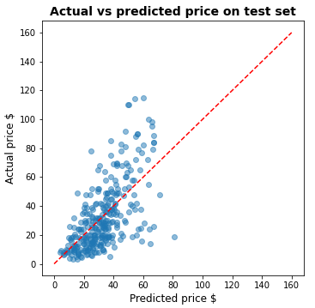
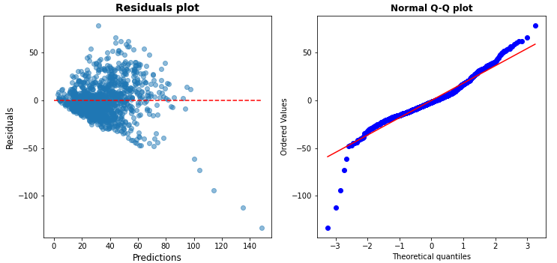
Model selection – cross validation
Linear regression without regularization
Predictors: 10 → 17 and 1501 datapoints
Mean train R² : 0.409 +/- 0.063
Test R² : 0.413
MAE: $13.66

Slide 7
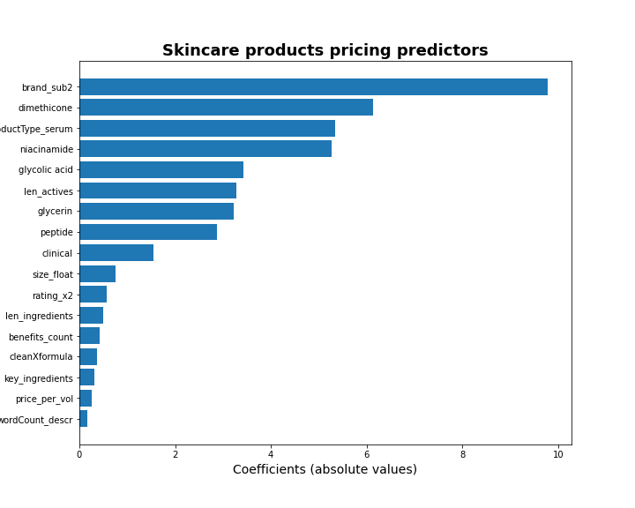
Predictors in the model
Predictors correlation with price (predictor)
len_ingredients 0.44
price_per_vol 0.44

Slide 8
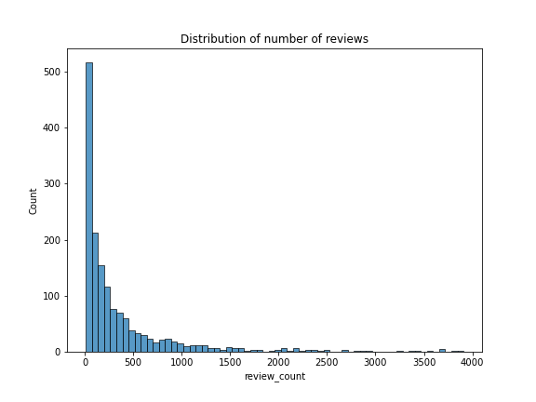
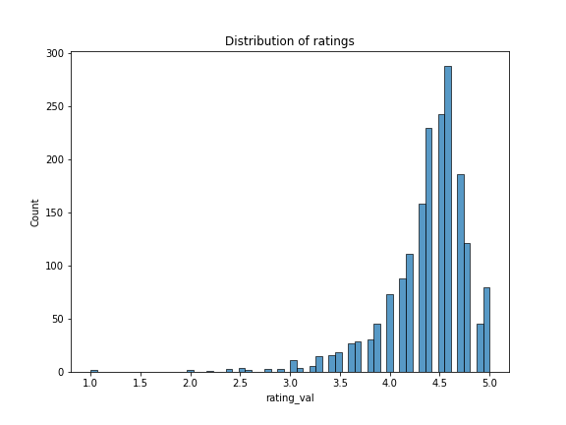
Other findings
Most brand come have the same 7 major parent companies
High ratings and low number of reviews and vice verse

Slide 9
Conclusions
Predicting price with linear regression and the current features is not a good model
Model has low prediction accuracy of ~ 41 %
Price prediction is +/- $13.66 is high considering average products cost ~$35
Missing important features such as investment in marketing which could heavily influence pricing and purchase power
There is no clear predictor for products pricing

Slide 10
Future work
Acquire data from other products sources
Sephora: luxury brands
Target: affordable brands
In depth study of the actual ingredients in the product to determine pricing
use of classification model to improve prediction
A feature to account for marketing influence

Slide 11
Thank you!!
Questions?

Slide 12
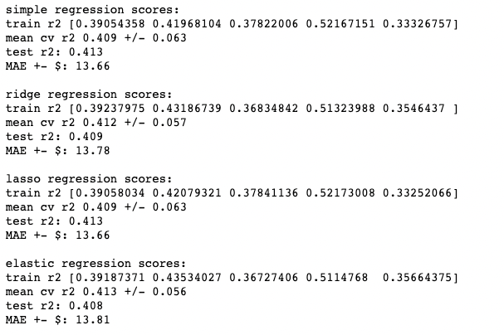
Appendix

Slide 13
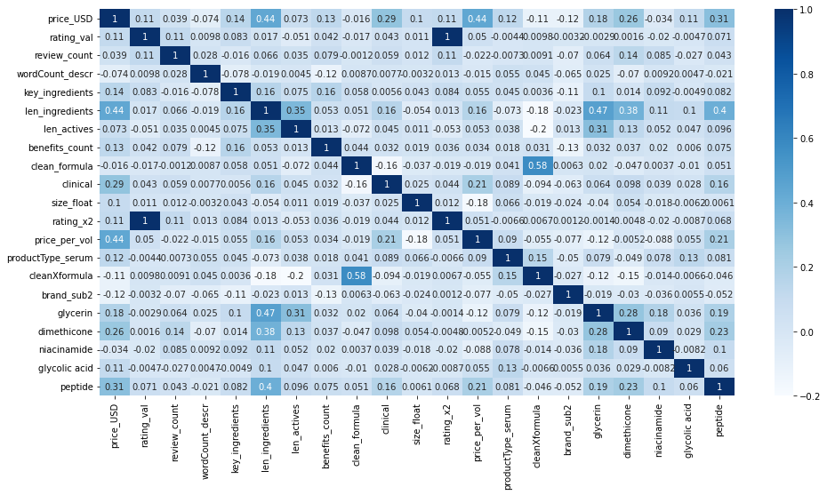
Heatmap

Slide 14
