Slide 1
Hyung-jin Joo Jisung Lee Jiwon Na
Share BZ

Slide 2
Content
Motivation
Target
Overview
Technology and Architecture
Website
Implements
Marketing Plan

Slide 3
01. Motivation

Slide 4
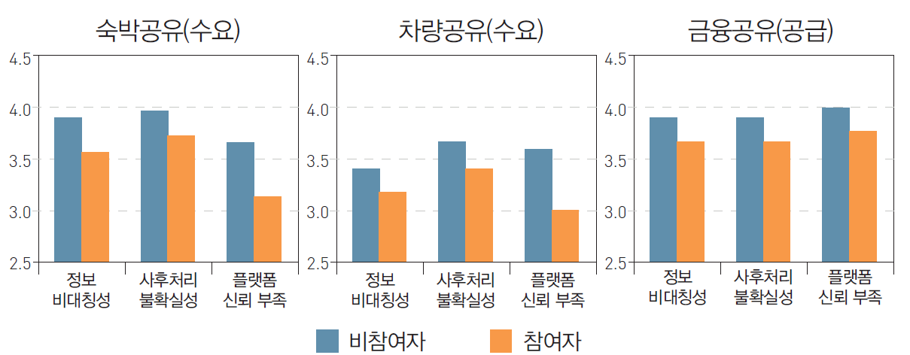
<Shared economic market size>
01. Motivation
<Shared market problems>
(10억 달러)
22배
자료: 김민정·이화령·황순주,” 공유경제의 안정적 성장을 위한 정책방향” 그림2
자료: 김민정·이화령·황순주,” 공유경제의 안정적 성장을 위한 정책방향” <표 1-27>, <표 1-28>.
Ethereum : smart contract + reliability + transparency
Need “reliability” and “Transparency “

Slide 5
We design and implement Shared economy system Named “Shared BZ”
01. Motivation
Share BZ

Slide 6
02. Target

Slide 7
People who are interested in shared economy.
02. Target
People who does not trust the shared economy system.
Shared economy system existing users.

Slide 8
03. Overview

Slide 9


03. Overview
Beads
guest
host

Slide 10
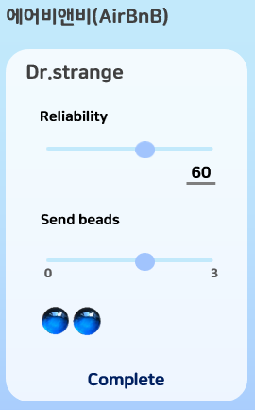
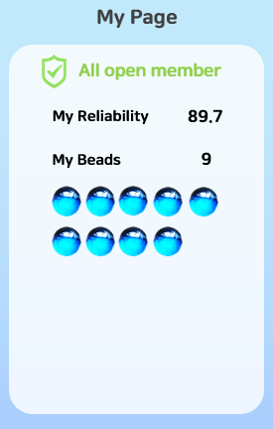
03. Overview

Slide 11
04. Technologies and Architecture

Slide 12
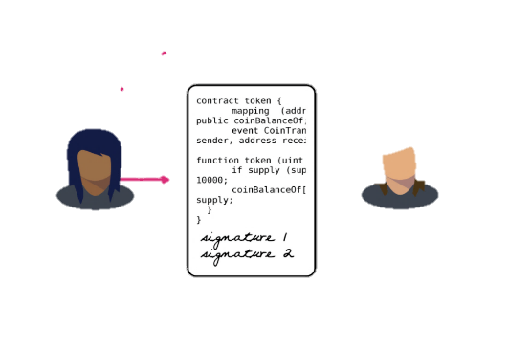








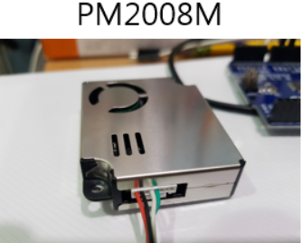
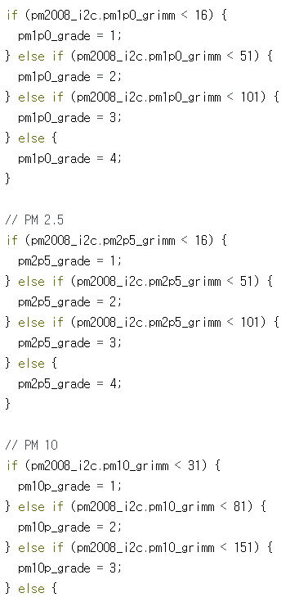
04. Technologies and Architecture
Implements Smart Contract with Solidity for using block chain technology based on ethereum technology.
Storing important data into the blockchain and send Ether for evaluation.
Smart Contract
Sensing extra data for provide to users
Implements Web Page for Front-end and Database to store general data
Web Page

Slide 13




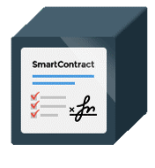
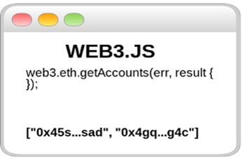
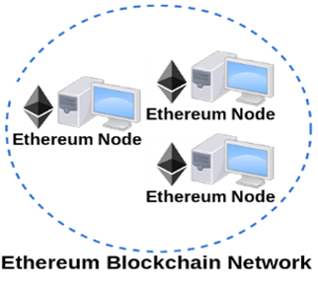
04. Technologies and Architecture
ShareBZ
Web Page
Database
Ganache TestRPC
MetaMask

Slide 14
05. Web site

Slide 15
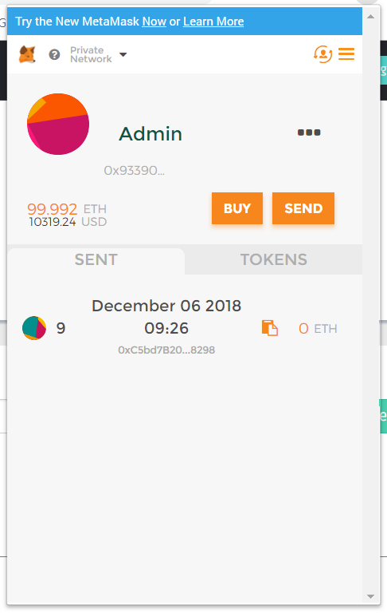
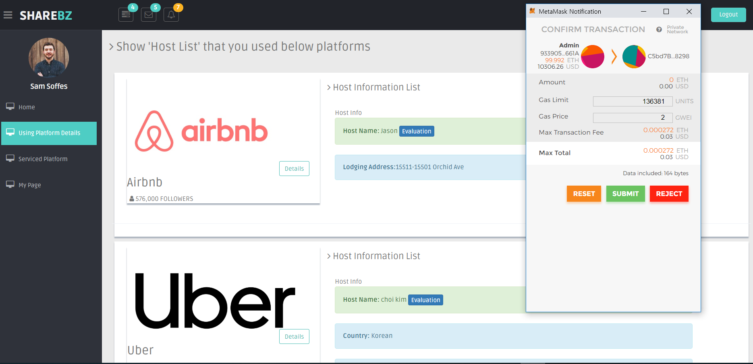
05. Web site
When users register web site, important data is stored in block chain and users can choose whether data is stored in block chain or not by choice submit or reject
When user choose submit, then user can confirm the result on the metamask

Slide 16
06. Implements

Slide 17
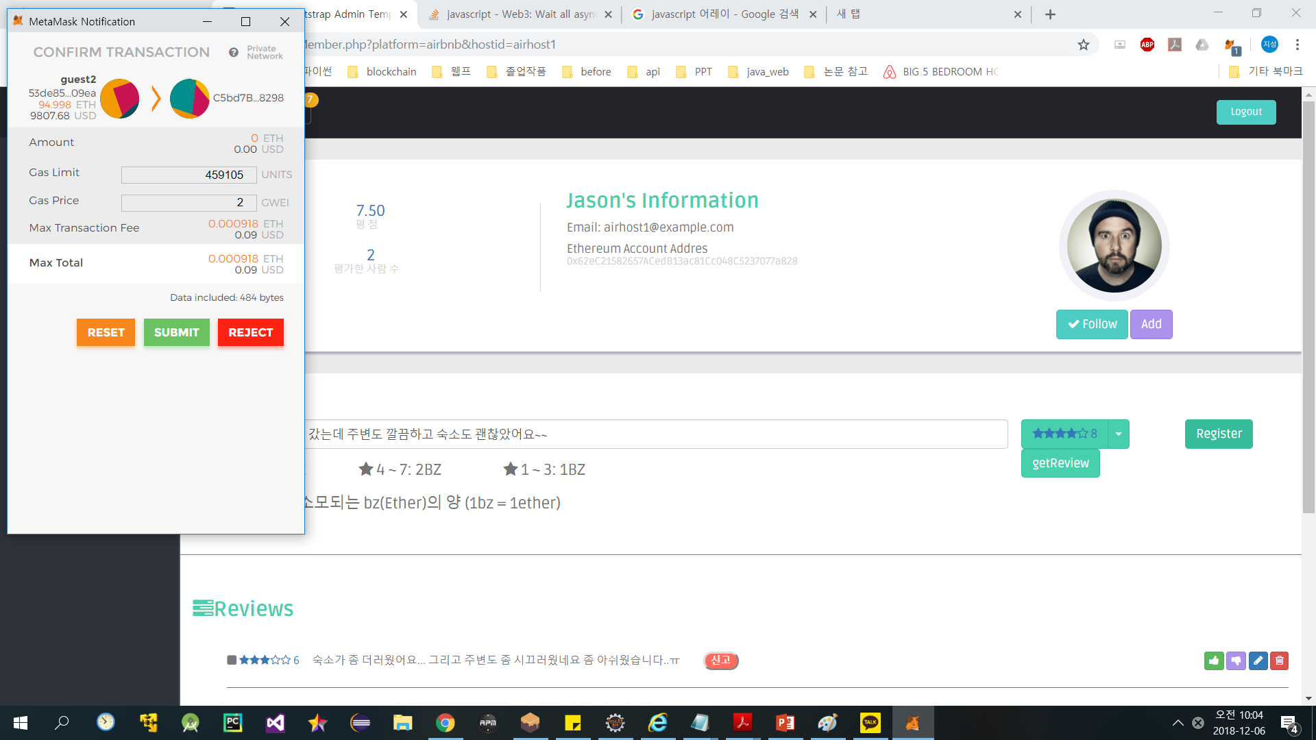

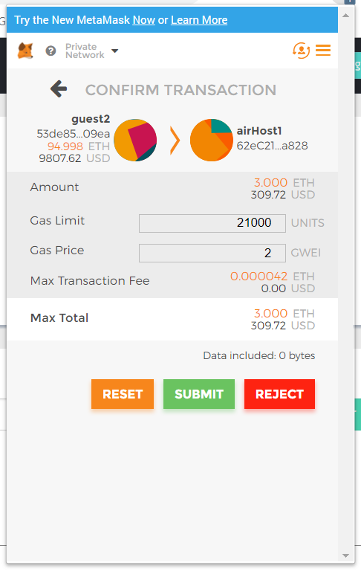
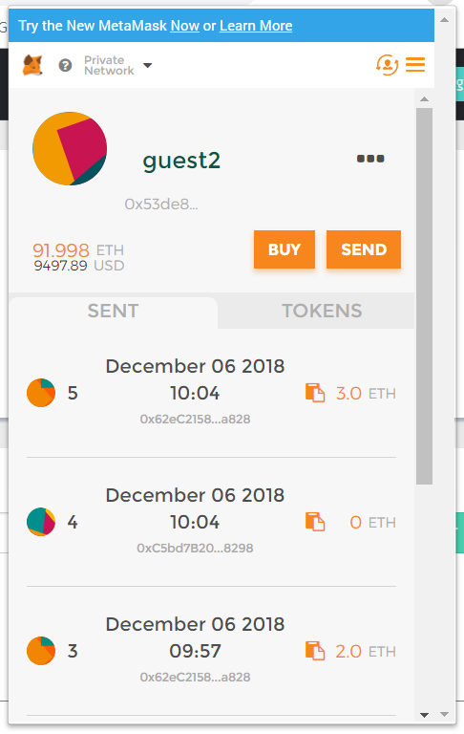
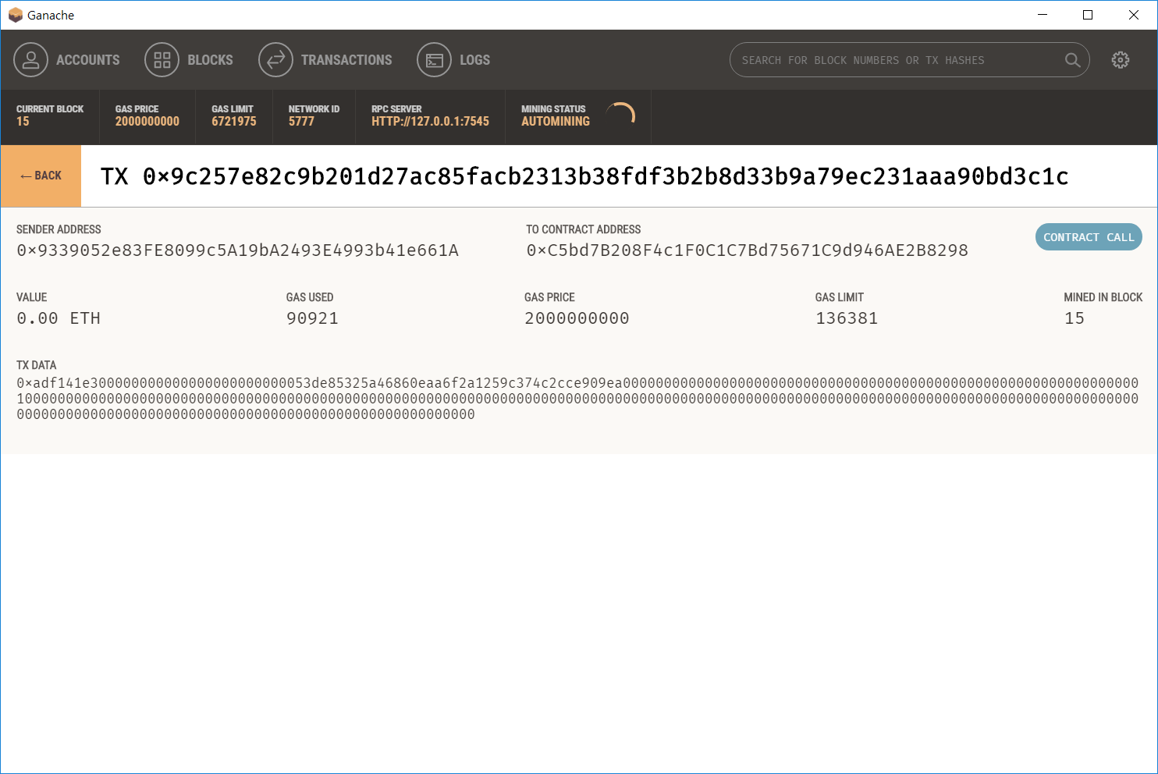
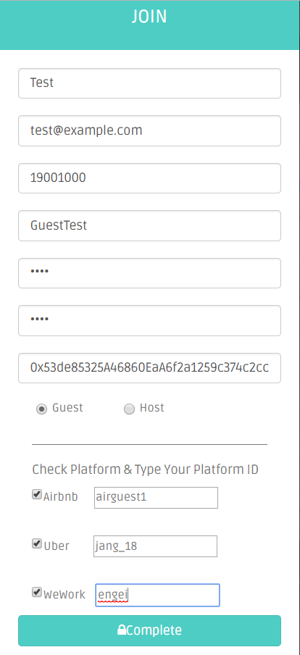
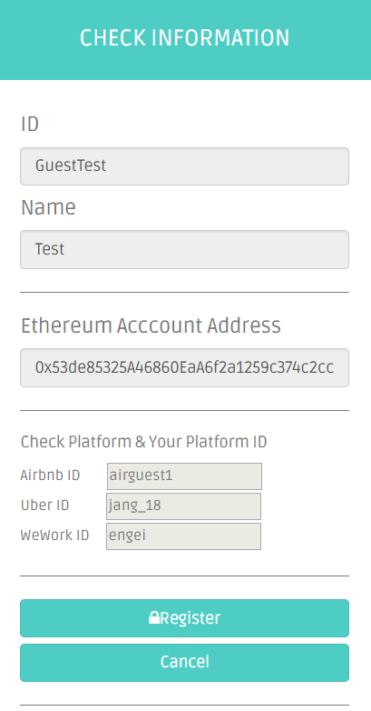
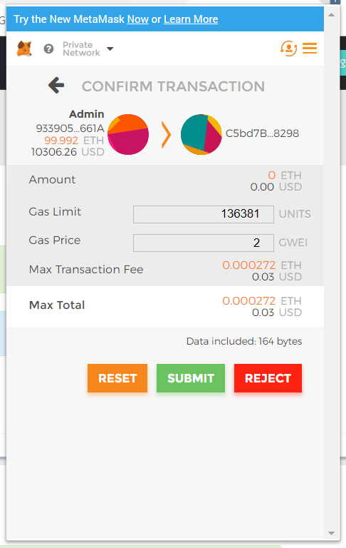
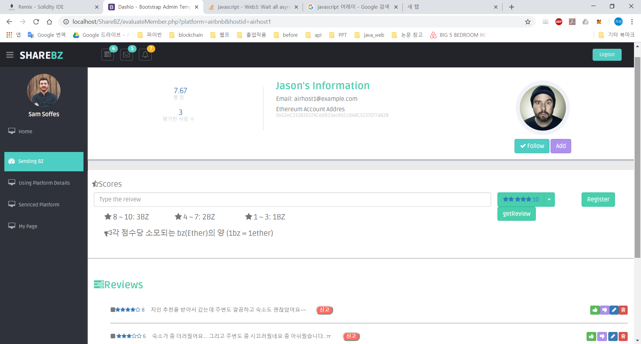
2
06. Implements
Architecture
1
When user evaluate other user, user can choose pass or no of this transaction.
when user select submit, then ether is transmitted to recipient.
3
Register on web site and submit the transaction, then important data is stored in block chain
After evaluation, result is posted on the web.

Slide 18
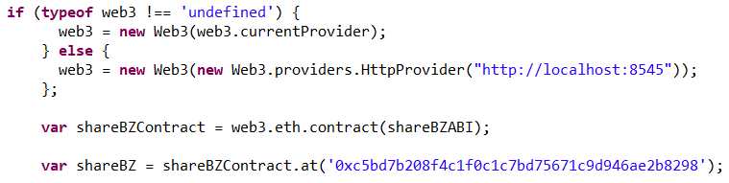
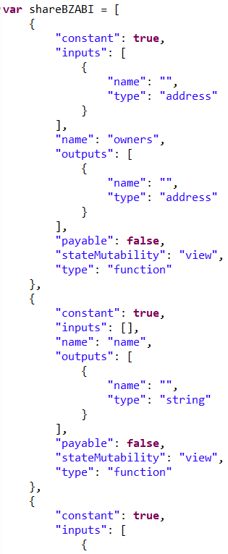
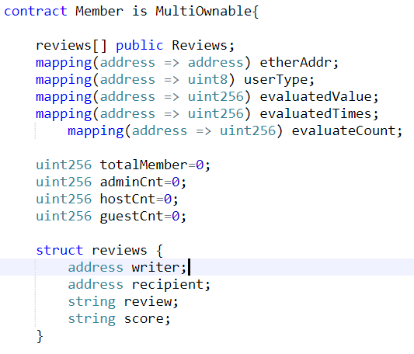
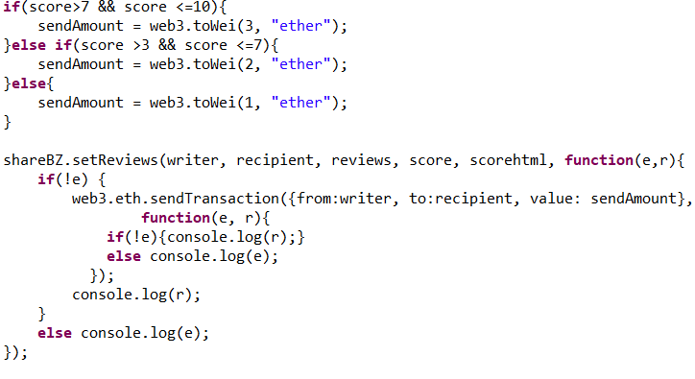
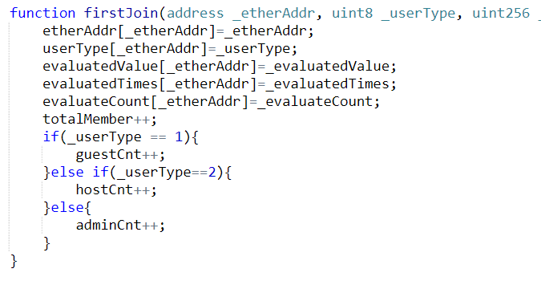
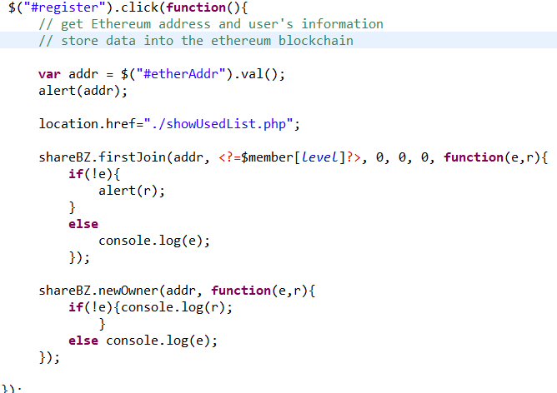
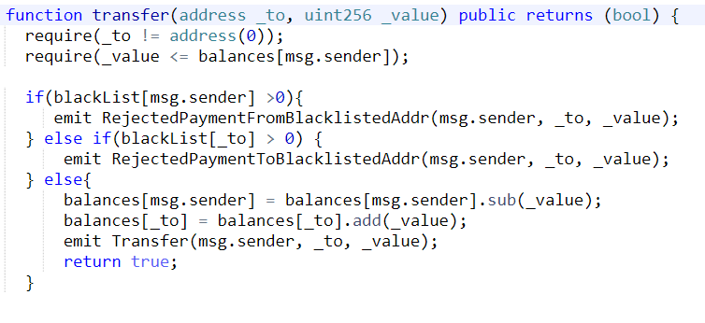
06. Implements (Code)
Web3.js
Smart contract ABI
Smart Contract (Solidity)

Slide 19
07. Marketing Plan

Slide 20

07. Marketing Plan
7-1) Market Analysis
Airbnb
A system for sharing a house and evaluating hosts with ratings and reviews.

Slide 21


07. Marketing Plan
7-1) Market Analysis
Uber, TADA
A system for sharing a car and evaluating hosts with ratings and reviews.

Slide 22
07. Marketing Plan
7-2) Marketing Strategy
SWOT
Strength
Weakness
Mutual trust assessment
Eliminate manipulability
Possible to check integrated information of existing user
Difficulty of attracting early users.
Improved user awareness about blockchain
Opportunities
Threats
Emphasize the need for a block chain
No related laws or restrictions.
Shared Economic Market Contraction

Slide 23
07. Marketing Plan
7-2) Marketing Strategy
STP
Segmentation
Targeting
Positioning
Shared economy market
Users aged 20 to 30.
Republic of Korea
Shared economy existing users
People who are curious about the reliability of people using shared economic platforms.
Shared economy based Mutual trust assessment solution

Slide 24
07. Marketing Plan
<Expected value>
Transparent disclosure of shared
businesses assessment is possible
Provides effective and reliable use
Use beadscoin as credit evaluation unit and various form
It brings the activation of distribution

