Slide 1


Redefining the use for Augmented Reality

Slide 2

LUMINARY
Luminary are about delivering traditional messages using the latest and greatest technology methods to differentiate from competitors.
What
They want a platform that allows continuous content updates that implements the use of AR.
Why
Each campaign requires a new application to be built which requires users to download a new app each time. This was ineffective.

Slide 3
WORKFLOW
Approach A
Build a platform where Luminary can continually add content.
Approach B
Build a ‘Plugin’ or SDK which companies can use to implement AR.
What we plan to do
Research.
Conclude research results and decide what approach to take.
Implement the approach.

Slide 4
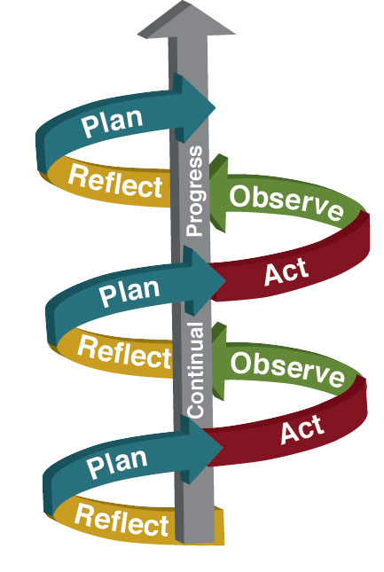
RESEARCH METHOD
Action Research Method
Cyclic Model
Four main phases
Planning
Acting
Observing/Evaluating
Reflecting

Slide 5
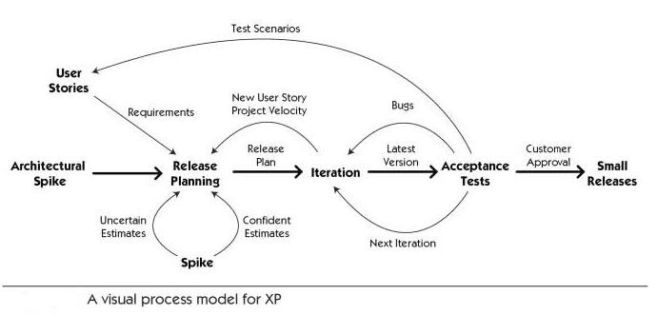
DEVELOPMENT METHOD
XP (Extreme Programming)
Agile
Flexible
Adaptable
Continuous Deliverables

