Slide 1
NYPD 311-Service-Request Calls 2019 vs 2020
Spring 2020 IS362 Final Project
by Sunah Lee

Slide 2
Outline
Introduction
Total Service Requests 2019 vs. 2020
2019 Service Requests by month
2020 Service Requests by month
Comparison Top 3 Complaint Types
January 2019 vs. January 2020
February 2019 vs. February 2020
March 2019 vs. March 2020
April 2019 vs. April 2020
Current In Progress Cases
Conclusion

Slide 3
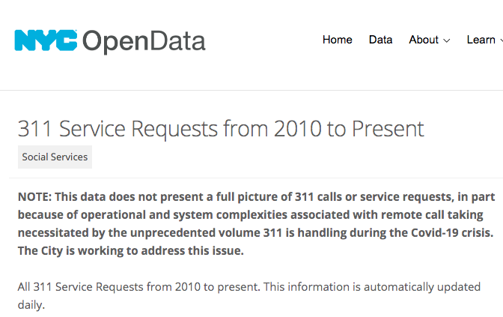
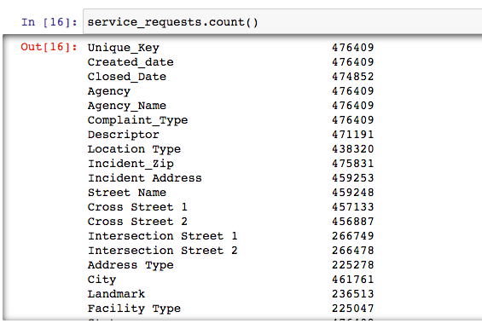
Introduction
The data was retrieved from: https://data.cityofnewyork.us/Social-Services/311-Service-Requests-from-2010-to-Present/erm2-nwe9
It was filtered for dates 01/01/2019-04/30/2019 and 01/01/2020-04/30/2020 and service agency NYPD.
The goal of this project is to compare NYPD service requests between Jan-April 2019 with Jan-April 2020 to find the impact of the COVID-19 quarantine on NYPD service request patterns.

Slide 4
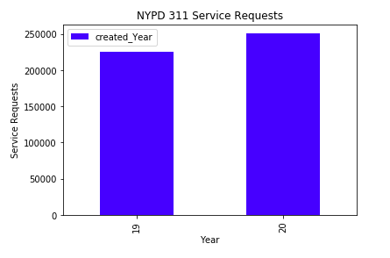
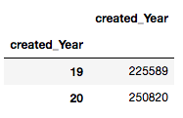
Total Service Requests 2019 vs. 2020

Slide 5
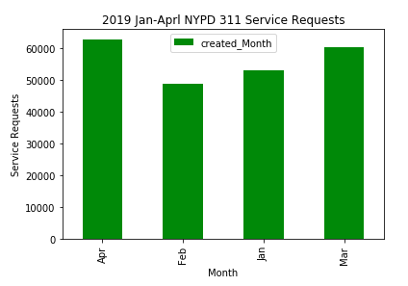
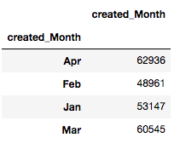
2019 Service Requests by month

Slide 6
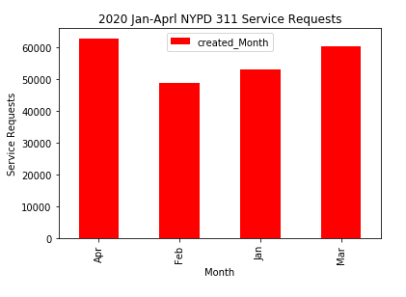
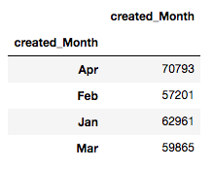
2020 Service Requests by month

Slide 7
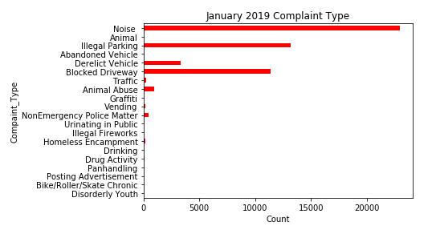
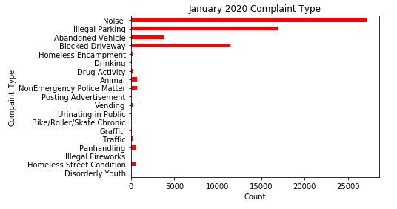
Jan 2019 vs. Jan 2020
Top 3 types of complaints are same both months:
1 – Noise
2 – Illegal Parking
3 – Blocked Driveway

Slide 8
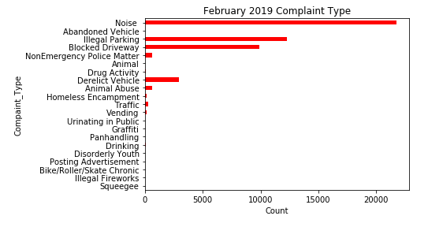
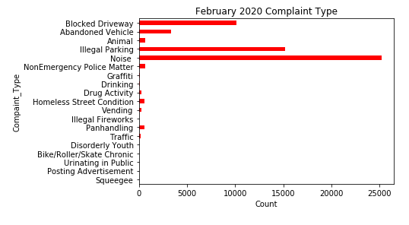
Feb 2019 vs. Feb 2020
Top 3 types of complaints are same both months:
1 – Noise
2 – Illegal Parking
3 – Blocked Driveway

Slide 9
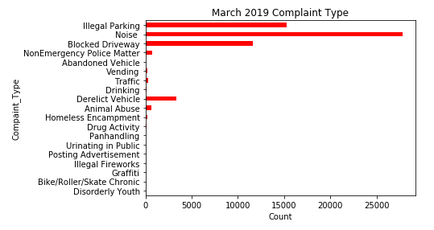
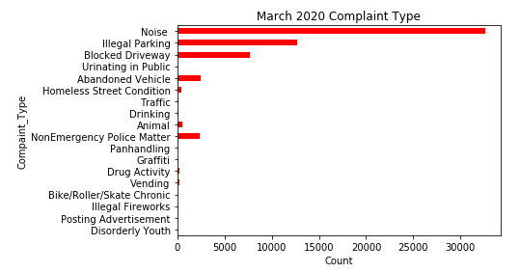
Mar 2019 vs. Mar 2020
Top 3 types of complaints are same both months:
1 – Noise
2 – Illegal Parking
3 – Blocked Driveway

Slide 10
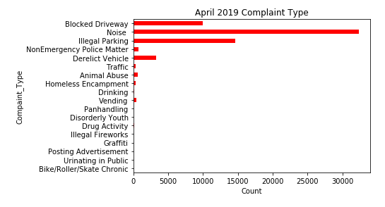
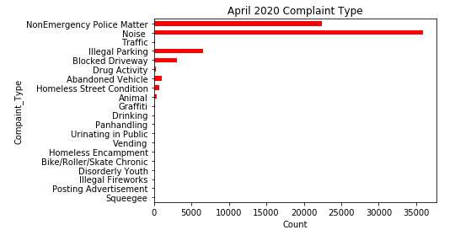
Apr 2019 vs. Apr 2020
Top 3 types of complaints are different:
April 2019
1 – Noise
2 – Illegal Parking
3 – Blocked Driveway
April 2020
1 – Noise
2 – Nonemergency
3 = Illegal Parking

Slide 11
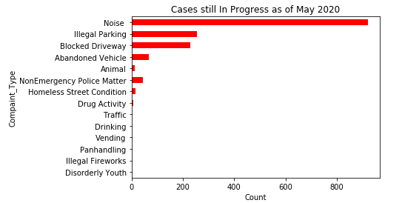
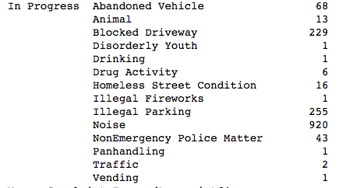
Current In Progress Cases
As of May 2020, 1,557 cases created in January,
February, March, and April of 2020 are still
In progress.
Noise complaints make up most of it with 920
Cases still in progress.

Slide 12
Conclusion
After comparing NYPD 311 service request calls placed in January-April 2019 and January-April 2020 within NYC area, I arrived at the following conclusions:
Total service requests increased from 2019 to 2020. In 2019 Jan-Apr, it was 225,589 and it was 250,820 in the same time frame in 2020.
The number of service requests increased each corresponding month in 2019 to 2020 except in March, where it decreased from 65,545 to 59,865.
In Jan, Feb, Mar, and Apr of 2019, as well as Jan, Feb, and Mar of 2020, the top three types of Complaints were, Noise, Illegal Parking and Blocked Driveway, in that order.
In April 2020, the top three complaint types were Noise, NonEmergency Police Matter, and Illegal Parking (in that order). Rise in Nonemergency police matter complaints and decrease in Illegal Parking and Blocked Driveway complaints may be explained by the COVID-19 stay-at-home lockdown in NYC from mid-March to May 2020.
There are still 1,557 cases open to date, the information gets updated daily. Most of them are noise complaints

