Slide 1
Analysis of emotions through color
Lee Cattarin
Data Science, Fall 2016

Slide 2
Overview
Goal: To analyze the colors associated with common emotions via Google Image search and image analysis in Python
Prevents bias from related ideas, thoughts, or emotions
Relation of happiness to sunshine or good weather
Relation of two separate emotions such as anger and sadness
If successful, possible expansion to look at differences across cultures and countries
Notes:
Pretty much what it says on the tin

Slide 3
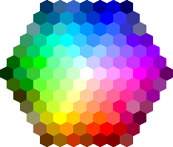
Original Plan
Python code with results stored in SQLite database
Scrape Google Images for top 100 results for common emotions
Set 127 distinct color groups for analysis based on web color picker
Count each pixel as color it is closest to and calculate fraction of that color
SQLite table for each emotion
Columns for colors named by RGB hex codes – floating point values
Column for URL source of image – text value
Notes:
* Indicates parts of the plan that changed to some extent
Logical collections:
Standard color palette to make clear color sets*
Table for each emotion, column for each color
Physical data handling:
Python libraries for working with Google Images and manipulating and analyzing images*
Stored in SQLite database
Interoperability support:
No need to combine multiple types of data
Percentages to two decimal points*
SQLite is easy to access and use via command line, programming languages, websites, and applications specifically for viewing databases
Security:
SQLite database, Python code, HTML code for color picker, and emotion images stored in Dropbox and on an external hard drive
Metadata collection, management, and access:
Table titles, column titles, column types (REAL and TEXT)
File names are descriptive with date, title of work, author
Emotion image files are named with [emotion]_###

Slide 4
Changes and Challenges
Google Image API deprecated – used mass download software instead
Loss of image URLs
Slightly fewer images than expected due to errors
Originally tried to pull hex codes from HTML for color chart site, but the resulting set of values was uneven – generated RGB instead
Pixels with different values –some 4-tuples with transparency, some just integers
No clear definition of closest in terms of color
Size of images made program too slow – resize down to 100px smaller dimension
Multiple image formats, including .gif
Choice of what emotions to use – Robert Plutchik’s 8 Primary Emotions
Notes:
Google Image API deprecated and web scraping becoming complicated, so turned to a mass download software
This meant that image URLs were no longer preserved and could not be saved in the database, and there needed to be a different way to “trace” data
Turned to image titles instead – joy_026 etc
Between 2 and 8 images per 100 had download errors, so the actual number of images per emotion is somewhere in the 90 to 100 range
The color chart didn’t have all possible combinations of several values, which was necessary for closest( ), so instead I generated decimal and hex values for RGB from several key points along a 0 to 255 scale
Color picker had white, but lacked grayscale, so it was added for emotions such as fear, sadness that looked to have many black and white images
Integer pixel color values. Who’lda thunk. Grayscale.
In terms of RBG, there’s no clear definition as to what color is “closest” as there’s a lot of intricacies to how we view color
Since I had 6 set values any R/G/B value could adhere to, I picked the closest for each and found the tuple that matched that set
PNG and JPG formats were acceptable, but the few GIF formats that were downloaded I manually converted into JPG
Anger, Anticipation, Disgust, Fear, Joy, Sadness, Surprise, Trust
Python is so slow
Changes in plan form:
Logical collections:
Standard color palette to make clear color sets – still a standardized palette, but differs from the intended source
Physical data handling:
Python libraries for working with Google Images and manipulating and analyzing images – bulk downloader instead
Interoperability support:
Percentages to two decimal points – unrounded, out of 1 rather than 100 (not expressed with percent sign)

Slide 5
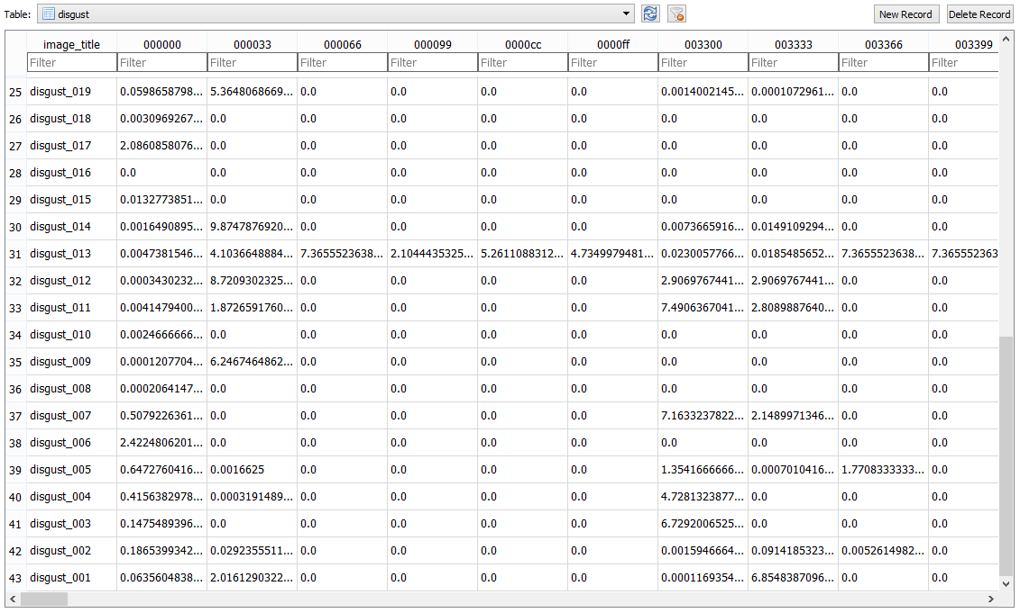
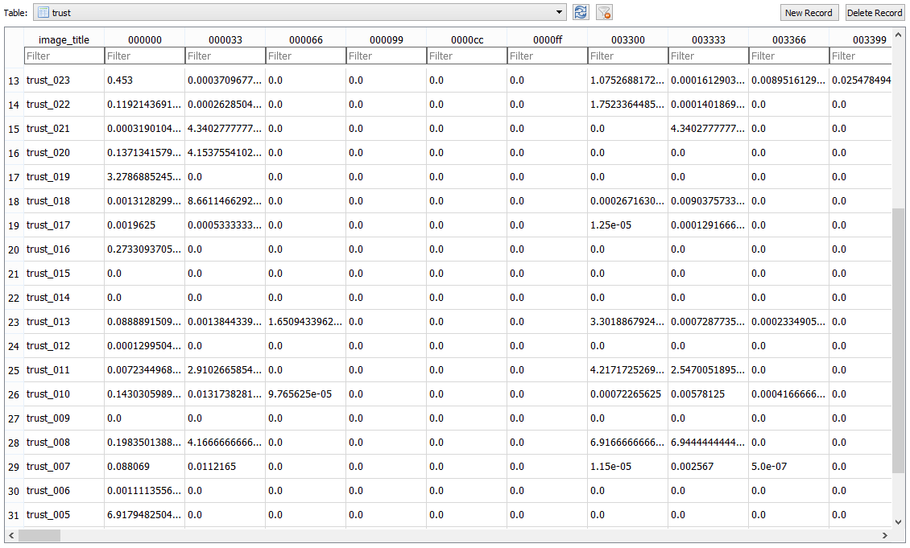
Notes:
Examples of data taken mid-processing: Disgust & Trust

Slide 6
Future Challenges and Questions
Notes:
Brief notes on upcoming challenges for analysis:
Many emotion images are human faces, which will not give meaningful results
Media like Inside Out (emotion characters) or Rocky Horror Picture Show and How I Met Your Mother (Anticipation) dilute meaning in emotion pictures
Dealing with white or black backgrounds in otherwise colorful pictures
Questions?

