Slide 1
Predicting Dropouts in MOOC
Course Project
By Rhea Chugh, Woochan Lee, Ishan Jain
COMP4331

Slide 2
The Problem
“Students’ high dropout rate on MOOC platforms has been heavily criticized, and predicting their likelihood of dropout would be useful for maintaining and encouraging students’ learning activities.”

Slide 3



Division of Labour
Ishan Jain
Research
Pre-processing feature 2
Slides & Report/ Ada boosting?
Rhea Chugh
Research
Did the classifications
Cross-fold Validation?
Woochan Lee
Research
Pre-processing feature 1
Ada Boosting?

Slide 4
Understanding the Data (1)
date.csv – timespan of each course
course_id
from – Course Start Date
to – Course End Date
log_train.csv -- behavior record
enrollment_id
Time
source
Event source (server or browser).
event - 7 different event types:
1. problem – Course assignments.
2. video - Course videos.
3. access – Accessing course objects
4. wiki - Accessing the course wiki.
5. discussion – Accessing course forum. 6. navigate - Navigating others
7. page_close – Closing web page.
object - The object the student access
object.csv -- module in a course
course_id
module_id
category - category of course module.
children – children modules
start – Module release time
enrollment_train.csv -- enrollment record
enrollment_id
Username
course_id
true_train.csv -- Ground Truth
1st column - Enrollment ID.
2nd column - Ground truth of dropout (1 for a dropout event and 0 for continuing study)

Slide 5
Understanding the Data (2)
Predicting their likelihood of dropout
The timespans of each course for calculating dropouts is 10 days after the last day of that course,
i.e. Course C is from 2014.4.1 to 2014.4.30 in the given data, a user enrolled the course C will be treated as a dropout if he/she leaves no record from 2014.5.1 to 2014.5.10
120,542 enrolments
95,581 -> Dropout
24,961->Completion
Imbalanced Data
SK-Learn Resample
Describe Resampling Technique

Slide 6
Pre-Processing
Index | Features | Index | Features
1 | # problem | 6 | # navigate
2 | # video | 7 | # page close
3 | # access | 8 | # server
4 | # wiki | 9 | # browser
5 | # discussion
Index | Feature
1 | last log time - first log time
2 | # effective study days
3 | # events in the late period
Table 1. Log Record Feature
Table 2. Time Features
Notes:
Approach people in emotional needs
Facial recognition to detect sad faces
Refer to database preference on distrub or not
Identify and satisfy needs on essentials
Conversations & interactions
Indicate essentials location
Entertainment
Jokes
Dance

Slide 7
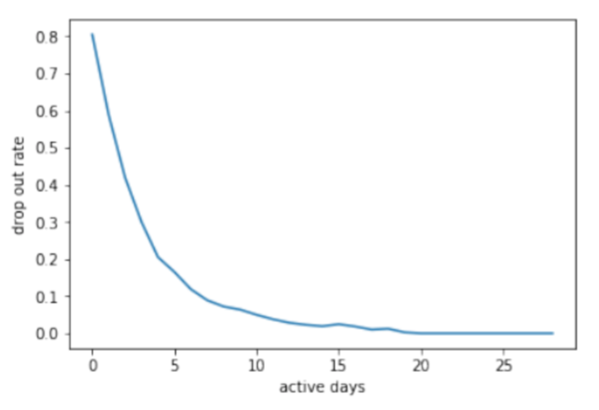
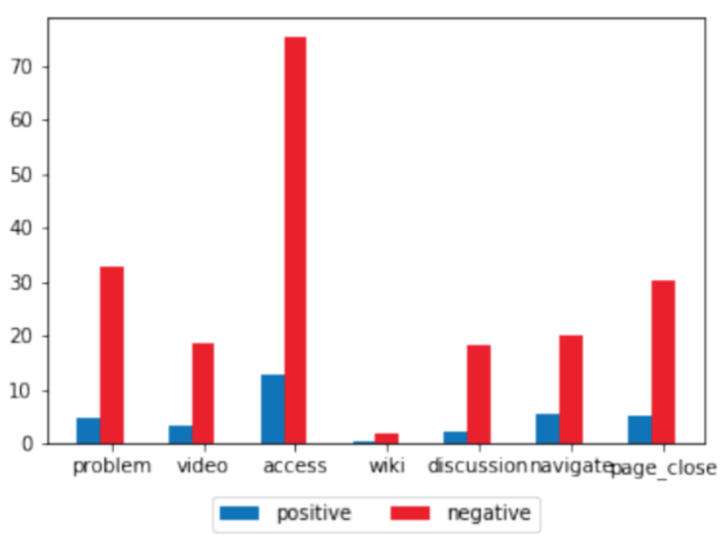
Data Insights
Active Days
Type of Events
Table 1: Dropout rate on different active days
Table 2: Average Amount of Events in an Enrolment
Definition : Active days are defined as days in which students have events
Action : We calculate the dropout rate with respect to different active days
Findings : dropout rate decreases as active days increases
Definition : Different types of events have different meaning
Action : We plotted the different events
Findings : Solving problems and discussion are two greatest method to differentiate dropout events

Slide 8
Classifiers
Random Forest
Research
Pre-processing feature 2
Slides & Report/ Ada boosting?
SVM
Research
Did the classifications
Cross-fold Validation?
Logistic Regression
Research
Pre-processing feature 1
Ada Boosting?

Slide 9
Optimal Hyper Parameters
Cross-Fold Validation
Classifier 1
Research
Pre-processing feature 2
Slides & Report/ Ada boosting?
Classifier 2
Research
Did the classifications
Cross-fold Validation?
Classifier 3
Research
Pre-processing feature 1
Ada Boosting?

Slide 10
Classifier Results
Classifier 1
Research
Pre-processing feature 2
Slides & Report/ Ada boosting?
Classifier 2
Research
Did the classifications
Cross-fold Validation?
Classifier 3
Research
Pre-processing feature 1
Ada Boosting?

Slide 11
Q&A

Slide 14
Empathize: Wearing the shoe of a victim
Situation
Super typhoon is going to hit my home hard. My properties will be destroyed but I cannot do anything.
I’m worried.
Location
The government opens temporary shelter in my district. I have to move fast to stay safe.
I’m anxious.
Feelings
I arrive at the shelter. It’s uncomfortable that I don’t know anyone here.
I’m lonely.

Slide 15

Define: POV
Need:
Safety
comfort
Want:
Understanding
Assurance
Do not
Want to approach strangers
Cannot
be with people they are familiar with and used to talk to

Slide 16

SHELTER HELPER
I identify & comfort people who need emotional support.

Slide 17
Ideate: The Interactions
Approach people in emotional needs
Entertain &
Boost Mood
Identify & satisfy
needs on essentials
Notes:
Approach people in emotional needs
Facial recognition to detect sad faces
Refer to database preference on distrub or not
Identify and satisfy needs on essentials
Conversations & interactions
Indicate essentials location
Entertainment
Jokes
Dance

Slide 18
Hello!
I AM PEPPER.
You seem a bit sad. What’s happened? {Dialogue}
I understand. How’re you feeling? {I’m…}
Clean blankets are available in the counter.
Hungry
Sad
Worried
Cold

