Slide 1
MOOC Dropout Prediction
Course Project
By Woochan Lee, Rhea Chugh, Ishan Jain
COMP4331
Notes:
Ishan

Slide 2

The Problem
“Students’ high dropout rate on MOOC platforms has been heavily criticized, and predicting their likelihood of dropout would be useful for maintaining and encouraging students’ learning activities.”
Notes:
Ishan

Slide 3



Division of Labour
Ishan Jain
Generate Feature 2
Test Oversampling
Integrate Results for Presentation and Report
Rhea Chugh
Pre-Process Log Data
Balanced Resampling
RF, XGBoost and MLP Classification
Woochan Lee
Generate Feature 1
Test Undersampling
Test Logistic Regression
Hard Voting to Ensemble Results
Notes:
Ishan

Slide 4
Understanding the Data
date.csv – timespan of each course
course_id
from – Course Start Date
to – Course End Date
log_train.csv -- behavior record
enrollment_id
Time
source
Event source (server or browser).
event - 7 different event types:
1. problem – Course assignments.
2. video - Course videos.
3. access – Accessing course objects
4. wiki - Accessing the course wiki.
5. discussion – Accessing course forum.
6. navigate - Navigating others
7. page_close – Closing web page.
object - The object the student access
object.csv -- module in a course
course_id
module_id
category - category of course module.
children – children modules
start – Module release time
enrollment_train.csv -- enrollment record
enrollment_id
Username
course_id
true_train.csv -- Ground Truth
1st column - Enrollment ID.
2nd column - Ground truth of dropout (1 for a dropout event and 0 for continuing study)
Notes:
Ishan

Slide 5
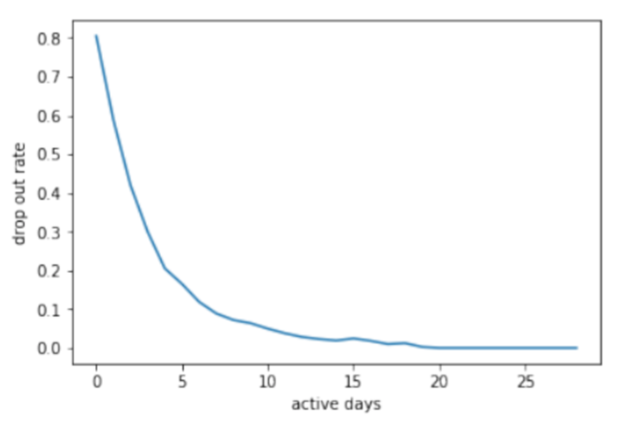
Data Hypothesis (1)
Event Counts
HP 1: Dropout rate on different active days
Definition : Days containing events
Action : Dropout rate with respect to active days in a course
Notes:
dropouts = positive
others = negative

Slide 6
Data Hypothesis (2)
Event Counts
Our hypothesis is that any student who completes a course will have more counts for each event i.e. more videos, problems, discussions etc.
Notes:
dropouts = positive
others = negative

Slide 7
Pre-Processing (1)
Building our Feature Vectors
Index | Features | Index | Features
1 | # enrollement_id | 6 | # navigate
2 | # video | 7 | # page close
3 | # access | 8 | # server
4 | # wiki | 9 | # browser
5 | # discussion | 10 | # problem
Table 1. Event Features
enrollment_id navigate access problem page_close video discussion wiki server browser lastlog-firstlog study days early events mid events late events
Notes:
each line in log tree is essentially a behaviour from different users
By doing that we are able to isolate all the number of events for each user by clustering them and that made up our Feature Vector #1 by counting each event occurence

Slide 8
Pre-Processing (1)
Building our Feature Vectors
Index | Features | Index | Features
1 | # enrollement_id | 6 | # navigate
2 | # video | 7 | # page close
3 | # access | 8 | # server
4 | # wiki | 9 | # browser
5 | # discussion | 10 | # problem
Index | Features
1 | # last log time - first log time
2 | # effective study days
3 | # events in course start
4 | # events in course mid
5 6 | # events in course end # Enrollment_id
Table 1. Event Features
Table 2. Day Count Features
enrollment_id navigate access problem page_close video discussion wiki server browser lastlog-firstlog study days early events mid events late events
Notes:
we clustered all the events from the log by enrollment_id and then converted it to dates, which you can then use min and max function to find the earliest and latest date… then we merge the table with the date.csv file where we can find the first date and last date for each course associated to each log… Then we divide the course into 3 sections beginning, middle and end. Depending on when the event is, we can count the number of events in each period of the course.

Slide 9
Pre-Processing (1)
Building our Feature Vectors
Index | Features | Index | Features
1 | # enrollement_id | 6 | # navigate
2 | # video | 7 | # page close
3 | # access | 8 | # server
4 | # wiki | 9 | # browser
5 | # discussion | 10 | # problem
Index | Features
1 | # last log time - first log time
2 | # effective study days
3 | # events in course start
4 | # events in course mid
5 6 | # events in course end # Enrollment_id
Table 1. Event Features
Table 2. Day Count Features
Index | Features | Index | Features
1 | # enrollement_id | 6 | # navigate
2 | # video | 7 | # page close
3 | # access | 8 | # server
4 | # wiki | 9 | # browser
5 | # discussion | 10 | # problem
Index | Features
11 | # last log-first log
12 | # effective study days
13 | # events in course start
14 | # events in course mid
15 | # events in course end
Table 3. Final Merged Features
enrollment_id navigate access problem page_close video discussion wiki server browser lastlog-firstlog study days early events mid events late events
Notes:
Using table 1 and table 2, we are then able to

Slide 10
Pre-Processing (2)
Handling Corrupt Log Records
Log shows access to modules before the modules were posted
Deleting
Log Instances
Corrupt Log Data
Post Processing Findings:
2% of the Enrollment IDs (1570 out of 72395)
Notes:
Rhea

Slide 11
Pre-Processing (3)
Taking care of Imbalanced Data
72,395 enrollments
80% Dropouts
20% Complete
Imbalanced Data
SMOTETomek
SMOTE(Synthetic Minority Oversampling Technique)
Oversamples minority data by creating new points using K-nearest neighbours of each minority class
Tomek(Tomek links)
Undersamples majority data by removing instances of the majority class of each Tomek links
Notes:
Woochan

Slide 12
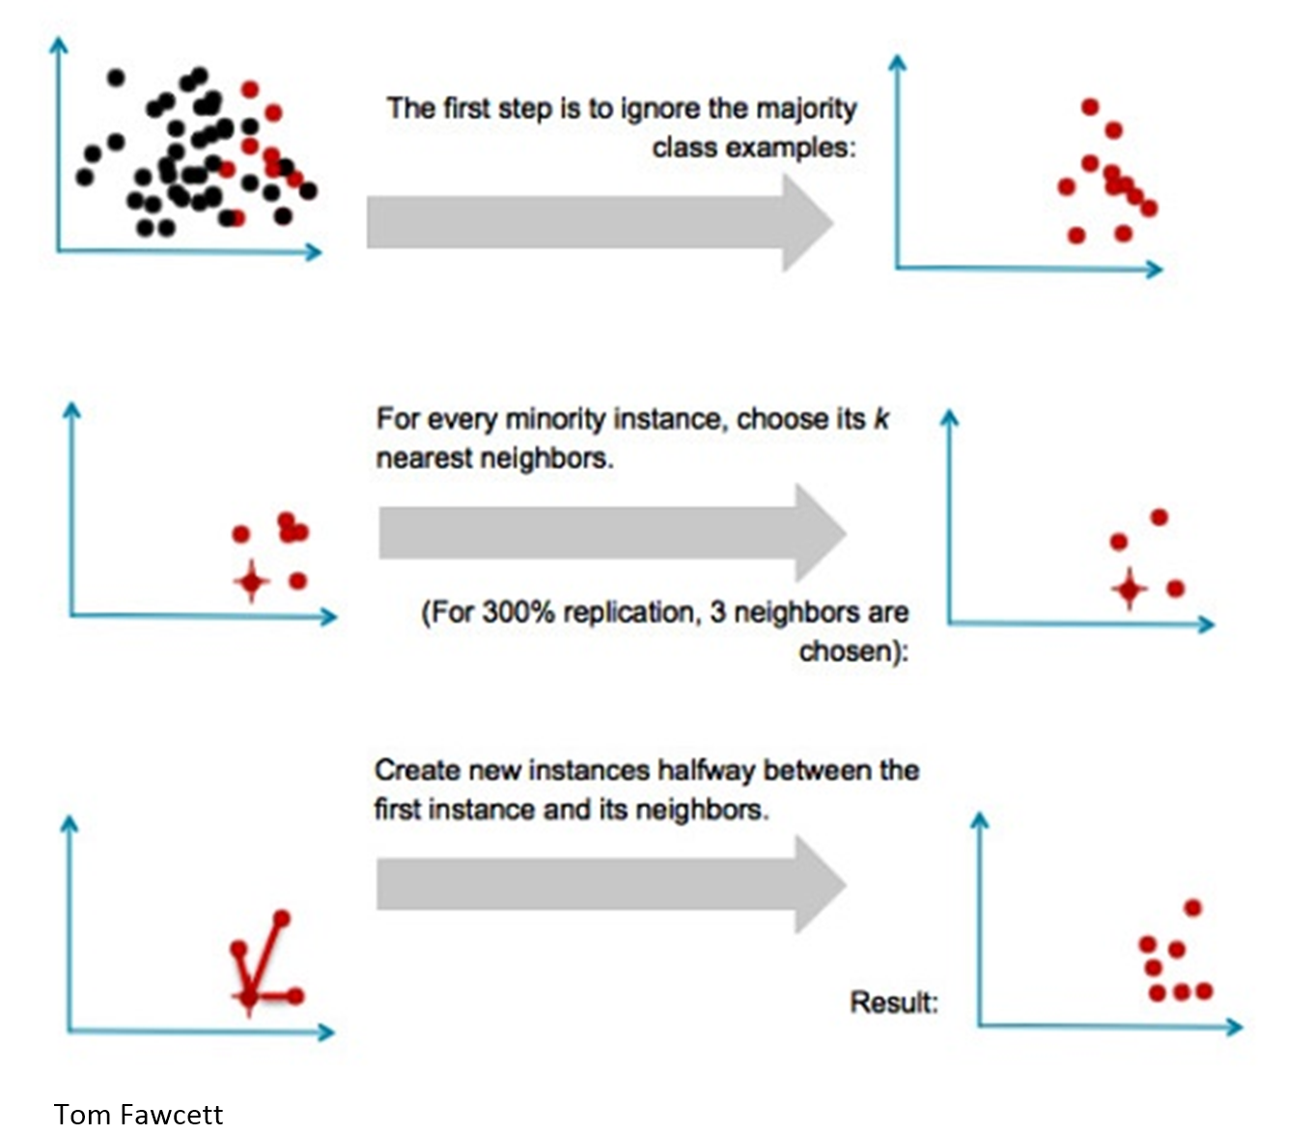
SMOTE
Notes:
Woochan

Slide 13

Tomek
Tomek links are pairs of very close instances, but of opposite classes. Tomek involves removing the instances of the majority class of each pair.
Notes:
Woochan

Slide 14
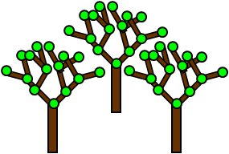


Classifiers
Random Forest
Less overfitting of decision trees
Less variance of classifier not performing well on test data
MLP
Extracts complex patterns from logs
Hidden layer efficiently identifies important information
XGBoost
Adaptive boosting tree model
Relatively fast to construct the model compared to Adaboost
Notes:
Rhea
Did not use SVM because it is too inefficient to train the dataset
Less variance: By using multiple trees, you reduce the chance of stumbling across a classifier that doesn’t perform well because of the relationship between the train and test data.

Slide 15
Optimal Hyper Parameters
Cross-Fold Validation
Random Forest
n-estimator: 100
MLP
Learning rate: 1e-6
Hidden Units: 200
XGBoost
n-estimator:100
Notes:
Rhea

Slide 16
Classification Results
Random Forest
MLP
XGBoost
 | precision | recall
micro avg | 0.86 | 0.86
macro avg | 0.79 | 0.77
 | precision | recall
micro avg | 0.83 | 0.83
macro avg | 0.74 | 0.79
 | precision | recall
micro avg | 0.86 | 0.86
macro avg | 0.79 | 0.78
Notes:
Rhea

Slide 17
Ensemble-Based Method: Hard Voting
The voting classifier ensembles the three classifiers we used
We used Hard Voting to select a model from the ensemble to make the final prediction by a simple majority vote for accuracy
Notes:
Rhea

Slide 18
Thank you
Notes:
Rhea

