Slide 1

Pkl
Apple Pkl: Programming Language for Configuration
Notes:
Hello guys today I will start with a question to you. What is a result of Apple plus open source? The ansewr is Pkl. Pkl Is a open source programming language

Slide 2
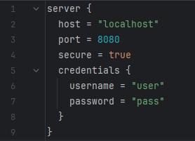
What is Pkl
Pkl
Is an open-source programming language for configuration, developed by Apple.
Designed to be safe, scalable, and high-performance in defining and validating configurations.
Allows you to create configurations programmatically
Notes:
So What is Pkl. How I said is a open-source programming language for configuraiton developed by Apple
Designed to be safe, scalable, and high-performance in defining and validating configurations
Allows you to create configurations programmatically

Slide 3
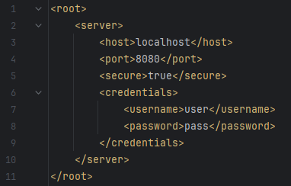
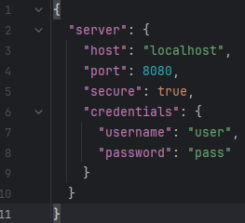
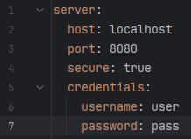
Why Pkl was created?
Static configuration like (XML, JSON, YAML)
XML
JSON
YAML
Notes:
What is Apple motivation to do that? We have static configuration files like XML, JSON and YAML. Its have a good fit for simple configuration like you can see here in XML, JSON, YAML.

Slide 4
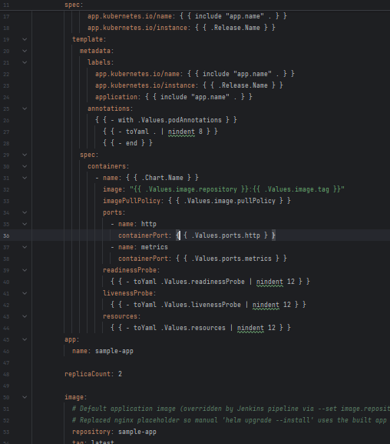
Why Pkl was created?
Static configuration like (XML, JSON, YAML)
No Validation, no reuse, difficult to maintain for complex configuration
YAML - complex
XML
JSON
YAML
Notes:
But whe configurations grows in complexity, like here, we have more verbose, repeatable code and easy to make errors.

Slide 5

Pkl Features
Safety: sandboxing features to prevent malicious or incorrect configurations
Strong Types
Reusability: Modular
Validation: Define constraints and invariants
Programmatic: use power of programming languages
Notes:
Here some Pkl features, like Safety: pkl runs in sandbox mode, so any malicious code will in worst case consume CPU and memory resources
Strong Types, pkl have type-cheking to avoid some incorrect configurations
Reusability: Modules and classes allow for the creation of reusable configuration components
Validation: Define constraints and invariants to ensure your configurations are always correct
Programmatic: Use conditional logic, loops, and functions to generate configurations dynamically

Slide 6
Demo
Let´s see some code

Slide 7
Pros and Cons
 | XML | JSON | YAML | PKL
PROS | Validation Extensibility Widely used in enterprise and legacy systems. | Simple Easy to read and write Widely support | More expressive than JSON Supports type-checking | More expressive than others Can include logic Supports type-cheking and validation
CONS | Verbose Parsing overhead Very limited data types | Not expressive Not support type-checking | More dificult to read and write than JSON Not as widely supported as JSON | More complex than others Not as widely supported as others Very new
Notes:
XML: Validation: Type Definition (DTD) and XML Schema Definition (XSD) ensuring data integrity
Extensibility: developers to define their own custom tags and structure

Slide 8

That's all for today
Thank you

