Slide 1
TETRIS
David Lefaive
Vincent Shen
Ziwen Li

Slide 2
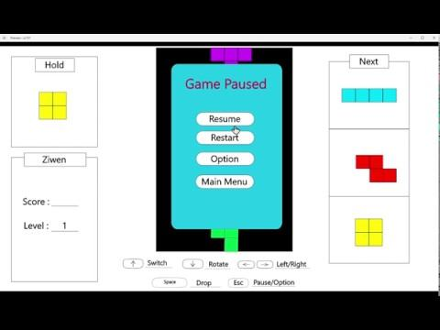

Slide 3
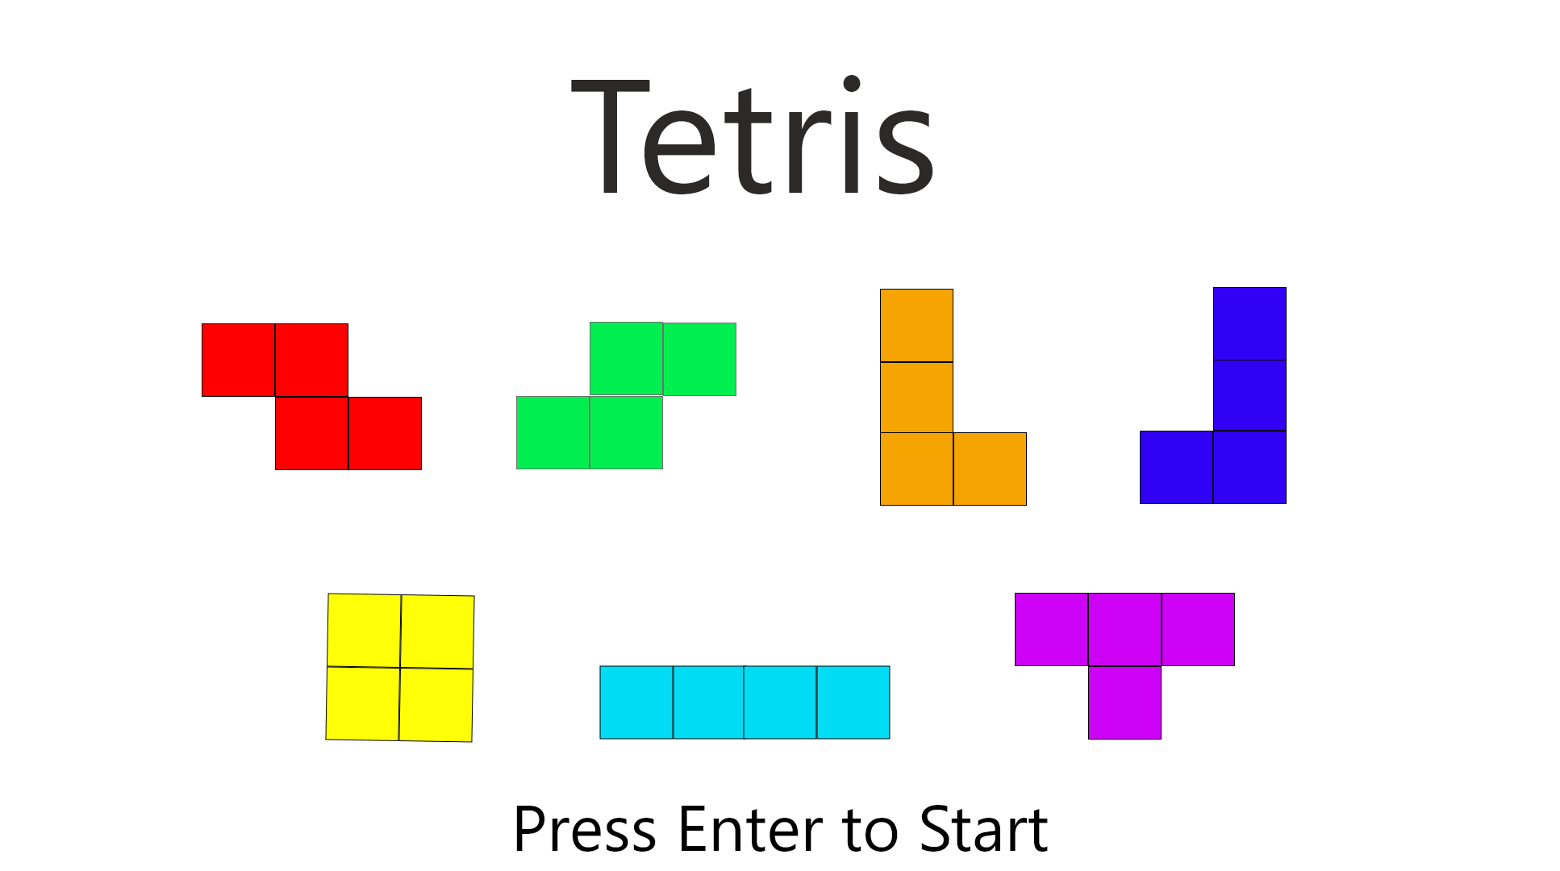
Title Screen

Slide 4
Title Screen Design
Implements a MouseListener and KeyboardListener to listen for a right click or if enter key was pressed.
Pressing esc at the title screen will close the game.
Tetromino pieces will be .jpeg images.
The components will include a text component for the title, the images of the tetromino pieces, and the animated press start button.

Slide 5
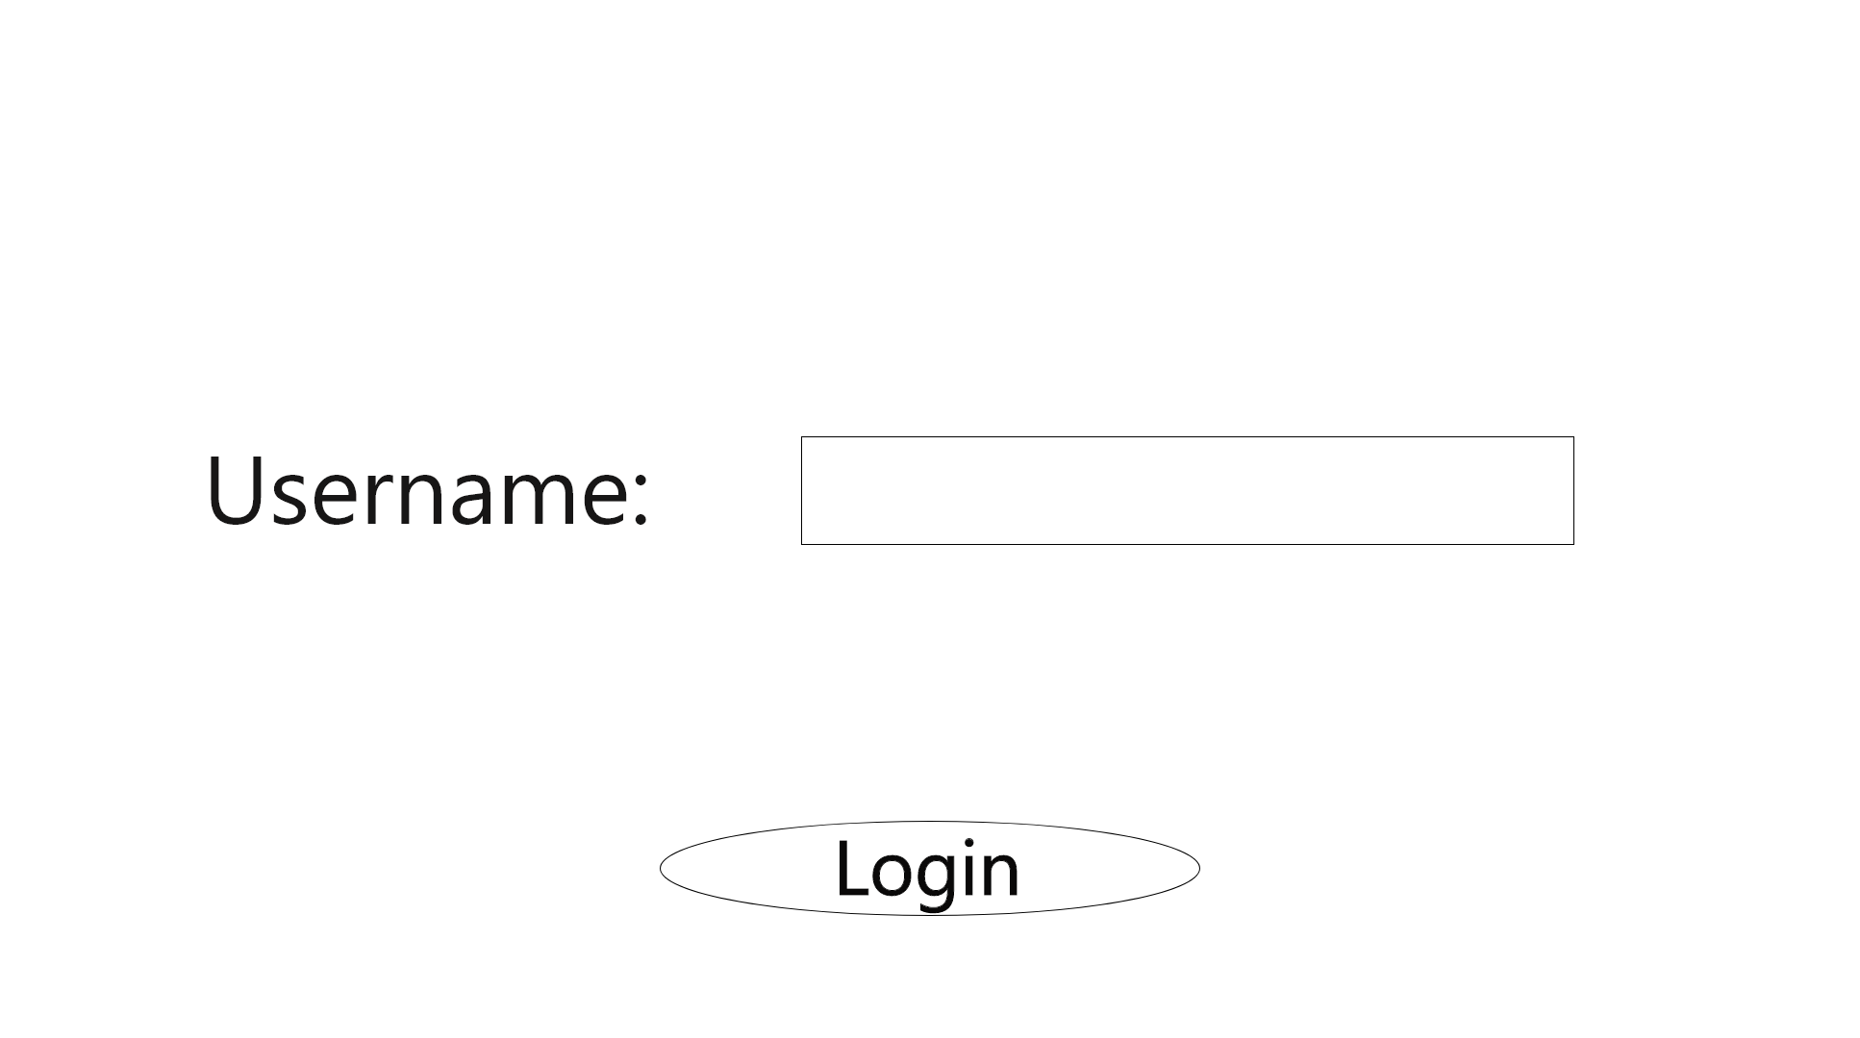
Login Screen

Slide 6
Login Design
The Layout will be a BoxLayout since we want the elements displayed vertically.
Components include the text field for the Username, as well as a login button.
Validation/appropriate feedback will need to be added to keep the length of usernames below a fixed amount to prevent errors with the scoreboard/Score HUD in-game.
Mouse and KeyboardListeners will be implemented to tell if the user has logged in.

Slide 7
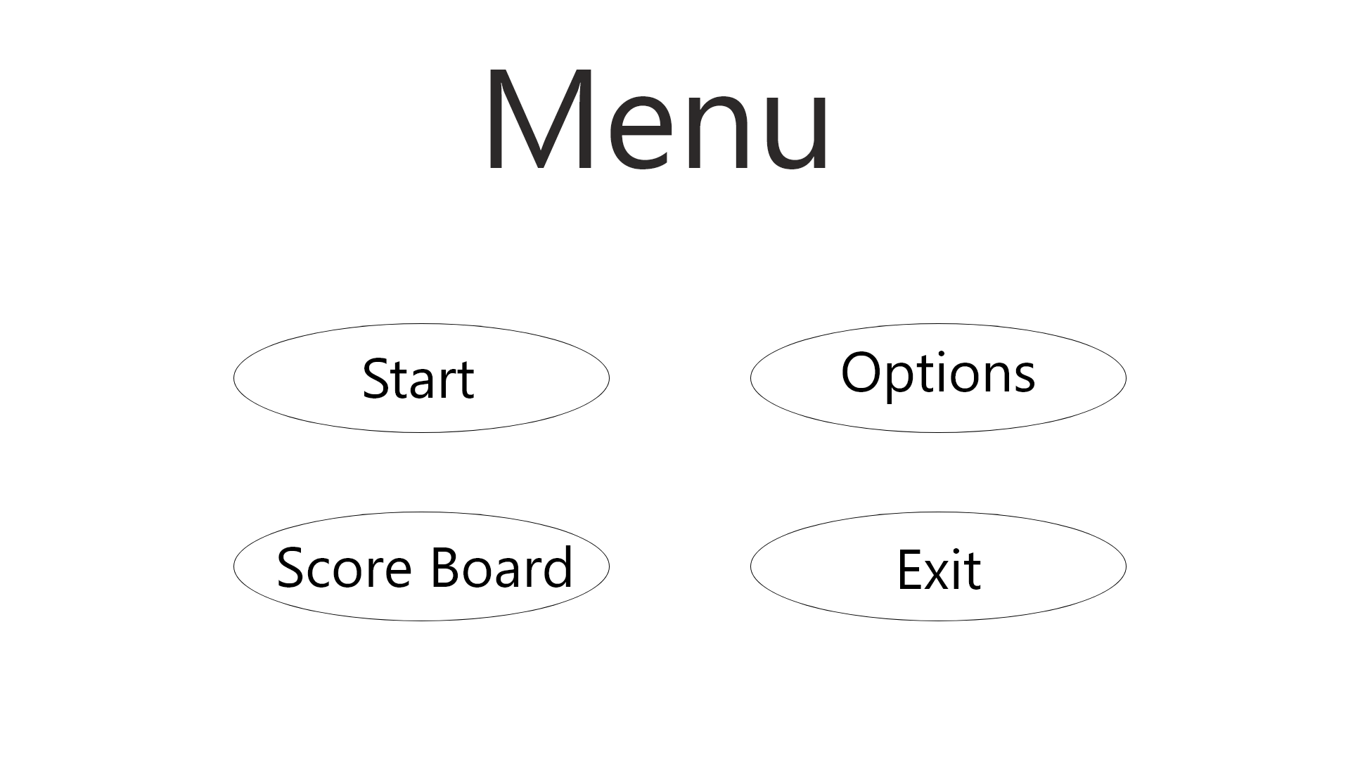
Menu Screen

Slide 8
Main Menu Design
The type of layout for the menu elements will be a BoxLayout so we can arrange them vertically.
The main menu will use a MouseListener to tell which buttons were clicked so the view can be updated to the appropriate page.
The components will include the Play game, Options, Highscores, and Exit buttons, as well as text for the title.

Slide 9
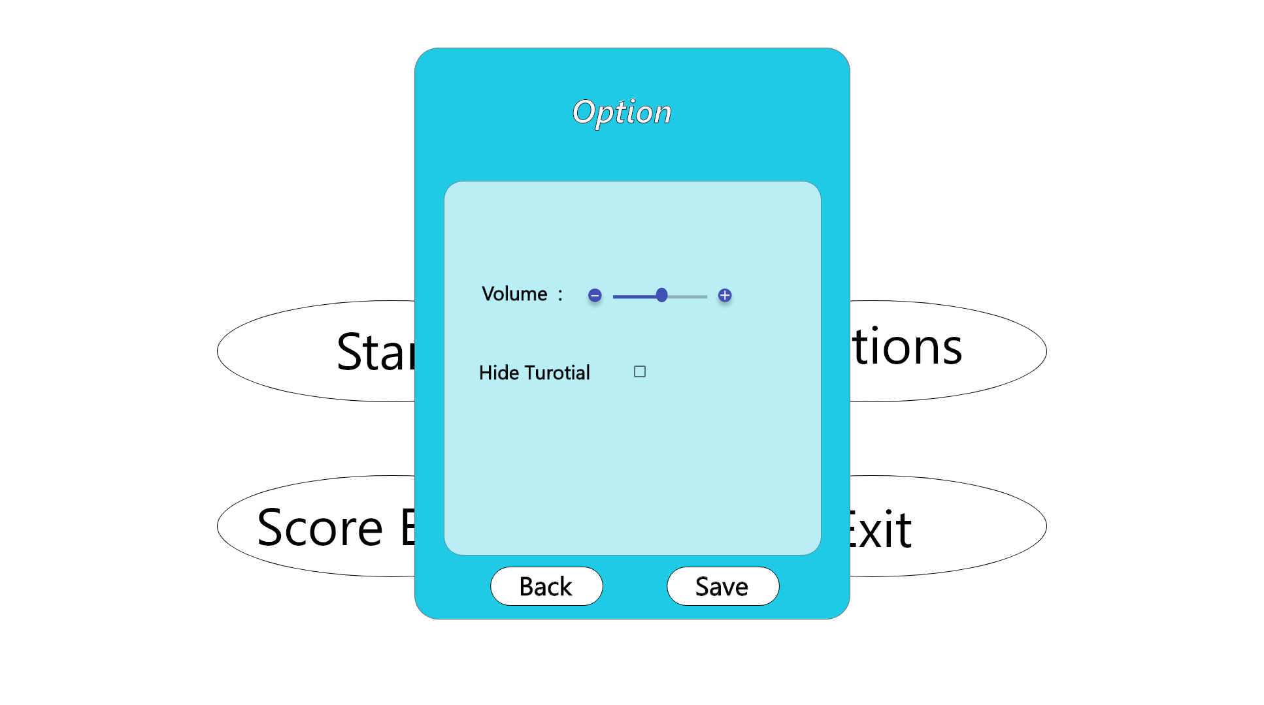
Option Page

Slide 10
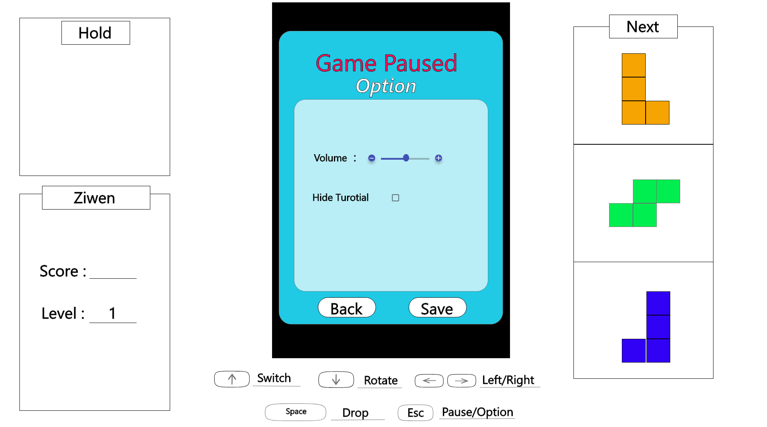

Slide 11
Options Design
BoxLayout will be used to show elements vertically.
The components will have a volume slider and a checkbox to disable the tutorial HUD in-game.
The changes should be saved before closing the options to be reflected in-game.

Slide 12
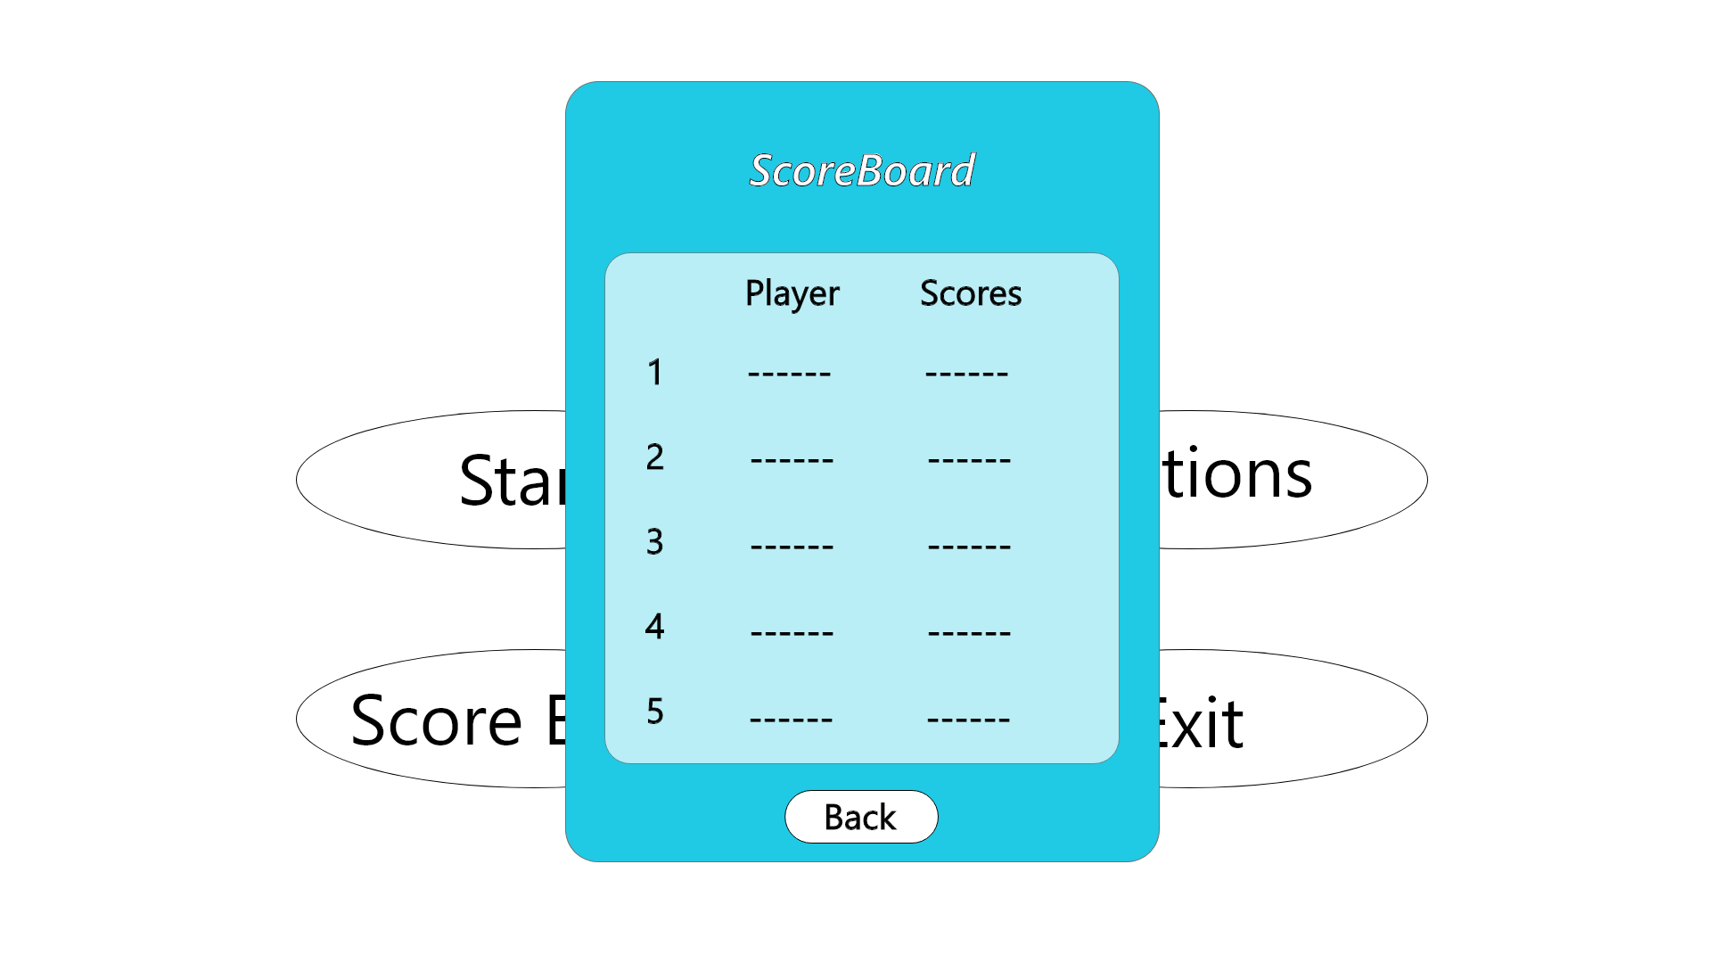
Scoreboard Page

Slide 13
Scoreboard Design
BoxLayout will be used to display elements vertically.
The components include text at the top to indicate the numbering of each entry as well as the respective username and score.
MouseListener will be implemented to detect when the user clicks to leave the highscore page.

Slide 14
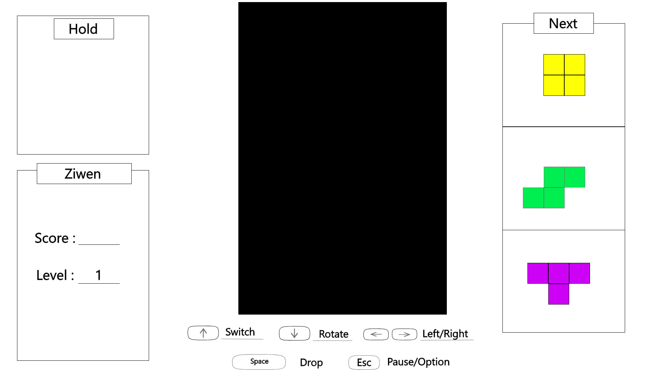
Game Page

Slide 15
Game Screen Design
The layout will be a GridBagLayout to allow for differently sized and spaced components.
The components include the Hold Queue, Next Queue, a 10 x 20 block grid, the score/level box, and the Tutorial HUD.
Blocks will be drawn with rectangle shapes for filled blocks on the grid.
Keyboard Listener will be implemented for the controls.
When the game ends, the scores will be displayed.

Slide 16
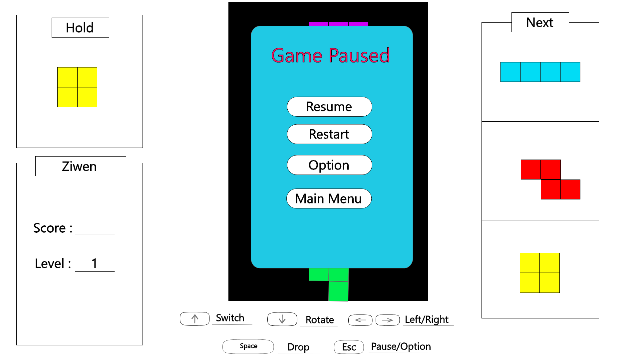
Pause Pop up

Slide 17
Pause Pop-up Design
The pause menu will have a BoxLayout to display items vertically.
The pop-up will have the button components: Resume, Restart, Options, and Main Menu.
MouseListener will be implemented so the game can tell which button was clicked.

