Slide 1
Case Study – Home Loan
JAVA 862 Team 8

Slide 2
Team
Group Leader - Sharanjeet Singh Sawhney
Group members
Anuj Vidhate
Leeaa Nair
Tahira Ishack

Slide 3
Project Statement
Our project is a java web-based application which provides the facility of home loan to eligible Customers. We provide a hassle-free user-friendly online platform to our users through which they can apply for loans based on their own requirements and keep a track of their status and record during the entire process of their loan approval. We also provide features such as eligibility and EMI calculators through which users can get a rough estimate of the EMI and the loan amount, they are eligible for.

Slide 4
Technologies Used
Angular 8
Bootstrap 4
Oracle
Java Spring Boot
HTML, CSS , JavaScript
SQL developer

Slide 5
Basic workflow of application:
User registers and logs in to the application
User explores the pages – About Us and FAQ
User uses the EMI and Eligibility calculator to get information regarding the loan
User applies for loan
Admin logs in and checks the list of applications yet to be approved
Admin verifies the details, approves/rejects the loan and generates an account number
User logs in to check their application status

Slide 6
Overview of Modules
User Registration & Authentication ( customer and admin login)
Calculators
Eligibility calculator
Emi Calculator
Loan Application
Personal Details
Income, loan and property details
Documents Uploads
Loan Tracker
User and Admin Dashboards

Slide 7
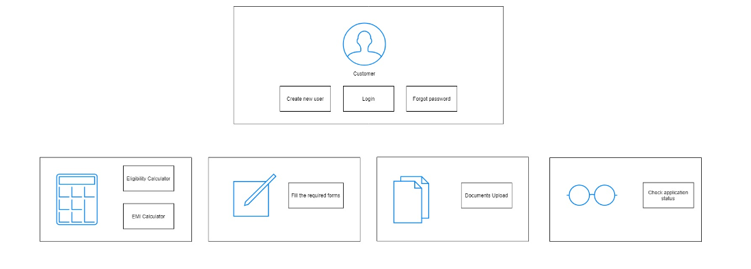
Customer Functionalities

Slide 8
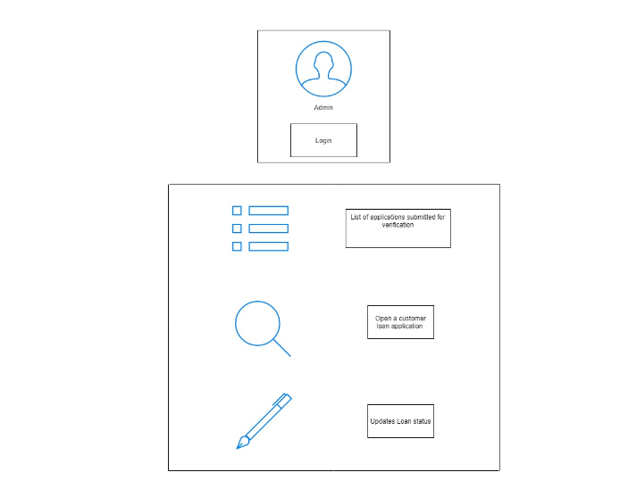
Admin Functionalities

Slide 9
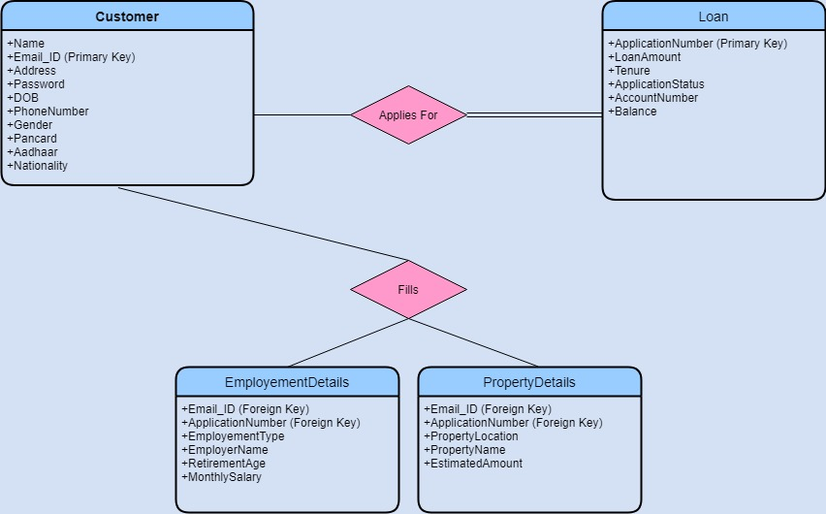
Database Structure

Slide 10
List of APIs Used
Register the customer
Login customer and admin(show dashboards)
Register customer details on database.
Upload documents(using multipart form data)
Display list of customer loan applications to admin
Display application details to admin
Display uploaded documents to admin
Check status of application
Change application status of customer

Slide 11
External Libraries Used
Material Module
Files array Service (for uploading files)
Reactive Forms Module
Angular Slider Module
HTTPClient Module

Slide 12
Problems Faced
Multiple forms taking a lot of space in front end. Solution: Use of stepper form
User had to manually enter all values. Solution: Slider
Orientation of components. Solution: Use of Bootstrap modules
Use of CRUD Repository
Retrieval and storage of multiple files. Solution: Store files directly after user uploads

