Slide 1
Notes:
Explanations of the technologies used
A couple paragraphs about the general approach you took
Installation instructions for any dependencies
Link to your user stories – who are your users, what do they want, and why?
Link to your wireframes – sketches of major views / interfaces in your application
Descriptions of any unsolved problems or major hurdles your team had to overcome

Slide 2

Who are we?
Ease is an on-demand marketplace for services, starting with pet sitting, baby sitting and home cleaning services.

Slide 3
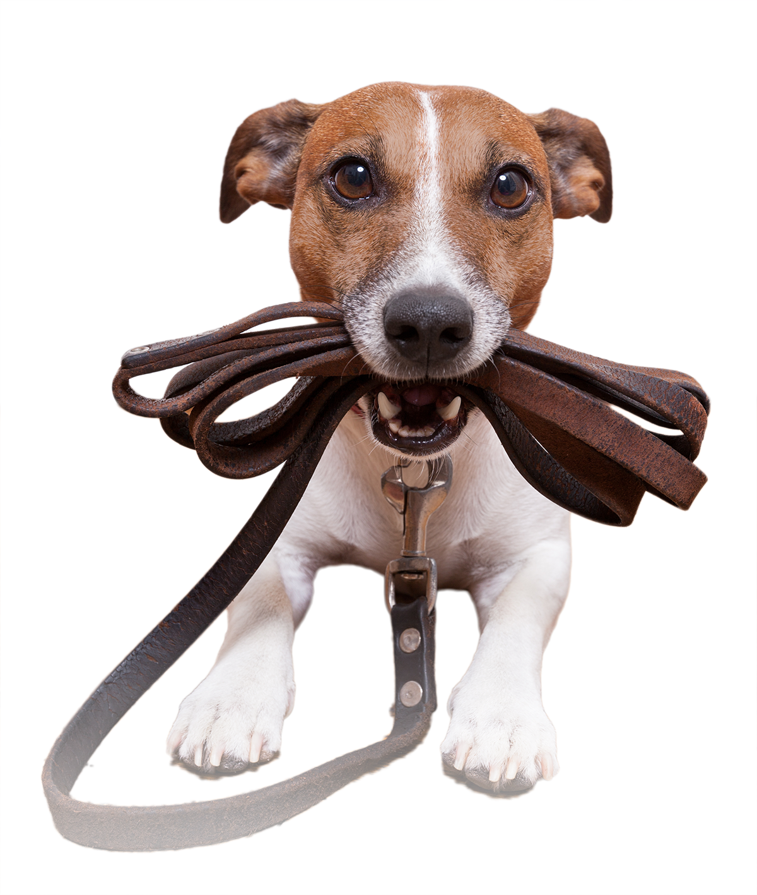


What do we do?
On-demand platform that offers 3 services
>850,000 pets in Singapore
62,000 dogs
Singaporean travel and busy lifestyle
Petsitting
Lack of ad-hoc childcare options
70-75% of couples, dual-income (>49)
Babysitting
Only 1/7 households have maids
High disposable income of citizens
Home cleaning
Notes:
Dogs: 62,000 dogs, 32% rise from 10 years ago. Almost 850k pets.
http://www.straitstimes.com/singapore/puppy-love-breeds-more-pet-services
Babysitting:
Set aspect ratio
Viewport ratios

Slide 4
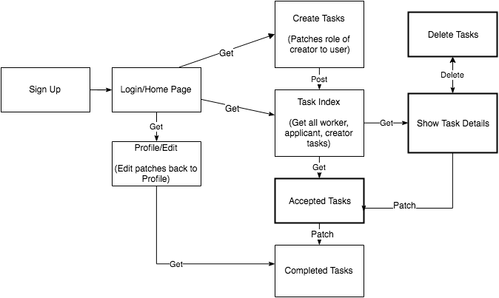
User Flow Diagram

Slide 5
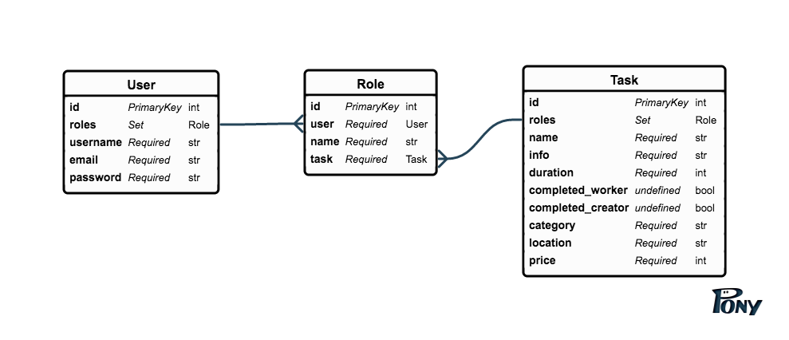
ERD

