Slide 1
Web API / Service Amending Demo Adding a Form
Web-Based Services

Slide 2
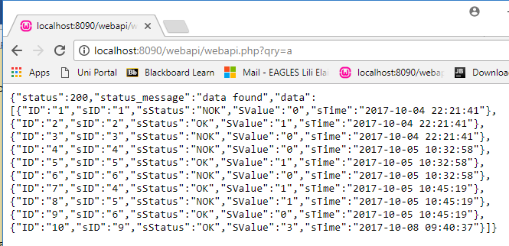


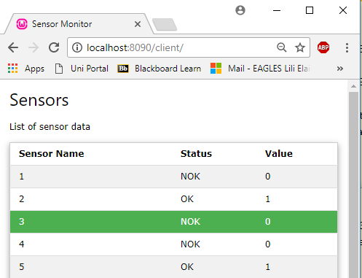
Example MVC (Model View Controller)
Data obtained from Web API, processed and stored in a variable
Web API
webapi.php
Controller
read_sensors.php
controller
DB library
dblib.inc
Client index.php
model
view
Uses w3.css with HTML to present data supplied by the controller.

Slide 3
Adding an HTML Form
Use an HTML form to allow a sensor to be selected from a drop-down list.
From this, the controller can extract the POSTed data and send it via CURL as the URL query data.
The controller script is included in the view (index.php) and therefore when a form is posted with no action, it will call itself and ultimately this means the controller script will be run. Thus the controller script can obtain the POSTed data.
sensor name
>
View script: index.php
<input type=“text” name=“sname” value=“sensor name”>
Controller script: read_sensors.php
$sname = filter_input(INPUT_POST, ‘sname’);
$url = "http://localhost:8090/webapi/webapi.php?qry=1&sname=$sname";

Slide 4
HTML Form
Remember when that the dblib.inc methods need parameter data to be passed to it.
Parameter data will come via the name/value pairs passed to the Web API URL.
Remember to extract all variables from the Web API URL and ensure that they are not empty, etc.

