Slide 1
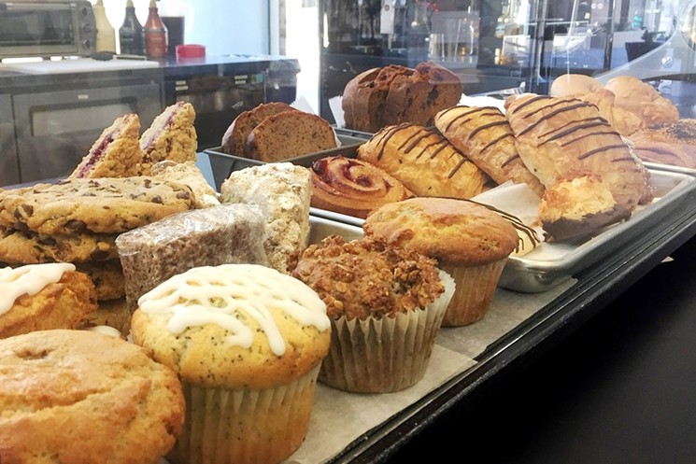
Toronto or New York? Where to start a bakery?

Slide 2
Introduction
A bakery chain wishes to explore where to build new bakeries in New York and Toronto.
An initial assessment of potential locations is critical in the success of specialty businesses.
But how to assess potential locations?
Businessmen may be interested in machine learning methods that can be used in selecting locations for new retail locations.

