Slide 1

Harrisburg CPLUG BareOS

Slide 2
What is BareOS?
Open-Source fork of Bacula

Slide 3
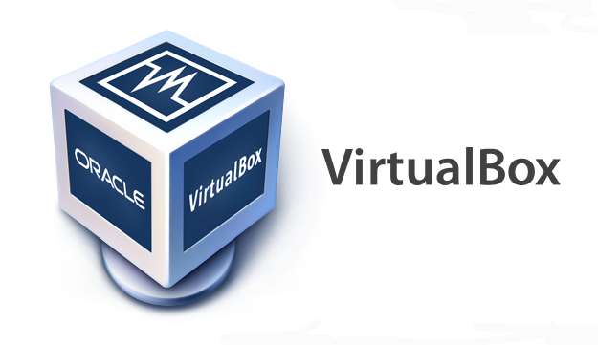


Installation Check List
VirtualBox 5.0.40_Ubuntu r11530
Vagrant 1.8.1
  vagrant-hostmanager (1.8.7)
  vagrant-hostsupdater (1.0.2)
Puppet 3.7.2

Slide 4
Environment Variables
VAGRANT_DEFAULT_PROVIDER=virtualbox
VAGRANT_HOME=<some-place-with-lots-of-space>

Slide 5
What running Vagrant Will Install on the guests…
Turnkey Linux 14
Puppet 3.7.2
BareOS 16.2

Slide 6
$ vagrant up <host-name>
vagrant status
vagrant up bareOSdirector
vagrant up webserver

Slide 7
Backup Job Types
Full
Differential
Incremental

Slide 8
Full Backup
Backup everything..

Slide 9
Incremental
What?
  Backup changes since last Incremental
  (or Full) Backup

Slide 10
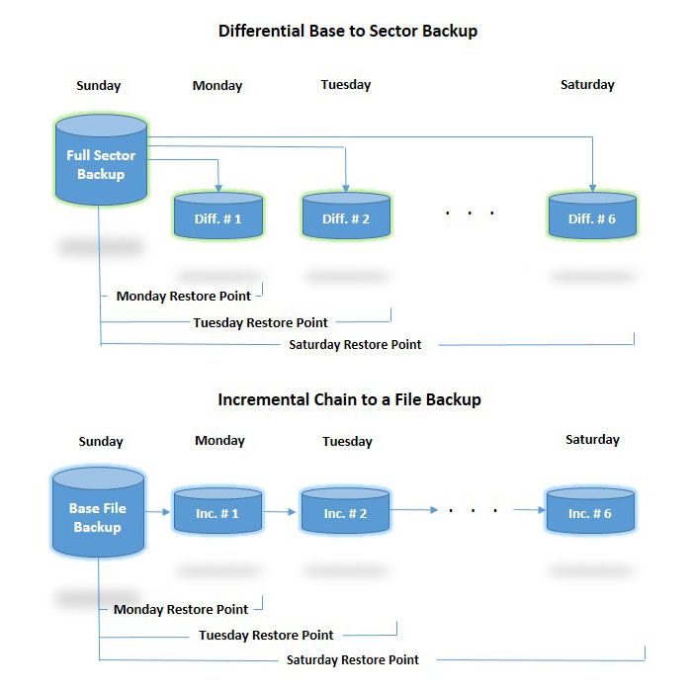
Incremental
Dependencies for Restore:
  Last Full Backup and every incremental backup taken since then to the point restored.
Sunday
Thursday
Friday
4

Slide 11
Differential
What?
  Backup changes since last Full Backup

Slide 12
Differential
Dependencies for Restore:
  Last Full Backup and Differential Backup from point to be restored.
Friday
Thursday

Slide 13
Pros / Cons
Incremental
  Pros:
    Takes up less space
    Since only the changes since the last backup are kept.
  Cons:
    Risky: You need every a good full backup and a good backup from every previous day of the entire week to restore a backup.
Differential
  Pros:
    Quicker to Restore
    Safer: You only need a good full backup and a good differential to restore it.
  Cons:
    Takes up more space

Slide 14
Daemons of BareOS
We’re going to look at the daemons and their purposes based on the creation and storage of a backup...(not the restoration...but that would just be the opposite).
We’ll start with what everybody already has that are looking into a backup solution...the client and work our way back from a backup, to a volume file to a pool that manages it, to a storage daemon manages a device that stores it.

Slide 15
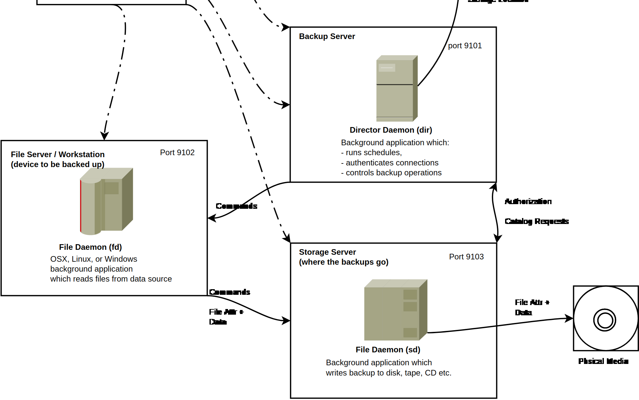
Daemons of BareOS
Director (bareos-dir)
File Daemon (bareos-fd)
Storage Daemon (bareos-sd)

Slide 16
File Daemon (bareos-fd)
File Daemon (bareos-fd)
It’s Basically the INPUT...where the backup jobs are created from.
The BareOS client itself. Machines that you want to make backups of have a file daemon installed on them.
All machines get one of these:
  client workstations
  BareOS Director
  BareOS Storage Daemon (if it’s a seperate machine from the Director)

Slide 17
Storage Daemon (bareos-sd)
Where backup volumes and their jobs are stored.
It’s Basically the OUTPUT...where the backup jobs are written to when backing up a bareos-fd.

Slide 18
Director (bareos-dir)
The core of the backup system; it commands most of the backup operations.
Administered via the bconsole.
The daemon that commands the bareos-fd to start reading a backup job and the bareos-sd to start writing a backup job.

Slide 19
Director (bareos-dir)
The majority (though not all) of the configuration resides on the director…so we’re going to look at that next.
The director is the daemon that manages the other two daemons.

Slide 20

Overview of BareOS Configuration
Machines
Physical Devices
Machines
Daemons
Configurations / Resulting Objects
Director
Director
Schedule
Director
bareos-dir
:9101
Client
Storage
FileSet
daily...weekly...monthly
Device
Job
Pool
configures
Client
Backup
Client
bareos-fd
FileSet
Selected
Files
Job
Instance
:9102
1..N
Storage
Daemon
(Receives Backups)
(Manages Devices)
Storage
Daemon
(Receives Backups)
(Manages Devices)
bareos-sd
bareos-sd
:9103
Director
1..N
Storage
Vol-01
(file that stores
backup jobs)
Pool
(Configures
Volumes,
recycles them)
Device
contains volume file...
HDD or Tape
on the
Storage
Daemon
Directory on Device
/mnt/backups/<client-name>/<pool-name>/

Slide 21
Parts of Configuration
Client
FileSet
Job
Job Instance
Volume
Pool
Storage
Schedule
Catalog
From here on out we’re going to work our way back from the client to the device that stores the backups.

Slide 22
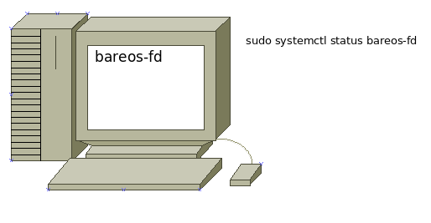
Client
The client is the machine to be backed up, which contains a File Daemon that connects to the server and backs up the files specified in the FileSet.
name: webserver-fd

Slide 23
Client
The File Daemon is configured by connecting to the Director (bareos-dir).
name: webserver-fd

Slide 24
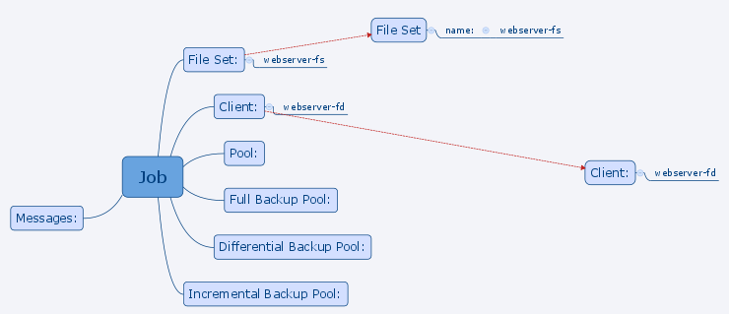
Client Config on Director - FileSet
FileSet {
Name = "webserver-fs"
Include {
Options {
signature = MD5
fstype = ext2
fstype = ext3
fstype = ext4
fstype = xfs
fstype = zfs
fstype = reiserfs
fstype = jfs
fstype = btrfs
}
File = /etc
File = /home
}
Exclude {
File = /var/lib/bareos
File = /var/lib/bareos/storage
File = /proc
File = /tmp
File = .journal
File = .fsck
}
}
fileset-webserver-fs.conf
Selects which files to backup (and not backup) to a job on the client.

Slide 25
Client Config on Director - Job
Job {
Name = "webserver-job"
JobDefs = "DefaultJob"
Type = Backup
FileSet = "webserver-fs"
...
}
job-webserver-fd-webserver-job.conf
Everything comes together in the job config (eventually)

Slide 26
Job {
Name = "webserver-job"
JobDefs = "DefaultJob"
Type = Backup
FileSet = "webserver-fs"
Client = “webserver-fd”
...
}
job-webserver-fd-webserver-job.conf
Specifying which
client to backup
with our job...

Slide 27
Overview of BareOS Configuration
Machines
Physical Devices
Machines
Daemons
Configurations / Resulting Objects
Director
Director
Schedule
Director
bareos-dir
:9101
Client
Storage
FileSet
daily...weekly...monthly
Device
Job
Pool
configures
Client
Backup
Client
bareos-fd
FileSet
Selected
Files
Job
Instance
:9102
1..N
Storage
Daemon
(Receives Backups)
(Manages Devices)
Storage
Daemon
(Receives Backups)
(Manages Devices)
bareos-sd
bareos-sd
Director
1..N
Storage
Vol-01
(file that stores
backup jobs)
Pool
(Configures
Volumes,
recycles them)
Device
contains volume file...
HDD or Tape
on the
Storage
Daemon
Directory on Device
/mnt/backups/<client-name>/<pool-name>/

Slide 28
# Directors who are permitted to contact this File daemon.
Director {
Name = "bareOSdirector"
Password = "some-passwd"
}
…
# "Global" File daemon configuration specifications.
FileDaemon {
Name = "webserver-fd"
FDport = 9102
WorkingDirectory = /var/lib/bareos
FDAddress = webserver
Heartbeat Interval = 1 minute
}
bareos-fd.conf – on the client
Client {
Name = "webserver-fd"
Address = webserver
FDPort = 9102
Password = "some-passwd"
Catalog = "MyCatalog"
FileRetention = 6 months
JobRetention = 1 year
AutoPrune = true
HeartbeatInterval = 1 minute
}
clients.d/webserver-fd.conf
– on the director

Slide 29
Director {
Name = "bareOSdirector"
DirPort = 9101
QueryFile = /etc/bareos/scripts/query.sql
WorkingDirectory = /var/lib/bareos
MaximumConcurrentJobs = 30
Password = "some-passwd"
Messages = "standard"
DirAddress = bareOSdirector
HeartbeatInterval = 1 minute
}
bareos-dir.conf

Slide 30
Job {
Name = "webserver-job"
JobDefs = "DefaultJob"
Type = Backup
FileSet = "webserver-fs"
Client = “webserver-fd”
...
}
job-webserver-fd-webserver-job.conf
The

Slide 31
Overview of BareOS Configuration
Machines
Physical Devices
Machines
Daemons
Configurations / Resulting Objects
Director
Director
Schedule
Director
bareos-dir
:9101
Client
Storage
FileSet
daily...weekly...monthly
Device
Job
Pool
configures
Client
Backup
Client
bareos-fd
FileSet
Selected
Files
Job
Instance
:9102
1..N
Storage
Daemon
(Receives Backups)
(Manages Devices)
Storage
Daemon
(Receives Backups)
(Manages Devices)
bareos-sd
bareos-sd
:9103
Director
1..N
Storage
Vol-01
(file that stores
backup jobs)
Pool
(Configures
Volumes,
recycles them)
Device
contains volume file...
HDD or Tape
on the
Storage
Daemon
Directory on Device
/mnt/backups/<client-name>/<pool-name>/

Slide 32
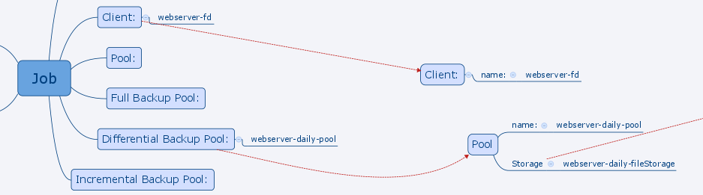
Job {
Name = "webserver-job"
JobDefs = "DefaultJob"
Type = Backup
FileSet = "webserver-fs"
Client = “webserver-sd”
Differential Backup Pool = ”webserver-daily-pool”
...
}
job-webserver-fd-webserver-job.conf

Slide 33
Pool {
Name = "webserver-daily-pool"
PoolType = Backup
MaximumVolumeJobs = 10
MaximumVolumeBytes = 10G
Maximum Volumes = 10
Recycle = yes
ActionOnPurge = truncate
AutoPrune = yes
Volume Use Duration = 4 days
VolumeRetention = 9 days
LabelFormat = "webserver-daily-volnum-\$\{NumVols\}"
Storage = "webserver-daily-fileStorage"
}
pool-webserver-daily-pool.conf – on bareos-dir

Slide 34
Overview of BareOS Configuration
Machines
Physical Devices
Machines
Daemons
Configurations / Resulting Objects
Director
Director
Schedule
Director
bareos-dir
:9101
Client
Storage
FileSet
daily...weekly...monthly
Device
Job
Pool
configures
Client
Backup
Client
bareos-fd
FileSet
Selected
Files
Job
Instance
:9102
1..N
Storage
Daemon
(Receives Backups)
(Manages Devices)
Storage
Daemon
(Receives Backups)
(Manages Devices)
bareos-sd
bareos-sd
:9103
Director
1..N
Storage
Vol-01
(file that stores
backup jobs)
Pool
(Configures
Volumes,
recycles them)
Device
contains volume file...
HDD or Tape
on the
Storage
Daemon
Directory on Device
/mnt/backups/<client-name>/<pool-name>/

Slide 35
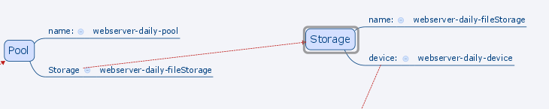
# Note: use external director address for clients to connect.
Storage {
Name = "bareOSdirector-sd"
SDAddress = 10.0.3.10
SDPort = 9103
WorkingDirectory = /var/lib/bareos
Maximum Concurrent Jobs = 30
Heartbeat Interval = 1 minute
}
# Director who is permitted to contact this Storage daemon.
Director {
Name = "bareOSdirector"
Password = "some_password"
}
Storage {
Name = "webserver-daily-fileStorage"
Device = “webserver-daily-device”
Media Type = File
Address = bareOSdirector
SDPort = 9103
Password = "some_password"
AllowCompression = Yes
# Autochanger = yes
}
storage-webserver-daily-fileStorage.conf
(on the director)

Slide 36
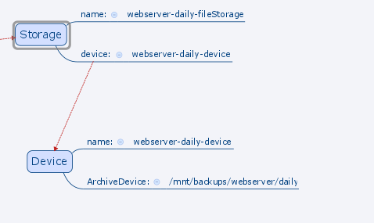
Device {
Name = "webserver-daily-device"
DeviceType = File
MediaType = File
ArchiveDevice = /mnt/backups/webserver/daily
LabelMedia = yes
RandomAccess = yes
AutomaticMount = yes
RemovableMedia = no
AlwaysOpen = yes
}

Slide 37

Catalog
MySQL or Postgres Database
Stores Information about:
  Auto Changers and Storage Media (hdd and tapes)
  Pools and their Volumes
  Which files for which backups are backed up where…
  Clients to be backed up
  Which Storage Daemons have which Media

Slide 38
Backup Jobs and Files

Slide 39
Pools and their Volumes
Pool
(Configures the Lifecycle of it’s Volumes)
Vol-01
(files that store backup jobs)
Vol-02
(files that store backup jobs)
Vol-03
(files that store backup jobs)

Slide 40
Volume Lifecycle

Slide 41
Volume Lifecycle - append

Slide 42
Volume Lifecycle - append

Slide 43
Volume Lifecycle - used

Slide 44
Volume Lifecycle - recycled

Slide 45
Volumes and Jobs

Slide 46
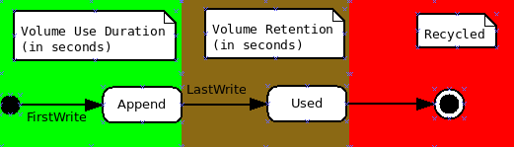
Volume States

Slide 47
Append - Volume States
A job runs and a volume is created and labeled.
The initial Volume Status is set to “Append”
  As long as the Volume Status is Append, the director can keep backing up jobs on to it.
A backup job is run and stored in the volume.

Slide 48
Append - Volume States
After the first backup job is run the “FirstWrite” date is recorded, and the “Volume Use Duration” begins counting the seconds after that date, so that the next time this volume is visited by the director if FirstWrite + Volume Use Duration has been exceeded, it will set the Volume Status to “Used” (see next slide).

Slide 49
Used - Volume States
Once the “Volume Status” is transitioned from “Appended” to “Used” a LastWrite date is recorded, and the Volume is read-only (does not accept new backup jobs)
Until the LastWrite date + Volume Retention is exceeded when the director next looks at this volume, it will Recycle the Volume.

Slide 50
Recycled - Volume States
Recycling the volume means that all the jobs within it disappear and that it can then go back to the Append State and start accepting backup jobs again.

Slide 51
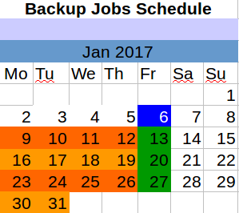
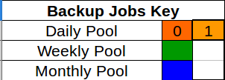
Pool Volume Configuration
Pool {
Name = "webserver-daily-pool"
PoolType = Backup
...
Recycle = yes
...
Volume Use Duration = 4 days
VolumeRetention = 9 days
...
}
pool-webserver-daily-pool.conf

Slide 52
Pools per client?
volnum-0
/mnt/backups/webserver/daily/
Two files (volumes):
- webserver-daily-volnum-0
- webserver-daily-volnum-1
volnum-1
volnum-0
volnum-1
The period of time we’re covering will generate two volumes, but we are only going to
focus on the lifecycle of one; it will contain 4 backup jobs, and be in existence
for 2 weeks total.

Slide 53
Pool Volume Configuration
Job {
Name = "webserver-job"
Client = "webserver-fd"
...
Schedule = "webserver-cycle-schedule"
Priority = 6
...
job-webserver-fd-webserver-job.conf
volnum-0
9
Schedule {
Name = "webserver-cycle-schedule"
Run = Level=Differential Pool=webserver-daily-pool monday-thursday at 22:00
…
schedule-webserver-cycle-schedule.conf
0. FirstWrite date set.
1. Set VolStatus to Append
2. Do a backup job and place it in the volume.

Slide 54
GFS19 - Monthly Pool
Pool {
Name = "webserver-daily-pool"
...
Volume Use Duration = 4 days
VolumeRetention = 9 days
...
}
pool-webserver-daily-pool.conf
volnum-0
9
10
11
12
Schedule {
Name = "webserver-cycle-schedule"
Run = Level=Differential Pool=webserver-daily-pool monday-thursday at 22:00
…
schedule-webserver-cycle-schedule.conf
0. Backup job2, job3, job4
1. Volume Use Duration ends…

Slide 55
GFS19 – Weekly Pool
Pool {
Name = "webserver-daily-pool"
...
Volume Use Duration = 4 days
VolumeRetention = 9 days
...
}
pool-webserver-daily-pool.conf
volnum-0
9
10
11
12
13
volnum-0
Schedule {
Name = "webserver-cycle-schedule"
Run = Level=Differential Pool=webserver-daily-pool monday-thursday at 22:00
…
schedule-webserver-cycle-schedule.conf
0. LastWrite date set...
1. Volume Retention Begins…

Slide 56
Pool {
Name = "webserver-daily-pool"
...
Volume Use Duration = 4 days
VolumeRetention = 9 days
...
}
pool-webserver-daily-pool.conf
volnum-0
9
10
11
12
13
14
15
volnum-0
16
17
18
19
20
21
Schedule {
Name = "webserver-cycle-schedule"
Run = Level=Differential Pool=webserver-daily-pool monday-thursday at 22:00
…
schedule-webserver-cycle-schedule.conf
0. Wait 9 days...and now the volume
retention period is over...but it won’t
Be recycled until….

Slide 57
Pool {
Name = "webserver-daily-pool"
...
Volume Use Duration = 4 days
VolumeRetention = 9 days
...
}
pool-webserver-daily-pool.conf
volnum-0
9
10
11
12
13
14
15
volnum-0
16
17
18
19
20
21
volnum-0
23
Schedule {
Name = "webserver-cycle-schedule"
Run = Level=Differential Pool=webserver-daily-pool monday-thursday at 22:00
…
schedule-webserver-cycle-schedule.conf
0. ...Monday when this volume is used
again...the old jobs (from 9th-12th)
in this volume are removed...(repeat)

Slide 58
bareos-dir /etc/ directory
bareos.sql
Bootstrap file sent via email.

Slide 59
What does this look like in practice?

Slide 60
GFS<num-vols-total>
In a GFS backup strategy, there is a number at the end that represents how many volumes total for the year there are in the backup of a client.
I was using GFS19 in this example.

Slide 61
Why use a Volume Lifecycle?
So we don’t run out of disk space.
If you’ve ever configured a BareOS server badly (without a Volume Lifecycle), you’ll notice that the Jobs just stack up inside the volumes and eventually you’ll just run out of disk space.
If you configure your pools to use the volume lifecycle instead, backups will be done and volumes will be recycled limiting the space that will be consumed; provided a backup strategy is used.

Slide 62
Backup Strategies
Pool {
Name = "webserver-monthly-pool"
PoolType = Backup
MaximumVolumeJobs = 100
MaximumVolumeBytes = 10G
Maximum Volumes = 12
Recycle = yes
ActionOnPurge = truncate
AutoPrune = yes
Volume Use Duration = 70 hours
VolumeRetention = 362 days
LabelFormat = "webserver-monthly-volnum-
Storage = "webserver-monthly-fileStorage"
}
pool-webserver-monthly-pool.conf
Backed up every 1st Friday
Recycled after about a year…
anywhere from 12 to 14 volumes per year.

Slide 63
Volume Lifecycle and Backup Copy Jobs
Pool {
Name = "webserver-weekly-pool"
PoolType = Backup
MaximumVolumeJobs = 100
MaximumVolumeBytes = 10G
Maximum Volumes = 10
Recycle = yes
ActionOnPurge = truncate
AutoPrune = yes
Volume Use Duration = 70 hours
VolumeRetention = 28 days
LabelFormat = "webserver-weekly-volnum-
Storage = "webserver-weekly-fileStorage"
Next Pool = "webserver-weekly-CopyPool"
}
pool-webserver-weekly-pool.conf
Only Copy on VolStatus: Used
  So BCJs must occur between the calculated VolumeDuration end date and the Volume Retention date
Backed up every 2nd-5th Friday
Recycled after about 5 weeks
About 4 volumes.

Slide 64
In a GFS* Strategy:
  Monthly (Full)
  Weekly (Full)
  Daily
  (Incremental or Differential)

Slide 65
What does this look like in practice?

Slide 66
bareos-dir /etc/ directory
bareos.sql
Bootstrap file sent via email.

Slide 67
Why use a Volume Lifecycle?
So we don’t run out of disk space.
If you’ve ever configured a BareOS server badly (without a Volume Lifecycle), you’ll notice that the Jobs just stack up inside the volumes and eventually you’ll just run out of disk space.
If you configure your pools to use the volume lifecycle instead, backups will be done and volumes will be recycled limiting the space that will be consumed; provided a backup strategy is used.

Slide 68
Backup Strategies

Slide 69
Volume Lifecycle and Backup Copy Jobs
Only Copy on VolStatus: Used
  So BCJs must occur between the calculated VolumeDuration end date and the Volume Retention date

