Slide 1

MATH417 L10
Chuqi CHEN
February 4, 2026

Slide 2
Warm up
Office Hour： by appointment cchenck@umich.edu
Recording course for Wed. （see the record, for HW1& HW2.)
No course in class.
Midterm: Feb 25 8:30-10:00am EH 1084.
Practice exam has released.
Homework 2: due date: 02/18
Homework 3: due date: 03/10

Slide 3
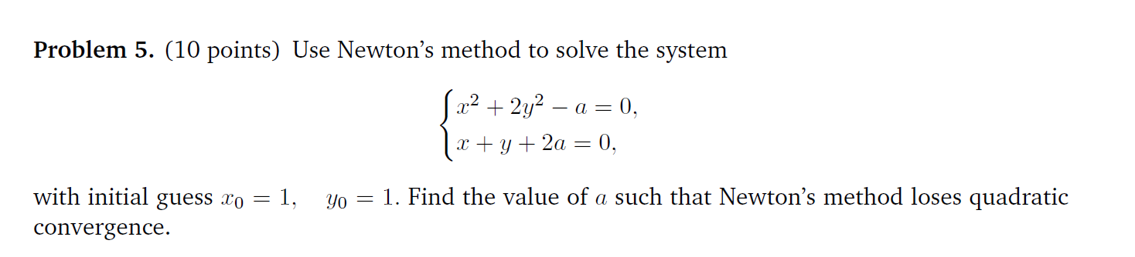
Warm up

Slide 4
Overviews
Norm
Condition Number
SVD

Slide 5
Overviews
Norm
Condition Number
SVD

Slide 6
Norm
How can we do the error estimation？

Slide 7
Norm
Idea:
How to determine distance between two vector?
What properties a distance should satisfies?

Slide 8




Norm
What properties a distance should satisfies?
Non-negativity
Identity of indiscernibles
Symmetry
Triangle inequality

Slide 9
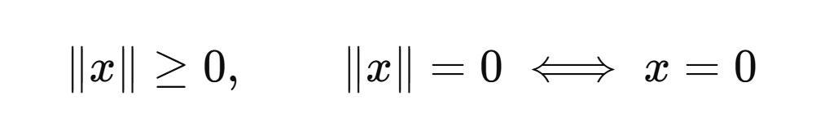

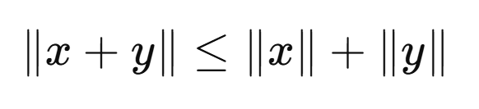
Norm
What properties a norm should satisfies?
Positive Definiteness
Homogeneity
Triangle Inequality

Slide 10
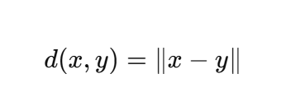
Norm
A norm induced a distance

Slide 11
Norm
Vector Norms
The p-norm of a vector X is:
Important examples of vector p-norms include:

Slide 12
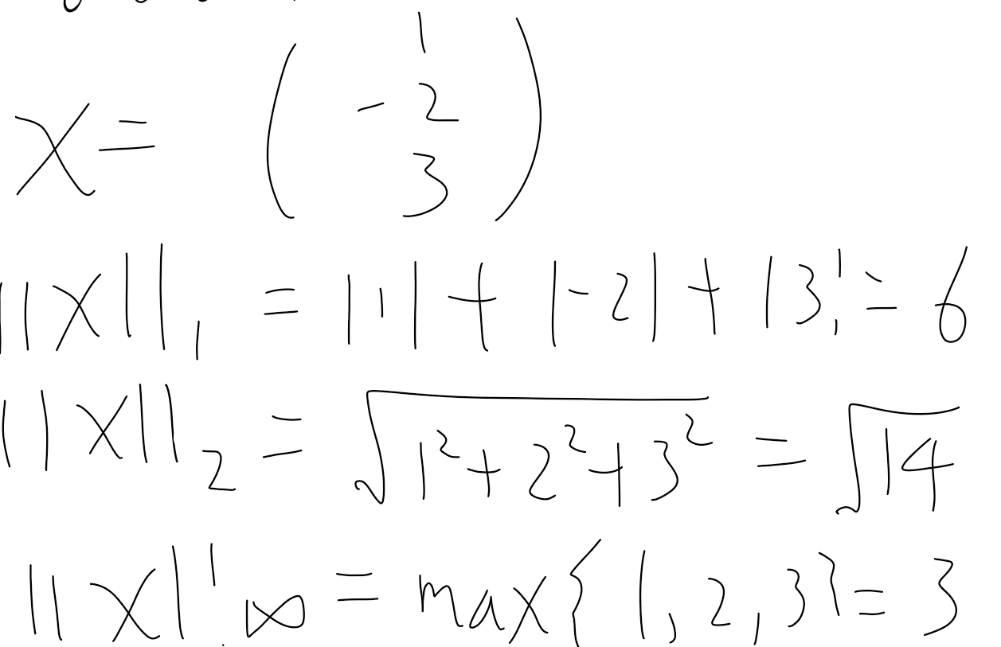
Norm

Slide 13

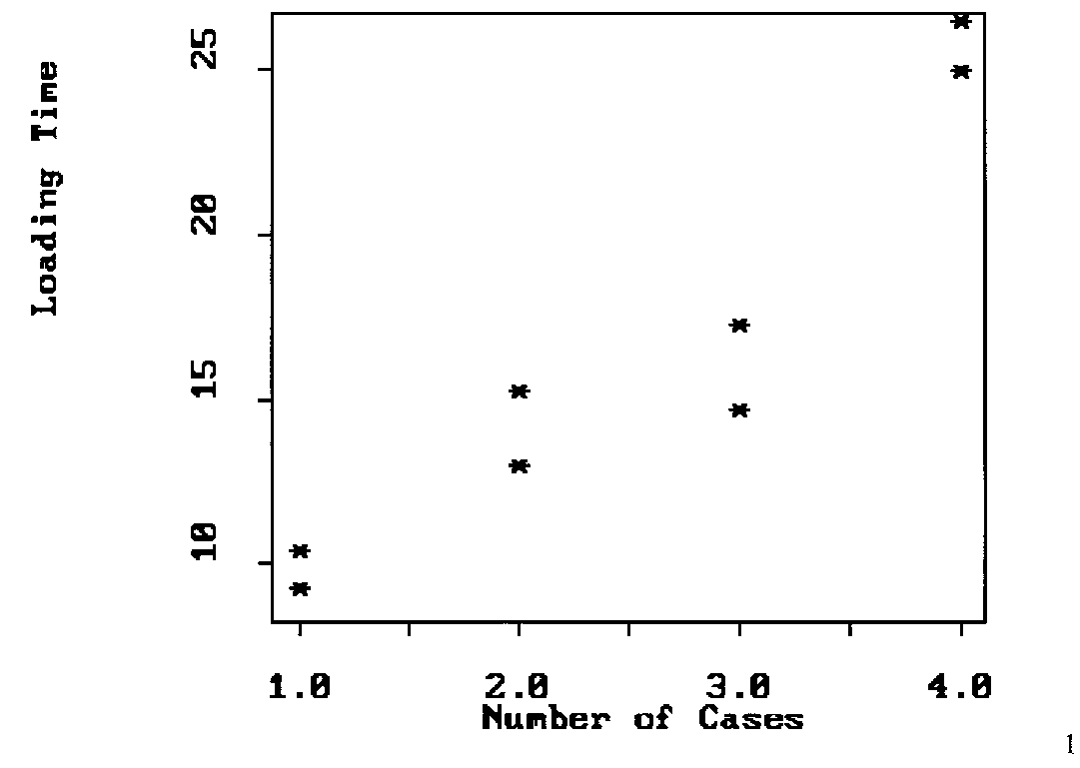

Remind
Regression problem
We have data with noise:
$${\left\{\left(x_{i},y_{i}\right)\right\}}_{i=1}^{m}$$
We want to find out the relationship between $y$ and $x$
How to find $b_{0}, b_{1}$ ?

Slide 14
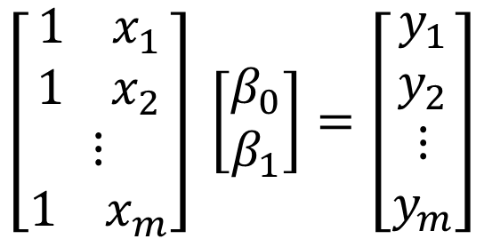
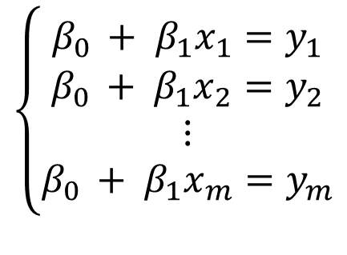
Motivation
Regression problem
We have data with noise:
$${\left\{\left(x_{i},y_{i}\right)\right\}}_{i=1}^{m}$$
We want to find out the relationship between $y$ and $x: y=β_{0}+β_{1}x$
$$\left\{\begin{aligned}β_{0 }+ β_{1}x_{1}=y_{1} \\ β_{0 }+ β_{1}x_{2}=y_{2} \\ ⋮ \\ β_{0 }+ β_{1}x_{m}=y_{m}\end{aligned}\right.$$
How to write down the matrix ? Ax = b
$$\left[\begin{aligned}{1 x}_{1} \\ {1 x}_{2} \\ ⋮ \\ {1 x}_{m}\end{aligned}\right] \left[\begin{aligned}β_{0} \\ β_{1}\end{aligned}\right]=\left[\begin{aligned}y_{1} \\ y_{2} \\ ⋮ \\ y_{m}\end{aligned}\right]$$

Slide 15
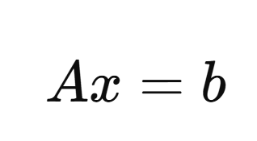
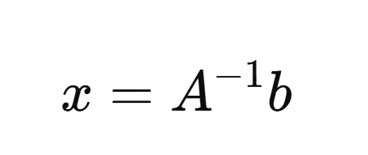
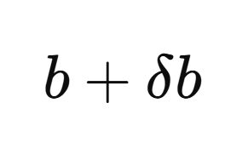
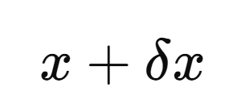
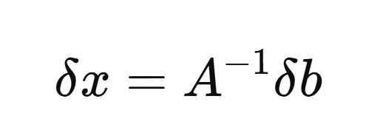
Norm
Look back to Gaussian elimination
Truth solution:
b has perturbation:
New solution:

Slide 16
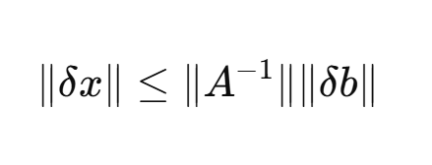
Norm
We want:

Slide 17
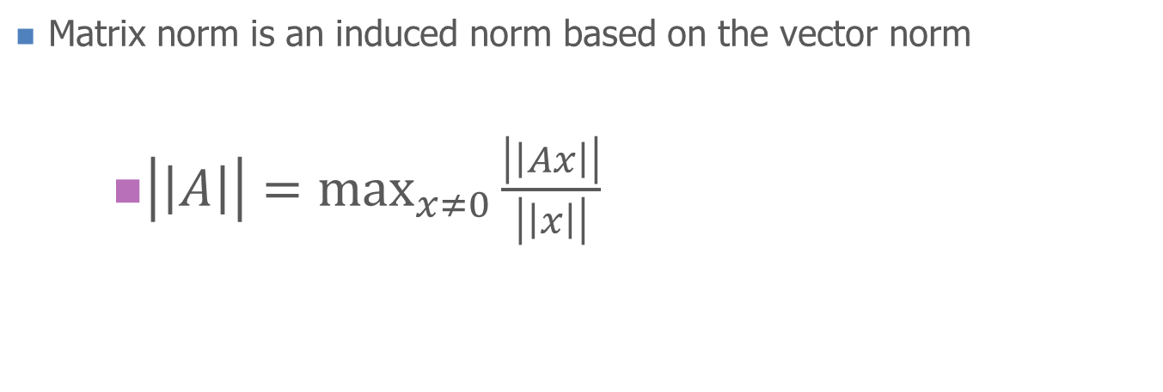
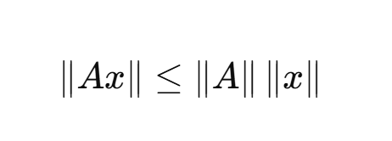
Norm
Matrix Norms

Slide 18
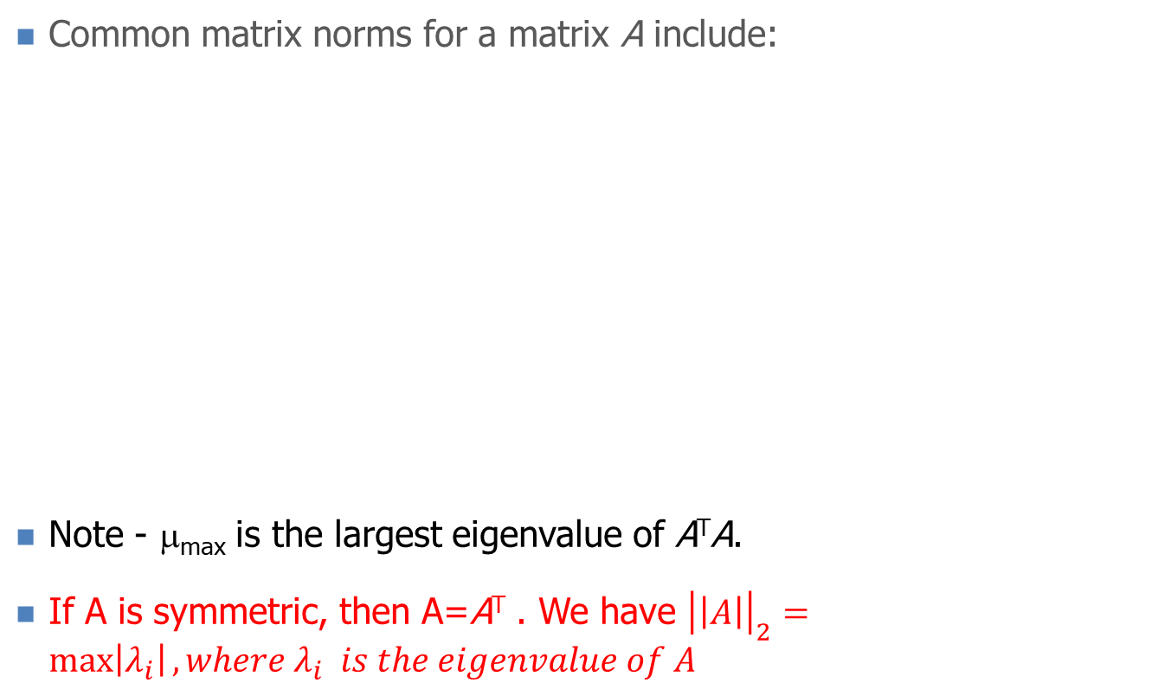


Norm

Slide 19
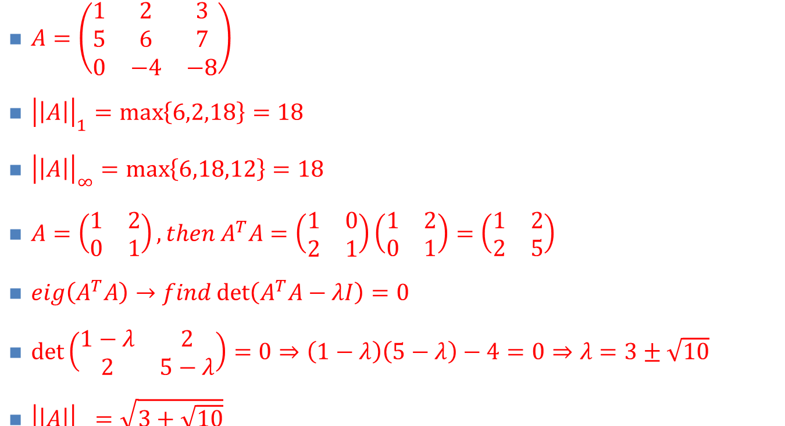
Norm
Matrix Norms: examples

Slide 20
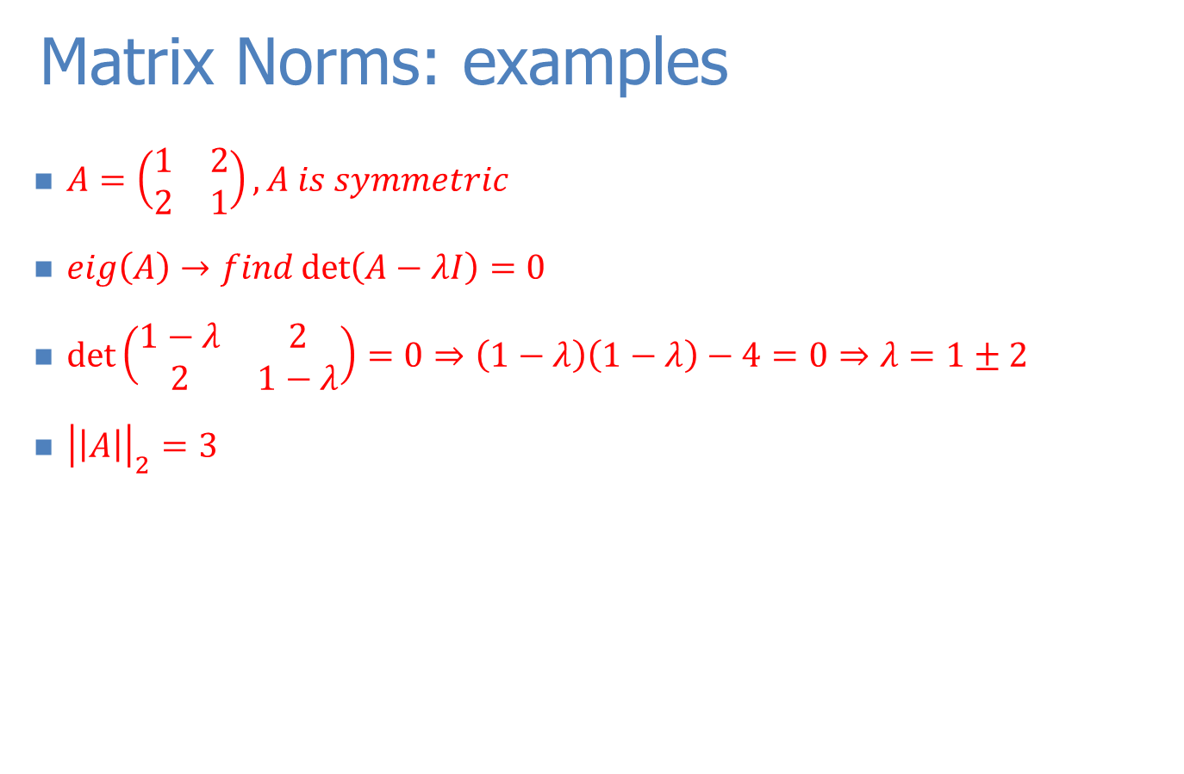
Norm

Slide 21
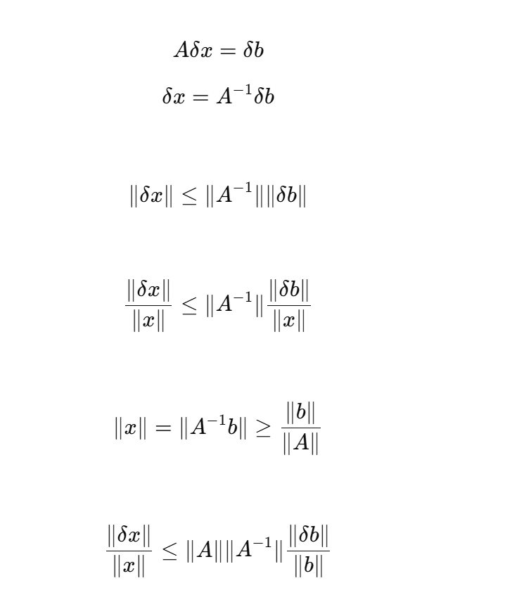
Example

Slide 22
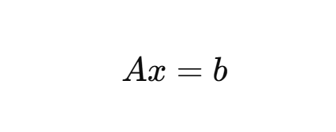
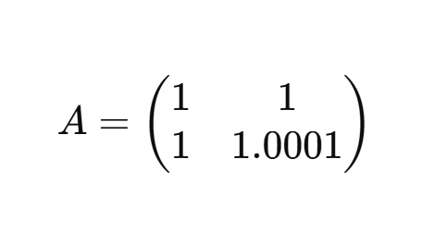
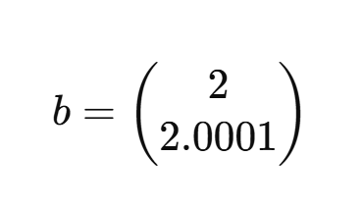
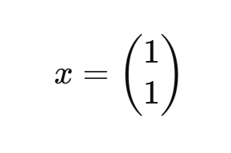
Example

Slide 23
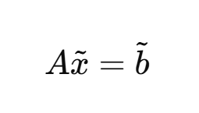
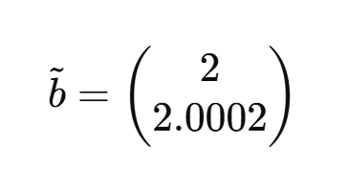
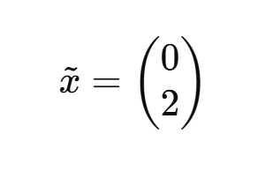
Example

Slide 24
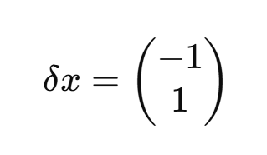
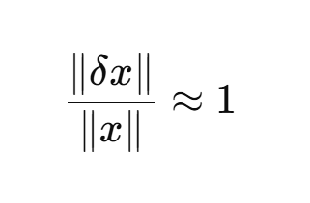
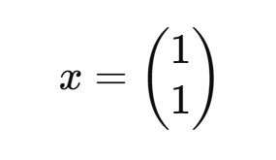
Example

Slide 25
Condition number
Matrix Condition Number
The matrix condition number Cond[A] is obtained by calculating Cond[A]=||A||·||A⁻¹||
In can be shown that:
Condition number is small if the matrix A is well-conditioned
Condition number is big if the matrix A is ill-conditioned.

Slide 26
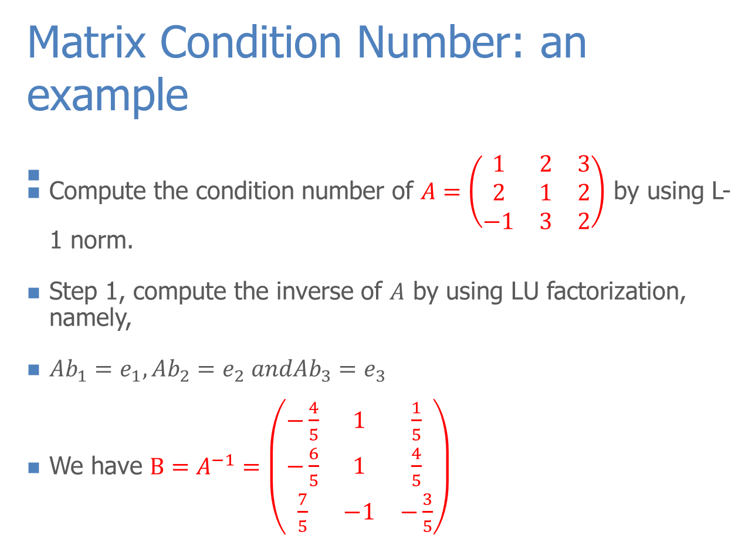
Condition number

Slide 27
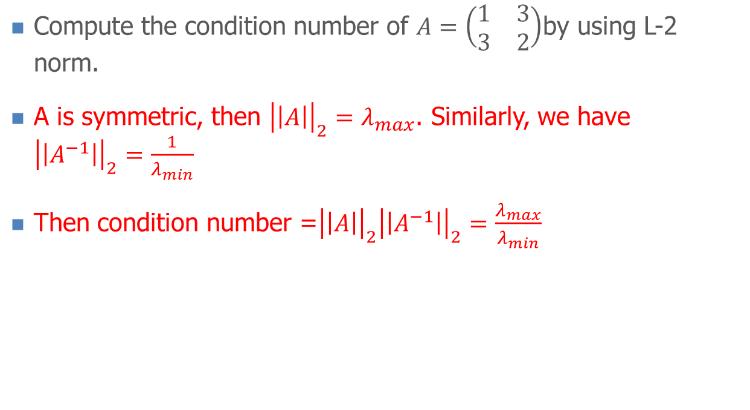

Condition number
Matrix Condition Number: an example

Slide 28
Condition number

Slide 29
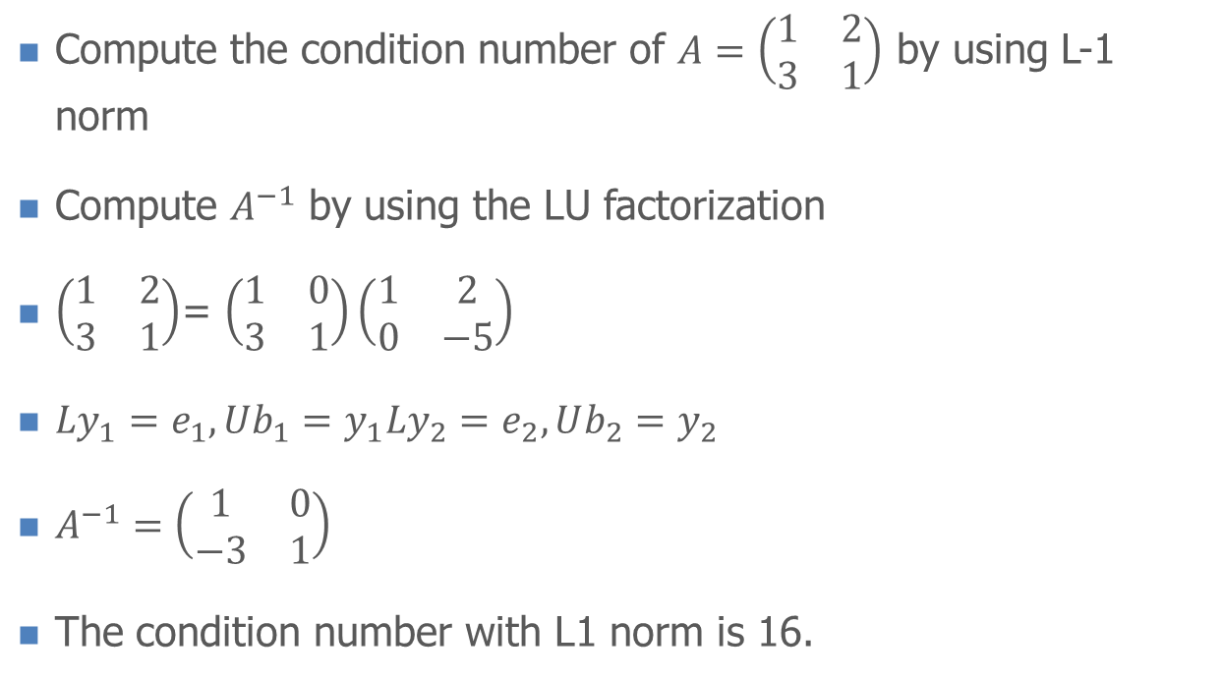
Condition number
Matrix Condition Number: an example (DIY)

Slide 30
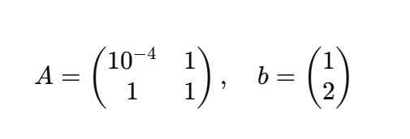
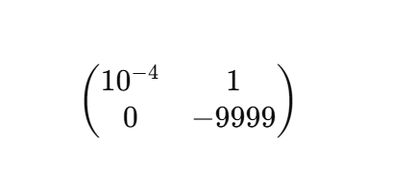
Thinking
Gaussian Elimination

Slide 31
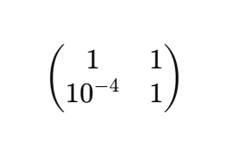
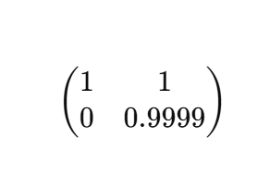
Thinking
Gaussian Elimination with Partial Pivoting

Slide 32
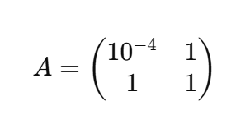
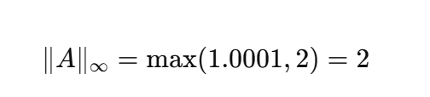
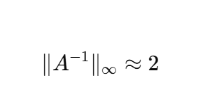
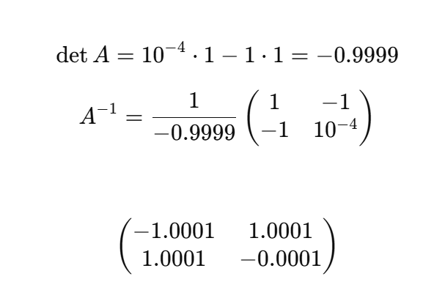
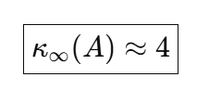
Thinking
Condition number of A

Slide 33
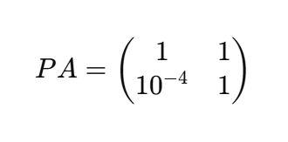
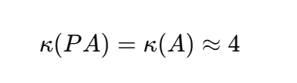
Thinking
Condition number of A
Pivoting will change the condition number of A?
No!!!

Slide 34
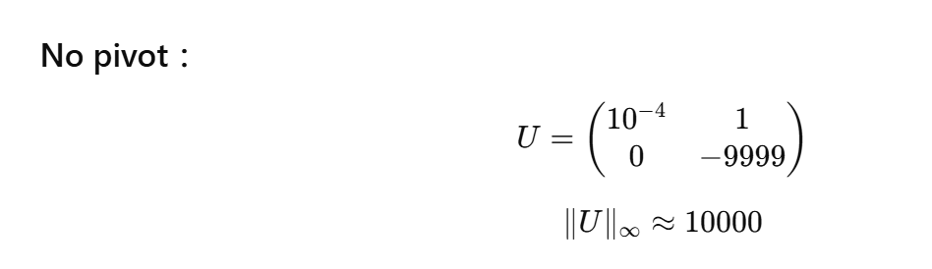
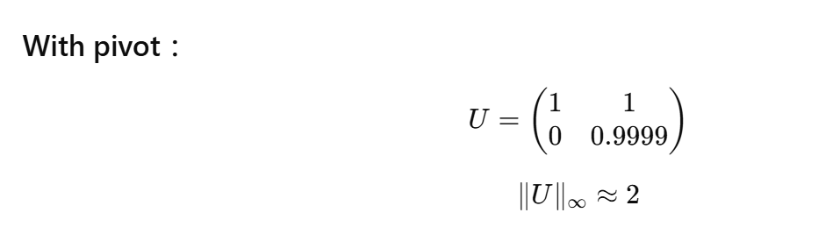
Thinking

