Slide 1

MATH417 L4
Chuqi CHEN
January 14, 2026

Slide 2
Overviews
Root Finding Problem
Newton Raphson method
Non-linear equations in two and more dimensions

Slide 3
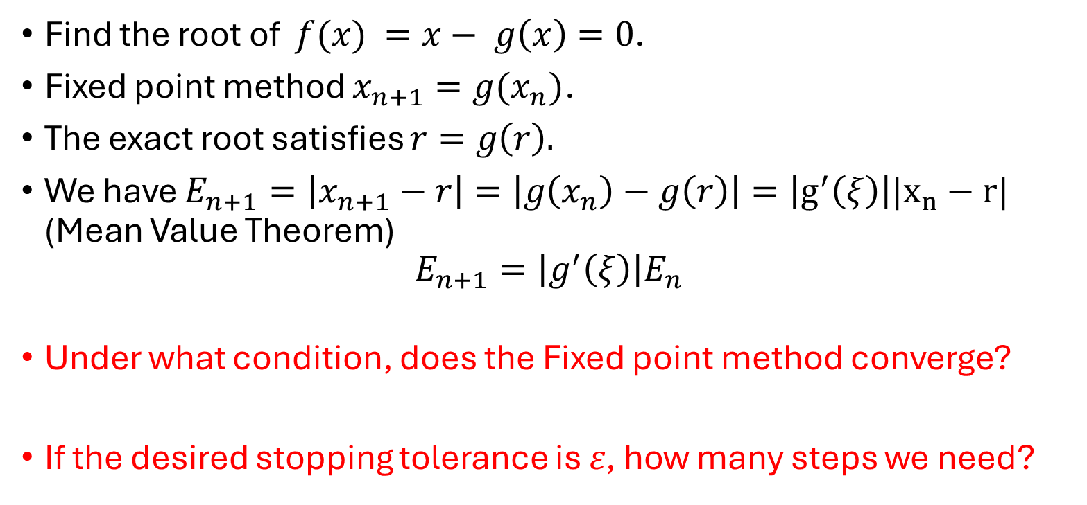
Warm up
Fixed point method
Find the root of $f({x)}_{ }=x− g\left(x\right)=0$.
Fixed point method $x_{n+1}=g(x_{n})$.
The exact root satisfies $r=g\left(r\right).$
We have $E_{n+1}=\left|x_{n+1}−r\right|=\left|g\left(x_{n}\right)−g\left(r\right)\right|=\left|g^{′}\left(ξ\right)\right||x_{n}−r|$ (Mean Value Theorem)
$$E_{n+1}=\left|g^{′}\left(ξ\right)\right|E_{n}$$
Under what condition, does the Fixed point method converge?
If the desired stopping tolerance is 𝜀, how many steps we need?

Slide 4
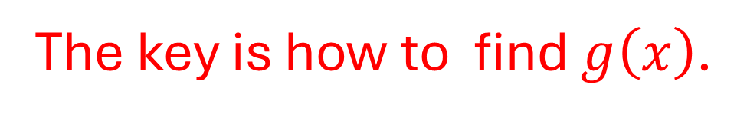
Warm up
Fixed point method
The key is how to find $g\left(x\right)$.

Slide 5
Newton’s method

Slide 6
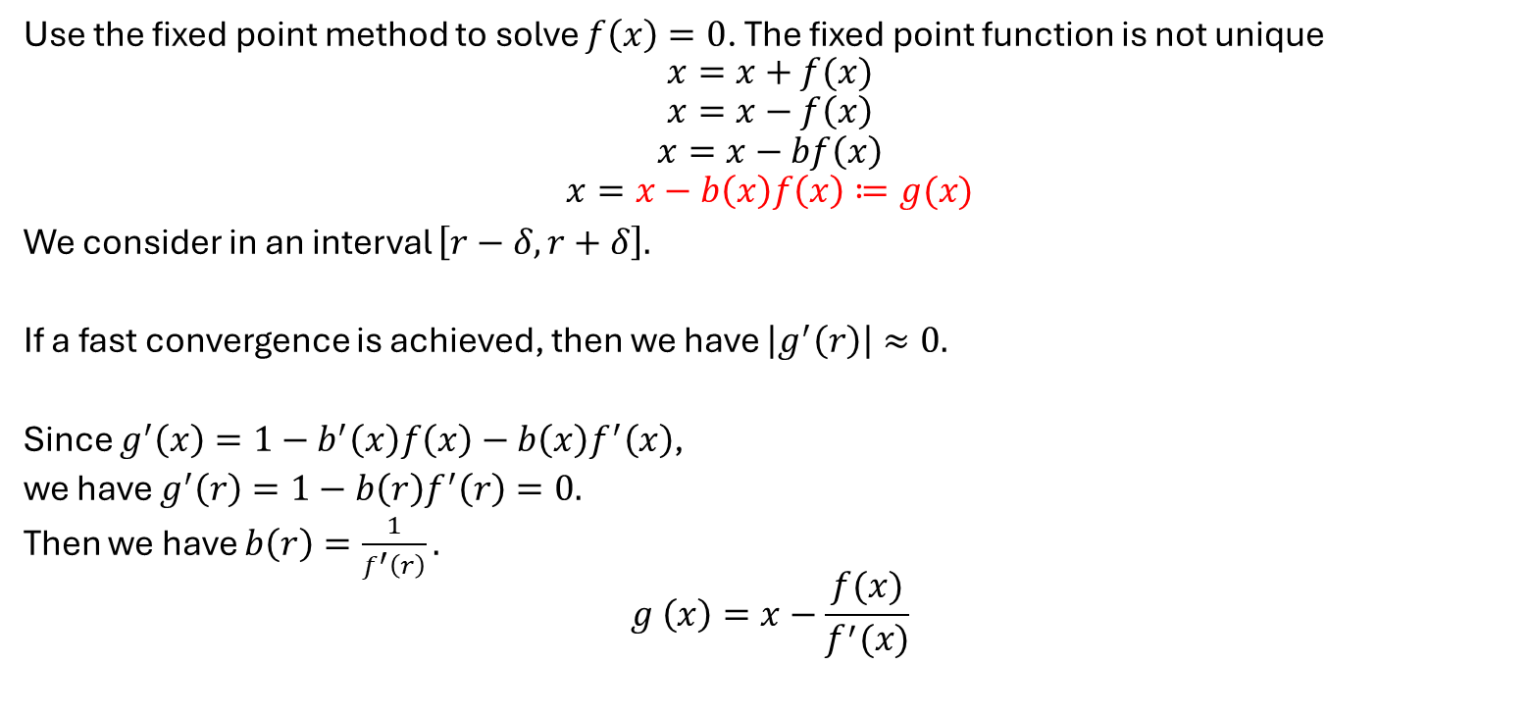
Motivation
Use the fixed point method to solve $f\left(x\right)=0$. The fixed point function is not unique
$$x=x+f(x)$$
$$x=x−f\left(x\right)$$
$$x=x−bf\left(x\right)$$
$$x=x−b\left(x\right)f\left(x\right)≔g(x)$$
We consider in an interval $\left[r−δ,r+δ\right].$
If a fast convergence is achieved, then we have $\left|g^{′}\left(r\right)\right|≈0.$
Since $g^{′}\left(x\right)=1−b^{′}\left(x\right)f\left(x\right)−b\left(x\right)f^{′}\left(x\right)$,
we have $g^{′}\left(r\right)=1−b\left(r\right)f^{′}\left(r\right)=0.$
Then we have $b\left(r\right)=\frac{1}{f^{′}\left(r\right)}.$
$$g^{ }\left(x\right)=x−\frac{f(x)}{f^{′}(x)}$$

Slide 7
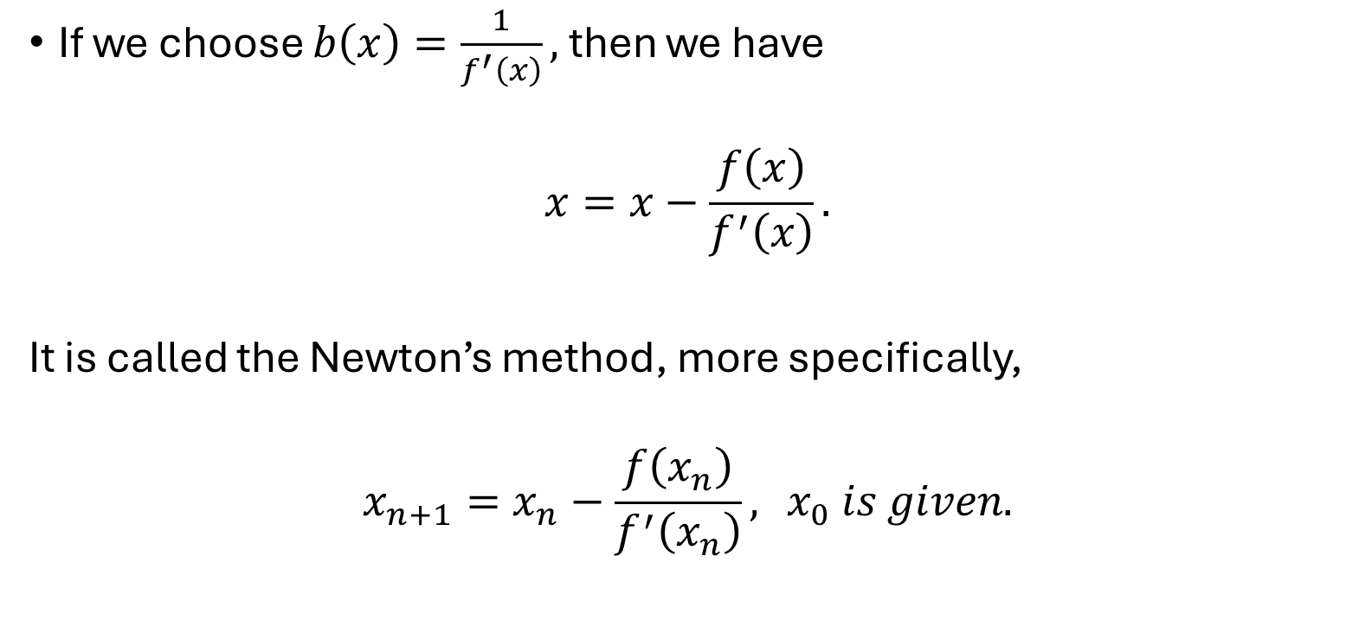
Newton’s method
If we choose $b\left(x\right)=\frac{1}{f^{′}\left(x\right)},$ then we have
$$x=x−\frac{f\left(x\right)}{f^{′}\left(x\right)}.$$
It is called the Newton’s method, more specifically,
$$x_{n+1}=x_{n}−\frac{f\left(x_{n}\right)}{f^{′}\left(x_{n}\right)}, { x}_{0} is given.$$

Slide 8
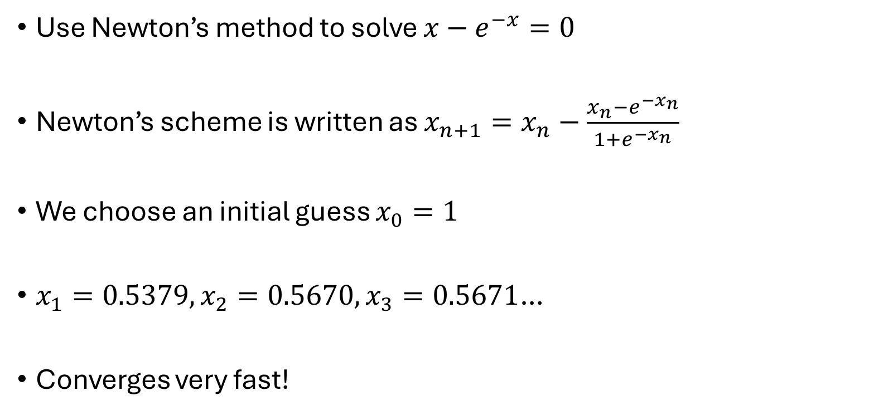
Example 1
Use Newton’s method to solve $x−e^{−x}=0$
Newton’s scheme is written as $x_{n+1}=x_{n}−\frac{x_{n}−e^{−x_{n}}}{1+e^{−x_{n}}}$
We choose an initial guess $x_{0}=1$
$x_{1}=0.5379, x_{2}=0.5670, x_{3}=0.5671$…
Converges very fast!

Slide 9
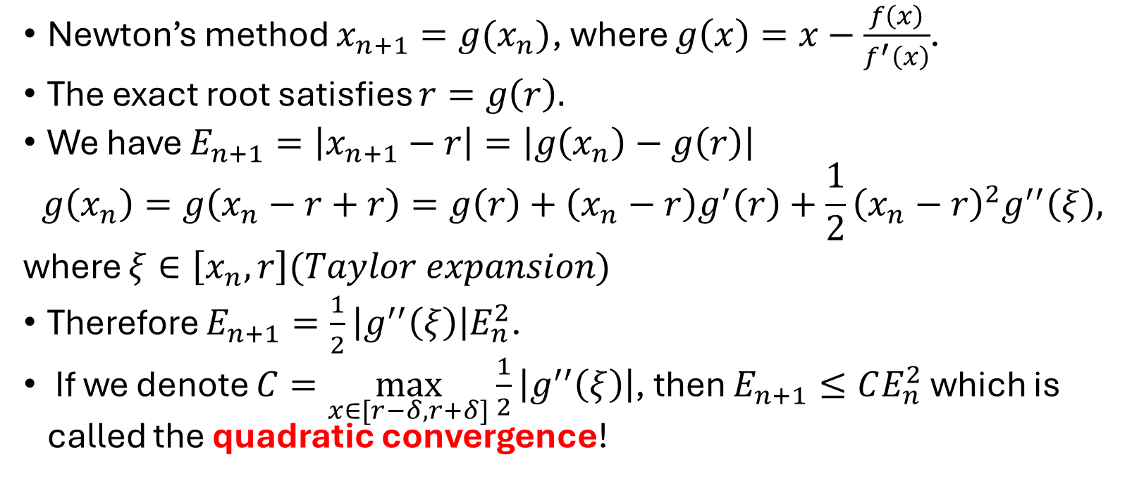
Error estimate
Newton’s method $x_{n+1}=g(x_{n})$, where $g\left(x\right)=x−\frac{f\left(x\right)}{f^{′}\left(x\right)}$.
The exact root satisfies $r=g\left(r\right).$
We have $E_{n+1}=\left|x_{n+1}−r\right|=\left|g\left(x_{n}\right)−g\left(r\right)\right|$
$$g\left(x_{n}\right)=g\left(x_{n}−r+r\right)=g\left(r\right)+\left(x_{n}−r\right)g^{′}\left(r\right)+\frac{1}{2}{\left(x_{n}−r\right)}^{2}g^{′′}\left(ξ\right),$$
where $ξ∈\left[x_{n},r\right](Taylor expansion)$
Therefore $E_{n+1}=\frac{1}{2}\left|g^{′′}\left(ξ\right)\right|E_{n}^{2}$.
If we denote $C=\max_{x∈[r−δ,r+δ]}\frac{1}{2}\left|g^{′′}\left(ξ\right)\right|$, then $E_{n+1}≤CE_{n}^{2}$ which is called the quadratic convergence!

Slide 10
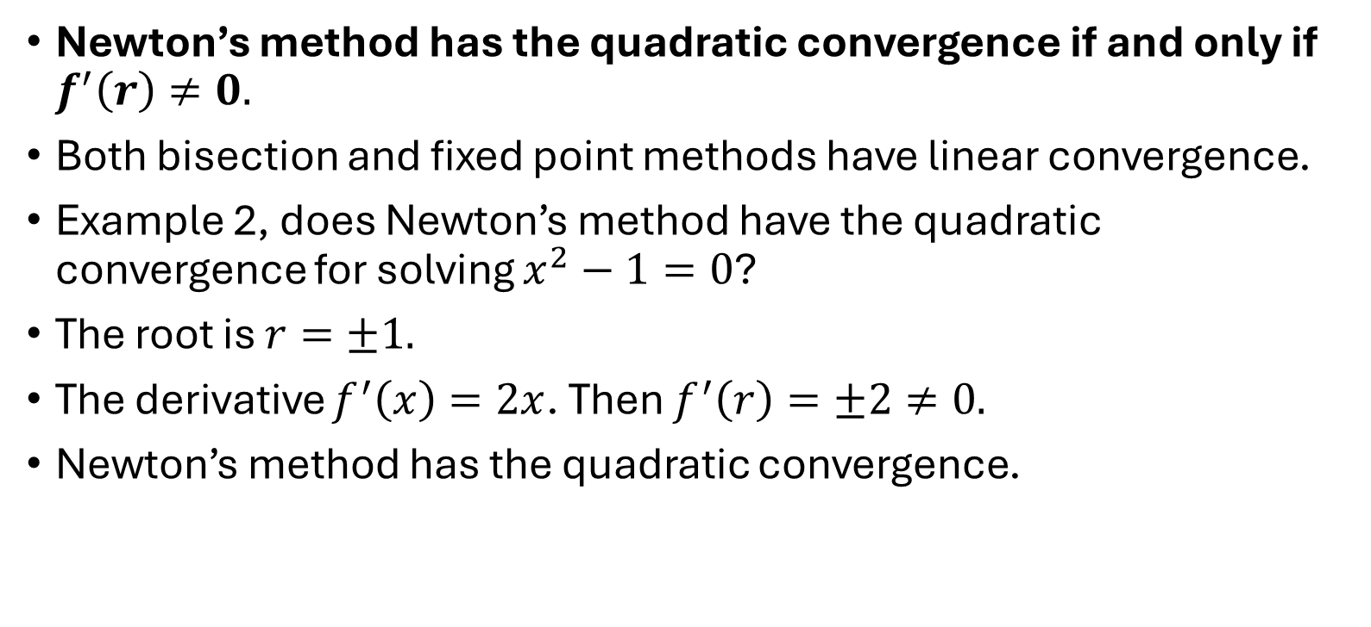
Quadratic convergence condition
Newton’s method has the quadratic convergence if and only if $f^{′}\left(r\right)≠0.$
Both bisection and fixed point methods have linear convergence.
Example 2, does Newton’s method have the quadratic convergence for solving $x^{2}−1=0$?
The root is $r=±1.$
The derivative $f^{′}\left(x\right)=2x$. Then $f^{′}\left(r\right)=±2≠0.$
Newton’s method has the quadratic convergence.

Slide 11
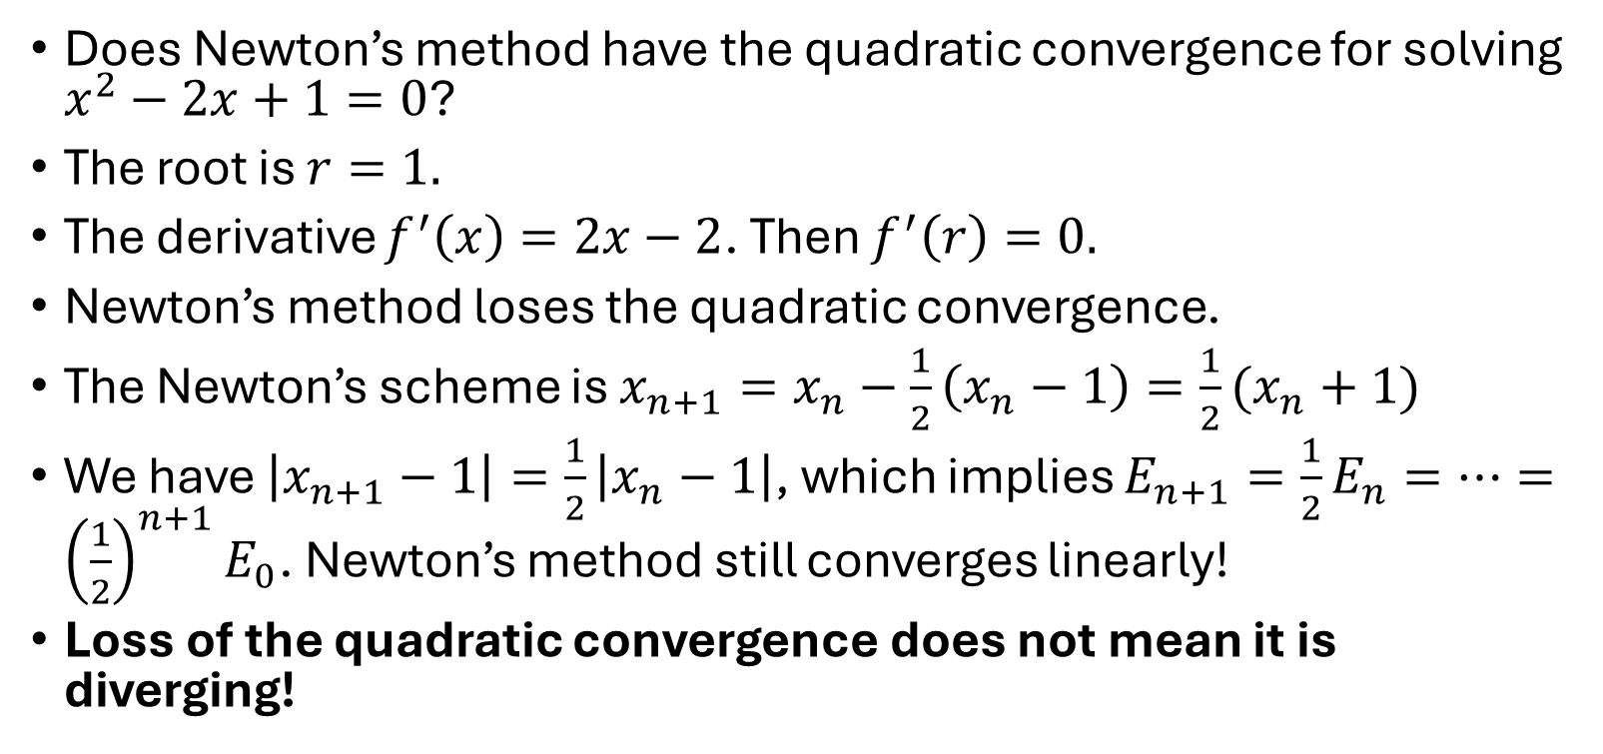
Example 3
Does Newton’s method have the quadratic convergence for solving $x^{2}−2x+1=0$?
The root is $r=1.$
The derivative $f^{′}\left(x\right)=2x−2$. Then $f^{′}\left(r\right)=0.$
Newton’s method loses the quadratic convergence.
The Newton’s scheme is $x_{n+1}=x_{n}−\frac{1}{2}\left(x_{n}−1\right)=\frac{1}{2}(x_{n}+1)$
We have $\left|x_{n+1}−1\right|=\frac{1}{2}\left|x_{n}−1\right|$, which implies $E_{n+1}=\frac{1}{2}E_{n}=⋯={\left(\frac{1}{2}\right)}^{n+1}E_{0}$. Newton’s method still converges linearly!
Loss of the quadratic convergence does not mean it is diverging!

Slide 12
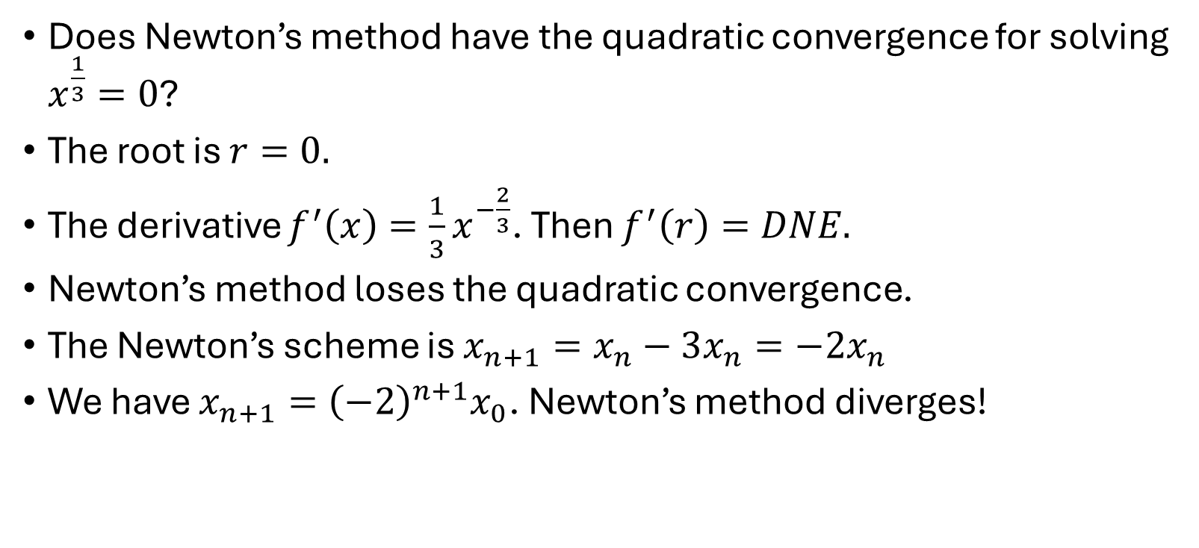
Example 4
Does Newton’s method have the quadratic convergence for solving $x^{\frac{1}{3}}=0$?
The root is $r=0.$
The derivative $f^{′}\left(x\right)=\frac{1}{3}x^{−\frac{2}{3}}$. Then $f^{′}\left(r\right)=DNE.$
Newton’s method loses the quadratic convergence.
The Newton’s scheme is $x_{n+1}=x_{n}−3x_{n}=−2x_{n}$
We have $x_{n+1}={\left(−2\right)}^{n+1}x_{0}$. Newton’s method diverges!

Slide 13
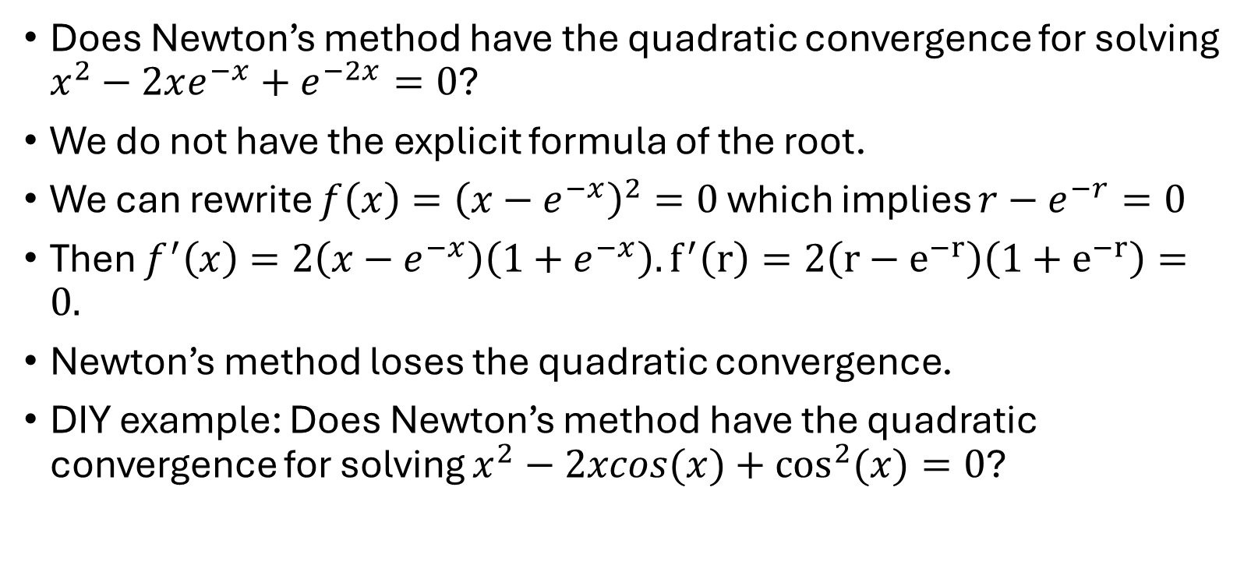
Example 5
Does Newton’s method have the quadratic convergence for solving $x^{2}−2xe^{−x}+e^{−2x}=0$?
We do not have the explicit formula of the root.
We can rewrite $f\left(x\right)={\left(x−e^{−x}\right)}^{2}=0$ which implies $r−e^{−r}=0$
Then $f^{′}\left(x\right)=2\left(x−e^{−x}\right)\left(1+e^{−x}\right). f^{′}\left(r\right)=2\left(r−e^{−r}\right)\left(1+e^{−r}\right)=0.$
Newton’s method loses the quadratic convergence.
DIY example: Does Newton’s method have the quadratic convergence for solving $x^{2}−2xcos(x)+\cos^{2}{(x)}=0$?

Slide 14

Example 6
Solve $x^{3}+4x^{2}−10=0; x∈[1,2]$ by the Newton method. How many iterations do you expect such that the error is less than ${10}^{−3}?$
By choosing${ x}_{k+1}=x_{k}−\frac{f(x_{k})}{f^{′}(x_{k})},$ we have $f^{′}\left(x\right)=3x^{2}+8x$

Slide 15
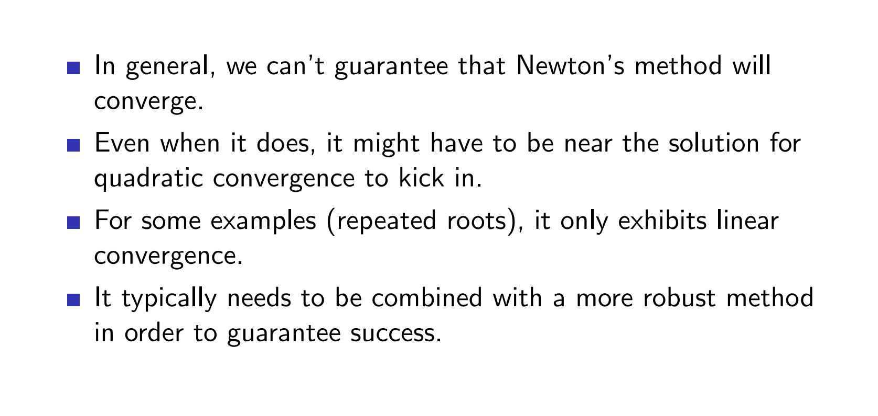
Limitations of Newton’s method

Slide 16
Overviews
Newton Raphson method
Scant method (quasi-Newton)

Slide 17
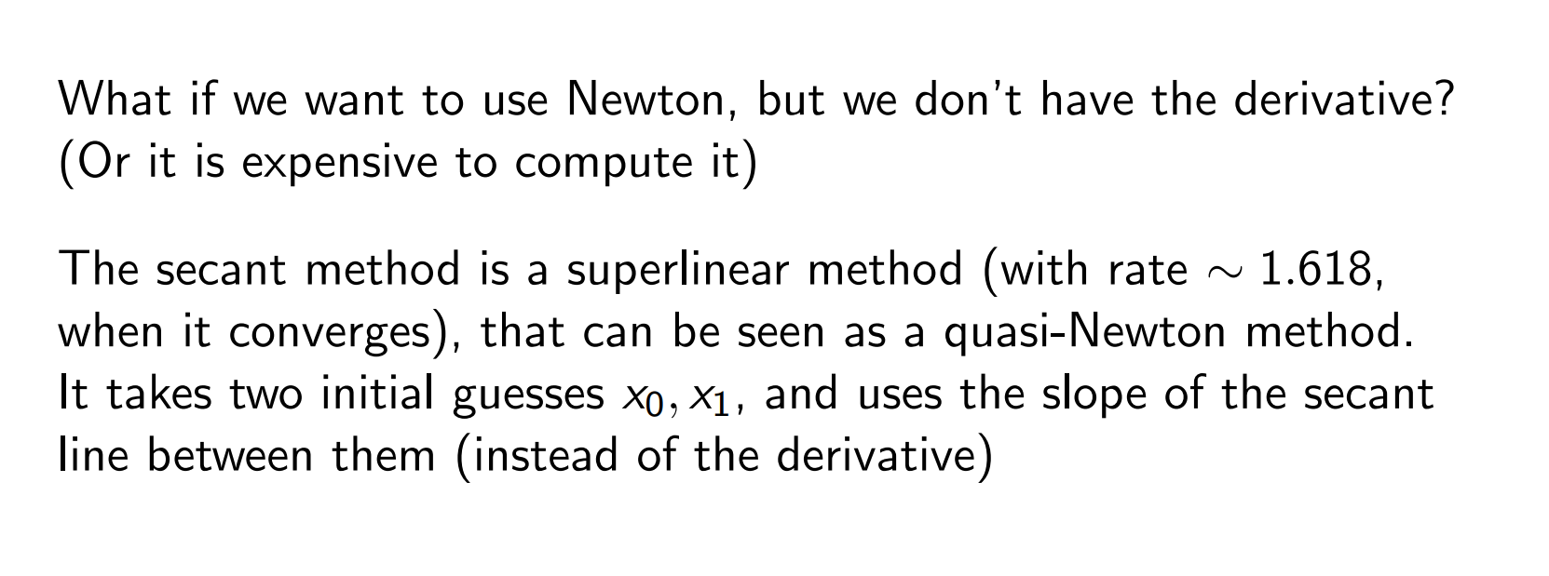
Question
Newton Raphson method
Secant method （quasi-Newton）

Slide 18
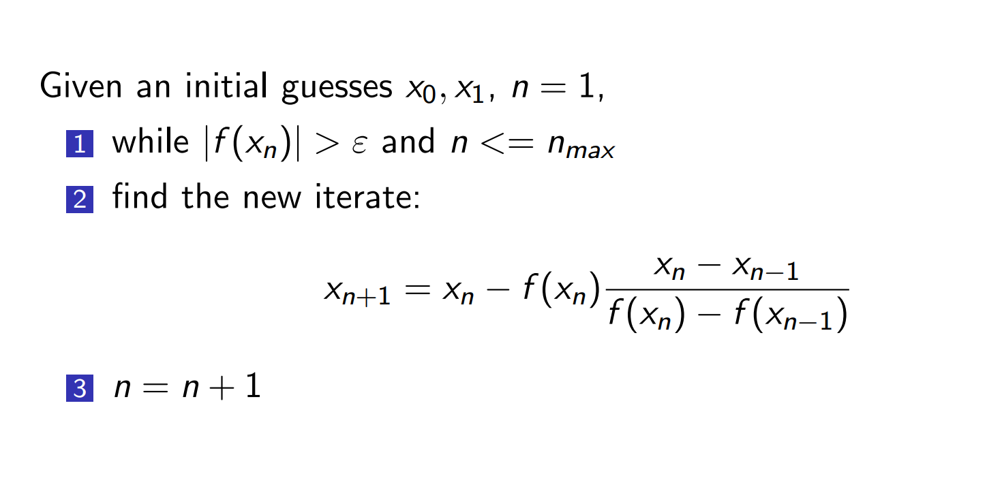
Scant method

Slide 19
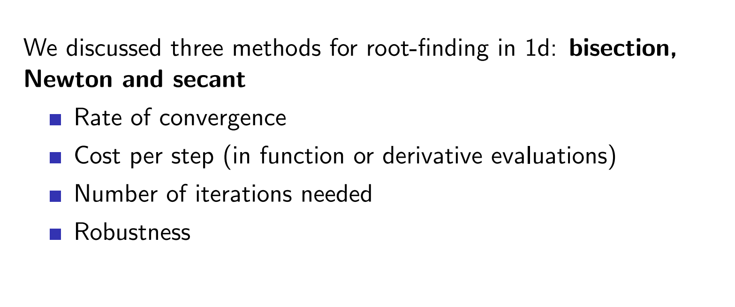
Summary

Slide 20
Overviews
Newton Raphson method
Scant method (quasi-Newton)
Systems of non-linear equations

Slide 21
A system of nonlinear equations

Slide 22
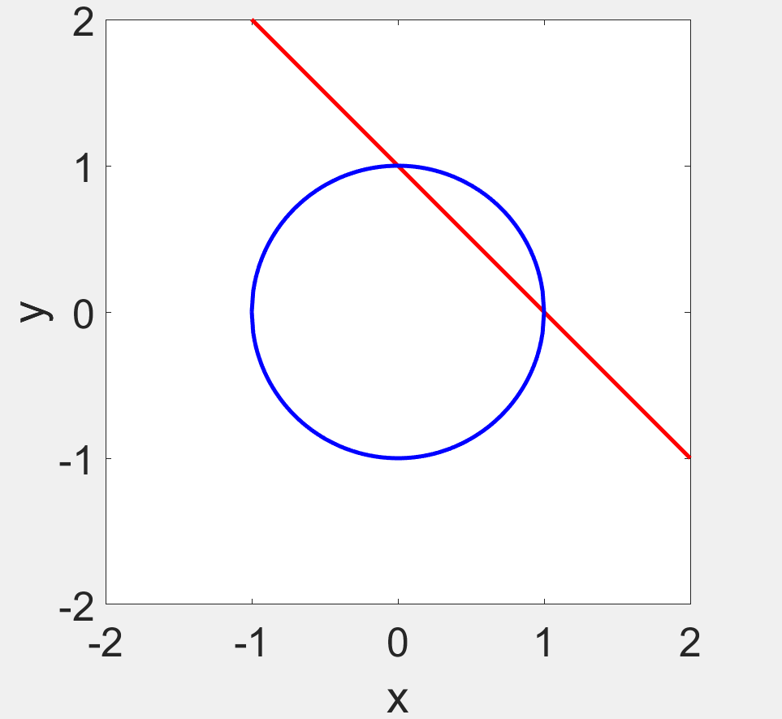
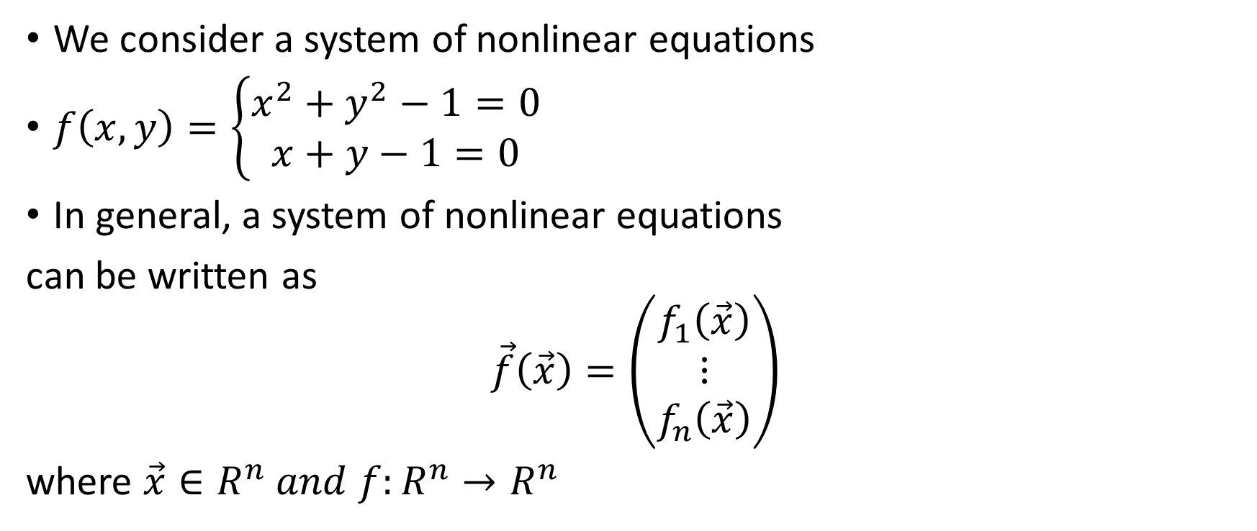
Motivation
We consider a system of nonlinear equations
$f\left(x,y\right)=\left\{\begin{matrix}x^{2}+y^{2}−1=0 \\ x+y−1=0\end{matrix}\right.$
In general, a system of nonlinear equations
can be written as
$$\vec{f}\left(\vec{x}\right)=\left(\begin{matrix}f_{1}\left(\vec{x}\right) \\ ⋮ \\ f_{n}\left(\vec{x}\right)\end{matrix}\right)$$
where $\vec{x}∈R^{n} and f:R^{n}→R^{n}$

Slide 23

Bisection method
The computation cost becomes very expensive!
Search on the n-dimensional space is about $2^{n}$!
y
c
d
a b x

Slide 24
Fixed point method
For a n-dimensional system of nonlinear equations, it is very difficult to construct the fixed point function.

Slide 25
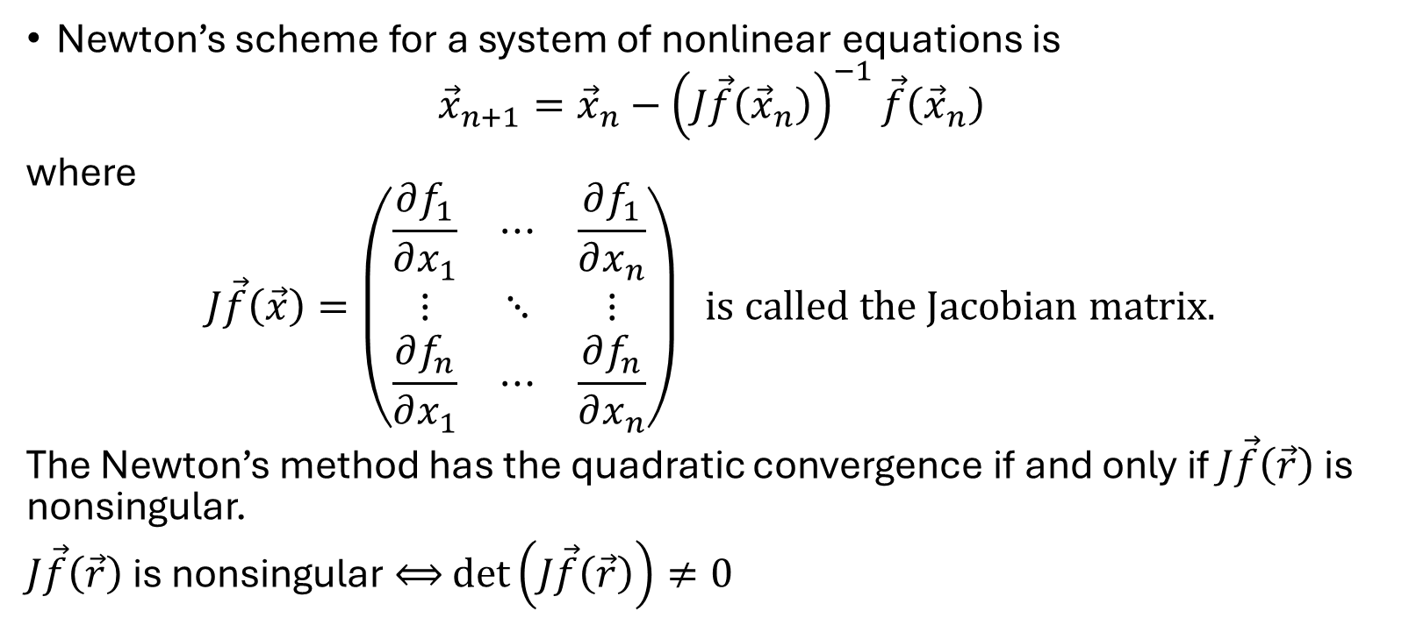
Newton’s method
Newton’s scheme for a system of nonlinear equations is
$${\vec{x}}_{n+1}={\vec{x}}_{n}−{\left(J\vec{f}\left({\vec{x}}_{n}\right)\right)}^{−1}\vec{f}\left({\vec{x}}_{n}\right)$$
where
$$J\vec{f}\left(\vec{x}\right)=\left(\begin{matrix}\frac{∂f_{1}}{∂x_{1}} & ⋯ & \frac{∂f_{1}}{∂x_{n}} \\ ⋮ & ⋱ & ⋮ \\ \frac{∂f_{n}}{∂x_{1}} & ⋯ & \frac{∂f_{n}}{∂x_{n}}\end{matrix}\right) is called the Jacobian matrix.$$
The Newton’s method has the quadratic convergence if and only if $J\vec{f}\left(\vec{r}\right)$ is nonsingular.
$J\vec{f}\left(\vec{r}\right)$ is nonsingular $⟺$ $\det\left(J\vec{f}\left(\vec{r}\right)\right)≠0$

Slide 26
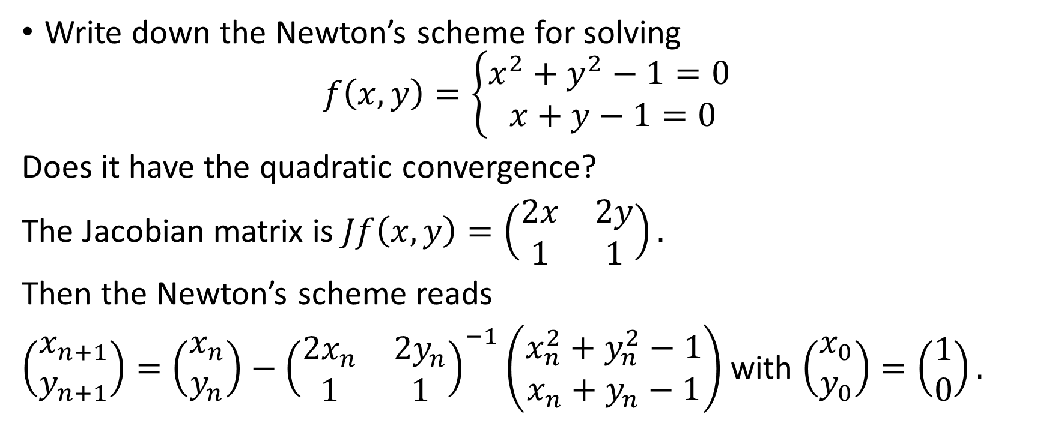
Example 1
Write down the Newton’s scheme for solving
$$f\left(x,y\right)=\left\{\begin{matrix}x^{2}+y^{2}−1=0 \\ x+y−1=0\end{matrix}\right.$$
Does it have the quadratic convergence?
The Jacobian matrix is $Jf\left(x,y\right)=\left(\begin{matrix}2x & 2y \\ 1 & 1\end{matrix}\right).$
Then the Newton’s scheme reads
$\left(\begin{matrix}x_{n+1} \\ y_{n+1}\end{matrix}\right)=\left(\begin{matrix}x_{n} \\ y_{n}\end{matrix}\right)−{\left(\begin{matrix}2x_{n} & 2y_{n} \\ 1 & 1\end{matrix}\right)}^{−1}\left(\begin{matrix}x_{n}^{2}+y_{n}^{2}−1 \\ x_{n}+y_{n}−1\end{matrix}\right)$ with $\left(\begin{matrix}x_{0} \\ y_{0}\end{matrix}\right)=\left(\begin{matrix}1 \\ 0\end{matrix}\right).$

Slide 27
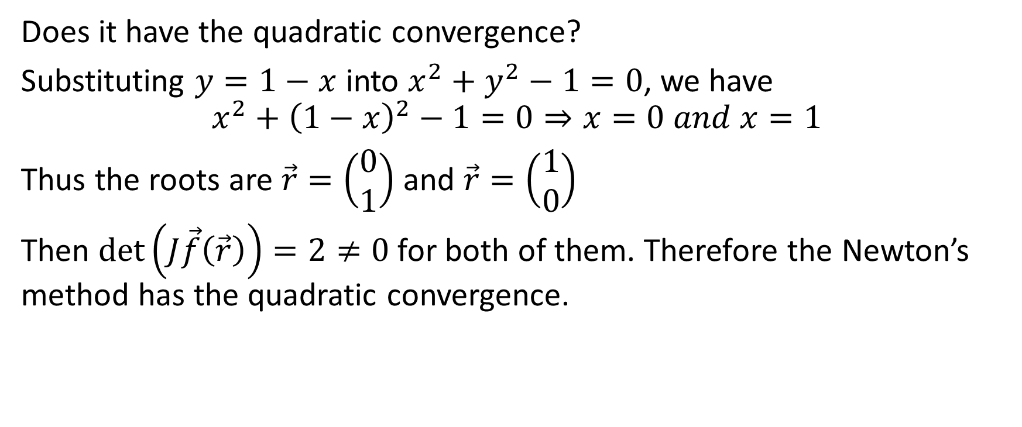
Example 1
Does it have the quadratic convergence?
Substituting $y=1−x$ into $x^{2}+y^{2}−1=0$, we have
$$x^{2}+{\left(1−x\right)}^{2}−1=0⇒x=0 and x=1$$
Thus the roots are $\vec{r}=\left(\begin{matrix}0 \\ 1\end{matrix}\right)$ and $\vec{r}=\left(\begin{matrix}1 \\ 0\end{matrix}\right)$
Then $\det\left(J\vec{f}\left(\vec{r}\right)\right)=2≠0$for both of them. Therefore the Newton’s method has the quadratic convergence.

Slide 28
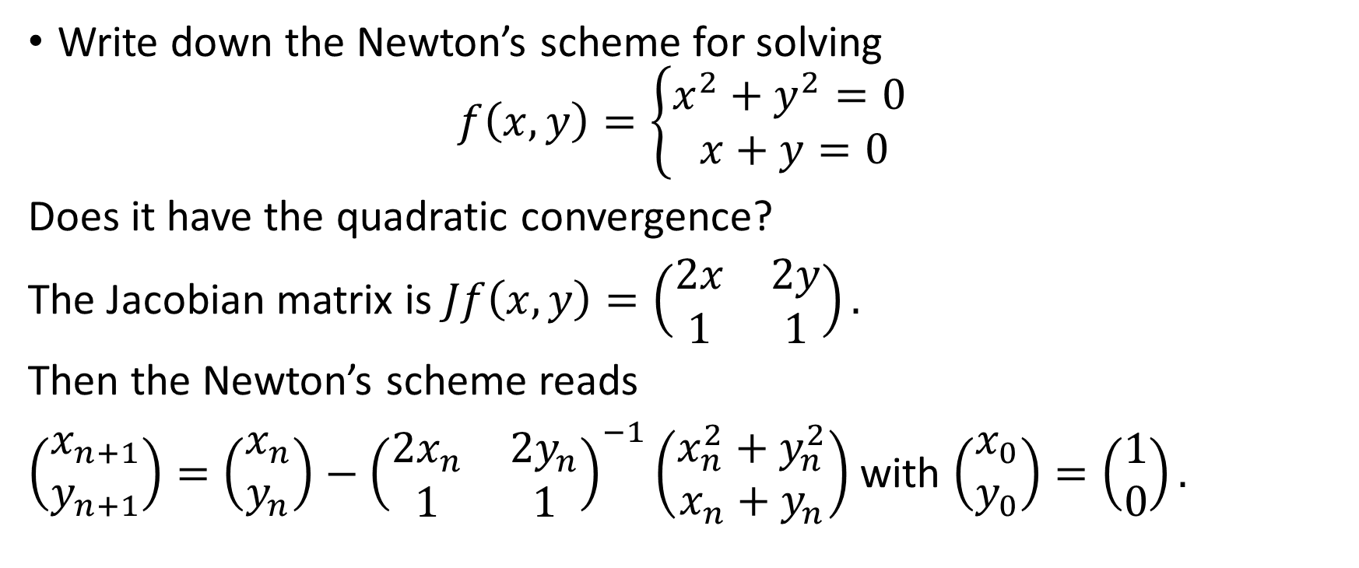
Example 2
Write down the Newton’s scheme for solving
$$f\left(x,y\right)=\left\{\begin{matrix}x^{2}+y^{2}=0 \\ x+y=0\end{matrix}\right.$$
Does it have the quadratic convergence?
The Jacobian matrix is $Jf\left(x,y\right)=\left(\begin{matrix}2x & 2y \\ 1 & 1\end{matrix}\right).$
Then the Newton’s scheme reads
$\left(\begin{matrix}x_{n+1} \\ y_{n+1}\end{matrix}\right)=\left(\begin{matrix}x_{n} \\ y_{n}\end{matrix}\right)−{\left(\begin{matrix}2x_{n} & 2y_{n} \\ 1 & 1\end{matrix}\right)}^{−1}\left(\begin{matrix}x_{n}^{2}+y_{n}^{2} \\ x_{n}+y_{n}\end{matrix}\right)$ with $\left(\begin{matrix}x_{0} \\ y_{0}\end{matrix}\right)=\left(\begin{matrix}1 \\ 0\end{matrix}\right).$

Slide 29
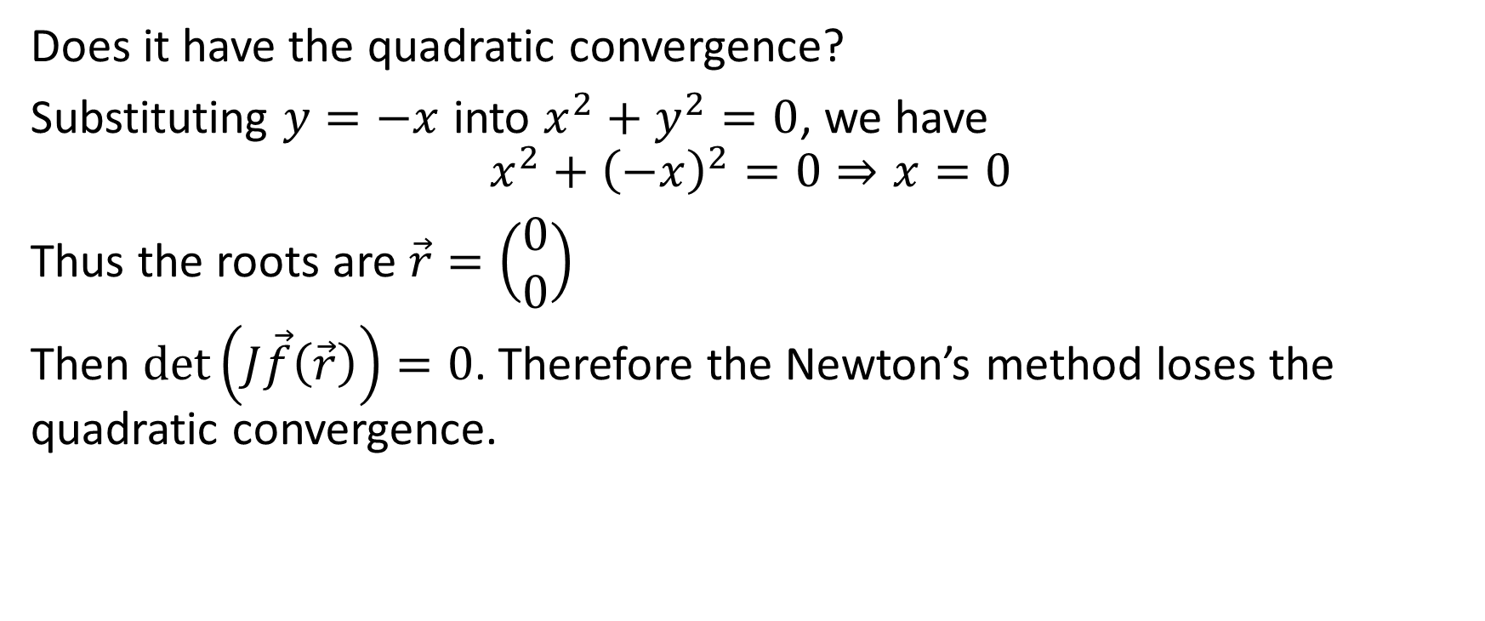
Example 2
Does it have the quadratic convergence?
Substituting $y=−x$ into $x^{2}+y^{2}=0$, we have
$$x^{2}+{\left(−x\right)}^{2}=0⇒x=0$$
Thus the roots are $\vec{r}=\left(\begin{matrix}0 \\ 0\end{matrix}\right)$
Then $\det\left(J\vec{f}\left(\vec{r}\right)\right)=0$. Therefore the Newton’s method loses the quadratic convergence.

Slide 30
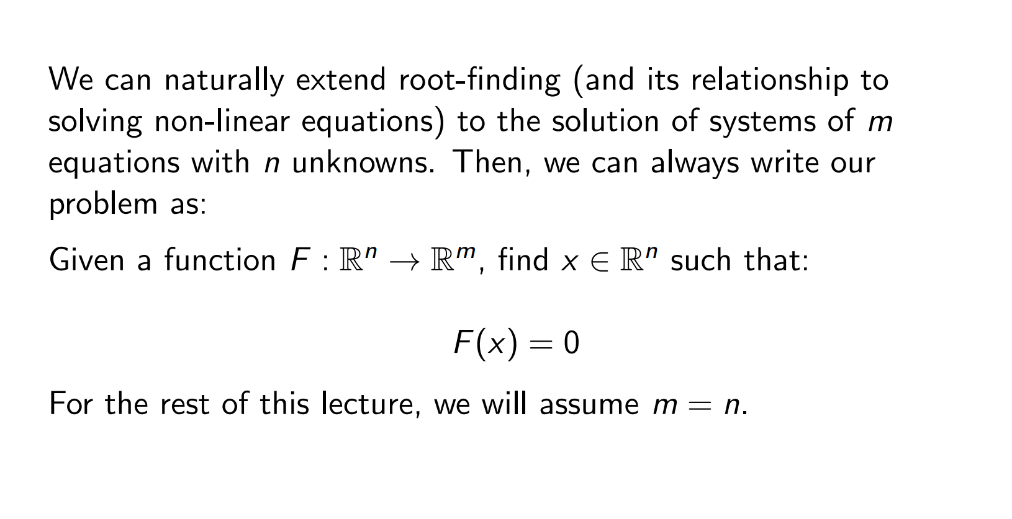
Systems of non-linear equations

Slide 31
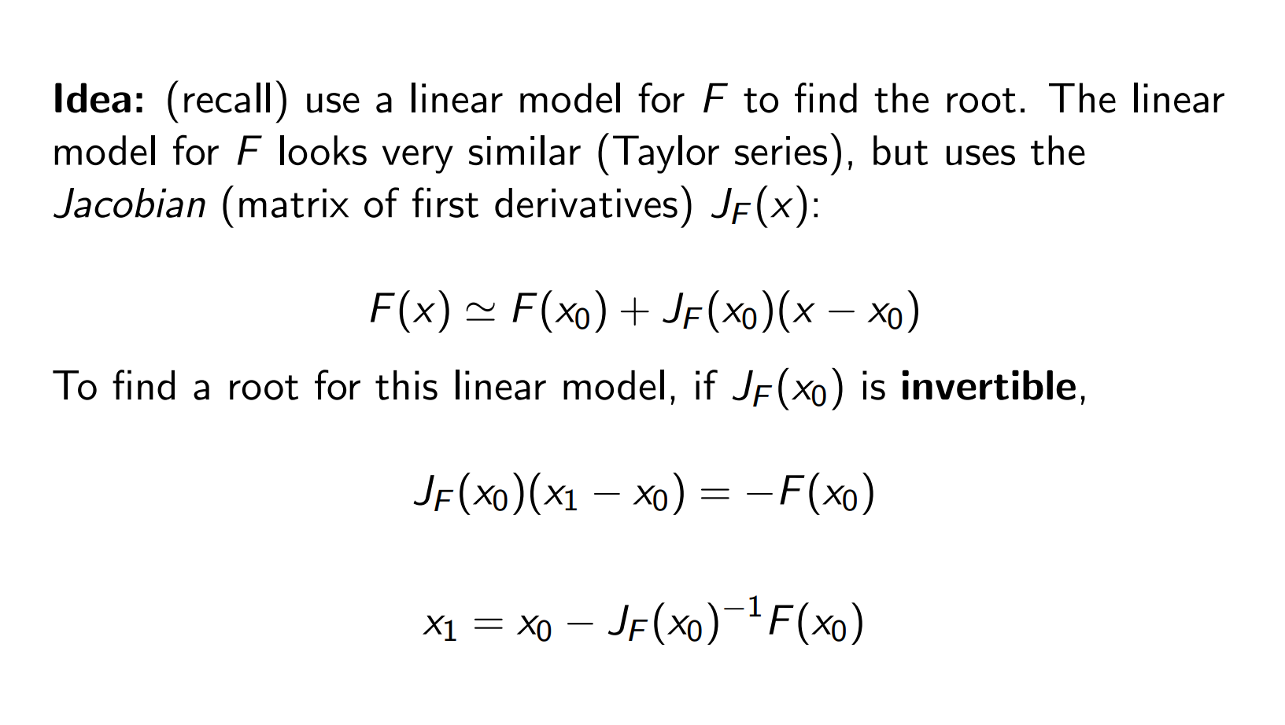

Slide 32
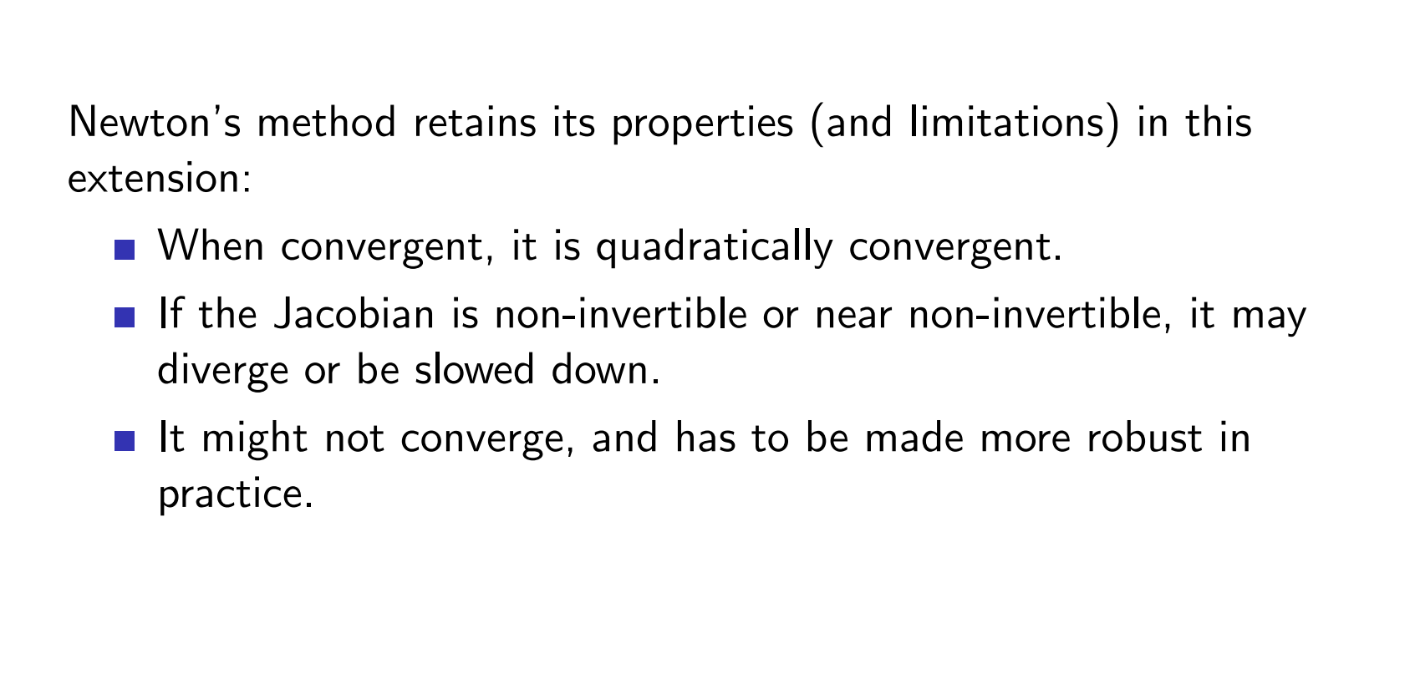
Example

Slide 33
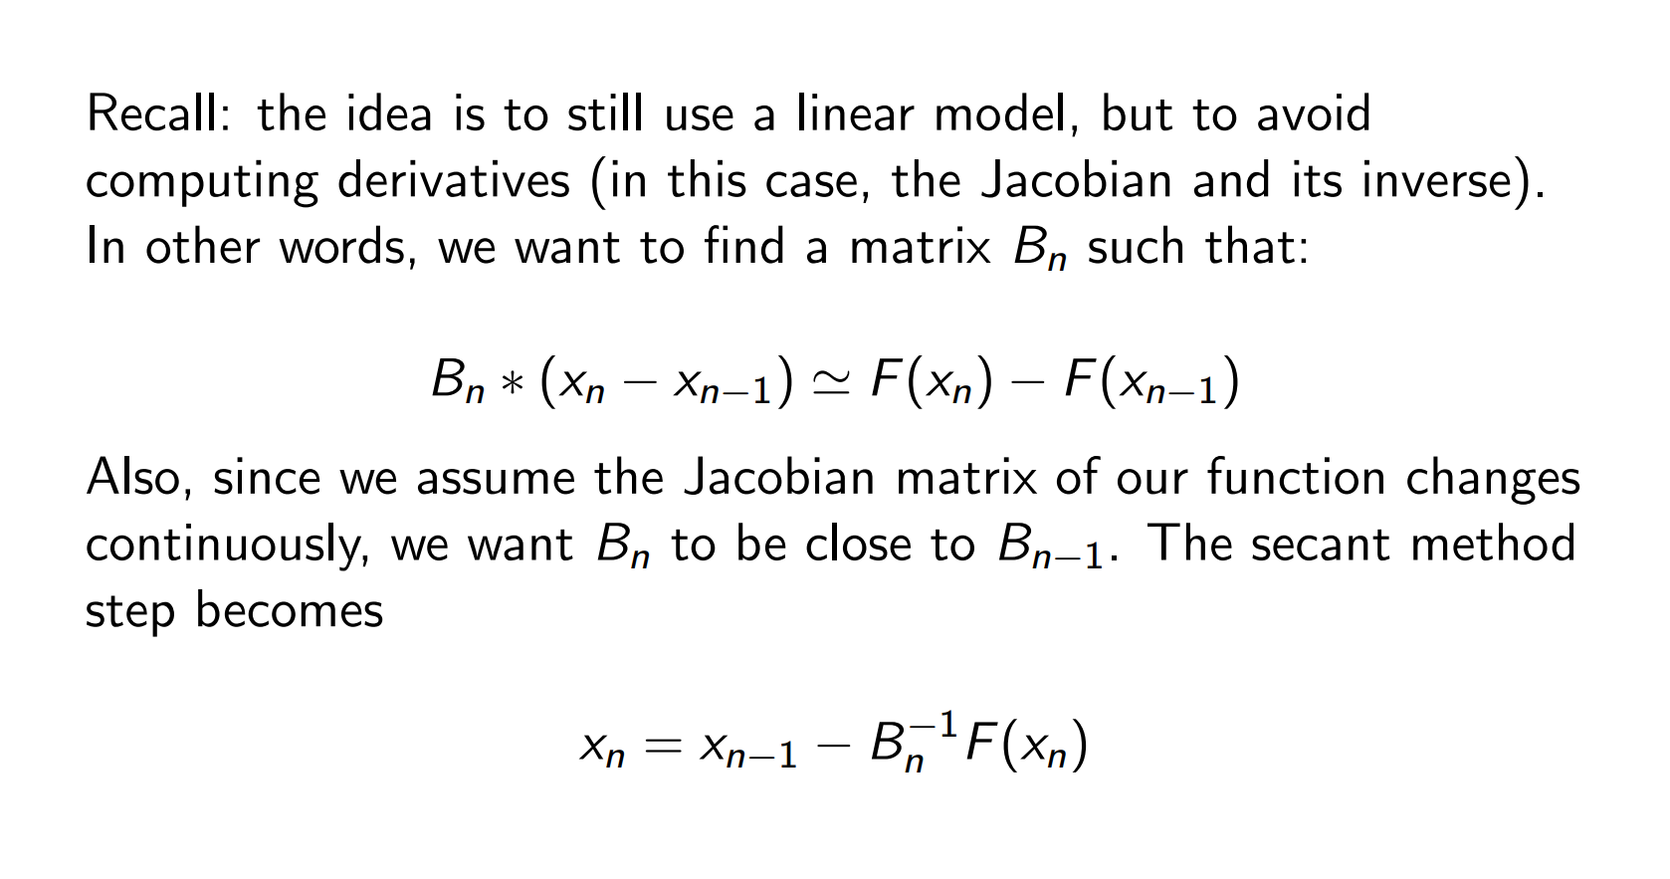
Extending the secant method

Slide 34
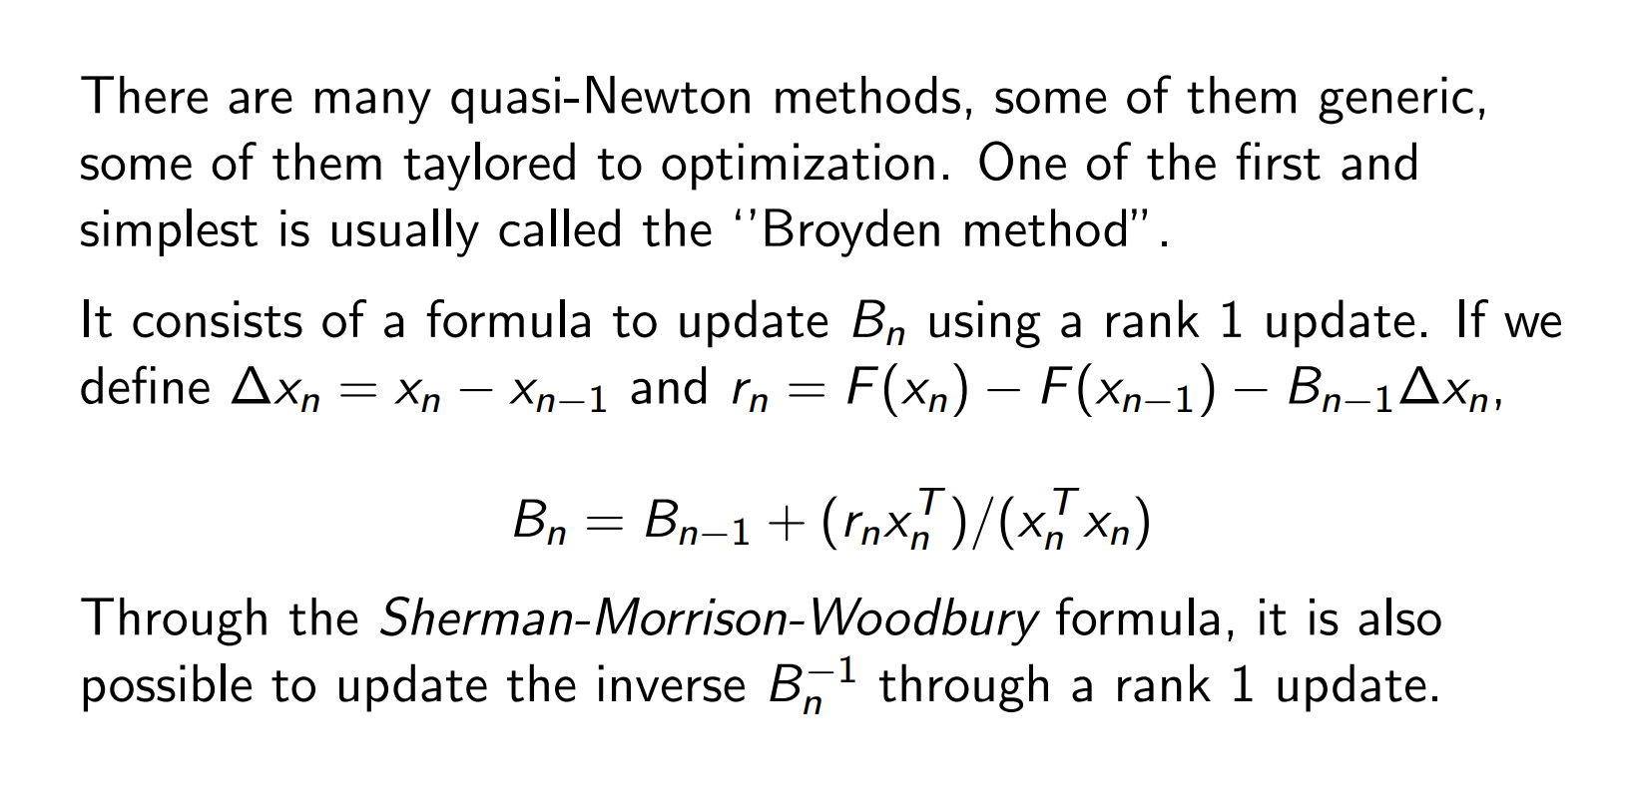
Broyden method

Slide 35
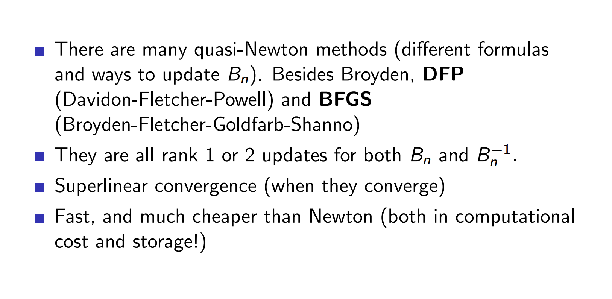
Broyden method

Slide 36
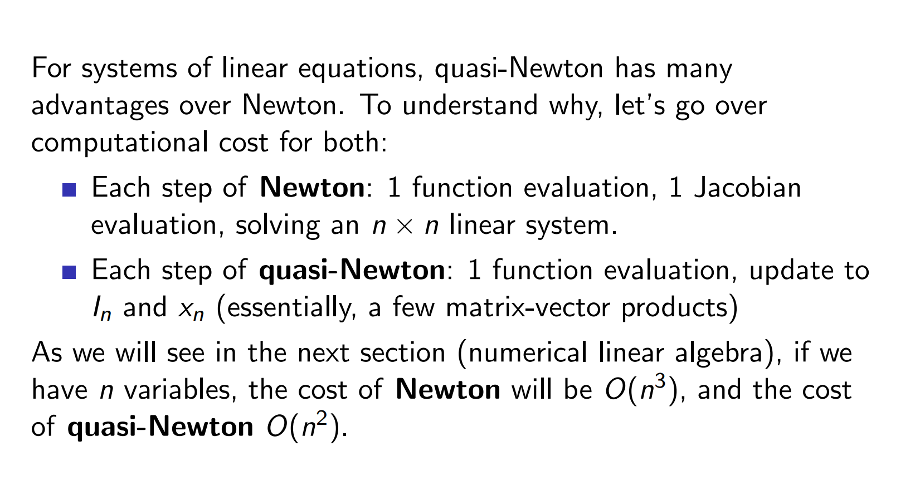
Broyden method

Slide 37
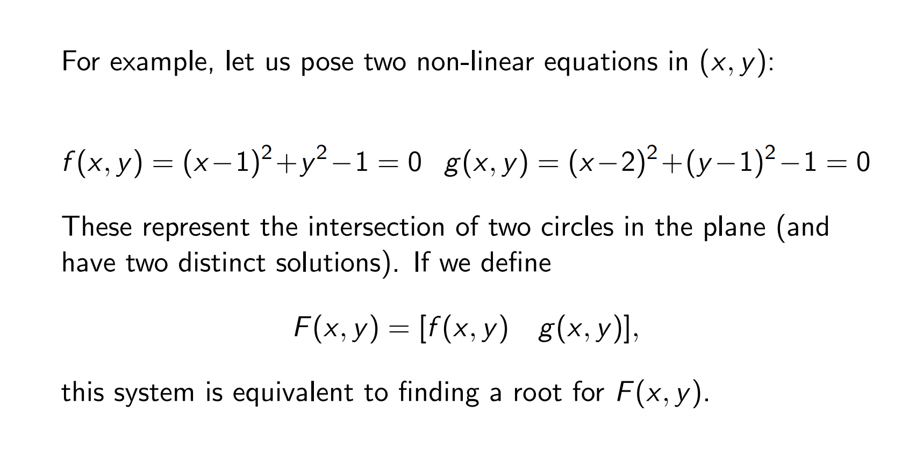
Example

Slide 38
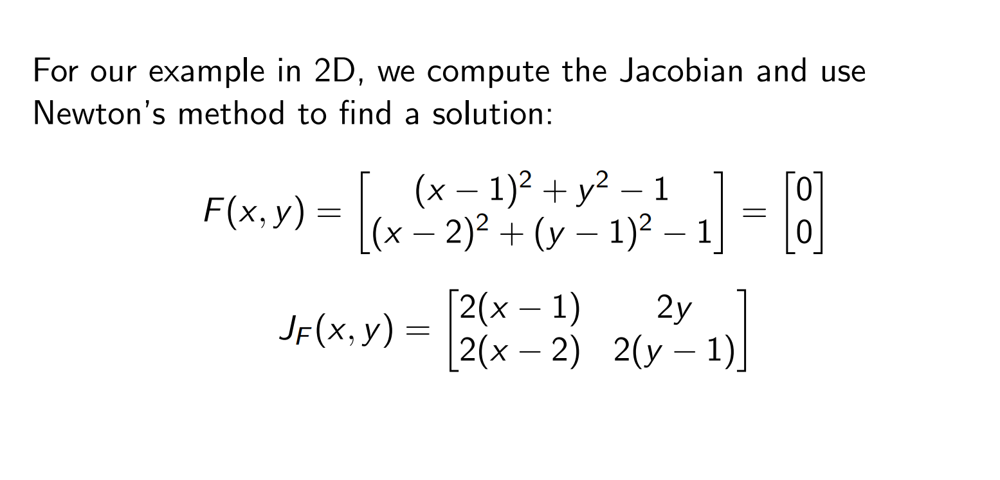
Example

Slide 39
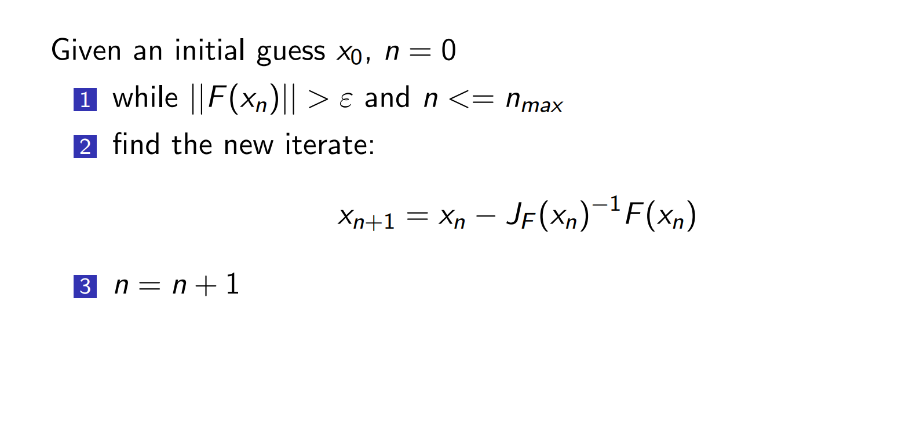
Example 1

