Slide 1

MATH417 L5
Chuqi CHEN
January 14, 2026

Slide 2
Overviews
Non-linear equations in two and more dimensions
Application：Optimization

Slide 3
Warm up
Homework 1

Slide 4
A system of nonlinear equations

Slide 5
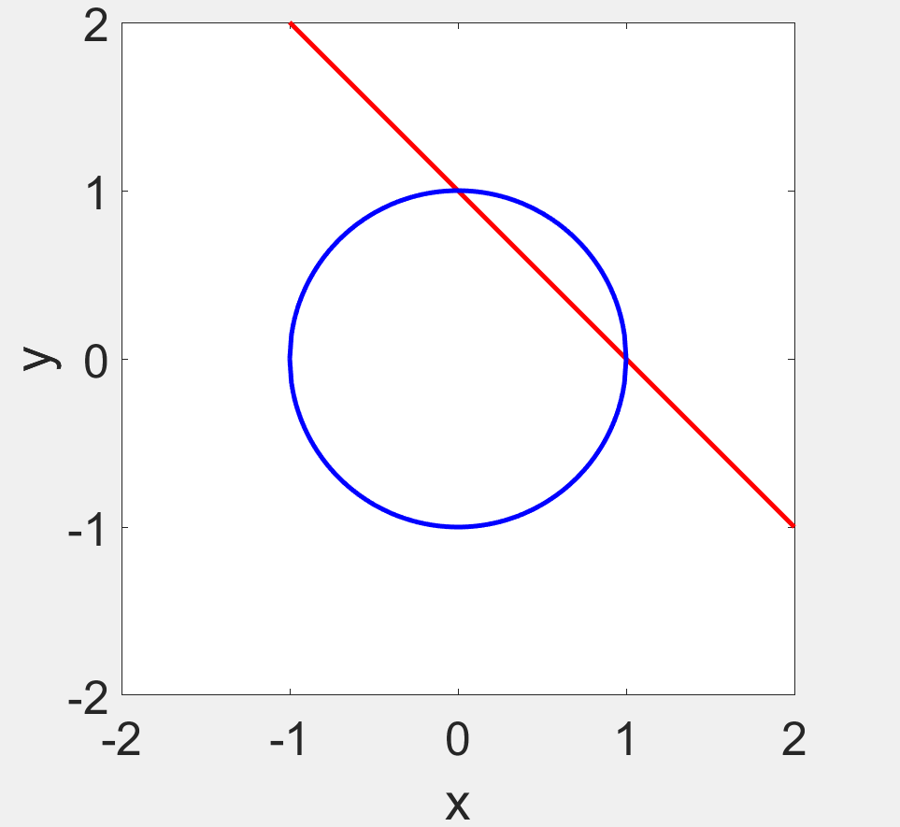
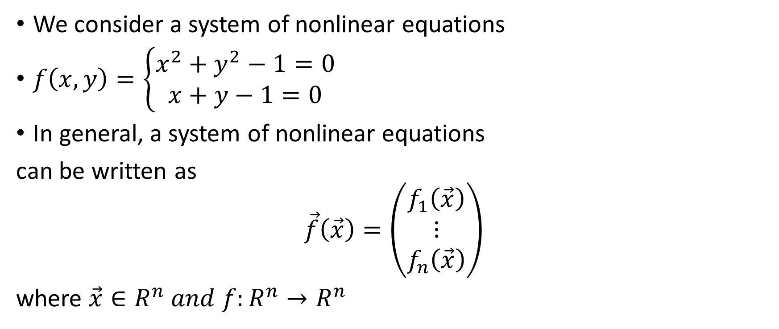
Motivation
We consider a system of nonlinear equations
$f\left(x,y\right)=\left\{\begin{matrix}x^{2}+y^{2}−1=0 \\ x+y−1=0\end{matrix}\right.$
In general, a system of nonlinear equations
can be written as
$$\vec{f}\left(\vec{x}\right)=\left(\begin{matrix}f_{1}\left(\vec{x}\right) \\ ⋮ \\ f_{n}\left(\vec{x}\right)\end{matrix}\right)$$
where $\vec{x}∈R^{n} and f:R^{n}→R^{n}$

Slide 6

Bisection method
The computation cost becomes very expensive!
Search on the n-dimensional space is about $2^{n}$!
y
c
d
a b x

Slide 7
Fixed point method
For a n-dimensional system of nonlinear equations, it is very difficult to construct the fixed point function.

Slide 8
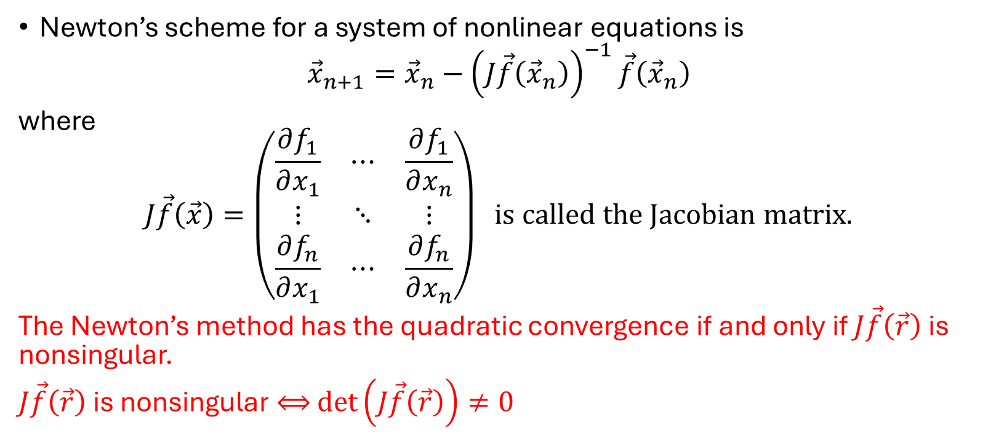
Newton’s method
Newton’s scheme for a system of nonlinear equations is
$${\vec{x}}_{n+1}={\vec{x}}_{n}−{\left(J\vec{f}\left({\vec{x}}_{n}\right)\right)}^{−1}\vec{f}\left({\vec{x}}_{n}\right)$$
where
$$J\vec{f}\left(\vec{x}\right)=\left(\begin{matrix}\frac{∂f_{1}}{∂x_{1}} & ⋯ & \frac{∂f_{1}}{∂x_{n}} \\ ⋮ & ⋱ & ⋮ \\ \frac{∂f_{n}}{∂x_{1}} & ⋯ & \frac{∂f_{n}}{∂x_{n}}\end{matrix}\right) is called the Jacobian matrix.$$
The Newton’s method has the quadratic convergence if and only if $J\vec{f}\left(\vec{r}\right)$ is nonsingular.
$J\vec{f}\left(\vec{r}\right)$ is nonsingular $⟺$ $\det\left(J\vec{f}\left(\vec{r}\right)\right)≠0$

Slide 9
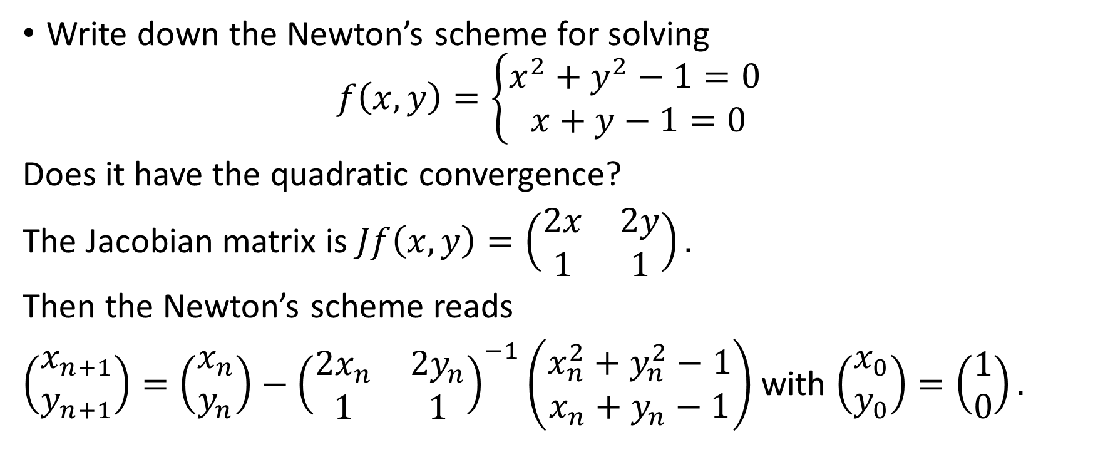
Example 1
Write down the Newton’s scheme for solving
$$f\left(x,y\right)=\left\{\begin{matrix}x^{2}+y^{2}−1=0 \\ x+y−1=0\end{matrix}\right.$$
Does it have the quadratic convergence?
The Jacobian matrix is $Jf\left(x,y\right)=\left(\begin{matrix}2x & 2y \\ 1 & 1\end{matrix}\right).$
Then the Newton’s scheme reads
$\left(\begin{matrix}x_{n+1} \\ y_{n+1}\end{matrix}\right)=\left(\begin{matrix}x_{n} \\ y_{n}\end{matrix}\right)−{\left(\begin{matrix}2x_{n} & 2y_{n} \\ 1 & 1\end{matrix}\right)}^{−1}\left(\begin{matrix}x_{n}^{2}+y_{n}^{2}−1 \\ x_{n}+y_{n}−1\end{matrix}\right)$ with $\left(\begin{matrix}x_{0} \\ y_{0}\end{matrix}\right)=\left(\begin{matrix}1 \\ 0\end{matrix}\right).$

Slide 10
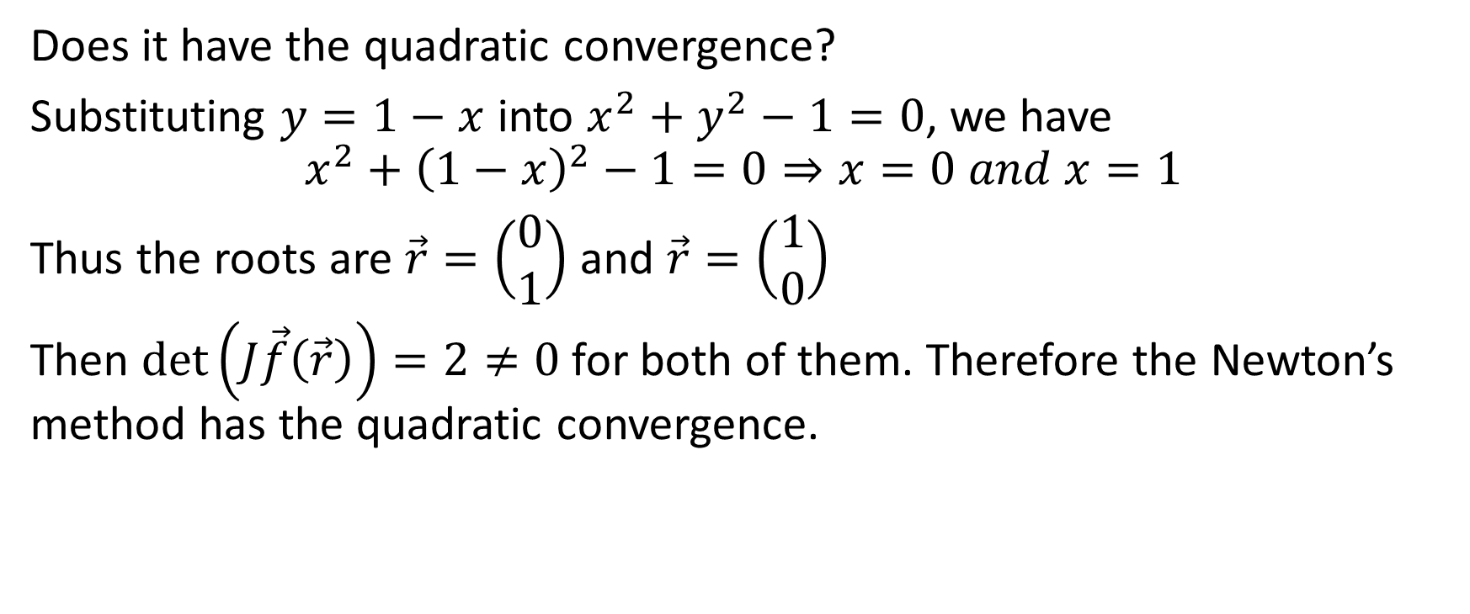
Example 1
Does it have the quadratic convergence?
Substituting $y=1−x$ into $x^{2}+y^{2}−1=0$, we have
$$x^{2}+{\left(1−x\right)}^{2}−1=0⇒x=0 and x=1$$
Thus the roots are $\vec{r}=\left(\begin{matrix}0 \\ 1\end{matrix}\right)$ and $\vec{r}=\left(\begin{matrix}1 \\ 0\end{matrix}\right)$
Then $\det\left(J\vec{f}\left(\vec{r}\right)\right)=2≠0$for both of them. Therefore the Newton’s method has the quadratic convergence.

Slide 11
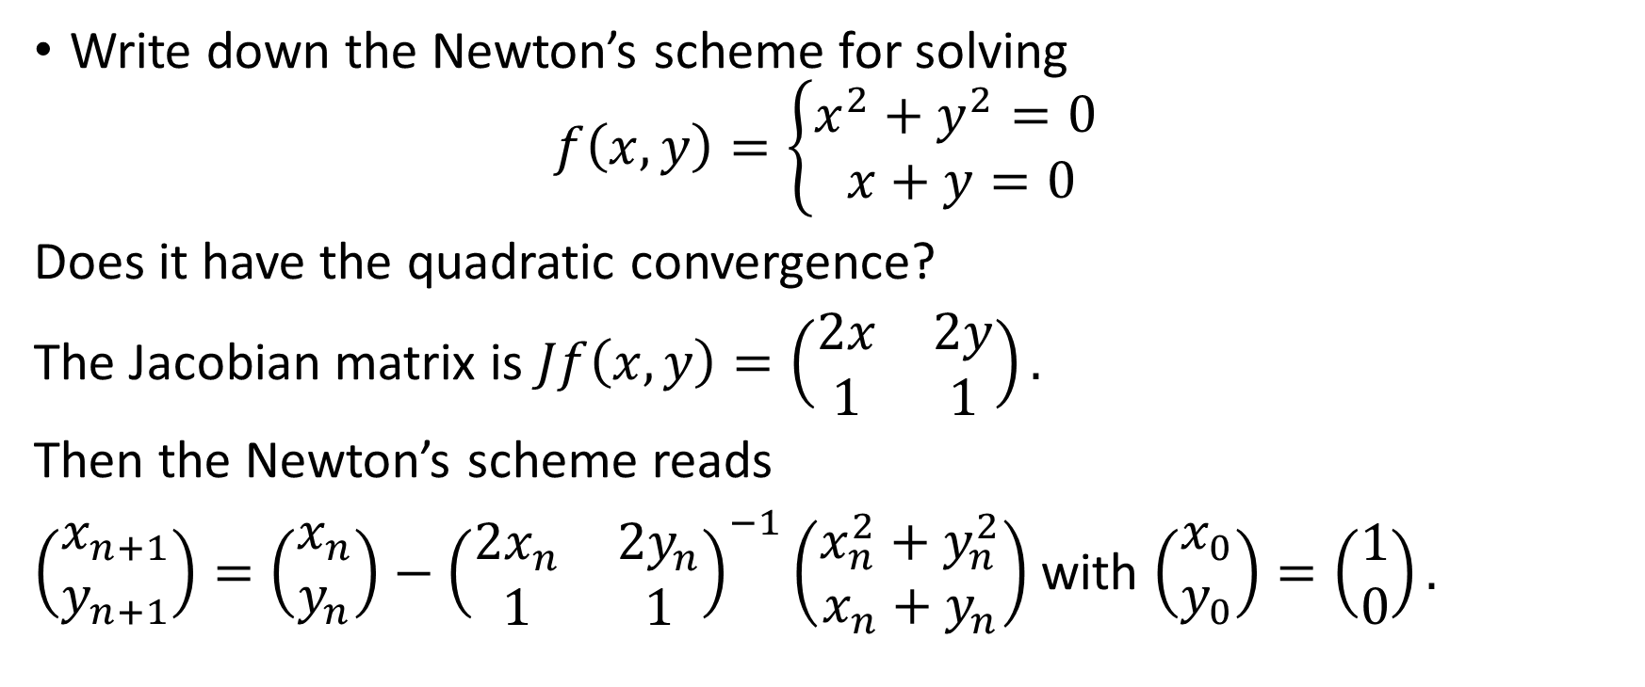
Example 2
Write down the Newton’s scheme for solving
$$f\left(x,y\right)=\left\{\begin{matrix}x^{2}+y^{2}=0 \\ x+y=0\end{matrix}\right.$$
Does it have the quadratic convergence?
The Jacobian matrix is $Jf\left(x,y\right)=\left(\begin{matrix}2x & 2y \\ 1 & 1\end{matrix}\right).$
Then the Newton’s scheme reads
$\left(\begin{matrix}x_{n+1} \\ y_{n+1}\end{matrix}\right)=\left(\begin{matrix}x_{n} \\ y_{n}\end{matrix}\right)−{\left(\begin{matrix}2x_{n} & 2y_{n} \\ 1 & 1\end{matrix}\right)}^{−1}\left(\begin{matrix}x_{n}^{2}+y_{n}^{2} \\ x_{n}+y_{n}\end{matrix}\right)$ with $\left(\begin{matrix}x_{0} \\ y_{0}\end{matrix}\right)=\left(\begin{matrix}1 \\ 0\end{matrix}\right).$

Slide 12
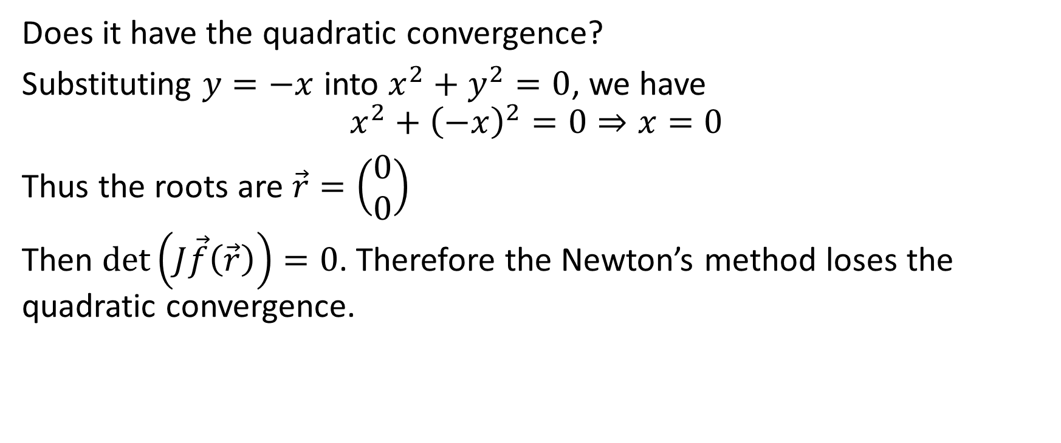
Example 2
Does it have the quadratic convergence?
Substituting $y=−x$ into $x^{2}+y^{2}=0$, we have
$$x^{2}+{\left(−x\right)}^{2}=0⇒x=0$$
Thus the roots are $\vec{r}=\left(\begin{matrix}0 \\ 0\end{matrix}\right)$
Then $\det\left(J\vec{f}\left(\vec{r}\right)\right)=0$. Therefore the Newton’s method loses the quadratic convergence.

Slide 13
Application: Optimization

Slide 14
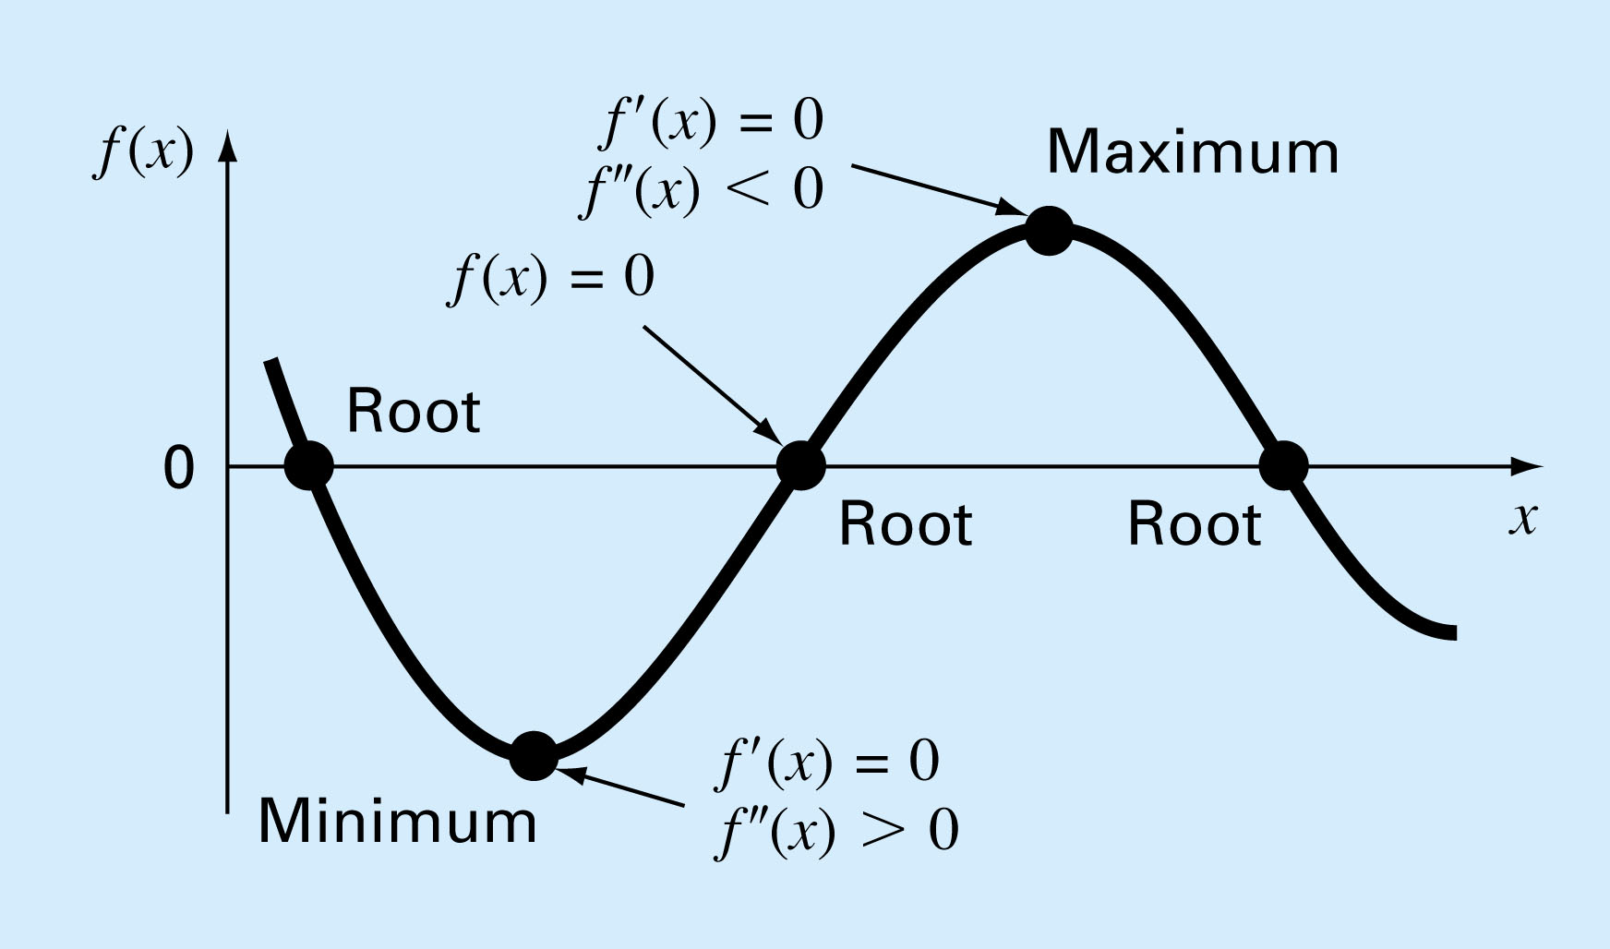
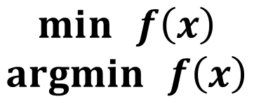
$$\min{ }f\left(x\right)$$
$$\operatorname{argmin}{ }f\left(x\right)$$

Slide 15
Root finding and optimization are related, both involve guessing and searching for a point on a function.
Fundamental difference is:
  Root finding is searching for zeros of a function or functions
  Optimization is finding the minimum or the maximum of a function of several variables.

Slide 16
Root finding and optimization are related, both involve guessing and searching for a point on a function.
Fundamental difference is:
  Root finding is searching for zeros of a function or functions
  Optimization is finding the minimum or the maximum of a function of several variables.

Slide 17
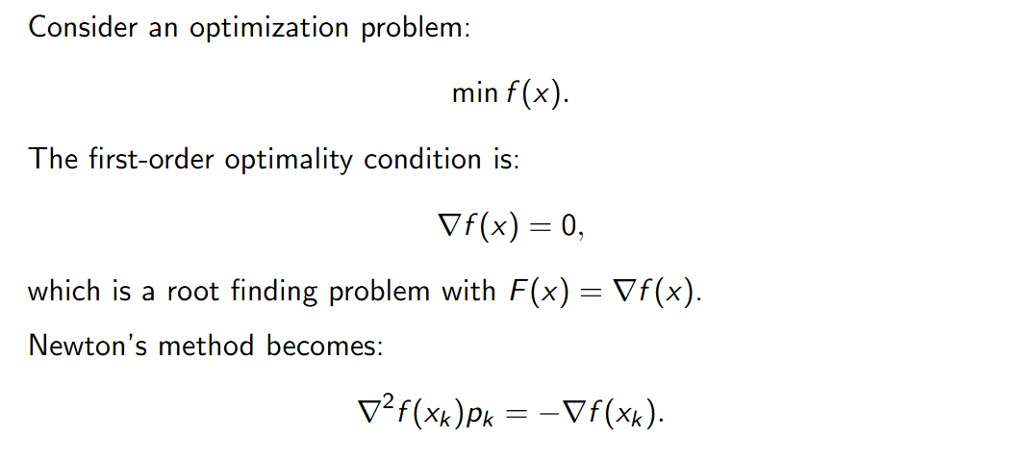
How to solve use
Fixed point method?
Newton Method?

Slide 18
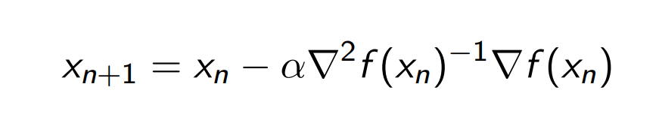
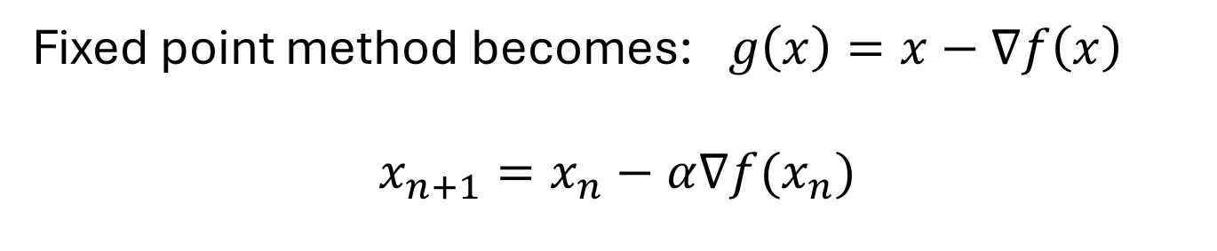
Fixed point method becomes:$g\left(x\right)=x−∇f\left(x\right)$
$$x_{n+1}=x_{n}−α∇f(x_{n})$$

Slide 19
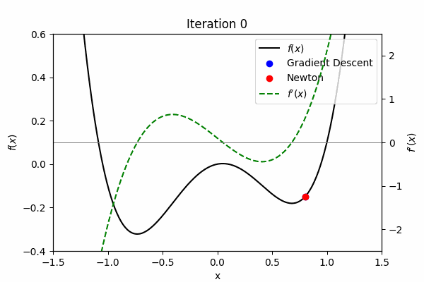
Newton converges faster !

Slide 20
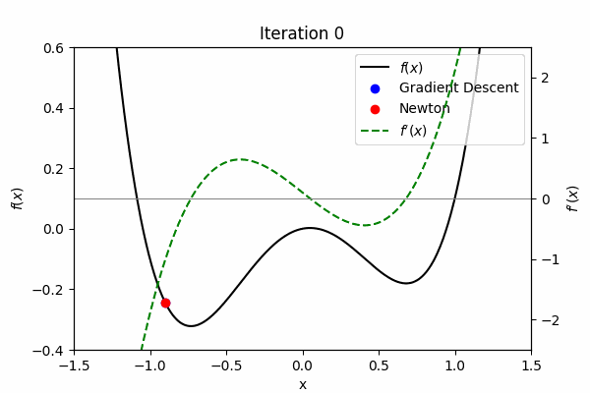
Converge to different local minima!

Slide 21
For High dimension case, what is the drawback for Newton method?
Computation of Jacobian is expensive
Computation of the inverse of the Jacobian is expensive

Slide 22
Quasi-Newton Methods

Slide 23
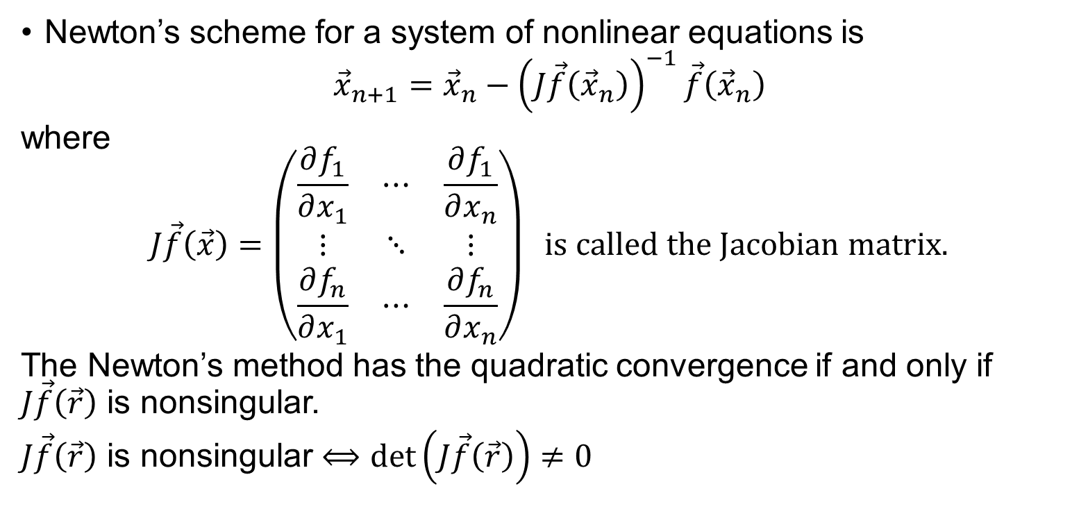
Review
Newton’s scheme for a system of nonlinear equations is
$${\vec{x}}_{n+1}={\vec{x}}_{n}−{\left(J\vec{f}\left({\vec{x}}_{n}\right)\right)}^{−1}\vec{f}\left({\vec{x}}_{n}\right)$$
where
$$J\vec{f}\left(\vec{x}\right)=\left(\begin{matrix}\frac{∂f_{1}}{∂x_{1}} & ⋯ & \frac{∂f_{1}}{∂x_{n}} \\ ⋮ & ⋱ & ⋮ \\ \frac{∂f_{n}}{∂x_{1}} & ⋯ & \frac{∂f_{n}}{∂x_{n}}\end{matrix}\right) is called the Jacobian matrix.$$
The Newton’s method has the quadratic convergence if and only if $J\vec{f}\left(\vec{r}\right)$ is nonsingular.
$J\vec{f}\left(\vec{r}\right)$ is nonsingular $⟺$ $\det\left(J\vec{f}\left(\vec{r}\right)\right)≠0$

Slide 24
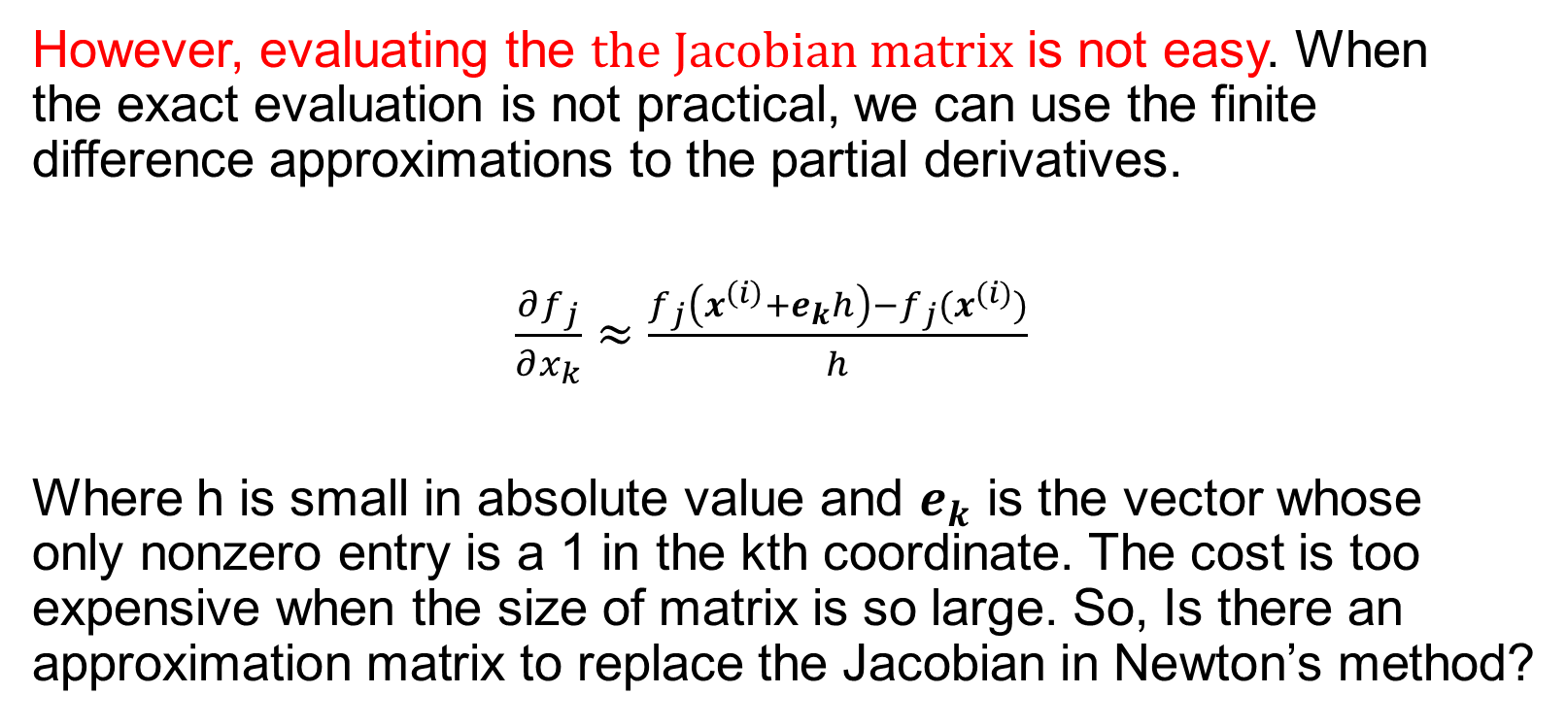
Review
However, evaluating the $the Jacobian matrix$ is not easy. When the exact evaluation is not practical, we can use the finite difference approximations to the partial derivatives.
$\frac{∂f_{j}}{∂x_{k}}≈\frac{f_{j}\left(x^{\left(i\right)}+e_{k}h\right)−f_{j}(x^{(i)})}{h}$
Where h is small in absolute value and $e_{k}$ is the vector whose only nonzero entry is a 1 in the kth coordinate. The cost is too expensive when the size of matrix is so large. So, Is there an approximation matrix to replace the Jacobian in Newton’s method?

Slide 25
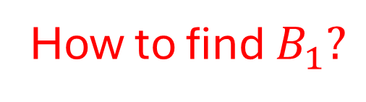
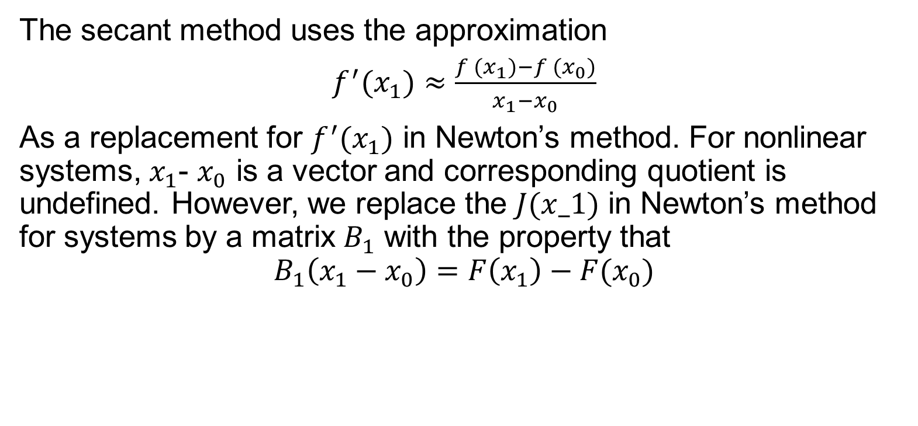
Quasi-Newton Method
The secant method uses the approximation
$f^{′}(x_{1})≈\frac{f (x_{1})−f (x_{0})}{x_{1}−x_{0}}$
As a replacement for $f^{′}(x_{1})$ in Newton’s method. For nonlinear systems, $x_{1}$- $x_{0}$ is a vector and corresponding quotient is undefined. However, we replace the $J(x_1)$ in Newton’s method for systems by a matrix $B_{1}$ with the property that
$$B_{1}\left(x_{1}−x_{0}\right)=F\left(x_{1}\right)−F(x_{0})$$
How to find $B_{1}?$

Slide 26
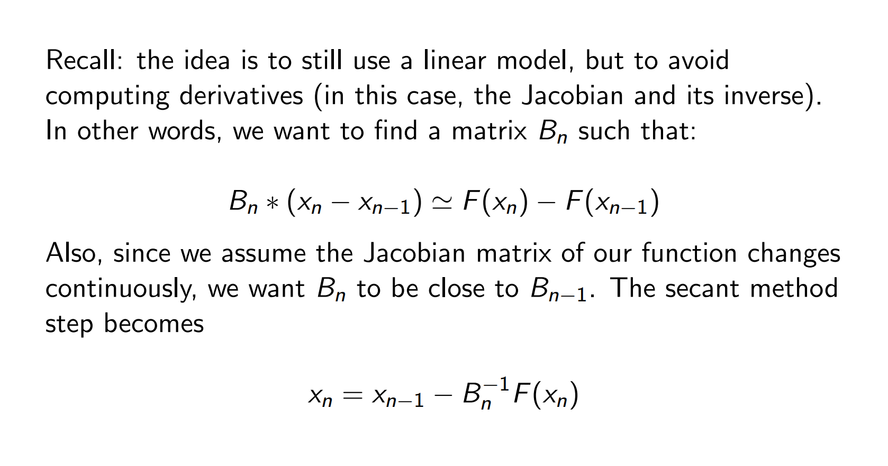
Extending the secant method

Slide 27
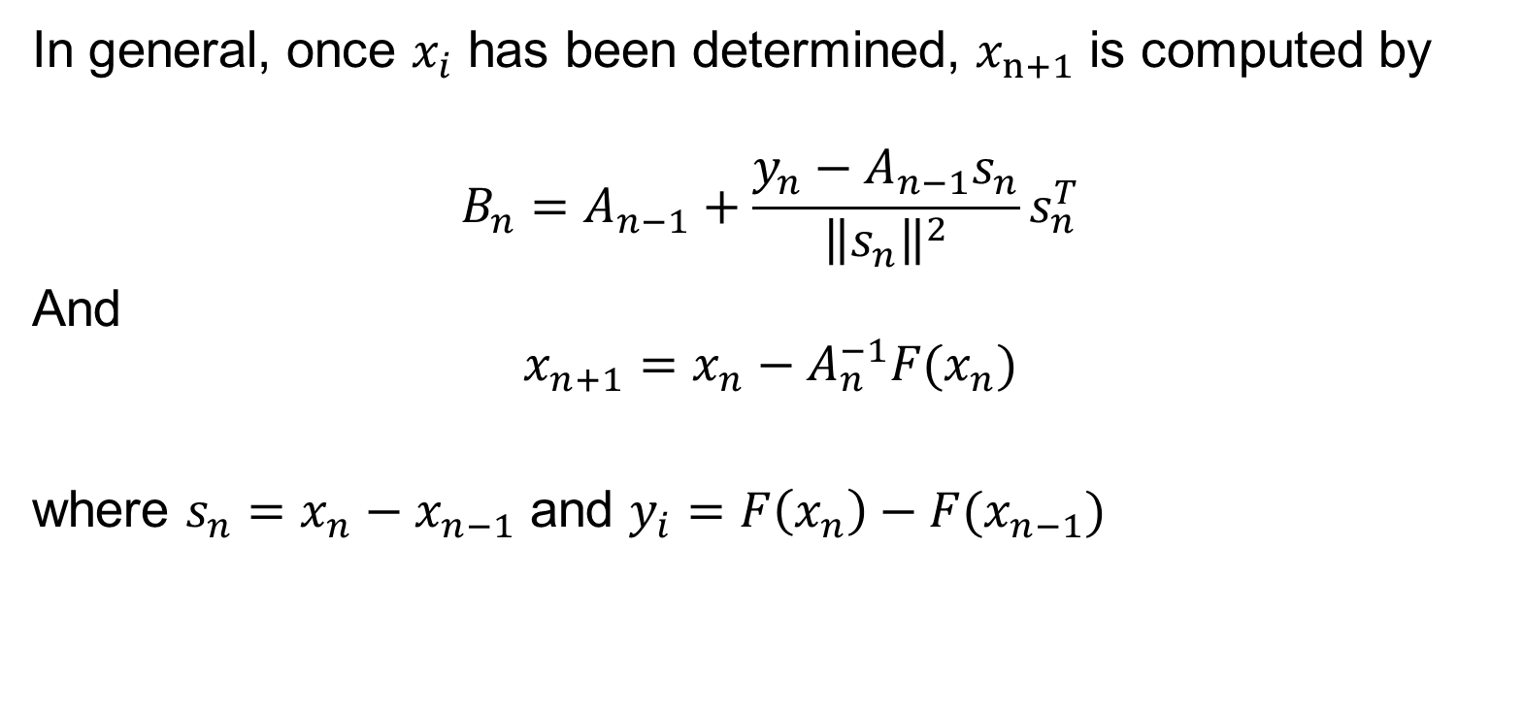
Quasi-Newton Method
In general, once $x_{i}$ has been determined, $x_{n+1}$ is computed by
$$B_{n}=A_{n−1}+\frac{y_{n}−A_{n−1}s_{n}}{{\left\|s_{n}\right\|}^{2}}s_{n}^{T}$$
And
$$x_{n+1}=x_{n}−A_{n}^{−1}F(x_{n})$$
where $s_{n}=x_{n}−x_{n−1}$ and $y_{i}=F\left(x_{n}\right)−F(x_{n−1})$

Slide 28
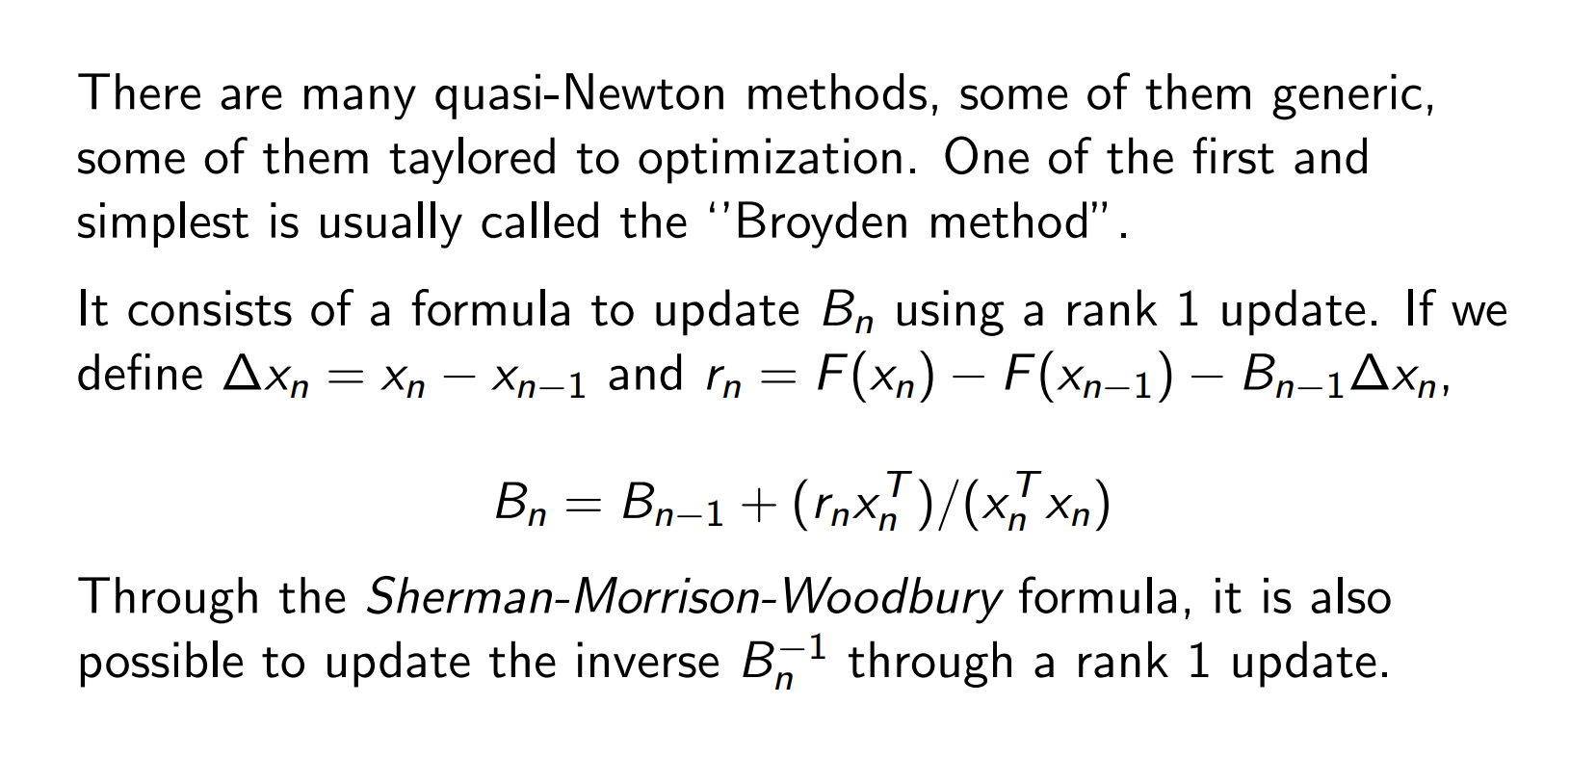
Broyden method

Slide 29
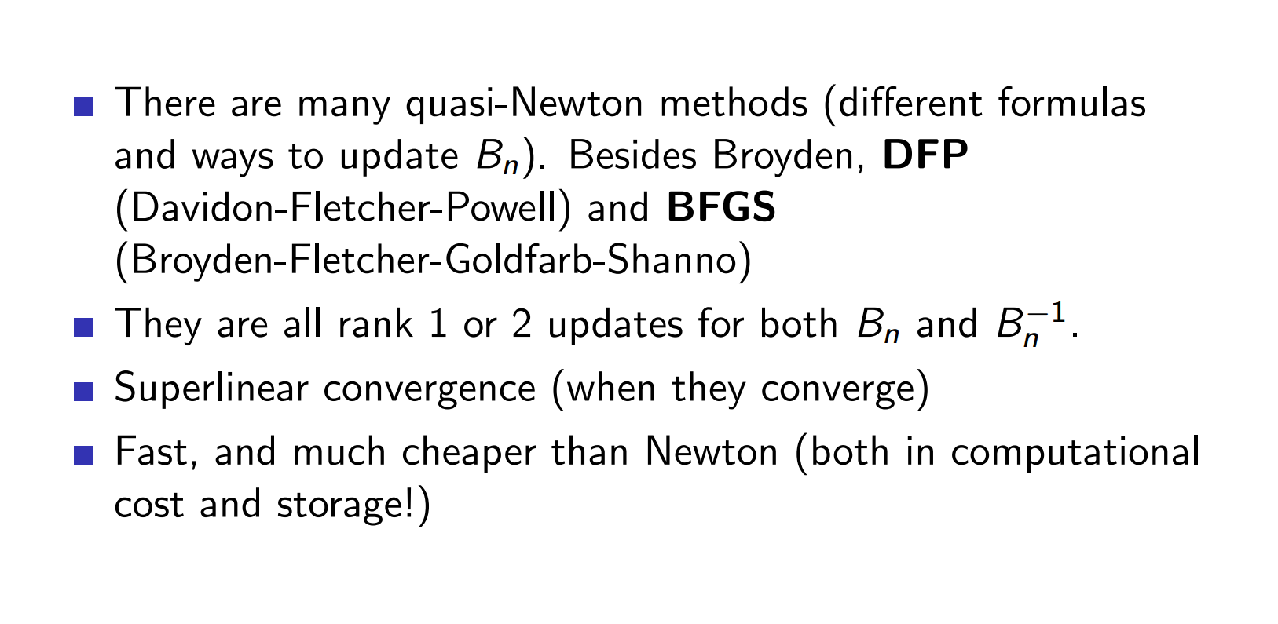
Broyden method

Slide 30
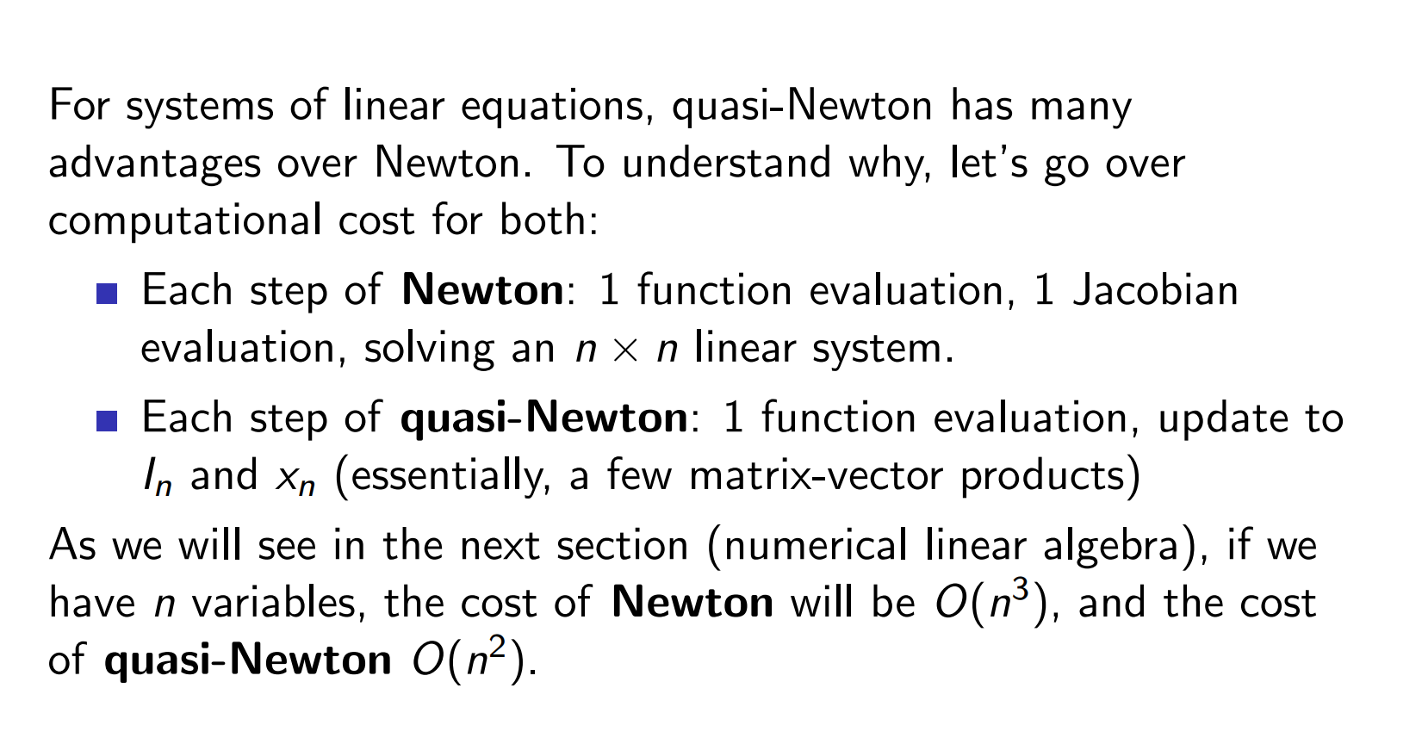
Broyden method

Slide 31
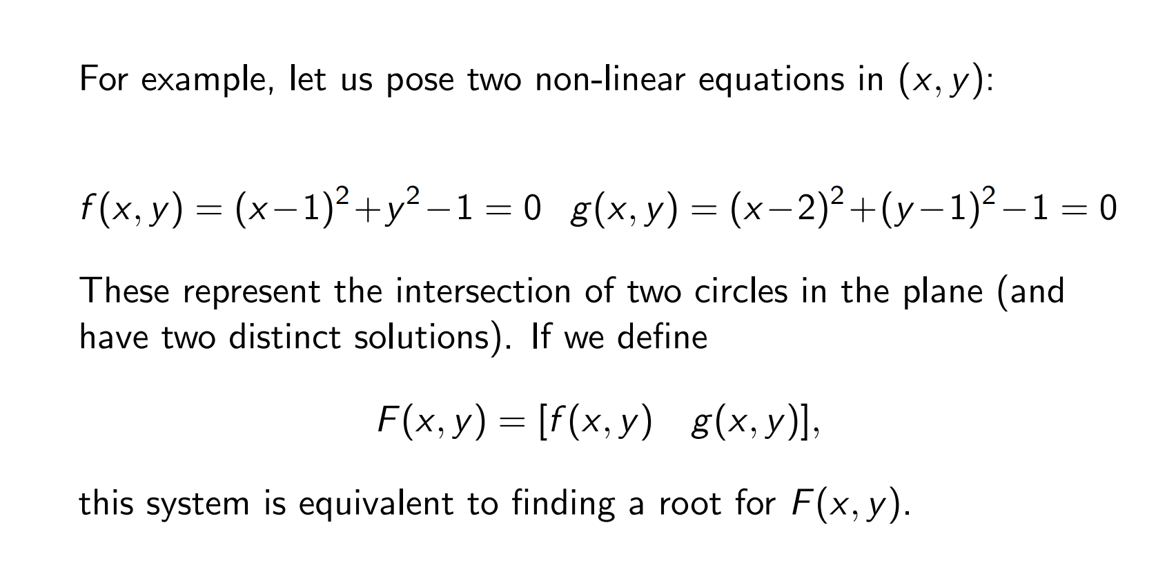
Practice
Does it have the quadratic convergence?

Slide 32
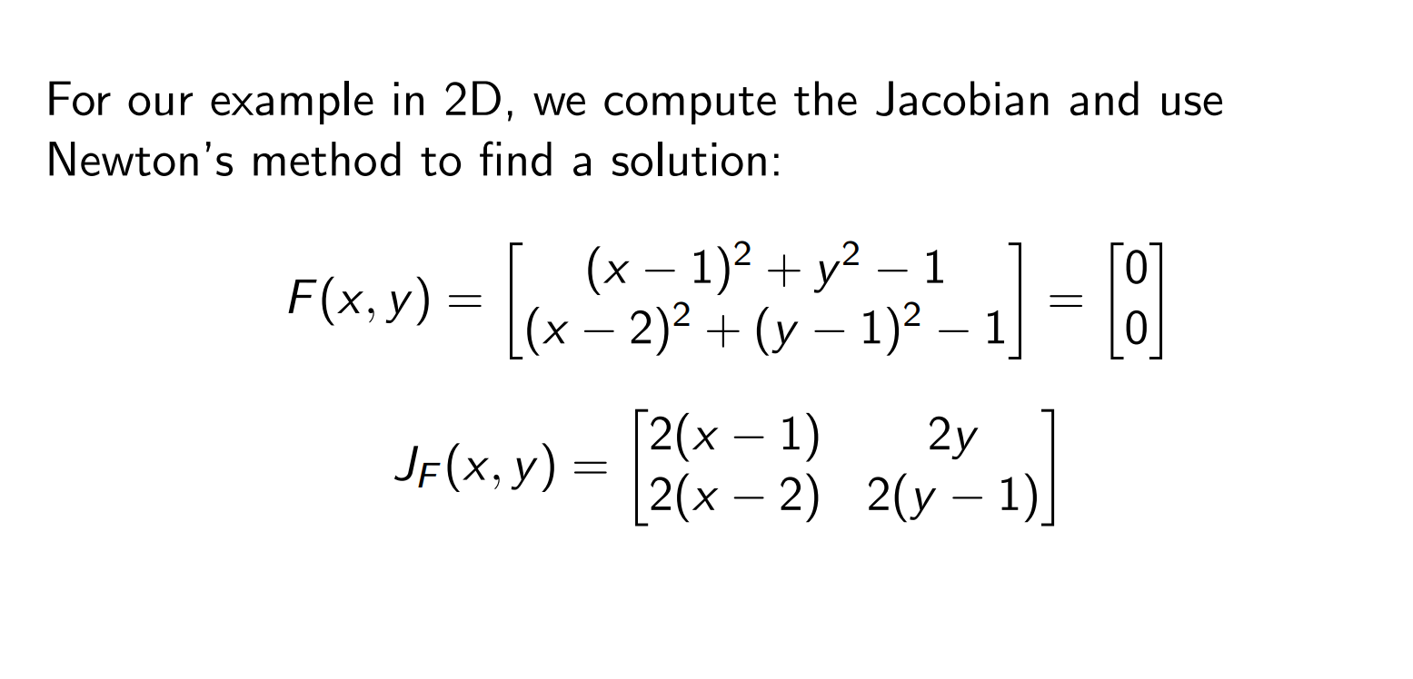
Example

