Slide 1

MATH417 L6
Chuqi CHEN
January 28, 2026

Slide 2
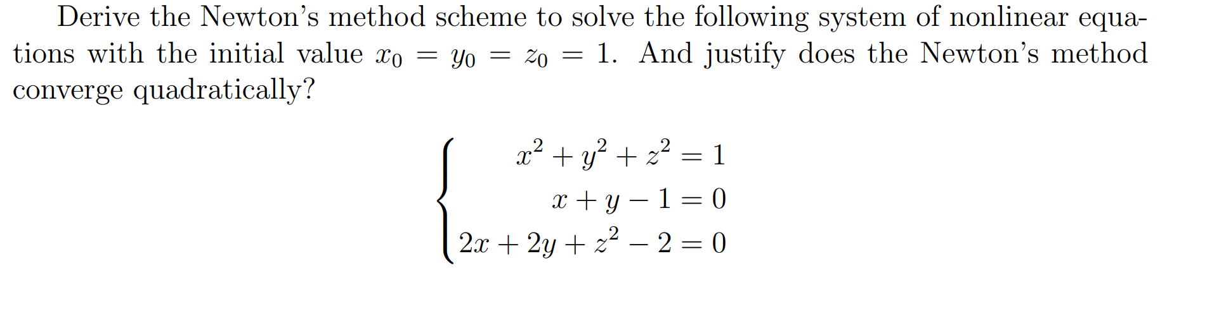
Warm up
Homework 1: due date: 02/06

Slide 3
Overviews
Review on Linear Algebra
Gaussian Elimination

Slide 4
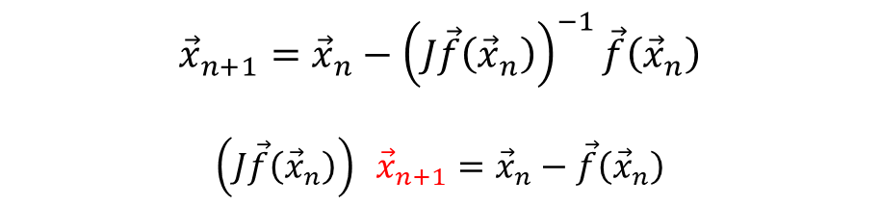
Motivation
For High dimension case, the drawback for Newton method
Computation of Jacobian is expensive
Computation of the inverse of the Jacobian is expensive
$${\vec{x}}_{n+1}={\vec{x}}_{n}−{\left(J\vec{f}\left({\vec{x}}_{n}\right)\right)}^{−1}\vec{f}\left({\vec{x}}_{n}\right)$$
$${\left(J\vec{f}\left({\vec{x}}_{n}\right)\right)}^{ } {\vec{x}}_{n+1}={\vec{x}}_{n}−\vec{f}\left({\vec{x}}_{n}\right)$$
Ax = b

Slide 5

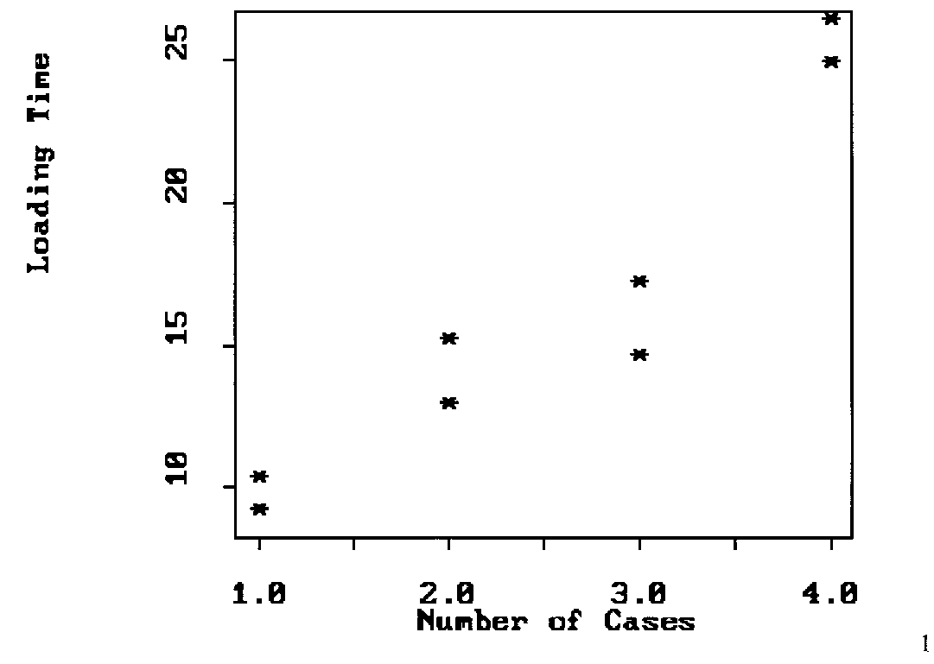

Motivation
Regression problem
We have data with noise:
$${\left\{\left(x_{i},y_{i}\right)\right\}}_{i=1}^{m}$$
We want to find out the relationship between $y$ and $x$
How to find $b_{0}, b_{1}$ ?

Slide 6
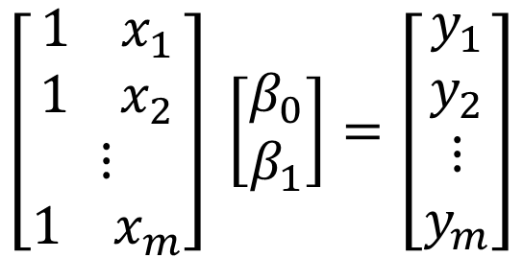
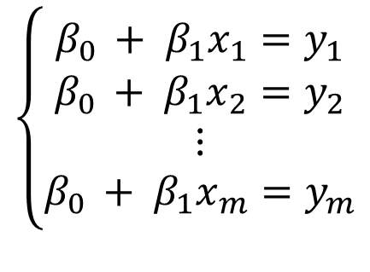
Motivation
Regression problem
We have data with noise:
$${\left\{\left(x_{i},y_{i}\right)\right\}}_{i=1}^{m}$$
We want to find out the relationship between $y$ and $x: y=β_{0}+β_{1}x$
$$\left\{\begin{aligned}β_{0 }+ β_{1}x_{1}=y_{1} \\ β_{0 }+ β_{1}x_{2}=y_{2} \\ ⋮ \\ β_{0 }+ β_{1}x_{m}=y_{m}\end{aligned}\right.$$
How to write down the matrix ? Ax = b
$$\left[\begin{aligned}{1 x}_{1} \\ {1 x}_{2} \\ ⋮ \\ {1 x}_{m}\end{aligned}\right] \left[\begin{aligned}β_{0} \\ β_{1}\end{aligned}\right]=\left[\begin{aligned}y_{1} \\ y_{2} \\ ⋮ \\ y_{m}\end{aligned}\right]$$
Has a solution?

Slide 7
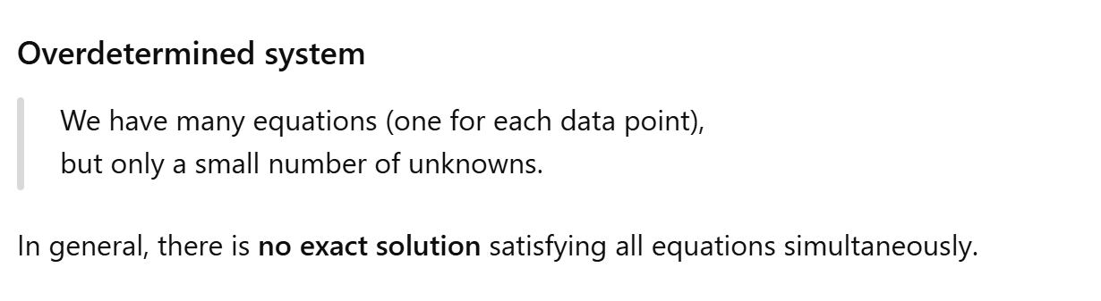
Motivation
Regression problem: Least squares regression
How to do?

Slide 8
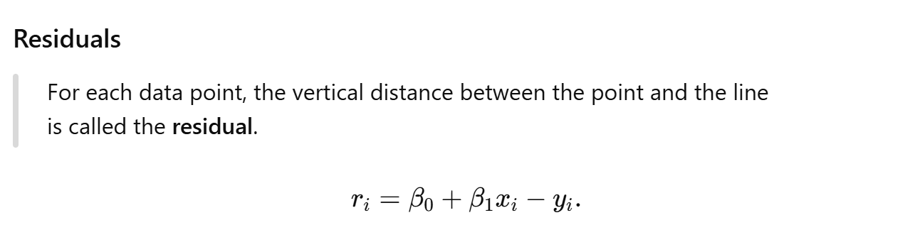
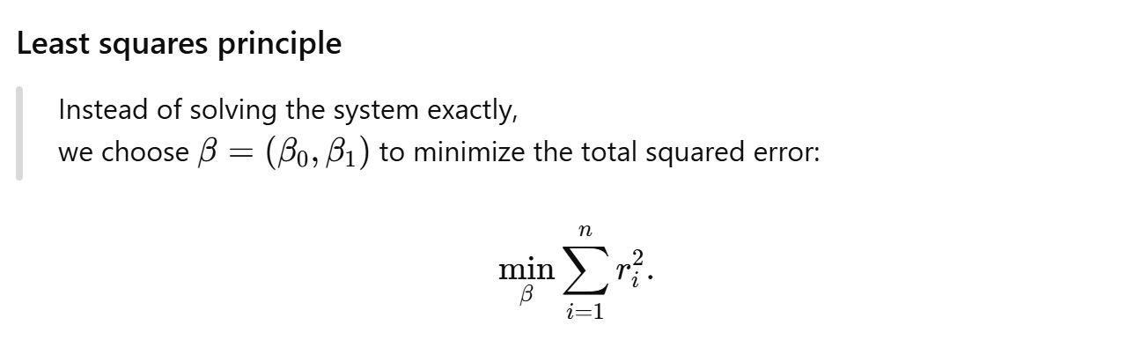
Motivation
Regression problem: Least squares regression

Slide 9
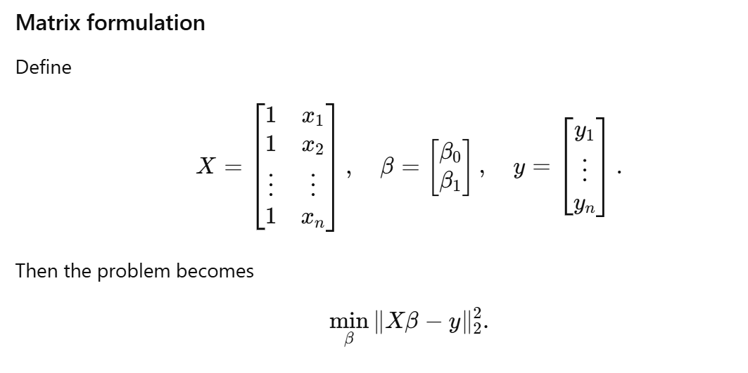
Motivation
Regression problem: Least squares regression

Slide 10
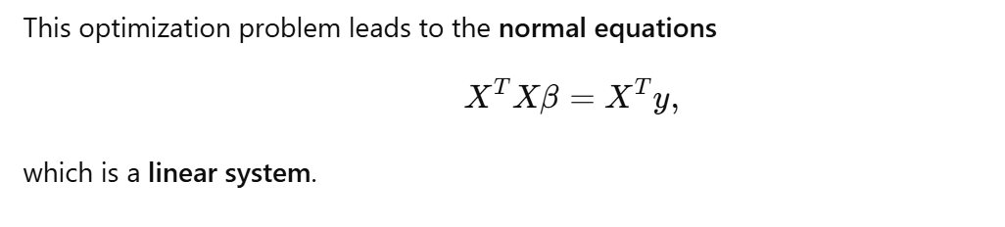
Motivation
Regression problem: Least squares regression

Slide 11
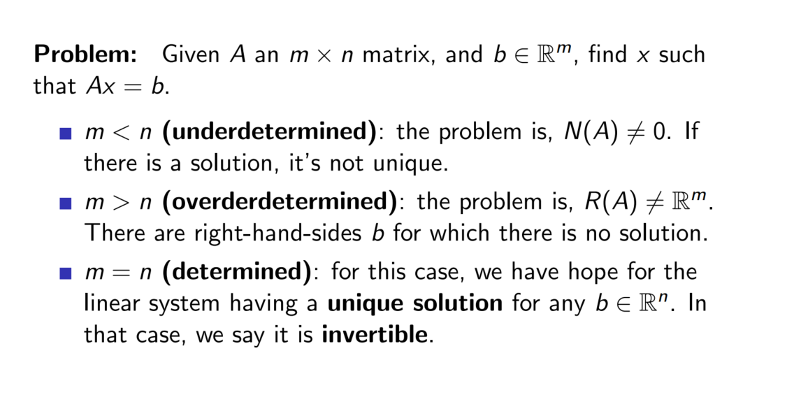
Remind
When is a linear system uniquely solvable?
m: number of data points;
n: number of unknown parameters;

Slide 12
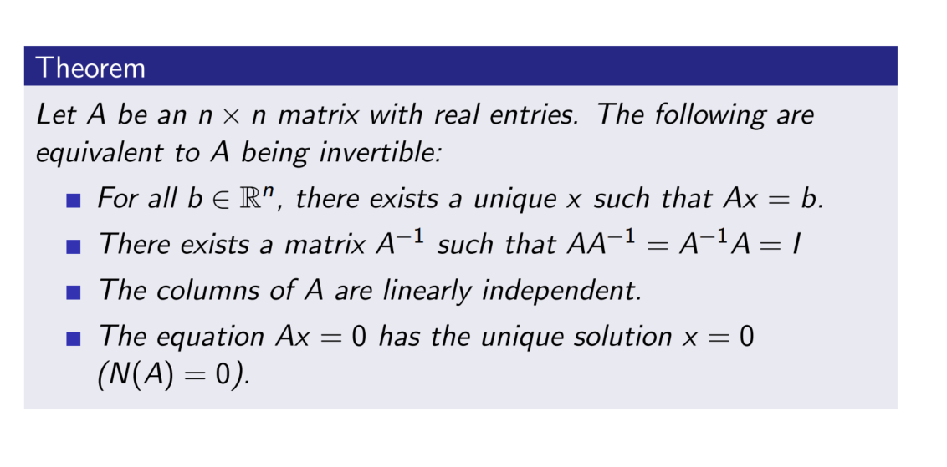
Remind
When is A invertible?

Slide 13

How can we solve Ax = b?
Gaussian elimination: Back substitution
$$\left[\begin{aligned}2 4 −4 \\ 0 1 2 \\ 0 0 1\end{aligned}\right]$$

Slide 14
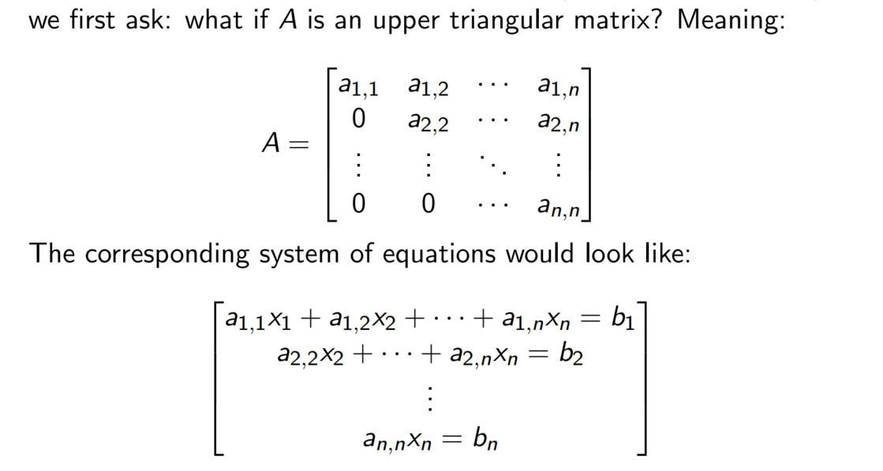
How can we solve Ax = b?
Gaussian elimination: Back substitution

Slide 15
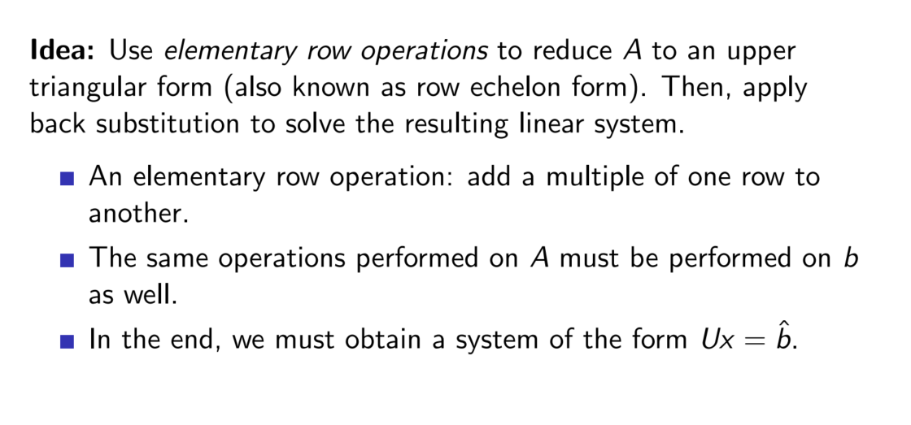
How can we solve Ax = b?
Gaussian elimination:

Slide 16
How can we solve Ax = b?
Gaussian elimination:

Slide 17
How can we solve Ax = b?
Gaussian elimination:
Using the first equation to eliminate x from the next two equations

Slide 18
How can we solve Ax = b?
Gaussian elimination:
Using the second equation to eliminate y from the third equation

Slide 19
How can we solve Ax = b?
Gaussian elimination:
Using the second equation to eliminate y from the third equation

Slide 20
How can we solve Ax = b?
Gaussian elimination:
From the previous work, we have

Slide 21
How can we solve Ax = b?
Gaussian elimination:

Slide 22
How can we solve Ax = b?
Gaussian elimination:

Slide 23
How can we solve Ax = b?
Gaussian elimination:

Slide 24
How can we solve Ax = b?
Gaussian elimination:

Slide 25
How can we solve Ax = b?
Gaussian elimination:
Consists of 2 steps
  Forward Elimination of Unknowns ➔ an upper triangular matrix.
  Back Substitution ➔ solve the system

Slide 26
How can we solve Ax = b?
Gaussian elimination:
Consists of 2 steps
  Forward Elimination of Unknowns ➔ an upper triangular matrix.
  Back Substitution ➔ solve the system

Slide 27
How can we solve Ax = b?
Gaussian elimination:
Let’s consider a general linear system Ax=b, where the size of A is nxn and x and b are nx1 vectors.
Definition 1:
an augmented matrix is a matrix obtained by appending the columns of A and is defined as
Augmented matrix = [A | b]

Slide 28
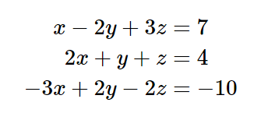
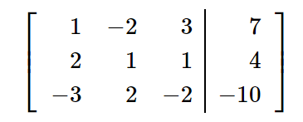
Gaussian elimination
Consider a system of equations
The augmented matrix for this system is
R₁
R₂
R₃

Slide 29
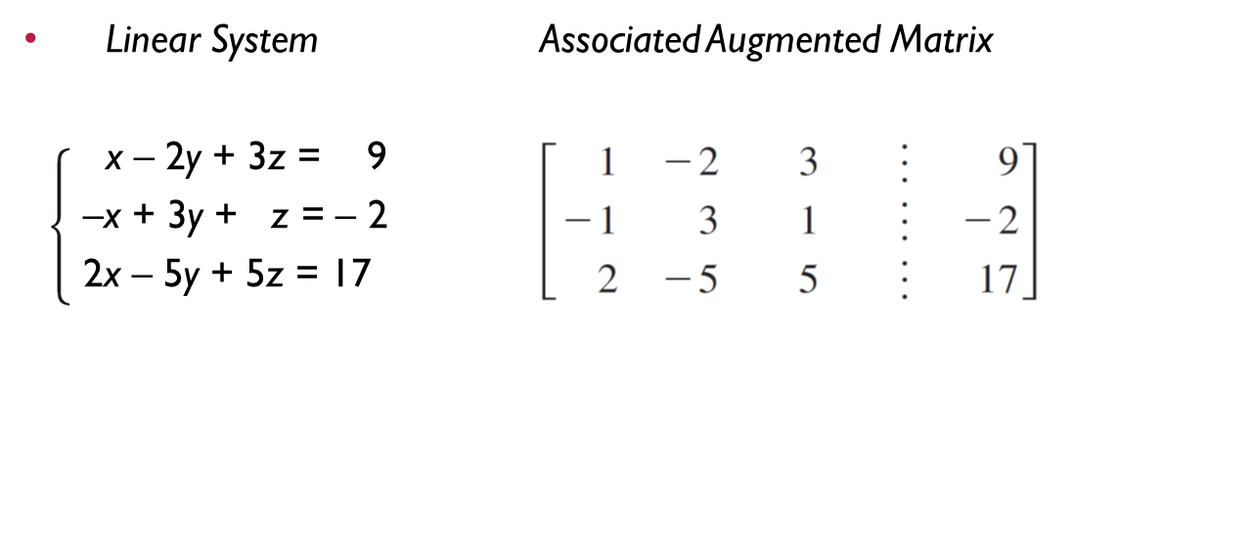
Gaussian elimination

Slide 30
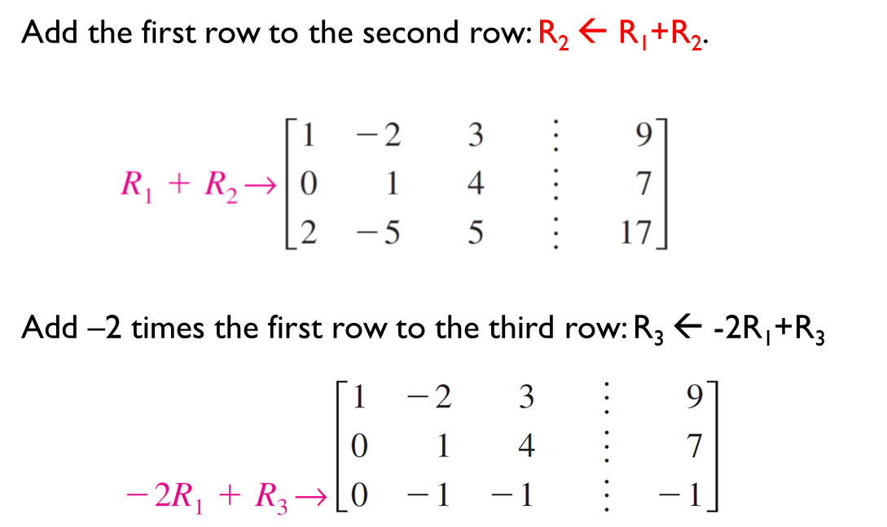
Gaussian elimination

Slide 31
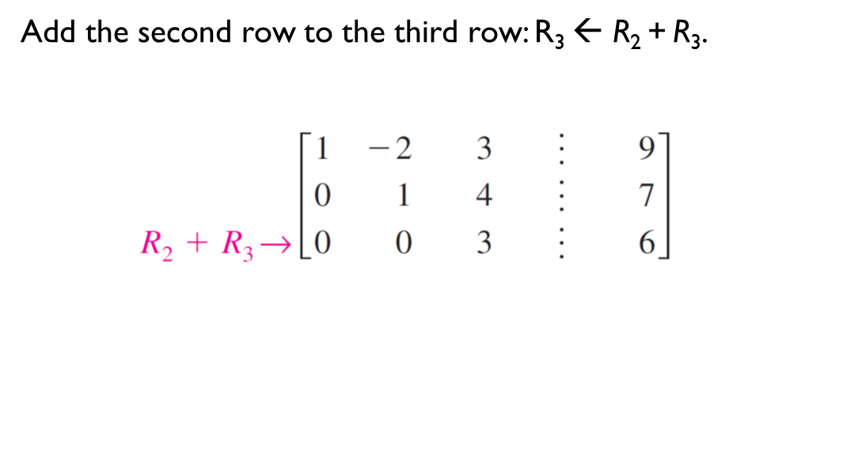
Gaussian elimination

Slide 32
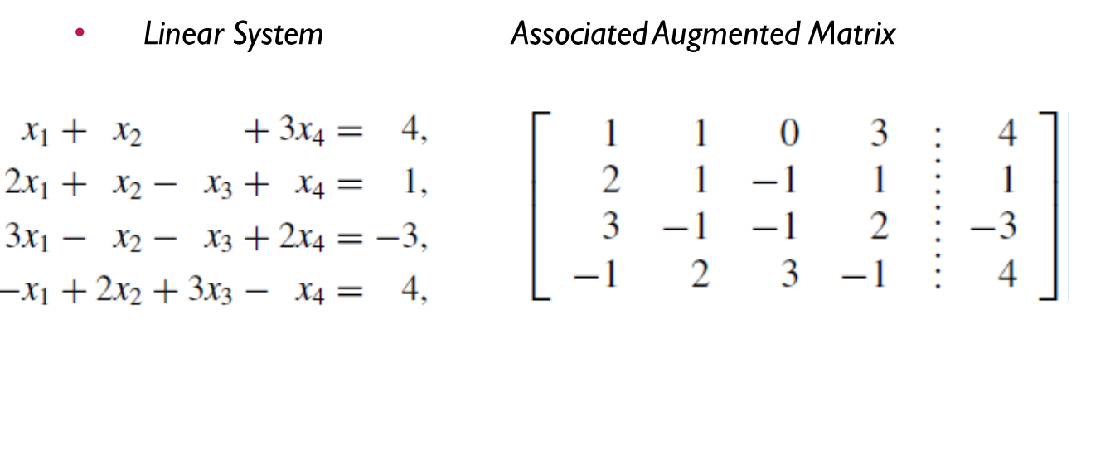
Gaussian elimination

Slide 33
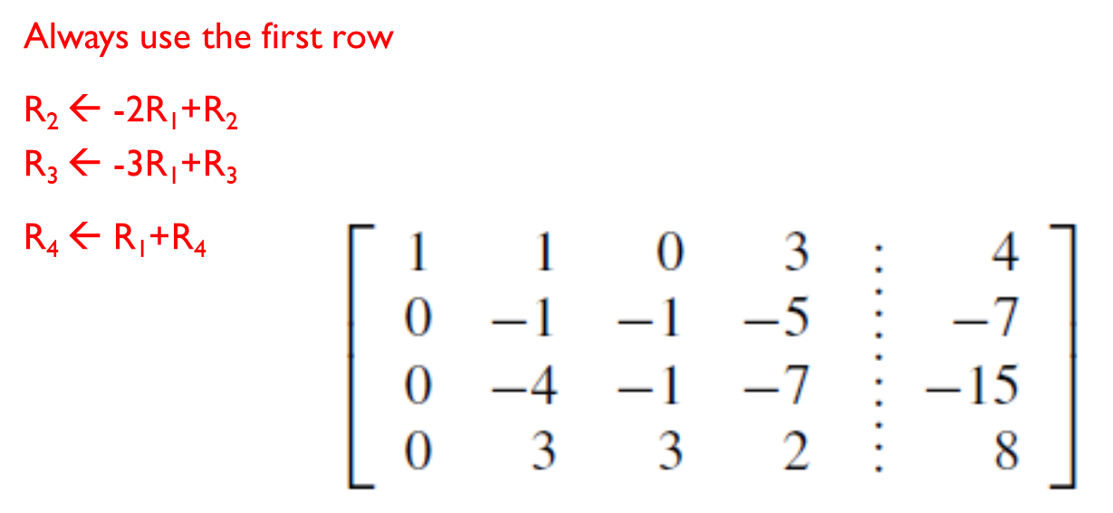
Gaussian elimination

Slide 34
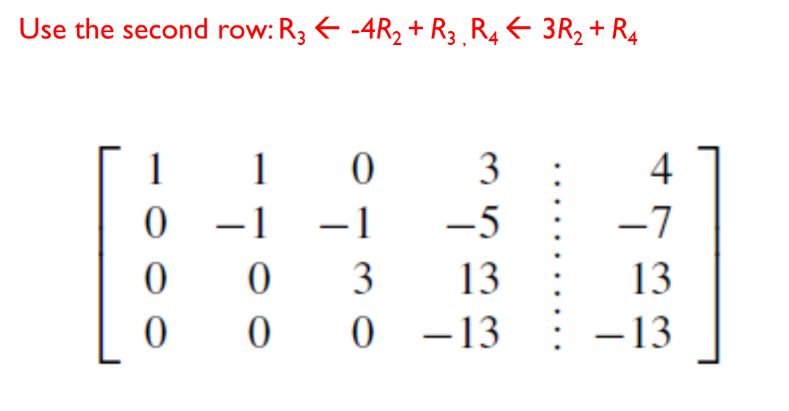
Gaussian elimination

Slide 35
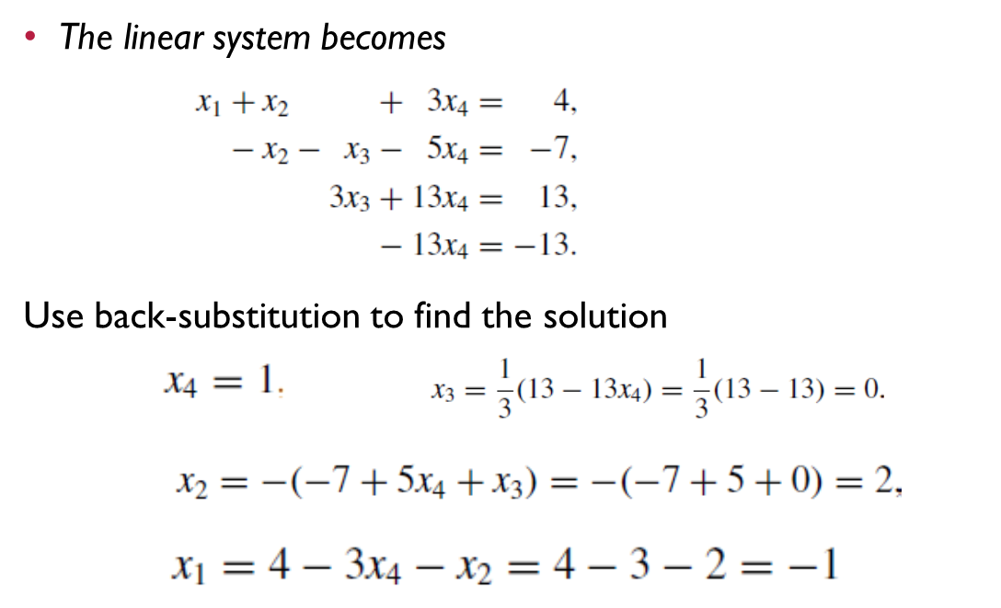
Gaussian elimination

Slide 36
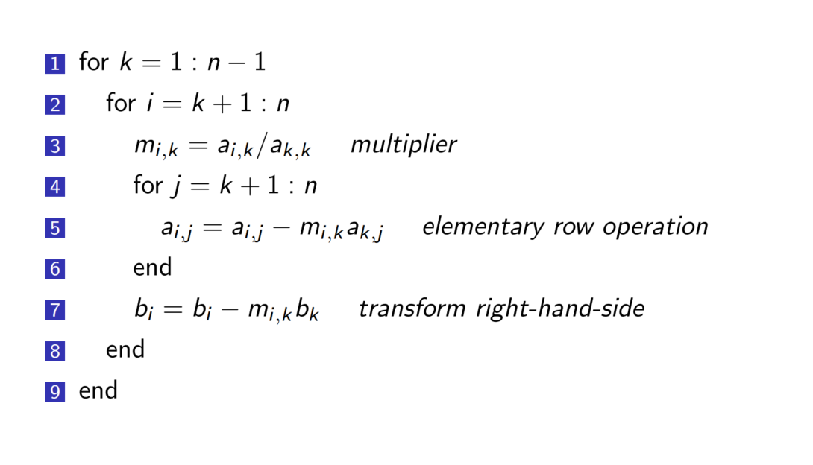
Gaussian elimination

Slide 37
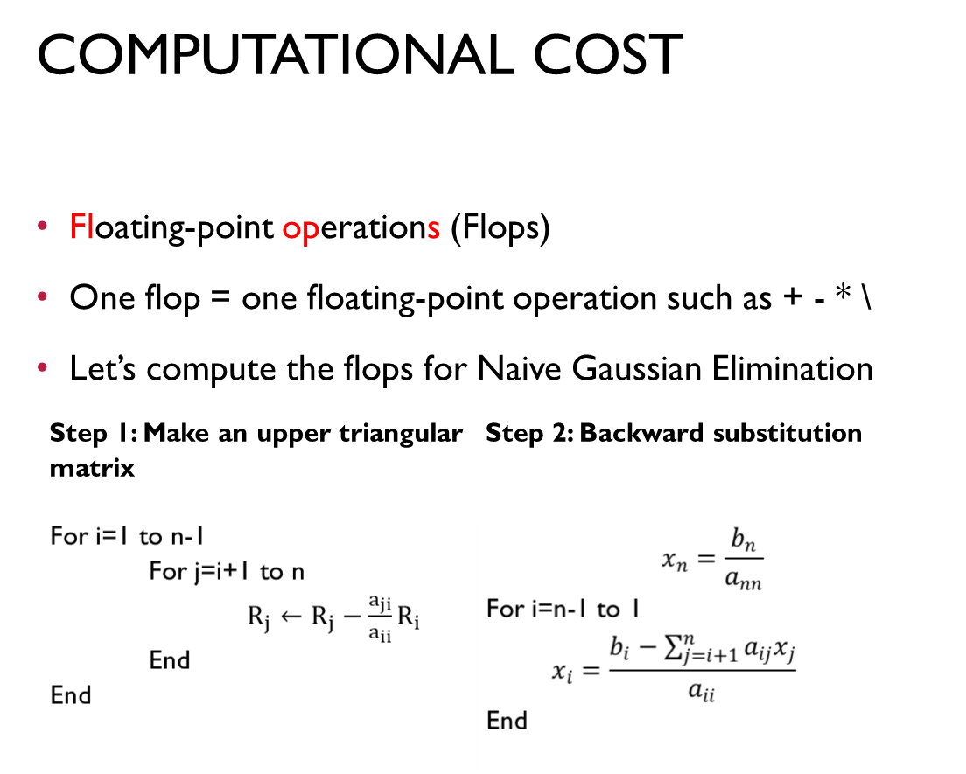
Gaussian elimination

Slide 38
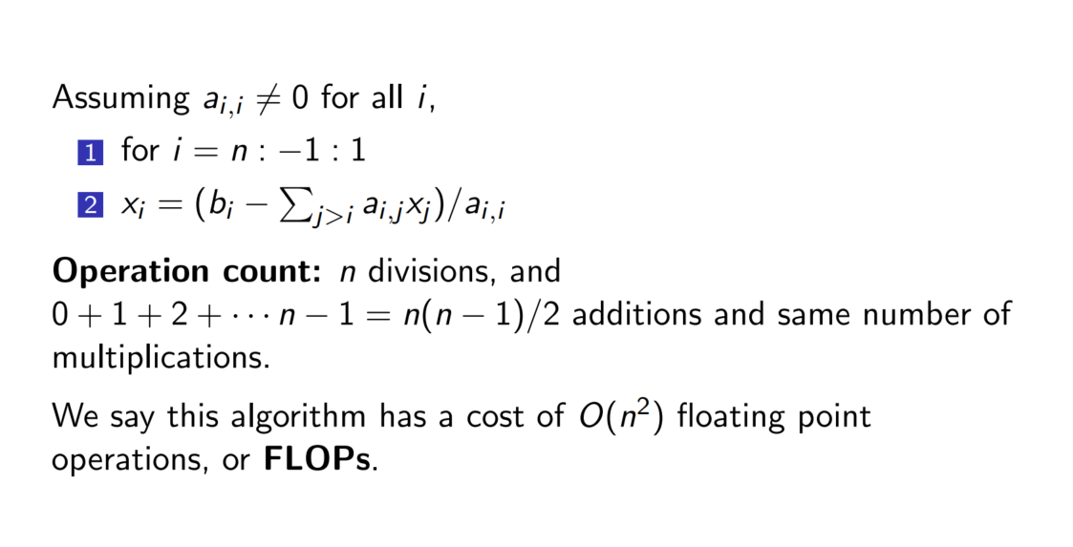
How can we solve Ax = b?
Gaussian elimination: Back substitution

Slide 39
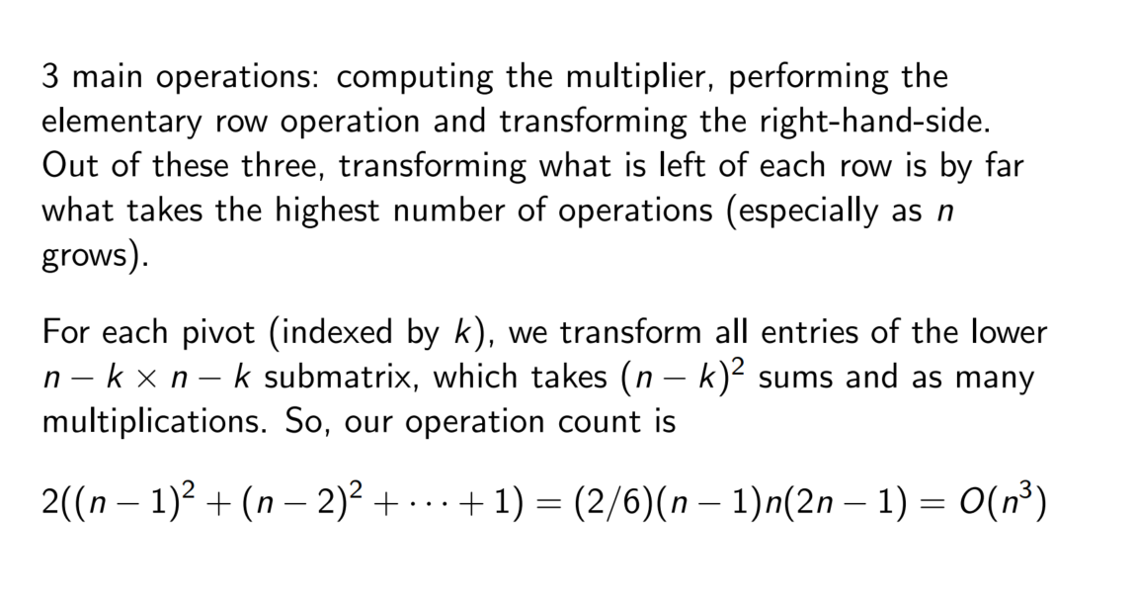
Gaussian elimination

Slide 40
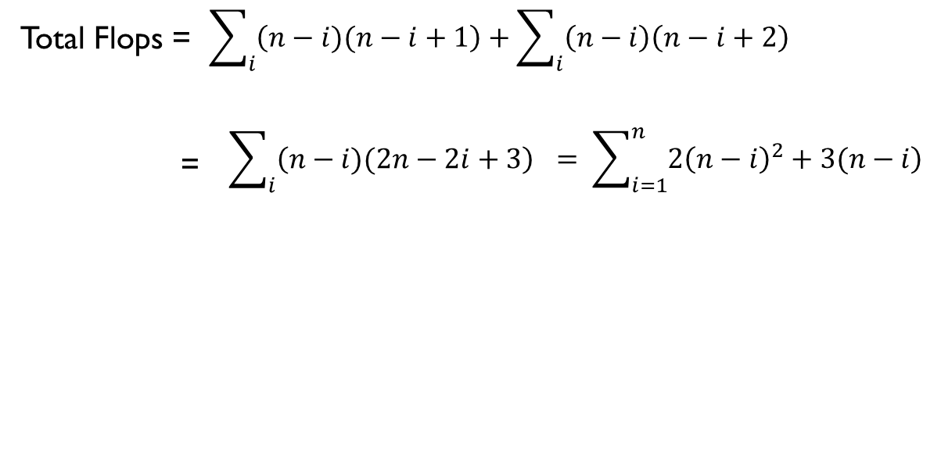
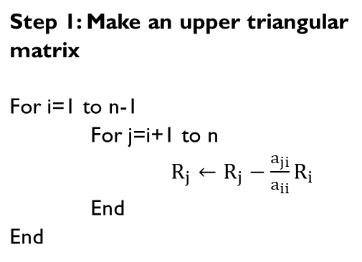
Gaussian elimination
i | Add/sub Flops | Mul/Div Flops
1 | (n-1)xn | (n-1)x(n+1)
2 | (n-2)x(n-1) | (n-2)xn
i | (n-i)x(n-i+1) | (n-i)x(n-i+2)
Step 1: Make an upper triangular matrix

Slide 41
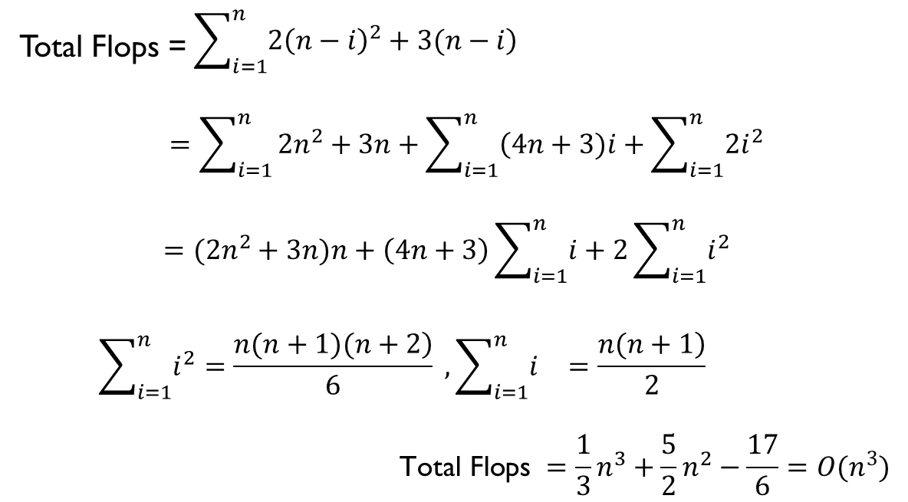
Gaussian elimination

Slide 42
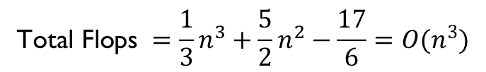


Gaussian elimination
This algorithm is very slow for large n due to the big flops!

Slide 43
Gaussian elimination

