Slide 1

MATH417 L7
Chuqi CHEN
February 2, 2026

Slide 2
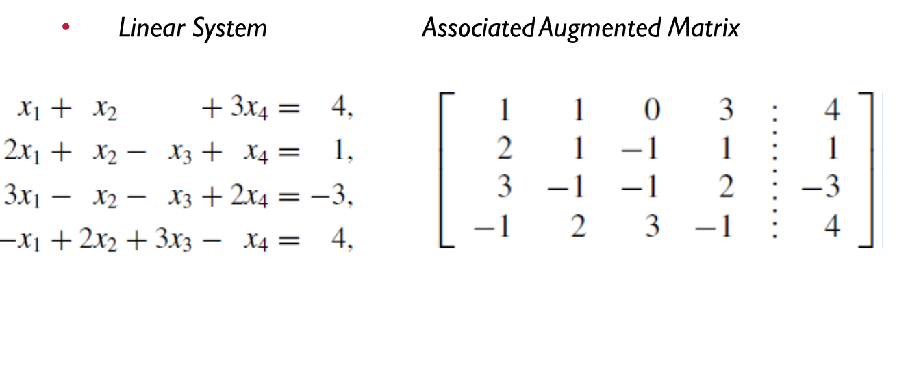
Warm up
Homework 1: due date: 02/06
Homework 2: due data: 02/16

Slide 3
Overviews
Review on Gaussian Elimination
Computation cost
Gaussian elimination with Partial Pivoting

Slide 4
Gaussian elimination

Slide 5
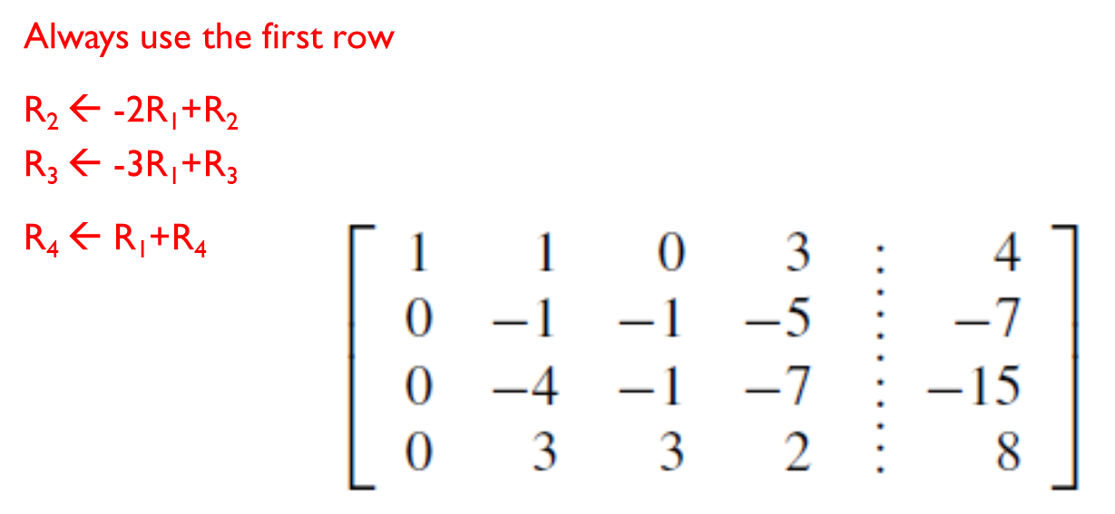
Gaussian elimination

Slide 6
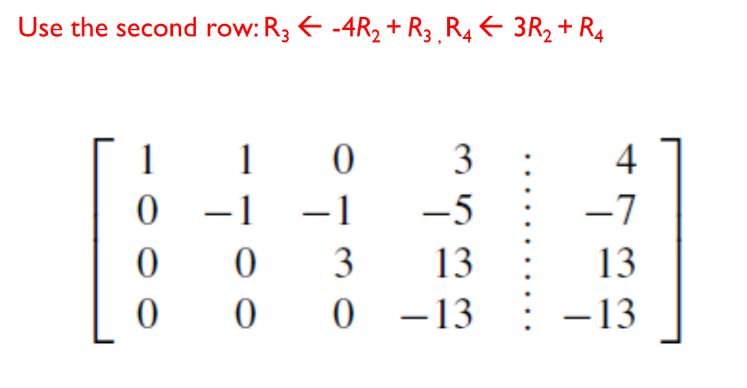
Gaussian elimination

Slide 7
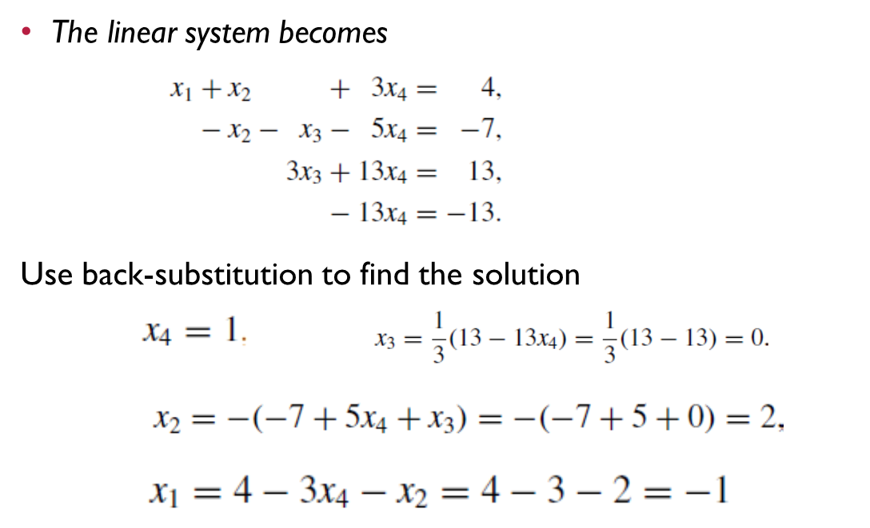
Gaussian elimination

Slide 8
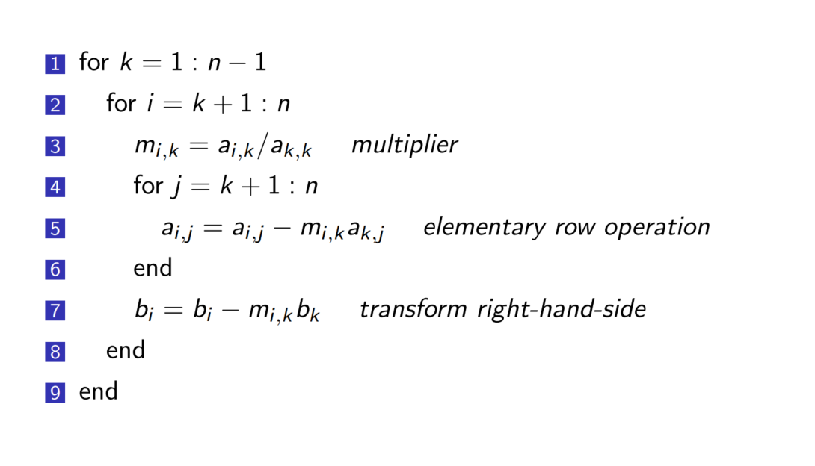
Gaussian elimination

Slide 9
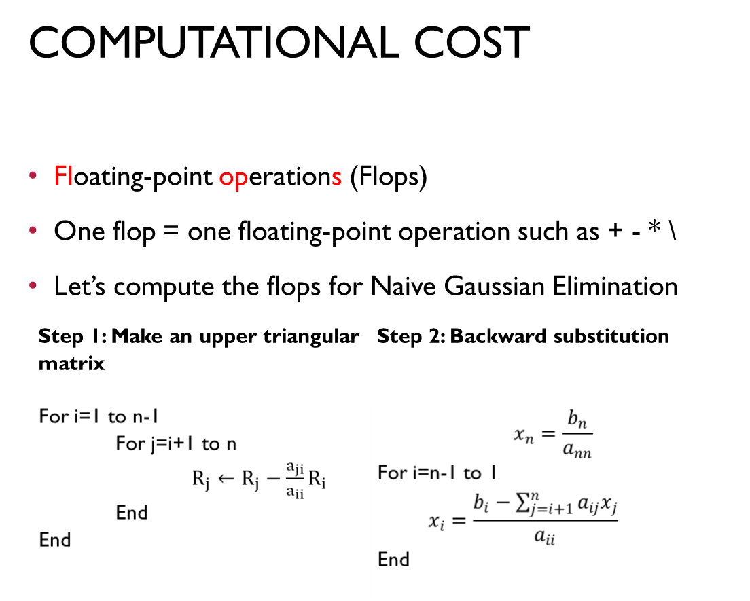
Gaussian elimination

Slide 10
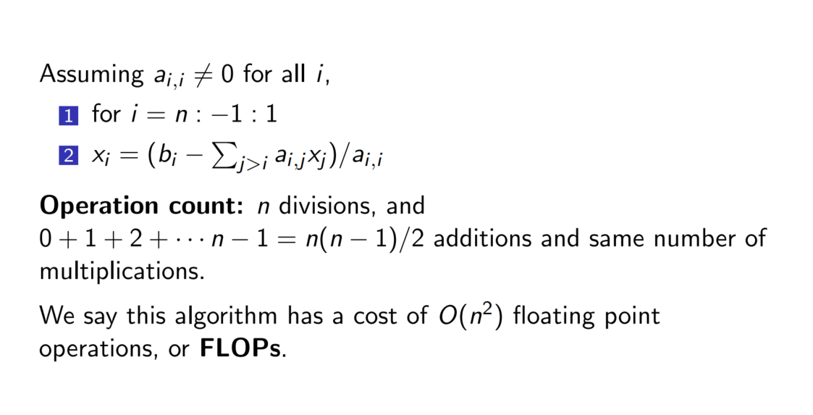
How can we solve Ax = b?
Gaussian elimination: Back substitution

Slide 11
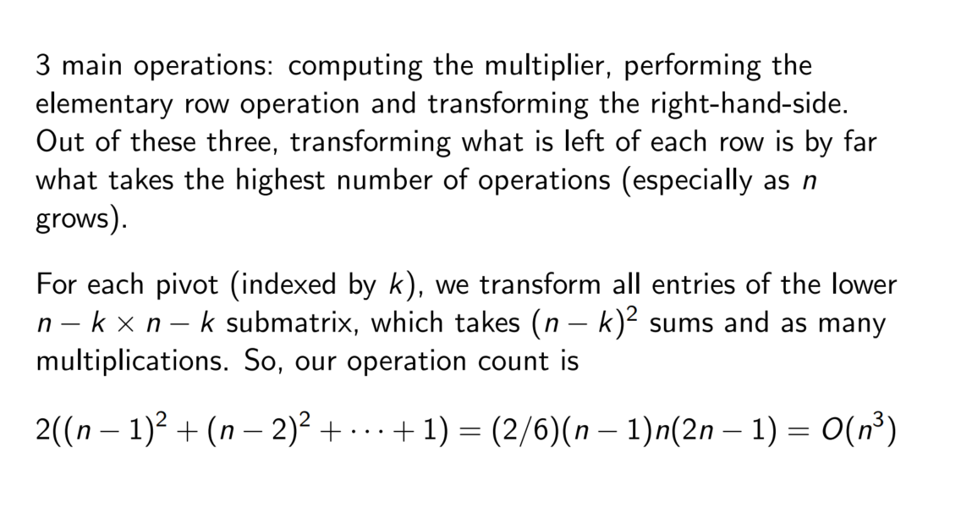
Gaussian elimination

Slide 12
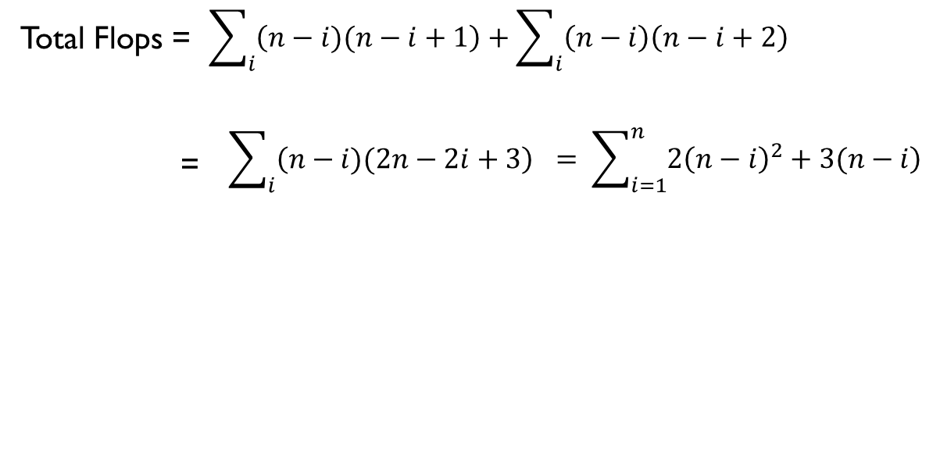
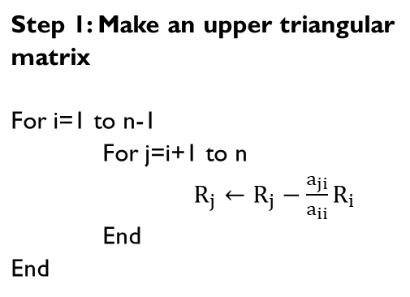
Gaussian elimination
i | Add/sub Flops | Mul/Div Flops
1 | (n-1)xn | (n-1)x(n+1)
2 | (n-2)x(n-1) | (n-2)xn
i | (n-i)x(n-i+1) | (n-i)x(n-i+2)
Step 1: Make an upper triangular matrix

Slide 13
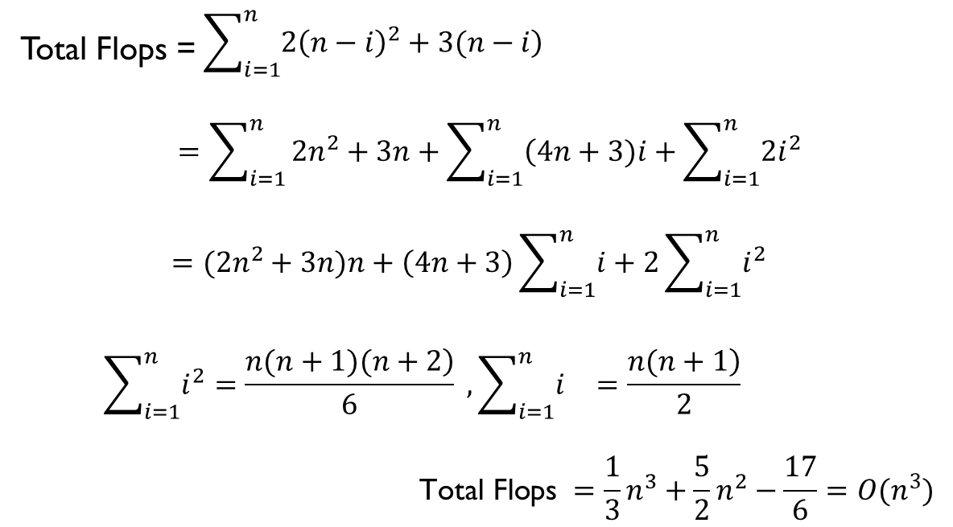
Gaussian elimination

Slide 14
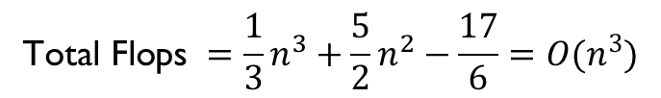


Gaussian elimination
This algorithm is very slow for large n due to the big flops!

Slide 15
Pitfalls for Gaussian elimination
Pitfall#1. Division by zero

Slide 16
Pitfalls for Gaussian elimination
Is division by zero an issue here?

Slide 17
Pitfalls for Gaussian elimination
Is division by zero an issue here? YES
Division by zero is a possibility at any step of forward elimination

Slide 18
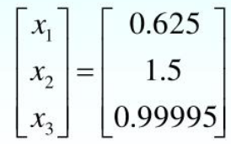
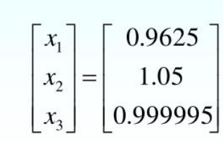
Pitfalls for Gaussian elimination
Pitfall#2. Large Round-off Errors
Exact Solution 5-significant digits 6-significant digits

Slide 19

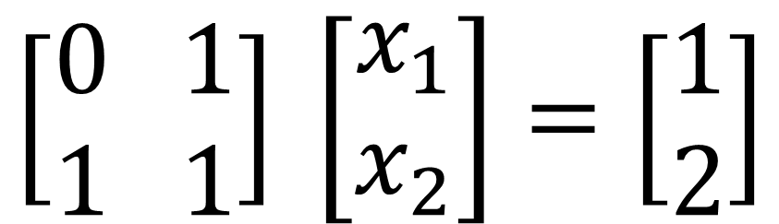
Pitfalls for Gaussian elimination
Pitfall#2. Large Round-off Errors
$$\left[\begin{aligned}0 1 \\ 1 1\end{aligned}\right] \left[\begin{aligned}x_{1} \\ x_{2}\end{aligned}\right]=\left[\begin{aligned}1 \\ 2\end{aligned}\right]$$
$$\left[\begin{aligned}x_{1}=1 \\ x_{2}=1\end{aligned}\right]$$

Slide 20
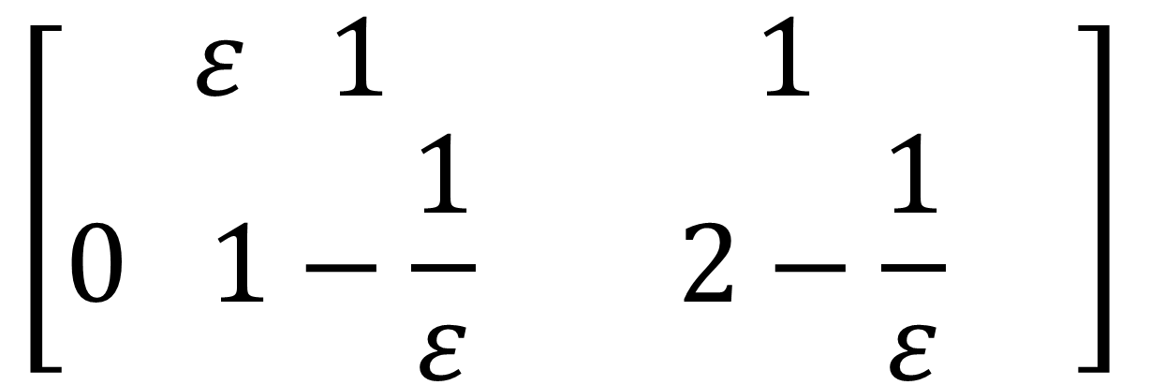
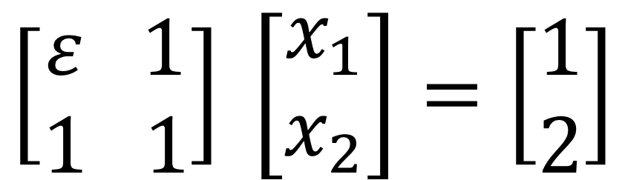
Pitfalls for Gaussian elimination
Pitfall#2. Large Round-off Errors
$$\left[\begin{aligned}ε 1 \\ 1 1\end{aligned}\right] \left[\begin{aligned}x_{1} \\ x_{2}\end{aligned}\right]=\left[\begin{aligned}1 \\ 2\end{aligned}\right]$$
$$\left[\begin{aligned}ε 1 1 \\ 0 1−\frac{1}{ε} 2−\frac{1}{ε}\end{aligned} \right]$$

Slide 21


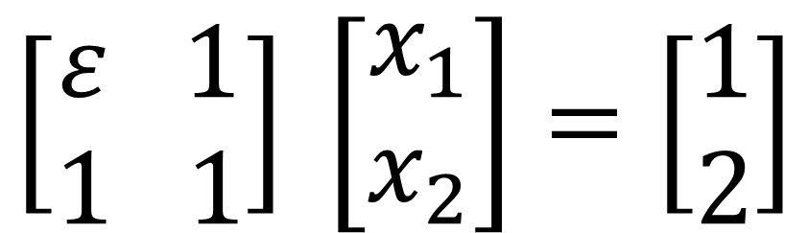
Pitfalls for Gaussian elimination
$$\left[\begin{aligned}ε 1 \\ 1 1\end{aligned}\right] \left[\begin{aligned}x_{1} \\ x_{2}\end{aligned}\right]=\left[\begin{aligned}1 \\ 2\end{aligned}\right]$$
$$x_{2}= \frac{2−\frac{1}{ε}}{1−\frac{1}{ε}}$$
$$x_{1}=(1−x_{2})\frac{1}{ε}$$

Slide 22
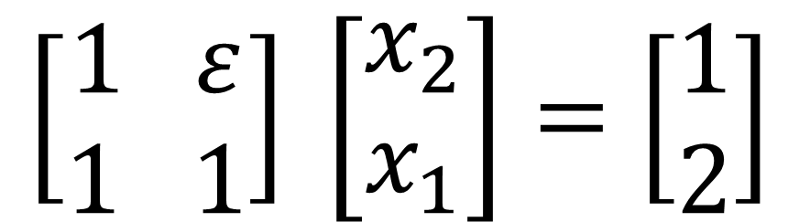
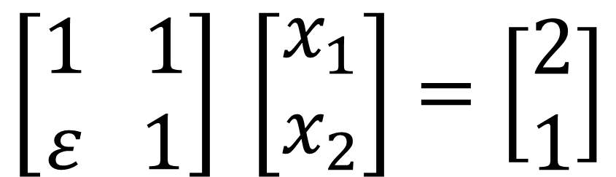
Pitfalls for Gaussian elimination
Is there a way to reduce the round off error?
$$\left[\begin{aligned}1 1 \\ ε 1\end{aligned}\right] \left[\begin{aligned}x_{1} \\ x_{2}\end{aligned}\right]=\left[\begin{aligned}2 \\ 1\end{aligned}\right]$$
Switch equations
$$\left[\begin{aligned}1 ε \\ 1 1\end{aligned}\right] \left[\begin{aligned}x_{2} \\ x_{1}\end{aligned}\right]=\left[\begin{aligned}1 \\ 2\end{aligned}\right]$$
Switch variables

Slide 23
Pivoting strategy
Avoiding Pitfalls
Pivoting strategy
Partial pivoting: switch either the equations or the variables
Complete pivoting: switch both the equations and the variables (computational cost is too large)
In our class, we refer the partial pivoting to switch the equations only.

Slide 24
Gauss Elimination with Partial Pivoting
Gaussian elimination with Partial Pivoting
To Avoid the Pitfalls of Naive Gauss Elimination
Possible division by zero
Large round-off errors

Slide 25
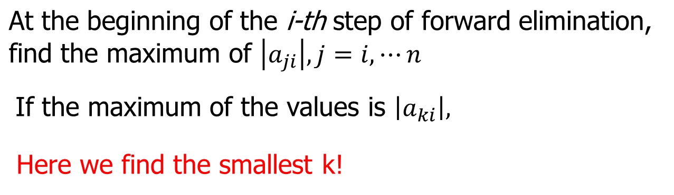
Gaussian elimination with Partial Pivoting

Slide 26
Gaussian elimination with Partial Pivoting
Example (2nd step of FE)
Which two rows would you switch?

Slide 27
Gaussian elimination with Partial Pivoting
Same as naive Gauss elimination method except that we switch rows before each of the (n-1) steps of forward elimination.
Solve the following set of equations by Gaussian elimination with partial pivoting

Slide 28
Gaussian elimination with Partial Pivoting

Slide 29
Gaussian elimination with Partial Pivoting
Forward Elimination: Step 1
Examine absolute values of first column, first row and below.
Largest absolute value is 144 and exists in row 3.
Switch row 1 and row 3.

Slide 30
Gaussian elimination with Partial Pivoting
Divide Equation 1 by 144 and
multiply it by 64, .
Subtract the result from Equation 2
Substitute new equation for Equation 2

Slide 31
Gaussian elimination with Partial Pivoting
Divide Equation 1 by 144 and
multiply it by 25, .
Subtract the result from Equation 3
Substitute new equation for Equation 3

Slide 32
Gaussian elimination with Partial Pivoting
Examine absolute values of second column, second row and below.
Largest absolute value is 2.917 and exists in row 3.
Switch row 2 and row 3.

Slide 33
Gaussian elimination with Partial Pivoting
Divide Equation 2 by 2.917 and
multiply it by 2.667,
Subtract the result from Equation 3
Substitute new equation for Equation 3

Slide 34
Gaussian elimination with Partial Pivoting
Solving for a₃

Slide 35
Gaussian elimination with Partial Pivoting
Solving for a₂

Slide 36
Gaussian elimination with Partial Pivoting
Solving for a₁

Slide 37
Gaussian elimination with Partial Pivoting

Slide 38
Gaussian elimination with Partial Pivoting
Consider the system of equations
In matrix form
=
Solve using Gaussian Elimination with Partial Pivoting using five significant digits with chopping

Slide 39
Gaussian elimination with Partial Pivoting
Forward Elimination: Step 1
Examining the values of the first column
|10|, |-3|, and |5| or 10, 3, and 5
The largest absolute value is 10, which means, to follow the rules of Partial Pivoting, we do not switch row.
Performing Forward Elimination

Slide 40
Gaussian elimination with Partial Pivoting
Forward Elimination: Step 2
Examining the values of the first column
|-0.001| and |2.5| or 0.0001 and 2.5
The largest absolute value is 2.5, so row 2 is switched with row 3
Performing the row swap

Slide 41
Gaussian elimination with Partial Pivoting
Forward Elimination: Step 2
Performing the Forward Elimination results in:

Slide 42
Gaussian elimination with Partial Pivoting
Back Substitution
Solving the equations through back substitution

Slide 43
Gaussian elimination with Partial Pivoting
Compare the calculated and exact solution
The fact that they are equal is coincidence, but it does illustrate the advantage of Partial Pivoting

Slide 44
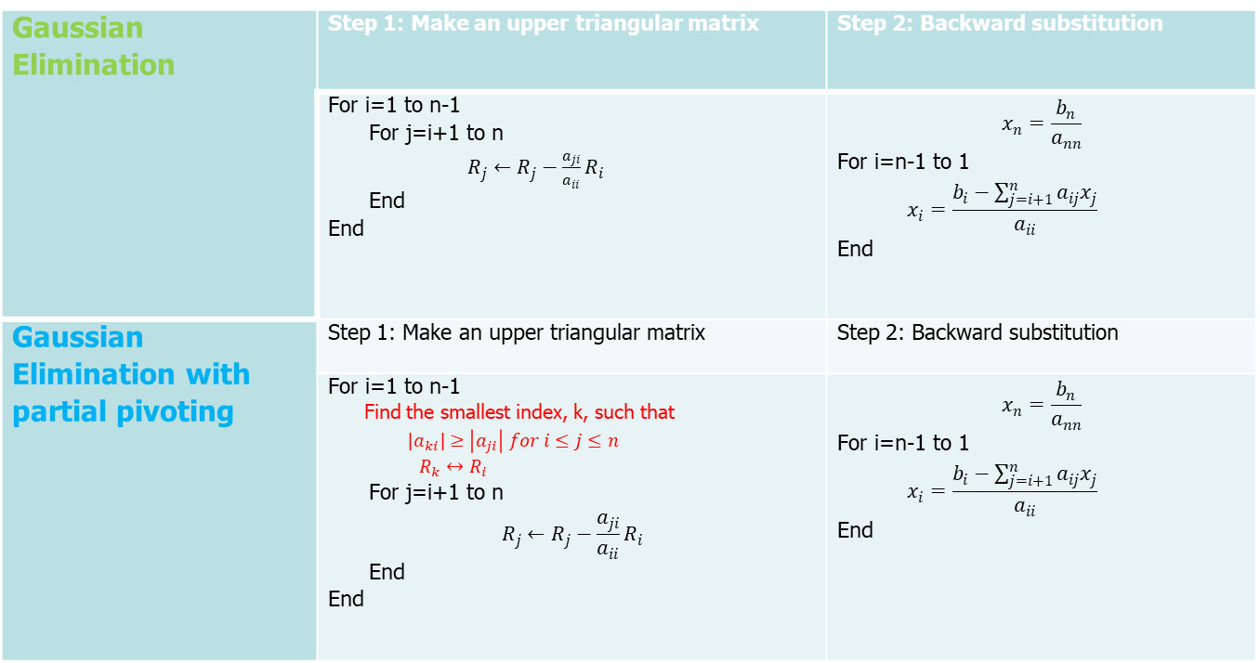
Gaussian elimination with Partial Pivoting
Gaussian Elimination | Step 1: Make an upper triangular matrix | Step 2: Backward substitution
Gaussian Elimination with partial pivoting | Step 1: Make an upper triangular matrix | Step 2: Backward substitution

Slide 45
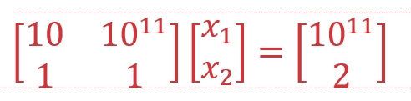
Gaussian elimination with Partial Pivoting
Problems with Gaussian Elimination with partial pivoting
Relatively small pivoting element may also have trouble

Slide 46
Gaussian elimination with Partial Pivoting
Very small pivoting element may result in , serious computation errors
Relatively small pivoting element may also have trouble

