Slide 1

MATH417 L7
Chuqi CHEN
February 4, 2026

Slide 2
Overviews
Loss of Significance
Gaussian Elimination with Scaled Partial Pivoting
LU Factorization

Slide 3
Overviews
Loss of Significance
Gaussian Elimination with Scaled Partial Pivoting
LU Factorization

Slide 4
Warm up
What may cause a problem when using computer to do the calculation?
While doing computation in computer we usually should keep significant digit!

Slide 5
Loss of significance
Notes:
Today, we’ll be discussing an important concept in numerical analysis: the loss of significance. This issue often arises when performing calculations that involve subtraction between two numbers that are very close to each other. Understanding this concept is crucial for ensuring accuracy in computations.

Slide 6
Outline
What’s the loss of significance?
How to solve this issue?

Slide 7
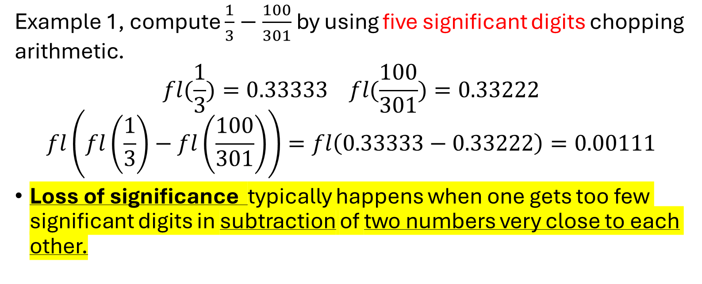
Loss of significance
Example 1, compute $\frac{1}{3}−\frac{100}{301}$ by using five significant digits chopping arithmetic.
$$fl(\frac{1}{3})=0.33333 fl(\frac{100}{301})=0.33222$$
$$fl\left(fl\left(\frac{1}{3}\right)−fl\left(\frac{100}{301}\right)\right)=fl\left(0.33333−0.33222\right)=0.00111$$
Loss of significance typically happens when one gets too few significant digits in subtraction of two numbers very close to each other.
Three significant digits only!
Example $\frac{1001}{6}−\frac{1000}{6}$ by using four significant digits rounding arithmetic.
Notes:
So, what exactly is the loss of significance? It typically occurs during the subtraction of two nearly equal numbers, where the significant digits of the result are drastically reduced. This can lead to a loss of precision and accuracy in numerical computations, especially when dealing with limited significant digits.
Let’s look at an example using five significant digits with chopping arithmetic
1000/6=166.6666666666
1001/6=166.83333333333

Slide 8
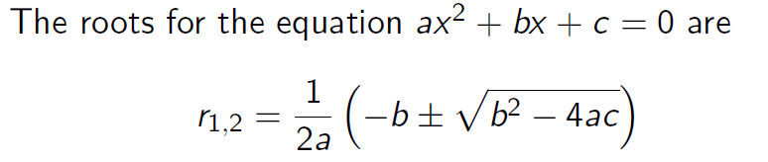
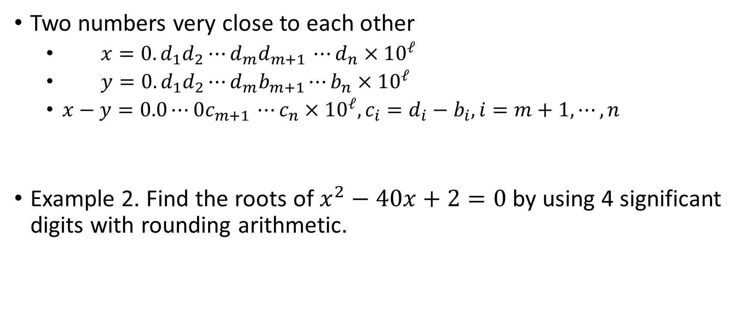
Loss of significance
Two numbers very close to each other
  $x=0.d_{1}d_{2}⋯d_{m}d_{m+1 }⋯d_{n}×{10}^{ℓ}$
  $y=0.d_{1}d_{2}⋯d_{m}b_{m+1}⋯b_{n}×{10}^{ℓ}$
  $x−y=0.0⋯0c_{m+1 }⋯c_{n}×{10}^{ℓ}, c_{i}=d_{i}−b_{i},i=m+1,⋯,n$
  Example 2. Find the roots of $x^{2}−40x+2=0$by using 4 significant digits with rounding arithmetic.
n significant digits
n-m significant digits
Notes:
Now, consider another example where we find the roots of an equation using four significant digits with rounding arithmetic. Initially, you’ll notice that the result loses accuracy due to the subtraction of two close numbers. However, by reformulating the equation, we can avoid this loss and restore the precision.

Slide 9

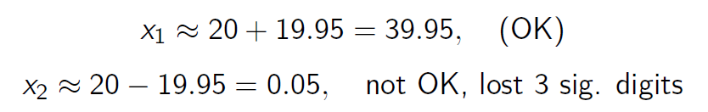
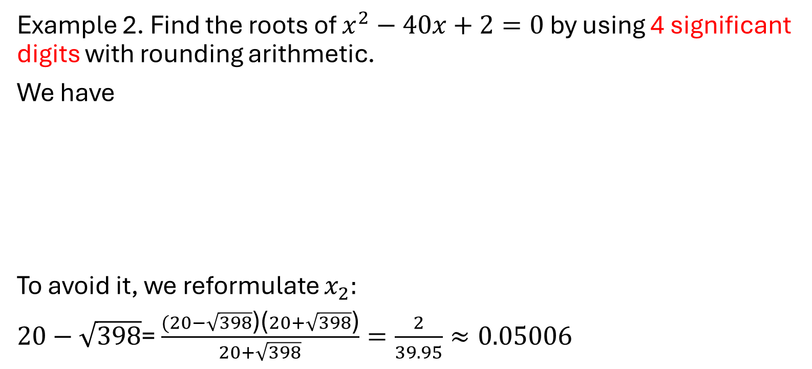
Loss of significance
  Example 2. Find the roots of $x^{2}−40x+2=0$by using 4 significant digits with rounding arithmetic.
  We have
  To avoid it, we reformulate $x_{2}:$
  $20−\sqrt{398}$= $\frac{(20−\sqrt{398}\text{)(}20+\sqrt{398}\text{)}}{20+\sqrt{398}}=\frac{2}{39.95}≈0.05006$
We get back 4 significant digits
Notes:
To address the loss of significance, one effective method is to reformulate the problem to avoid subtracting two nearly equal numbers. For example, instead of directly solving an equation that causes this issue, we can manipulate the equation to maintain more significant digits in the result.

Slide 10
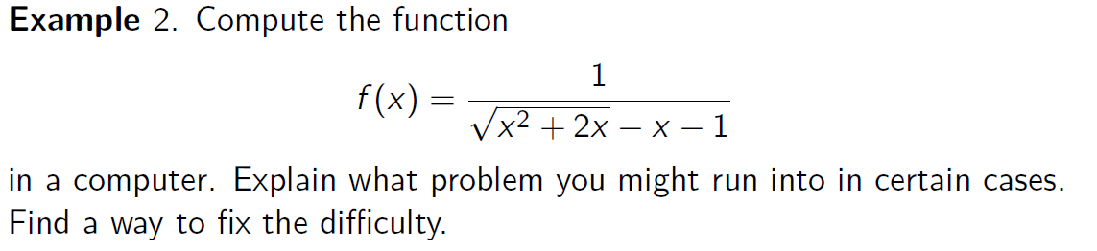
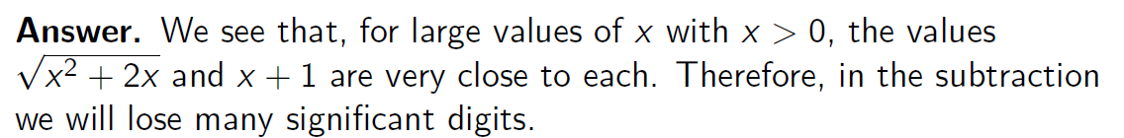
Loss of significance
Notes:
In summary, the loss of significance is a common problem in numerical computations but can be mitigated by careful formulation of the equations and mindful arithmetic operations. Always be aware of how significant digits are handled in your calculations to avoid unnecessary loss of accuracy.

Slide 11
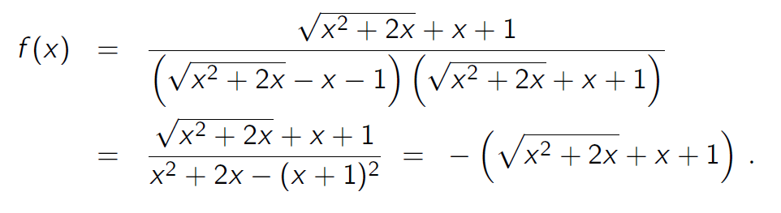
Loss of significance
  To avoid this problem, we reformulate the function $f(x)$

Slide 12
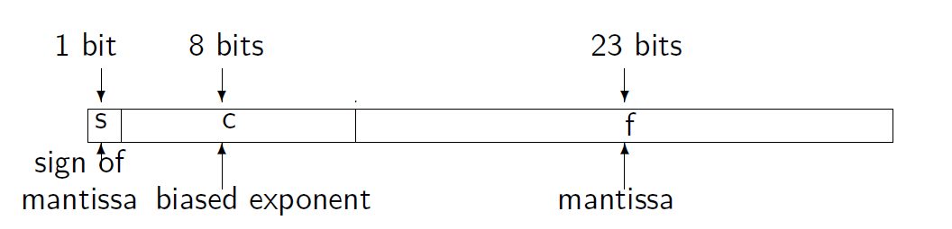

Write (64.625)₁₀ into normalized scientific notation in binary. You could use the result in the previous problem. Then determine how it would look like in a 32-bit computer, using a single-precision floating point representation.
the value of the number is written as

Slide 13
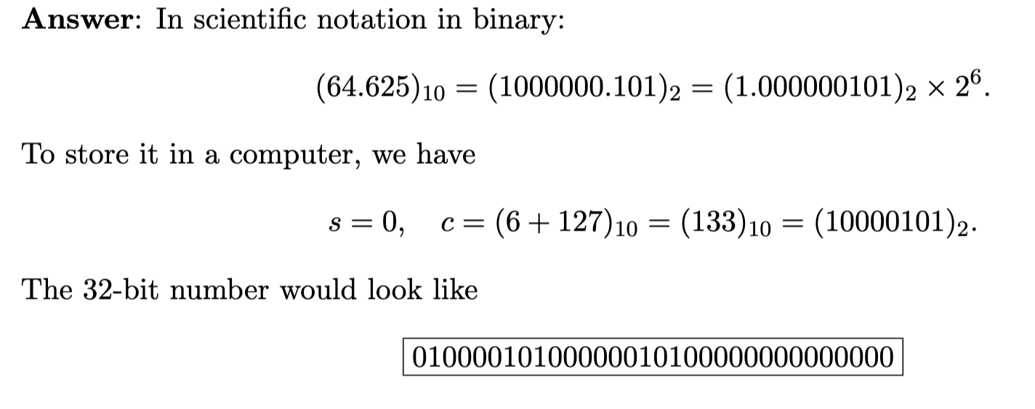

Slide 14
Overviews
Loss of Significance
Gaussian Elimination with Scaled Partial Pivoting
LU Factorization

Slide 15
Example
Example 1:
Exact Solution

Slide 16

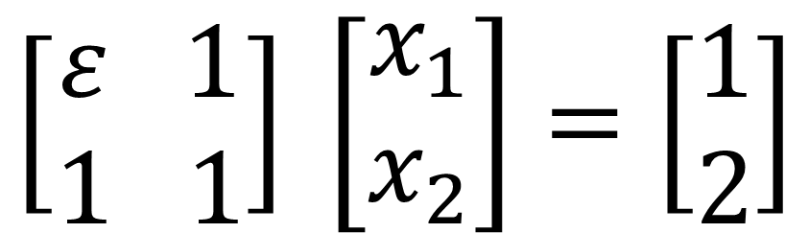

Example
Example 2:
$$\left[\begin{aligned}ε 1 \\ 1 1\end{aligned}\right] \left[\begin{aligned}x_{1} \\ x_{2}\end{aligned}\right]=\left[\begin{aligned}1 \\ 2\end{aligned}\right]$$
$$x_{2}= \frac{2−\frac{1}{ε}}{1−\frac{1}{ε}}$$
$$x_{1}=(1−x_{2})\frac{1}{ε}$$

Slide 17
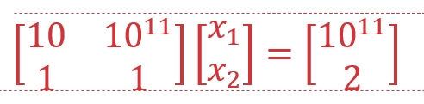
Example
Example 3:

Slide 18
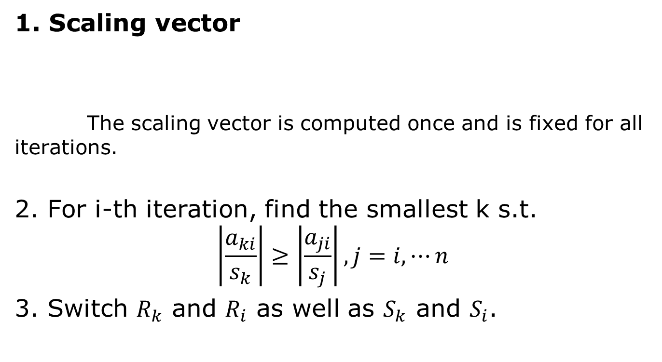
Gaussian Elimination with Scaled Partial Pivoting

Slide 19
Gaussian Elimination with Scaled Partial Pivoting

Slide 20
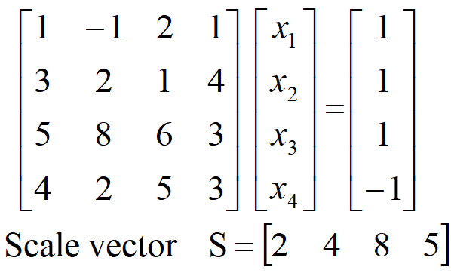
Gaussian Elimination with Scaled Partial Pivoting
Scaling vector:
find largest absolute value in each row

Slide 21
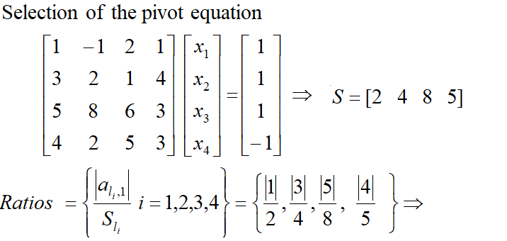

Gaussian Elimination with Scaled Partial Pivoting

Slide 22
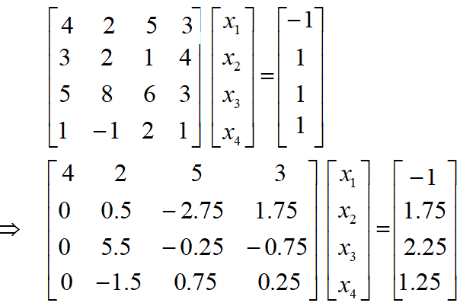
Gaussian Elimination with Scaled Partial Pivoting
S=[5 4 8 2]

Slide 23
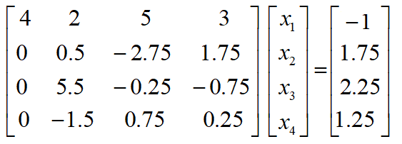


Gaussian Elimination with Scaled Partial Pivoting
S=[5 4 8 2]
K=4

Slide 24
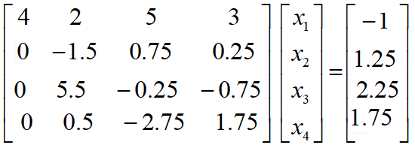
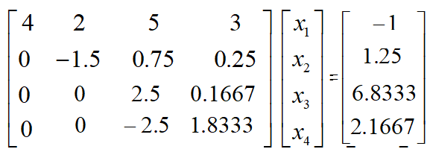
Gaussian Elimination with Scaled Partial Pivoting
S=[5 2 8 4]

Slide 25


Gaussian Elimination with Scaled Partial Pivoting
S=[5 2 8 4]
K=4

Slide 26
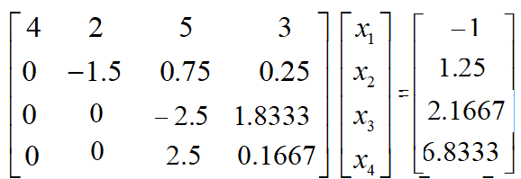
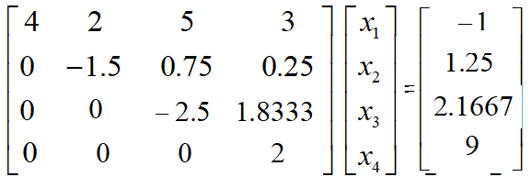
Gaussian Elimination with Scaled Partial Pivoting
S=[5 2 4 8]

Slide 27

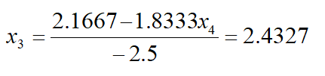


Gaussian Elimination with Scaled Partial Pivoting

Slide 28
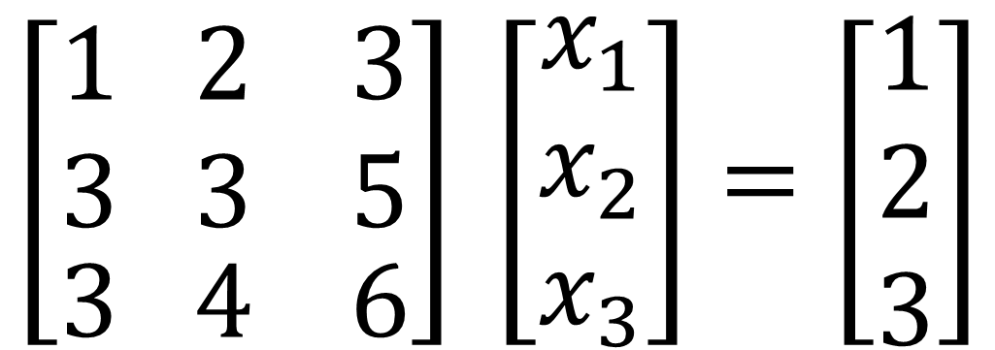
Gaussian Elimination with Scaled Partial Pivoting
$$\left[\begin{aligned}\begin{aligned}1 2 3 \\ 3 3 5\end{aligned} \\ 3 4 6\end{aligned}\right] \left[\begin{aligned}x_{1} \\ x_{2} \\ x_{3}\end{aligned}\right]=\left[\begin{aligned}1 \\ 2 \\ 3\end{aligned}\right]$$

Slide 29
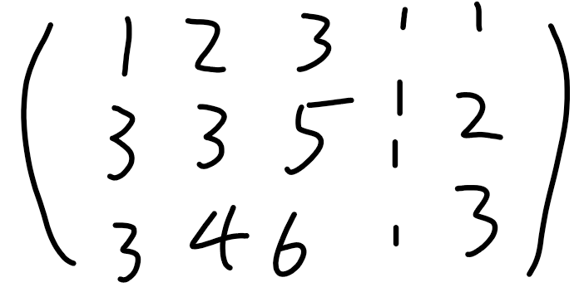
Gaussian Elimination with Scaled Partial Pivoting

Slide 30
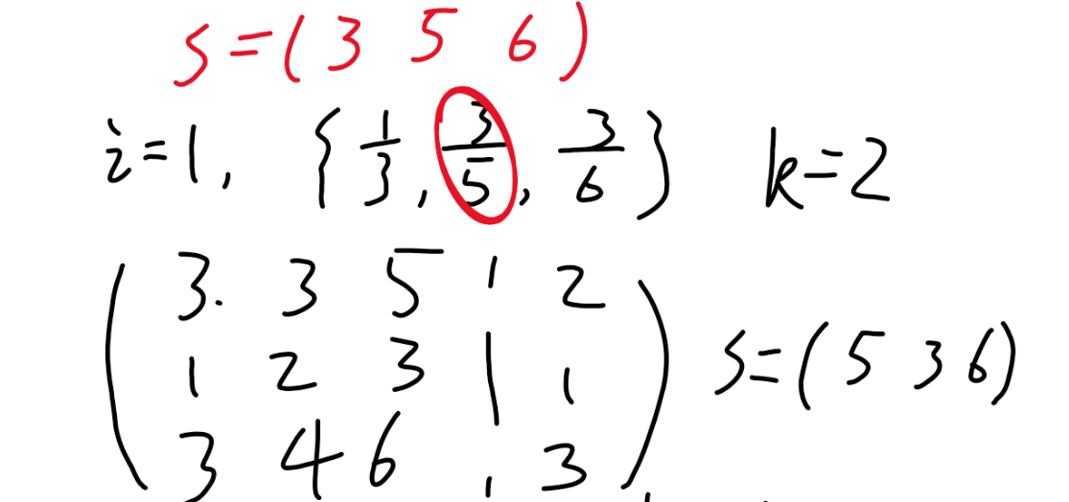
Gaussian Elimination with Scaled Partial Pivoting

Slide 31
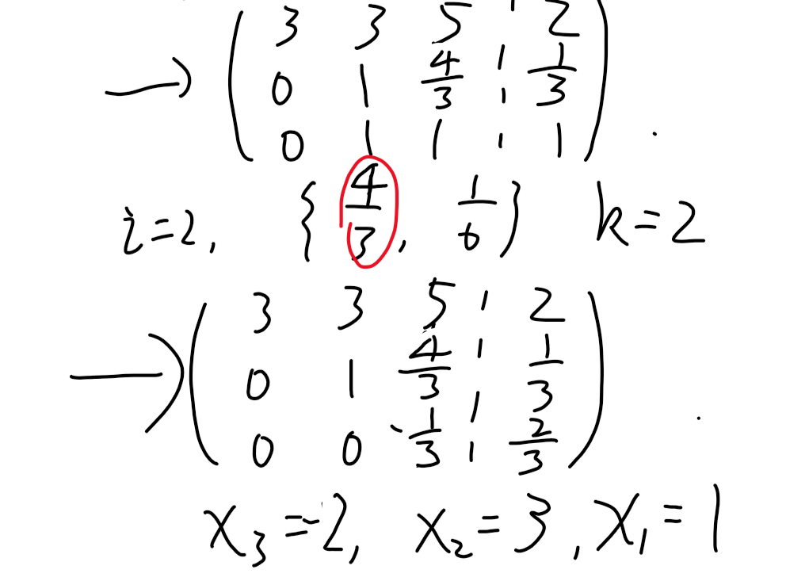
Gaussian Elimination with Scaled Partial Pivoting

Slide 32
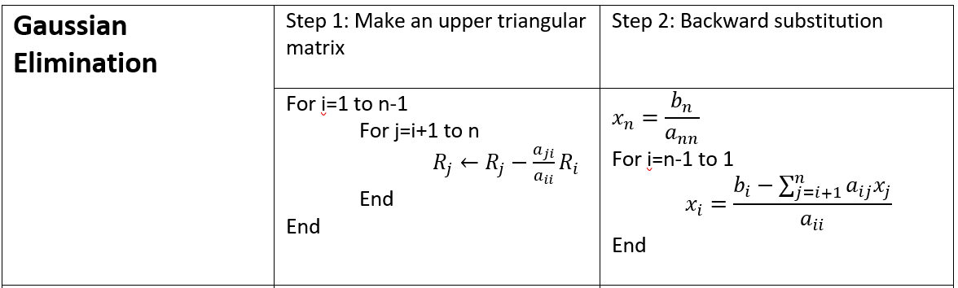
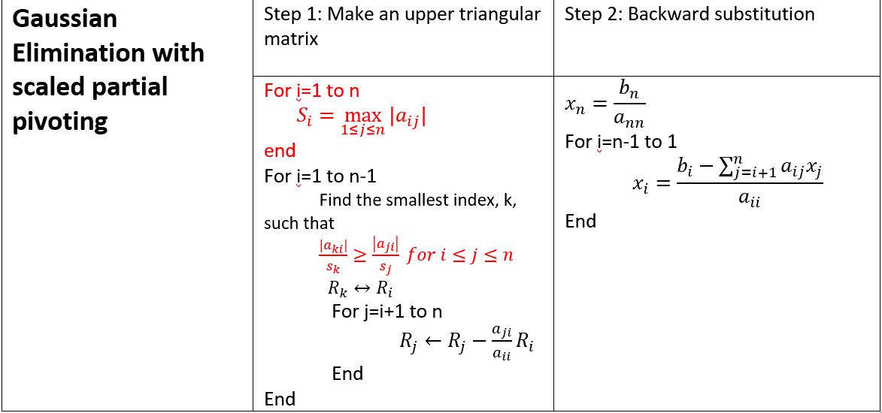
Gaussian Elimination with Scaled Partial Pivoting

Slide 33
Overviews
Loss of Significance
Gaussian Elimination with Scaled Partial Pivoting
LU Factorization

Slide 34
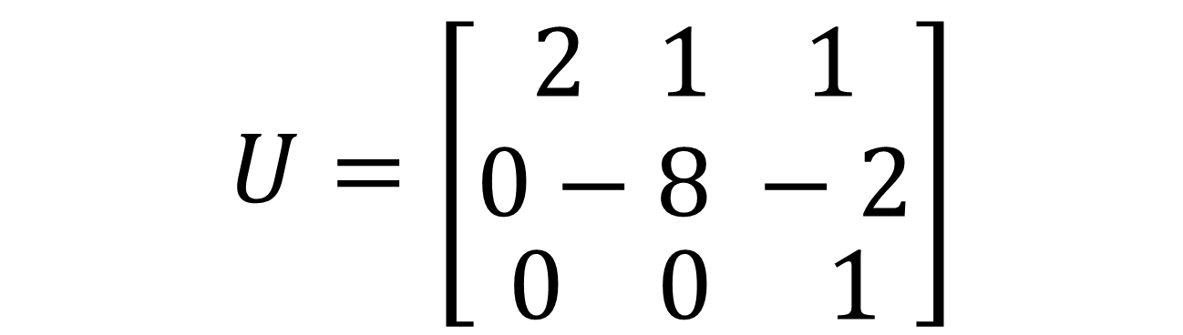

LU Factorization
Gaussian elimination
$$A=\left[\begin{aligned}\begin{aligned}2 1 1 \\ 4 −6 5\end{aligned} \\ −2 7 0\end{aligned}\right]$$
$$U=\left[\begin{aligned}\begin{aligned}2 1 1 \\ 0−8 −2\end{aligned} \\ 0 0 1\end{aligned}\right]$$

Slide 35
LU Factorization
For most non-singular matrix [A] that one could conduct Naïve Gauss Elimination forward elimination steps, one can always write it as
[A] = [L][U]
where
[L] = lower triangular matrix
[U] = upper triangular matrix

Slide 36
LU Factorization
[U] is the same as the coefficient matrix at the end of the forward elimination step.
[L] is obtained using the multipliers that were used in the forward elimination process

Slide 37
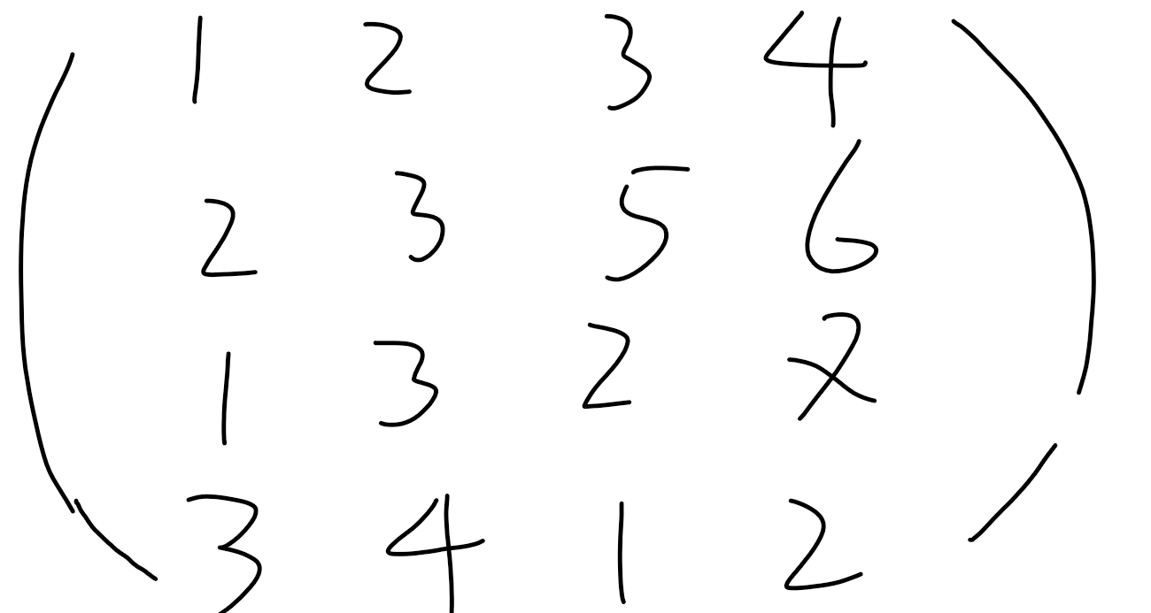
LU Factorization

Slide 38
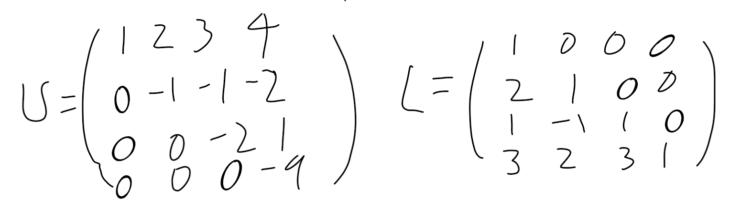
LU Factorization

Slide 39
LU Factorization
How can this be used?
Given [A][X] = [b]
Decompose [A] into [L] and [U]
Solve [L][Z] = [b] for [Z] by forward substitution
Solve [U][X] = [Z] for [X] by Backward substitution

Slide 40

LU Factorization
Example: Solve Ax=b
Find the solution of [A][x ]=[b]
[b]
Using the decomposition procedure, the [L] and [U] matrices are found to be

Slide 41
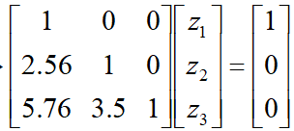
LU Factorization
Example: Inverse of a Matrix
Solving for the each column of [B] requires two steps
Solve [L] [Z] = [b] for [Z]
Solve [U] [X] = [Z] for [X]
Step 1:
This generates the equations:

Slide 42
LU Factorization
Solving for [Z]

Slide 43
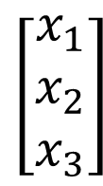
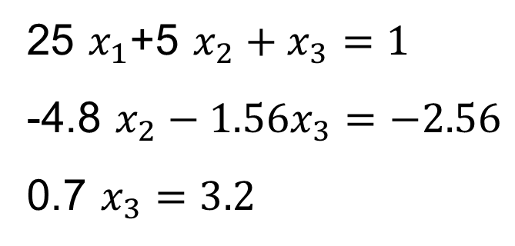
LU Factorization

Slide 44
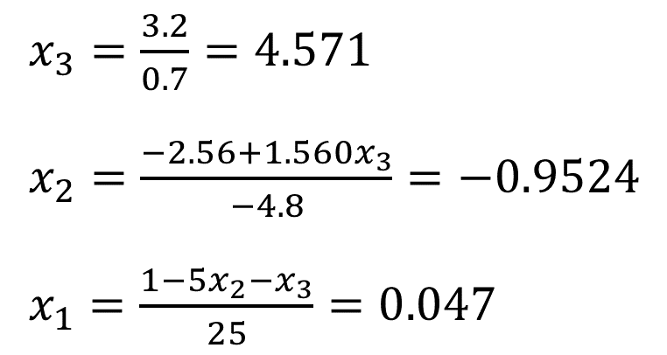
LU Factorization
Using Backward Substitution

Slide 45
LU Factorization
Finding the inverse of a square matrix
The inverse [B] of a square matrix [A] is defined as
[A][B] = [I] = [B][A]

Slide 46
LU Factorization
Finding the inverse of a square matrix
How can LU Decomposition be used to find the inverse?
Assume the first column of [B] to be [b₁₁ b₁₂ … b_{n1}]^{T}
Using this and the definition of matrix multiplication
First column of [B] Second column of [B]
The remaining columns in [B] can be found in the same manner

Slide 47
LU Factorization
Example: Inverse of a Matrix
Find the inverse of a square matrix [A]
Using the decomposition procedure, the [L] and [U] matrices are found to be

Slide 48
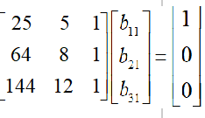
LU Factorization
First Column Second Column Third Column

Slide 49
LU Factorization
Solving for the each column of [B] requires two steps
Solve [L] [Z] = [b] for [Z]
Solve [U] [X] = [Z] for [X]
Step 1:
This generates the equations:

Slide 50
LU Factorization
Solving for [Z]

Slide 51
LU Factorization
Solving [U][X] = [Z] for [X]

Slide 52
LU Factorization
Using Backward Substitution
So the first column of the inverse of [A] is:

Slide 53
LU Factorization
Repeating for the second and third columns of the inverse
Second Column Third Column

