Slide 1

MATH417 L9
Chuqi CHEN
February 4, 2026

Slide 2
Warm up
Office Hour： by appointment cchenck@umich.edu
Recording course for Wed. （see the record, for HW1& HW2.)
No course in class.
Midterm: Feb 25 8:30-10:00am EH 1084.
Homework 2: due date: 02/16
Homework 3: due date: 03/10

Slide 3


Warm up
Gaussian elimination
$$A=\left[\begin{aligned}\begin{aligned}2 1 1 \\ 4 −6 5\end{aligned} \\ −2 7 0\end{aligned}\right]$$
$$U=\left[\begin{aligned}\begin{aligned}2 1 1 \\ 0−8 3\end{aligned} \\ 0 0 4\end{aligned}\right]$$

Slide 4
Overviews
LU Factorization
Eigenvalue and Eigenvector
Norm

Slide 5
Overviews
LU Factorization
Eigenvalue and Eigenvector
Norm

Slide 6
LU Factorization
For most non-singular matrix [A] that one could conduct Naïve Gauss Elimination forward elimination steps, one can always write it as
[A] = [L][U]
where
[L] = lower triangular matrix
[U] = upper triangular matrix

Slide 7
LU Factorization
[U] is the same as the coefficient matrix at the end of the forward elimination step.
[L] is obtained using the multipliers that were used in the forward elimination process

Slide 8
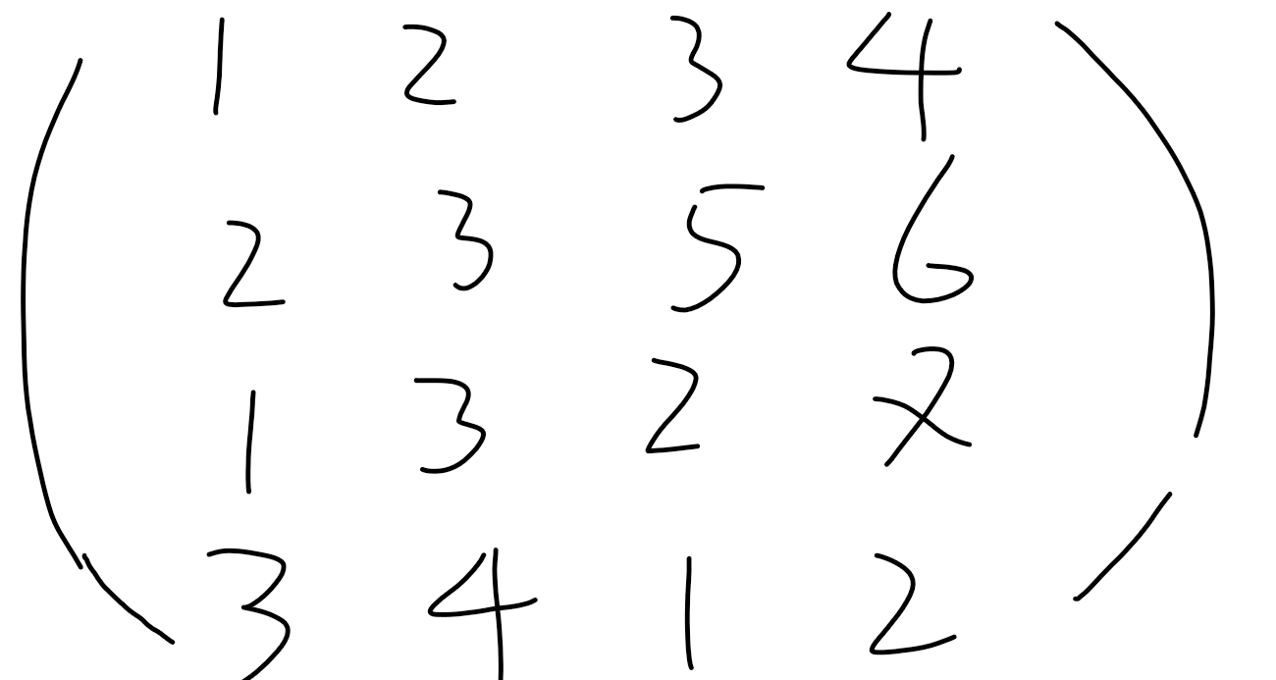
LU Factorization

Slide 9
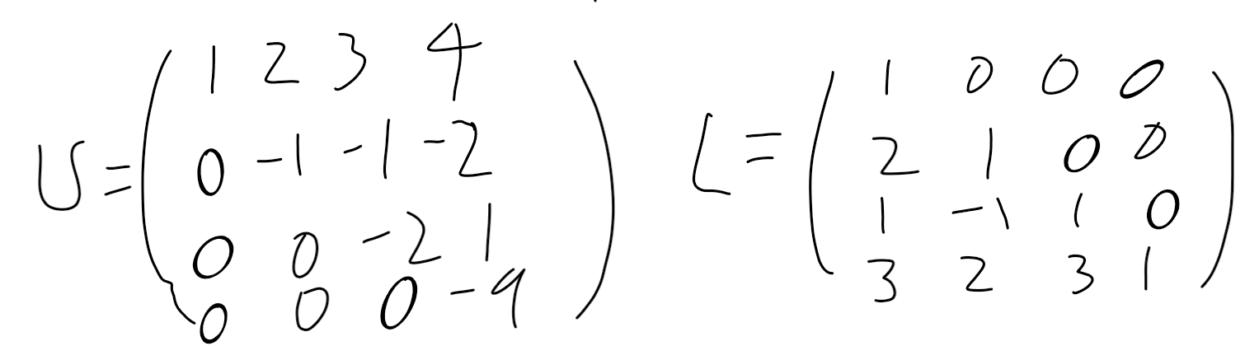
LU Factorization

Slide 10
LU Factorization
How can this be used?
Given [A][X] = [b]
Decompose [A] into [L] and [U]
Solve [L][Z] = [b] for [Z] by forward substitution
Solve [U][X] = [Z] for [X] by Backward substitution

Slide 11

LU Factorization
Example: Solve Ax=b
Find the solution of [A][x ]=[b]
[b]
Using the decomposition procedure, the [L] and [U] matrices are found to be

Slide 12
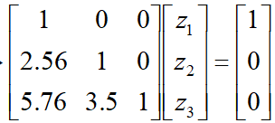
LU Factorization
Example: Inverse of a Matrix
Solving for the each column of [B] requires two steps
Solve [L] [Z] = [b] for [Z]
Solve [U] [X] = [Z] for [X]
Step 1:
This generates the equations:

Slide 13
LU Factorization
Solving for [Z]

Slide 14
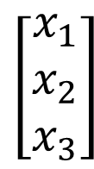
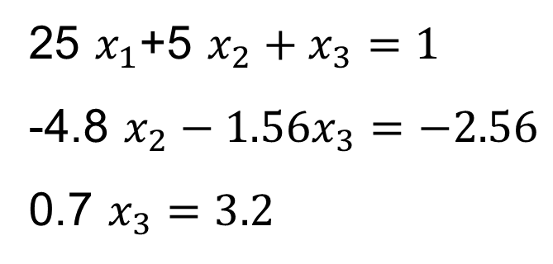
LU Factorization

Slide 15
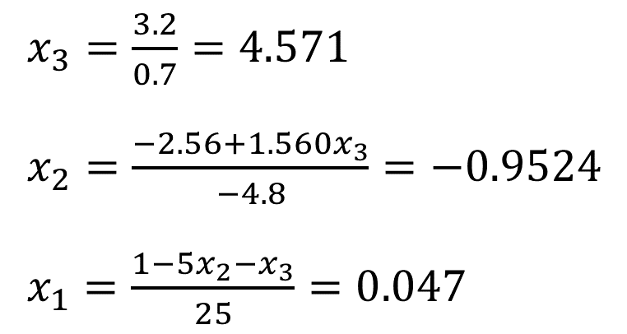
LU Factorization
Using Backward Substitution

Slide 16
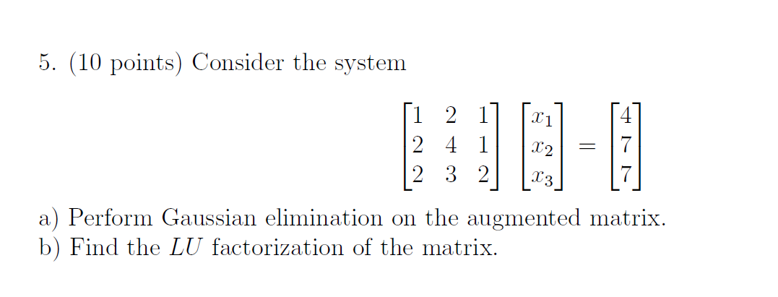
LU Factorization

Slide 17
LU Factorization
Finding the inverse of a square matrix
The inverse [B] of a square matrix [A] is defined as
[A][B] = [I] = [B][A]

Slide 18
LU Factorization
Finding the inverse of a square matrix
How can LU Decomposition be used to find the inverse?
Assume the first column of [B] to be [b₁₁ b₁₂ … b_{n1}]^{T}
Using this and the definition of matrix multiplication
First column of [B] Second column of [B]
The remaining columns in [B] can be found in the same manner

Slide 19
LU Factorization
Example: Inverse of a Matrix
Find the inverse of a square matrix [A]
Using the decomposition procedure, the [L] and [U] matrices are found to be

Slide 20
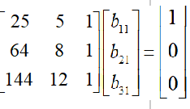
LU Factorization
First Column Second Column Third Column

Slide 21
LU Factorization
Solving for the each column of [B] requires two steps
Solve [L] [Z] = [b] for [Z]
Solve [U] [X] = [Z] for [X]
Step 1:
This generates the equations:

Slide 22
LU Factorization
Solving for [Z]

Slide 23
LU Factorization
Solving [U][X] = [Z] for [X]

Slide 24
LU Factorization
Using Backward Substitution
So the first column of the inverse of [A] is:

Slide 25
LU Factorization
Repeating for the second and third columns of the inverse
Second Column Third Column

Slide 26
Overviews
LU Factorization
Eigenvalue and Eigenvector
Norm

Slide 27
Linear algebra
1. The definitions of Eigenvalues and Eigenvectors;
2. Compute the Eigenvalues of a matrix ;
3. Compute the Eigenvectors for a given eigenvalue.

Slide 28
Linear algebra
Definition
Let A be an n × n matrix. A scalar λ is called an eigenvalue of A if there exists a nonzero vector x in R^{n} such that
Ax = λx.
The vector x is called an eigenvector corresponding to λ.

Slide 29
Computation of Eigenvalues
Let A be an n × n matrix with eigenvalue λ and corresponding eigenvector x. Thus Ax = λx.
This equation may be written
Ax – λx = 0
given
(A – λI_{n})x = 0
Solving the equation |A – λI_{n}| = 0 for λ leads to all the eigenvalues of A.
The equation |A – λI_{n}| = 0 is called the characteristic equation of A.
Solve the characteristic equation to get the eigenvalues!

Slide 30
Computation of Eigenvalues
Example 1
Let us first derive the characteristic polynomial of A.
We now solve the characteristic equation of A.
The eigenvalues of A are 2 and –1.

Slide 31

Computation of Eigenvalues
For λ = –1
We solve the equation (A + 1I₂)x = 0 for x.
The matrix (A + 1I₂) is obtained by adding 1 to the diagonal elements of A. We get
This leads to the system of equations
Thus x₁ = –2x₂. The solutions to this system of equations are x₁ = –2 and x₂ = 1. Thus the eigenvectors of A corresponding to λ = –1 are

Slide 32
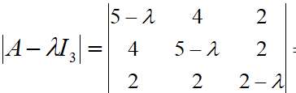
Computation of Eigenvalues
Example 2
The matrix A – λI₃ is obtained by subtracting λ from the diagonal elements of A.
The characteristic polynomial of A is |A – λI₃|.

Slide 33
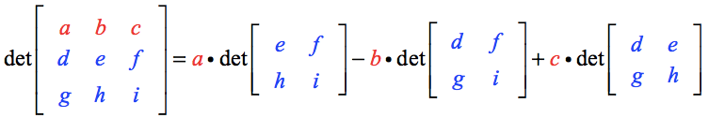
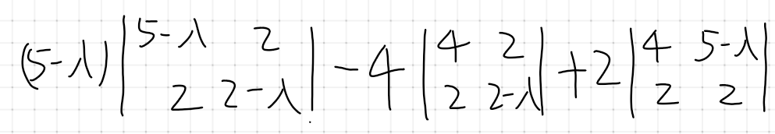
Computation of Eigenvalues
The Formula of the Determinant of 3×3 Matrix
See more details and examples on https://www.chilimath.com/lessons/advanced-algebra/determinant-3x3-matrix/

Slide 34
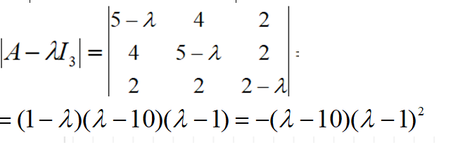
Computation of Eigenvalues
We now solving the characteristic equation of A:
The eigenvalues of A are 10 and 1.

Slide 35
Computation of Eigenvalues
A practice example

Slide 36
Computation of Eigenvalues
A practice example
The characteristic equation is
There is a single eigenvalue, λ = 2.

Slide 37
Overviews
LU Factorization
Eigenvalue and Eigenvector
Norm Condition number

Slide 38
Norm
How can we do the error estimation？

Slide 39
Norm
Vector Norms
The p-norm of a vector X is:
Important examples of vector p-norms include:

Slide 40
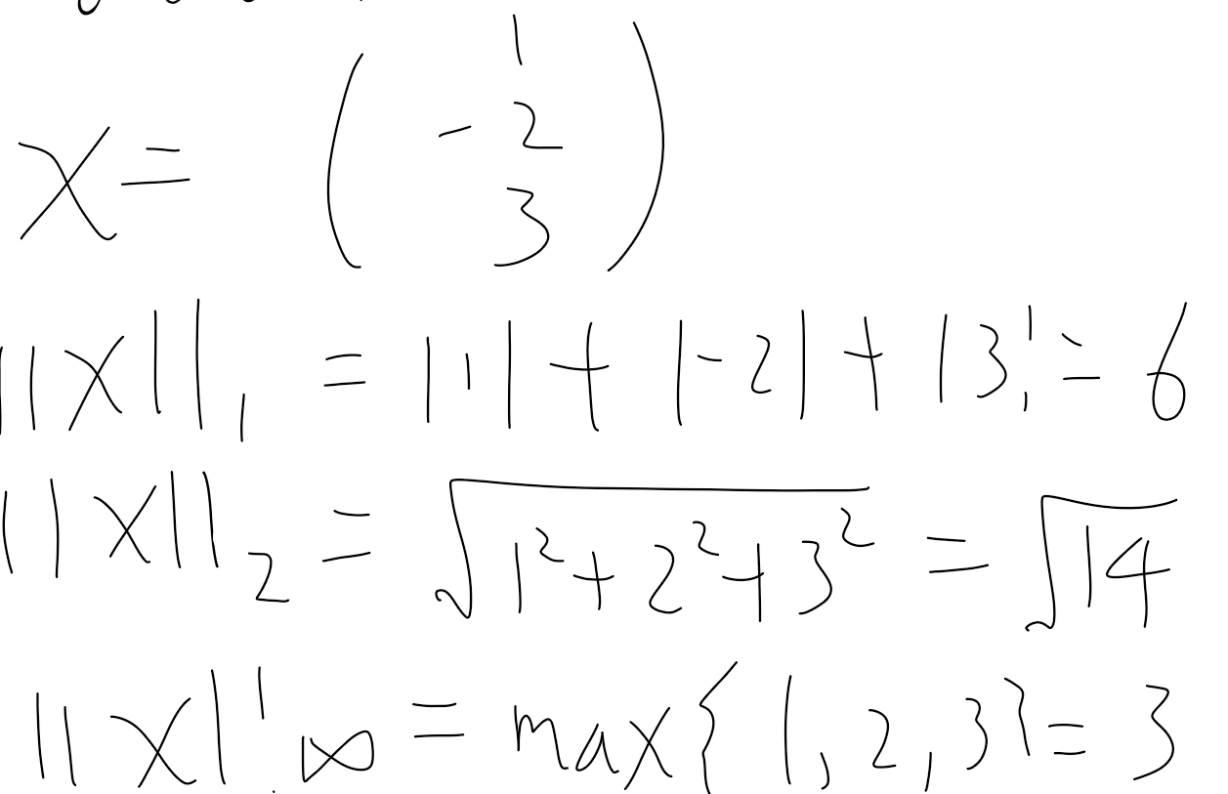
Norm

Slide 41
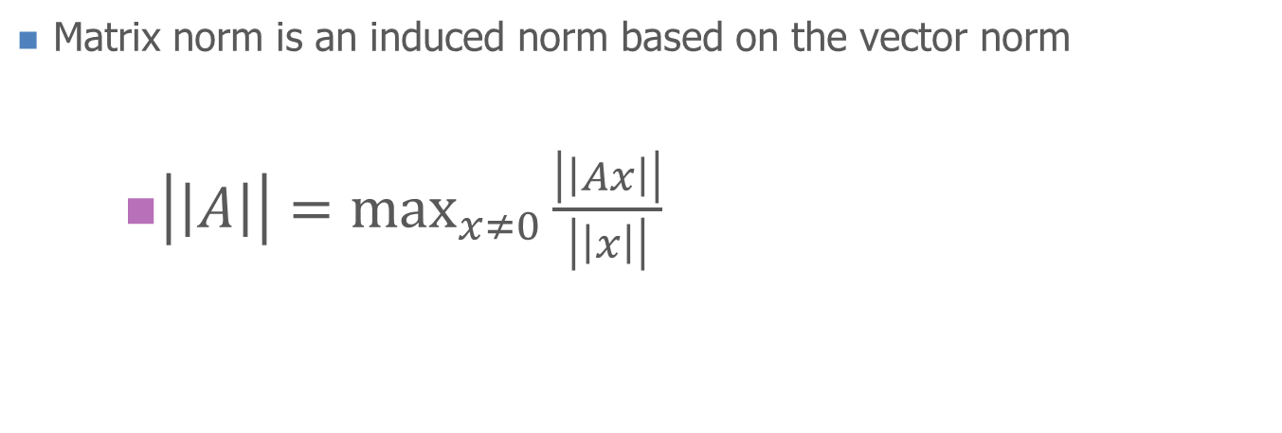
Norm
Matrix Norms

Slide 42
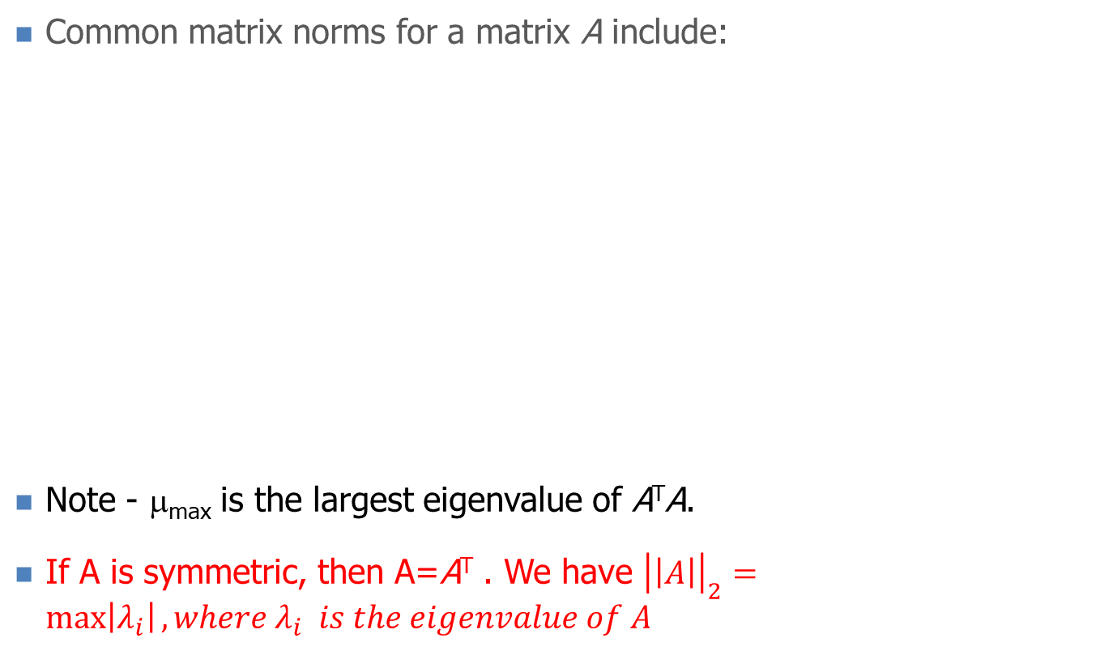

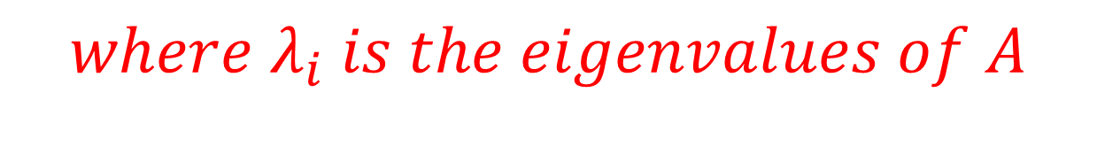
Norm

Slide 43
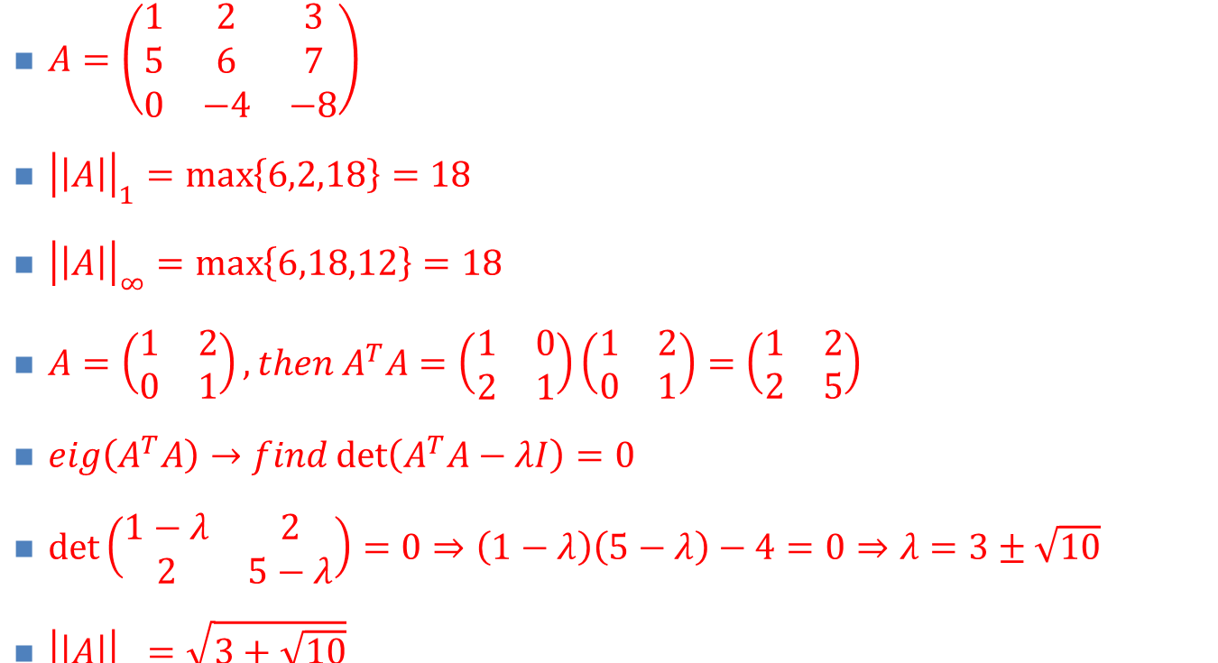
Norm
Matrix Norms: examples

Slide 44
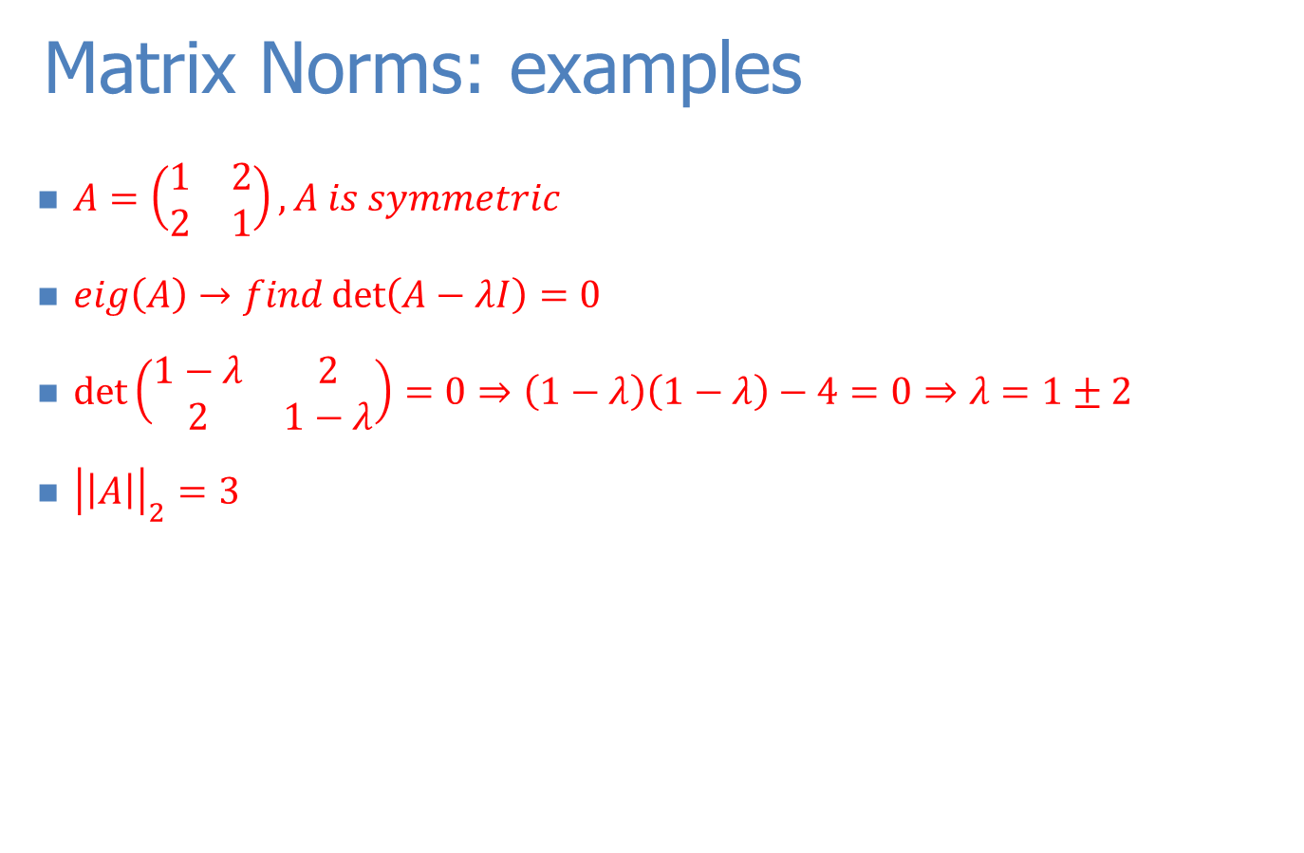
Norm

