Slide 1



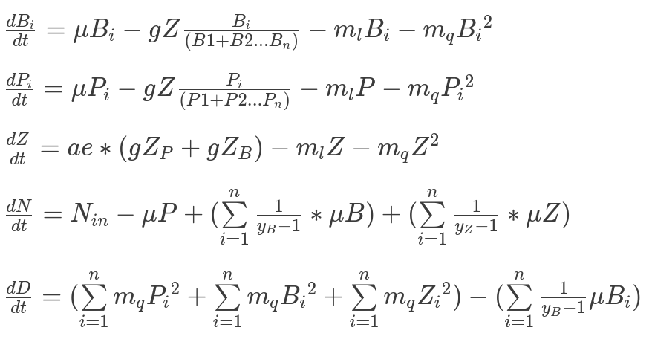
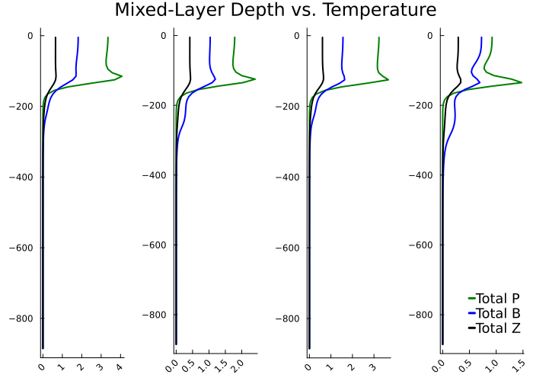
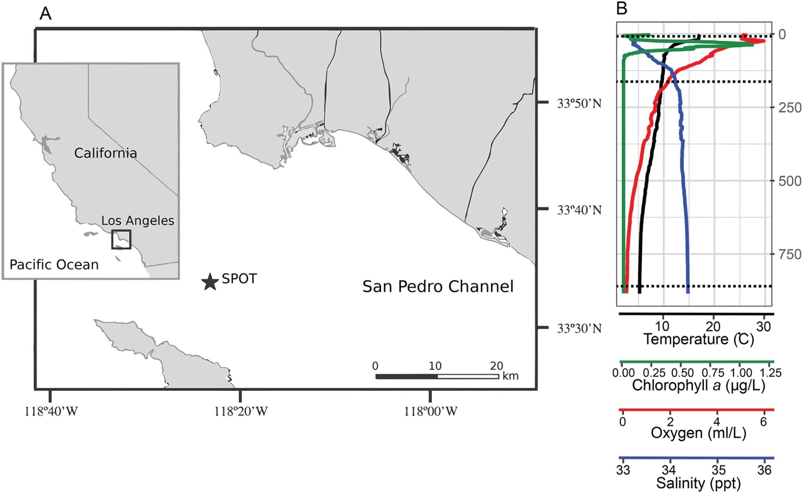
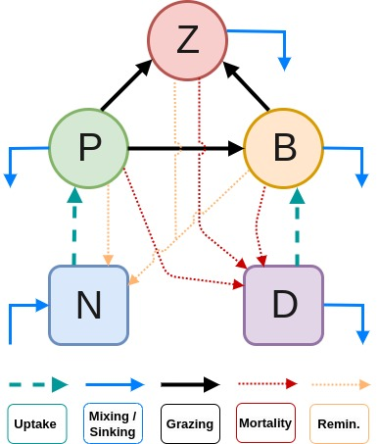
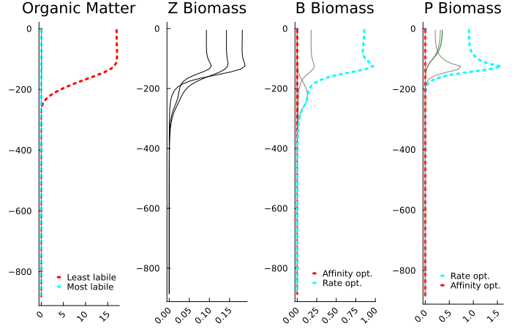
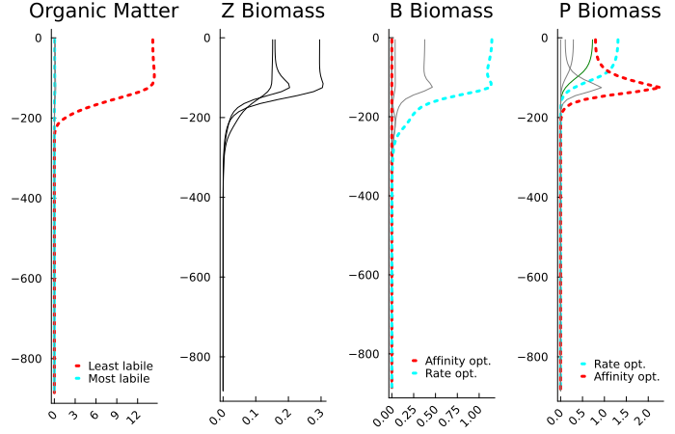
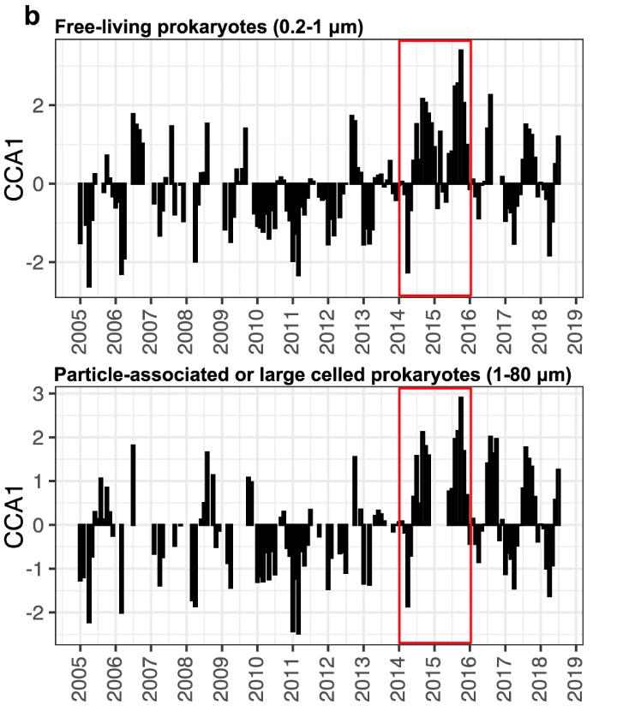
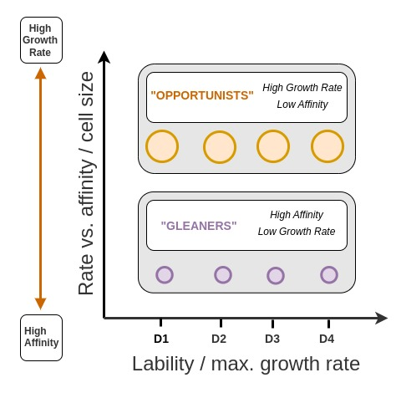
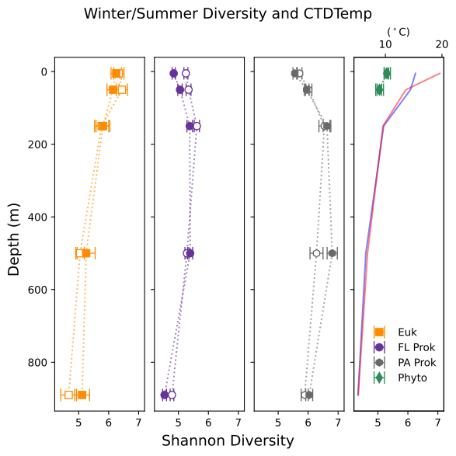
Capturing Complexity: Can we improve how we represent marine microbes in climate models?
Lee Bardon
Emily Zakem
Univ. of Southern California
Carnegie Science
Motivation
2. Construct mechanistic ecosystem model
3. Determine key mechanisms controlling structure & dynamics over time & depth
Marine plankton communities play a critical role in Earth’s climate system. Their global biogeography interacts with the ocean’s inventory of nutrient elements, and its capacity to capture and sequester atmospheric CO2, as well as contributing over half of Earth’s atmospheric oxygen stock. Despite their significance, these diverse and dynamic ecosystems are influenced by a multitude of highly-coupled biotic and abiotic drivers and processes, representing a challenging source of uncertainty in climate models.
Development is ongoing on a trait-based microbial ecosystem model that resolves phytoplankton, heterotrophic bacteria, and zooplankton biomasses, as well as organic nitrogen concentrations. Following Zakem et al. (2020)^{3,} organic matter is remineralized back into its inorganic constituents due to the respiration of explicitly resolved microbial populations.
Can heterotrophic communities emerging in the model be linked to a low-chlorophyll, oligotrophic mode and a high-chlorophyll, productive mode?
Can this help us understand the year-round shift from cold-water to warm-water ecotypes during extended El Niño warming period of 2014-2016?
1. Analyze ocean time-series data
Seasonal temp profiles obtained from SPOT data, and a modification to metabolic rates applied within model.
Light-limitation of phytoplankton growth modeled with attenuation of light through the upper ocean.
The 1D water column has a resolution of 10m. Tracers are diffused according to vertical diffusion coefficient that attenuates with depth to simulate simple mixed layer.
Particulate organic matter sinks according to prescribed vertical velocity. Total N conserved over the domain.
Given the multiscaled spatiotemporal variability inherent to microbial dynamics and environmental fluxes, long-term marine time-series data have become fundamental to furthering our understanding of structures, functions and dynamics in marine microbial ecosystems¹. Thus, we begin our investigation with the analysis of a long-term, ongoing ocean time-series.
MLD vs. Temp.
Total Biomass = 88.9
Total Biomass = 56.1
Total Biomass = 84.9
Total Biomass = 34.0
(Fig. 5) Summer is ~20°C and winter ~16°C at surface, with both converging at ~10°C between 150-200m depth.
Identical initial conditions of nutrient availability for all.
Depth of mixed layer has most significant impact on total biomass than temp. variability.
In the more realistic regimes, (higher temp > greater stratification) productivity much higher in winter.
Depth (m)
Summer
MLD = 30m
Summer
MLD = 15m
Winter
MLD = 30m
Winter
MLD = 15m
The San Pedro Ocean Time-series (SPOT)
Physicochemical environmental measurements since 1998, biological samples for sequencing since 2000.
Measurements taken along the water column, and samples are extracted at 5m, DCM, 150m, 500m and 890m (sea floor).
Periodicity ranges from monthly to daily (the latter during times of rapid change, e.g. spring blooms).
Conc. (mmol / m³)
NPZBD Model
Fig. 5. Testing the relative influence of temperature-linked modification to metabolic rate vs. mixed-layer depth on total biomass. All other parameters held constant. Fig. plotted at end of 30 year run using 1N, 6P, 3Z, 10B, 4D.
(Fig. 3) Grazing and consumption matrices are constructed via quasi-random assignment, whereby each resource is assigned a minimum of one consumer.
Zooplankton (Z) receive inputs from grazing on phytoplankton (P) and microheterotrophs (B, bacteria).
B receives inputs from detritus pools (D) while phytoplankton (P) compete for the inorganic nutrient pool (N).
Microbes sustain losses via mortality (to D, detritus) and respiration (remineralized to N, inorganic nutrients).
Metabolic Strategy
(Fig. 6) Fate of “opportunists” (high growth/low affinity) and “grazers” (low growth/high affinity) is examined.
“Summer” regime > higher surface temps (thus metabolic rates) with more stratified water column.
“Winter” regime > lower surface temps, less stratification, more mixing.
D’s of all lability are distributed equally, so rate-optimized B’s consuming labile substrates dominate in both regimes.
P’s compete for single resource of equal lability - yet more complex dynamics (further analysis of grazing required).
Fig. 1. (A) Location of SPOT station, off the coast of California. (B) Example of vertical profile of temp., chlorophyll-a fluorescence, oxygen, salinity.
Hu et al. (2018)
Depth (m)
Summer
MLD = 15m
Summer
MLD = 15m
Summer
MLD = 15m
SPOT has already generated a wealth of valuable insights, but many causal mechanisms remain unclear.
E.g. Yeh & Fuhrman (2022) noted year-round shift from cold to warm-water ecotypes during 2014-2016 El Niño.
(Fig. 2) Higher (positive) numbers reflect summer-like (warm, lower chlorophyll) communities, and vice versa.
What are the primary drivers?
Fig. 3. Schematic diagram of NPZBD microbial ecosystem model demonstrating relationship between state variables.
Depth (m)
Winter
MLD = 30m
Winter
MLD = 30m
Winter
MLD = 30m
Microbial Diversity
Conc. (mmol / m³)
(Fig. 4) Functionality distinguished across two axes: lability of organic matter consumption & trade-off between optimization for growth rate or affinity.
Phytoplankton draw from a single pool of inorganic matter; populations trade-off between intrinsic maximum growth rate & substrate affinity.
Organic matter produced from mortalities & excretions of microbes, partitioned into multiple lability classes.
Microbes grow and respire organic matter, mechanistically and dynamically resolving remineralization in the model.
Fig. 6. Tracking the performance of rate-optimized “opportunists” and affinity-optimized “grazers”. Each population plotted individually, and plot generated at end of 30 year run using 1N, 6P, 3Z, 10B, 4D.
Next Steps
Uncertain whether equilibrium concentrations reached at 30 years - extend to 100 years.
Model generates diversity – quantify, compare to SPOT (Fig. 7), analyse model components using ecological theories for coexistence.
Scale up, use SPOT data to constrain growth rates (metagenomics) & ratio of P/B/Z in model.
Introduce nutrient pulses with frequencies that approx. correspond to seasonal trends.
Fig. 2. Plot based on temporal variation of the first canonical correspondence analysis (CCA) scores; measures of the incidence of particular community components. Yeh & Fuhrman (2022)
References
Zakem et al., (2022), “A unified theory for organic matter accumulation”, PNAS, vol. 118, no. 6, p. e2016896118
Yeh & Fuhrman, (2022), “Effects of phytoplankton, viral communities, and warming on free-living and particle-associated marine prokaryotic community structure”, Nature, vol. 13, no. 1, p. 7905
Hu et al., (2018), “Shifting metabolic priorities among key protistan taxa within and below the euphotic zone”, Environ. Microbio. vol. 20, no. 8, pp. 2865–2879
Fig. 4. Schematic diagram of trait-based microheterotroph diversity model. Metabolic trade-off between optimization for growth rate or affinity (substrate uptake kinetics) corresponds to differences in cell size
Fig. 7. Shannon Diversity Index for the four described groups: Eukaryotes, free-living prok., particle-associated prok., phytoplankton.
Notes:
Citations
equations

