Slide 1

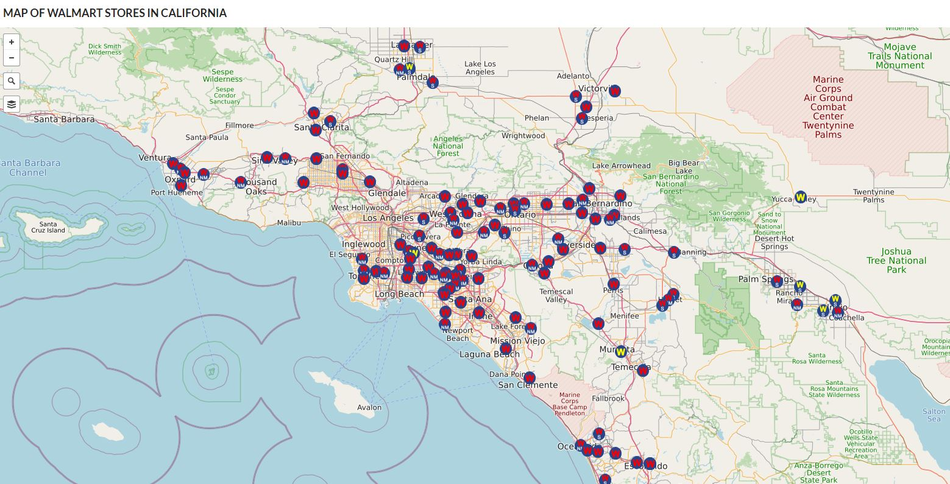
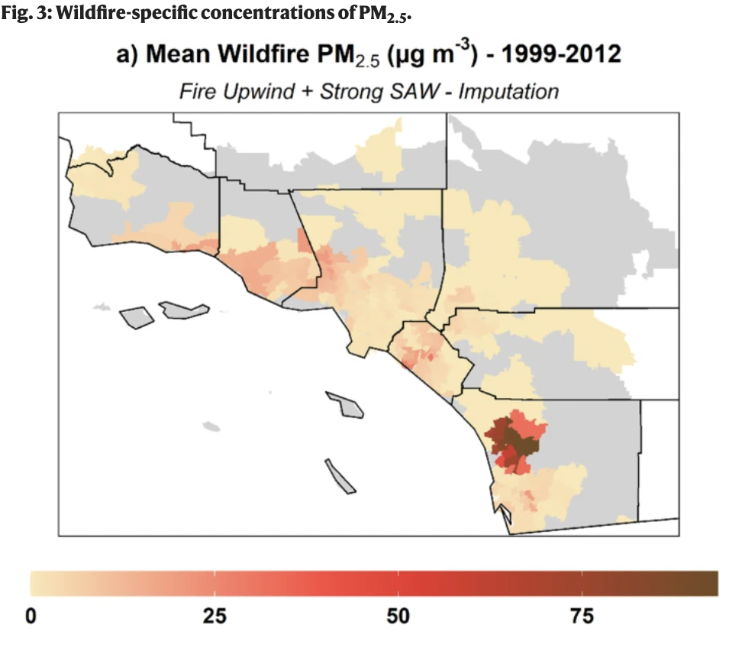
Wildfire Forecast Model in California
Insert Corporate Partner Logo Here
Anshima Mishra, Shreya Jariwala, Brandon Lee, Kaitlyn Meador
Introduction
Current Progress/Future Goals
Acknowledgements
The ultimate goal for this project is to create an alert system for Walmart if the PM 2.5 level increases over a specific threshold due to a forest fire and to prevent false alarms.
The business objective for this forecasting model is to prevent losses to Walmart during wildfires, increase revenue, and to alert customers and suppliers regarding blocked routes to and away from Walmart.
Our project scope focuses on wildfire prone areas such as California and we try to narrow the scope to the top 5 counties within California.
The existing limitations might be that we cannot predict wildfires at every specific Walmart location, no live data is provided, and the data needs to be streamlined as much as possible.
We plan to work towards finding a consolidated set of data and using past wildfire data and inputs, accessing the damaged areas, and inputting them into the algorithm of a current fire, to test the accuracy of our model.
For our future, we plan to collect all data and start interpolating data and to implement our data to a statistical model to create a model for wildfire prediction via R and/or Python.
We wholeheartedly thank Walmart for their support for our project, especially our mentors, Faith Newton, Suyu Hou, and Sneha Kawle.
We also thank The Data Mine and the accompanying staff, specifically, Dr. Mark Ward, Jain Aashi Ajitkumar, and Chopra Darsh.
Data collection
We plan to utilize public data such as data from government websites, air quality websites, and existing public research data.
We plan on interpolating the PM2.5 and forest fire data on to the map to view the correlations and establish the need to integrate the data further into the model. This should look like Figure 2.
The data variables we aim to utilize in our model is provided in Figure 3.
For the data collected, we would use a statistical model formula to create constraints for our model, Figure 4.
Figure 4. Statistical Model
Figure 2. Mean Wildfire PM 2.5 in California
Figure 3 Variables for model
Figure 1. Map of Walmart in California
The Data Mine Corporate Partners Symposium 2023

