Slide 1
Building a ReSTful Web Service w/NodeJS and MongoDB
Lee Brandt
Developer Advocate

Slide 2
FRIENDS DON’T LET FRIENDS WRITE AUTHENTICATION

Slide 3

Who IS This Dude?
Programmer
Teacher
Keeper of Keys
TV Star
Super Serious
Very Professional

Slide 4

(Leonard) Richardson Maturity Model
00 - Swamp of POX
01 - Resources
02 - HTTP Verbs
03 - Hypermedia

Slide 5

POX

Slide 6
Resources

Slide 7
HTTP Verbs
HTTP VOY
HTTP VAS
HTTP VA
HTTP VAMOS
HTTP VAN

Slide 8

HATEOAS

Slide 9


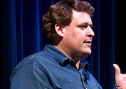

Slide 10
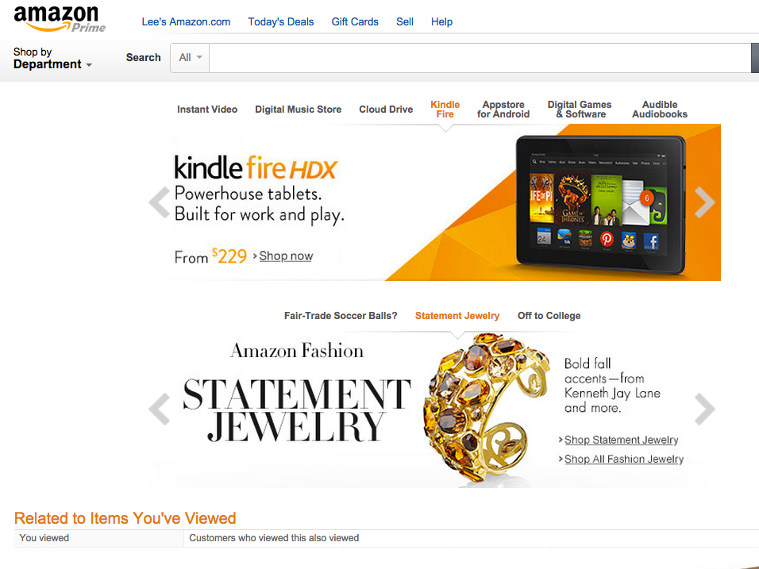

Slide 11
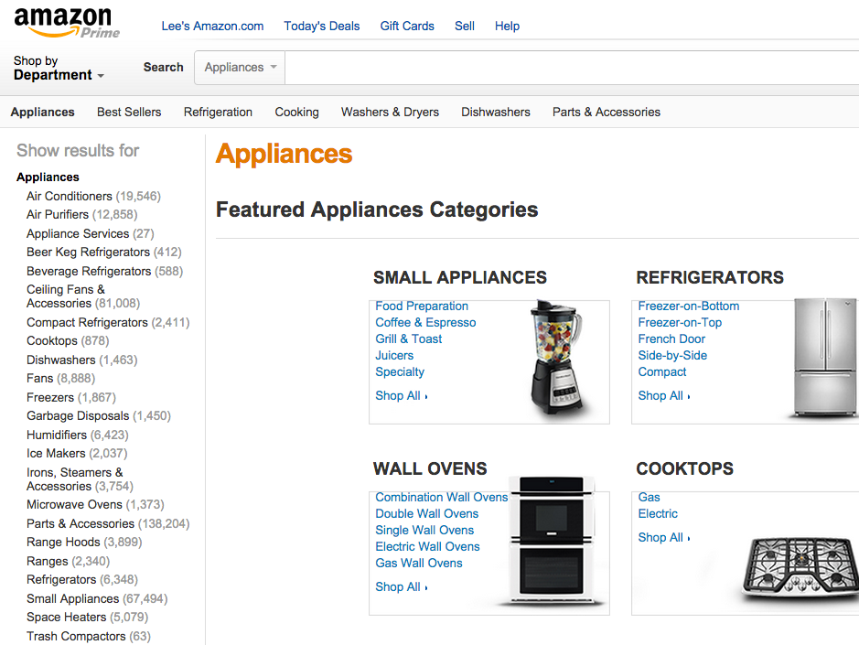

Slide 12
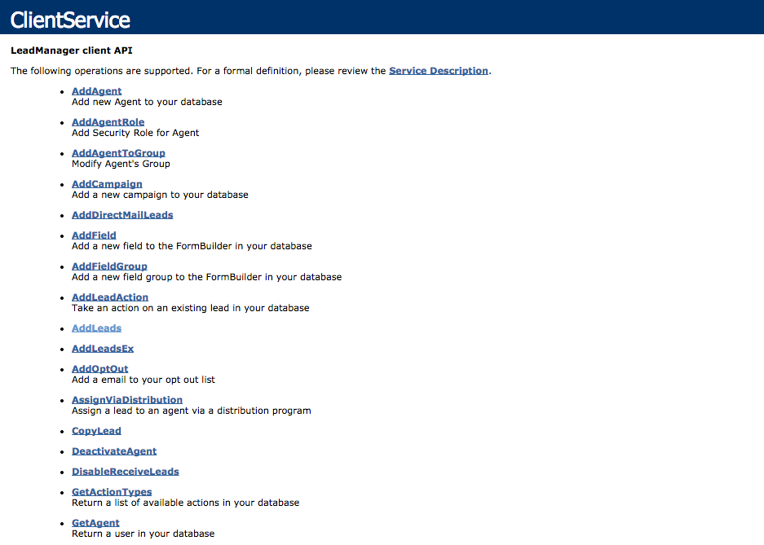

Slide 13
{
apiName: "Conference API",
apiVersion: "1.0",
links: [{
rel: “Sessions”,
href: “http://api.somewhere.com/sessions”
},
{
rel: “Speakers”,
href: "http://api.somewhere.com/speakers"
},
{
rel: “Sponsors”,
href: "http://api.somewhere.com/sponsors"
}]
}

Slide 14
[{
firstName: "Jim",
lastName: "Beam",
location: “Inside us all”,
links: [{
rel: “self”,
href: “http://api2.somewhere.com/speakers/42”
},{
rel: “parent”,
href: “http://api2.somewhere.com/speakers”
}]
sessions: [{
sessionName: "Whisky Deployments”
links: [{
rel: “self”,
href: “http://api2.somewhere.com/sessions/42”
}]
}]
}{
… other speakers …
}]

Slide 15
Nice Slide Show Fat Boy, Get To the DEMO!!

Slide 16

Violating ReST?!?

Slide 17


