Slide 1
DOCKER
A Developer’s Guide to

Slide 2
OKTA
FRIENDS DON’T LET FRIENDS WRITE AUTH

Slide 3
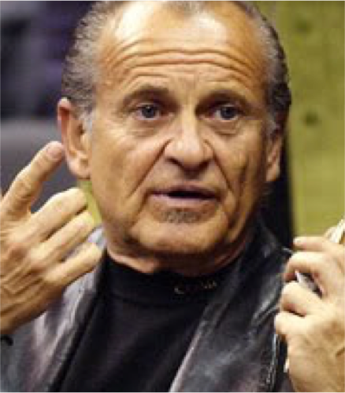
WHO IS THIS FREAKIN’ GUY?
Programmer of things
Vodkatarian
Eater Of Villagers
Keeper of Keys and Grounds
Star of Finding Bigfoot
Very Serious
Very Professional

Slide 4

IN THE
BEGINNING
Notes:
◦ Hardware servers
▪ Massive process for getting resources
▪ Buy hardware,
▪ Install in rack,
▪ Setup OS,
▪ Setup software needed to run app
▪ Barely utilizing server
▪ Server with one .NET app at 10% utilization
▪ Massive overspending

Slide 5

THE VM
ENTER…
Notes:
◦ VMs
▪ Easy to procure a server
▪ Hardware server utilization went up
▪ Isolated User space
▪ Still need to buy/install OS on each VM
▪ Still need to update/patch each VM
▪ Dedicating physical resources at setup/design time
▪ Even if the app that’s going to run on it only uses 100Mb of RAM, the OS needs 4G of RAM

Slide 6
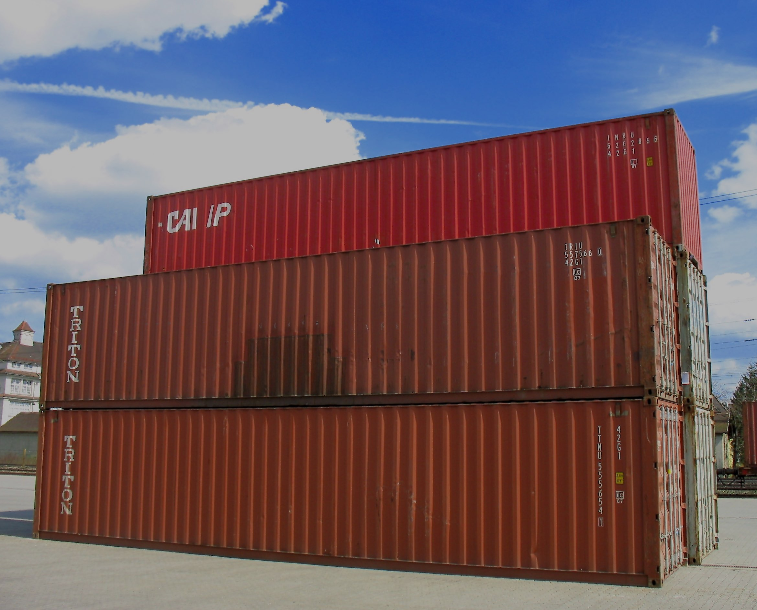

SO… WHAT ARE
CONTAINERS?
Notes:
• Containers
◦ Share host resources (like an app)
◦ Application runtime environment
◦ WAY more lightweight than VMs
▪ Consumes less resources than VM (CPU, RAM, HDD)
◦ Still isolated user space for each app

Slide 7



Why Containers?
VMs
vs
Containers
App
App
App
Software
Software
Software
OS
OS
OS
App
App
App
VM
VM
VM
CNT
CNT
CNT
Host OS
Host OS

Slide 8

WHAT THE HECK IS
DOCKER?
Notes:
• Why Docker?
◦ Came from dotCloud
▪ it was their internal system for their PAAS
◦ Written in GoLang
◦ Open Source
◦ VERY popular container system
◦ Working VERY closely with MS to get Windows and .NET working seamlessly
◦ Standard runtime
▪ Windows, linux, AWS, Azure, etc
▪ Toolbox is almost exactly the same regardless of host
◦ Uses isolated cgroups
▪ easy to control resource access
▪ easy to expand contract resource access
▪ keeps DOS attack on one container from crashing all containers on that server

Slide 9
C’MON FAT GUY, SHOW US THE
DEMO

Slide 10

BUT WHAT ABOUT
.NET?
Notes:
Support for .NET 4.x (classic?) is a little janky
And only for Windows
Built in to VS 2015 update 3
Support for .NET Core is A LOT better!
Works easy on Windows and macOS
Versioning
Selling point for .NET Core
Definitely the way to go

Slide 11
https://developer.okta.com
lee.brandt@okta.com
@leebrandt

