Slide 1
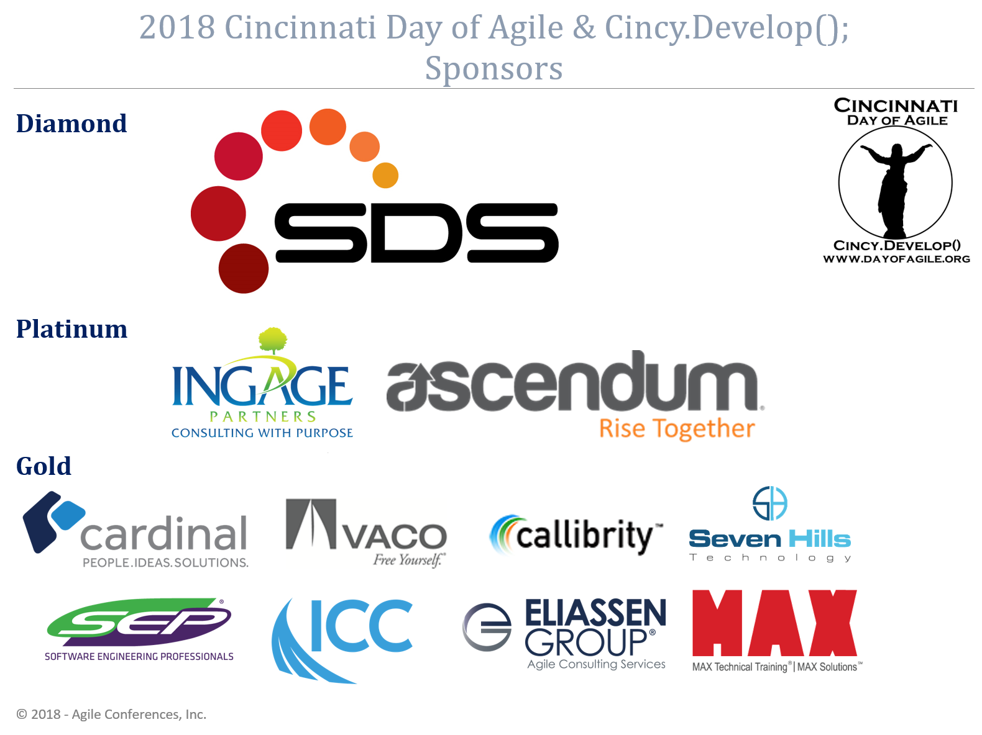

Slide 2
Real Agile
for real software

Slide 3
Okta
Friends don’t let friends write auth

Slide 4
What this talk is
Stories from real agile transitions
Common mistakes
Interactive
A little silly

Slide 5
What this talk ISN’T
A sales pitch
Details about agile
Me talking, you listening
Boring

Slide 6
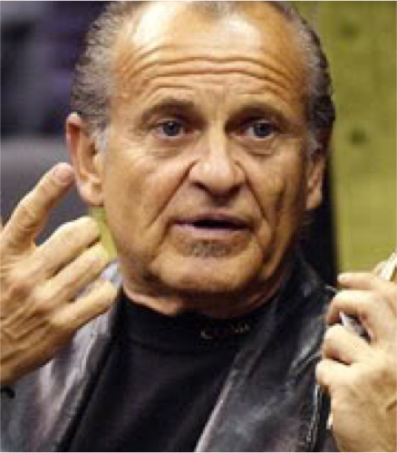
Who is this freakin’ guy?
Programmer of things
Teacher of Stuff
Vodkatarian
Keeper of Grounds at Hogwart’s
Star of Finding Bigfoot
Very Serious
Very Professional

Slide 7
Good agile, Bad Agile
Notes:
What IS agile? and what is Agile?
Agile is a brand
has mostly lost its meaning
describes any number of Scrums, Kanbans or XPs
strikes fear into the hearts of BAs (Tom Smykowski) and PMs
agile is an adjective
means nimble or spritely
better description of what we're trying to do
means we’ll be better adept at responding to changes/mistakes
strikes fear into CFOs and the hearts of the lazy

Slide 8
Tools can help you to become more agile.
(But they don’t make you agile)
Notes:
Tools for becoming agile
eXtreme Programming
Scrum - Scrumbut - Scrumban
Kanban - Lean

Slide 9
Common Missteps

Slide 10
“Agile just won’t work here.”
Notes:
Summarily dismissing agile software development.
Comes from a misunderstanding of Agile/agile usually.
Followed by TDD, Pair-programming, etc. won’t work here
What would have to happen in order for it to work here?

Slide 11
“I’m on the QA team.”
Notes:
No. You are on the team that is building this software.
Stop thinking about your company in functional silos.
Contractor model is not a bad idea.
You can still have those departments, but contract them out to each team.

Slide 12
“That’s what the process says to do.”
Notes:
You are not your process.
Your process exists to serve the organization. Not the other way around.
Your process should be set to improve software delivery, not for the sake of the process.
Understand you were not hired to follow a process. You were hired to make software.

Slide 13
Me: “Things are always changing.” Retort: “Yeah, that’s the problem with Agile.”
Notes:
Agile didn't _cause_ the change.
Business must inherently handle change.
Agile is all about how you respond to change.
The process should make change easier, more fluid
When change is painful, you can choose to ignore change, or make change easier.
What's more important: giving the business what they asked for? Or giving them what they need?
If something is painful, do it more often.

Slide 14
“My team isn’t meeting their commitments, I don’t know what to do.”
Notes:
Commit to less.
Success begets success.
Make sure you start with a commitment your team can achieve.
It's easy to pull in more stories if you finish early and it builds confident, successful teams.
If your team isn't meeting it's commitments, either you're over committing or your team is lazy and not getting their work done.
If you assume they are lazy, you:
put websense in place to keep them from Facebook, etc.
Keep a tighter leash on them to make them do their work.
(Scientific Mgmt) It creates a subjugated relationship (parent/child).
If you act like the parent, your team will act like children.
Sociology 101, people fill the roles they think others expect them to fill.
If you are authoritarian, you will create "subjects" that don't think for themselves.
They ask every time. They run EVERYTHING past you.
If you assume they are over committed, you:
Back their commitments off a little to the point that they can achieve their commitments.
Maybe even pull in some extra stories.
They feel confident. They feel good. You stay out of their way.
They become empowered to charge ahead, to make improvements, to think for themselves (and make mistakes).
This is a recipe for innovation.
Which team would you rather work on/with?

Slide 15
“But Agile, say we don’t do x.”
Notes:
Being agile doesn’t mean we stop doing _anything_ except things we don’t have to do.
For the most part, even Agile doesn’t specify that you don’t do something.
The Agile Manifesto only proclaims that some things are more valuable than others.

Slide 16
Individuals and interactions over processes and tools
Working software over comprehensive documentation
Customer collaboration over contract negotiation
Responding to change over following a plan

Slide 17
That is, while there is value in the items on the right, we value the items on the left more.

Slide 18
“We tried Agile once, it was a mess.”
Notes:
Don’t make it sound like _spinach_!
It’s not about Agile, it’s about being agile.
Chances are the mess is already there, and your new process just made it visible.
Agile tools are SUPPOSED to help you find problems, so you can address them.

Slide 19
“What about planning?”
Notes:
If we make a plan, and something (requirements, assumptions, etc.) changes, what happens to the plan?
Why spend a lot of time developing a plan?
When reality starts diverging from the plan:
Developers want to adjust the plan to fit reality.
Project Managers want to adjust reality to fit the plan.
Managers/C-Levels want to fire someone. (which is probably why PMs want to adjust reality)

Slide 20
Communication
Notes:
Most of the Agile tools out there, are meant to increase communication:
Stand-Ups
Retrospectives
Pair-Programming
Task Boards
Team Co-Location
etc..

Slide 21
Some Good Reads
Extreme Programming Explained: Embrace Change - Kent Beck
Agile Software Development With Scrum - Ken Schwaber & Mike Beedle
Kanban: Successful Evolutionary Change for Your Technology Business - David J. Anderson
Managing the Design Factory - Donald Reinertsen
Lessons in Agile Management: On the Road to Kanban - David J. Anderson

Slide 22

Closing Words
Silver Bullet
Start With What You Do Now
Question Everything
Improve
:||

Slide 23













Thanks For Coming!
For more information about me or Okta, go to:
https://developer.okta.com

