Slide 1
STRATEGIC CYBER-DEFENCE: Analysis of Modern Cyber-Warfare Tactics and National Security Protections
Submitted in the partial fulfillment for the award of the degree of
BACHELOR OF ENGINEERING
IN
COMPUTER SCIENCE WITH SPECIALIZATION IN
ARTIFICIAL INTELLIGENCE AND MACHINE LEARNING
Submitted by:
NAME OF THE STUDENT: Brian Edwin Kihore
UNIVERSITY ROLL NUMBER: 22BIS70024
Under the Supervision of:
SUPERVISORS NAME: Shakshi Kattna
DISCOVER . LEARN . EMPOWER
Department of AIT-CSE

Slide 2
The Problem: The Digital Batlefield is changing
Reactive Defence is Failing Against Strategic Cyber-Warfare.
A critical misalignment exists between dynamic, state-sponsored cyber campaigns and static, compliance-based national defences.
Attacks like SolarWinds and MOVEit are not just IT issues; they are tools of espionage, coercion, and disruption.
Current models are siloed. We lack an integrated framework that connects technical defence to national security outcomes.
A simple graphic showing a shield (Traditional defence) failing to stop multiple, diverse attack vectors (e.g, Phishing, Supply chain, Ransomware)

Slide 3
Abstract
Modern cyber warfare has expanded geopolitical conflict into cyberspace.
State and non-state actors use advanced tactics including APTs, AI-enabled attacks, and supply-chain compromises.
Study analyses 2,847 cyber incidents (2015–2024). Introduces Multi-Layered Strategic Defence Model (MLSDM).
Intelligence-based defense improves threat mitigation 47–63× faster than reactive models.

Slide 4
Introduction
Digital transformation increases vulnerability of national critical infrastructure.
CISA: 285% rise in cyber-attacks on critical infrastructure (2015–2023).
Notable incidents:
  SolarWinds (2020) – systemic supply-chain breach
  Colonial Pipeline (2021) – ransomware affecting national logistics
Research Aims:
  Classify modern cyber warfare tactics
  Examine national defense effectiveness
  Identify legal/policy gaps
  Propose MLSDM
  Align cyber capabilities with national security strategy

Slide 5
Research Questions
What Do We Need to Know?
This research is guided by four key questions:
RQ1: How can we categorize modern cyber-tactics by their strategic objectives, not just their technical mechanisms?
RQ2: Where do current national cybersecurity frameworks fail against adaptive threats?
RQ3: What are the biggest practical barriers to implementing better defences?
RQ4: What would an effective, integrated strategic defence framework look like, and does it work?

Slide 6
Literature Review
Cyber warfare conceptual foundations (Libicki, Rid).
Frameworks:
  MITRE ATT&CK (adversary behavior mapping)
  Cyber Kill Chain (intrusion lifecycle)
  International law: Tallinn Manual 2.0 – lacks enforcement authority.
Gap identified:
  Weak integration of technical defenses with national strategic goals.
  Insufficient empirical analysis of AI-based attacks and quantum era risks.

Slide 7
Our Multi-Method Approach
A Three-Phase, Evidence-Based Methodology.
Phase 1: Qualitative Deep Dive
Case Study Analysis: Deconstruct real-world attacks (MOVEit, Storm-0558) using MITRE ATT&CK framework.
Expert Delphi Study: Survey 25+ experts to identify and prioritize implementation barriers.
Phase 2: Quantitative Trend Analysis
Analyze public threat reports (2021-2024) to identify macro-trends.
Phase 3: Experimental Simulation
Agent-Based Model(ABM): Test the proposed framework against a traditional model in a simulated environment.

Slide 8
Research Methodology
Mixed-method approach combining:
Quantitative
  Analysis of 2,847 cyber incidents from OSINT databases.
  Supply-chain, APT, and infrastructure attack patterns.
Qualitative
  Six major case studies (SolarWinds, NotPetya, Colonial Pipeline, etc.)
  Comparative analysis of 12 countries’ cyber strategies.
Validation
  Expert reviews (12 experts)
  Triangulation
  Intercoder reliability (0.87 Cohen’s Kappa)

Slide 9
The Proposed Solution: An integrated Defence Architecture
From Silos to Synergy; A National Cyber Defence Network.
Introducing a hub-and-spoke model:
A National Cyber Intelligence Fusion Cell for Analysis and coordination.
Critical Infrastructure Sectors (Energy, Finance, Health) with bi-
directional, real-time threat sharing.
Core Principle: Collective intelligence enables proactive, coordinated defence.

Slide 10
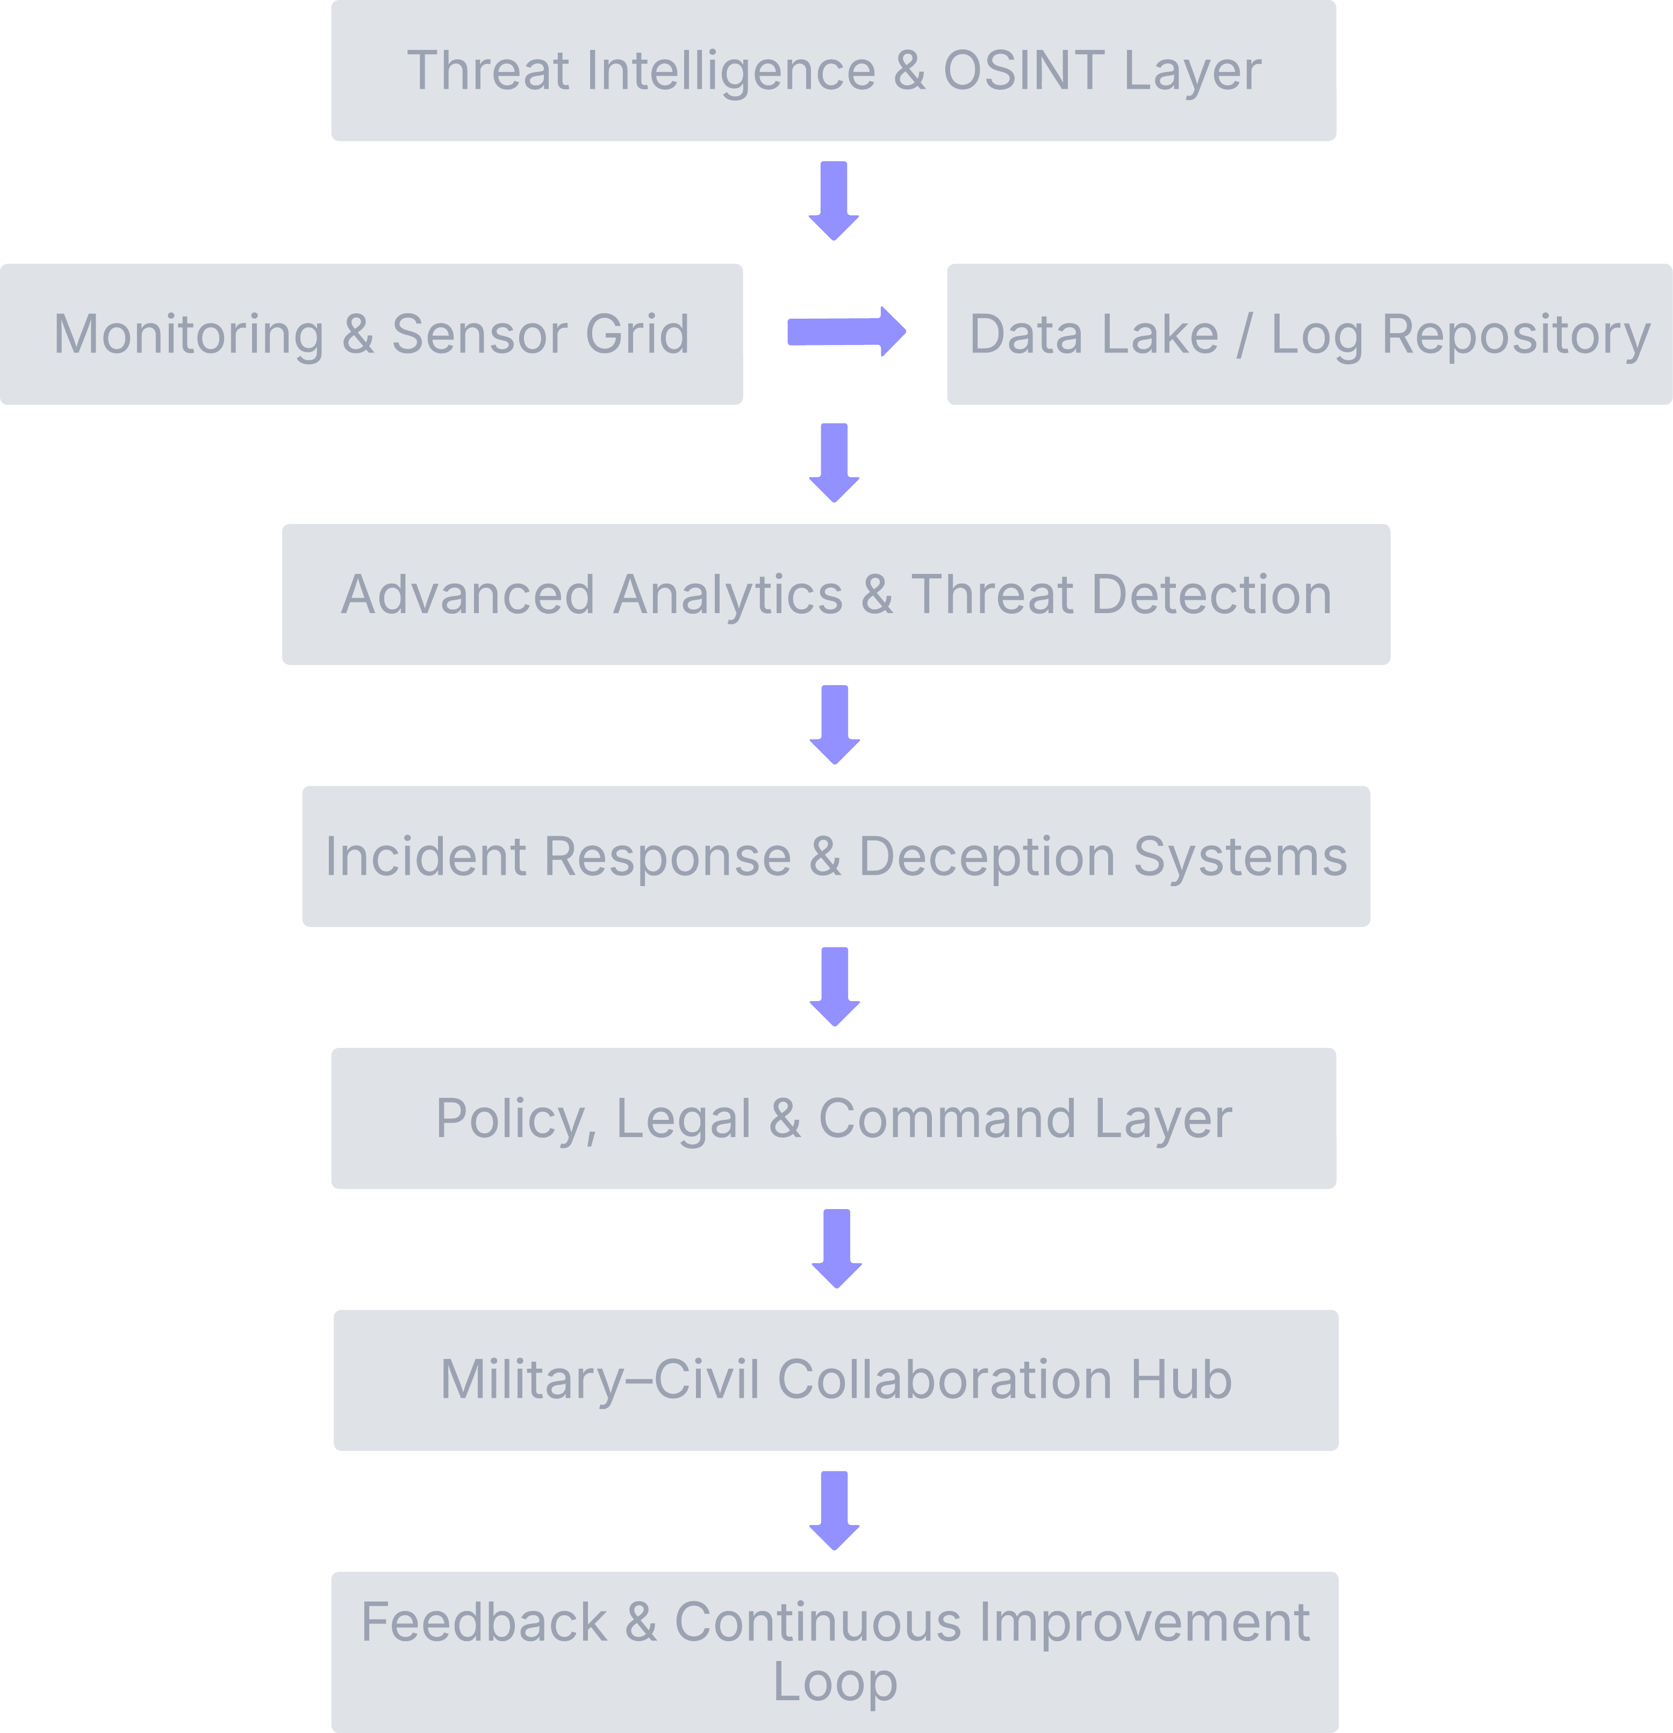
The Simulation Model
Validating the Framework with Computational Experimentation.
Tool: Agent-Based Model (ABM) built in Python.
What We Simulate: A simulated national network with two defence setups:
* Condition A (Baseline): Siloed, traditional defence.
* Condition B (Intervention): Our proposed integrated framework.
What We Measure:
* Mean Time to Detection (MTTD)
* Lateral Movement Speed
* Overall Impact Score

Slide 11
Modern Cyber Warfare Tactics
Main categories:
  Intelligence Gathering – espionage, supply-chain compromise.
  Infrastructure Sabotage – wipers, ICS/SCADA attacks.
  Influence Operations – deepfakes, misinformation.
  Economic Warfare – banking system attacks, ransomware.
  Logistics Disruption – GPS spoofing, transport disruptions.
Trends:
  Supply-chain attacks increased 340% since 2018.
  AI-enabled social engineering and automated exploitation.

Slide 12
Expected Results & Contribution
Building a Credible Case for Strategic Change.
Anticipated Findings:
* A clear taxonomy of tactics by strategic intent.
* A prioritized list of critical implementation barriers.
* Quantitative evidence from the ABM showing the integrated framework's superiority in reducing detection times and minimizing impact.
Key Contribution: This research provides an evidence-based blueprint for policymakers to transition from reactive compliance to proactive, resilient national cyber defence.

Slide 13
Case Study: NotPetya (2017)
Appeared as ransomware but was a destructive wiper.
Used compromised update mechanism (M.E.Doc).
Spread globally → $10 billion damages.
Key lessons:
  State-sponsored attacks blur lines between crime & warfare.
  Attribution challenges complicate response.
  Interconnected digital ecosystems amplify collateral damage.

Slide 14
National Cyber Strategies: Comparative Assessment
4 Strategic Models Identified:
Whole-Nation Approach (US, UK, Israel)
  Strengths: innovation, resources
  Weakness: bureaucracy, coordination issues
Sovereign Internet Model (China, Russia)
  Strengths: fast directives
  Weakness: limited global cooperation
Collective Defence Model (NATO, EU)
  Strengths: mutual support, intelligence sharing
  Weakness: slow joint decisions
Neutrality-Based Model (Sweden, Switzerland)
  Strengths: conflict avoidance, strong norms
  Weakness: weak offensive/deterrence posture

Slide 15
Identified Capability Gaps
Attribution Lag: avg. 187 days to attribute state-sponsored attacks.
Public–Private Gaps: only 1/3 of critical infrastructure receives actionable threat intel.
Cyber Workforce Shortage: 3.4 million professionals needed globally.
Weak Software Supply Chain Defenses (highlighted by SolarWinds).
Fragmented legal norms controlling state cyber behavior.

Slide 16
Multi-Layered Strategic Defence Model (MLSDM)
Layer 1: Strategic Governance
  Dynamic policy framework
  Cyber diplomacy & norms-building
  Adaptive authorization processes
Layer 2: Operational Intelligence
  National Cyber Intelligence Fusion Center (NCIFC)
  Predictive analytics, AI-driven threat modeling
  Automated indicator sharing (STIX/TAXII)
Layer 3: Tactical Defense
  Zero-trust infrastructures
  Resilience-by-design architecture
  Active defense (deception, counterintelligence)

Slide 17
Major Challenges
Attribution ambiguity and geopolitical complexity
Increasing sophistication of AI-driven cyberattacks
Quantum computing threatening encryption standards
Fragmented international cyber norms
Overdependence on private sector infrastructure
Skilled workforce shortage

Slide 18
MLSDM Implementation Roadmap
Phase 1 (Months 1–12): Foundations
Create governance structures
Build sharing protocols
Establish 5 sector analysis cells
Phase 2 (Months 13–24): Capability Development
Deploy zero-trust architectures
Map cross-sector dependencies
Phase 3 (Months 25–36): Full Operationalization
70% faster threat mitigation
90% of national infrastructure meeting resilience standards

Slide 19
Aligning Cyber Capabilities with National Security
Nations with alignment achieve 47% better incident response.
Alignment Principles:
  Threat-informed investment
  Integrated deterrence posture
  Cross-domain planning (cyber + military + diplomatic)
  Private sector integration (critical infrastructure operators)
Example: Israel
  Centralized cyber authority
  Mandatory compliance audits
  Civil–military ecosystem

Slide 20
Key KPIs for National Cyber Alignment
Strategic Responsiveness: Implementation in <6 months
Threat Adaptation: Defensive updates in <72 hours
Resilience Impact: Downtime <4 hours
Deterrence Effectiveness:
  50% reduction in successful attacks
  3× increase in adversary campaign cost

Slide 21
Implemented Solutions and Mitigations
Solution to Challenge 1: Abstracted yet Representative Modeling
Action: Adopted a "keep it simple but significant" principle for the ABM. The model simulates a representative sample of a national network (e.g., 500 nodes) rather than a 1:1 scale.
Solution to Challenge 2: Anonymity and Structured Elicitation
Action: Implemented a modified Delphi method with guaranteed anonymity across all rounds. Used structured rating scales (Likert) after an initial open-ended round to quantify subjective opinions.
Solution to Challenge 3: A Priori Framework Integration
Action: Designed the research workflow so that outputs from one phase became direct inputs for the next. For example, the TTPs from the case studies (Phase 1) were hardcoded into the Attacker Agent in the ABM (Phase 3).

Slide 22
Future Prospects & Research Directions
AI-driven predictive defense models
Adoption of quantum-resistant cryptography
Global cyber norms framework for conflict prevention
Real-time international attribution coalitions
Cyber-kinetic escalation modelling
National cyber ranges for MLSDM stress testing

Slide 23
Conclusion
The study provides:
✓ A detailed taxonomy of modern cyber tactics
✓ Comparative assessment of global defense postures
✓ MLSDM model integrating strategic, operational, tactical layers
✓ Framework for aligning cyber defense with national security
Strengthens strategic cyber resilience in an era of escalating cyber warfare.

Slide 24
References
Pell Reddy, R. (2025). Cyber Warfare: National Security Implications and Strategic Defense Mechanisms. International Journal of Computer Trends and Technology, 73(4), 48–59. https://doi.org/10.14445/22312803/IJCTT-V73I4P107
Tinnel, L. S., Saydjari, O. S., & Farrell, D. (2024). Cyberwar strategy and tactics: An analysis of cyber goals, strategies, tactics, and techniques. arXiv. https://doi.org/10.48550/arXiv.2406.00496
“Cyber Warfare: National Security Implications and Strategic Defense …” (2025). International Journal of Computer Trends and Technology, 73(4), 48–59.
U.S. Department of Defense. (n.d.). U.S. Department of Defense Strategy for Operating in Cyberspace. In Wikipedia. Retrieved [Access Date], from https://en.wikipedia.org/wiki/U.S._Department_of_Defense_Strategy_for_Operating_in_Cyberspace

