Slide 1
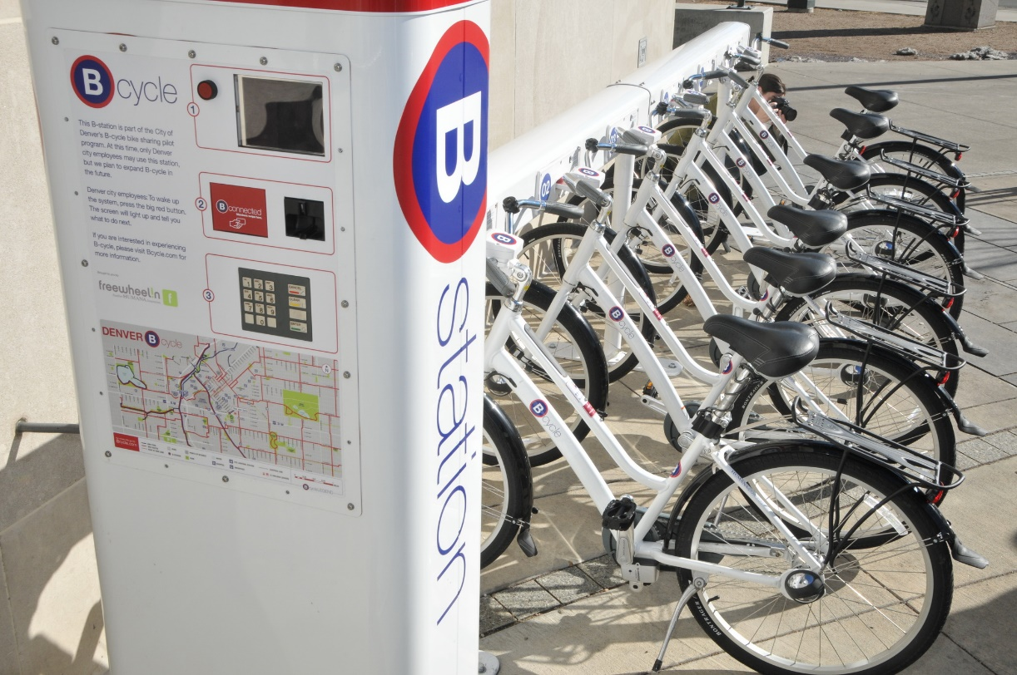
Bike Share Repositioning
Casey Jordan
Bryan Lee
Mark Trybulski
Soichi Ueki
Jeremy Weng
Notes:
Jeremy

Slide 2
Bike sharing model creates unique challenges
Sources of uncertainty
Total and location specific demand
Traffic variations
Maintenance timeline
What takes precedence?
Distance versus availability
Frequency of rebalancing
How and when to react to changes in demand
Which cost structure to use?
Membership / Per use
Account for unmet demand
Routing cyclists to alternate locations
Notes:
Jeremy

Slide 3
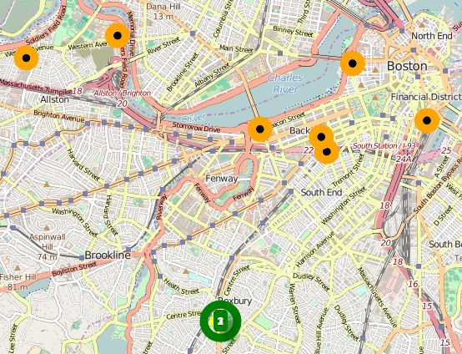


MIP Model
Objective
minimize: α₁*TotalDistance + α₂*TotalUnmetDemand + α₃*TimeViolation
Modeling Changes
Expanded routing model with index for vehicles (v)
Generated inventory balance model
Statistical approximation for distance, travel time, and demand
Visualization
Stations
Depot
Notes:
Soichi

Slide 4
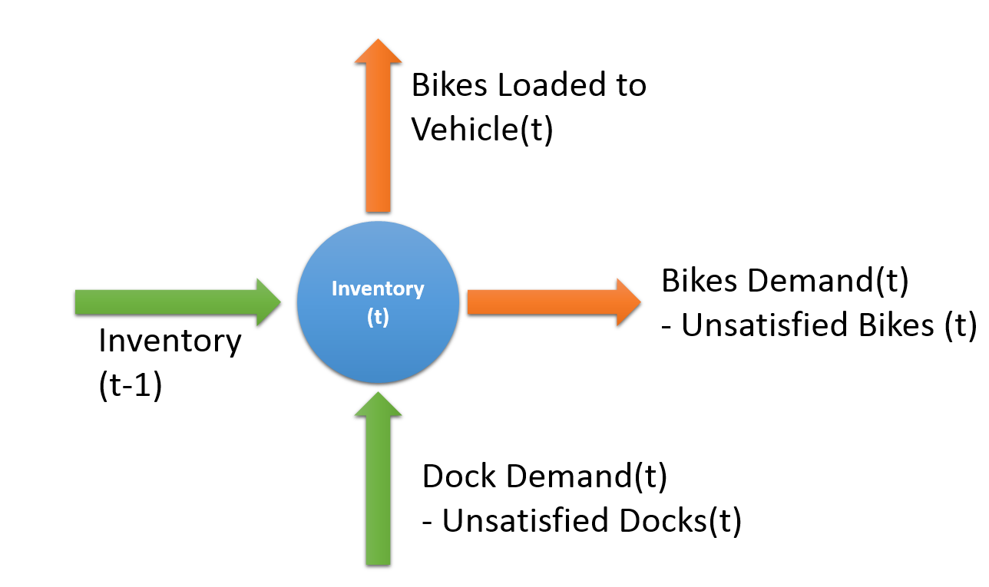
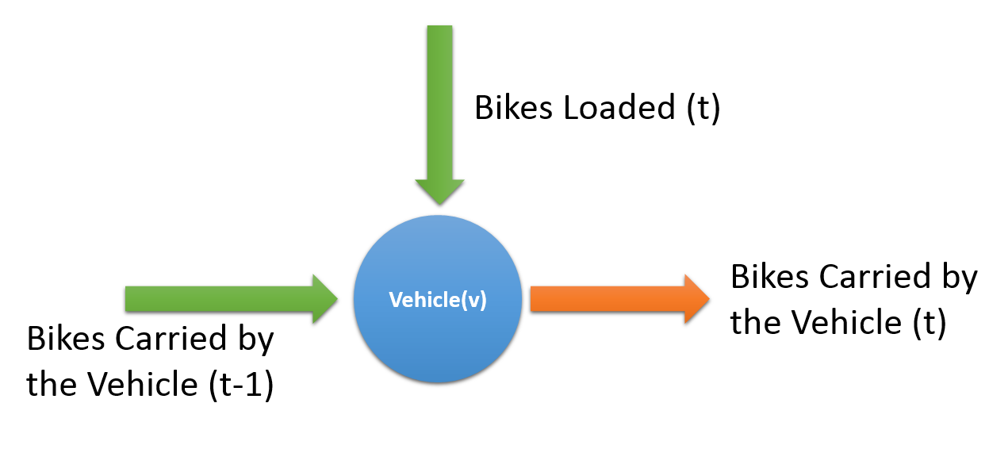
Key Constraints
Bike and routing flow conservations
Capacity Requirements
Each location and each truck
Vehicle routing
Vehicles forced to complete route and return instead of replicating path
Notes:
Soichi

Slide 5
Statistical Input Data
Bike and Dock Demand
2012-2013 Data from Hubway
Average Records per station over time
Estimated with Polynomial equation
Travel Times
Great Circle Calculation between Lat/Long
Demand
Bikes
Hours
Demand
Docks
Hours
Notes:
Bryan

Slide 6
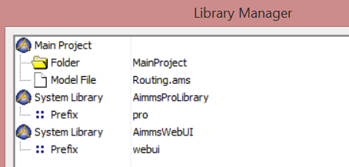

AIMMS Pro Visualization
Aimms Library Additions
ProUI
WebUI
Tools
Start Web UI
Stop Web UI
Local Host
Localhost:12001/ProjectName
Current Functionality
http://www.aimms.com/english/software-solutions/software/demos/
Notes:
Casey

Slide 7
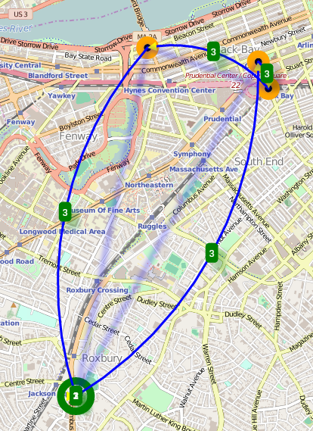
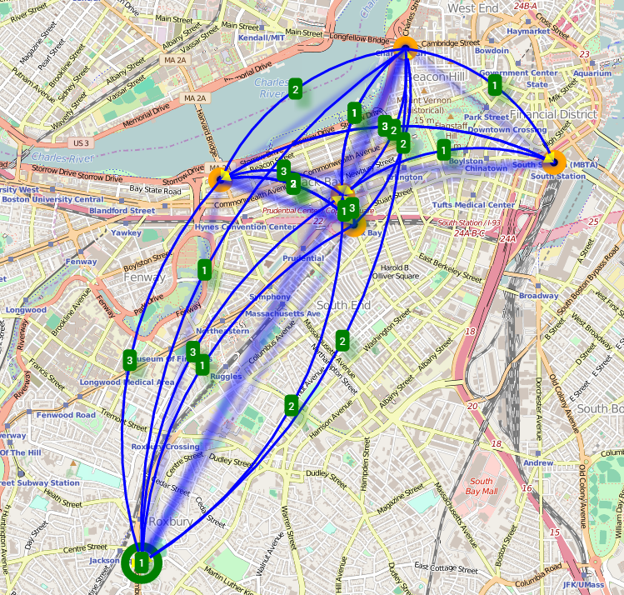
Model Output
Options
Prioritize distance
Prioritize meeting demand
Balanced priorities
Notes:
Casey

Slide 8
Model Capabilities / Areas for Improvement
Current Capabilities
Enables prioritization of objectives
Optimizes rebalancing for every location
Protect for bike shortages but not against overages
Trucks start and end with no capacity
Determine routing time based on expected travel time
Scalability
Potential Improvements
Reduce time steps to improve model capabilities
Address CSL goals
Account for bikes requiring repair
Account for loading & unloading times
Add bike bank at depot
Include discrete routing with Google Maps
Notes:
Mark

Slide 9
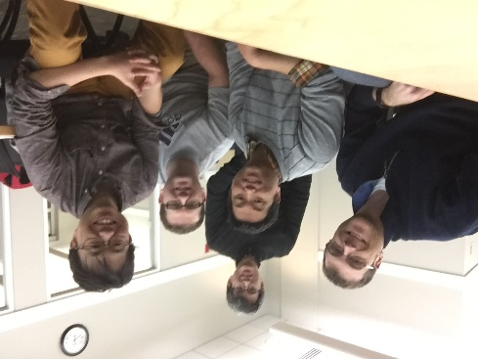
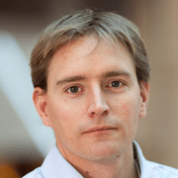
Questions?
Notes:
Mark

Slide 10
Bike Share Model
Sets | Parameters | Variables | Constraints
Locations (i,j) | NrVehicles | Travel (i,j,v,t) | FlowConservation(i,v,t)
Vehicles (v) | Vehicle Capacity (v) | DistanceTraveled (v,t) | TotalDistanceLimit(v)
Steps (t) | Distance (i, j) | TotalDistance | StartAtDepot(v)
 | LocationCapacity (i) | TimeViolation(j) | DontStartElsewhere(i)
 | Initial Inventory (i,t) | TotalTimeViolation | EndatDepot(v)
 | BikeDemand (i,t) | BikesCarriedfrom(i,j,v,t) | DontEndElsewhere(j)
 | DockDemand (i,t) | BikesLoaded(i,v,t) | LBtimeWindow(i,j,v,t)
 | Xcoord(i) | UnSatisfiedBikes(i,t) | UBtimeWindow(i,j,v,t)
 | Ycoord(i) | UnSatisfiedDocks(i,t) | OneStep(v,t)
 | LB(i) | AvailableBikes(i,t) | BikeFlowConservation(i,v,t)
 | UB(i) | UnmetDemand(i,t) | AvailableBikeConstraint(i,t)
 | Depot | TotalUnmetDemand | UnSatDock(i,t)
 |  | TotalCombined | UnSatBike(i,t)
 |  |  | NoMissingBikes(i,v,t)
 |  |  | TruckCarryingCapacity(i,j,v,t)
 |  |  | LoadingLB(i,v,t)
 |  |  | LoadingUB(i,v,t)
 |  |  | StationCapacityConstraint(i,t)
 |  |  | VehicleLoadingConservation(v)
 |  |  | BikesNotCarriedTODepot(i,v,t)

