Slide 1

Weka
Prof. Moon Hyun Kim, AILab,SKKU

Slide 2

What is WEKA?
Waikato Environment for Knowledge Analysis
  It’s a data mining/machine learning tool developed by Department of Computer Science, University of Waikato, New Zealand.
  Weka is also a bird found only on the islands of New Zealand.
Prof. Moon Hyun Kim, AILab,SKKU

Slide 3
Download and Install WEKA
Website: http://www.cs.waikato.ac.nz/~ml/weka/index.html
Support multiple platforms (written in java):
  Windows, Mac OS X and Linux
Prof. Moon Hyun Kim, AILab,SKKU

Slide 4
Main Features
49 data preprocessing tools
76 classification/regression algorithms
8 clustering algorithms
3 algorithms for finding association rules
15 attribute/subset evaluators + 10 search algorithms for feature selection
Prof. Moon Hyun Kim, AILab,SKKU

Slide 5
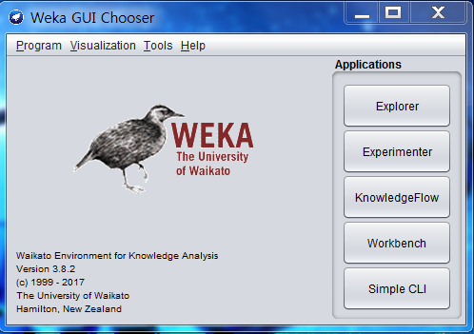
Main GUI
graphical user interfaces
  “The Explorer” (exploratory data analysis)
Prof. Moon Hyun Kim, AILab,SKKU

Slide 6
Explorer: pre-processing the data
Data can be imported from a file in various formats: ARFF, CSV, C4.5, binary
Data can also be read from a URL or from an SQL database (using JDBC)
Pre-processing tools in WEKA are called “filters”
WEKA contains filters for:
  Discretization, normalization, resampling, attribute selection, transforming and combining attributes, …
Prof. Moon Hyun Kim, AILab,SKKU

Slide 7
WEKA only deals with “flat” files
@relation heart-disease-simplified
@attribute age numeric
@attribute sex { female, male}
@attribute chest_pain_type { typ_angina, asympt, non_anginal, atyp_angina}
@attribute cholesterol numeric
@attribute exercise_induced_angina { no, yes}
@attribute class { present, not_present}
@data
63,male,typ_angina,233,no,not_present
67,male,asympt,286,yes,present
67,male,asympt,229,yes,present
38,female,non_anginal,?,no,not_present
...
Flat file in
ARFF format
Prof. Moon Hyun Kim, AILab,SKKU

Slide 8
WEKA only deals with “flat” files
@relation heart-disease-simplified
@attribute age numeric
@attribute sex { female, male}
@attribute chest_pain_type { typ_angina, asympt, non_anginal, atyp_angina}
@attribute cholesterol numeric
@attribute exercise_induced_angina { no, yes}
@attribute class { present, not_present}
@data
63,male,typ_angina,233,no,not_present
67,male,asympt,286,yes,present
67,male,asympt,229,yes,present
38,female,non_anginal,?,no,not_present
...
numeric attribute
nominal attribute
Prof. Moon Hyun Kim, AILab,SKKU

Slide 9
Explorer: building “classifiers”
Classifiers in WEKA are models for predicting nominal or numeric quantities
Implemented learning schemes include:
  Decision trees and lists, instance-based classifiers, support vector machines, multi-layer perceptrons, logistic regression, Bayes’ nets, …
Prof. Moon Hyun Kim, AILab,SKKU

Slide 10
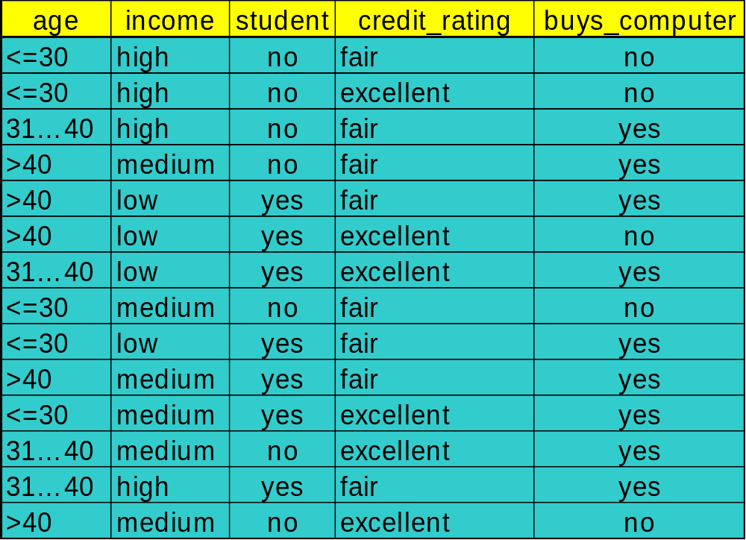
Decision Tree Induction: Training Dataset
This follows an example of Quinlan’s ID3 (Playing Tennis)
Prof. Moon Hyun Kim, AILab,SKKU

Slide 11
Output: A Decision Tree for “buys_computer”
age?
<=30
overcast
>40
31..40
student?
yes
credit rating?
no
yes
excellent
fair
no
yes
no
yes
Prof. Moon Hyun Kim, AILab,SKKU

Slide 12
Algorithm for Decision Tree Induction
Basic algorithm (a greedy algorithm)
  Tree is constructed in a top-down recursive divide-and-conquer manner
  At start, all the training examples are at the root
  Attributes are categorical (if continuous-valued, they are discretized in advance)
  Examples are partitioned recursively based on selected attributes
  Test attributes are selected on the basis of a heuristic or statistical measure (e.g., information gain)
Prof. Moon Hyun Kim, AILab,SKKU

Slide 13
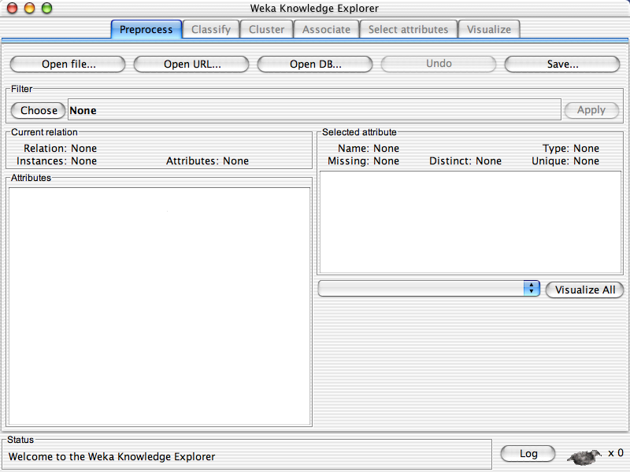
Prof. Moon Hyun Kim, AILab,SKKU

Slide 14
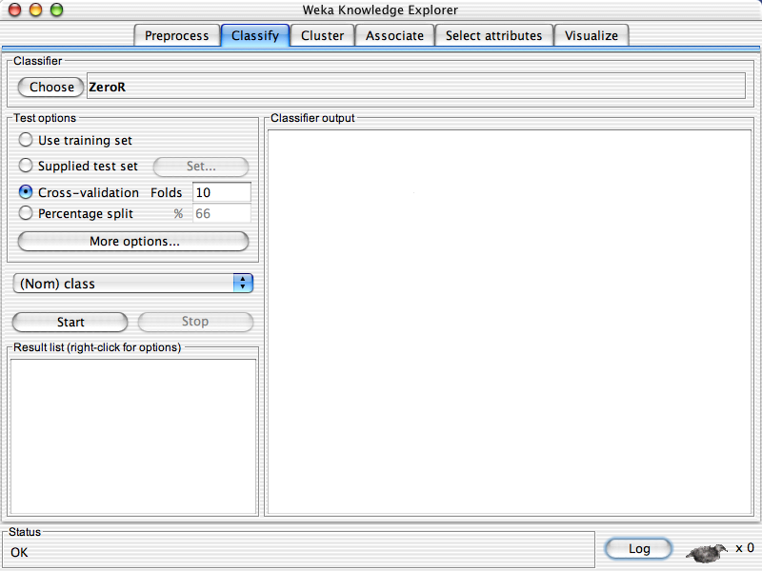
Prof. Moon Hyun Kim, AILab,SKKU

Slide 15
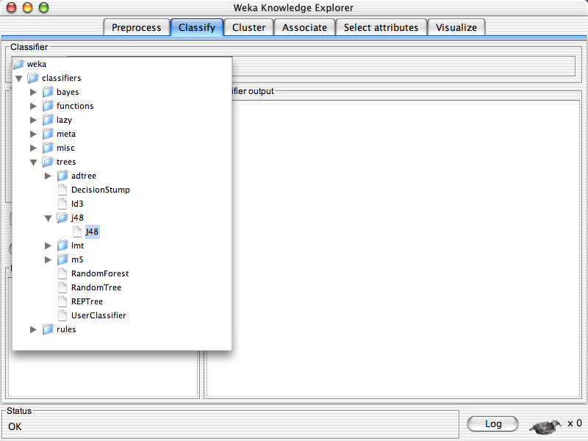
Prof. Moon Hyun Kim, AILab,SKKU

Slide 16
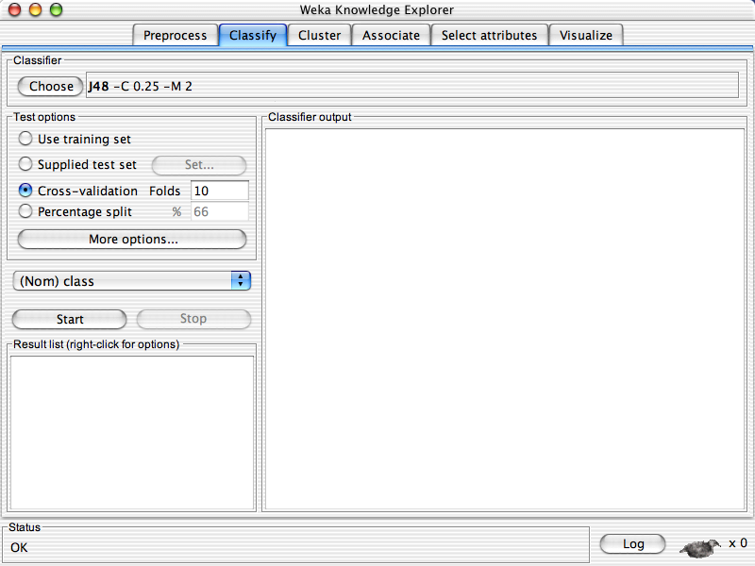
Prof. Moon Hyun Kim, AILab,SKKU

Slide 17
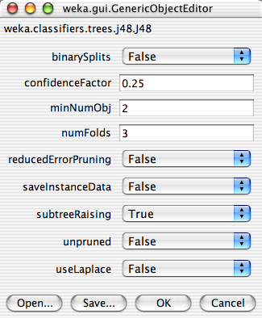
Prof. Moon Hyun Kim, AILab,SKKU

Slide 18
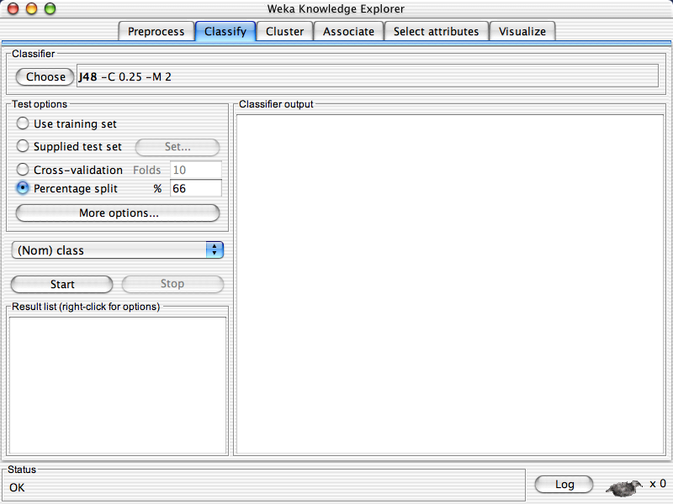
Prof. Moon Hyun Kim, AILab,SKKU

Slide 19
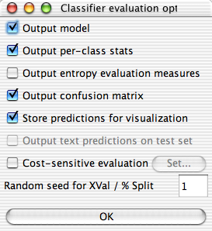
Prof. Moon Hyun Kim, AILab,SKKU

Slide 20
Prof. Moon Hyun Kim, AILab,SKKU

Slide 21
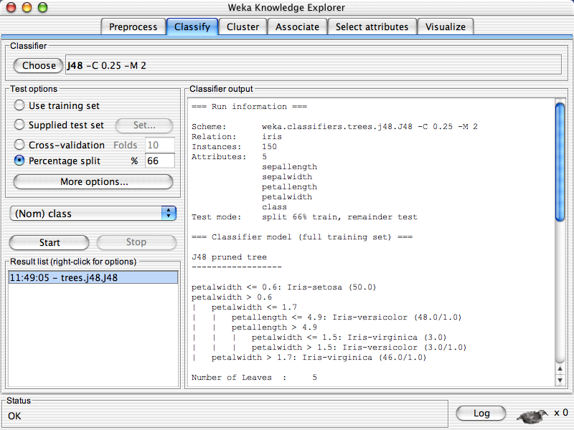
Prof. Moon Hyun Kim, AILab,SKKU

Slide 22
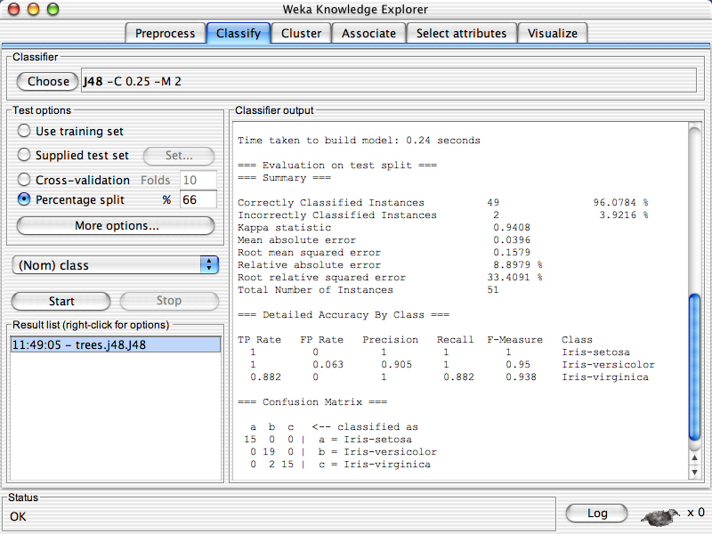
Prof. Moon Hyun Kim, AILab,SKKU

Slide 23
Prof. Moon Hyun Kim, AILab,SKKU

Slide 24
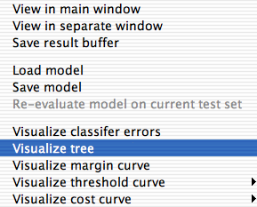
Prof. Moon Hyun Kim, AILab,SKKU

Slide 25
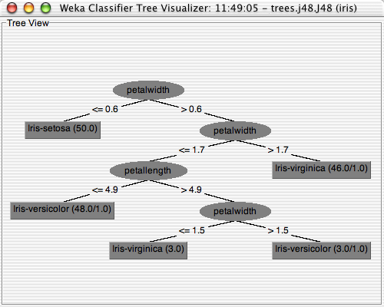
Prof. Moon Hyun Kim, AILab,SKKU

Slide 26
Explorer: clustering data
WEKA contains “clusterers” for finding groups of similar instances in a dataset
Implemented schemes are:
  k-Means, EM, Cobweb, X-means, FarthestFirst
Clusters can be visualized and compared to “true” clusters (if given)
Evaluation based on loglikelihood if clustering scheme produces a probability distribution
Prof. Moon Hyun Kim, AILab,SKKU

Slide 27
Explorer: attribute selection
Panel that can be used to investigate which (subsets of) attributes are the most predictive ones
Attribute selection methods contain two parts:
  A search method: best-first, forward selection, random, exhaustive, genetic algorithm, ranking
  An evaluation method: correlation-based, wrapper, information gain, chi-squared, …
Very flexible: WEKA allows (almost) arbitrary combinations of these two
Prof. Moon Hyun Kim, AILab,SKKU

Slide 28
Explorer: data visualization
Visualization very useful in practice: e.g. helps to determine difficulty of the learning problem
WEKA can visualize single attributes (1-d) and pairs of attributes (2-d)
  To do: rotating 3-d visualizations (Xgobi-style)
Color-coded class values
“Jitter” option to deal with nominal attributes (and to detect “hidden” data points)
“Zoom-in” function
Prof. Moon Hyun Kim, AILab,SKKU

Slide 29
References and Resources
References:
  WEKA website: http://www.cs.waikato.ac.nz/~ml/weka/index.html
  WEKA Tutorial:
    Machine Learning with WEKA: A presentation demonstrating all graphical user interfaces (GUI) in Weka.
    A presentation which explains how to use Weka for exploratory data mining.
  WEKA Data Mining Book:
    Ian H. Witten and Eibe Frank, Data Mining: Practical Machine Learning Tools and Techniques (Second Edition)
  WEKA Wiki: http://weka.sourceforge.net/wiki/index.php/Main_Page
  Others:
    Jiawei Han and Micheline Kamber, Data Mining: Concepts and Techniques, 2nd ed.
Prof. Moon Hyun Kim, AILab,SKKU

