Slide 1

HDB resale and rentals Data analysis and price prediction
Lee Shu Ling Charlene
Hew Sock Fang
Huang Zichen
Seah Ee Wei

Slide 2
Process
Data preprocessing
Models
Result Analysis
Ensured proper formatting
Imputed missing values
Developed new features
Added new features
Linear regression
XGBoost
Random Forest Regression
Mean squared error
Mean root squared error
Mean absolute error
R squared

Slide 3
Data cleaning and preprocessing – resales
Original features
month
town
flat type
flat model
block
street name
storey range
floor area sqm
lease commence date
remaining lease
resale price
Developed from existing features
month sold
year sold
remaining lease
average storey
price psm
New features: location data + facilities + building info
address
postal code
latitude, longitude
maximum floor level
nearest MRT station
distance to nearest MRT station
nearest primary school
distance to nearest primary school
nearest mall
distance to nearest mall
nearest hawker centre
distance to nearest hawker centre
distance to nearest amenity

Slide 4
Data cleaning and preprocessing – rentals
Original features
rent approval date
town
block
street name
flat type
monthly rent
New features: location data + facilities + building info
address
postal code
latitude, longitude
maximum floor level
nearest MRT station
distance to nearest MRT station
nearest primary school
distance to nearest primary school
nearest mall
distance to nearest mall
nearest hawker centre
distance to nearest hawker centre
distance to nearest amenity

Slide 5
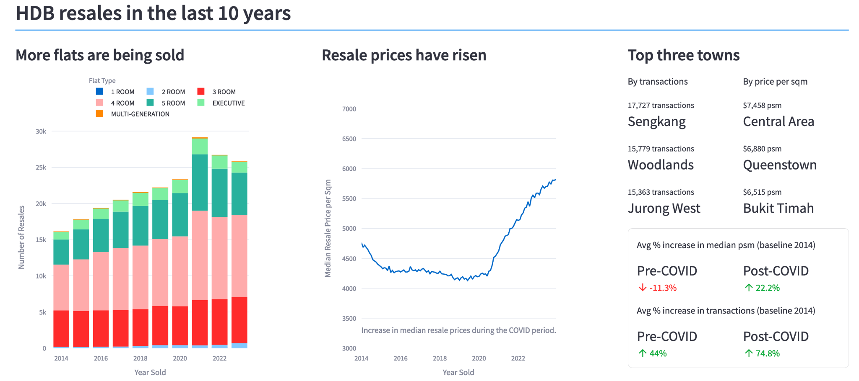
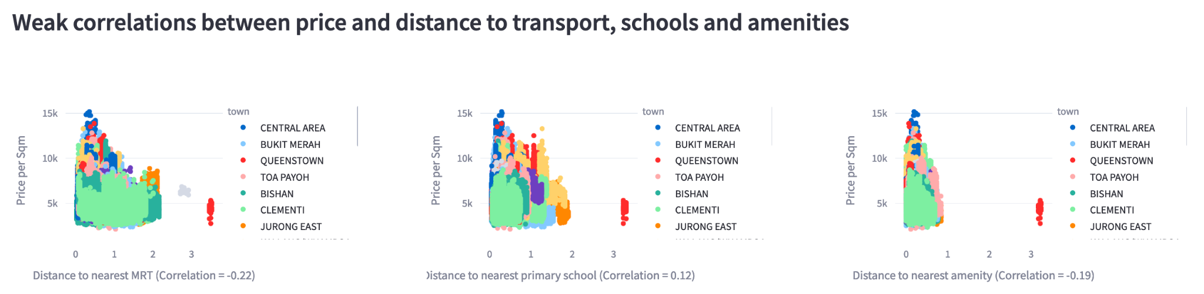
App

Slide 6
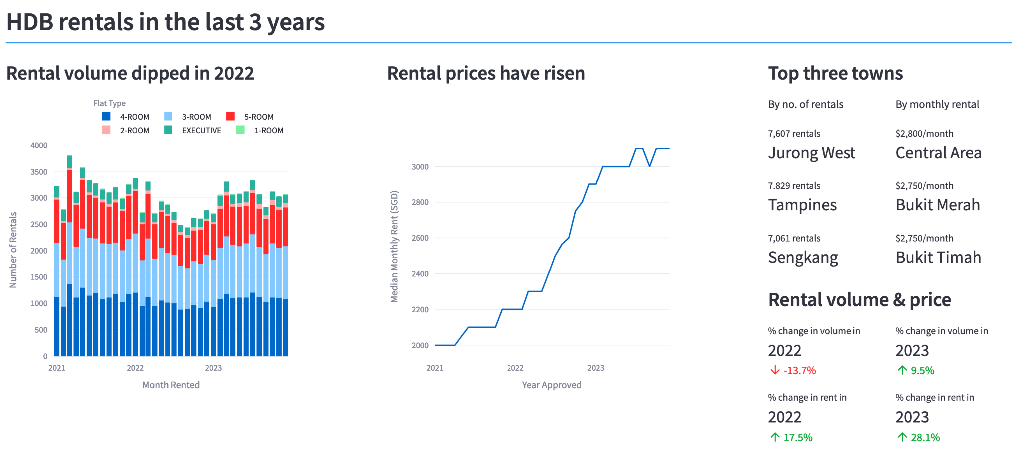
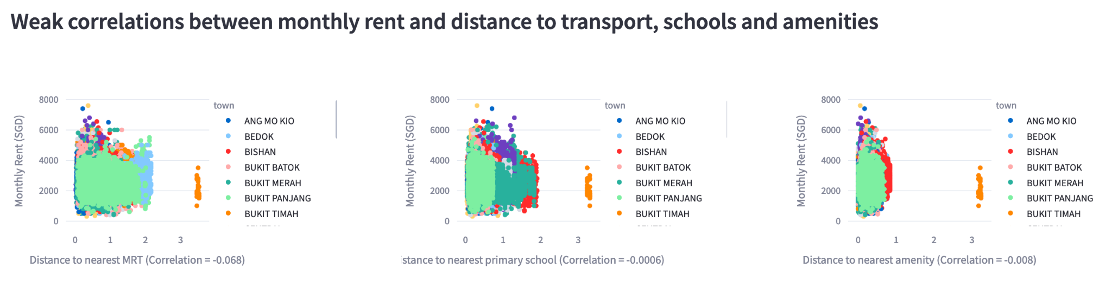
App

Slide 7

Random forest regression model selected for resale and rental price prediction
Good overall performance and interpretability
Resale dataset:
R Squared value of 0.98
Average error of 6.6%
Rental dataset:
R Squared value of 0.5
Average error of 16.1%

Slide 8




Other models trained
Linear regression
XGBoost
Best performance obtained with polynomial features up to x³
Targeting location features gave the best results
K-means clustering based on latitude and longitude
Target encoding of town and nearest train station
Easily interpretable but weakest overall performance
Best overall performance but most complex

Slide 9
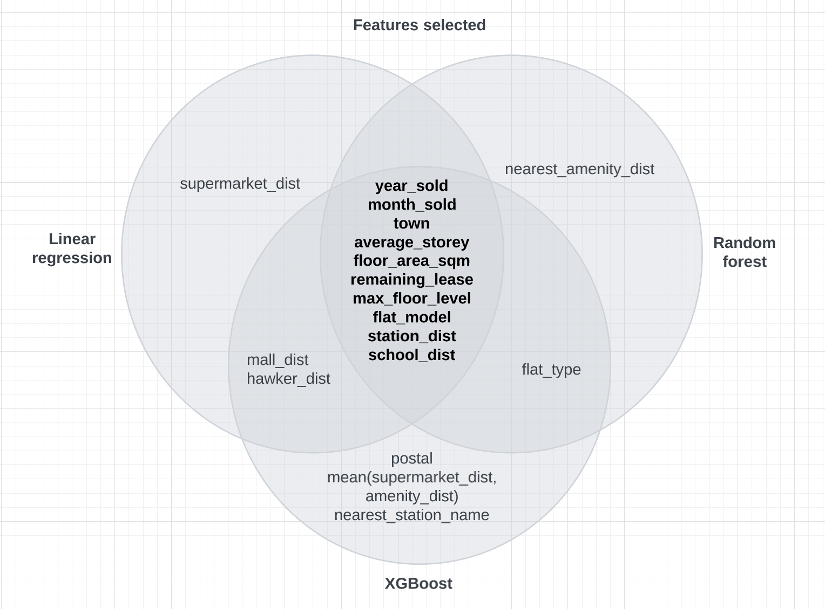
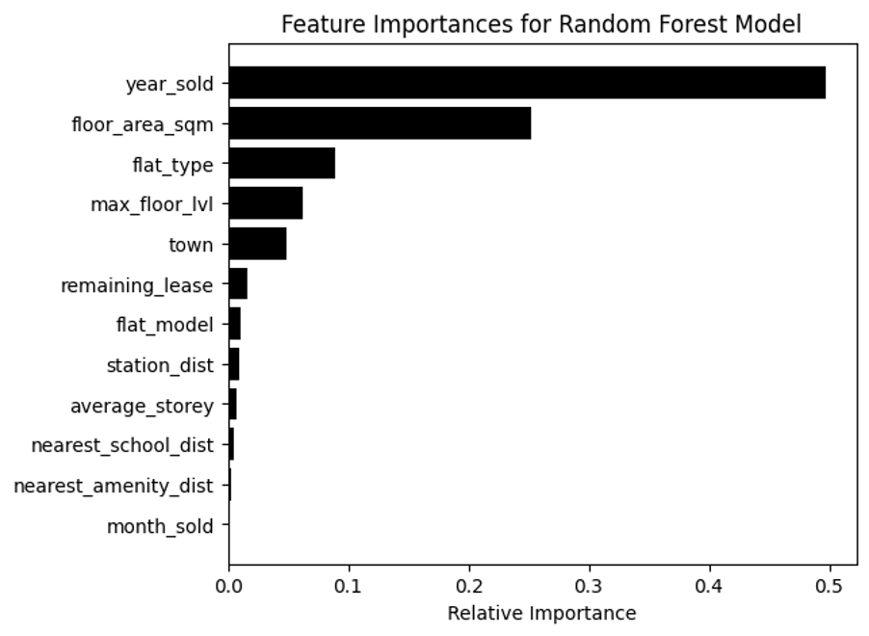
Predictive factors for resale prices

Slide 10
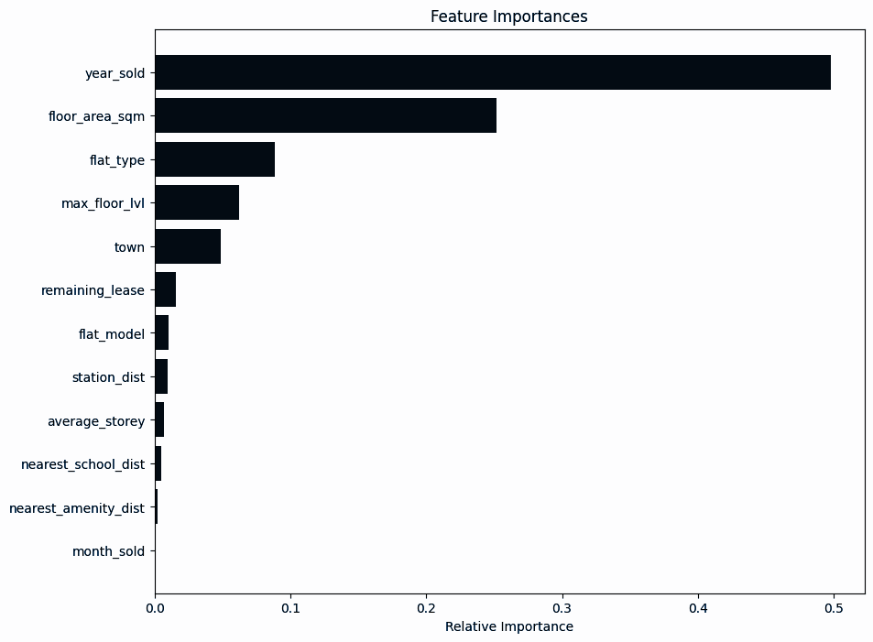
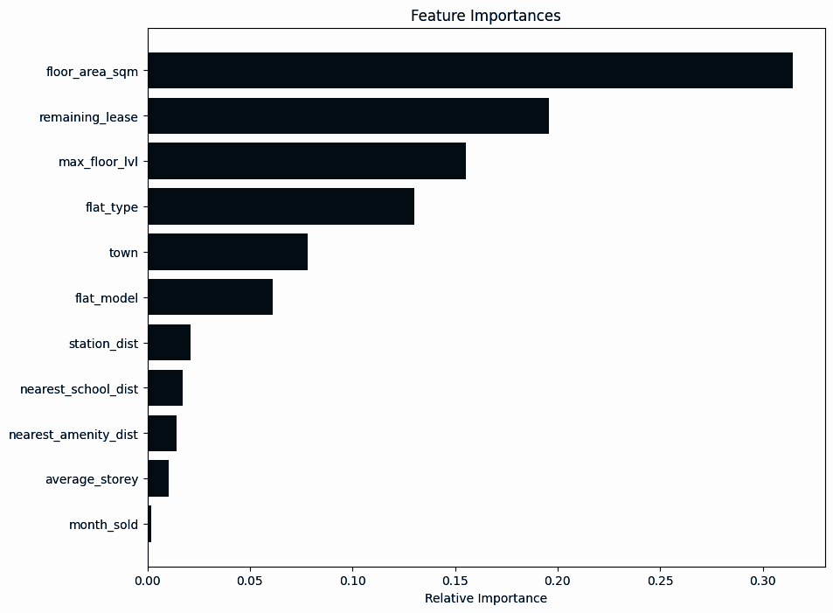
What if the year_sold feature is removed?

Slide 11
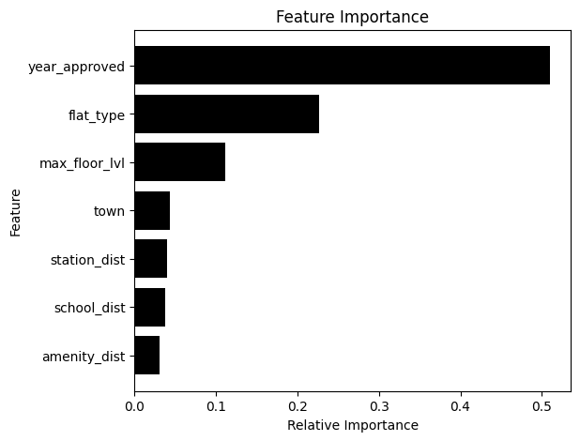


Weaker performance for rentals
Possible factors:
Insufficient data
Unreliable self-reported statistics

Slide 12

App demo

Slide 13
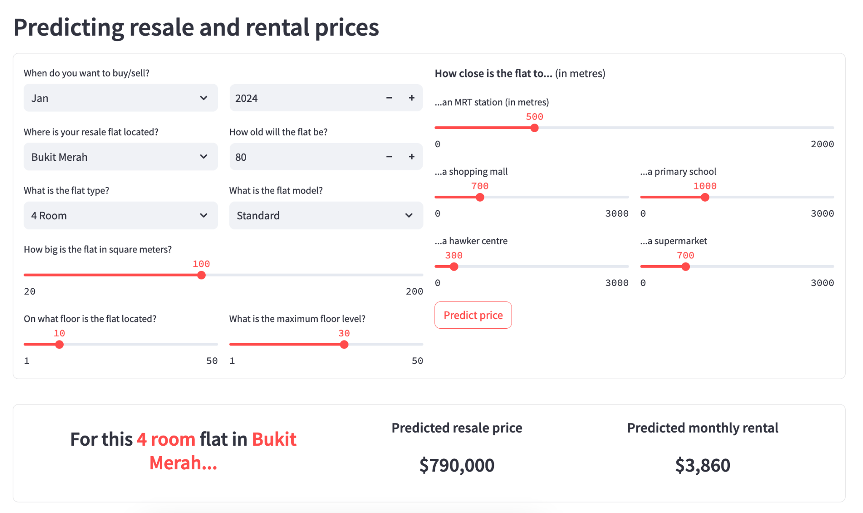

Slide 14
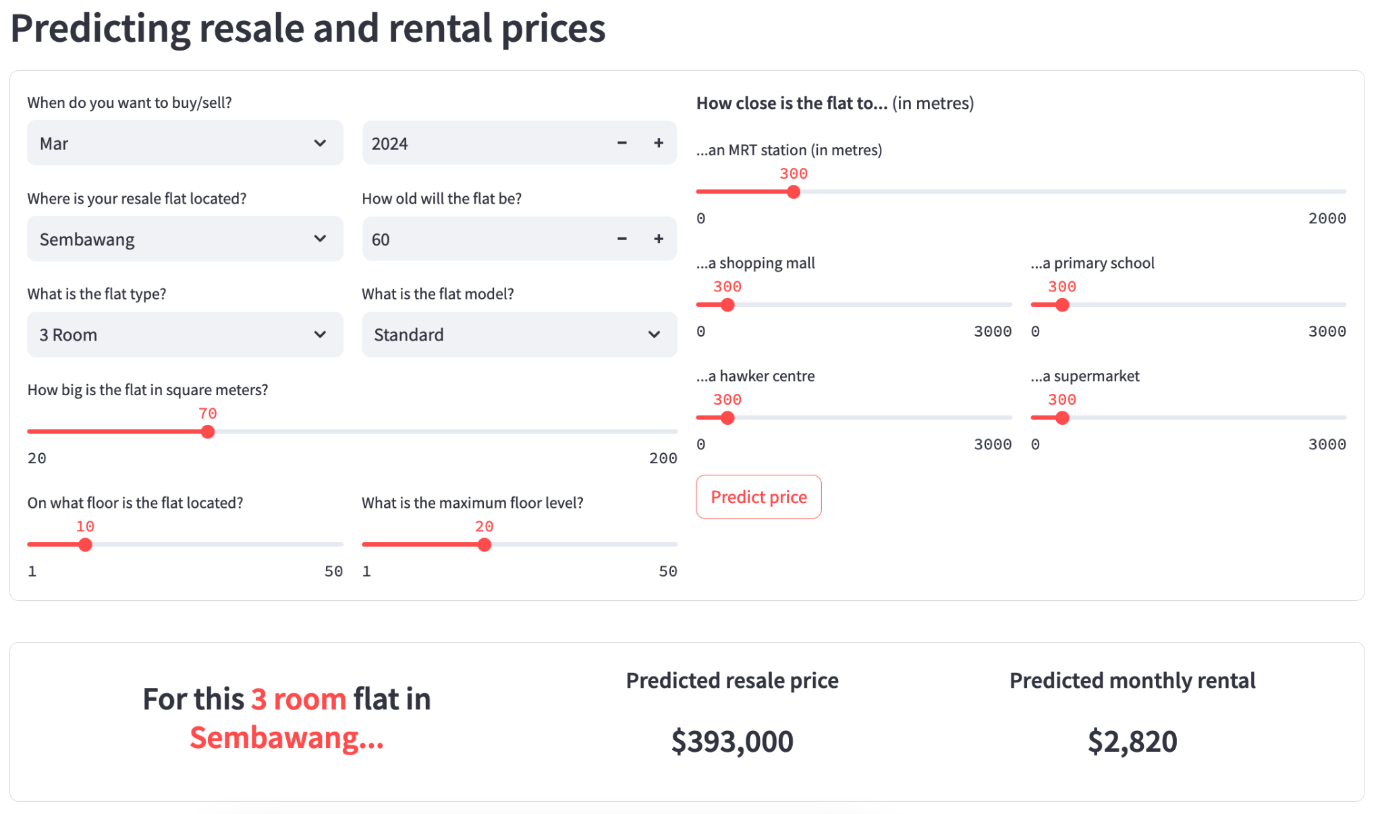

Slide 15
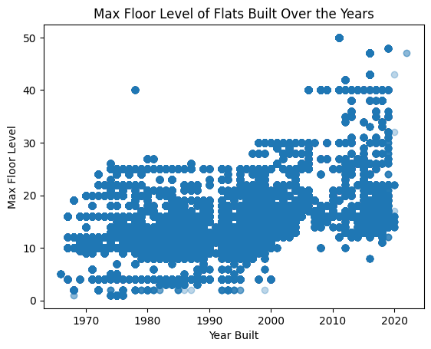
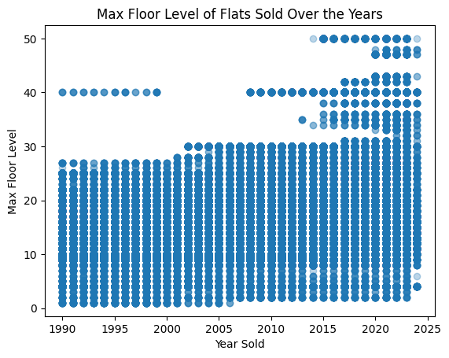
Block’s max floor level was of higher importance than the Unit’s floor level

